Slide 1
INST 798/808 Prompt Engineering and Qualitative Coding

Slide 2
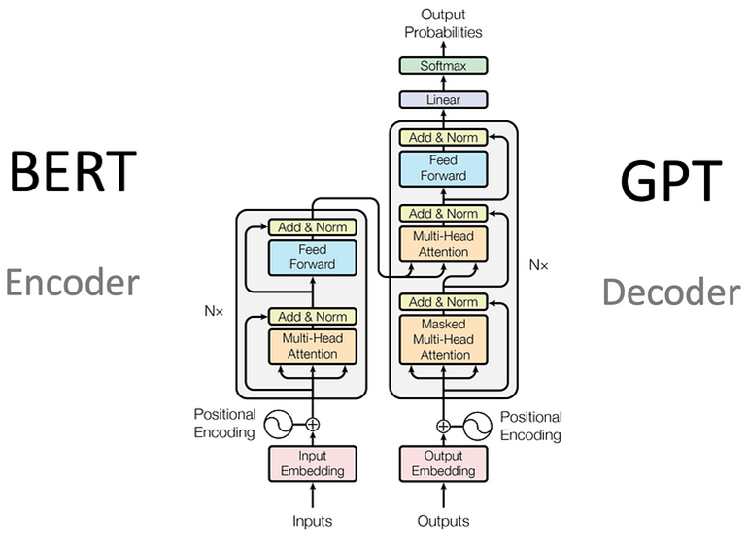
So far this semester …
Focus on understanding Encoder models:
Encoders prediction function in masked language modeling
How self-attention finds interactions between words.
Updates the representation of a token based on meanings of relevant words in the focal word’s context
How Feed Forward network finds interactions between dimensions of a word’s representation

Slide 3
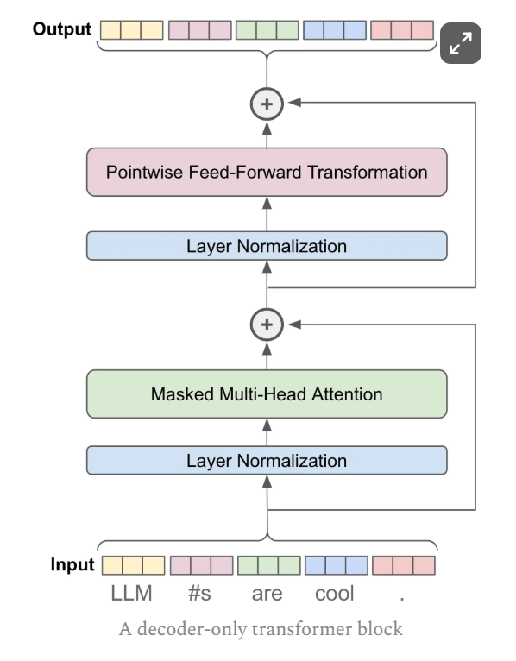
Decoder Only Model
One main difference is the masked or “causal” attention mechanism
Another is that prediction function is next word prediction
Generally require a lot more parameters than encoder models

Slide 4
Two Phases of Model Interaction
Pre-training: Knowledge acquisition phase
Model learns patterns, relationships, and facts from massive text corpora
Self-supervised objectives (next token prediction or masked token prediction)
Builds foundation of knowledge and capabilities
Computationally intensive, often requiring thousands of GPU days

Slide 5
Two Phases of Model Interaction
Post-training: Knowledge utilization phase
Methods to access and direct the knowledge acquired during pre-training
No/little new fundamental knowledge is added
Instead, we're learning to "unlock" or "access" existing knowledge
Two key approaches we'll focus on today:
Instruction tuning: Teaching models to follow directions
Prompting: Crafting inputs to elicit specific outputs

Slide 6
Instruction Tuning
What It Is
Definition: Fine-tuning language models on datasets of instruction-response pairs
Fine-tuning: Process of adapting a pre-trained language model to specific tasks or behaviors by updating its parameters using additional training on a smaller, targeted dataset.
Purpose: Teaches models to follow human instructions rather than just predict text
How It Works
Model is trained on thousands of examples: "Do X" → "Helpful response that does X"
Creates a bridge between pre-training knowledge and practical user needs
No new fundamental knowledge is added, but existing knowledge becomes accessible
Example
Base model: "Explain quantum computing" → "is a form of computation that..."
Instruction-tuned: "Explain quantum computing" → "Quantum computing is a field that uses quantum mechanics to process information..."

Slide 7
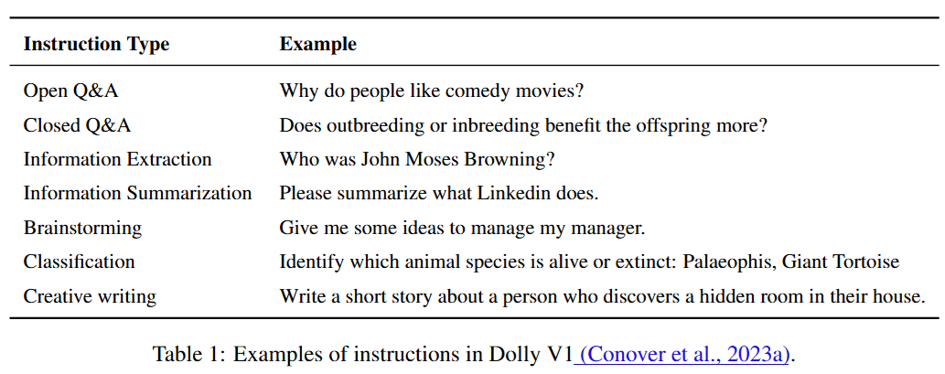
Trained on Different Instruction Tasks

Slide 8
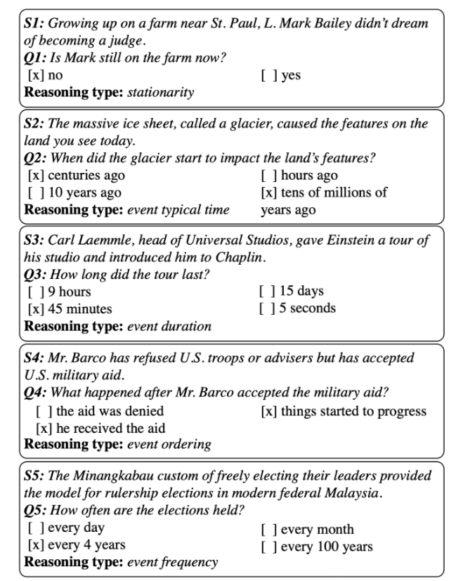
MC-TACO Example
Temporal commonsense task
13K examples of format:
Sentence
Question
Candidate Answer
Ask for valid and invalid answers from crowdworkers
MC-TACO: Multiple Choice TemporAl COmmonsense

Slide 9
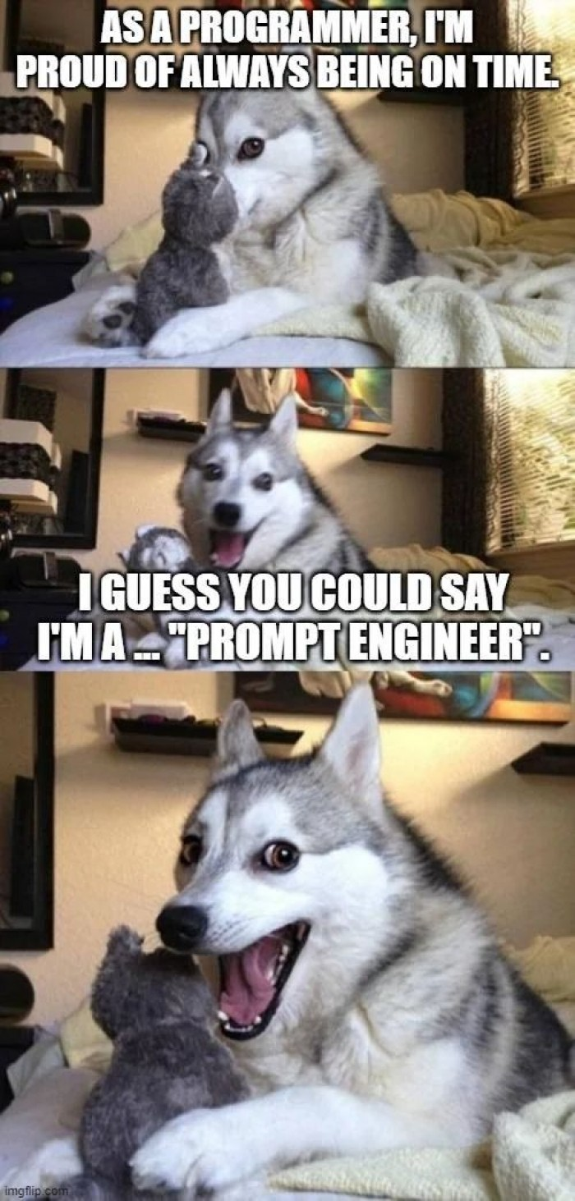
Prompting
Art + science of crafting inputs to get desired outputs
Prompting Strategies
Zero-shot: Direct instructions without examples
Few-shot: Including examples of desired inputs and outputs
Chain-of-Thought: Requesting step-by-step reasoning
Role-based: Assigning specific personas to guide responses
Structured formats: Using templates, JSON, or XML to shape outputs
Relationship with Instruction Tuning (IT)
IT reduces the need for complex prompting techniques
Prompting complexity and IT exist on a spectrum:
Base models → require elaborate prompts with many examples
Instruction-tuned models → respond well to direct requests
Highly aligned models → understand nuanced or ambiguous prompts

Slide 10

Prompting w/o Instruct Tuning
Base model interprets prompt as text it should complete:
Input to base model: "The capital of France is"
Base model output: "The capital of France is Paris. The city is known for its iconic landmarks such as the Eiffel Tower and the Louvre Museum. Paris has been the capital of France since 987 CE when Hugh Capet, the first king of the Capetian dynasty, made the city his seat of government..."

Slide 11
“Trick” model for complicated outputs
With base models, often need elaborate prompting techniques that essentially "trick" the model into the desired behavior:
Here, you're formatting your input to make the model believe it's continuing a document that already contains a summary. The model will then generate what it thinks a summary should look like based on the patterns it learned during pre-training.
The following is a summary of an article about climate change:
Article: Global temperatures have risen by an average of 1.1°C since the pre-industrial era, according to the latest IPCC report. This warming is causing more frequent and severe weather events worldwide, including floods, droughts, and hurricanes…
Summary:

Slide 12
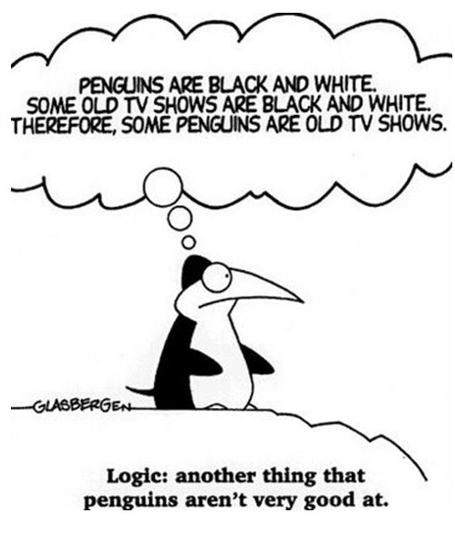
Types of Qualitative Coding
Inductive: codes emerge from the data without predetermined categories
Deductive: data is analyzed according to existing theoretical frameworks
Which one might be more challenging for a language model?

Slide 13
Demonstration with Claude
Four approaches:
Simple prompt
Detailed instructions with specified output format
Chain-of-thought Prompt with Analytical Framework
Role-based prompt

Slide 14
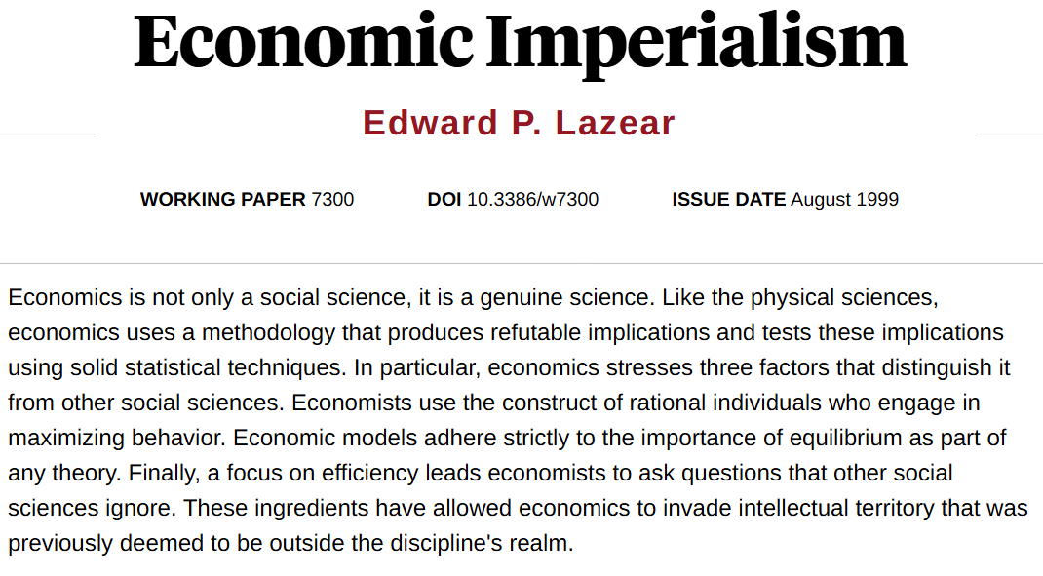

Slide 15
Final Project Goal
The final project proposal should outline your plan to investigate how LLMs can enhance research methods in social sciences, with a focus on any of the following:
concept tracing / topic model
qualitative analysis
Other ideas are also possible

Slide 16
Final Project Proposal
Maximum of 3 pages
Introduction:
Describe the research question or LLM evaluation task
Explain why it’s important
Methodology:
Outline research design
Data source
Models
Analytic Approaches
Explain your prompting strategy or embedding analysis technique
Evaluation
Timeline

Slide 17
Potential Project Types
Compare qualitative coding
Between LLM models
Between prompting strategies
Compare LLM to human
Compare embedding approaches for concept tracing
Trace how a specific concept (e.g., "algorithmic bias," "open science") has evolved in academic literature over time. Compare embedding-based approaches.

Slide 18
Potential Project Types
Compare embedding vs generative approaches for concept tracing
Trace how a specific concept (e.g., "algorithmic bias," "open science") has evolved in academic literature over time. Compare embedding-based approaches to generative approaches.
Using LLM as a data analyst
Design and implement a pipeline where an LLM acts as a data analyst
Creating a systematic approach for LLMs to explore and analyze unfamiliar datasets
Developing prompting strategies for exploratory data analysis, hypothesis testing, etc.
Comparing LLM-generated analyses with traditional statistical methods for accuracy and insight quality

Slide 19
Evaluations
Paper | Induction/Deduction | Evaluation
Rasheed et al. (2024) | Both | 10 Experts
Gao et al. (2025) | Inductive | 12 Users of varying expertise
De Paoli (2024) | Inductive | Ground-truth, Semantic Similarity, LLM evaluator
Overney et al. (2024) | Inductive | Online RCT w/ 180 participants / Efficiency / IRR
Relins et al. (2024) | Deductive | IRR / Error analysis
Lam et al. (2024) | Inductive | Analysis scenarios / Benchmark method against GPT-4 and BERTopic / Ask original researchers to reanalyze / IRR
Zhang et al. (2024) | Both | Efficiency / IRR
Chew (2023) | Deductive | Efficiency / IRR
Dai (2023) | Inductive | IRR / Error Analysis
Raza (2025) | Inductive | Efficiency / Embedding similarity / Expert evaluation
Dunivin (2024) | Deductive | IRR

Slide 20
Some examples of evaluations
Experts:
Someone intimately familiar with a particular dataset
People with lots of coding experience
Embedding-measured Semantic Similarity:
If task has natural language output (e.g. human written and LLM written), embed these and compute similarity
Compare with humans:
IRR
Use humans groundtruth (precision, recall, etc.)

Slide 21
Summary From Reflections
Trade-offs
Depth vs. Efficiency: Do time savings compromise deep understanding of qualitative data?
Consistency vs. Validity: LLMs show higher inter-rater reliability than humans - but are they measuring the right things?
Methods
Codebook Design: How should codebooks be structured differently for LLMs vs. human coders?
Can text-only interaction capture the multimodal richness of qualitative discussions?
Are there parallels between human cognition and LLM architecture?
Ethical considerations
Risk of reinforcing dominant narratives while missing marginalized voices
Privacy and data security when uploading sensitive qualitative data
What role should human oversight play in LLM-assisted qualitative research?

Slide 22
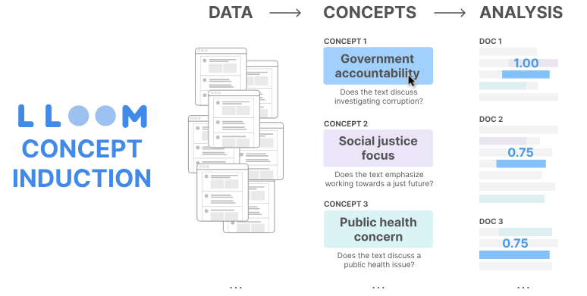

Slide 23
Background
How can we extract high-level concepts from text?
Tools like topic models produce topics that are
Too general or vague
Bound to surface-level features
“junk”
Requires analyst interpretation
Example: For misogynistic social media posts, BERTopic provides "women, power, female" but doesn't help answer questions like "how are women in power described?"

Slide 24
Concept Induction
LLooM’s procedure produces high-level concepts: Human-interpretable descriptions defined by explicit inclusion criteria
Each concept includes:
Natural language description
Explicit criteria (e.g., "Does the example critique traditional gender roles?")
Representative examples
Concept scores for all examples in dataset

Slide 25
LLooM’s Algorithm
Iteratively extracts concepts from unstructured text using three key “operators”.
Operators: Take certain inputs, perform operations, and produce a output.
Distill (initial coding): Condenses input data while preserving salient details
Cluster (groups): Groups related items based on patterns
Synthesize (thematic analysis): Identifies unifying concepts among examples using LLMs

Slide 26
LLooM Workbench
Interactive visualization tool
Components:
Matrix View: Overview of concepts (rows) and data slices (columns)
Concept Detail View: Information about a specific concept
Slice Detail View: Information about a specific data slice

Slide 27
Evaluations
1) Demonstration of concepts uncovered using 4 scenarios
Developing Moderation Policiesfor Toxic Content
Mitigating Partisan Animosityon Social Media
Analyzing UIST Paper Abstracts
Investigating Consequences of AI Research
Method:
Compare LLooM vs BERTopic generated concepts
Member of research team groups outputs

Slide 28
Content Moderation
Data from social media posts, 17K raters
Ran BERTopic and selected feminism topic
Results:
LLooM 10 concepts
BERT 8 topics

Slide 29
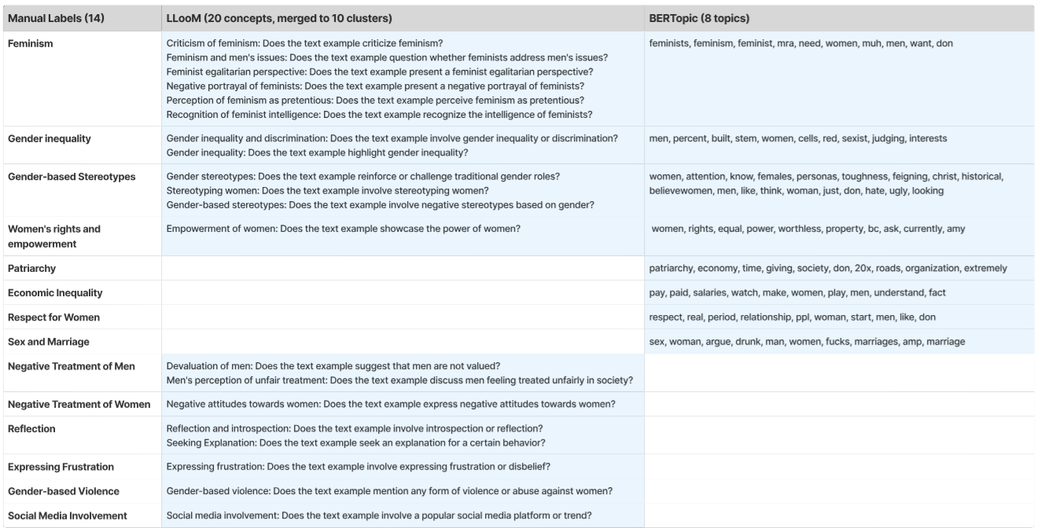

Slide 30
Evaluations
2) Compare against human annotations
Datasets:
Wikipedia (15 topics)
U.S. Congressional Bills (28 topics)
Synthetic dataset
Metric: “Concept Coverage”: Proportion of ground truth topics that are covered by generated concepts
Manual and automated methods for calculating
Use manual inspection to verify automated approach

Slide 31
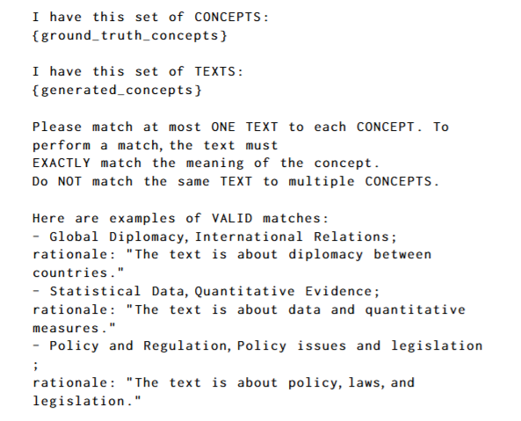
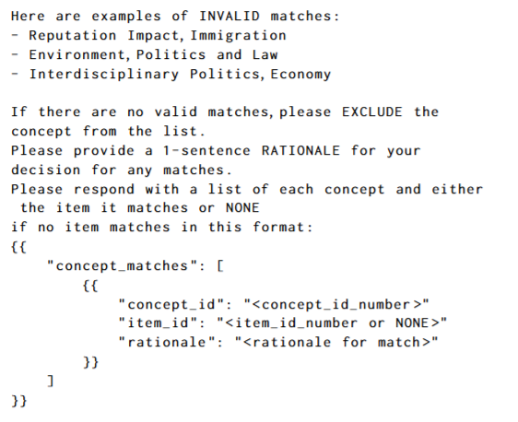
Automated Coverage Prompt

Slide 32
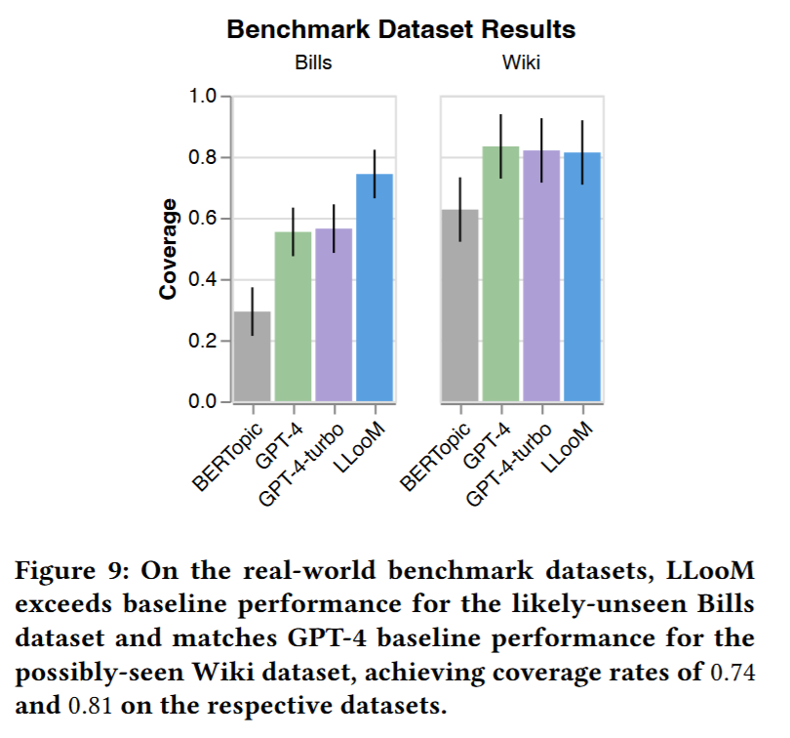

Slide 33
Synthetic Dataset
Start with seed set of Generic and Specific concepts
Politics topic
10 Generic concepts
Each with 4 Specific concepts
Parameters:
Document length (5 or 10 sentences)
Share of document containing concept. (20% or 40%)

Slide 34
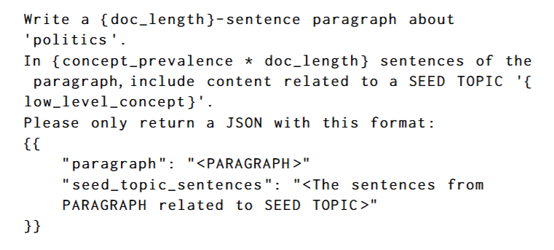
Generation
For each unique combination of
Document length
Concept Prevalence
Generate 40 documents using GPT-4

Slide 35
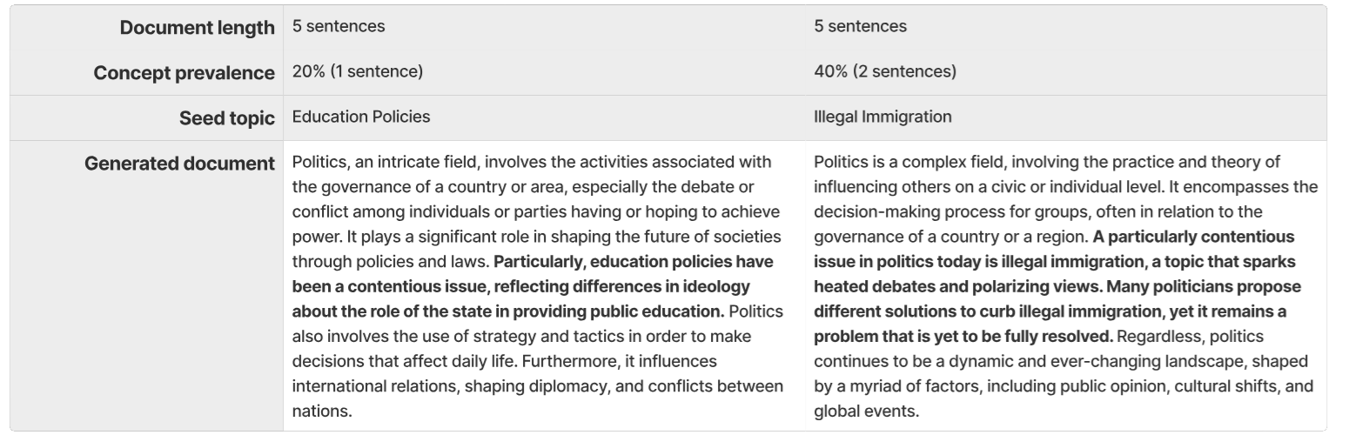
Example Generations

Slide 36
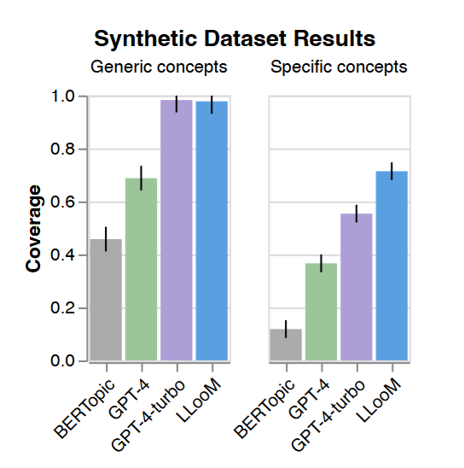
Results

Slide 37
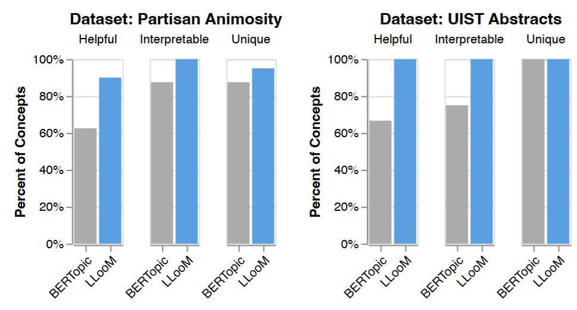
Evaluation
3) Expert evaluation

Slide 38
Summary
The core innovation is extracting high-level concepts defined by explicit inclusion criteria
Benefits over traditional topic models:
Higher quality concepts (more interpretable)
Better data coverage (up to 97.5%)
Improved steerability (analyst-guided)
Limitations:
Uncertain LLM behaviors: Performance may vary across domains
Closed-source LLMs: Cost and transparency concerns
Potential to bias analysts: Risk of over-reliance on automated outputs

