Slide 1
INST 414: Data Science Techniques Overfitting

Slide 2
Recap

Slide 3

The Story So Far
Data Science is largely about prediction
In this class, prediction means estimating $P(Y=1|X=x)$
Re-arrest, dropout, etc

Slide 4
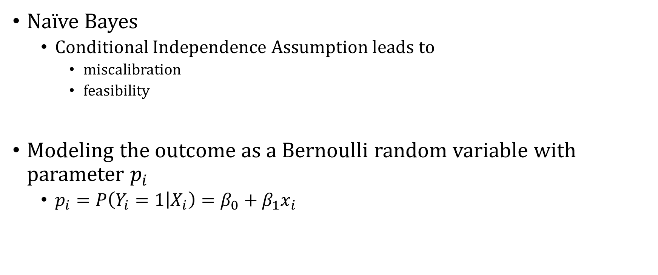
The Story So Far
Naïve Bayes
Conditional Independence Assumption leads to
miscalibration
feasibility
Modeling the outcome as a Bernoulli random variable with parameter $p_{i}$
$p_{i}=P\left(Y_{i}=1 | X_{i}\right)=β_{0}+β_{1}x_{i}$

Slide 5
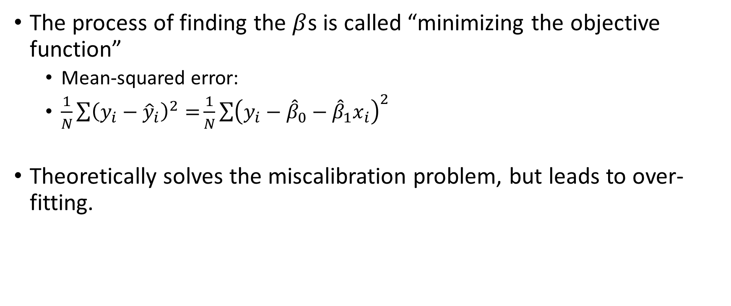
The Story So Far
The process of finding the $β$s is called “minimizing the objective function”
Mean-squared error:
$\frac{1}{N}\sum{{\left(y_{i}−{\hat{y}}_{i}\right)}^{2}=}\frac{1}{N}\sum{{\left(y_{i}−{\hat{β}}_{0}−{\hat{β}}_{1}x_{i}\right)}^{2}}$
Theoretically solves the miscalibration problem, but leads to over-fitting.

Slide 6
Overfitting

Slide 7
Can You Minimize the Objective “Too Much”?
I said that if you get the error down to zero, you are guaranteed calibration --- in sample
But we care about calibration out of sample
Could that go wrong?

Slide 8
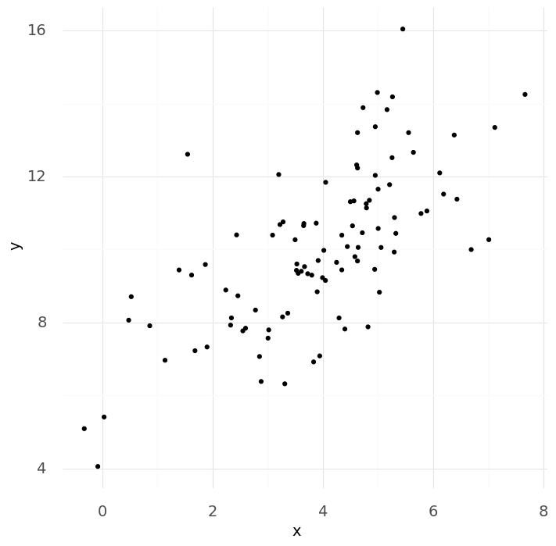

Slide 9
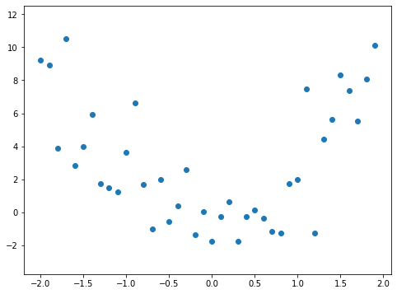
Let’s Fit a Line to This Data

Slide 10
Let’s Fit a Line to This Data
Training Data

Slide 11
Let’s Fit a Line to This Data
Training Data
Testing Data

Slide 12
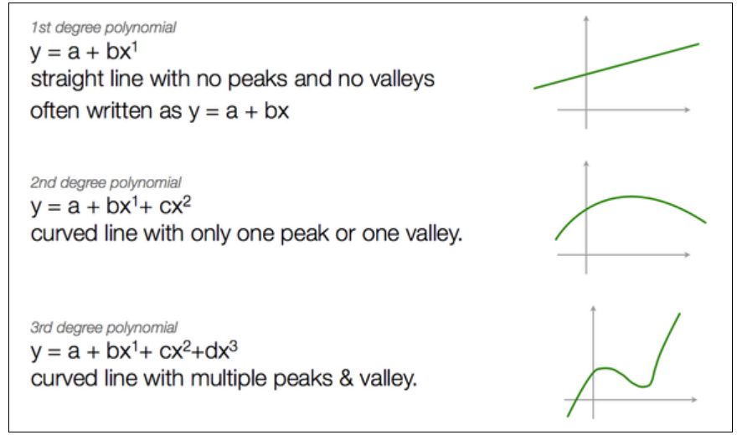
Source

Slide 13
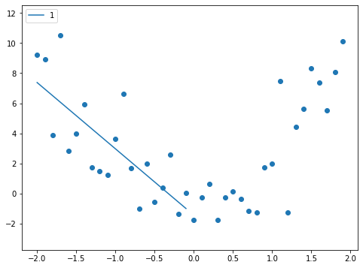
Add a 1st-Degree Polynomial (a straight line)
Training Data
$$\hat{f}\left(x\right)=β_{0}+β_{1} X_{1}=−1.4−4.4 X_{1}$$

Slide 14
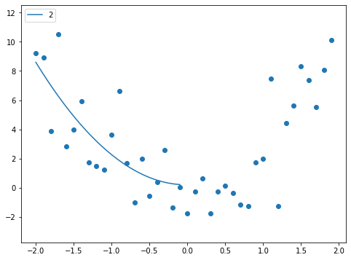
Add a 2nd-Degree Polynomial (a curved line)
Training Data
$$\hat{f}\left(x\right)=β_{0}+β_{1} X_{1}+β_{2}X_{1}^{2}=0.2+0.07 X_{1}+2.1 X_{1}^{2}$$

Slide 15

Add a 3rd-Degree Polynomial
Training Data
$$\hat{f}\left(x\right)=β_{0}+β_{1} X_{1}+β_{2} X_{1}^{2}+β_{3} X_{1}^{3}=−1.0−6.3 X_{1}−5.3 X_{1}^{2}−2.4X^{3}$$

Slide 16

Add a 4th-Degree Polynomial
Training Data
$$\hat{f}\left(x\right)=β_{0}+β_{1} X_{1}+β_{2} X_{1}^{2}+β_{3} X_{1}^{3}+β_{4} X_{1}^{4}=−0.43−1.5 X_{1}+4.5 X_{1}^{2}+4.8 X^{3}+1.7 X^{4}$$

Slide 17
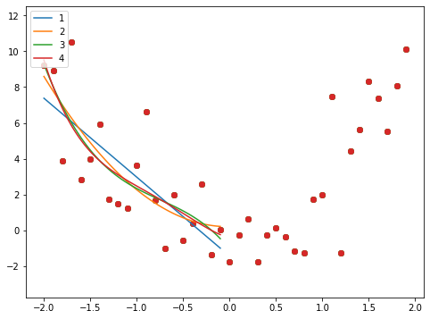
Let’s Put Everything onto the Same Chart
Training Data

Slide 18
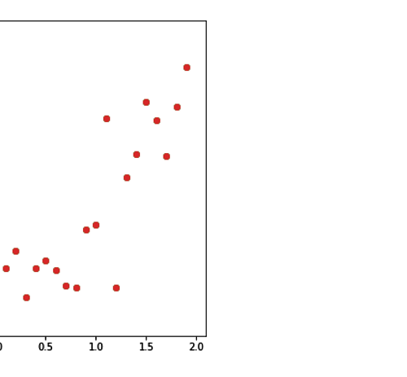
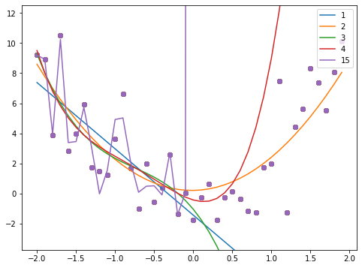
15th Degree Polynomial – Massive Overfitting
Training Data

Slide 19
Compute Error on Training Data
Training Data

Slide 20
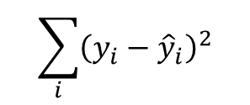
Error = Sum of Squared Errors
$$\sum_{i}{{\left(y_{i}−{\hat{y}}_{i}\right)}^{2}}$$
Training Data
Degree | Training Error
1 | 97.4
2 | 89.4
3 | 87
4 | 86.7

Slide 21
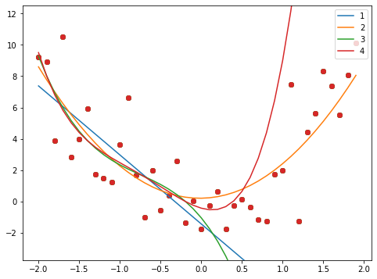
Now Let’s Predict With Each Model
Training Data
Testing Data

Slide 22
Compute Test Error and Compare
Training Data
Testing Data
Degree | Training Error | Test Error
1 | 97.4 | 2,148
2 | 89.4 | 89.6
3 | 87 | 14,827
4 | 86.7 | 10,142

Slide 23
Recap
We want to optimize an objective function
Find weights that minimize the loss
We use the data we have (training data)
We varied the order of the polynomial (less complex to more complex)
We saw that training error was not a good predictor of test error
We chose a 2nd order polynomial by looking at the test error
Can we automate this process?

