Slide 1
INST 414: Data Science Techniques Regularization

Slide 2
Preventing Overfitting a.k.a Regularization

Slide 3
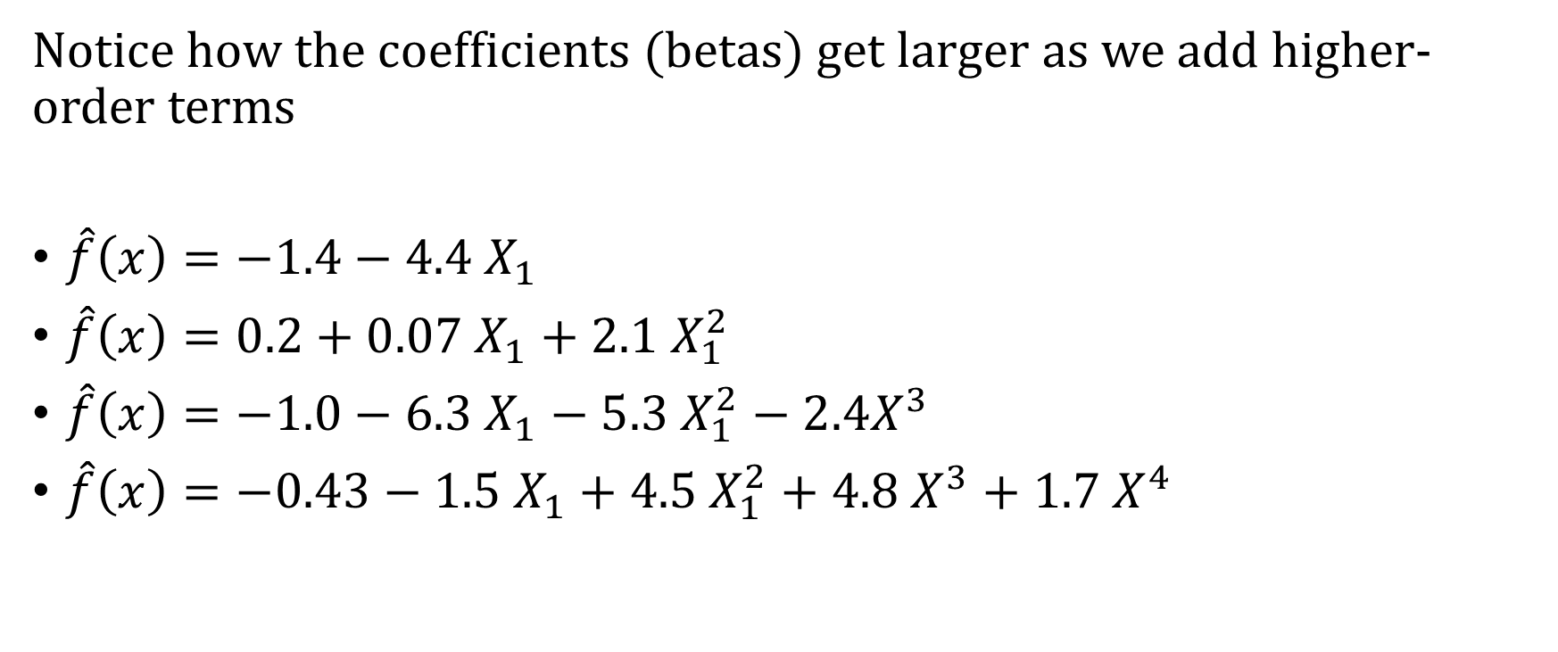
Can We Automate the Selection Process
Notice how the coefficients (betas) get larger as we add higher-order terms
$\hat{f}\left(x\right)=−1.4−4.4 X_{1}$
$\hat{f}\left(x\right)=0.2+0.07 X_{1}+2.1 X_{1}^{2}$
$\hat{f}\left(x\right)=−1.0−6.3 X_{1}−5.3 X_{1}^{2}−2.4X^{3}$
$\hat{f}\left(x\right)=−0.43−1.5 X_{1}+4.5 X_{1}^{2}+4.8 X^{3}+1.7 X^{4}$

Slide 4

Objective Functions with Regularization
Ordinary Least Squares (OLS):
$$\sum_{i}{{\left(Y_{i}−{\hat{p}}_{i}\right)}^{2}}$$
Ridge Regression:
$$\sum_{i}{{\left(Y_{i}−{\hat{p}}_{i}\right)}^{2}}+λ \sum_{j}{β_{j}^{2}}$$
Lasso Regression:
$$\sum_{i}{{\left(Y_{i}−{\hat{p}}_{i}\right)}^{2}}+λ \sum_{j}{|β_{j}|}$$

Slide 5
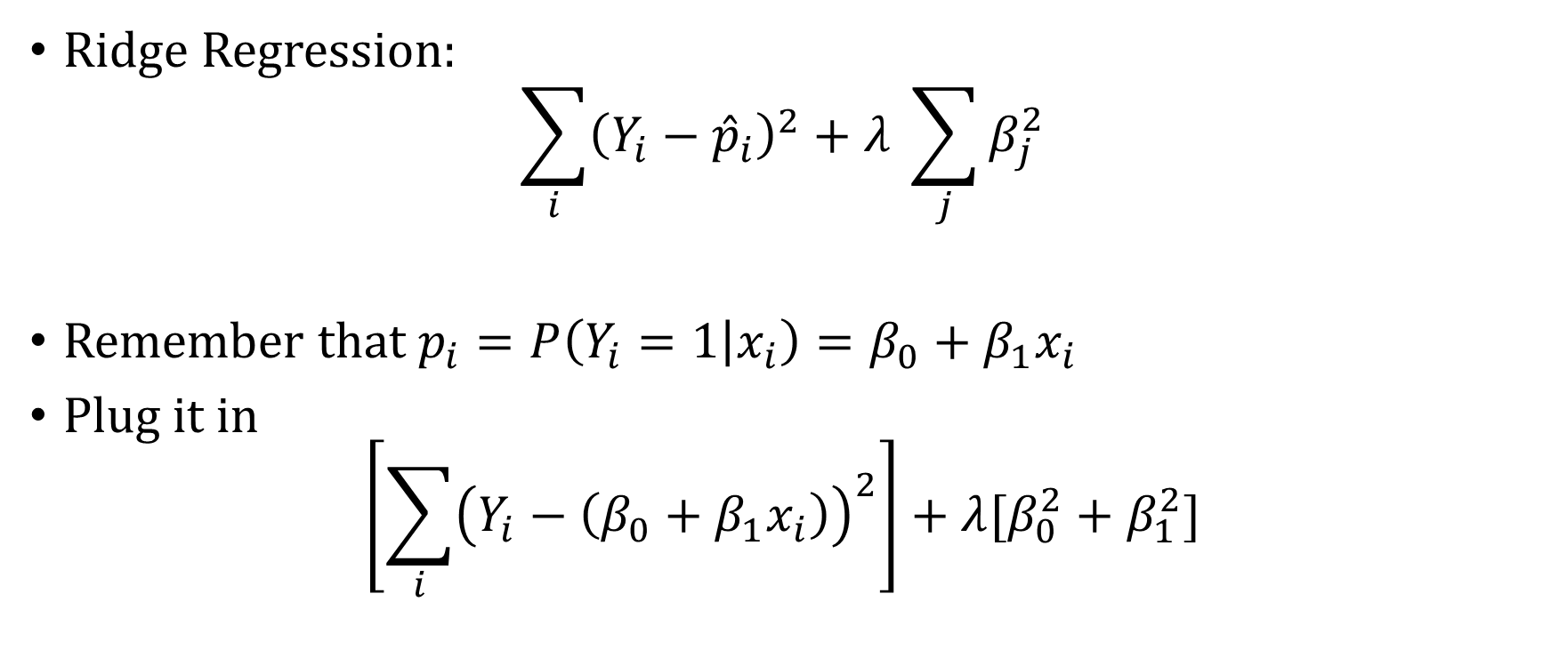
Ridge Regression Objective
Ridge Regression:
$$\sum_{i}{{\left(Y_{i}−{\hat{p}}_{i}\right)}^{2}}+λ \sum_{j}{β_{j}^{2}}$$
Remember that $p_{i}=P\left(Y_{i}=1 | x_{i}\right)=β_{0}+β_{1}x_{i}$
Plug it in
$$\left[\sum_{i}{{\left(Y_{i}−\left(β_{0}+β_{1}x_{i}\right)\right)}^{2}}\right]+λ[β_{0}^{2}+β_{1}^{2}]$$

Slide 6
Ridge vs Lasso Regularization
See here for visualization of difference between Ridge and Lasso:
https://www.youtube.com/watch?v=Xm2C_gTAl8c&vl=en

Slide 7
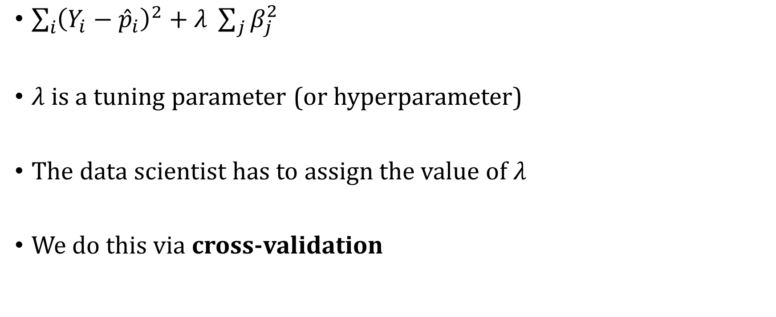

Finding $λ$, the penalty strength
$\sum_{i}{{\left(Y_{i}−{\hat{p}}_{i}\right)}^{2}}+λ \sum_{j}{β_{j}^{2}}$
$λ$ is a tuning parameter (or hyperparameter)
The data scientist has to assign the value of $λ$
We do this via cross-validation

Slide 8
Cross-validation
We want our model to perform well out-of-sample
We mimic this by splitting up our data first into two parts:
Training
Holdout (ultimate out-of-sample performance measure)
All Data
Train
Holdout

Slide 9

K-fold Cross-validation
Training data:
We split this up into $k$ folds
Train
Fold 1
Fold 2
Fold 3
Fold 4
Fold 5

Slide 10
K-fold Cross-validation
Training data:
We iteratively holdout one fold (validation set) and train on the rest.
Validation
Train
Train
Validation
Train
Train
Validation

Slide 11




K-Fold Cross-Validation
For each fold we train the model with many different values of $λ$
Validation
Train
$$λ∈\{.01, .1, 1, …,10, …\}$$
Train
Validation
Train
$$λ∈\{.01, .1, 1, …,10, …\}$$
Train
Validation
$$λ∈\{.01, .1, 1, …,10, …\}$$

Slide 12
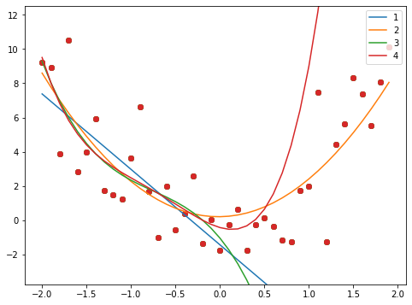
Training Data
Holdout Data
Validation Point
Training Point
1st Fold

Slide 13
Training Data
Holdout Data
Validation Point
Training Point
2nd Fold

Slide 14


K-Fold Cross-Validation
For each $λ$ and for each fold, we predict for the validation set
We average performance across the validation sets for each $λ$
We choose the $λ$ with the best performance for our final model
Fold | $$λ=1$$ | $$λ=5$$ | $$λ=25$$ | $$λ=50$$
1 | 92.0 | 49.1 | 39.3 | 44.4
2 | 17.3 | 13.8 | 11.9 | 11.8
3 | 33.5 | 34.9 | 38.4 | 40.1
4 | 100.0 | 8.3 | 6.8 | 6.6
5 | 7.9 | 7.9 | 7.8 | 7.9
Average | 32.1 | 22.8 | 20.9 | 22.2

Slide 15

K-fold Cross-validation
Build Ridge Regression on Train data (all folds combined):
$$\sum_{i=1}^{n}{{{(y}_{i}−(β_{0}+β_{1}x_{i}))}^{^2}+}25\sum_{j=1}^{k}{β_{j}^{2}}$$
Predict and evaluate for the Holdout
Train
Holdout

Slide 16
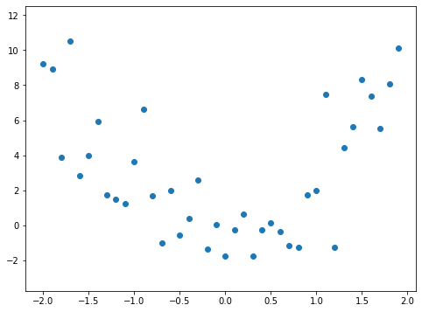
Adding the Ridge Regression Model
Training Data
Holdout Data
Degree | Training Error | Holdout Error
1 | 97.4 | 2,148
2 | 89.4 | 89.6
3 | 87 | 14,827
4 | 86.7 | 10,142

Slide 17
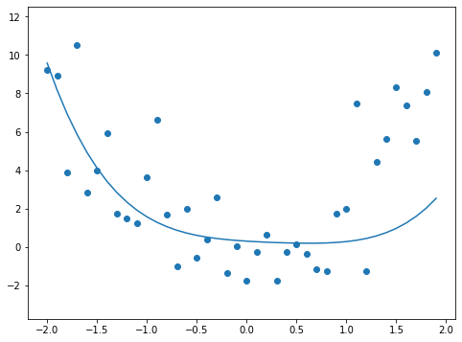
Predicting With Ridge
Training Data
Holdout Data
Degree | Training Error | Holdout Error
1 | 97.4 | 2,148
2 | 89.4 | 89.6
3 | 87 | 14,827
4 | 86.7 | 10,142
Ridge | 92.5 | 312.7

Slide 18
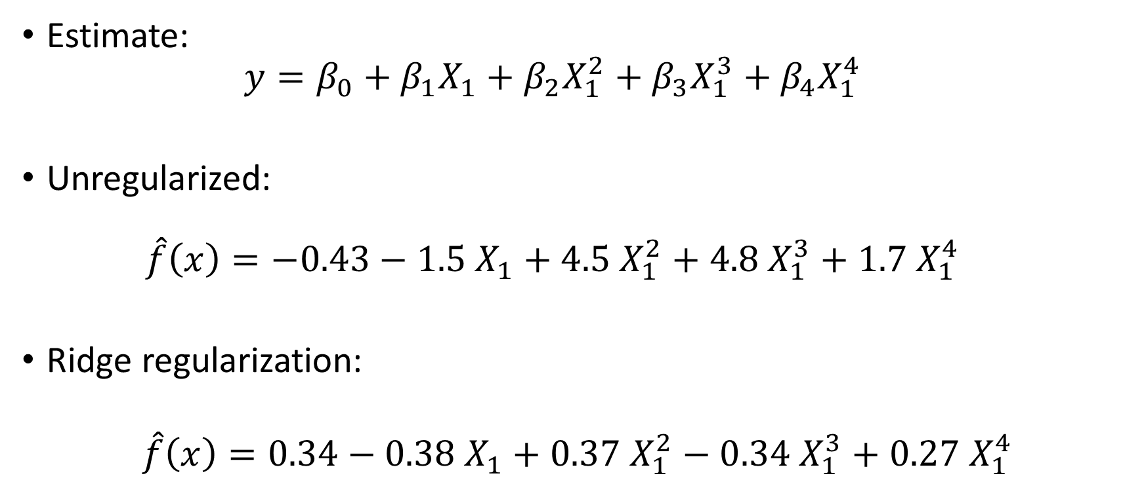
Difference Between
Estimate:
$$y=β_{0}+β_{1}X_{1}+β_{2}X_{1}^{2}+β_{3}X_{1}^{3}+β_{4}X_{1}^{4}$$
Unregularized:
$$\hat{f}\left(x\right)=−0.43−1.5 X_{1}+4.5 X_{1}^{2}+4.8 X_{1}^{3}+1.7 X_{1}^{4}$$
Ridge regularization:
$$\hat{f}\left(x\right)=0.34−0.38 X_{1}+0.37 X_{1}^{2}−0.34 X_{1}^{3}+0.27 X_{1}^{4}$$

Slide 19
Now Let’s Predict With Ridge
Training Data
Holdout Data
Degree | Training Error | Holdout Error
1 | 97.4 | 2,148
2 | 89.4 | 89.6
3 | 87 | 14,827
4 | 86.7 | 10,142
Ridge | 92.5 | 312.7

