Slide 1
INST 414: Data Science Techniques Bias-Variance Tradeoff

Slide 2
Bias-Variance Tradeoff

Slide 3
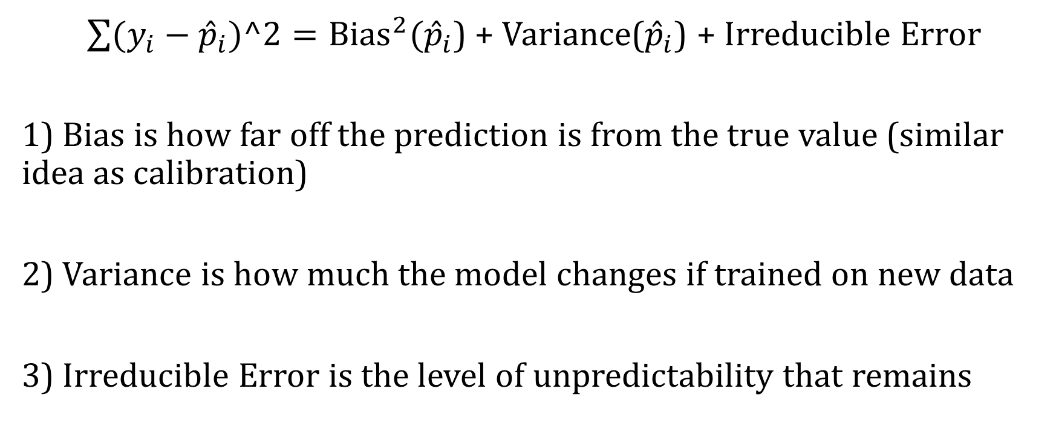
Three Sources of Error on Unseen Data
$\sum{(y_{i}−{\hat{p}}_{i})^2}={Bias}^{2}({\hat{p}}_{i}$) + Variance(${\hat{p}}_{i}$) + Irreducible Error
1) Bias is how far off the prediction is from the true value (similar idea as calibration)
2) Variance is how much the model changes if trained on new data
3) Irreducible Error is the level of unpredictability that remains

Slide 4
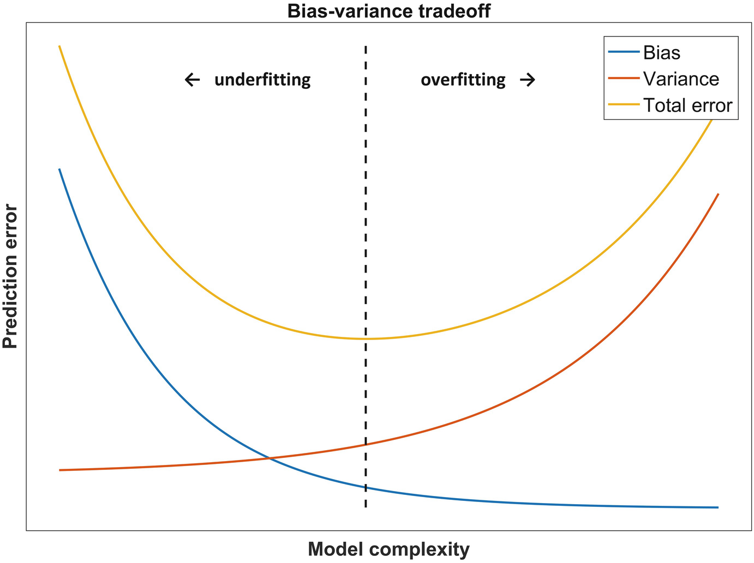

Slide 5
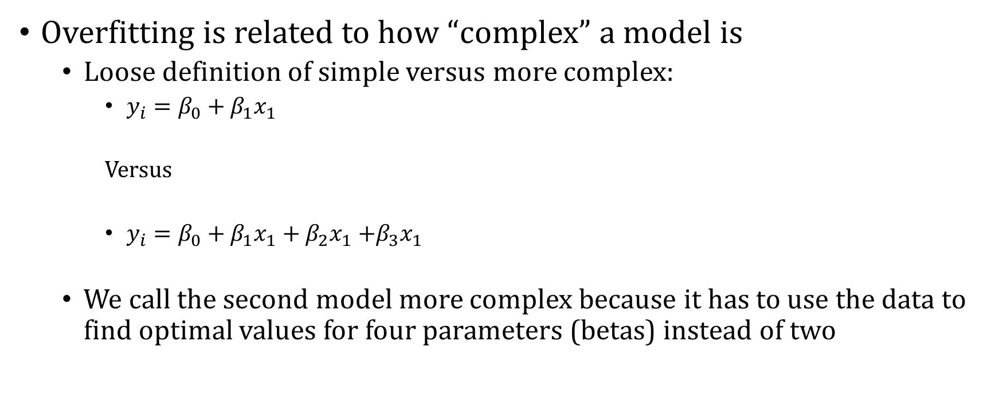
Model Complexity
Overfitting is related to how “complex” a model is
Loose definition of simple versus more complex:
$y_{i}=β_{0}+β_{1}x_{1}$
Versus
$y_{i}=β_{0}+β_{1}x_{1}+β_{2}x_{1}$ $+β_{3}x_{1}$
We call the second model more complex because it has to use the data to find optimal values for four parameters (betas) instead of two

Slide 6
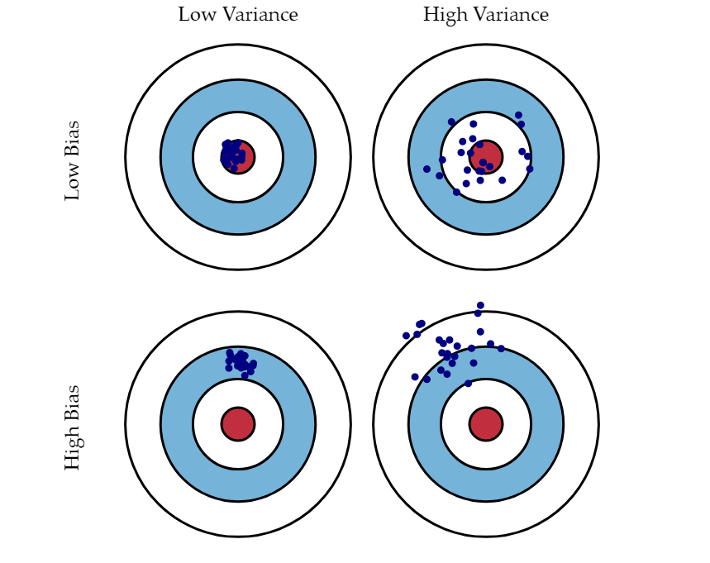
Bias-Variance Tradeoff
Source

Slide 7
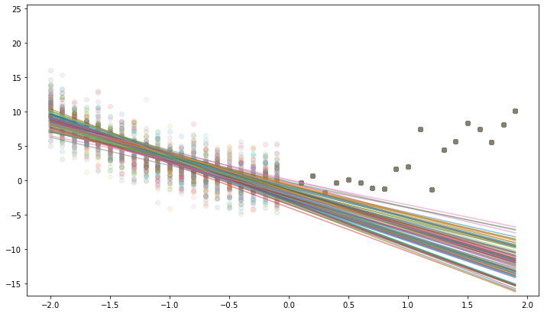
Bias + Variance: 1st Degree Polynomial
We generate data 1,000 times
We run OLS with one predictor on the training data
We predict with each model

Slide 8
Bias + Variance: 1st Degree Polynomial
We see that the predictions are pretty consistent
Low Variance
We see that predictions have a lot of error
High Bias

Slide 9
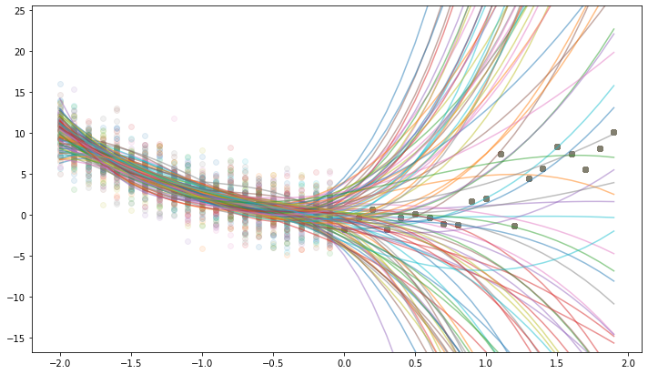
Bias + Variance: 3rd Degree Polynomial
We generate data 1,000 times
We run OLS with three predictors on the training data
We predict with each model

Slide 10
Bias + Variance: 3rd Degree Polynomial
We see that the predictions are all of the place
High Variance
We see that the average of the predictions have low error
Low Bias

Slide 11
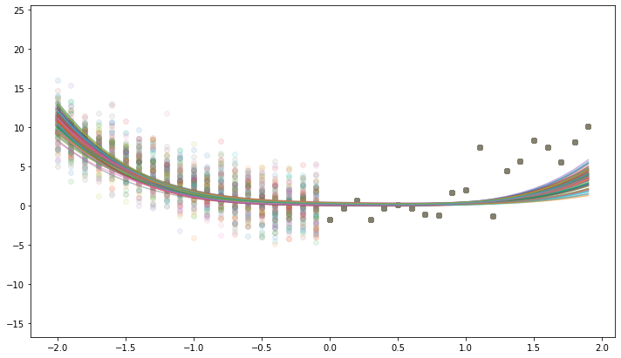
Bias + Variance: Ridge Regression
We generate data 1,000 times
We run Ridge Regression with four predictors on the training data
We predict with each model

Slide 12
Bias + Variance: Ridge Regression
We see that the predictions are pretty consistent
Low Variance
We see that the average of the predictions have low/medium error
Low/Medium Bias

Slide 13
Bias – Variance Tradeoff
Degree | Training Error | Test Error | Bias | Variance
1 | 97.4 | 2,148 | 135 | 2.5
2 | 89.4 | 89.6 | 4.1 | 49.9
3 | 87 | 14,827 | 67.2 | 1060
4 | 86.7 | 10,142 | 52.5 | 33130
Ridge | 92.5 | 312.7 | 19.4 | 0.23

