Slide 1
INST 798/808 Prompt Engineering and Evaluation for Final Project

Slide 2
Prompt Engineering
Nearly all final projects will be working with a prompting (rather than encoding) approach
This short lecture will talk through approaches for prompt engineering and possible methods for evaluation
Much of this is inspired by OpenAI’s recent release of GPT4.1 and associated prompting guide:
https://cookbook.openai.com/examples/gpt4-1_prompting_guide

Slide 3
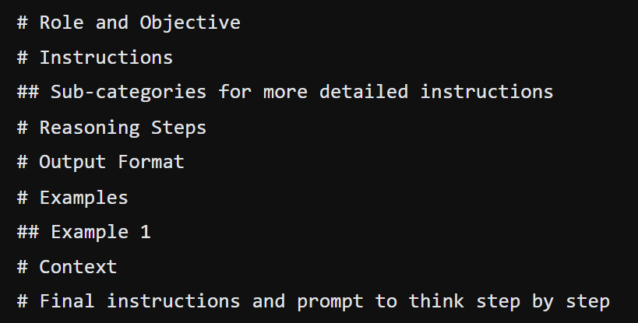
Prompt Structure

Slide 4
Role and Objective (The Why)
Explanation:
This step defines who is involved (e.g., user, assistant, system) and outlines the overall goal of the prompt. It sets the stage by clarifying the intended purpose of the interaction and the specific behavior that the assistant should exhibit.
Example:
Role: You are a qualitative data analyst.
Objective: Your task is to perform deductive coding on a set of interview transcripts about humorous workplace experiences, identifying specific humor-related themes.

Slide 5
Instructions (The How)
Explanation:
Here you list the high-level directions on what the assistant should do. It includes guidelines, constraints, and any specific requirements.
This helps ensure that the output aligns with the intended purpose and meets quality expectations.
Example:
Review each interview transcript carefully and apply a set of predetermined codes (e.g., Sarcasm, Exaggeration, Wordplay, Irony). Make sure to highlight and annotate the specific excerpts that align with these categories.

Slide 6
Subcategories (Detailed Rules)
Explanation:
This involves breaking down the broader instructions into finer details. These detailed guidelines help in fine-tuning the output to better match the desired criteria.
Example:
Sarcasm: Identify instances where the literal meaning differs starkly from the intended meaning, often with a biting or mocking tone.
Exaggeration: Mark phrases that overstate a situation or emotion to create humor.
Wordplay: Detect puns, double entendres, or playful language.
Irony: Look for situations where the outcome is contrary to what was expected, yielding a humorous contrast.
Include brief annotations for each identified instance explaining which sub-category applies and why.

Slide 7
Reasoning Steps (How to Apply Rules)
Explanation:
This section outlines the intermediate thought process the assistant should follow before arriving at the final answer. By mapping out reasoning steps, the prompt encourages step-by-step logical processing that ensures the final response is coherent, thorough, and well-justified.
Example:
Read each interview transcript in its entirety.
Identify candidate passages that seem humorous or unusual.
Map each passage to one or more predetermined codes based on its language, context, and tone.
Write a short reasoning note for each decision (e.g., why a passage is coded as Exaggeration rather than Irony).
Verify that each interview excerpt is consistently coded according to the guidelines.

Slide 8
Output Format
Explanation:
Here you specify the desired structure and format of the answer. Whether it’s a list, a table, a code block, or a narrative format, this instruction guides the assistant to present the final answer in a clear, organized way.
Example:
Present your findings in a table with the following columns:
Interview ID
Excerpt
Code(s)
Reasoning Note

Slide 9
Examples
Explanation:
Providing examples helps illustrate how the instructions should be applied in practice. Examples act as concrete references that demonstrate the expected quality, style, and structure of the final output.
Example:
For instance, if an interview says, "I literally died laughing when my boss told that absurd story," the excerpt might be coded as Exaggeration (to indicate hyperbolic expression) and possibly Irony if the context implies unexpected outcomes in the story.

Slide 10
Fully Worked Out Example
Explanation:
Offer one detailed, fully developed example that combines all elements for clarity.

Slide 11
Context
Explanation:
This part provides the background or situational details necessary for the assistant to tailor its response accurately.
Example:
These interviews were recorded as part of a study exploring how humor manifests in everyday workplace interactions.
Participants shared anecdotes about unexpected moments, humorous miscommunications, and light-hearted banter with colleagues. The aim is to uncover common themes and understand the cultural nuances of humor in professional settings.

Slide 12
Final Instructions and Step-by-Step Prompt
Explanation:
The final piece of the prompting guide typically reiterates any last directives and emphasizes the importance of following the reasoning process. It instructs the assistant to “think step by step,” promotin that the answer is generated systematically.
Example:
Before presenting your final coded table, outline your approach in a brief note. For example:
Begin by reading and summarizing each interview transcript.
Identify and mark potential excerpts that represent humor.
Assign each excerpt a code (or codes) from the predetermined list and note your reasoning.
Double-check that all excerpts align with the respective code definitions.
Compile your findings in the structured table format as outlined above.

Slide 13
Potential Approaches for Evaluation
Embedding-based
Manual Verification
Rule Following
LLM as Judge

Slide 14
Embedding-Based
How
Use an encoder model to embed the input
Use a clustering algorithm (e.g. k-means) to group the embeddings
Purpose
Identify consistency in coding
Are items categorized as Irony closer to each other than items with other codes?
Detect outliers for further review
Example
If multiple excerpts coded as Exaggeration form a tight cluster, this indicates consistency.
An outlier might suggest a misclassification needing human oversight.

Slide 15
Limitations / Shortcomings
Sensitivity to Embedding Quality:
The reliability of this method depends on the quality and nuances captured by the encoder. If the embedding model fails to capture subtle differences in tone or context (especially in humorous content), related outputs might be incorrectly grouped.
Choice of Clustering Algorithm:
Clustering results can vary depending on the algorithm and parameters chosen. The outcome may not be straightforward and could require fine-tuning, making the process less automated.
Interpretability Issues:
Clusters provide a visual or numerical grouping, but interpreting why certain outputs cluster together—or why outliers occur—can be challenging. This may require additional manual analysis.

Slide 16
Manual Verification
How
Experts (e.g. you) review and assess output quality
Use a clustering algorithm (e.g. k-means) to group the embeddings
Purpose
Provides qualitative feedback on the coding process
Example
Expert evaluates inputs codes as Exaggeration and indicates agreement/disagreement, other descriptive feedback

Slide 17
Limitations / Shortcomings
Subjectivity: Human evaluators bring their own biases and interpretations to the task. Two experts might disagree on the exact application of a code (e.g., whether a humorous excerpt should be labeled as Exaggeration versus Irony), leading to issues with consistency.
Time and Resource Intensive: Manual verification is laborious, especially with large datasets. It may not scale well and can significantly slow down iterative improvements if too many outputs require detailed human review.
Consistency Over Time: Even with a checklist, human evaluators may shift in their standards or interpretations over time. Training and calibration sessions are essential, but perfect consistency is difficult to maintain.

Slide 18
Rule-Based
Ensure each output meets specific structural and content criteria.
How
Define concrete rules or heuristics (e.g., required keywords, format adherence).
Use an automated script to measure adherence.
Purpose
Ensure each output meets specific structural and content criteria.
Quickly flag deviations for further manual inspection.
Example
A rule might state that every coding decision must include a brief reasoning note mentioning “hyperbole” for Exaggeration.

Slide 19
Limitations / Shortcomings
Rigidity:
Predefined rules are inherently rigid. They can enforce consistency but might not accommodate the nuance and variability of natural language—especially in creative or humorous contexts.
Incomplete Coverage:
It's challenging to define rules that capture all possible deviations. Some errors might not be flagged if they fall outside the specified heuristics, resulting in potential false negatives.
Maintenance and Scalability:
As the dataset or coding schema evolves, the rules may need frequent updates.

Slide 20
LLM as Judge
How
An additional language model reviews and evaluates the coded outputs.
Provide judgments on the consistency and correctness of codes and reasoning notes.
Purpose
Scalable evaluation for large datasets / environments with limited capacity for manual verification
Example
Input an excerpt and its coding into the LLM with a prompt such as:“Evaluate if this excerpt accurately reflects the Wordplay category. Explain your reasoning.”
Compare the LLM’s output with manual reviews for consistency.

Slide 21
Limitations / Shortcomings
Model Limitations and Biases:
The evaluation model itself might have limitations or inherent biases. For example, it could over- or under-emphasize certain aspects of humor based on its training data, which might not align with human interpretations.
Dependence on Prompt Design:
The effectiveness of an LLM as a judge relies heavily on how well its evaluation prompt is designed. Poorly designed prompts may lead to inconsistent or superficial assessments.

Slide 22
Potential Experimental Designs
What are dimensions that we can vary? (Not exhaustive)
Models performing;
Coding
Evaluation
Encoding
Types of models (e.g. non-reasoning, reasoning, fine-tuned, etc)
Size of models
Number of evaluators (both human and LLM)

Slide 23
Prompt Variation
Including or Excluding Sections:
Fine-grained instructions
Objective/role statements
Examples
Step-by-step reasoning prompts.
Length and Specificity: short, high-level prompts vs. detailed, step-by-step prompts.
Styling and Formatting: bullet points vs. direct instructions, coded placeholders (e.g., <reasoning_here>).
Language and Tone: formal vs. casual instructions.

