Slide 1
INST 414: Data Science Techniques Feature Importance

Slide 2
Maryland data and setup
• Use Maryland data to predict violent rearrest within one year for all cases in 2017
• Three feature groups: prior history, current charge, demographics
• Black and White defendants only, so the comparison stays focused
Measure | Value
Rows | 7,914
People | 5,255
One-year violent rearrest rate | 5.8%
Feature groups | 3
Predictors | 10
• The same data will answer three questions. • Which variables matter? • What changes when a group is removed? • Do those choices change group-level metrics?

Slide 3
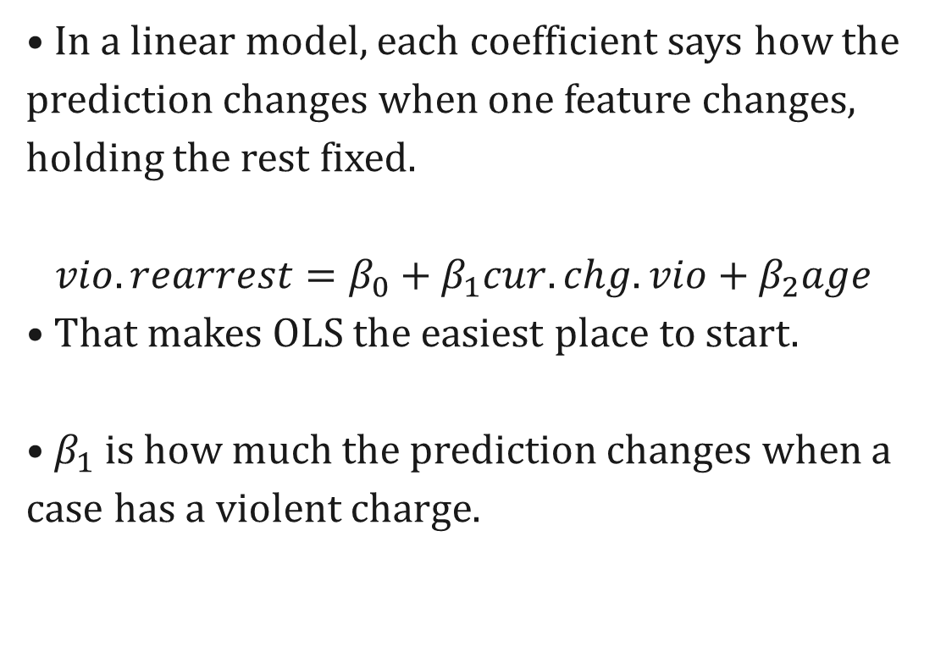
OLS coefficients: the baseline idea
• In a linear model, each coefficient says how the prediction changes when one feature changes, holding the rest fixed.
$$vio.rearrest=β_{0}+β_{1}cur.chg.vio+β_{2}age$$
• That makes OLS the easiest place to start.
• $β_{1}$is how much the prediction changes when a case has a violent charge.
• Coefficient = conditional change in predicted probability. • It is still conditional on the other variables, so scaling and correlation matter.

Slide 4
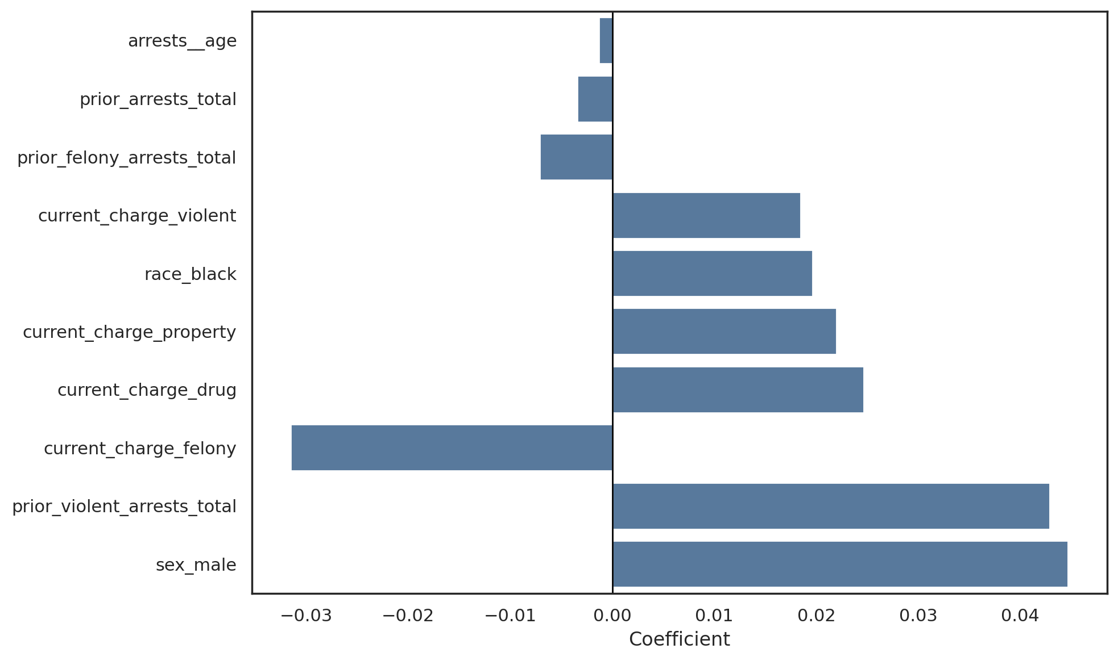
OLS coefficients: what the model learned
Feature | Coefficient
Male | 0.045
Prior violent arrests | 0.043
Current charge: felony | -0.032
Current charge: drug | 0.025
Current charge: property | 0.022
Look at the sign and the size. The table helps translate the plot into feature names.

Slide 5
Tree-based importance: a different notion
• Trees do not have coefficients.
• Instead, importance comes from how much each feature helps split the data.
• Intuitive notion: How often is a feature used to make a split • Impurity-based: In the binary case, how much does a feature reduce impurity across all of the times it was used for a split.
• Tree importance is about how much a feature helps the forest split the data. • Caveat: Two highly correlated features share splits in messy ways

Slide 6
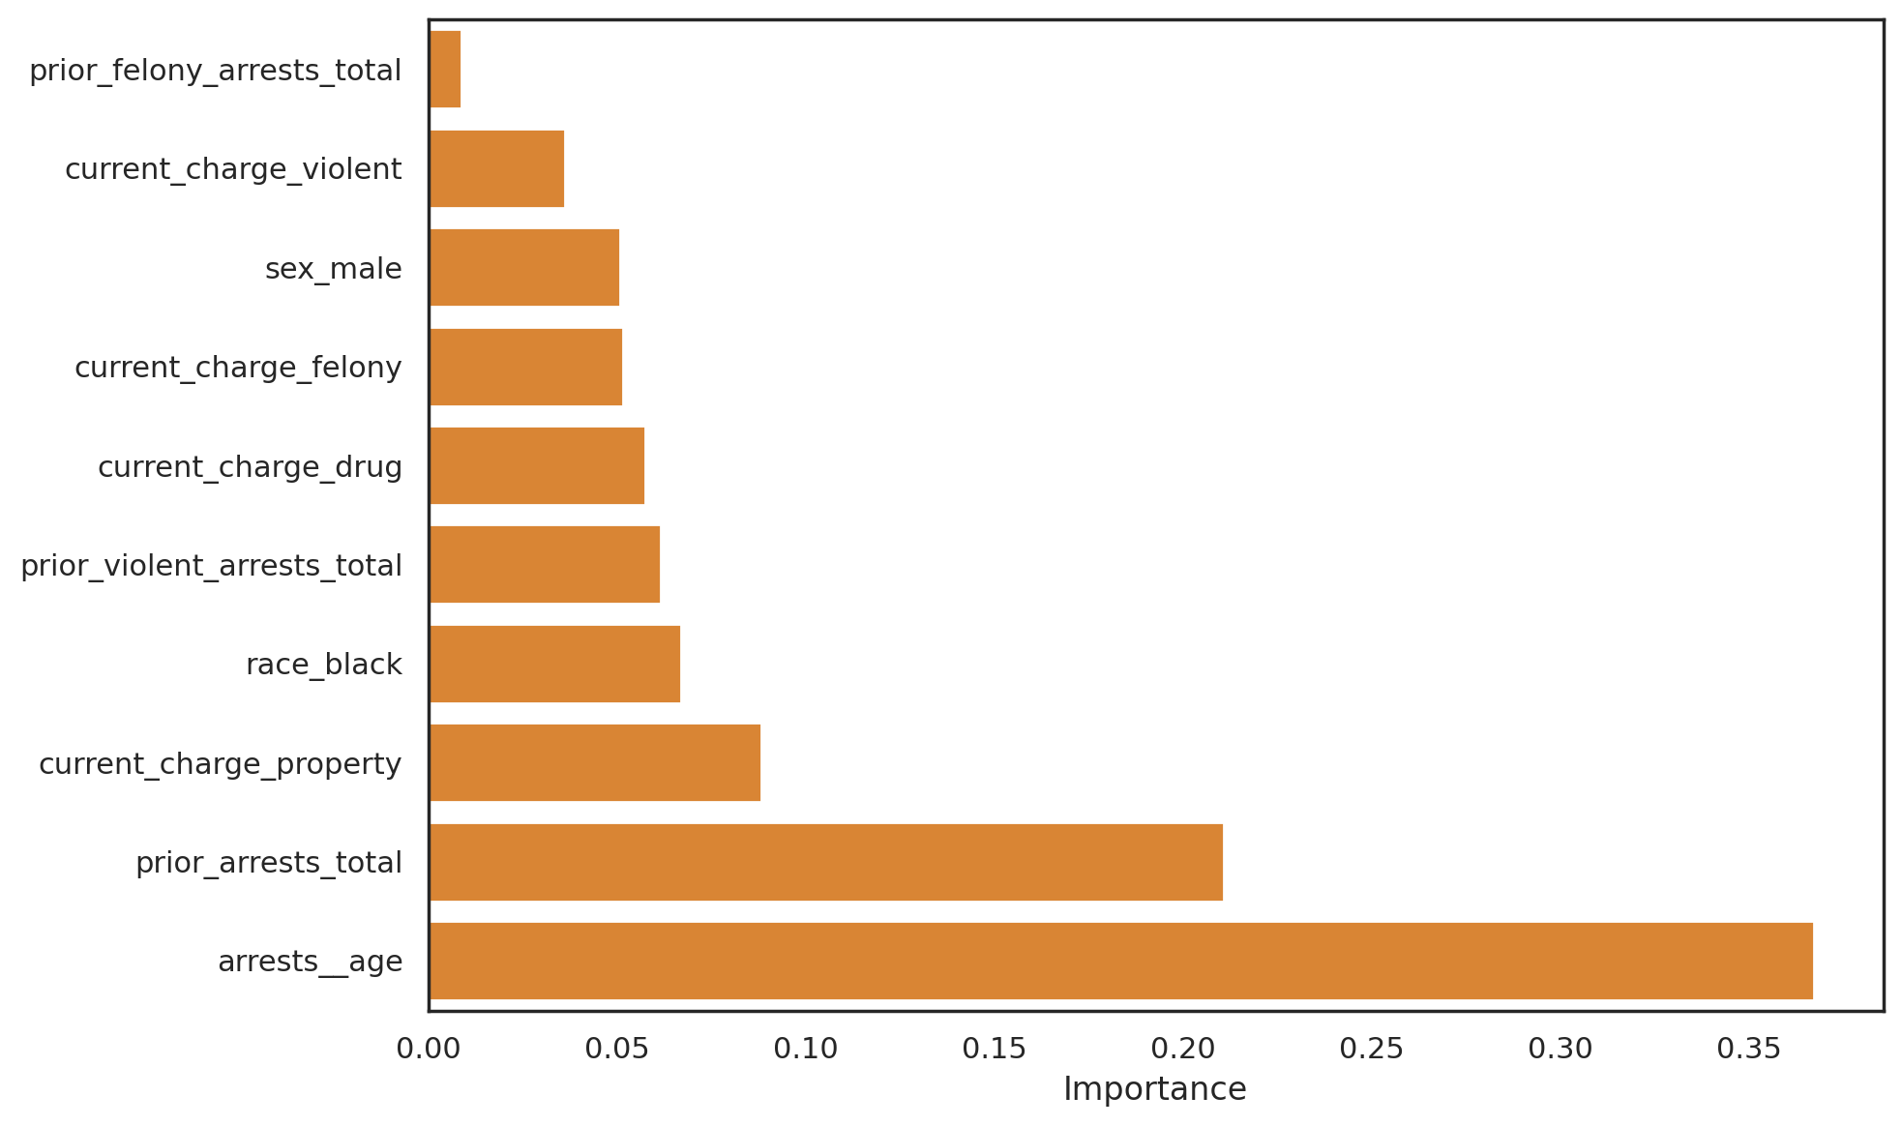
Random forest feature importance
Feature | Importance
Age | 0.367
Total prior arrests | 0.211
Current charge: property | 0.088
Black | 0.067
Prior violent arrests | 0.062
This ranking shows which inputs the forest used most to separate the outcome.

Slide 7
SHAP: local explanations
• SHAP explains one prediction at a time.
• Start with a baseline prediction, then add feature contributions.
• That helps you ask why one person got a particular score.
• Averaging SHAP values gives a global picture, too.
• Baseline + feature pushes up or down. • Local first, then global.

Slide 8
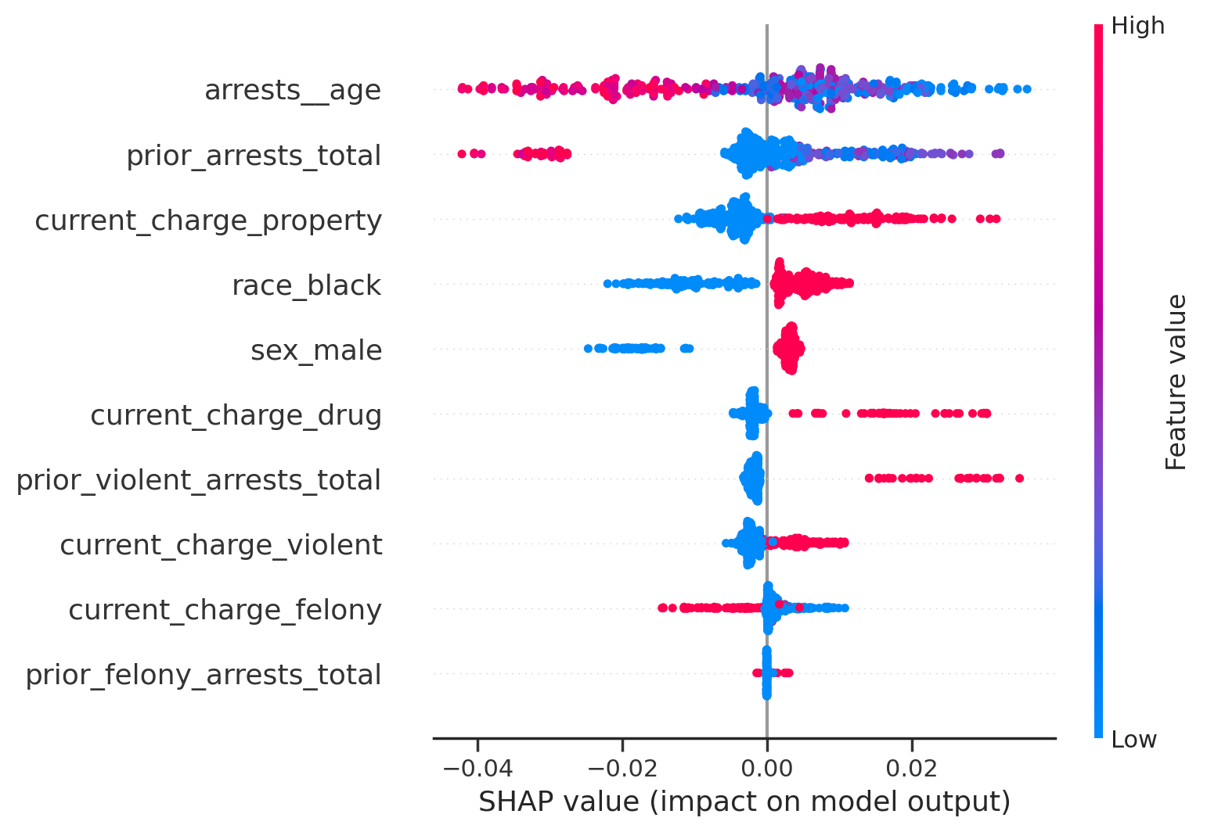
SHAP summary plot
Feature | Mean |SHAP|
Age | 0.014
Total prior arrests | 0.008
Current charge: property | 0.007
Black | 0.007
Male | 0.005
The summary plot shows which features move predictions the most on average.

Slide 9
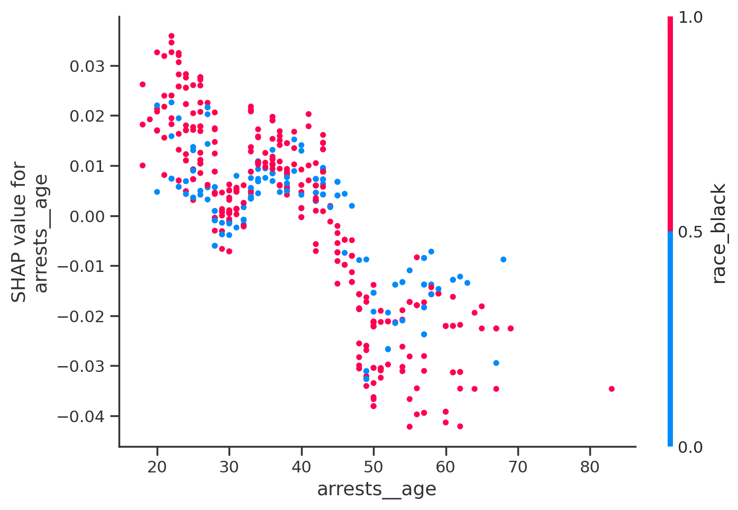
SHAP dependence on age
Age does not have to act linearly. The dependence plot shows how the SHAP contribution changes across the age range.

Slide 10
Ablation: remove a feature group and retrain
• Ablation asks what the model loses when a feature group disappears.
• That is a direct way to see what the model depends on.
• Here we compare the full model to versions with one feature group removed.
• Remove a group. • Retrain. • See what changes.

Slide 11
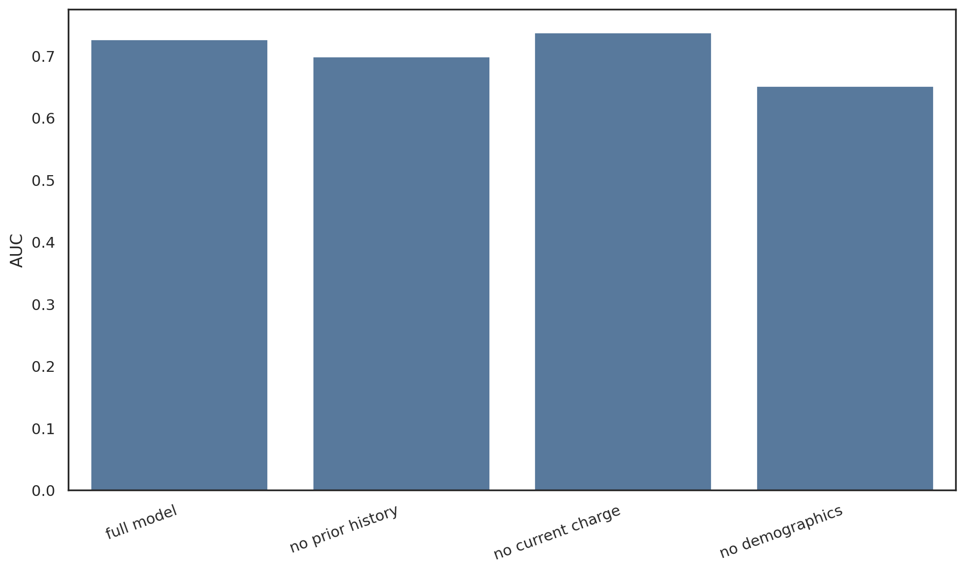
Ablation: AUC
Model | AUC
full model | 0.727
no prior history | 0.698
no current charge | 0.737
no demographics | 0.651
• AUC tells us whether the ranking gets better or worse when we remove a group.

Slide 12
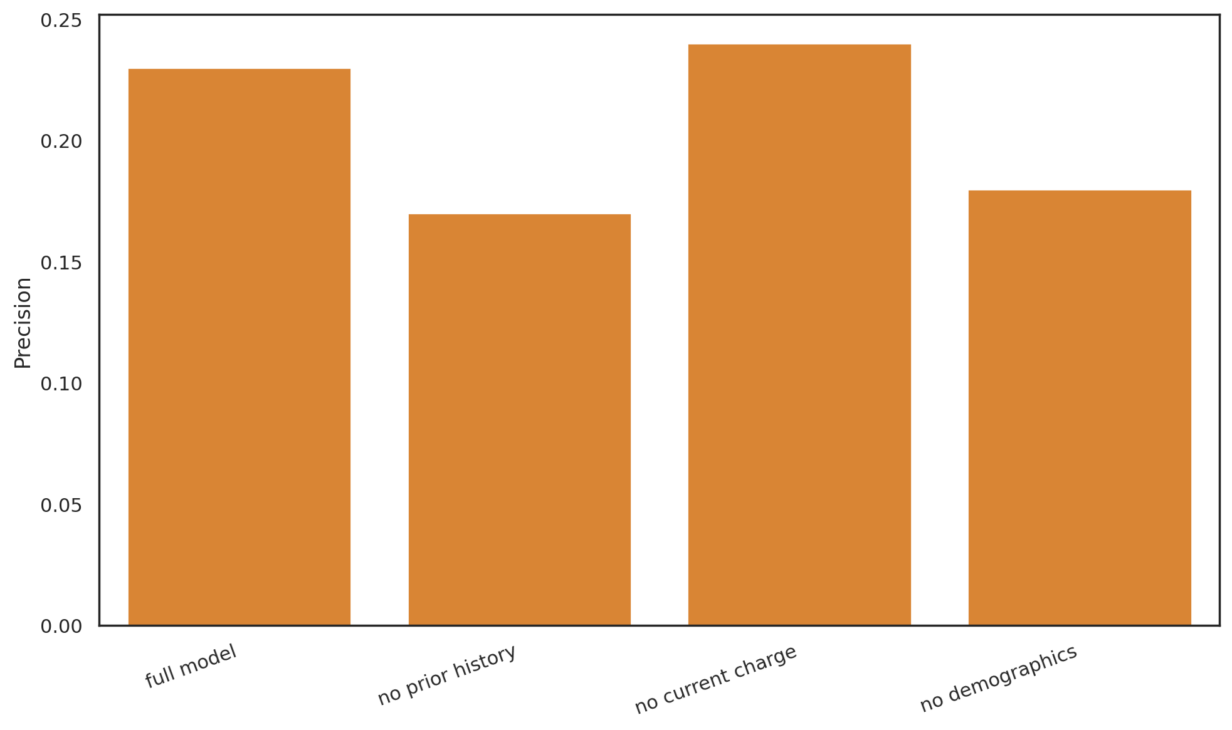
Ablation: top-100 precision
Model | Precision | Share flagged
full model | 0.230 | 0.025
no prior history | 0.170 | 0.025
no current charge | 0.240 | 0.025
no demographics | 0.180 | 0.025
• Top 100 covers 2.5% of the test set.

Slide 13
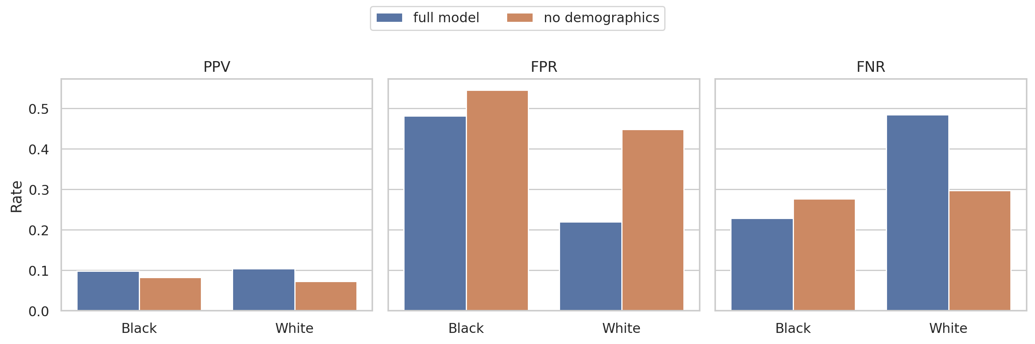
Fairness by race: full model vs. no demographics
Model | Group | PPV | FPR | FNR
full model | Black | 0.098 | 0.481 | 0.229
full model | White | 0.104 | 0.220 | 0.484
no demographics | Black | 0.083 | 0.546 | 0.277
no demographics | White | 0.072 | 0.449 | 0.297
• The key fairness question is whether dropping demographics changes the group gaps.

Slide 14
Takeaways
• OLS coefficients, tree importance, SHAP, and ablation answer different questions.
• A feature can be predictive without being the right feature to rely on .
• A model can look strong overall and still behave differently across groups.
• Feature importance and fairness are related, but they are not the same thing.

