Slide 1
Lecture 11b
Sources of Bias in Predictions I

Slide 2
A Key Distinction
A model can look biased even if the source of the difference is in the world or the data
So we now shift from fairness definitions to sources of bias in predictions

Slide 3
What Do We Mean by Bias?
Define a “fairness criterion”
For example, that False Positive Rates should be balanced between groups (race, gender, age, etc)
Could be more than one
If the criteria are not balanced, we’ll call this biased or unfair for today’s discussion.
There are infinite definitions of bias, so no claim that this is the only way to measure it

Slide 4
Our Data
Will be coming from police arrests
So we will either want to predict arrest in the future (next year)
Or use arrest data to predict another outcome (likelihood of dropping out of high school)
Or you could use arrest data as a predictor (X) or outcome to predict (Y)

Slide 5
Where Does Bias Come From?
Arrested
$$P\left(Arrest=1 | Crime=1, Report=1\right)$$
Crime Reported
$$P\left(Report=1 | Crime=1 \right)$$
Not Arrested
$$P\left(Arrest=0 | Crime=1, Report=1\right)$$
Crime Committed
Arrested
$$P\left(Arrest=1 | Crime=1, Report=0\right)$$
$$P\left(Report=0 | Crime=1 \right)$$
Crime Not Reported
Not Arrested
$$P\left(Arrest=0 | Crime=1, Report=0\right)$$

Slide 6
Possible Sources of Bias
different underlying rates across groups
different chances of being observed or arrested
measurement error
labels that do not perfectly capture what we care about

Slide 7
Where Does Bias Come From?
$$P\left(Arrest=1 | Crime=1, Race=A\right)$$
Arrested
Crime
Not Arrested
$$P\left(Arrest=0 | Crime=1, Race=A\right)$$
$$P\left(Arrest=1 | Crime=1, Race=B\right)$$
Arrested
Crime
Not Arrested
$$P\left(Arrest=0 | Crime=1, Race=B\right)$$

Slide 8
Where Does Bias Come From? Scenario 1
Arrested
$P\left(Arrest=1 | Crime=1, Race=A\right)=50\%$
Crime
Not Arrested
$$P\left(Arrest=0 | Crime=1, Race=A\right)=50\%$$
Arrested
$$P\left(Arrest=1 | Crime=1, Race=B\right)=100\%$$
Crime
Not Arrested
$$P\left(Arrest=0 | Crime=1, Race=B\right)=0\%$$

Slide 9
Where Does Bias Come From? Scenario 1
Arrested
$P\left(Arrest=1 | Crime=1, Race=A\right)=50\%$
Crime
Not Arrested
$$P\left(Arrest=0 | Crime=1, Race=A\right)=50\%$$
In this scenario, one group is more likely to be re-arrested given that they committed a crime
Arrested
$$P\left(Arrest=1 | Crime=1, Race=B\right)=100\%$$
Crime
Not Arrested
$$P\left(Arrest=0 | Crime=1, Race=B\right)=0\%$$

Slide 10
Where Does Bias Come From? Scenario 2
Arrested
$P\left(Arrest=1 | Crime=1, Race=A\right)=100\%$
Crime
Not Arrested
$$P\left(Arrest=0 | Crime=1, Race=A\right)=0\%$$
Arrested
$$P\left(Arrest=1 | Crime=1, Race=B\right)=100\%$$
Crime
Not Arrested
$$P\left(Arrest=0 | Crime=1, Race=B\right)=0\%$$

Slide 11
No Differences in Measurement
Arrested
$P\left(Arrest=1 | Crime=1, Race=A\right)=100\%$
Crime
Not Arrested
$$P\left(Arrest=0 | Crime=1, Race=A\right)=0\%$$
In this scenario, both groups are always arrested if they have committed a crime.
Arrested
$$P\left(Arrest=1 | Crime=1, Race=B\right)=100\%$$
Crime
Not Arrested
$$P\left(Arrest=0 | Crime=1, Race=B\right)=0\%$$

Slide 12
What Leads to Bias
We are going to imagine a world where everything is measured perfectly
We are going to compare two subgroups: race=0 and race=1
One subgroup will have a higher arrest rate than the other one
Why is there a difference in re-arrest rate?
Important for real-world discussions
Today we primarily care about the math

Slide 13
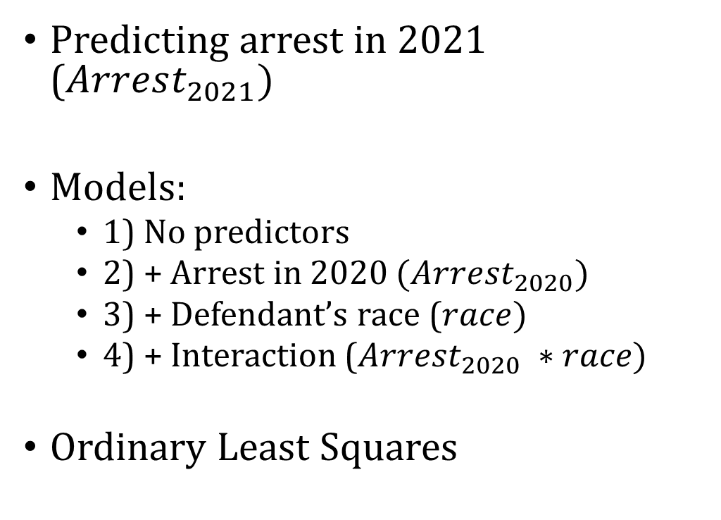
Example
Predicting arrest in 2021 ($Arrest_{2021})$
Models:
1) No predictors
2) + Arrest in 2020 $(Arrest_{2020})$
3) + Defendant’s race ($race)$
4) + Interaction ($Arrest_{2020} ∗race)$
Ordinary Least Squares

Slide 14
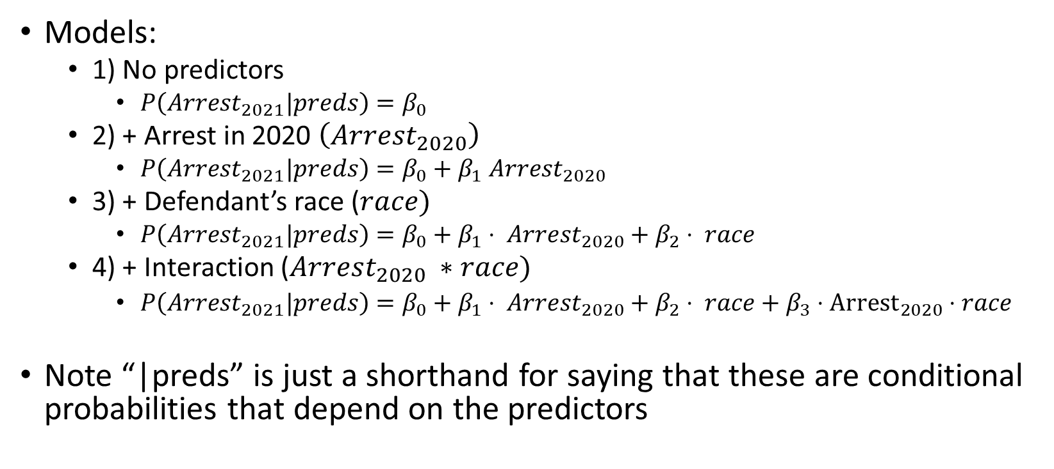
Example
Models:
1) No predictors
$P\left(Arrest_{2021}|preds\right)=β_{0}$
2) + Arrest in 2020 $\left(Arrest_{2020}\right)$
$P\left(Arrest_{2021}|preds\right)=β_{0}+β_{1} Arrest_{2020}$
3) + Defendant’s race ($race)$
$P\left(Arrest_{2021}|preds\right)=β_{0}+β_{1}⋅ Arrest_{2020}+β_{2}⋅ race$
4) + Interaction ($Arrest_{2020} ∗race)$
$P\left(Arrest_{2021}|preds\right)=β_{0}+β_{1}⋅ Arrest_{2020}+β_{2}⋅ race+β_{3}⋅{Arrest}_{2020}⋅race$
Note “|preds” is just a shorthand for saying that these are conditional probabilities that depend on the predictors

Slide 15

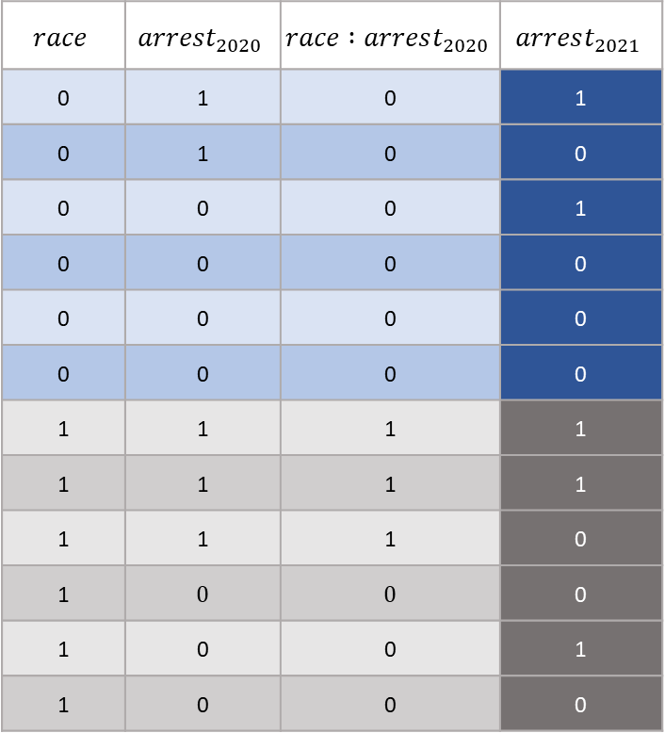
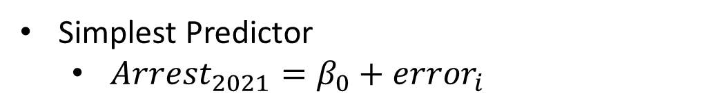
$$P(Arrest_{2021})$$
Simplest Predictor
$Arrest_{2021}=β_{0}+error_{i}$
$$race$$ | $$arrest_{2020}$$ | $$race :arrest_{2020}$$ | $$arrest_{2021}$$
0 | 1 | 0 | 1
0 | 1 | 0 | 0
0 | 0 | 0 | 1
0 | 0 | 0 | 0
0 | 0 | 0 | 0
0 | 0 | 0 | 0
1 | 1 | 1 | 1
1 | 1 | 1 | 1
1 | 1 | 1 | 0
1 | 0 | 0 | 0
1 | 0 | 0 | 1
1 | 0 | 0 | 0

Slide 16
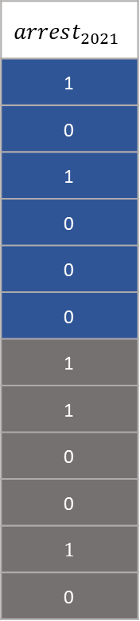
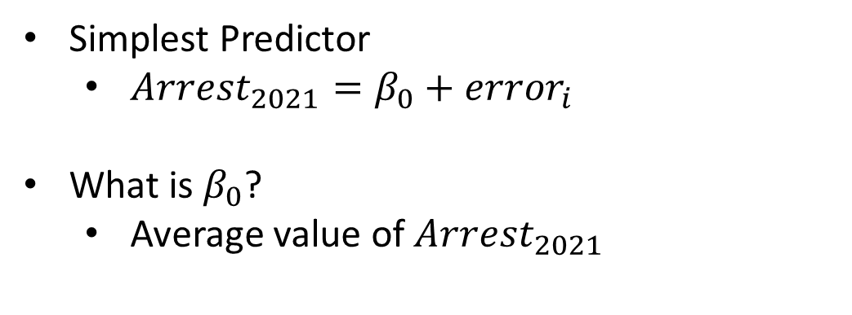
$$P(Arrest_{2021})$$
Simplest Predictor
$Arrest_{2021}=β_{0}+error_{i}$
What is $β_{0}$?
Average value of $Arrest_{2021}$
$$arrest_{2021}$$
1
0
1
0
0
0
1
1
0
0
1
0

Slide 17
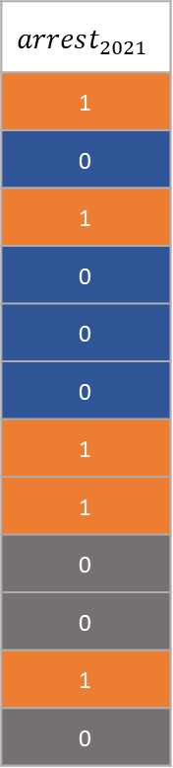
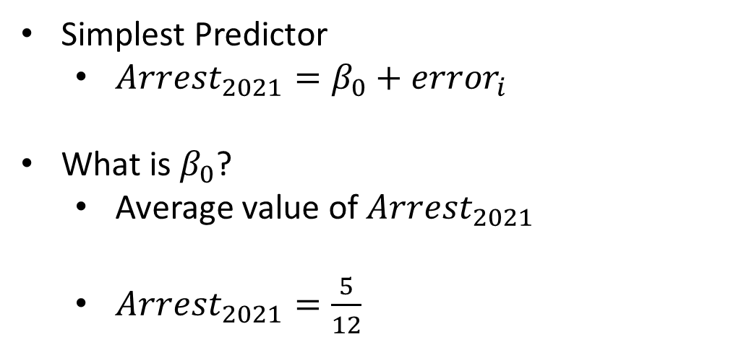
$$P(Arrest_{2021})$$
Simplest Predictor
$Arrest_{2021}=β_{0}+error_{i}$
What is $β_{0}$?
Average value of $Arrest_{2021}$
$Arrest_{2021}=\frac{5}{12}$
$$arrest_{2021}$$
1
0
1
0
0
0
1
1
0
0
1
0

Slide 18
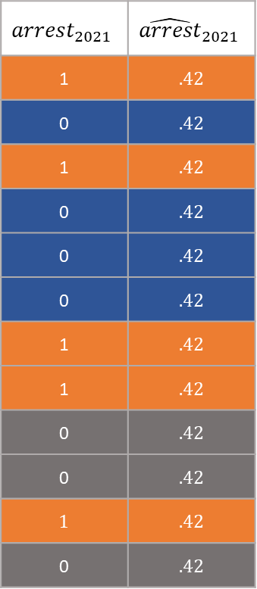
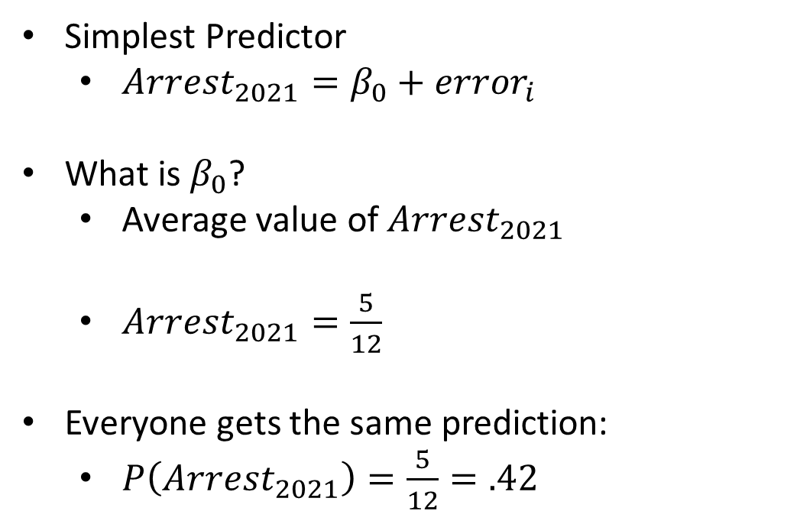
$$P(Arrest_{2021})$$
Simplest Predictor
$Arrest_{2021}=β_{0}+error_{i}$
What is $β_{0}$?
Average value of $Arrest_{2021}$
$Arrest_{2021}=\frac{5}{12}$
Everyone gets the same prediction:
$P\left(Arrest_{2021}\right)=\frac{5}{12}=.42$
$$arrest_{2021}$$ | $${\hat{arrest}}_{2021}$$
1 | .42
0 | .42
1 | .42
0 | .42
0 | .42
0 | .42
1 | .42
1 | .42
0 | .42
0 | .42
1 | .42
0 | .42

Slide 19
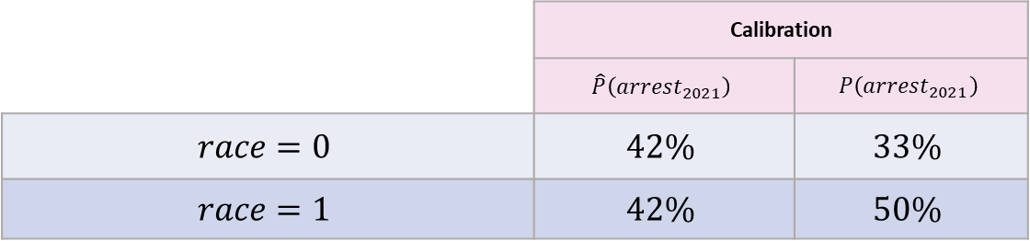
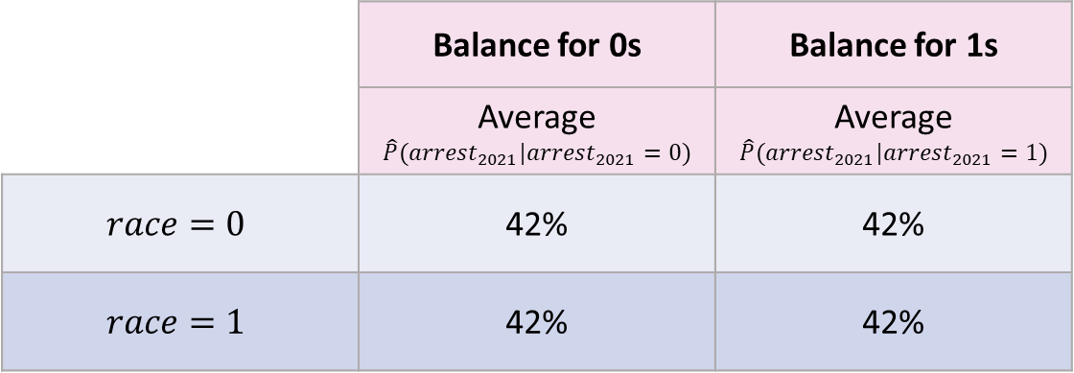
Compute Fairness Metrics
 | Calibration
 | $$\hat{P}\left(arrest_{2021}\right)$$ | $$P\left(arrest_{2021}\right)$$
$$race=0$$ | $$42\%$$ | $$33\%$$
$$race=1$$ | $$42\%$$ | $$50\%$$
 | Balance for 0s | Balance for 1s
 | Average $$\hat{P}(arrest_{2021}|arrest_{2021}=0)$$ | Average $$\hat{P}(arrest_{2021}|arrest_{2021}=1)$$
$$race=0$$ | 42% | 42%
$$race=1$$ | 42% | 42%

Slide 20

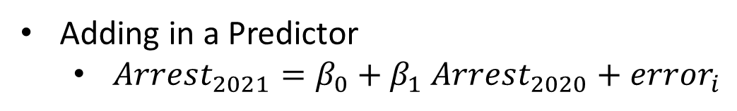
$$P(Arrest_{2021}|Arrest_{2020})$$
Adding in a Predictor
$Arrest_{2021}=β_{0}+β_{1} Arrest_{2020}+error_{i}$
$$race$$ | $$arrest_{2020}$$ | $$race :arrest_{2020}$$ | $$arrest_{2021}$$
0 | 1 | 0 | 1
0 | 1 | 0 | 0
0 | 0 | 0 | 1
0 | 0 | 0 | 0
0 | 0 | 0 | 0
0 | 0 | 0 | 0
1 | 1 | 1 | 1
1 | 1 | 1 | 1
1 | 1 | 1 | 0
1 | 0 | 0 | 0
1 | 0 | 0 | 1
1 | 0 | 0 | 0

Slide 21
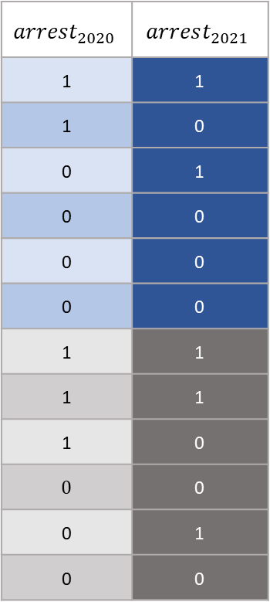
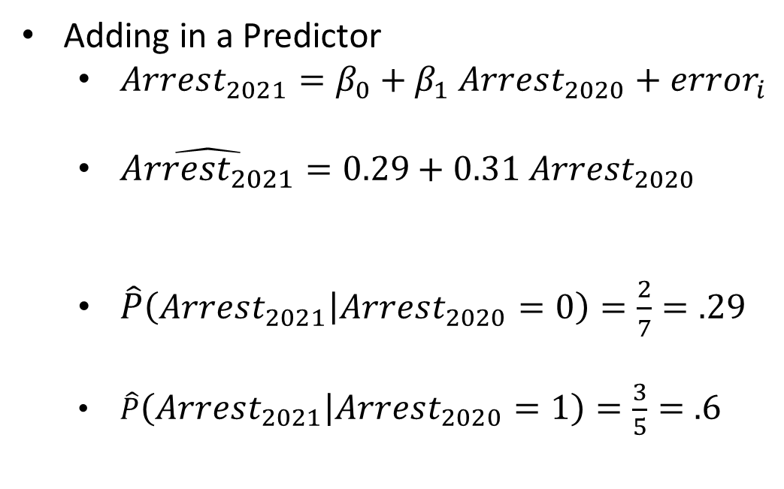
$$P(Arrest_{2021}|Arrest_{2020})$$
Adding in a Predictor
$Arrest_{2021}=β_{0}+β_{1} Arrest_{2020}+error_{i}$
$\hat{Arrest_{2021}}=0.29+0.31 Arrest_{2020}$
$\hat{P}\left(Arrest_{2021} | Arrest_{2020}=0\right)=\frac{2}{7}=.29$
$\hat{P}\left(Arrest_{2021} | Arrest_{2020}=1\right)=\frac{3}{5}=.6$
$$arrest_{2020}$$ | $$arrest_{2021}$$
1 | 1
1 | 0
0 | 1
0 | 0
0 | 0
0 | 0
1 | 1
1 | 1
1 | 0
0 | 0
0 | 1
0 | 0

Slide 22
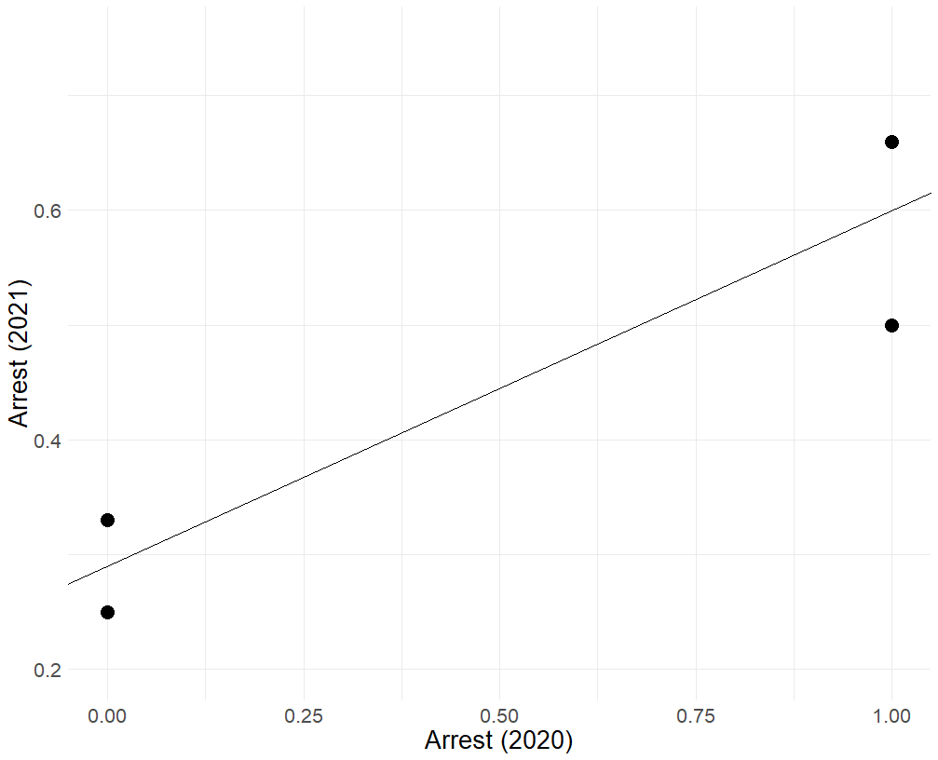
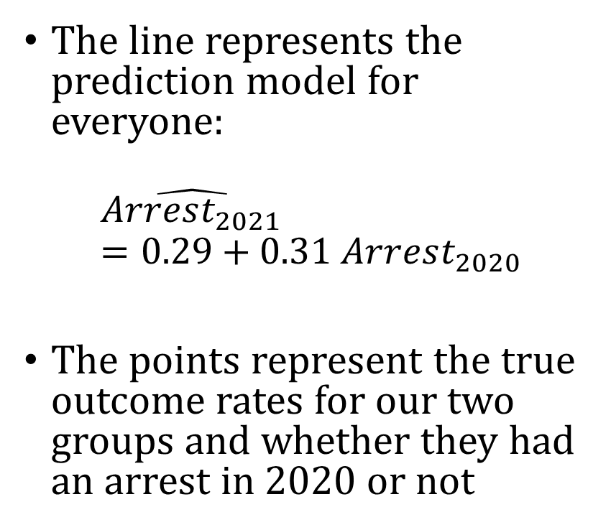




Visualizing the model
Base rate for Race = 1 and $Arrest_{2020}=1$
The line represents the prediction model for everyone:
$$\hat{Arrest_{2021}}=0.29+0.31 Arrest_{2020}$$
The points represent the true outcome rates for our two groups and whether they had an arrest in 2020 or not
Base rate for Race = 1 and $Arrest_{2020}=0$
Base rate for Race = 0 and $Arrest_{2020}=1$
Base rate for Race = 0 and $Arrest_{2020}=0$

Slide 23
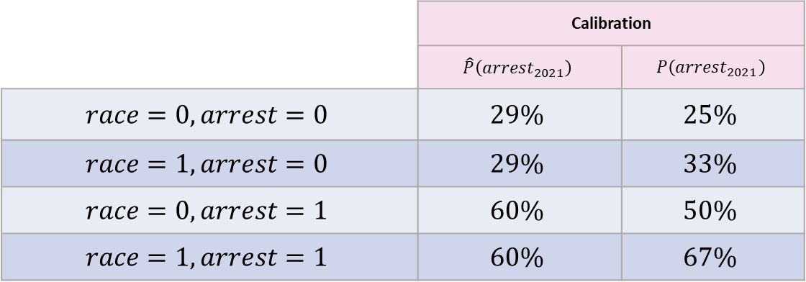
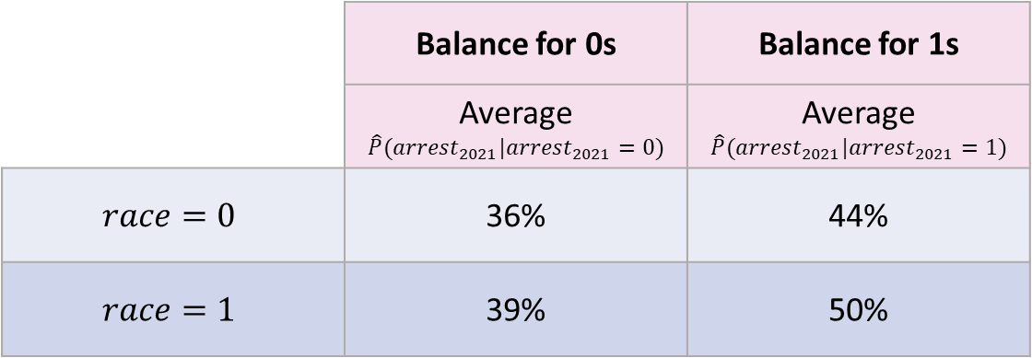
Compute Fairness Metrics
 | Calibration
 | $$\hat{P}\left(arrest_{2021}\right)$$ | $$P\left(arrest_{2021}\right)$$
$$race=0, arrest=0$$ | $$29\%$$ | $$25\%$$
$$race=1, arrest=0$$ | $$29\%$$ | $$33\%$$
$$race=0, arrest=1$$ | $$60\%$$ | $$50\%$$
$$race=1, arrest=1$$ | $$60\%$$ | $$67\%$$
 | Balance for 0s | Balance for 1s
 | Average $$\hat{P}(arrest_{2021}|arrest_{2021}=0)$$ | Average $$\hat{P}(arrest_{2021}|arrest_{2021}=1)$$
$$race=0$$ | 36% | 44%
$$race=1$$ | 39% | 50%

Slide 24
A Key Distinction
A model can look biased even if the source of the difference is in the world or the data
So we now shift from fairness definitions to sources of bias in predictions

Slide 25
Possible Sources of Bias
different underlying rates across groups
different chances of being observed or arrested
measurement error
labels that do not perfectly capture what we care about

Slide 26
What We Have Seen So Far
group differences in model outputs can come from the data-generating process
adding predictors can change those differences
even simple models can reveal tradeoffs across fairness metrics

Slide 27
Next
Next we focus on measurement error, arrests versus crimes, and possible responses
This will help explain why fairness problems can remain even after model changes

Slide 28
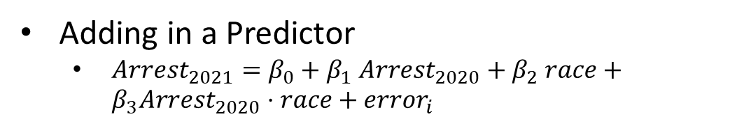
Add interaction
Adding in a Predictor
$Arrest_{2021}=β_{0}+β_{1} Arrest_{2020}+β_{2} race+β_{3}Arrest_{2020}⋅race+error_{i}$
$$race$$ | $$arrest_{2020}$$ | $$race :arrest_{2020}$$ | $$arrest_{2021}$$
0 | 1 | 0 | 1
0 | 1 | 0 | 0
0 | 0 | 0 | 1
0 | 0 | 0 | 0
0 | 0 | 0 | 0
0 | 0 | 0 | 0
1 | 1 | 1 | 1
1 | 1 | 1 | 1
1 | 1 | 1 | 0
1 | 0 | 0 | 0
1 | 0 | 0 | 1
1 | 0 | 0 | 0

Slide 29
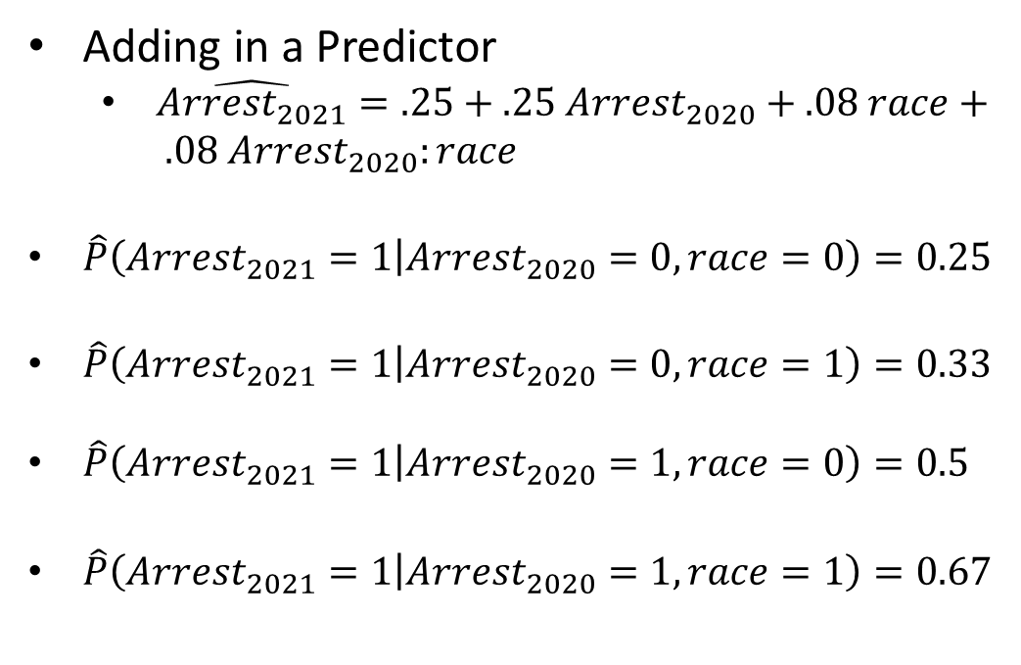
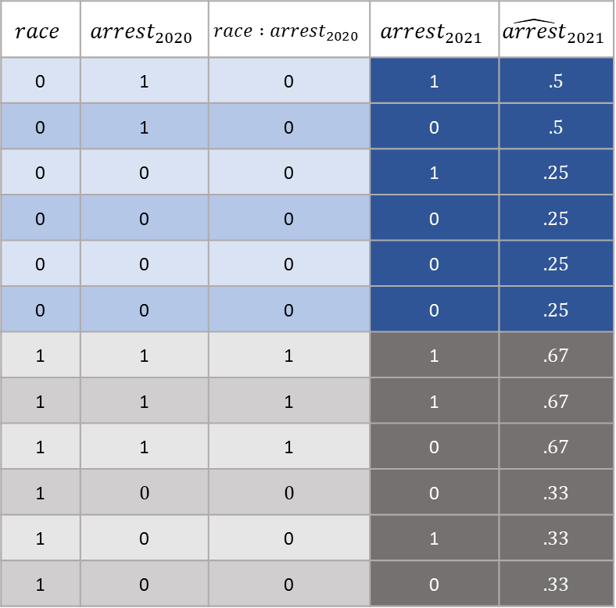
$$P(Arrest_{2021}|Arrest_{2020})$$
Adding in a Predictor
$\hat{Arrest_{2021}}=.25+.25 Arrest_{2020}+.08 race+ .08 Arrest_{2020}:race$
$\hat{P}\left(Arrest_{2021}=1 | Arrest_{2020}=0, race=0\right)=0.25$
$\hat{P}\left(Arrest_{2021}=1 | Arrest_{2020}=0, race=1\right)=0.33$
$\hat{P}\left(Arrest_{2021}=1 | Arrest_{2020}=1, race=0\right)=0.5$
$\hat{P}\left(Arrest_{2021}=1 | Arrest_{2020}=1, race=1\right)=0.67$
$$race$$ | $$arrest_{2020}$$ | $$race :arrest_{2020}$$ | $$arrest_{2021}$$ | $${\hat{arrest}}_{2021}$$
0 | 1 | 0 | 1 | .5
0 | 1 | 0 | 0 | .5
0 | 0 | 0 | 1 | .25
0 | 0 | 0 | 0 | .25
0 | 0 | 0 | 0 | .25
0 | 0 | 0 | 0 | .25
1 | 1 | 1 | 1 | .67
1 | 1 | 1 | 1 | .67
1 | 1 | 1 | 0 | .67
1 | 0 | 0 | 0 | .33
1 | 0 | 0 | 1 | .33
1 | 0 | 0 | 0 | .33

Slide 30
Visualizing the model
Base rate for Race = 1 and $Arrest_{2020}=1$
The line represents the prediction model for everyone:
$$\hat{Arrest_{2021}}=0.29+0.31 Arrest_{2020}$$
The points represent the true outcome rates for our two groups and whether they had an arrest in 2020 or not
Base rate for Race = 1 and $Arrest_{2020}=0$
Base rate for Race = 0 and $Arrest_{2020}=1$
Base rate for Race = 0 and $Arrest_{2020}=0$

Slide 31
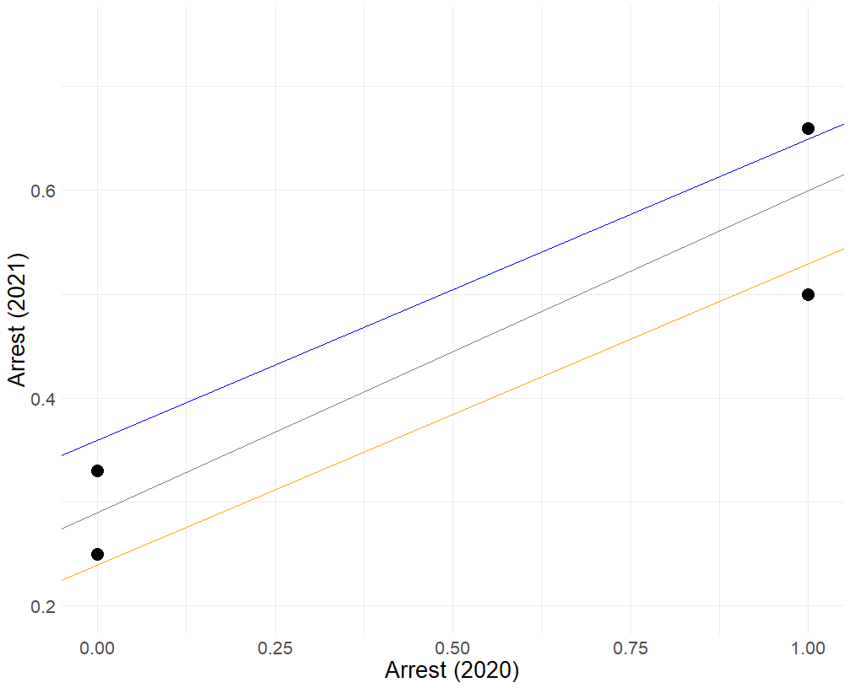
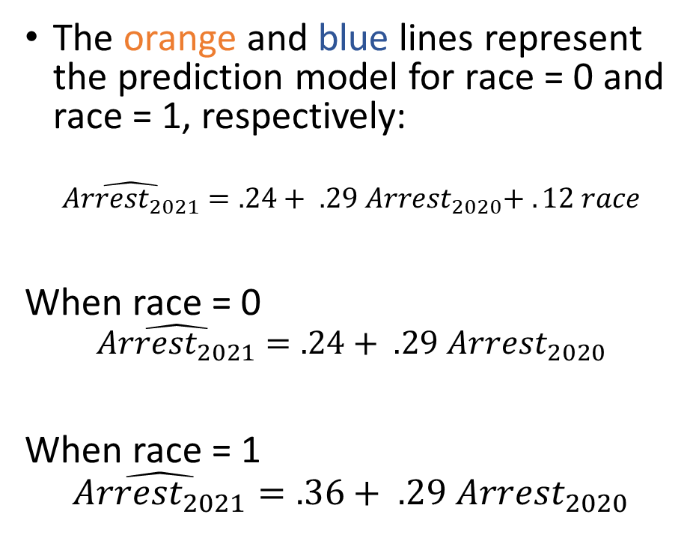


Visualizing the model
Base rate for Race = 1 and $Arrest_{2020}=1$
The orange and blue lines represent the prediction model for race = 0 and race = 1, respectively:
$$\hat{Arrest_{2021}}=.24+ .29 Arrest_{2020}+ . 12 race$$
When race = 0
$$\hat{Arrest_{2021}}=.24+ .29 Arrest_{2020}$$
When race = 1
$$\hat{Arrest_{2021}}=.36+ .29 Arrest_{2020}$$
Base rate for Race = 1 and $Arrest_{2020}=0$
Base rate for Race = 0 and $Arrest_{2020}=1$
Base rate for Race = 0 and $Arrest_{2020}=0$

Slide 32
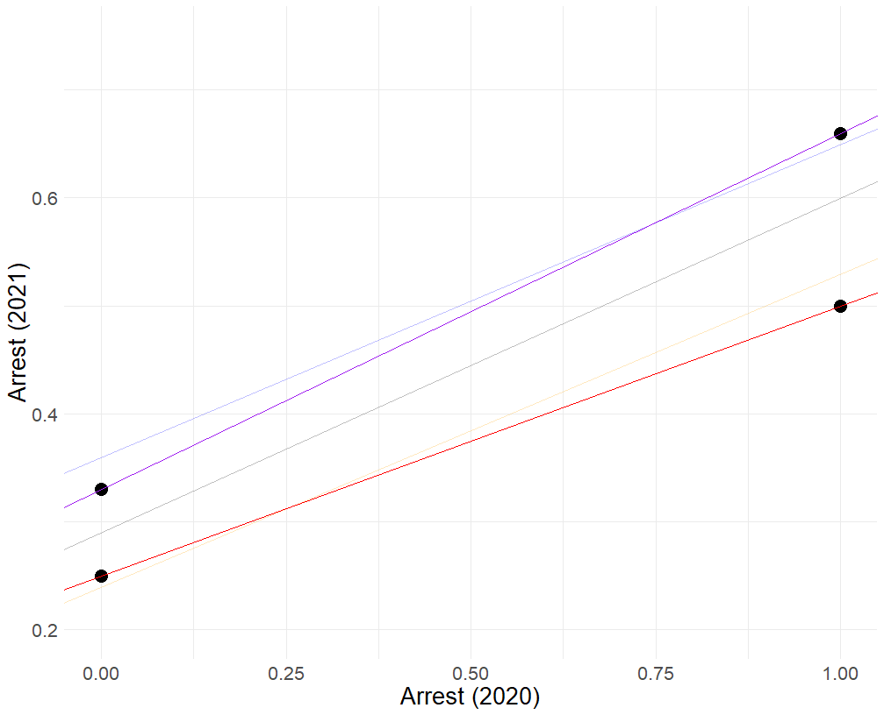
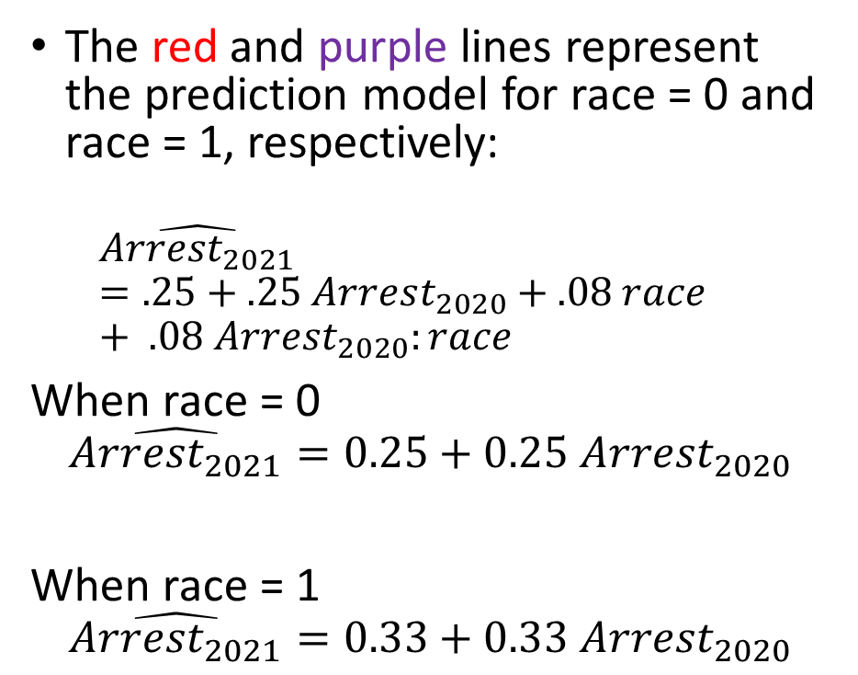
Visualizing the model
Base rate for Race = 1 and $Arrest_{2020}=1$
The red and purple lines represent the prediction model for race = 0 and race = 1, respectively:
$$\hat{Arrest_{2021}}=.25+.25 Arrest_{2020}+.08 race+ .08 Arrest_{2020}:race$$
When race = 0
$$\hat{Arrest_{2021}}=0.25+0.25 Arrest_{2020}$$
When race = 1
$$\hat{Arrest_{2021}}=0.33+0.33 Arrest_{2020}$$
Base rate for Race = 1 and $Arrest_{2020}=0$
Base rate for Race = 0 and $Arrest_{2020}=1$
Base rate for Race = 0 and $Arrest_{2020}=0$

Slide 33

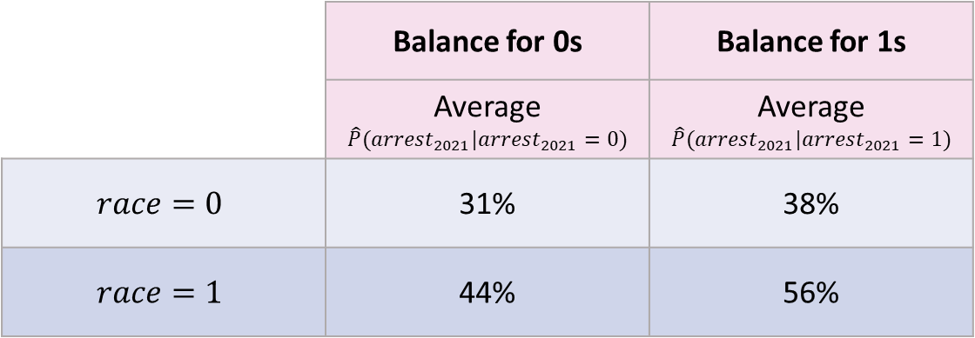
Compute Fairness Metrics
 | Calibration
 | $$\hat{P}\left(arrest_{2021}\right)$$ | $$P\left(arrest_{2021}\right)$$
$$race=0, arrest=0$$ | $$25\%$$ | $$25\%$$
$$race=1, arrest=0$$ | $$33\%$$ | $$33\%$$
$$race=0, arrest=1$$ | $$50\%$$ | $$50\%$$
$$race=1, arrest=1$$ | $$67\%$$ | $$67\%$$
 | Balance for 0s | Balance for 1s
 | Average $$\hat{P}(arrest_{2021}|arrest_{2021}=0)$$ | Average $$\hat{P}(arrest_{2021}|arrest_{2021}=1)$$
$$race=0$$ | 31% | 38%
$$race=1$$ | 44% | 56%

Slide 34
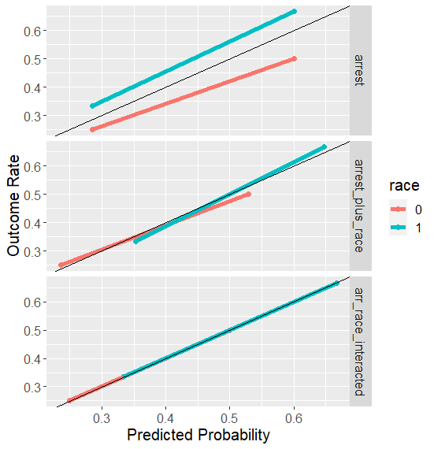
Calibration/PPV Balance
Improves with more features.

Slide 35
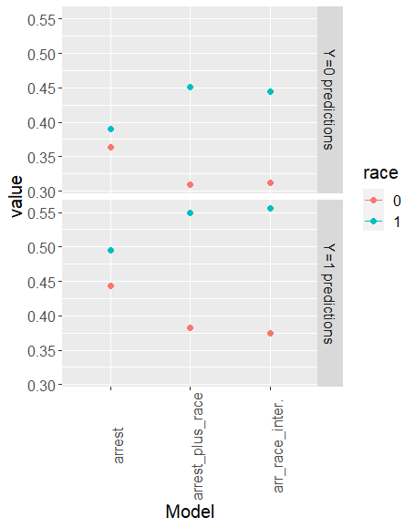
Error Rates
Degrade with more features

Slide 36
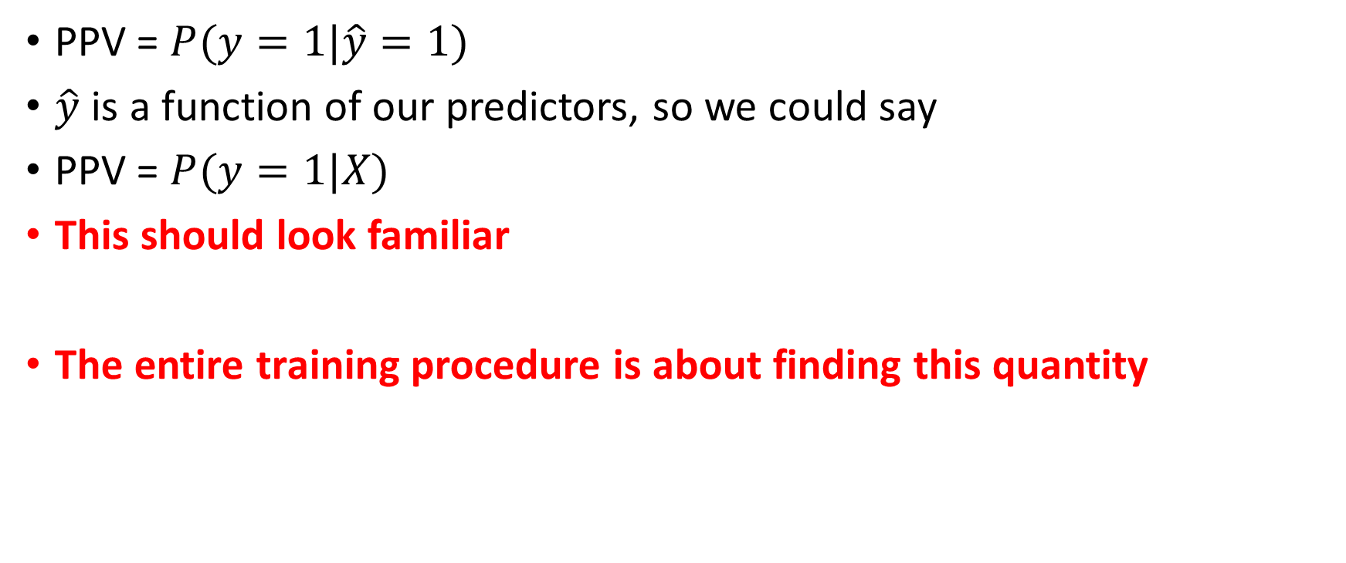
What Explains This Pattern?
PPV = $P(y=1|\hat{y}=1)$
$\hat{y}$ is a function of our predictors, so we could say
PPV = $P(y=1|X)$
This should look familiar
The entire training procedure is about finding this quantity

Slide 37

What Explains This Pattern?
But not the case for balance for positive and negative classes (FPR or FNR):
FNR: $P\left(\hat{y}=0 | y=1\right)$
How can we get our algorithms to optimize for this?

Slide 38
What We Have Seen So Far
group differences in model outputs can come from the data-generating process
adding predictors can change those differences
even simple models can reveal tradeoffs across fairness metrics

Slide 39

Constraints
Recall the objective function for ridge
$$\sum{{\left(y_{i}−{\hat{y}}_{i}\right)}^{2}+λ\sum_{j}{β_{j}^{2}}}$$

Slide 40

Constraints
Recall the objective function for ridge
$$\sum{{\left(y_{i}−{\hat{y}}_{i}\right)}^{2}+λ\sum_{j}{β_{j}^{2}}}$$
Penalty term: $\sum_{j}{β_{j}^{2}}$

Slide 41

Constraints
Other ways you could constrain
$$\sum{{\left(y_{i}−{\hat{y}}_{i}\right)}^{2}+λ Φ(y_{i}, {\hat{y}}_{i})}$$
$Φ\left(y_{i}, {\hat{y}}_{i}\right):$ a constraint to take into account FPR and/or FNR

Slide 42

What Would a “Constraint” Look Like
Differences in False Positive Rates should be zero, or close to zero
$P\left(\hat{y}=1 | y=0,race=0\right)=P\left(\hat{y}=1 | y=0,race=1\right)$
$\frac{1}{N_{0}}\sum_{i=1}^{N_{0}}{{\hat{y}}_{i}\left(1−y_{i}\right)}−\frac{1}{N_{1}}\sum_{j=1}^{N_{1}}{{\hat{y}}_{j}\left(1−y_{j}\right)}$

Slide 43
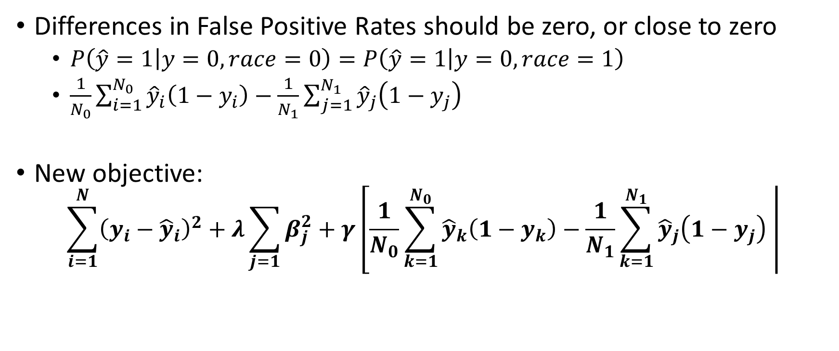
What Would a “Constraint” Look Like
Differences in False Positive Rates should be zero, or close to zero
$P\left(\hat{y}=1 | y=0,race=0\right)=P\left(\hat{y}=1 | y=0,race=1\right)$
$\frac{1}{N_{0}}\sum_{i=1}^{N_{0}}{{\hat{y}}_{i}\left(1−y_{i}\right)}−\frac{1}{N_{1}}\sum_{j=1}^{N_{1}}{{\hat{y}}_{j}\left(1−y_{j}\right)}$
New objective:
$$\sum_{i=1}^{N}{{\left(y_{i}−{\hat{y}}_{i}\right)}^{2}+λ\sum_{j=1}{β_{j}^{2}+γ\left[\frac{1}{N_{0}}\sum_{k=1}^{N_{0}}{{\hat{y}}_{k}\left(1−y_{k}\right)}−\frac{1}{N_{1}}\sum_{k=1}^{N_{1}}{{\hat{y}}_{j}\left(1−y_{j}\right) }\right|}}$$

Slide 44
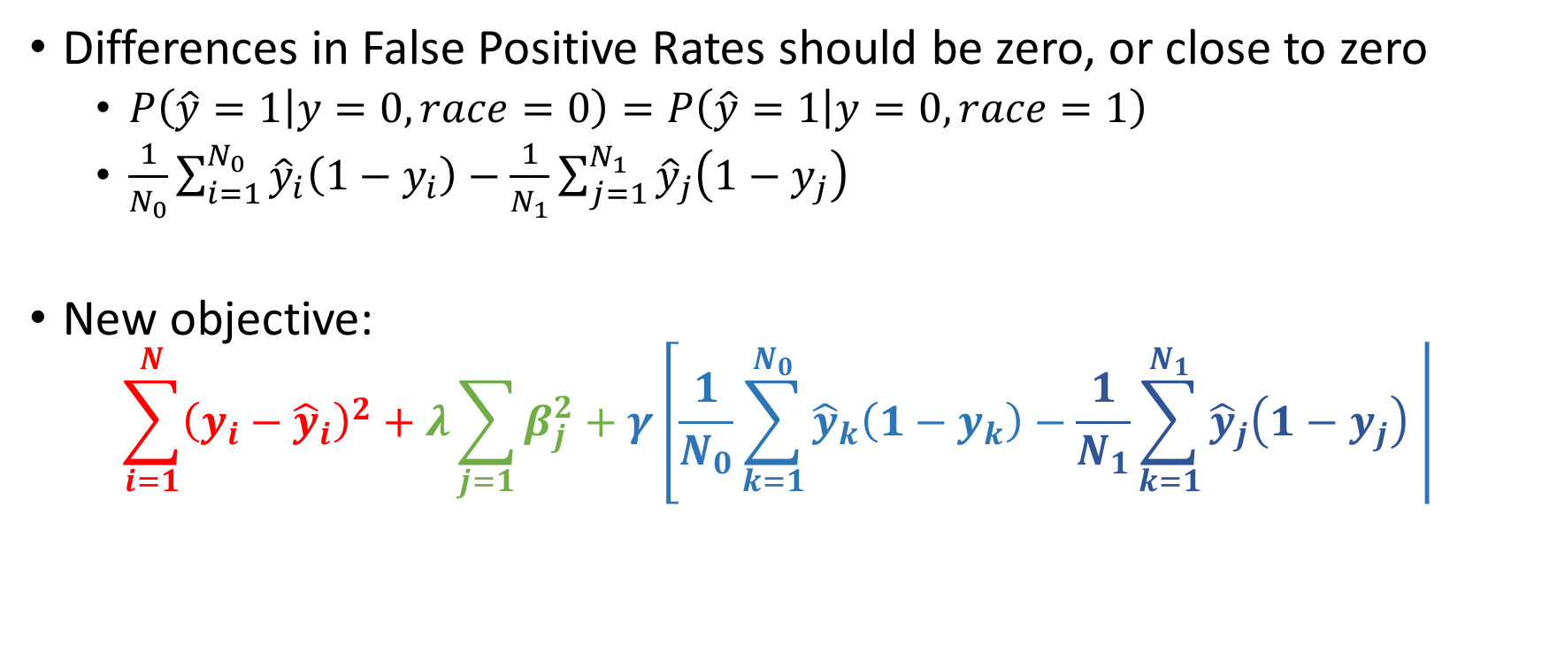
What Would a “Constraint” Look Like
Differences in False Positive Rates should be zero, or close to zero
$P\left(\hat{y}=1 | y=0,race=0\right)=P\left(\hat{y}=1 | y=0,race=1\right)$
$\frac{1}{N_{0}}\sum_{i=1}^{N_{0}}{{\hat{y}}_{i}\left(1−y_{i}\right)}−\frac{1}{N_{1}}\sum_{j=1}^{N_{1}}{{\hat{y}}_{j}\left(1−y_{j}\right)}$
New objective:
$$\sum_{i=1}^{N}{{\left(y_{i}−{\hat{y}}_{i}\right)}^{2}+λ\sum_{j=1}{β_{j}^{2}+γ\left[\frac{1}{N_{0}}\sum_{k=1}^{N_{0}}{{\hat{y}}_{k}\left(1−y_{k}\right)}−\frac{1}{N_{1}}\sum_{k=1}^{N_{1}}{{\hat{y}}_{j}\left(1−y_{j}\right) }\right|}}$$

Slide 45
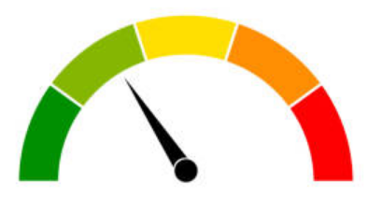
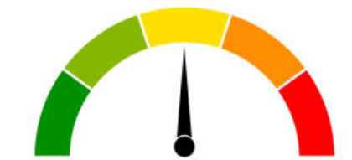
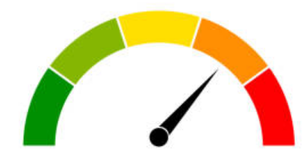
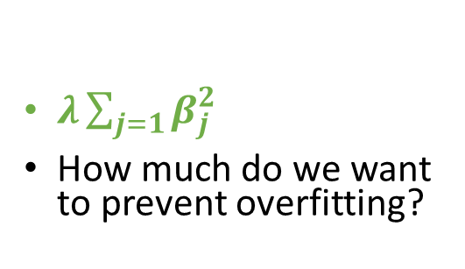
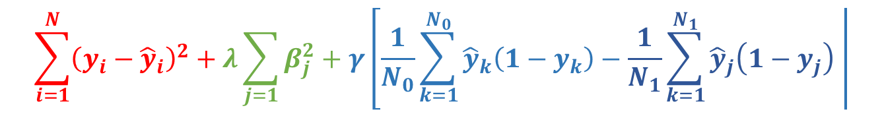
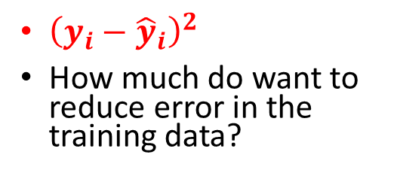
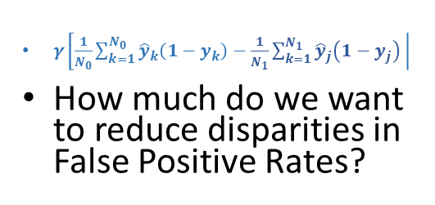
“Control Dials” for Algorithms
$$\sum_{i=1}^{N}{{\left(y_{i}−{\hat{y}}_{i}\right)}^{2}+λ\sum_{j=1}{β_{j}^{2}+γ\left[\frac{1}{N_{0}}\sum_{k=1}^{N_{0}}{{\hat{y}}_{k}\left(1−y_{k}\right)}−\frac{1}{N_{1}}\sum_{k=1}^{N_{1}}{{\hat{y}}_{j}\left(1−y_{j}\right) }\right|}}$$
${\left(y_{i}−{\hat{y}}_{i}\right)}^{2}$
How much do want to reduce error in the training data?
$λ\sum_{j=1}{β_{j}^{2}}$
How much do we want to prevent overfitting?
$γ\left[\frac{1}{N_{0}}\sum_{k=1}^{N_{0}}{{\hat{y}}_{k}\left(1−y_{k}\right)}−\frac{1}{N_{1}}\sum_{k=1}^{N_{1}}{{\hat{y}}_{j}\left(1−y_{j}\right) }\right|$
How much do we want to reduce disparities in False Positive Rates?

Slide 46
The Importance of Base Rates

Slide 47
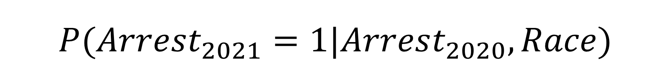
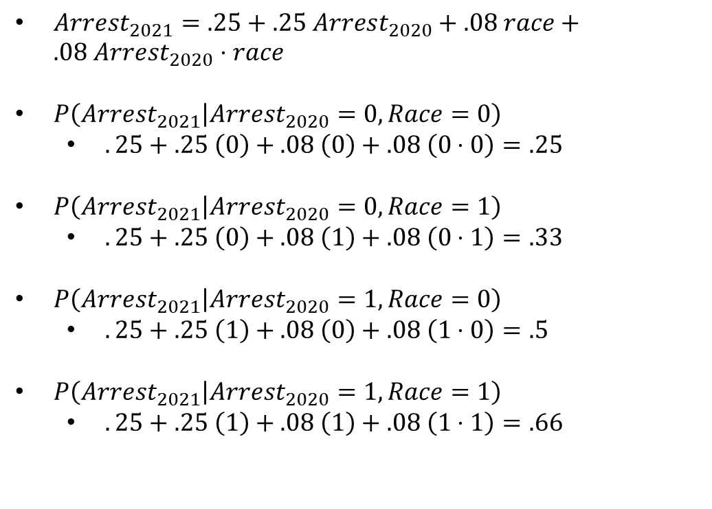

$$P(Arrest_{2021}=1|Arrest_{2020}, Race)$$
$Arrest_{2021}=.25+.25 Arrest_{2020}+.08 race+.08 Arrest_{2020}⋅race$
$P\left(Arrest_{2021} | Arrest_{2020}=0,Race=0\right)$
$.25+.25 \left(0\right)+.08 \left(0\right)+.08 \left(0⋅0\right)=.25$
$P\left(Arrest_{2021} | Arrest_{2020}=0,Race=1\right)$
$.25+.25 \left(0\right)+.08 \left(1\right)+.08 \left(0⋅1\right)=.33$
$P\left(Arrest_{2021} | Arrest_{2020}=1,Race=0\right)$
$.25+.25 \left(1\right)+.08 \left(0\right)+.08 \left(1⋅0\right)=.5$
$P\left(Arrest_{2021} | Arrest_{2020}=1,Race=1\right)$
$.25+.25 \left(1\right)+.08 \left(1\right)+.08 \left(1⋅1\right)=.66$
$$race$$ | $$arrest_{2020}$$ | $$race :arrest_{2020}$$ | $$arrest_{2021}$$ | $${\hat{arrest}}_{2021}$$
0 | 1 | 0 | 1 | .5
0 | 1 | 0 | 0 | .5
0 | 0 | 0 | 1 | .25
0 | 0 | 0 | 0 | .25
0 | 0 | 0 | 0 | .25
0 | 0 | 0 | 0 | .25
1 | 1 | 1 | 1 | .66
1 | 1 | 1 | 1 | .66
1 | 1 | 1 | 0 | .66
1 | 0 | 0 | 0 | .33
1 | 0 | 0 | 1 | .33
1 | 0 | 0 | 0 | .33

Slide 48
Why Is Race Predictive of the outcome?
Race is a stand-in for missing predictors
Differences in police behavior
Differences in treatment of different subgroups historically
Differences in environment, broadly speaking

Slide 49
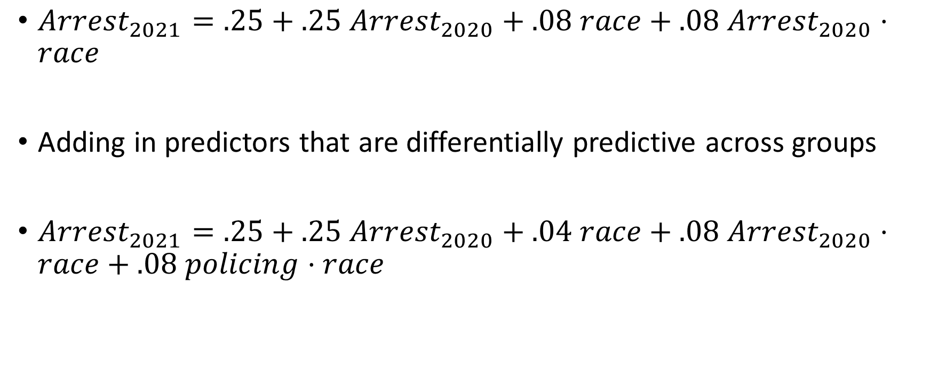
How Would We Equalize P-Hats?
$Arrest_{2021}=.25+.25 Arrest_{2020}+.08 race+.08 Arrest_{2020}⋅race$
Adding in predictors that are differentially predictive across groups
$Arrest_{2021}=.25+.25 Arrest_{2020}+.04 race+.08 Arrest_{2020}⋅race+.08 policing⋅race$

Slide 50
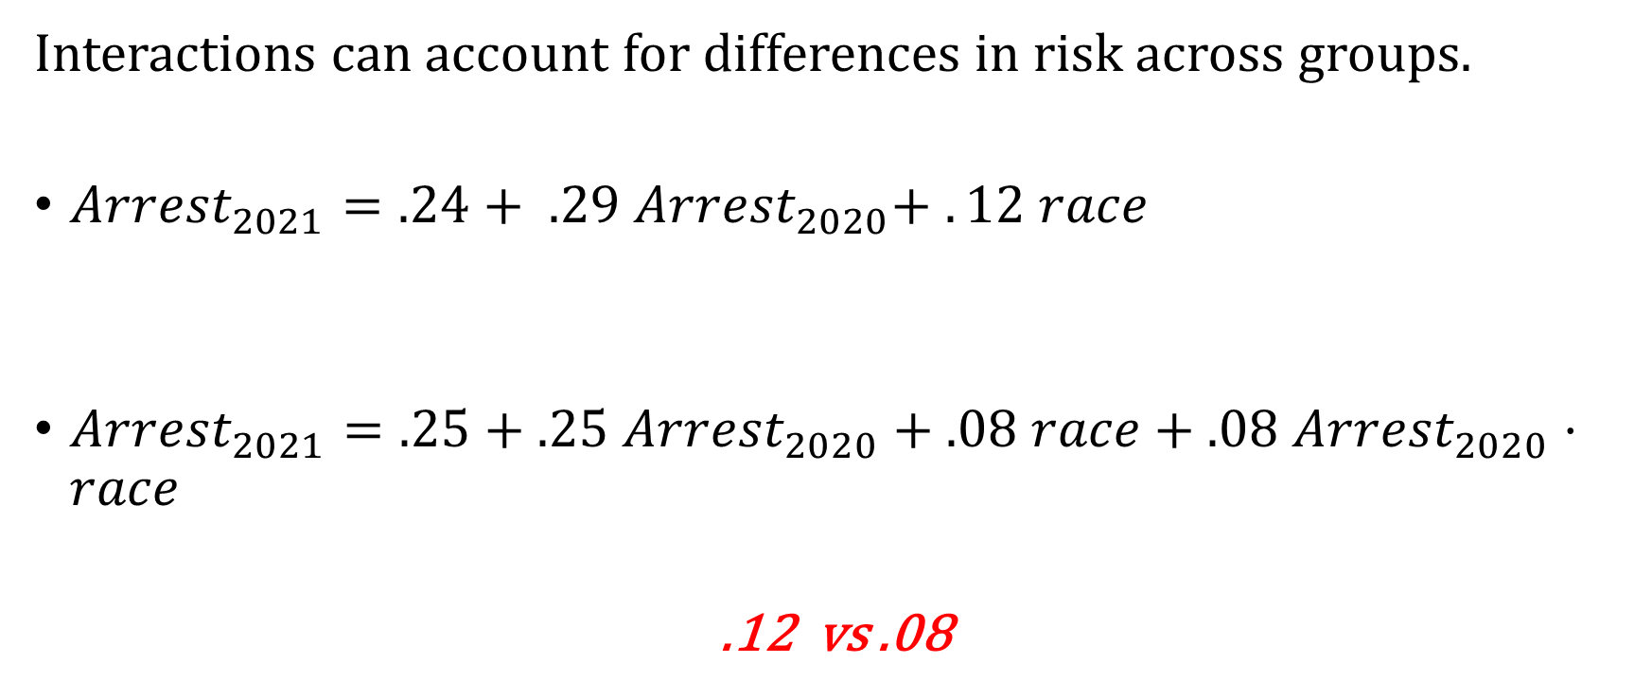
We See This Already
Interactions can account for differences in risk across groups.
${Arrest}_{2021}=.24+ .29 Arrest_{2020}+ . 12 race$
$Arrest_{2021}=.25+.25 Arrest_{2020}+.08 race+.08 Arrest_{2020}⋅race$
.12 vs .08
Pure group differences matter less

Slide 51
Next
Next we focus on measurement error, arrests versus crimes, and possible responses
This will help explain why fairness problems can remain even after model changes

