Slide 1
INST 414: Data Science Techniques
Fairness Metrics and COMPAS

Slide 2
Two Questions About Algorithmic Systems
Fairness: Does the system treat different groups similarly?
Legitimacy: Should this system exist at all?

Slide 3
What the Textbook Says
"The legitimacy question should precede other fairness questions. Debating distributive justice in the context of a fundamentally unjust institution is at best a waste of time, and at worst helps prop up the institution's legitimacy, and is thus counterproductive."
— Barocas, Hardt, & Narayanan, Fairness and Machine Learning, Ch. 2

Slide 4
What Legitimacy Asks
Does the prediction target match the actual goal?
Is the system accurate enough to justify its consequences?
Can people contest decisions made about them?
Does the system respect people's agency?
Is the data a reliable measure of what it claims to measure?

Slide 5
What This Lecture Does — and Doesn't Do
Today we will:
Learn how to measure fairness in a prediction system's outputs
See that different fairness definitions conflict with each other
Understand why they cannot all be satisfied at the same time
Today we will not:
Ask whether pretrial detention is a legitimate system
Keep this gap in mind.

Slide 6
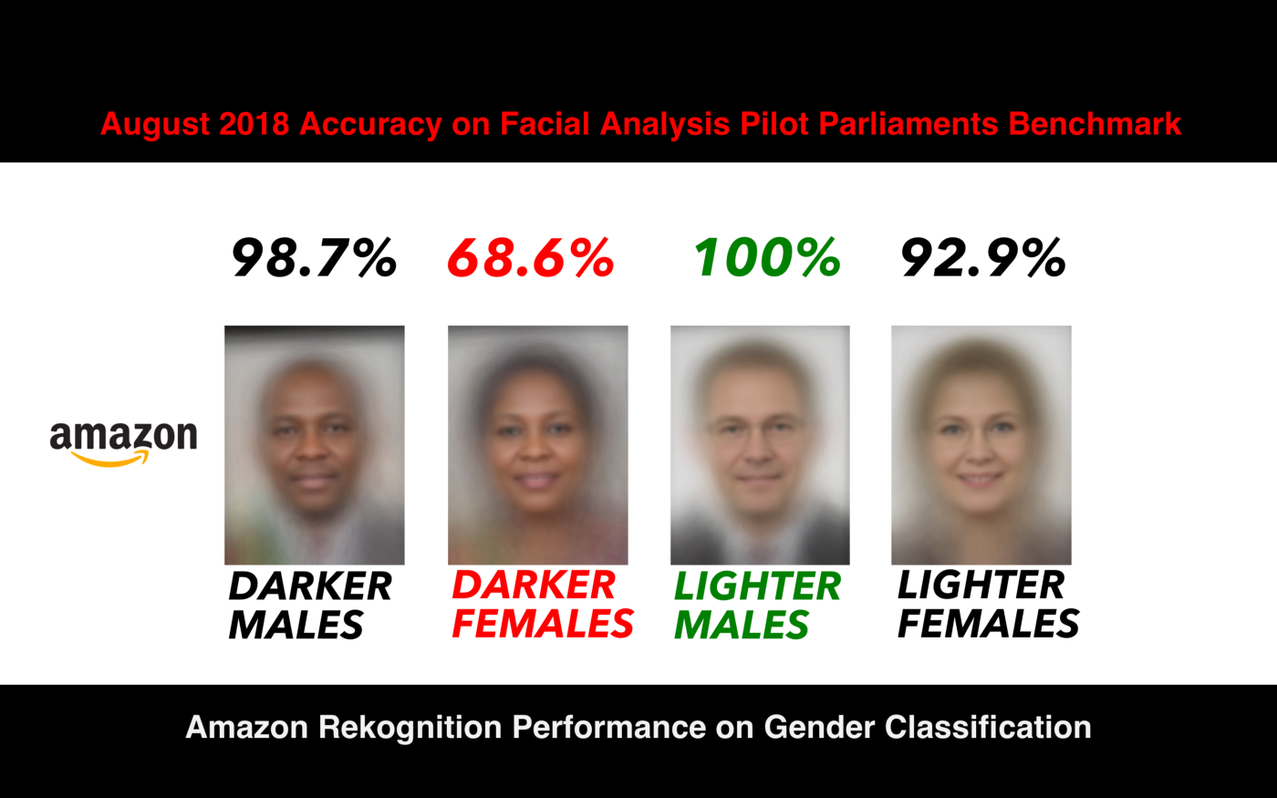
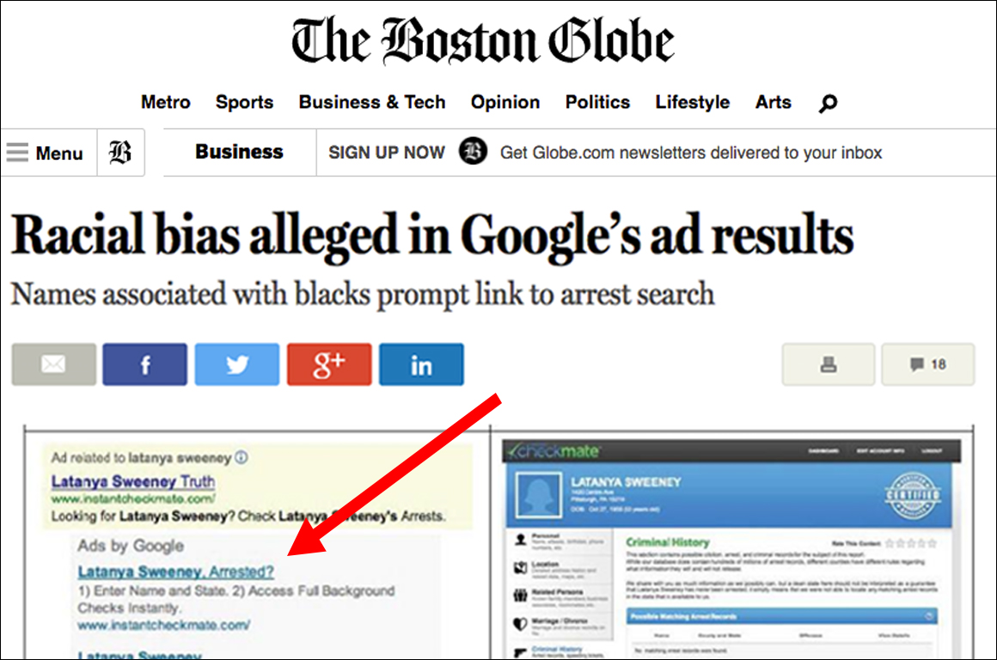
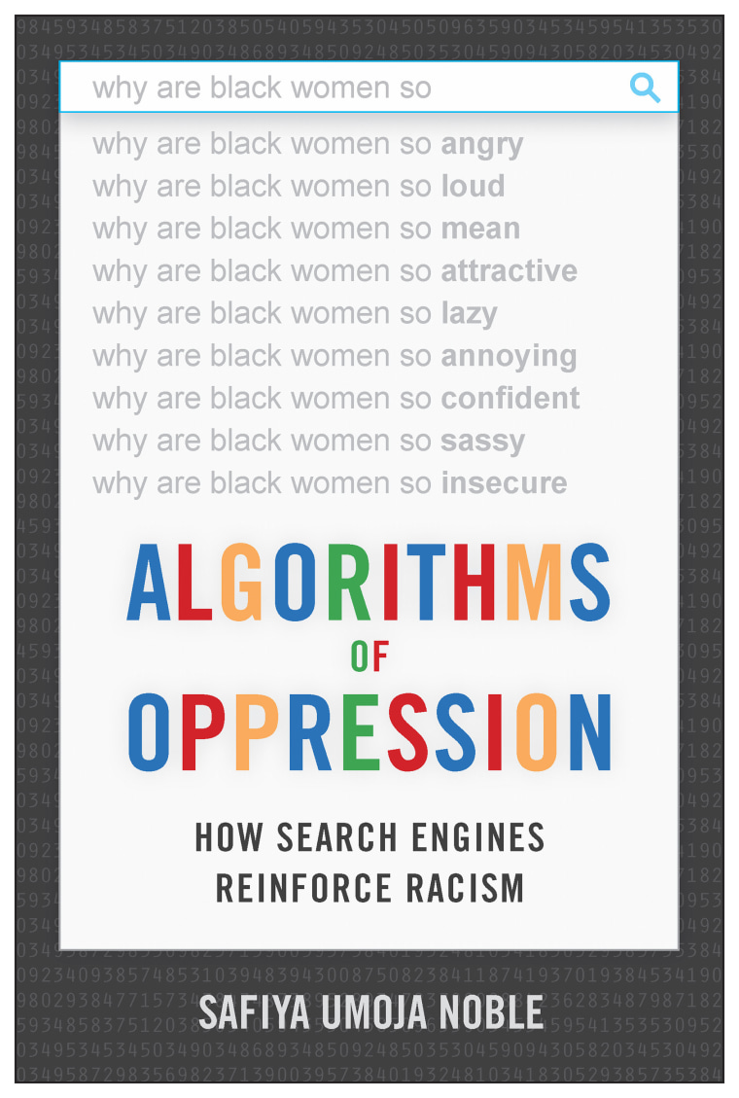
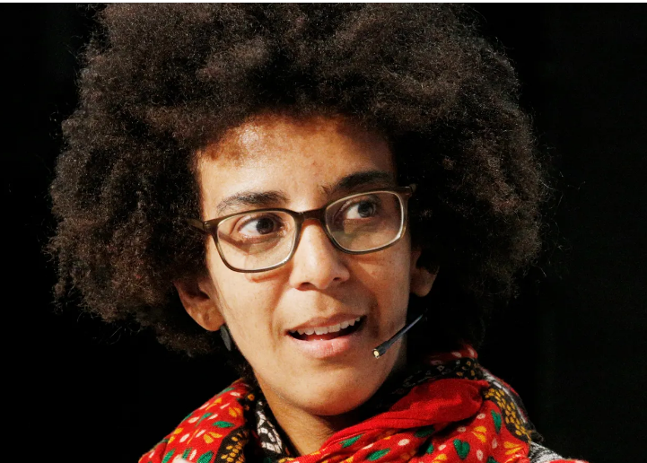

Slide 7
What This Lecture Does
Different fairness definitions focus on different quantities
Those definitions can disagree
We will use COMPAS as the motivating example

Slide 8
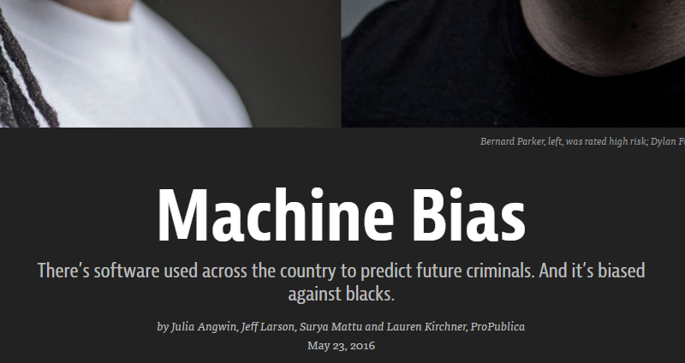
Fairness
Notes:
There are a lot of

Slide 9
What is Compas
“Correctional Offender Management Profiling for Alternative Sanction”
Risk assessment designed for use in
Pretrial
Prison
Parole
Developed by NorthPointe/equivant
Predict the likelihood of recidivism
Gives a score between 1 and 10

Slide 10
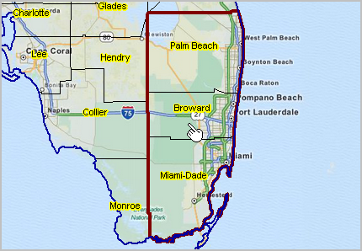
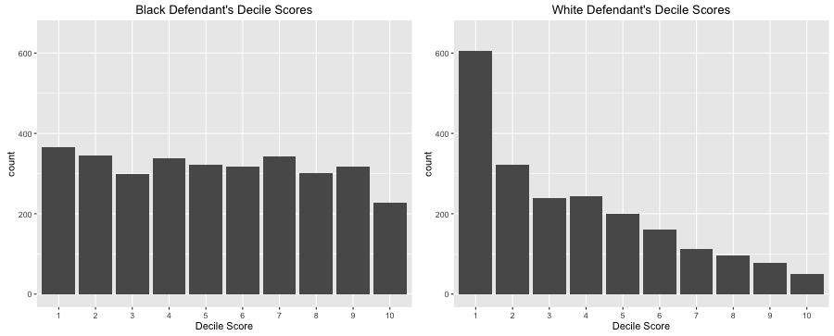
Compas Tool
Pro Publica examined defendants in Broward County, FL

Slide 11
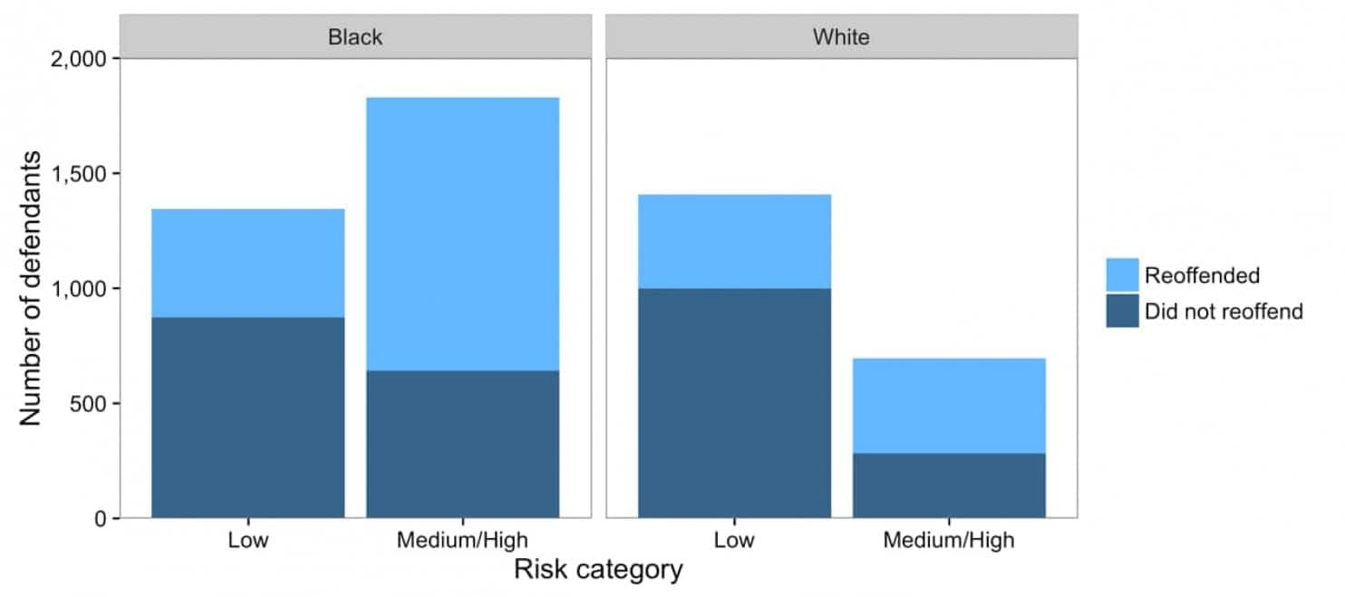

Slide 12

What is Compas
Equal False Positive Rates across groups
$P\left( \hat{y}=1 | y=0, race=Black\right)>P(\hat{y}=1|y=0, race=White)$

Slide 13


Slide 14
False Positive Rate

Slide 15

Pro Publica Fairness Definition 2
Equal False Negative Rates across groups
$P\left( \hat{y}=0 | y=1, race=Black\right)<P(\hat{y}=0|y=1, race=White)$

Slide 17
False Negative Rate

Slide 18

NorthPointe Fairness Definition
Equal Positive Predictive Values across groups (calibrated)
$P\left(y=1\right| \hat{y}=1, race=Black)=P\left(y=1\right| \hat{y}=1, race=White)$

Slide 19


Slide 20
Positive Predictive Value

Slide 21
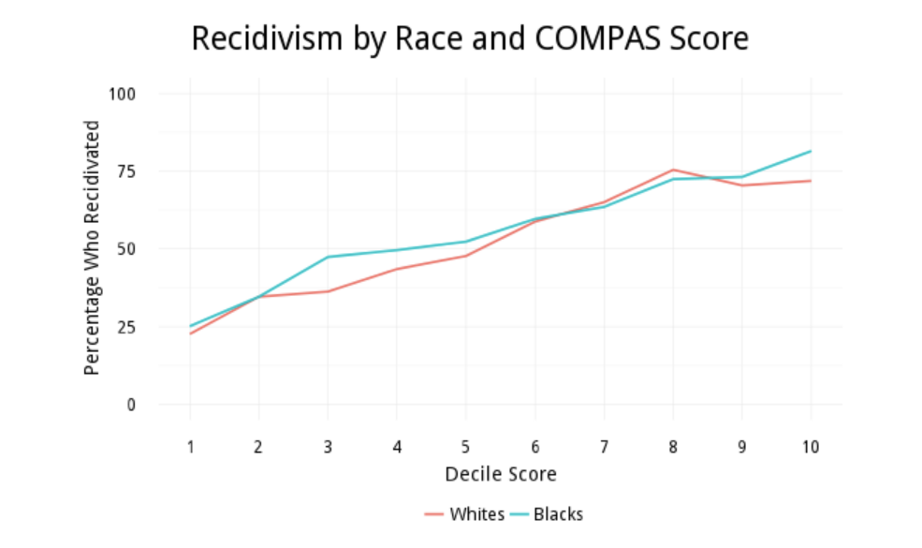

Slide 22
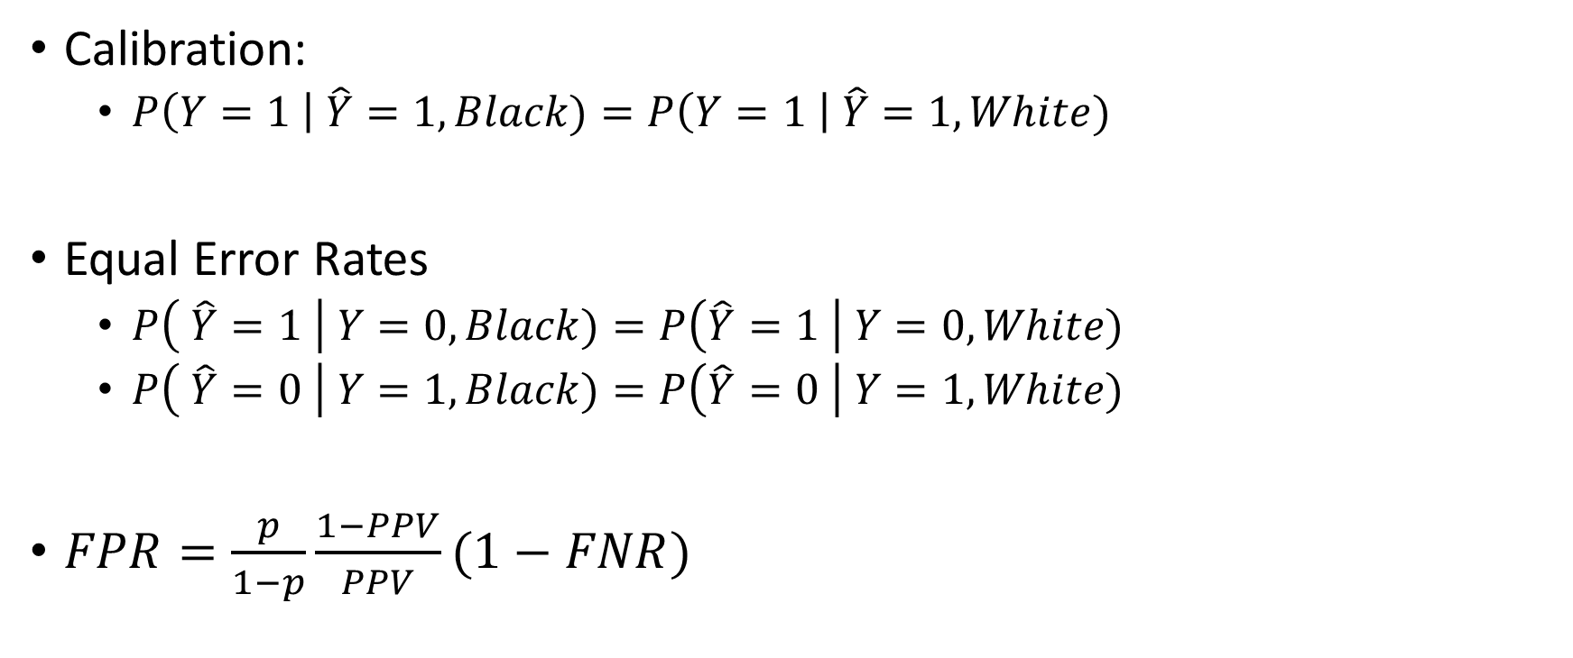
Reasonable Definitions for Fairness
Calibration:
$P\left(Y=1 \right| \hat{Y}=1, Black)=P\left(Y=1 \right| \hat{Y}=1, White)$
Equal Error Rates
$P\left( \hat{Y}=1 \right| Y=0, Black)=P\left(\hat{Y}=1 \right| Y=0, White)$
$P\left( \hat{Y}=0 \right| Y=1, Black)=P\left(\hat{Y}=0 \right| Y=1, White)$
$FPR=\frac{p}{1−p}\frac{1−PPV}{PPV}(1−FNR)$

Slide 23
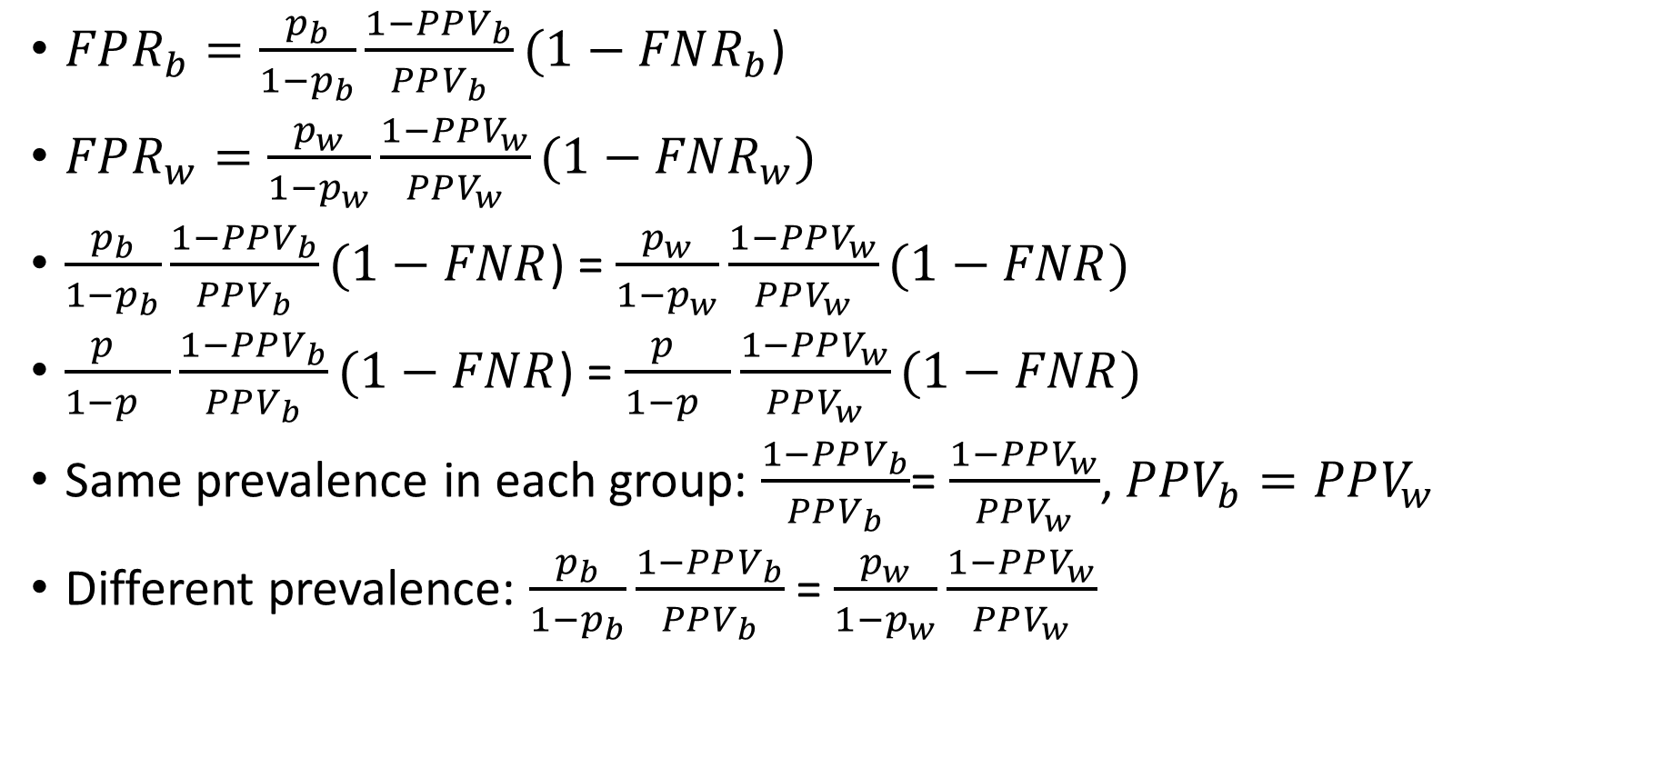
Impossibility
$FPR_{b}=\frac{p_{b}}{1−p_{b}}\frac{1−PPV_{b}}{PPV_{b}}(1−FNR_{b}$)
$FPR_{w}=\frac{p_{w}}{1−p_{w}}\frac{1−PPV_{w}}{PPV_{w}}(1−FNR_{w})$
$\frac{p_{b}}{1−p_{b}}\frac{1−PPV_{b}}{PPV_{b}}(1−FNR$) = $\frac{p_{w}}{1−p_{w}}\frac{1−PPV_{w}}{PPV_{w}}(1−FNR)$
$\frac{p_{}}{1−p_{}}\frac{1−PPV_{b}}{PPV_{b}}(1−FNR$) = $\frac{p_{}}{1−p_{}}\frac{1−PPV_{w}}{PPV_{w}}(1−FNR)$
Same prevalence in each group: $\frac{1−PPV_{b}}{PPV_{b}}$= $\frac{1−PPV_{w}}{PPV_{w}}$, $PPV_{b}=PPV_{w}$
Different prevalence: $\frac{p_{b}}{1−p_{b}}\frac{1−PPV_{b}}{PPV_{b}}$ = $\frac{p_{w}}{1−p_{w}}\frac{1−PPV_{w}}{PPV_{w}}$
Notes:
You can get two out of 3 but not all three.
Algorithms are not going to solve fairness.
Different definitions may be of interest to different stake holders.
For example, from the perspective of defendants, being treated the same if flagged as
Calibration: From a defendant’s point of view

Slide 24
Recap: Performance Metrics

Slide 25

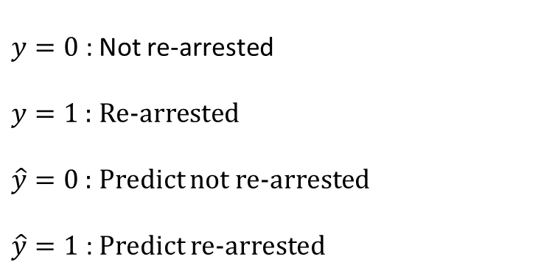
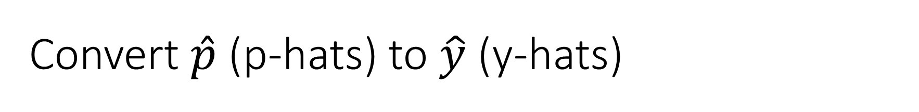



Convert $\hat{p}$ (p-hats) to $\hat{y}$ (y-hats)
$$\hat{y}$$
$$y$$
Risk Score
Outcome
High risk
$y=0$ : Not re-arrested
$y=1$ : Re-arrested
$\hat{y}=0$ : Predict not re-arrested
$\hat{y}=1$ : Predict re-arrested
1
1
1
0
1
1
0
0
1
0
0
1
0
0
0
0
$\hat{y}$=1
Threshold
$\hat{y}$=0
Low risk

Slide 26




Confusion Matrix
$$\hat{y}$$
$$y$$
Risk Score
Outcome
High risk
$$y=0$$
$$y=1$$
1
1
1
0
1
1
0
0
1
0
0
1
0
0
0
0
$\hat{y}$=1
True Negative (TN)
False Negative (FN)
$$\hat{y}=0$$
Threshold
False Positive (FP)
True Positive (TP)
$$\hat{y}=1$$
$\hat{y}$=0
Low risk

Slide 27


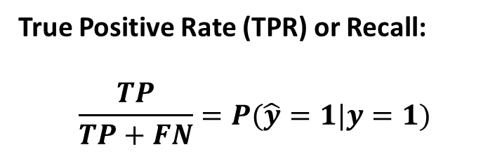


Performance Metrics
True Positive Rate (TPR) or Recall:
$$\frac{TP}{TP+FN}=P(\hat{y}=1|y=1)$$
$$y=0$$
$$y=1$$
True Negative (TN)
False Negative (FN)
$$\hat{y}=0$$
False Positive (FP)
True Positive (TP)
$$\hat{y}=1$$

Slide 28
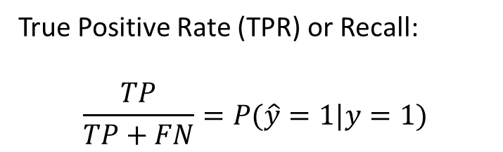
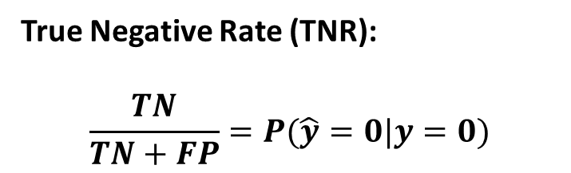
Performance Metrics
True Positive Rate (TPR) or Recall:
$$\frac{TP}{TP+FN}=P(\hat{y}=1|y=1)$$
$$y=0$$
$$y=1$$
True Negative (TN)
False Negative (FN)
$$\hat{y}=0$$
True Negative Rate (TNR):
$$\frac{TN}{TN+FP}=P(\hat{y}=0|y=0)$$
False Positive (FP)
True Positive (TP)
$$\hat{y}=1$$

Slide 29
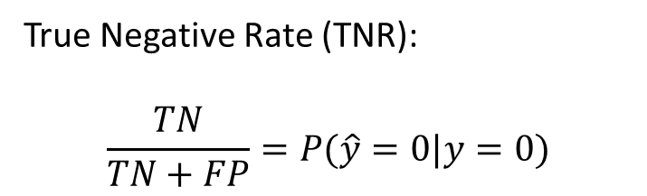

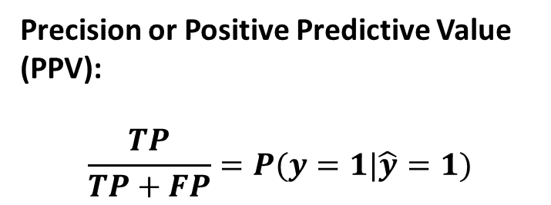

Performance Metrics
True Positive Rate (TPR) or Recall:
$$\frac{TP}{TP+FN}=P(\hat{y}=1|y=1)$$
$$y=0$$
$$y=1$$
True Negative (TN)
False Negative (FN)
$$\hat{y}=0$$
True Negative Rate (TNR):
$$\frac{TN}{TN+FP}=P(\hat{y}=0|y=0)$$
False Positive (FP)
True Positive (TP)
$$\hat{y}=1$$
Precision or Positive Predictive Value (PPV):
$$\frac{TP}{TP+FP}=P(y=1|\hat{y}=1)$$

Slide 30
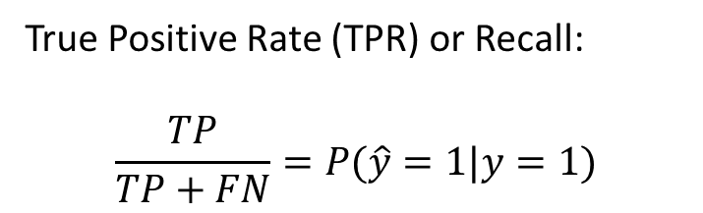
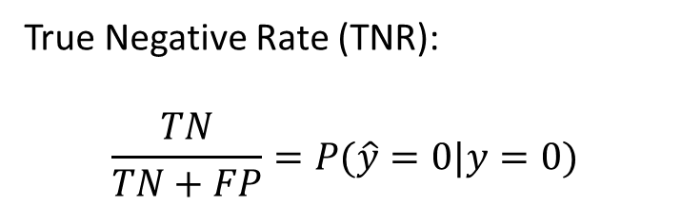
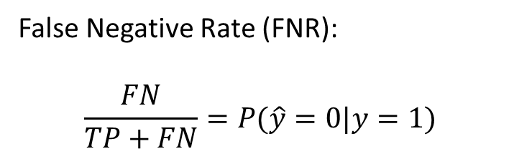
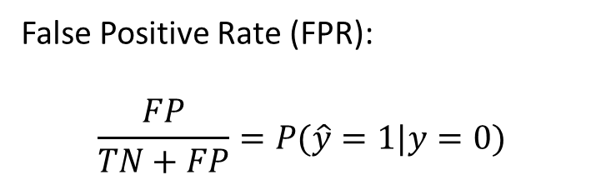
Error Metrics
True Positive Rate (TPR) or Recall:
$$\frac{TP}{TP+FN}=P(\hat{y}=1|y=1)$$
False Negative Rate (FNR):
$$\frac{FN}{TP+FN}=P(\hat{y}=0|y=1)$$
1 - TPR
True Negative Rate (TNR):
$$\frac{TN}{TN+FP}=P(\hat{y}=0|y=0)$$
False Positive Rate (FPR):
$$\frac{FP}{TN+FP}=P(\hat{y}=1|y=0)$$
1 - TNR

Slide 31
Next Question
So far, we have compared different fairness definitions in model outputs
Next, we ask where these differences come from
The answer may lie in the world, the data, or the labels — not just the model

