Slide 1
Do Yankees Games Cause More Noise Complaints?
Prof. Zubin Jelveh CCJS 418E - Coding for Criminology Fall 2025

Slide 2
PART 1: Presentation Slides
The Plan

Slide 3
Research Question & Why It Matters
Main Research Question:
Do noise complaints increase on days when the Yankees play home games?
Why This Question Matters:
Helps NYPD allocate resources on game days
Informs stadium community relations policy
Shows how major events affect neighborhood quality of life

Slide 4
My Dataset
Data Source:
NYC 311 Service Requests (NYC Open Data)
Yankees 2023 Home Game Schedule
Time Period:
January 1, 2023 - December 31, 2023
Dataset Size:
265,638 noise complaints
83 home games

Slide 5
My Dataset: Key Variables
Key Variables I'm Using:
`created_date` - When complaint was filed
`borough` - BRONX, BROOKLYN, etc.
`complaint_type` - Type of noise complaint
`game_date` - Yankees home game dates
Data Cleaning:
Filtered to noise complaints only
Created is_game_day flag by matching dates

Slide 6
My Analysis Strategy
First, I'll compare game days to non-game days across all of NYC to establish whether a basic pattern exists. If there's no difference at all, we can stop here.
Then, I'll look at the percent increase by day of week. This helps rule out "it's just the weekend" as an alternative explanation, since games happen on different days.
Finally, I'll compare the change in the Bronx to the change in Brooklyn using diff-in-diff. This rules out citywide trends and shows the localized stadium effect.

Slide 7
Comparison #1: Game Days vs Non-Game Days
What I'm calculating:
Average noise complaints per day, grouped by game day status
How I'll calculate it:
groupby(['date', 'is_game_day']).size()
Then calculate mean for each group
Visualization:
Bar chart: X = Day Type, Y = Average Complaints

Slide 8
Comparison #2: Percent Increase by Day of Week
What I'm calculating:
Percent increase on game days for each day of the week
How I'll calculate it:
groupby(['day_of_week', 'is_game_day']).mean()
Calculate (game_day - non_game_day) / non_game_day * 100
Visualization:
Bar chart: X = Day of Week, Y = Percent Increase

Slide 9
Comparison #3: Bronx vs Brooklyn (Diff-in-Diff)
What I'm calculating:
Change in complaints for each borough
Difference between those changes
How I'll calculate it:
Filter to Bronx and Brooklyn
Calculate change for each borough
Subtract: Bronx change - Brooklyn change
Visualization:
Grouped bar chart: boroughs x game day status

Slide 10
PART 2: Results
The Findings

Slide 11
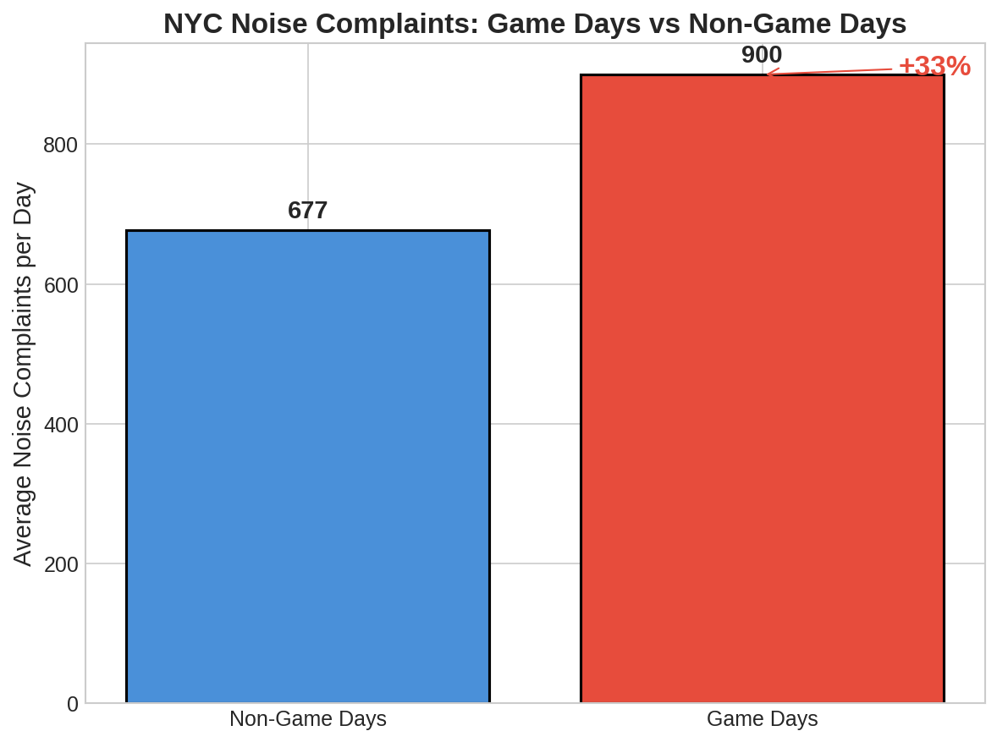
Result #1: Game Days vs Non-Game Days

Slide 12
Result #1: What This Tells Us
Key Numbers:
Non-game days: 677 complaints/day average
Game days: 900 complaints/day average
33% increase on game days
What This Means:
Major sporting events are associated with more noise complaints
How This Advances My Story:
This establishes the basic pattern exists - game days are noisier

Slide 13
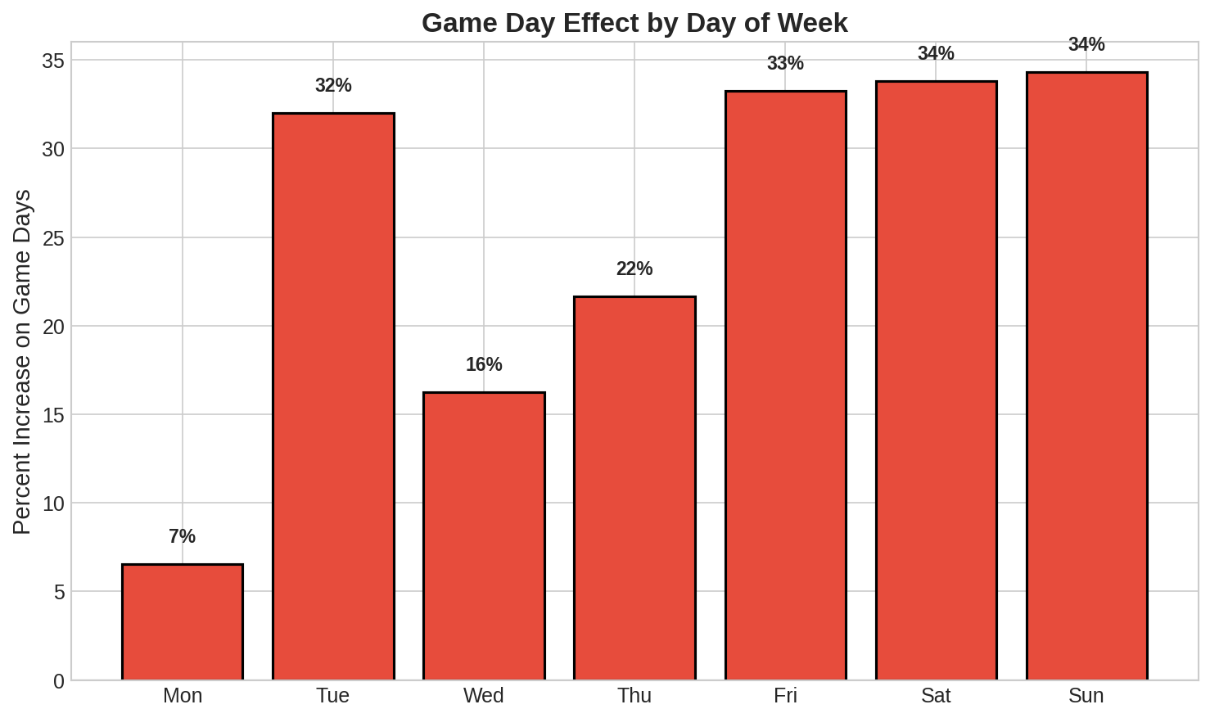
Result #2: Percent Increase by Day of Week

Slide 14
Result #2: What This Tells Us
Key Numbers:
Increases range from ~20% to ~45% depending on day
Effect exists on weekdays AND weekends
What This Means:
The game day effect is not just a "weekend effect"
How This Advances My Story:
Rules out the alternative explanation that weekends are naturally noisier

Slide 15
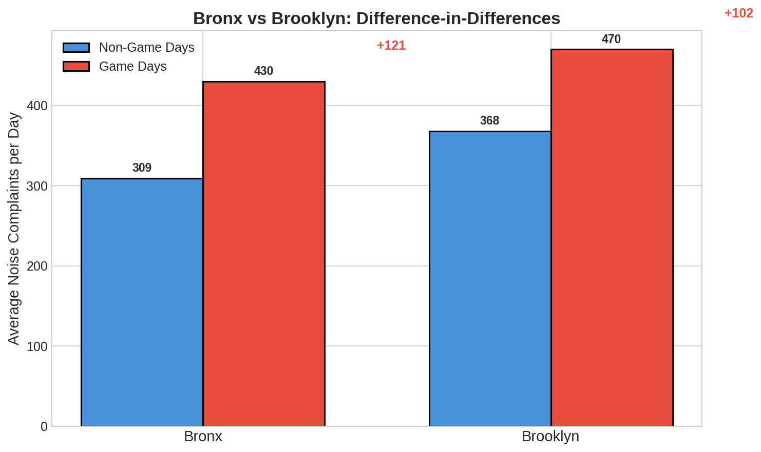
Result #3: Bronx vs Brooklyn

Slide 16
Result #3: What This Tells Us
Key Numbers:
Bronx: +121 complaints on game days (+39%)
Brooklyn: +102 complaints on game days (+28%)
Diff-in-diff: +19 extra complaints in Bronx
What This Means:
The Bronx has an EXTRA increase beyond citywide trends
How This Advances My Story:
Isolates the localized stadium effect from general game day excitement

Slide 17
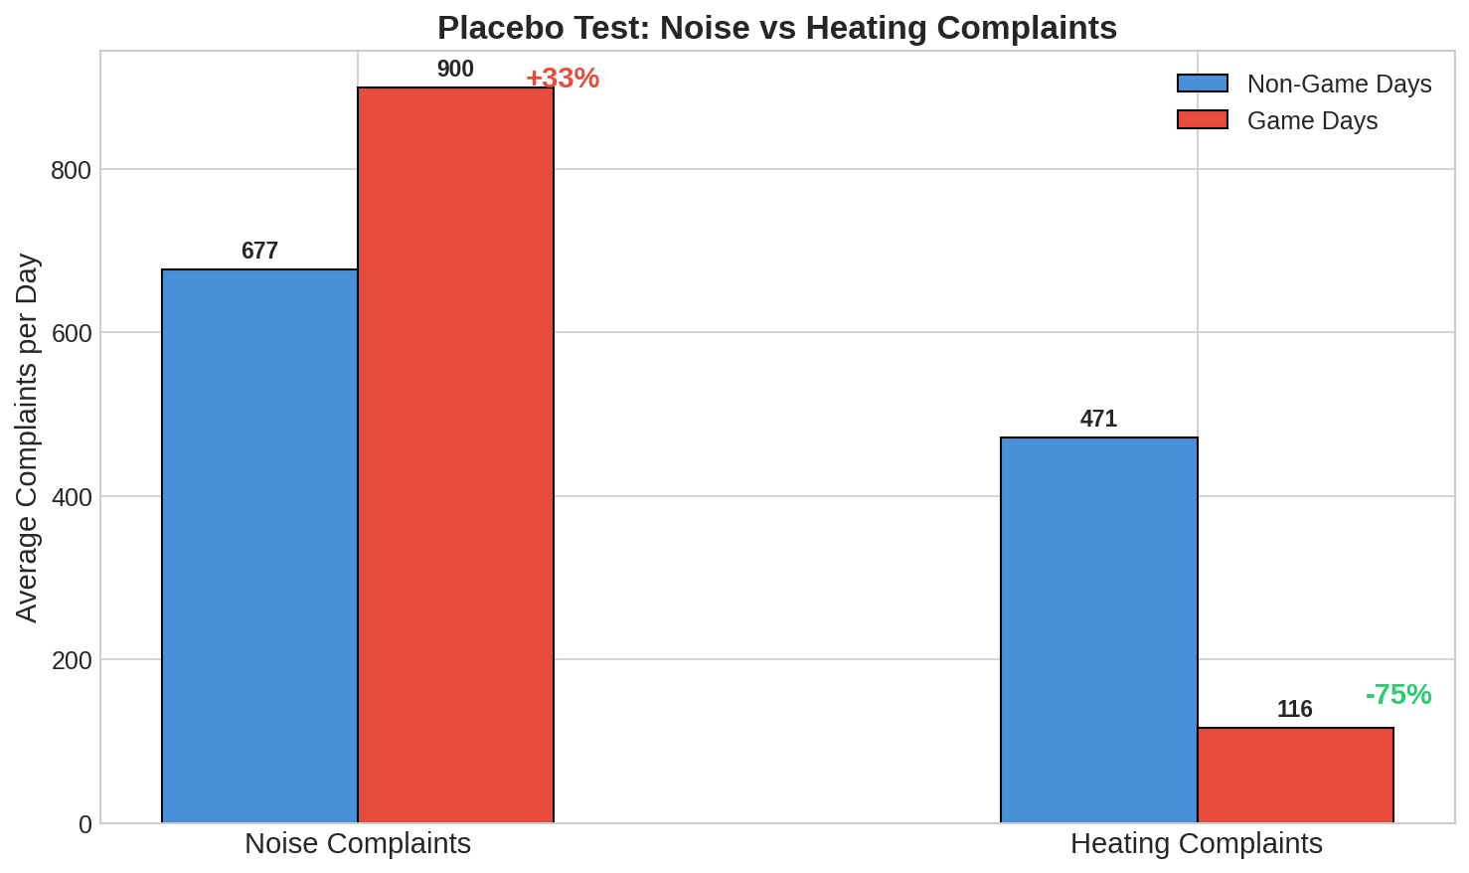
Bonus: Placebo Test (Heating Complaints)

Slide 18
Placebo: What This Tells Us
Key Numbers:
Noise: +33% on game days
Heating: -75% on game days
What This Means:
Heating goes DOWN because baseball is in summer
No Bronx-specific effect for heating (diff-in-diff ≈ 0)
How This Advances My Story:
Confirms the noise effect is real, not just "people complain more on game days"

Slide 19
Challenges
Challenge #1:
Matching dates between different data formats
Challenge #2:
Understanding what diff-in-diff actually measures
Challenge #3:
Choosing the right comparison borough (Brooklyn vs Manhattan)

Slide 20
Summary
Research Question:
Do Yankees games cause more noise complaints?
Main Findings:
33% more noise complaints on game days overall
Effect persists across all days of the week
Bronx has 11% EXTRA effect vs Brooklyn (localized impact)
Placebo test confirms the pattern is real

Slide 21
Why It Matters
Policy Implications:
NYPD should increase presence near Yankee Stadium on game days
Stadium should invest in community noise mitigation
311 resources should anticipate higher volume during games
What I Learned:
Multiple comparisons make causal claims more credible
Placebo tests strengthen findings by ruling out alternatives
Thank you! Questions?

