Slide 1
INST 798/808 Transformers and Sentence Embeddings

Slide 2
Presentations
Aim for 20 minutes of material and 10 minutes of discussion
Imaging you are teaching the paper rather than reviewing it
Proposed structure:
Part I
What specific problem/research gap does the paper address?
Why is this problem important? What are the implications of solving it?
Part II
What is the core insight or innovation of the paper?
How does their solution work? Focus on the conceptual understanding before diving into technical details.

Slide 3
Presentations
Part III
What was the experimental setup?
Make sure to mention datasets
Describe the high-level details of any benchmarks used
What were the results?
Mention specific performance metrics
What was the baseline that was being compared to?
Part IV
Prepare 2 to 3 questions for discussion
Focus on methodology, connections to other work, or applications
Be honest about complex aspects you found challenging
Goal is collective understanding, not perfect knowledge

Slide 4
Last Time
Basics of embeddings spaces:
Weights associated with a layer move input points into new spaces
Word2vec
Example: When we multiply each input one-hot encoded vector by the weight matrix, distances in the new space are meaningful.
Whereas distances in the input space were not meaningful
Every word’s representation as a one hot-encoded vector is orthogonal to every other word’s representation
This concept applies to more complicated models

Slide 5
Shortcoming of word2vec-style embeddings
“I tried to deposit money at the river bank... the fish now have better credit scores than I do."
"The bank called to say my account was frozen... so I put on a sweater before making a withdrawal.“
The embedding for bank will be the same regardless of the context it appears in.
“Static” embeddings

Slide 6
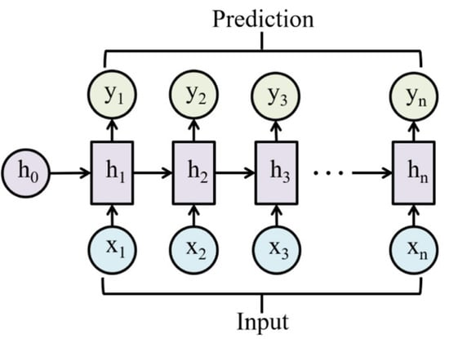
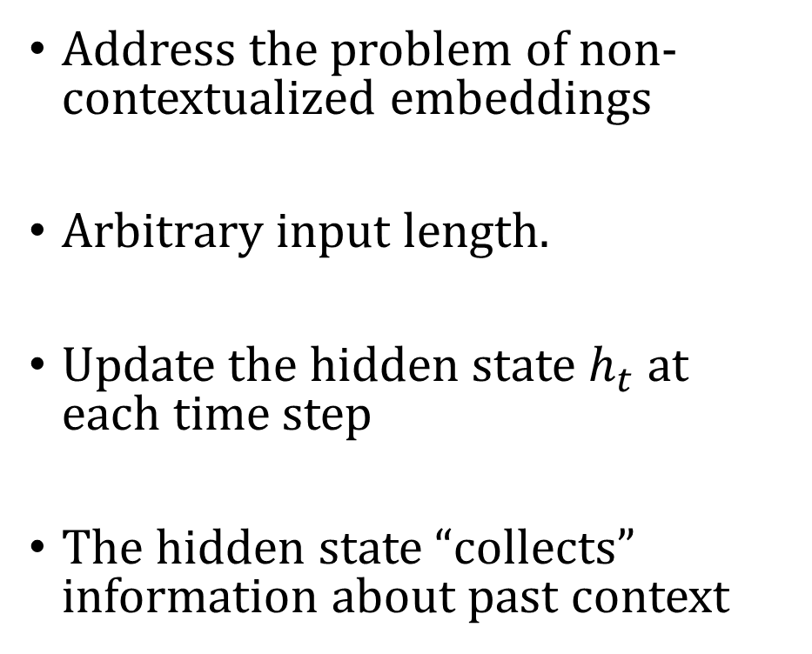
RNNs
Address the problem of non-contextualized embeddings
Arbitrary input length.
Update the hidden state $h_{t}$ at each time step
The hidden state “collects” information about past context

Slide 7
Limitations
Sequential Processing Bottleneck: RNNs process tokens one-by-one, making them inherently sequential and difficult to parallelize.
Limited Context Window: The vanishing/exploding gradient problem means RNNs struggle to maintain information over long sequences, even with LSTM/GRU improvements.
Fixed-Size Hidden States: Information from the entire sequence must be compressed into a fixed-dimension vector, creating an information bottleneck.

Slide 8
Transformers to the Rescue
The Sequential Processing Bottleneck
Transformer Solution: Self-attention processes all tokens simultaneously, allowing for parallelization during training.
Long-Range Dependencies
Transformer Solution: Self-attention creates direct connections between any two positions in a sequence, regardless of their distance. Each token can directly attend to every other token, making it much easier to learn long-range interactions.

Slide 9
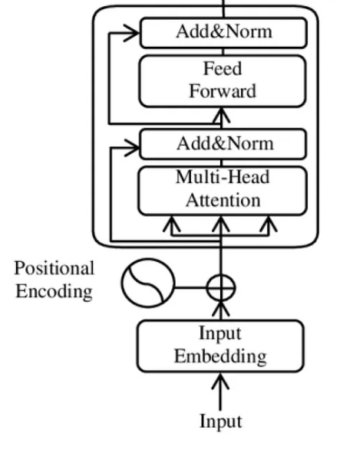
Typical Transformer Block
Input -> Input Embeddings -> Positional Encoding -> Multi-Head Self -> Add to Residual Stream & Normalize -> FFN -> Add to Residual Stream & Normalize -> Output

Slide 10
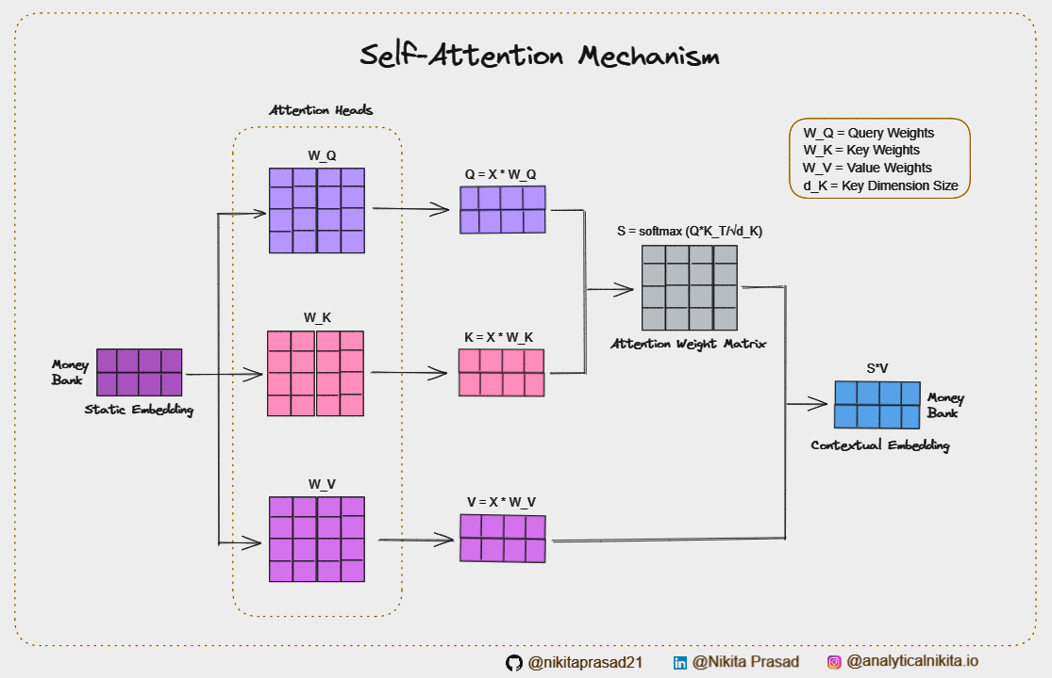
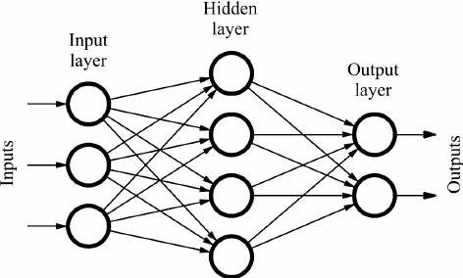
Two Main Components
Self-Attention:
Captures context
Allows words to inform each other
Feed-Forward Network:
Token processed independently
Extract relevant information from current token + position

Slide 11
Residual Stream
Represents the original input embedding as it gets updated. Helps stabilize and accelerate training.
Steps:
After the Self-Attention step, the value from SA is added to the input embeddings
Then the embedding is normalized and fed into FFN step
After the FFN step, the value is added to the input into the FFN step embeddings
The embedding is normalized

Slide 12
Causal vs Bi-Directional Attention
In the following, we will describe the “bidirectional” self-attention
Any one word can “attend” to any other word in the input sequence
This is different than “causal” self-attention
Words can only “attend” to words that came before in the input sequence
Causal self-attention is used for next-word prediction
Don’t want information that you are trying to predict leaking through
Bidirectional self-attention is used for interpretation tasks

Slide 13
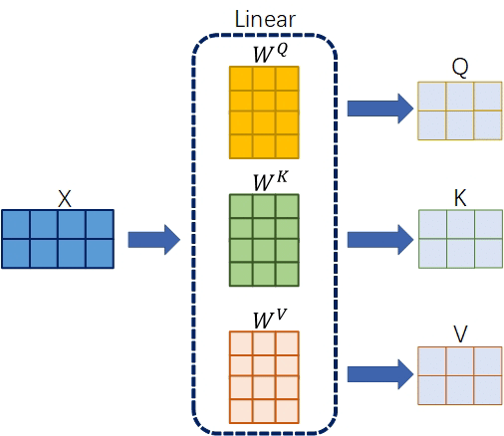
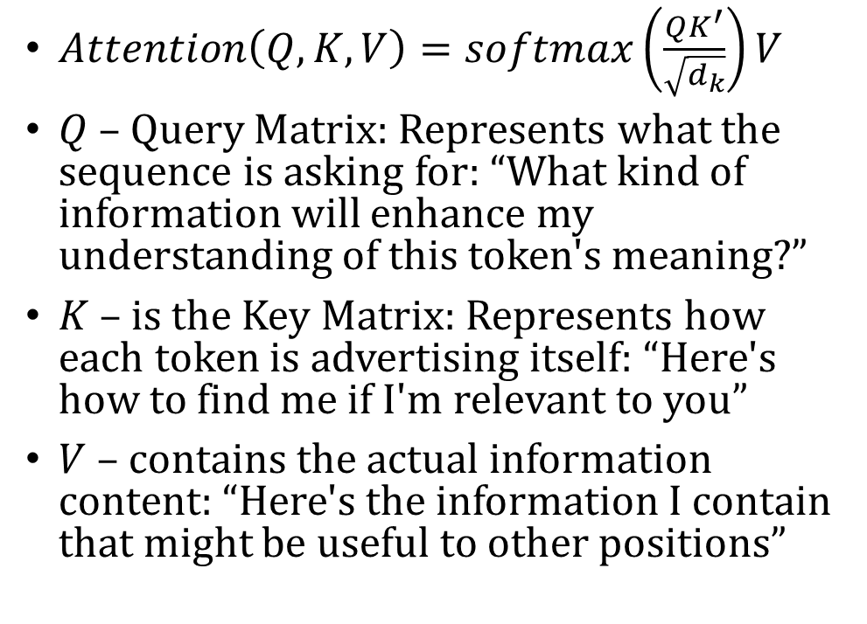
Self-Attention: “Context finder”
$Attention\left(Q,K,V\right)=softmax\left(\frac{QK^{′}}{\sqrt{d_{k}}}\right)V$
$Q$ – Query Matrix: Represents what the sequence is asking for: “What kind of information will enhance my understanding of this token's meaning?”
$K$ – is the Key Matrix: Represents how each token is advertising itself: “Here's how to find me if I'm relevant to you”
$V$ – contains the actual information content: “Here's the information I contain that might be useful to other positions”

Slide 14
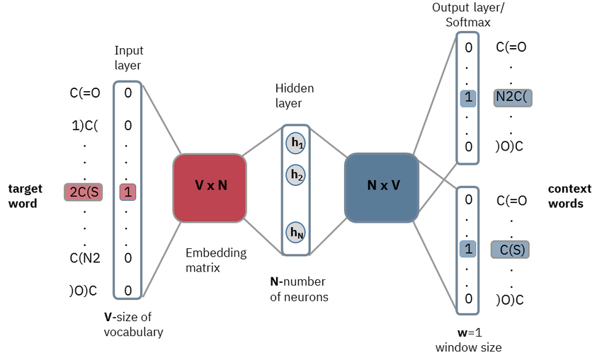
Comparison to word2vec
Recall word2vec skipgram model had 2 embeddings per word
Center-word/Input embedding:
Query-like: Seeks information about what should appear in its context.
But the context is static
Context-word/Output embedding:
Key-like: Determines compatibility with the center word through dot product scoring, similar to how Keys determine attention weights
No separate Value-like mechanism in word2vec

Slide 15
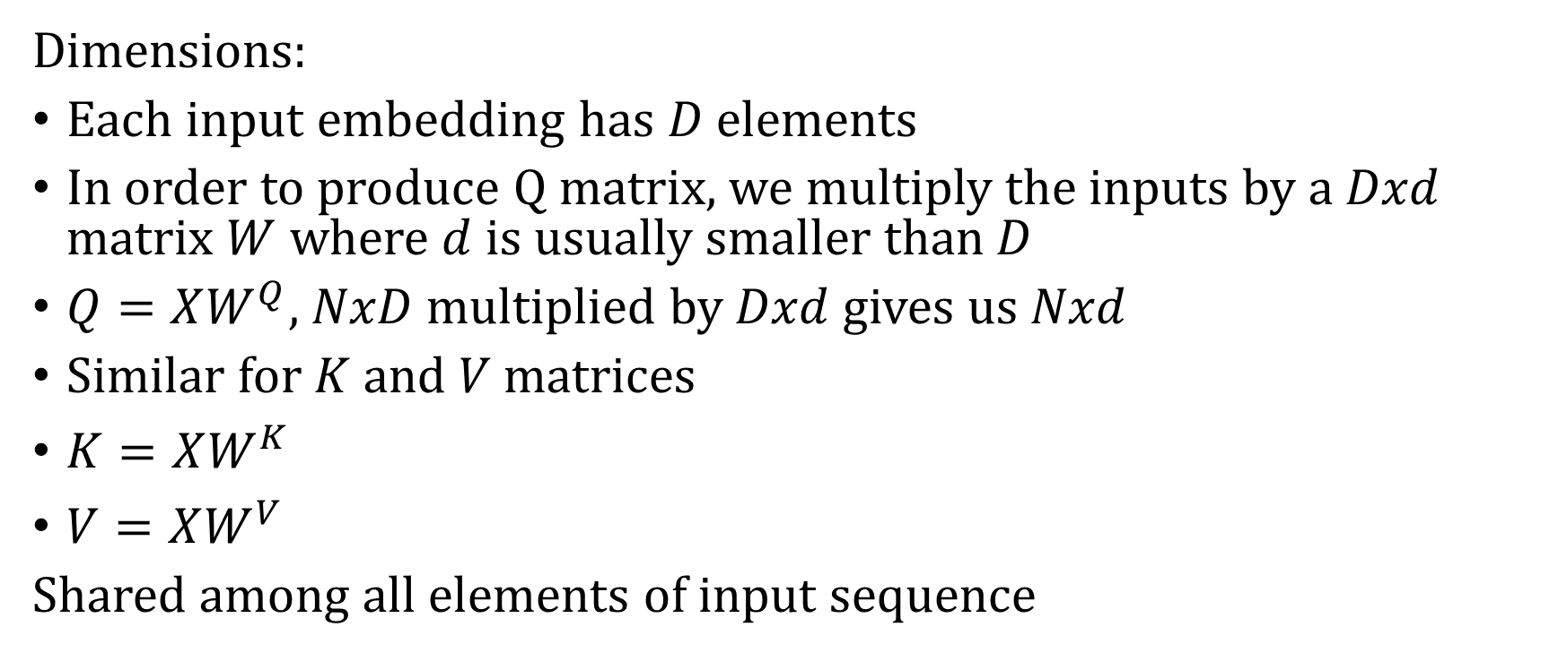
Self-Attention Setup
Dimensions:
Each input embedding has $D$ elements
In order to produce Q matrix, we multiply the inputs by a $Dxd$ matrix $W$ where $d$ is usually smaller than $D$
$Q=XW^{Q}$, $NxD$ multiplied by $Dxd$ gives us $Nxd$
Similar for $K$ and $V$ matrices
$K=XW^{K}$
$V=XW^{V}$
Shared among all elements of input sequence

Slide 16





Construction Q Matrix (Similar for K and V)
$$X$$
$$W^{Q}$$
$$Q$$
$$∗$$
$$=$$
5x5
5x3
5x3

Slide 17



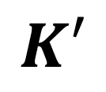
Compatibility Matrix
Compatibility
Matrix
$$Q$$
$$K′$$
$$∗$$
$$=$$
5x3
3x5
5x5

Slide 18
Scale and apply softmax to Compatibility Matrix
Scale:
If the embedding dimension is big, then dot product of Q and K -> vanishing gradient problem
So each element in the new matrix is divided by the square root of the size of the embedding
Softmax:
Apply softmax to each row so that each row is a probability distribution
This converts the compatibility matrix into the Attention matrix

Slide 19


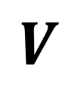
Then we scale and apply softmax
Attention
Matrix
$$V$$
Self-Attention Output
$$∗$$
$$=$$
5x5
5x3
5x3

Slide 20

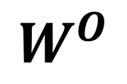
Output Projection
Self-Attention Output
$$W^{O}$$
Projected Back to
Embedding Dimensions
$$∗$$
$$=$$
5x3
3x5
5x5

Slide 21
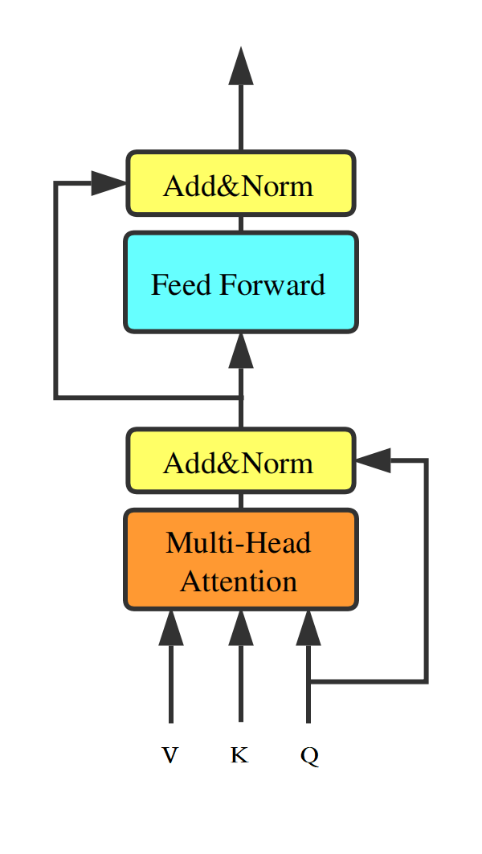
Finishing Transformer Block
Output of Self-Attention is added to residual stream and normalized
Then fed into Feed Forward network
Role of Feedforward network:
Extract relevant information from current token + position
Output is is added to residual stream followed by a normalization

Slide 22
Multi-headed Attention
Instead of running self-attention once, run it multiple times independently and in parallel
Create Multiple "Heads":
Instead of having just one set of Q, K, V transformations, create multiple sets (typically 8, 12, or 16)
Each "head" has its own separate set of weight matrices to transform the input embeddings
Each head can focus on different patterns (e.g. syntactic vs semantic relationship)
Combine the heads by concatenating (and converting back to input dimensions)

Slide 23
Transformer Flavors
Come in three flavors:
Encoder-Decoder
Encoder only
Decoder only

Slide 24
Encoder-Only Models
Key characteristics:
Bidirectional attention (each token can see all other tokens)
Good for understanding tasks that require context from the entire input
Often use masked language modeling as pre-training objective
Typically produce contextual embeddings for each token
Common applications:
Text classification
Named entity recognition
Question answering
Sentence and document embeddings (with pooling)
Examples:
BERT, RoBERTa

Slide 25
Decoder-Only Models
Key characteristics:
Unidirectional/causal attention (each token can only see previous tokens)
Autoregressive: predicts the next token based on previous ones
Well-suited for text generation tasks
Common applications:
Text generation
Dialogue systems
Creative writing
Code generation
Examples: GPT series, LLaMA, Claude, PaLM

Slide 26
Encoder-Decoder
Key characteristics:
Encoder processes input bidirectionally
Decoder generates output autoregressively
Cross-attention allows decoder to focus on relevant parts of the input
Well-suited for tasks that transform one sequence into another
Common applications:
Machine translation
Summarization
Question answering (when framed as generation)
Data-to-text generation
Examples: T5, BART, mT5, Pegasus

Slide 27
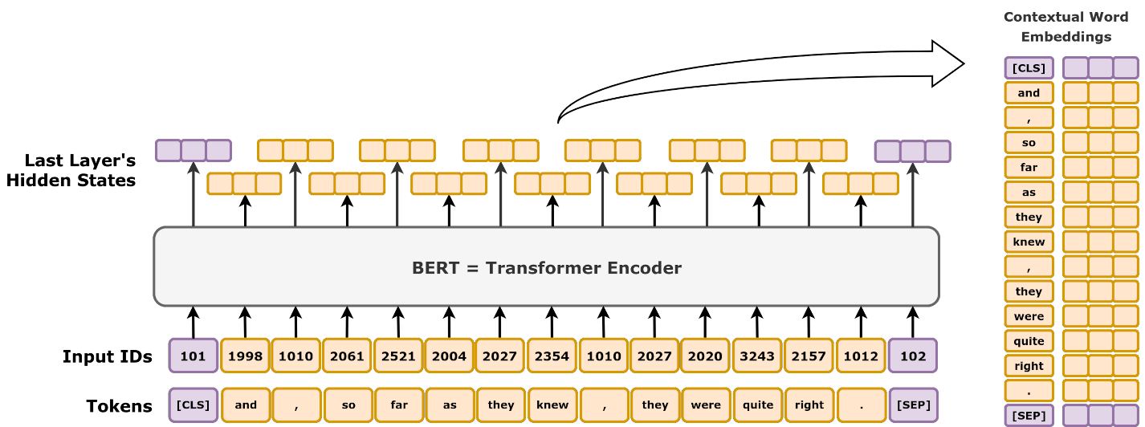
BERT Model

Slide 28
BERT Facts
English only
Context window of N=512 tokens
Implication for size of document you can get embedding for
12 Transformer blocks
100 Million parameters

Slide 29
Prediction Function
Instead of next word prediction, we now randomly select a subset of words/tokens to be potentially censored or replaced. We then ask the model to predict the censored/replaced words in the text. This goes by the name of Masked Language Modeling (MLM). BERT randomly selected 15% of tokens for masking.
Next word prediction:
Mary had a little lamb, little lamb, little lamb
Masked language modeling:
Mary [x] a little [scarf], little [x], little lamb

Slide 30
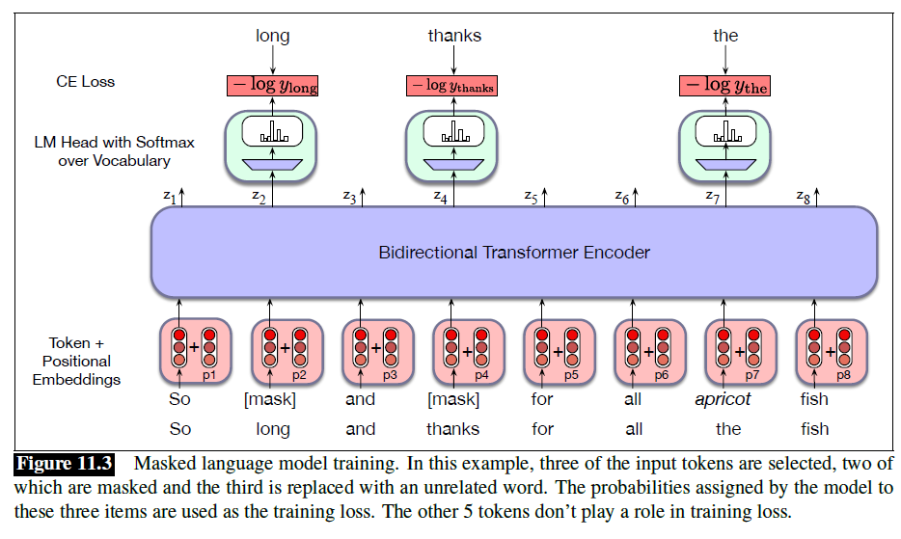

Slide 31
Language Modeling Head
We want to generate probabilities for each of the masked words
The language modeling head does this
The head takes the output for each masked word from the last transformer layer, multiplies it by the unembedding layer, and then applies softmax
Unembedding layer is the operation that gets us from the embedding dimension back to the token dimension

Slide 32
Next Sentence Prediction
NLP Tasks at the sentence level:
Paraphrase detection (if two sentences have similar meanings)
Entailment (does 1st sentence imply 2nd, or does latter contradict)
Coherence (do two sentences form a coherent discourse)
BERT included a Next Sentence Prediction task to capture the relationships in text needed to perform these tasks

Slide 33
Next Sentence Prediction
<CLS> tag introduced as first token in a sentence.
<SEP> tags put between sentences and end of 2nd sentences
I'm feeling pretty good. Pretty, pretty, pretty, pretty good.
Becomes
<cls> I'm feeling pretty good <sep> Pretty, pretty, pretty, pretty good <sep>

Slide 34
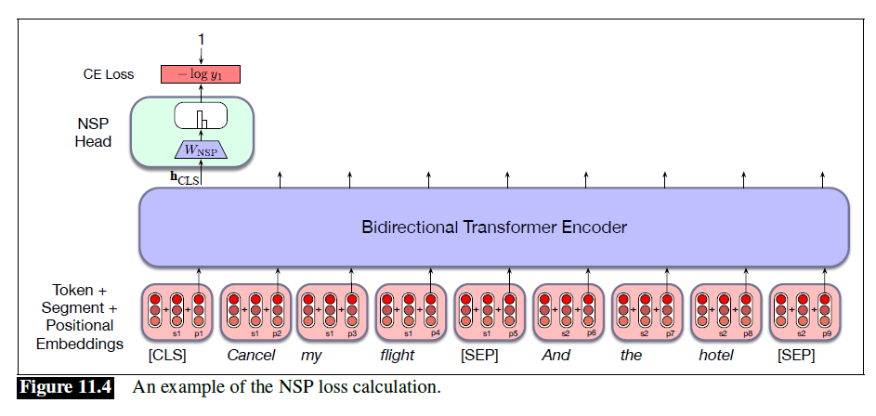
Next Sentence Prediction
During training, the output associated with the <CLS> token is targeted for next sentence prediction

Slide 35
BERT Shortcomings
BERT is optimized for token-level predictions, not for generating unified sentence embeddings.
The [CLS] token often fails to capture the full semantic content of the sentence.
Requires pairwise processing for similarity tasks, leading to high computation costs.

Slide 36
Sentence BERT
Siamese Architecture
Direct optimization for similarity with contrastive / triplet loss
Uses a pre-trained BERT model

