Slide 1
INST 414: Data Science Techniques Calibration

Slide 2
Recap of Naïve Bayes

Slide 3
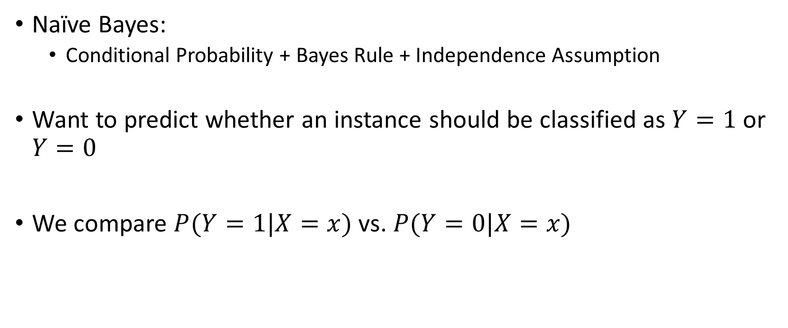
Our First Prediction Algorithm
Naïve Bayes:
Conditional Probability + Bayes Rule + Independence Assumption
Want to predict whether an instance should be classified as $Y=1$ or $Y=0$
We compare $P(Y=1|X=x)$ vs. $P(Y=0|X=x)$

Slide 4
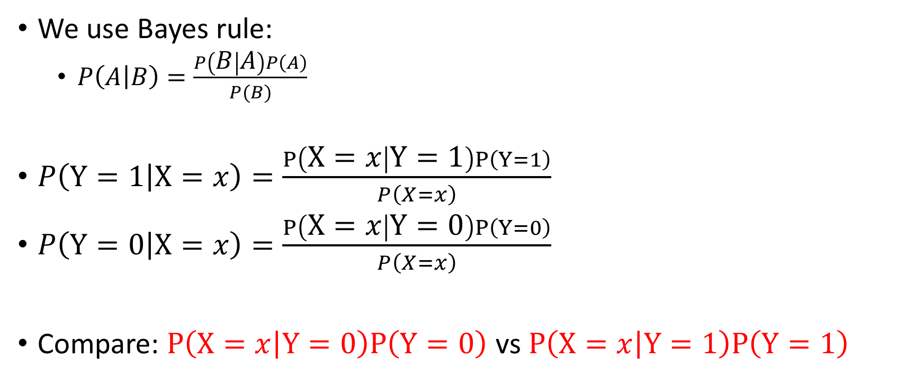
Naïve Bayes
We use Bayes rule:
$P\left(A | B\right)=\frac{P\left(B | A\right)P\left(A\right)}{P(B)}$
$P\left(Y=1 | X=x\right)=\frac{P\left(X=x | Y=1\right)P\left(Y=1\right)}{P\left(X=x\right)}$
$P\left(Y=0 | X=x\right)=\frac{P\left(X=x | Y=0\right)P\left(Y=0\right)}{P\left(X=x\right)}$
Compare: $P\left(X=x | Y=0\right)P\left(Y=0\right)$ vs $P\left(X=x | Y=1\right)P\left(Y=1\right)$

Slide 5
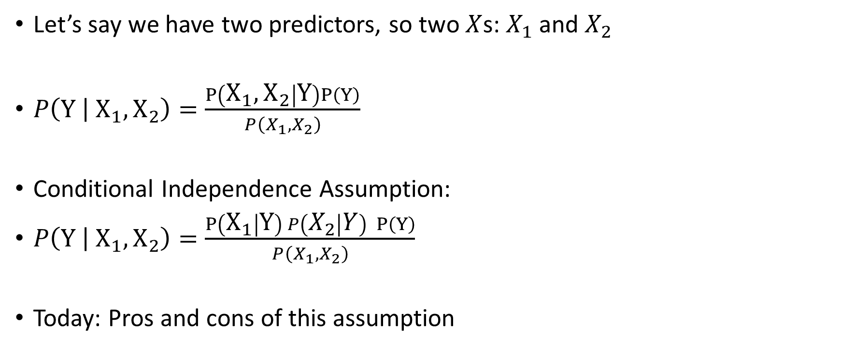
Naïve Bayes
Let’s say we have two predictors, so two $X$s: $X_{1}$ and $X_{2}$
$P\left(Y | X_{1},X_{2}\right)=\frac{P\left(X_{1},X_{2} | Y\right)P\left(Y\right)}{P\left(X_{1}, X_{2}\right)}$
Conditional Independence Assumption:
$P\left(Y | X_{1},X_{2}\right)=\frac{P\left(X_{1} | Y\right) P\left(X_{2} | Y\right) P\left(Y\right)}{P\left(X_{1}, X_{2}\right)}$
Today: Pros and cons of this assumption

Slide 6
The Limitation of Naïve Bayes

Slide 7
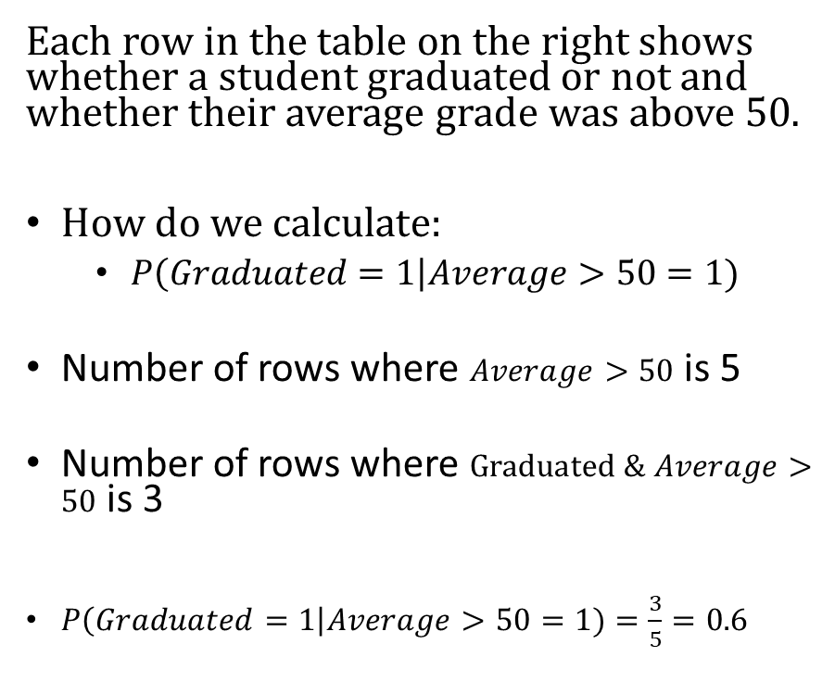
Our Data
Each row in the table on the right shows whether a student graduated or not and whether their average grade was above 50.
How do we calculate:
$P\left(Graduated=1\right|Average>50=1)$
Number of rows where $Average>50$ is 5
Number of rows where $Graduated \& Average>50$ is 3
$P\left(Graduated=1\right|Average>50=1)=\frac{3}{5}=0.6$
Graduated | Average > 50 | X2
1 | 0 | 1
0 | 0 | 0
0 | 0 | 1
1 | 1 | 1
0 | 0 | 0
0 | 1 | 1
1 | 1 | 0
1 | 1 | 0
1 | 0 | 1
0 | 1 | 1

Slide 8
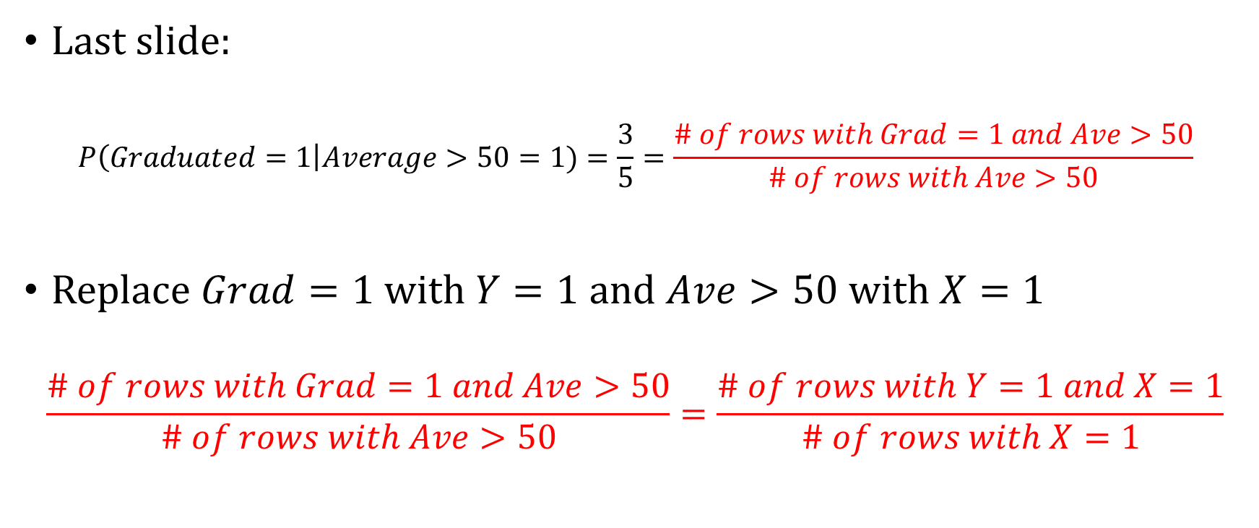
How Does Naïve Bayes Estimate P(Y=1|X)?
Last slide:
$$P\left(Graduated=1\right|Average>50=1)=\frac{3}{5}=\frac{\# of rows with Grad=1 and Ave>50}{\# of rows with Ave>50}$$
Replace $Grad=1$with $Y=1$ and $Ave>50$ with $X=1$
$$\frac{\# of rows with Grad=1 and Ave>50}{\# of rows with Ave>50}=\frac{\# of rows with Y=1 and X=1}{\# of rows with X=1}$$

Slide 9

How Does Naïve Bayes Estimate P(Y=1|X)?
Last slide: $\frac{\# of rows with Y=1 and X=1}{\# of rows with X=1}$
Naïve Bayes:
$P\left(Y=1 | X=1\right)=\frac{P\left(X=1 | Y=1\right) P(Y=1)}{P(X=1)}$

Slide 10

How Does Naïve Bayes Estimate P(Y=1|X)?
Last slide: $\frac{\# of rows with Y=1 and X=1}{\# of rows with X=1}$
Naïve Bayes:
$P\left(Y=1 | X=1\right)=\frac{P\left(X=1 | Y=1\right) P(Y=1)}{P(X=1)}$
$P\left(X=1 | Y=1\right)=\frac{\# of rows with Y=1 and X=1}{\# of rows with Y=1}$

Slide 11
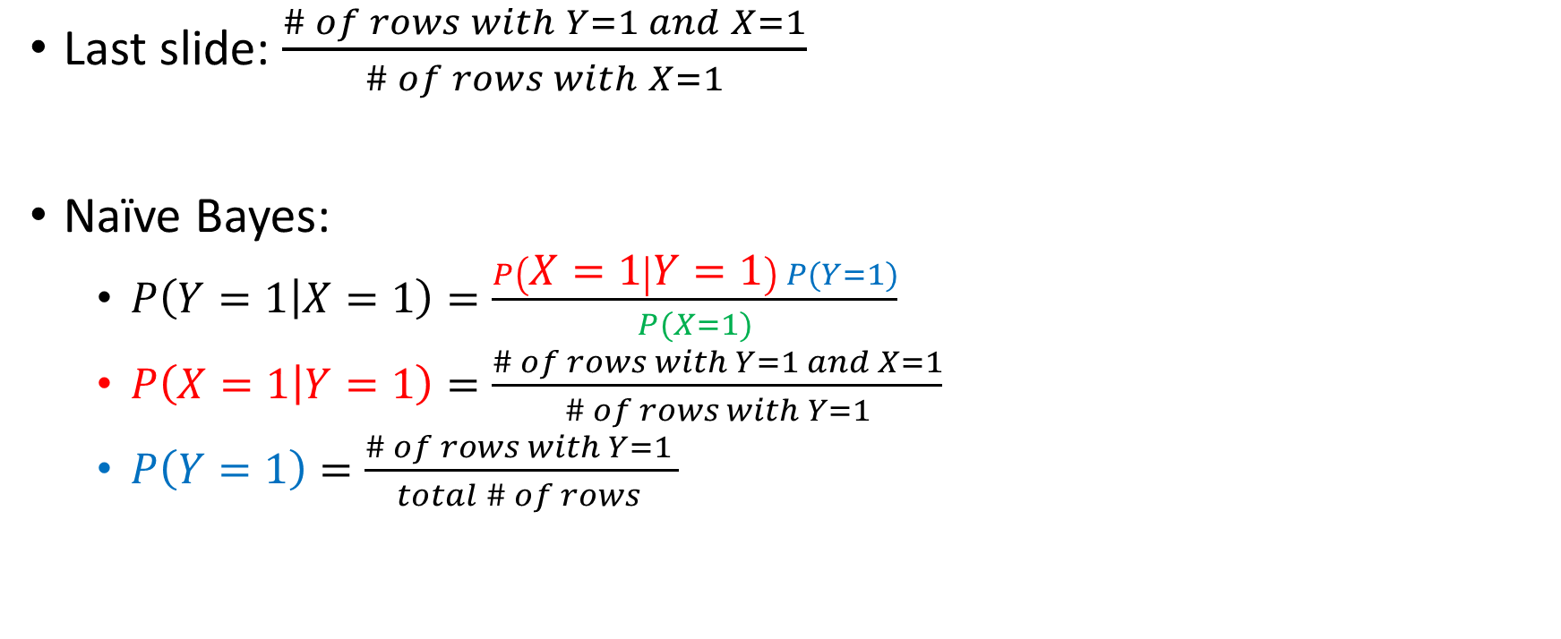
How Does Naïve Bayes Estimate P(Y=1|X)?
Last slide: $\frac{\# of rows with Y=1 and X=1}{\# of rows with X=1}$
Naïve Bayes:
$P\left(Y=1 | X=1\right)=\frac{P\left(X=1 | Y=1\right) P(Y=1)}{P(X=1)}$
$P\left(X=1 | Y=1\right)=\frac{\# of rows with Y=1 and X=1}{\# of rows with Y=1}$
$P\left(Y=1\right)=\frac{\# of rows with Y=1 }{total \# of rows }$

Slide 12
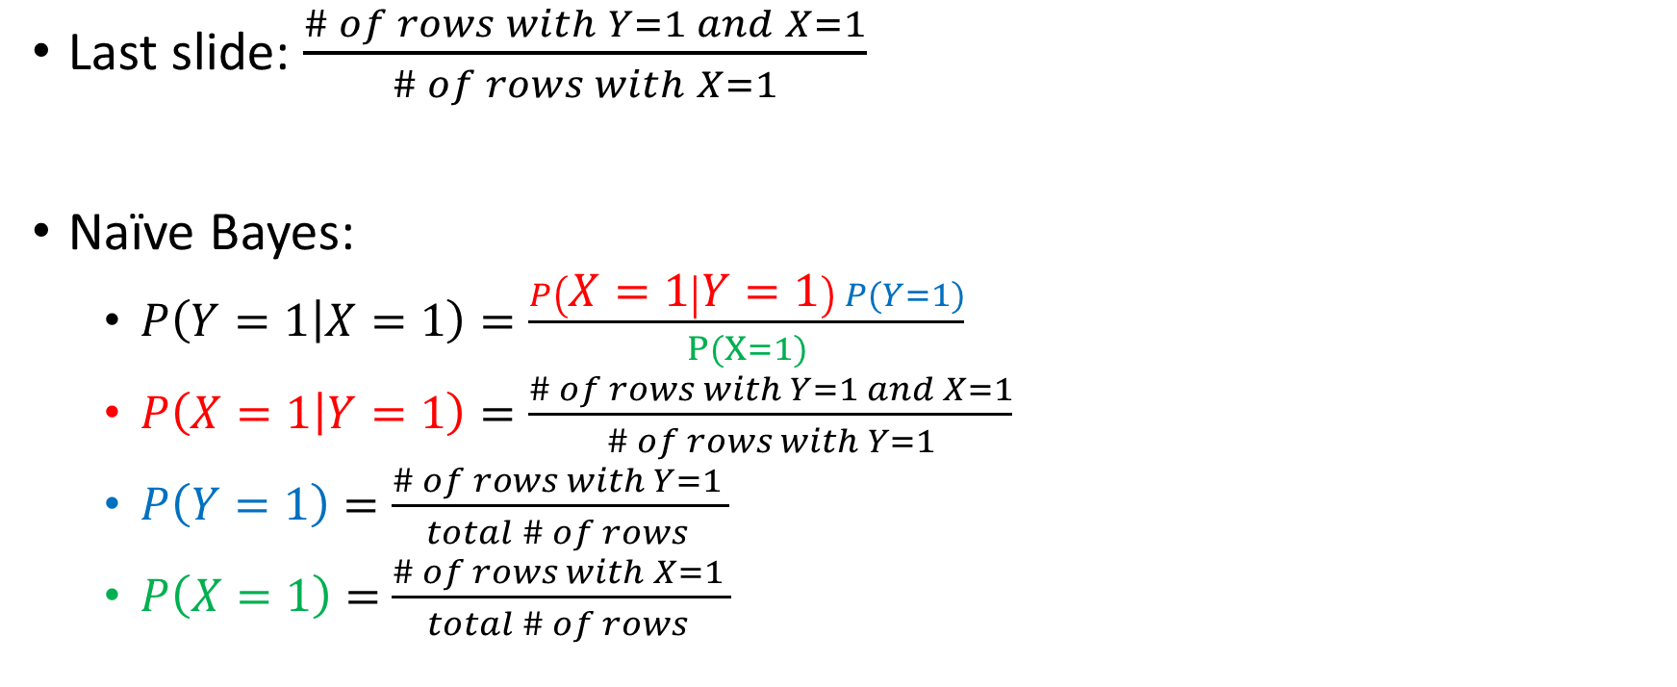
How Does Naïve Bayes Estimate P(Y=1|X)?
Last slide: $\frac{\# of rows with Y=1 and X=1}{\# of rows with X=1}$
Naïve Bayes:
$P\left(Y=1 | X=1\right)=\frac{P\left(X=1 | Y=1\right) P(Y=1)}{P(X=1)}$
$P\left(X=1 | Y=1\right)=\frac{\# of rows with Y=1 and X=1}{\# of rows with Y=1}$
$P\left(Y=1\right)=\frac{\# of rows with Y=1 }{total \# of rows }$
$P\left(X=1\right)=$ $\frac{\# of rows with X=1 }{total \# of rows }$

Slide 13

How Does Naïve Bayes Estimate P(Y=1|X)?
$\frac{P\left(X=1 | Y=1\right) P(Y=1)}{P(X=1)}=\frac{\left(\frac{\# of rows with Y=1 and X=1}{\# of rows with Y=1}\right) \left(\frac{\# of rows with Y=1 }{total \# of rows }\right)}{\left(\frac{\# of rows with X=1 }{total \# of rows }\right)}$

Slide 14
How Does Naïve Bayes Estimate P(Y=1|X)?
$\frac{P\left(X=1 | Y=1\right) P(Y=1)}{P(X=1)}=\frac{\left(\frac{\# of rows with Y=1 and X=1}{\# of rows with Y=1}\right) \left(\frac{\# of rows with Y=1 }{total \# of rows }\right)}{\left(\frac{\# of rows with X=1 }{total \# of rows }\right)}$

Slide 15

How Does Naïve Bayes Estimate P(Y=1|X)?
$\frac{P\left(X=1 | Y=1\right) P(Y=1)}{P(X=1)}=\frac{\left(\frac{\# of rows with Y=1 and X=1}{\# of rows with Y=1}\right) \left(\frac{\# of rows with Y=1 }{total \# of rows }\right)}{\left(\frac{\# of rows with X=1 }{total \# of rows }\right)}=$
$\frac{\left(\frac{\# of rows with Y=1 and X=1}{total \# of rows}\right) }{\left(\frac{\# of rows with X=1 }{total \# of rows }\right)}=\left(\frac{\# of rows with Y=1 and X=1}{total \# of rows}\right)⋅\left(\frac{total \# of rows }{\# of rows with X=1}\right)$

Slide 16

How Does Naïve Bayes Estimate P(Y=1|X)?
$\frac{P\left(X=1 | Y=1\right) P(Y=1)}{P(X=1)}=\frac{\left(\frac{\# of rows with Y=1 and X=1}{\# of rows with Y=1}\right) \left(\frac{\# of rows with Y=1 }{total \# of rows }\right)}{\left(\frac{\# of rows with X=1 }{total \# of rows }\right)}=$
$\frac{\left(\frac{\# of rows with Y=1 and X=1}{total \# of rows}\right) }{\left(\frac{\# of rows with X=1 }{total \# of rows }\right)}=\left(\frac{\# of rows with Y=1 and X=1}{total \# of rows}\right)⋅\left(\frac{total \# of rows }{\# of rows with X=1}\right)=$

Slide 17
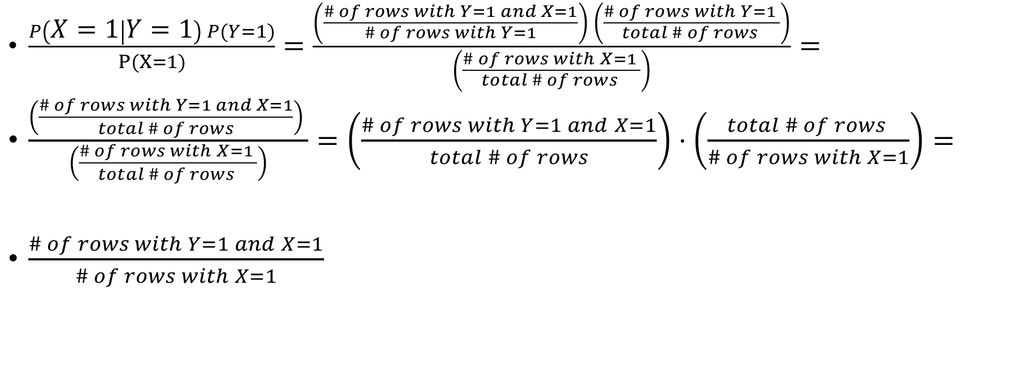
How Does Naïve Bayes Estimate P(Y=1|X)?
$\frac{P\left(X=1 | Y=1\right) P(Y=1)}{P(X=1)}=\frac{\left(\frac{\# of rows with Y=1 and X=1}{\# of rows with Y=1}\right) \left(\frac{\# of rows with Y=1 }{total \# of rows }\right)}{\left(\frac{\# of rows with X=1 }{total \# of rows }\right)}=$
$\frac{\left(\frac{\# of rows with Y=1 and X=1}{total \# of rows}\right) }{\left(\frac{\# of rows with X=1 }{total \# of rows }\right)}=\left(\frac{\# of rows with Y=1 and X=1}{total \# of rows}\right)⋅\left(\frac{total \# of rows }{\# of rows with X=1}\right)=$
$\frac{\# of rows with Y=1 and X=1}{\# of rows with X=1}$

Slide 18
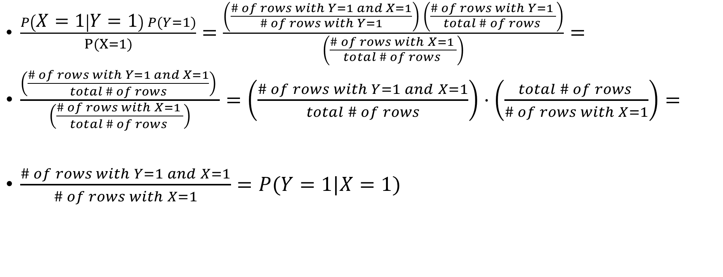
How Does Naïve Bayes Estimate P(Y=1|X)?
$\frac{P\left(X=1 | Y=1\right) P(Y=1)}{P(X=1)}=\frac{\left(\frac{\# of rows with Y=1 and X=1}{\# of rows with Y=1}\right) \left(\frac{\# of rows with Y=1 }{total \# of rows }\right)}{\left(\frac{\# of rows with X=1 }{total \# of rows }\right)}=$
$\frac{\left(\frac{\# of rows with Y=1 and X=1}{total \# of rows}\right) }{\left(\frac{\# of rows with X=1 }{total \# of rows }\right)}=\left(\frac{\# of rows with Y=1 and X=1}{total \# of rows}\right)⋅\left(\frac{total \# of rows }{\# of rows with X=1}\right)=$
$\frac{\# of rows with Y=1 and X=1}{\# of rows with X=1}=P(Y=1|X=1)$

Slide 19

What if there are two predictors?
$P(Y=1|X=1, W=1)$

Slide 20

What if there are two predictors?
$P\left(Y=1 | X=1, W=1\right)=\frac{P\left(X=1, W=1 | Y=1\right)P\left(Y=1\right)}{P(X=1, W=1)}$

Slide 21

What if there are two predictors?
$P\left(Y=1 | X=1, W=1\right)=\frac{P\left(X=1, W=1 | Y=1\right)P\left(Y=1\right)}{P(X=1, W=1)}=$
$\frac{P\left(X=1 | Y=1\right) P\left(W=1 | Y=1\right) P\left(Y=1\right)}{P(X=1, W=1)}$

Slide 22
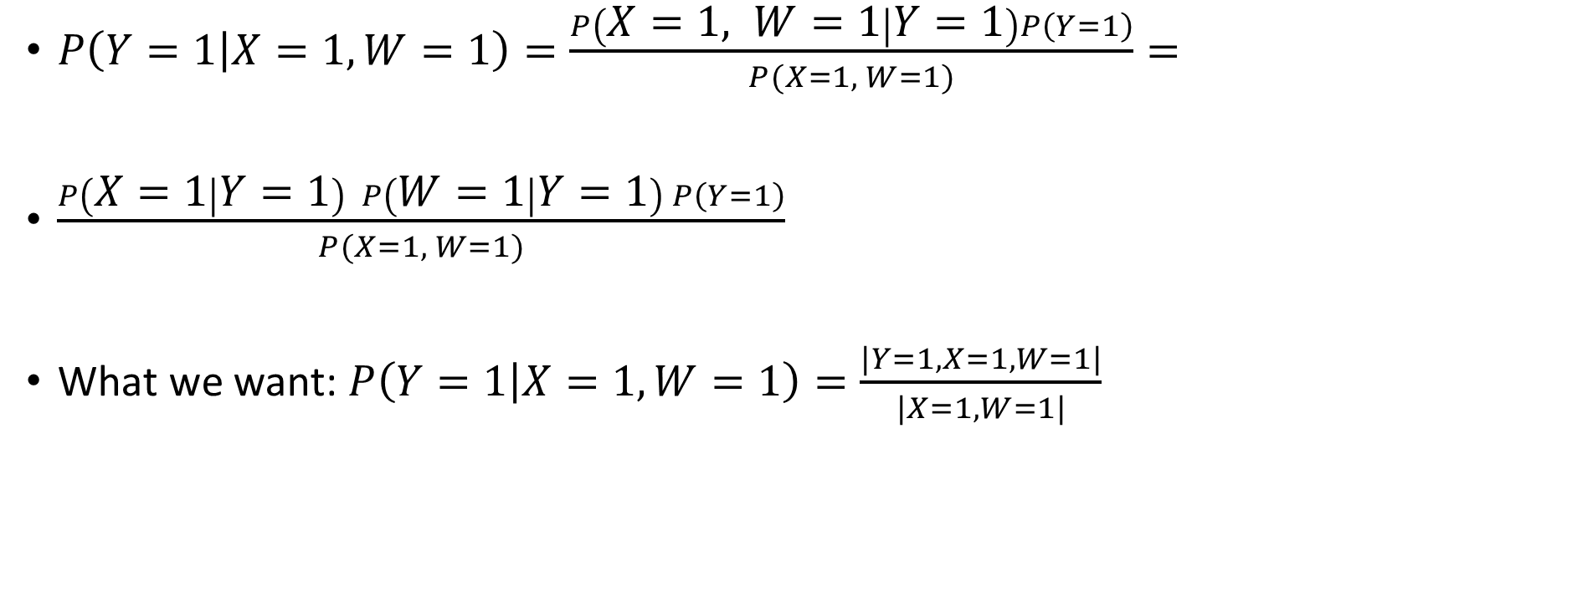
What if there are two predictors?
$P\left(Y=1 | X=1, W=1\right)=\frac{P\left(X=1, W=1 | Y=1\right)P\left(Y=1\right)}{P(X=1, W=1)}=$
$\frac{P\left(X=1 | Y=1\right) P\left(W=1 | Y=1\right) P\left(Y=1\right)}{P(X=1, W=1)}$
What we want: $P\left(Y=1 | X=1, W=1\right)=\frac{|Y=1, X=1, W=1|}{|X=1,W=1|}$

Slide 23
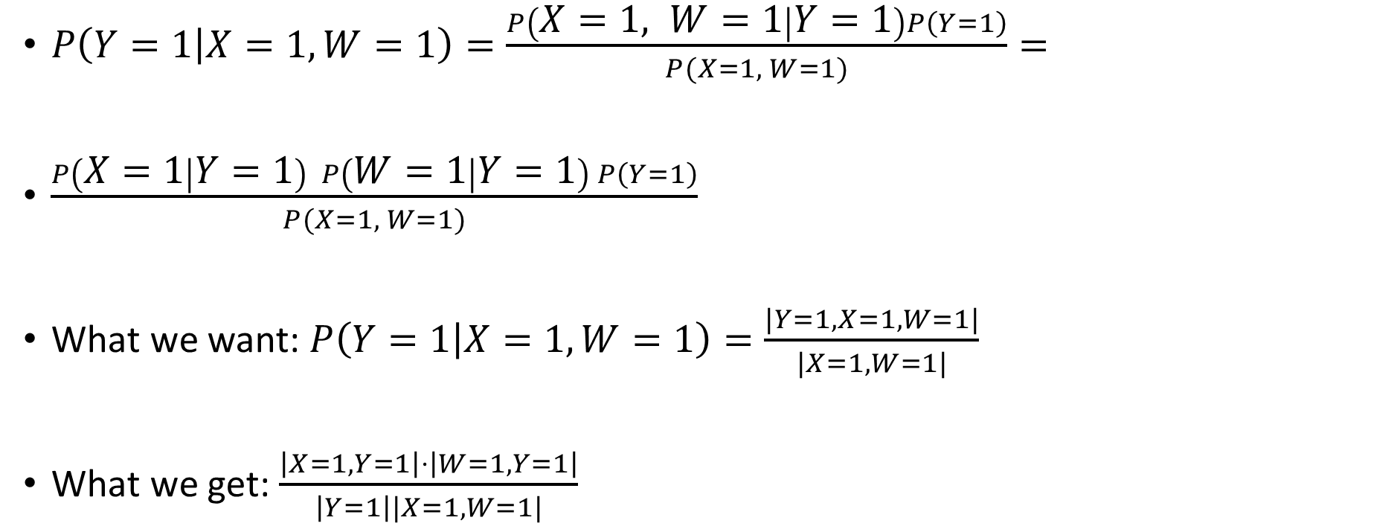
What if there are two predictors?
$P\left(Y=1 | X=1, W=1\right)=\frac{P\left(X=1, W=1 | Y=1\right)P\left(Y=1\right)}{P(X=1, W=1)}=$
$\frac{P\left(X=1 | Y=1\right) P\left(W=1 | Y=1\right) P\left(Y=1\right)}{P(X=1, W=1)}$
What we want: $P\left(Y=1 | X=1, W=1\right)=\frac{|Y=1, X=1, W=1|}{|X=1,W=1|}$
What we get: $\frac{\left|X=1, Y=1\right|⋅\left|W=1, Y=1\right|}{\left|Y=1\right||X=1,W=1|}$

Slide 24
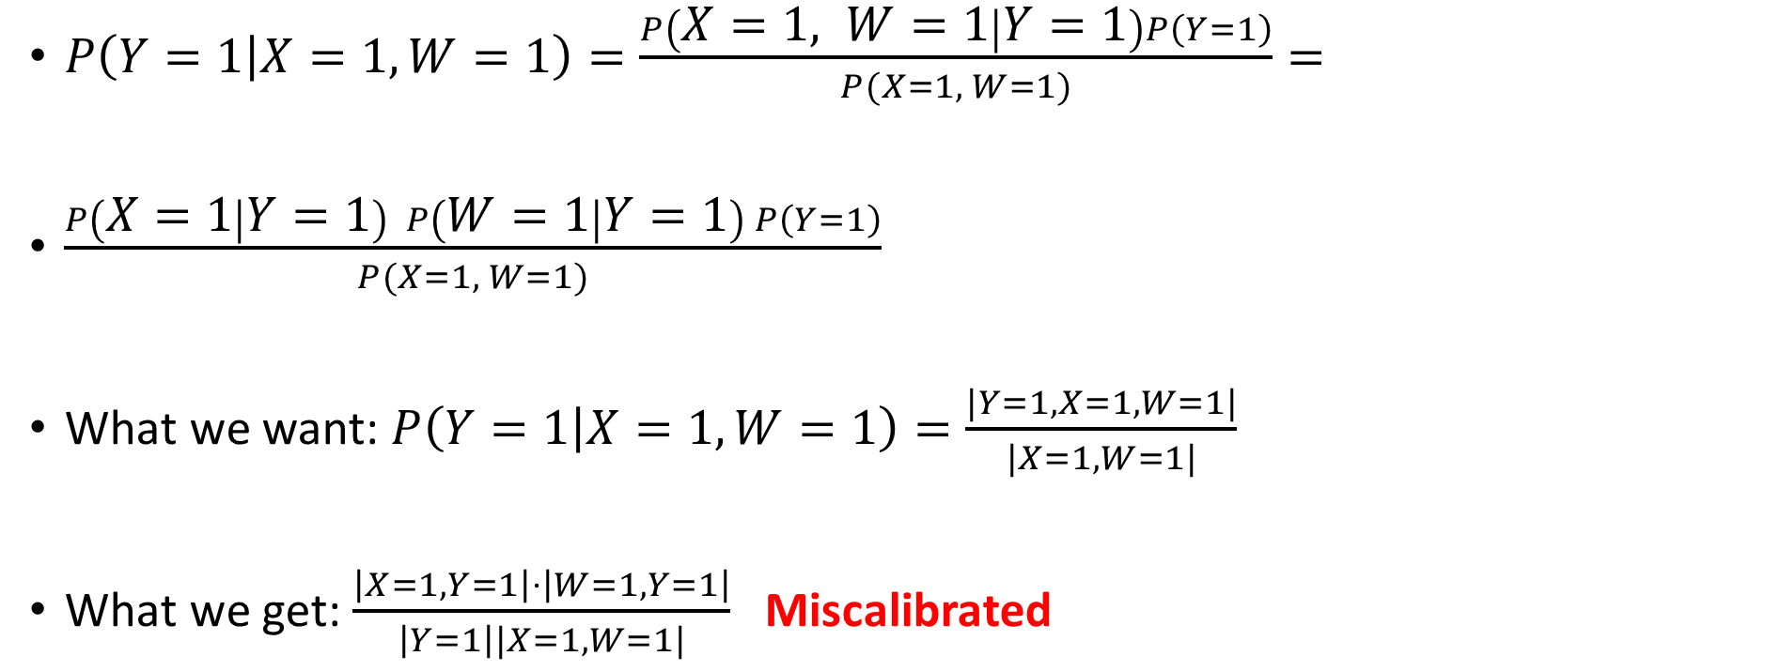
What if there are two predictors?
$P\left(Y=1 | X=1, W=1\right)=\frac{P\left(X=1, W=1 | Y=1\right)P\left(Y=1\right)}{P(X=1, W=1)}=$
$\frac{P\left(X=1 | Y=1\right) P\left(W=1 | Y=1\right) P\left(Y=1\right)}{P(X=1, W=1)}$
What we want: $P\left(Y=1 | X=1, W=1\right)=\frac{|Y=1, X=1, W=1|}{|X=1,W=1|}$
What we get: $\frac{\left|X=1, Y=1\right|⋅\left|W=1, Y=1\right|}{\left|Y=1\right||X=1,W=1|}$ Miscalibrated

Slide 25
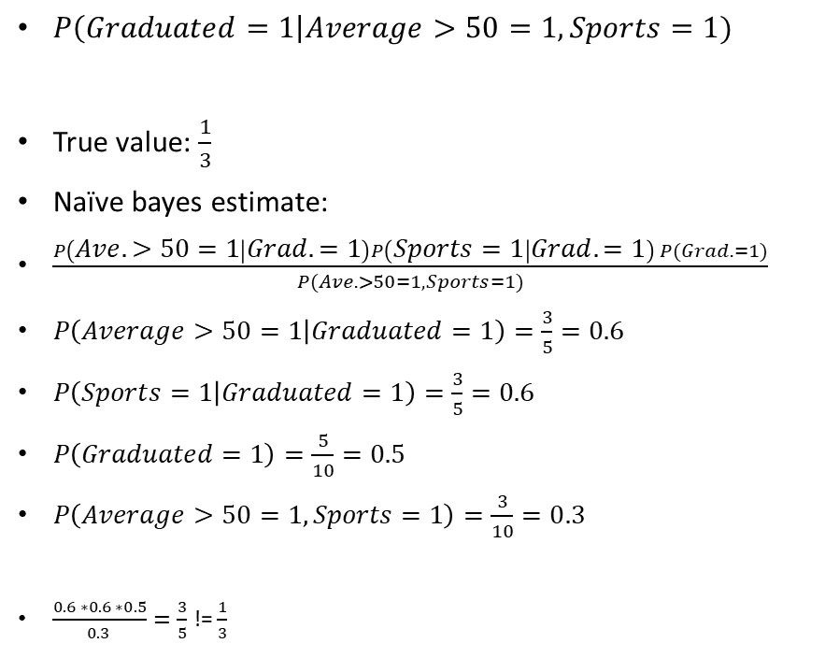
An example of miscalibration
$P\left(Graduated=1\right|Average>50=1, Sports=1)$
True value: $\frac{1}{3}$
Naïve bayes estimate:
$\frac{P\left(Ave.>50=1 | Grad.=1\right)P\left(Sports=1 | Grad.=1\right) P(Grad.=1)}{P(Ave.>50=1, Sports=1)}$
$P\left(Average>50=1 | Graduated=1\right)=\frac{3}{5}=0.6$
$P\left(Sports=1 | Graduated=1\right)=\frac{3}{5}=0.6$
$P\left(Graduated=1\right)=\frac{5}{10}=0.5$
$P\left(Average>50=1, Sports=1\right)=\frac{3}{10}=0.3$
$\frac{0.6 ∗0.6 ∗0.5}{0.3 }=\frac{3}{5}$ != $\frac{1}{3}$
Graduated | Average > 50 | Sports
1 | 0 | 1
0 | 0 | 0
0 | 0 | 1
1 | 1 | 1
0 | 0 | 0
0 | 1 | 1
1 | 1 | 0
1 | 1 | 0
1 | 0 | 1
0 | 1 | 1

Slide 26

So Why Make the CI Assumption?
Two binary predictors: $X_{1},X_{2}$

Slide 27

So Why Make the CI Assumption?
Two binary predictors: $X_{1},X_{2}$
Want to estimate: $P(Y|X_{1},X_{2})$

Slide 28

So Why Make the CI Assumption?
Two binary predictors: $X_{1},X_{2}$
Want to estimate: $P\left(Y | X_{1},X_{2}\right)$
How many combinations could we possibly see?

Slide 29
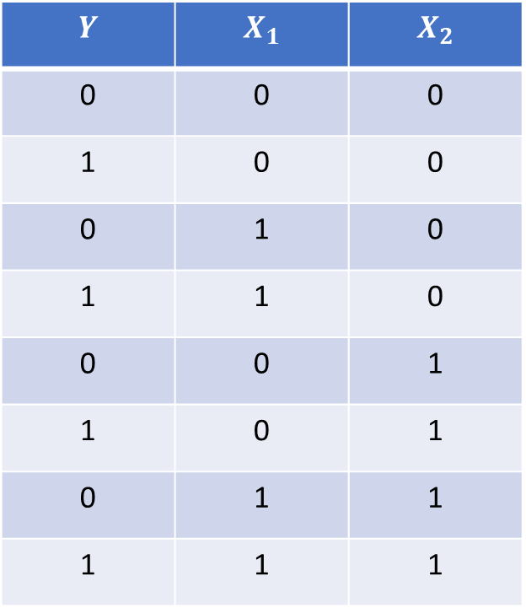

So Why Make the CI Assumption?
Two binary predictors: $X_{1},X_{2}$
Want to estimate: $P\left(Y | X_{1},X_{2}\right)$
How many unique ways can $X_{1}, X_{2},$ and $Y$ appear together?
$$Y$$ | $$X_{1}$$ | $$X_{2}$$
0 | 0 | 0
1 | 0 | 0
0 | 1 | 0
1 | 1 | 0
0 | 0 | 1
1 | 0 | 1
0 | 1 | 1
1 | 1 | 1

Slide 30

So Why Make the CI Assumption?
Two binary predictors: $X_{1},X_{2}$
Want to estimate: $P\left(Y | X_{1},X_{2}\right)$
Since all three variables take on 2 values, there are 8 possibilities
$$Y$$ | $$X_{1}$$ | $$X_{2}$$
0 | 0 | 0
1 | 0 | 0
0 | 1 | 0
1 | 1 | 0
0 | 0 | 1
1 | 0 | 1
0 | 1 | 1
1 | 1 | 1

Slide 31
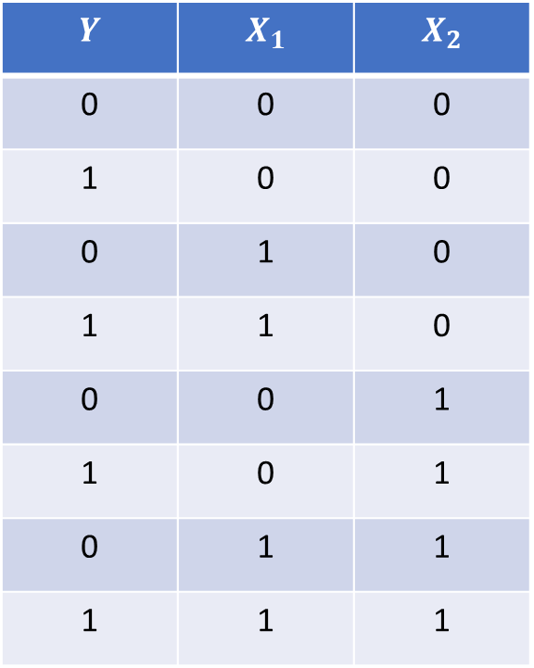

So Why Make the CI Assumption?
Compare:
$P(X_{1},X_{2}|Y)$ vs $P\left(X_{1} | Y\right)P\left(X_{2} | Y\right)$
$$Y$$ | $$X_{1}$$ | $$X_{2}$$
0 | 0 | 0
1 | 0 | 0
0 | 1 | 0
1 | 1 | 0
0 | 0 | 1
1 | 0 | 1
0 | 1 | 1
1 | 1 | 1

Slide 32
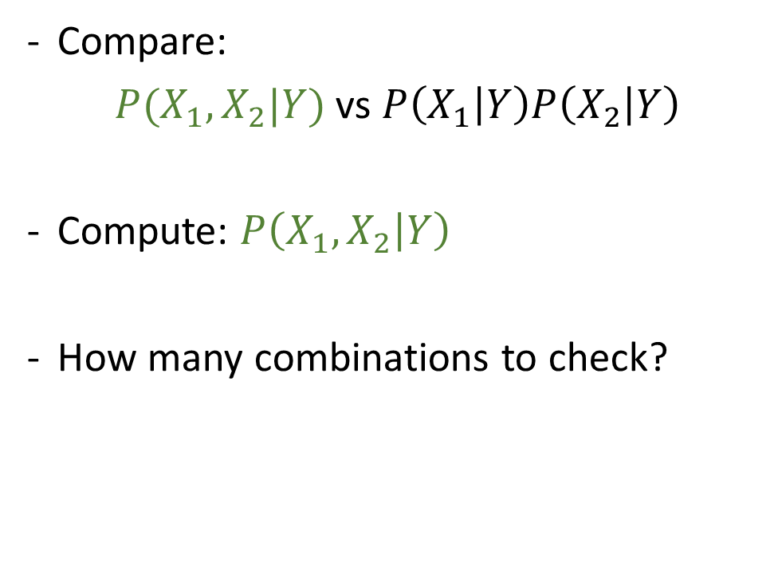
So Why Make the CI Assumption?
Compare:
$P(X_{1},X_{2}|Y)$ vs $P\left(X_{1} | Y\right)P\left(X_{2} | Y\right)$
Compute: $P\left(X_{1},X_{2} | Y\right)$
How many combinations to check?
$$Y$$ | $$X_{1}$$ | $$X_{2}$$
0 | 0 | 0
1 | 0 | 0
0 | 1 | 0
1 | 1 | 0
0 | 0 | 1
1 | 0 | 1
0 | 1 | 1
1 | 1 | 1

Slide 33
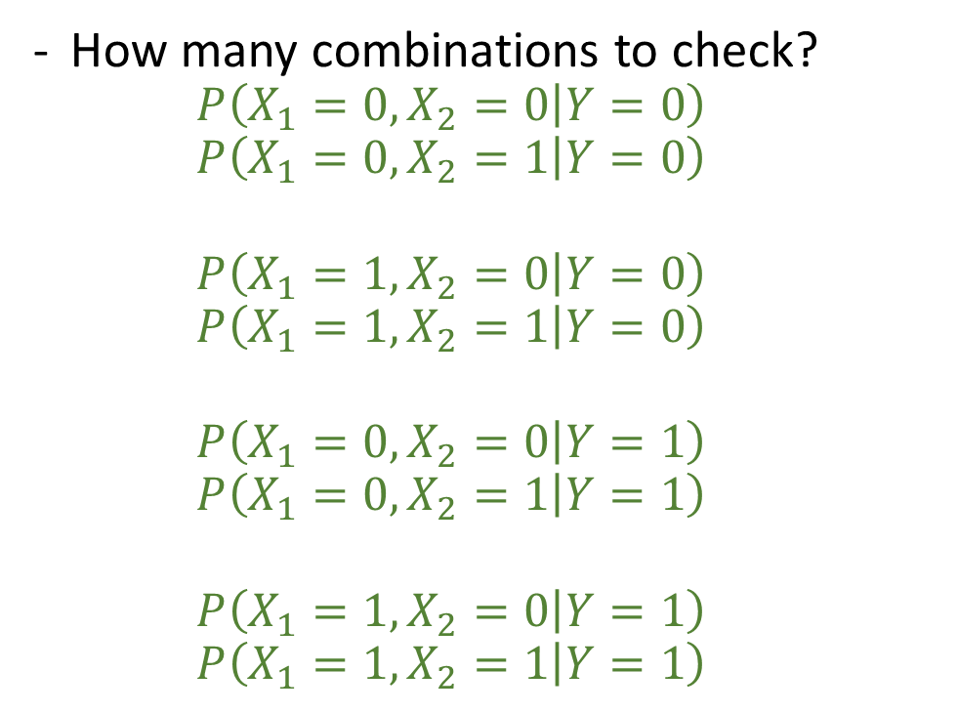
So Why Make the CI Assumption?
How many combinations to check?
$$P\left(X_{1}=0,X_{2}=0 | Y=0\right)$$
$$P\left(X_{1}=0,X_{2}=1 | Y=0\right)$$
$$P\left(X_{1}=1,X_{2}=0 | Y=0\right)$$
$$P\left(X_{1}=1,X_{2}=1 | Y=0\right)$$
$$P\left(X_{1}=0,X_{2}=0 | Y=1\right)$$
$$P\left(X_{1}=0,X_{2}=1 | Y=1\right)$$
$$P\left(X_{1}=1,X_{2}=0 | Y=1\right)$$
$$P\left(X_{1}=1,X_{2}=1 | Y=1\right)$$
$$Y$$ | $$X_{1}$$ | $$X_{2}$$
0 | 0 | 0
1 | 0 | 0
0 | 1 | 0
1 | 1 | 0
0 | 0 | 1
1 | 0 | 1
0 | 1 | 1
1 | 1 | 1

Slide 34

So Why Make the CI Assumption?
Compare:
$P(X_{1},X_{2}|Y)$ vs $P\left(X_{1} | Y\right)P\left(X_{2} | Y\right)$
Compute: $P\left(X_{1},X_{2} | Y\right)$
How many combinations to check? 8
$$Y$$ | $$X_{1}$$ | $$X_{2}$$
0 | 0 | 0
1 | 0 | 0
0 | 1 | 0
1 | 1 | 0
0 | 0 | 1
1 | 0 | 1
0 | 1 | 1
1 | 1 | 1

Slide 35

So Why Make the CI Assumption?
Compare:
$P(X_{1},X_{2}|Y)$ vs $P\left(X_{1} | Y\right)P\left(X_{2} | Y\right)$
Compute: $P\left(X_{1} | Y\right)P(X_{2}|Y)$
$$Y$$ | $$X_{1}$$ | $$X_{2}$$
0 | 0 | 0
1 | 0 | 0
0 | 1 | 0
1 | 1 | 0
0 | 0 | 1
1 | 0 | 1
0 | 1 | 1
1 | 1 | 1

Slide 36
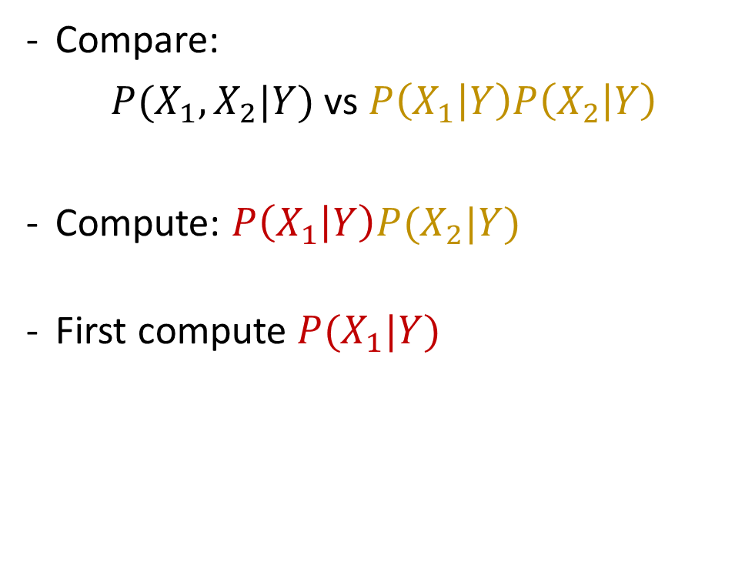
So Why Make the CI Assumption?
Compare:
$P(X_{1},X_{2}|Y)$ vs $P\left(X_{1} | Y\right)P\left(X_{2} | Y\right)$
Compute: $P\left(X_{1} | Y\right)P(X_{2}|Y)$
First compute $P(X_{1}|Y)$
$$Y$$ | $$X_{1}$$ | $$X_{2}$$
0 | 0 | 0
1 | 0 | 0
0 | 1 | 0
1 | 1 | 0
0 | 0 | 1
1 | 0 | 1
0 | 1 | 1
1 | 1 | 1

Slide 37
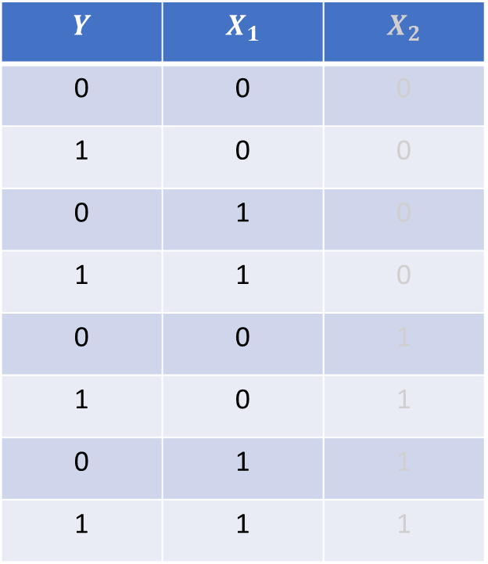

So Why Make the CI Assumption?
How many combinations?
$$P(X_{1}=0|Y=0)$$
$$P(X_{1}=1|Y=0)$$
$$P(X_{1}=0|Y=1)$$
$$P(X_{1}=1|Y=1)$$
$$Y$$ | $$X_{1}$$ | $$X_{2}$$
0 | 0 | 0
1 | 0 | 0
0 | 1 | 0
1 | 1 | 0
0 | 0 | 1
1 | 0 | 1
0 | 1 | 1
1 | 1 | 1

Slide 38
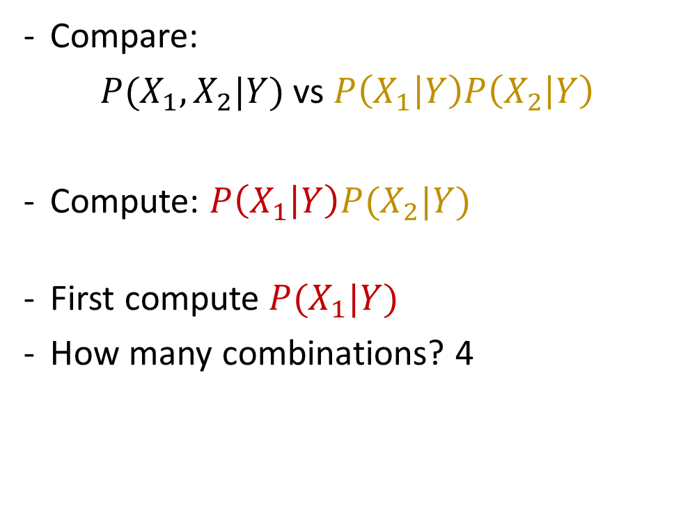
So Why Make the CI Assumption?
Compare:
$P(X_{1},X_{2}|Y)$ vs $P\left(X_{1} | Y\right)P\left(X_{2} | Y\right)$
Compute: $P\left(X_{1} | Y\right)P(X_{2}|Y)$
First compute $P(X_{1}|Y)$
How many combinations? 4
$$Y$$ | $$X_{1}$$ | $$X_{2}$$
0 | 0 | 0
1 | 0 | 0
0 | 1 | 0
1 | 1 | 0
0 | 0 | 1
1 | 0 | 1
0 | 1 | 1
1 | 1 | 1

Slide 39
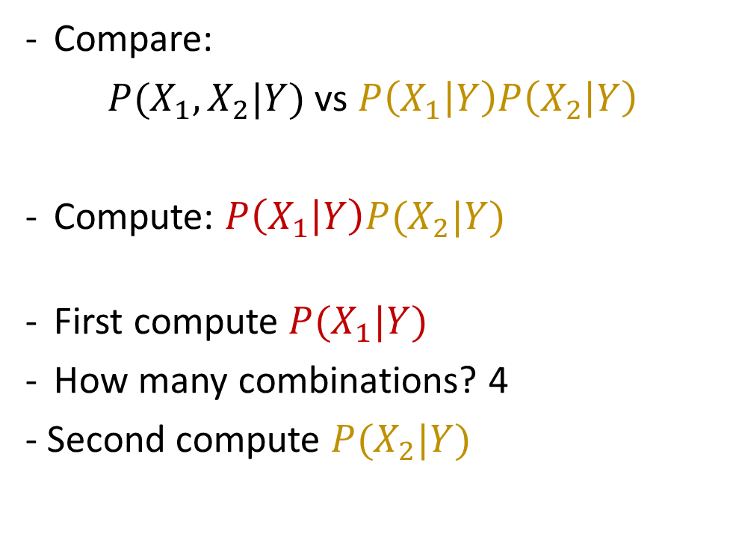
So Why Make the CI Assumption?
Compare:
$P(X_{1},X_{2}|Y)$ vs $P\left(X_{1} | Y\right)P\left(X_{2} | Y\right)$
Compute: $P\left(X_{1} | Y\right)P(X_{2}|Y)$
First compute $P(X_{1}|Y)$
How many combinations? 4
- Second compute $P(X_{2}|Y)$
$$Y$$ | $$X_{1}$$ | $$X_{2}$$
0 | 0 | 0
1 | 0 | 0
0 | 1 | 0
1 | 1 | 0
0 | 0 | 1
1 | 0 | 1
0 | 1 | 1
1 | 1 | 1

Slide 40
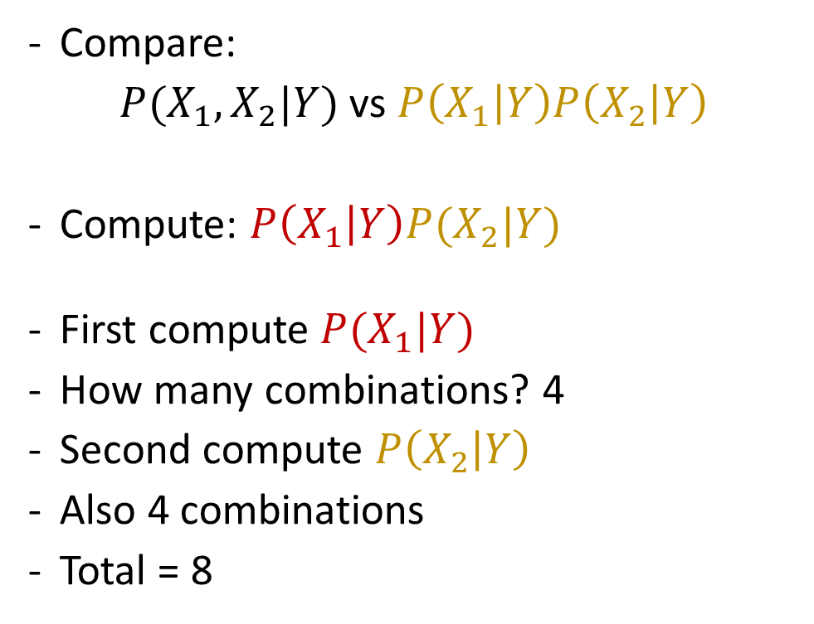
So Why Make the CI Assumption?
Compare:
$P(X_{1},X_{2}|Y)$ vs $P\left(X_{1} | Y\right)P\left(X_{2} | Y\right)$
Compute: $P\left(X_{1} | Y\right)P(X_{2}|Y)$
First compute $P(X_{1}|Y)$
How many combinations? 4
Second compute $P\left(X_{2} | Y\right)$
Also 4 combinations
Total = 8
$$Y$$ | $$X_{1}$$ | $$X_{2}$$
0 | 0 | 0
1 | 0 | 0
0 | 1 | 0
1 | 1 | 0
0 | 0 | 1
1 | 0 | 1
0 | 1 | 1
1 | 1 | 1

Slide 41
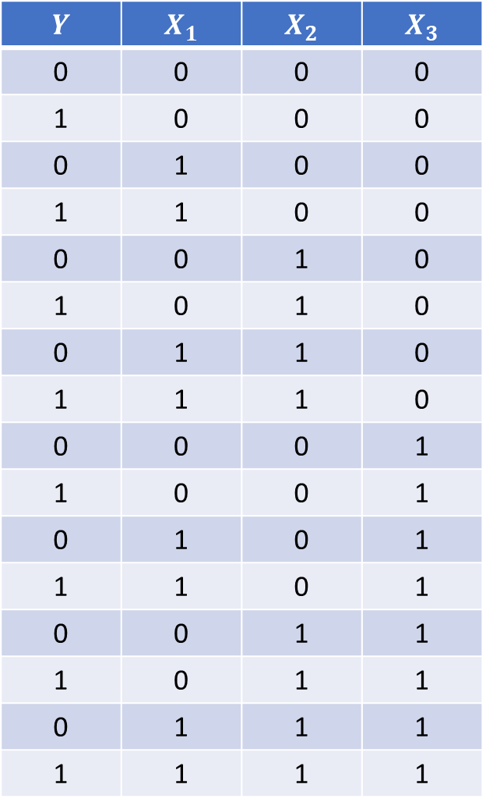

Three Predictors
$$Y$$ | $$X_{1}$$ | $$X_{2}$$ | $X_{3}$
0 | 0 | 0 | 0
1 | 0 | 0 | 0
0 | 1 | 0 | 0
1 | 1 | 0 | 0
0 | 0 | 1 | 0
1 | 0 | 1 | 0
0 | 1 | 1 | 0
1 | 1 | 1 | 0
0 | 0 | 0 | 1
1 | 0 | 0 | 1
0 | 1 | 0 | 1
1 | 1 | 0 | 1
0 | 0 | 1 | 1
1 | 0 | 1 | 1
0 | 1 | 1 | 1
1 | 1 | 1 | 1
Three binary predictors: $X_{1},X_{2},X_{3}$
Want to estimate: $P\left(Y | X_{1},X_{2},X_{3}\right)$

Slide 42

Three Predictors
$$Y$$ | $$X_{1}$$ | $$X_{2}$$ | $X_{3}$
0 | 0 | 0 | 0
1 | 0 | 0 | 0
0 | 1 | 0 | 0
1 | 1 | 0 | 0
0 | 0 | 1 | 0
1 | 0 | 1 | 0
0 | 1 | 1 | 0
1 | 1 | 1 | 0
0 | 0 | 0 | 1
1 | 0 | 0 | 1
0 | 1 | 0 | 1
1 | 1 | 0 | 1
0 | 0 | 1 | 1
1 | 0 | 1 | 1
0 | 1 | 1 | 1
1 | 1 | 1 | 1
Compare:
$P(X_{1},X_{2},X_{3}|Y)$ vs $P\left(X_{1} | Y\right)P\left(X_{2} | Y\right)P\left(X_{3} | Y\right)$

Slide 43
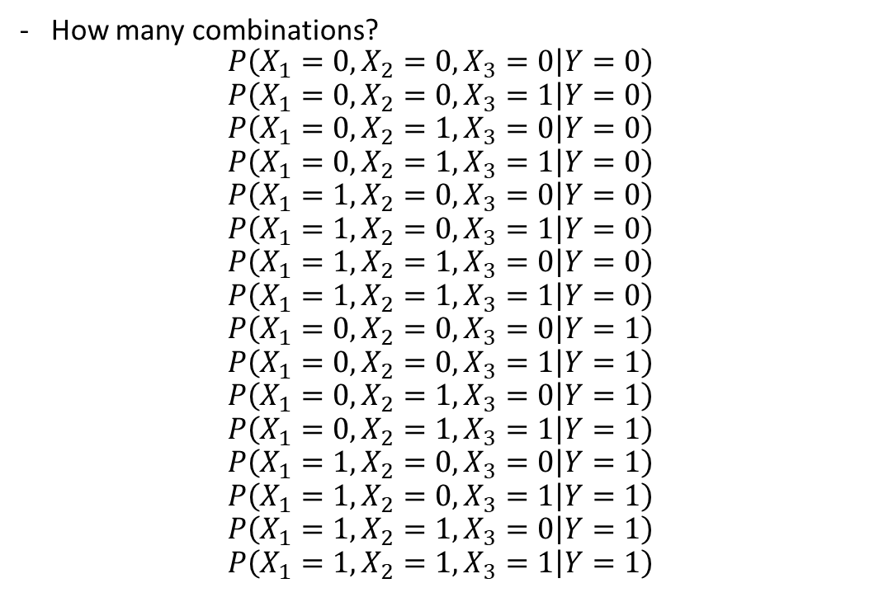
Three Predictors
$$Y$$ | $$X_{1}$$ | $$X_{2}$$ | $X_{3}$
0 | 0 | 0 | 0
1 | 0 | 0 | 0
0 | 1 | 0 | 0
1 | 1 | 0 | 0
0 | 0 | 1 | 0
1 | 0 | 1 | 0
0 | 1 | 1 | 0
1 | 1 | 1 | 0
0 | 0 | 0 | 1
1 | 0 | 0 | 1
0 | 1 | 0 | 1
1 | 1 | 0 | 1
0 | 0 | 1 | 1
1 | 0 | 1 | 1
0 | 1 | 1 | 1
1 | 1 | 1 | 1
How many combinations?
$$P\left(X_{1}=0,X_{2}=0,X_{3}=0 | Y=0\right)$$
$$P\left(X_{1}=0,X_{2}=0,X_{3}=1 | Y=0\right)$$
$$P\left(X_{1}=0,X_{2}=1,X_{3}=0 | Y=0\right)$$
$$P\left(X_{1}=0,X_{2}=1,X_{3}=1 | Y=0\right)$$
$$P\left(X_{1}=1,X_{2}=0,X_{3}=0 | Y=0\right)$$
$$P\left(X_{1}=1,X_{2}=0,X_{3}=1 | Y=0\right)$$
$$P\left(X_{1}=1,X_{2}=1,X_{3}=0 | Y=0\right)$$
$$P\left(X_{1}=1,X_{2}=1,X_{3}=1 | Y=0\right)$$
$$P\left(X_{1}=0,X_{2}=0,X_{3}=0 | Y=1\right)$$
$$P\left(X_{1}=0,X_{2}=0,X_{3}=1 | Y=1\right)$$
$$P\left(X_{1}=0,X_{2}=1,X_{3}=0 | Y=1\right)$$
$$P\left(X_{1}=0,X_{2}=1,X_{3}=1 | Y=1\right)$$
$$P\left(X_{1}=1,X_{2}=0,X_{3}=0 | Y=1\right)$$
$$P\left(X_{1}=1,X_{2}=0,X_{3}=1 | Y=1\right)$$
$$P\left(X_{1}=1,X_{2}=1,X_{3}=0 | Y=1\right)$$
$$P\left(X_{1}=1,X_{2}=1,X_{3}=1 | Y=1\right)$$

Slide 44

Three Predictors
$$Y$$ | $$X_{1}$$ | $$X_{2}$$ | $X_{3}$
0 | 0 | 0 | 0
1 | 0 | 0 | 0
0 | 1 | 0 | 0
1 | 1 | 0 | 0
0 | 0 | 1 | 0
1 | 0 | 1 | 0
0 | 1 | 1 | 0
1 | 1 | 1 | 0
0 | 0 | 0 | 1
1 | 0 | 0 | 1
0 | 1 | 0 | 1
1 | 1 | 0 | 1
0 | 0 | 1 | 1
1 | 0 | 1 | 1
0 | 1 | 1 | 1
1 | 1 | 1 | 1
Compare:
$P(X_{1},X_{2},X_{3}|Y)$ vs $P\left(X_{1} | Y\right)P\left(X_{2} | Y\right)P\left(X_{3} | Y\right)$
Total combinations for $P\left(X_{1},X_{2},X_{3} | Y\right)=16$

Slide 45
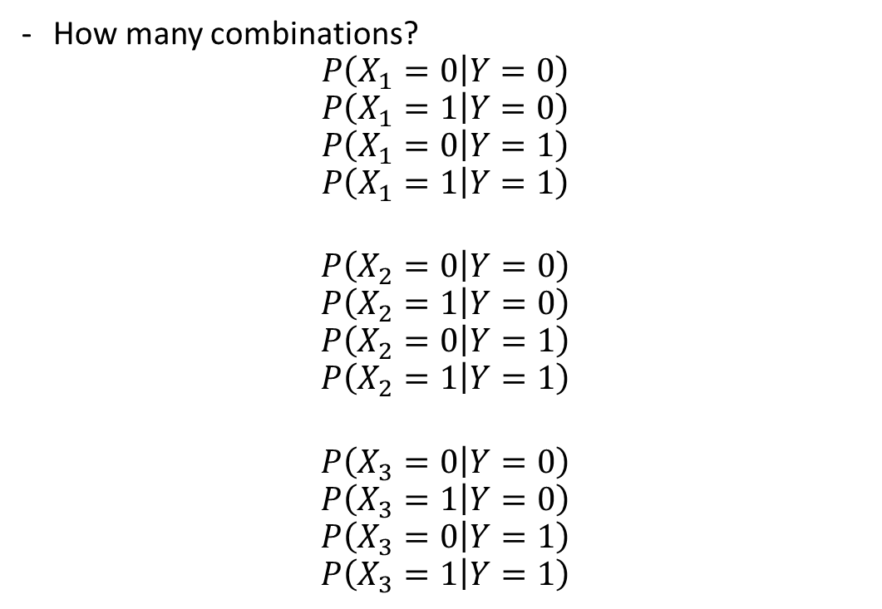
Three Predictors
$$Y$$ | $$X_{1}$$ | $$X_{2}$$ | $X_{3}$
0 | 0 | 0 | 0
1 | 0 | 0 | 0
0 | 1 | 0 | 0
1 | 1 | 0 | 0
0 | 0 | 1 | 0
1 | 0 | 1 | 0
0 | 1 | 1 | 0
1 | 1 | 1 | 0
0 | 0 | 0 | 1
1 | 0 | 0 | 1
0 | 1 | 0 | 1
1 | 1 | 0 | 1
0 | 0 | 1 | 1
1 | 0 | 1 | 1
0 | 1 | 1 | 1
1 | 1 | 1 | 1
How many combinations?
$$P\left(X_{1}=0 | Y=0\right)$$
$$P\left(X_{1}=1 | Y=0\right)$$
$$P\left(X_{1}=0 | Y=1\right)$$
$$P\left(X_{1}=1 | Y=1\right)$$
$$P\left(X_{2}=0 | Y=0\right)$$
$$P\left(X_{2}=1 | Y=0\right)$$
$$P\left(X_{2}=0 | Y=1\right)$$
$$P\left(X_{2}=1 | Y=1\right)$$
$$P\left(X_{3}=0 | Y=0\right)$$
$$P\left(X_{3}=1 | Y=0\right)$$
$$P\left(X_{3}=0 | Y=1\right)$$
$$P\left(X_{3}=1 | Y=1\right)$$

Slide 46
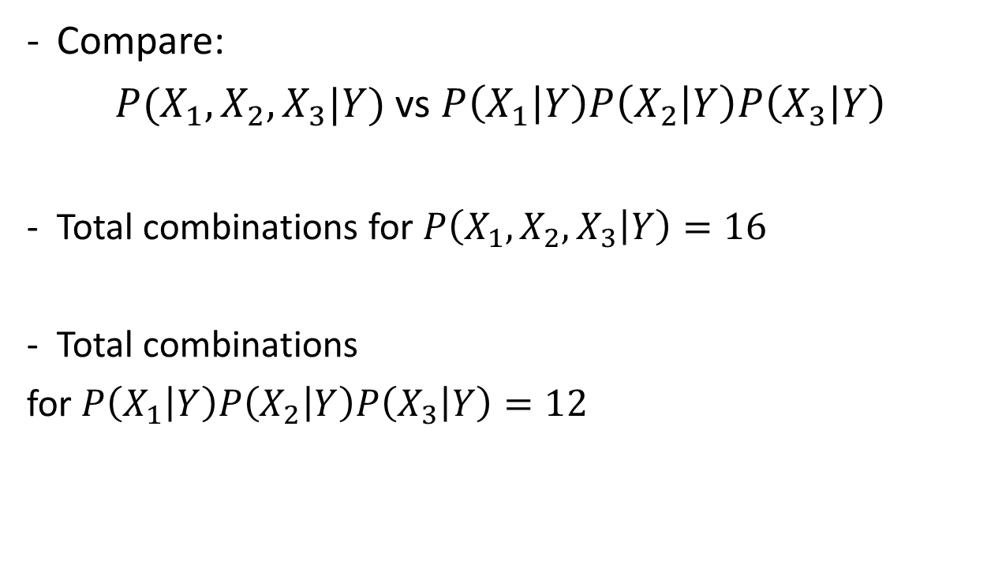
Three Predictors
$$Y$$ | $$X_{1}$$ | $$X_{2}$$ | $X_{3}$
0 | 0 | 0 | 0
1 | 0 | 0 | 0
0 | 1 | 0 | 0
1 | 1 | 0 | 0
0 | 0 | 1 | 0
1 | 0 | 1 | 0
0 | 1 | 1 | 0
1 | 1 | 1 | 0
0 | 0 | 0 | 1
1 | 0 | 0 | 1
0 | 1 | 0 | 1
1 | 1 | 0 | 1
0 | 0 | 1 | 1
1 | 0 | 1 | 1
0 | 1 | 1 | 1
1 | 1 | 1 | 1
Compare:
$P(X_{1},X_{2},X_{3}|Y)$ vs $P\left(X_{1} | Y\right)P\left(X_{2} | Y\right)P\left(X_{3} | Y\right)$
Total combinations for $P\left(X_{1},X_{2},X_{3} | Y\right)=16$
Total combinations
for $P\left(X_{1} | Y\right)P\left(X_{2} | Y\right)P\left(X_{3} | Y\right)=12$

Slide 47

Formula For This
(When everything is binary valued --- can be either 0 or 1)
If we don’t assume conditional independence, then
Number of combinations as a function of the number of predictors + outcome:
$2^{(Number of predictors+1)}$

Slide 48
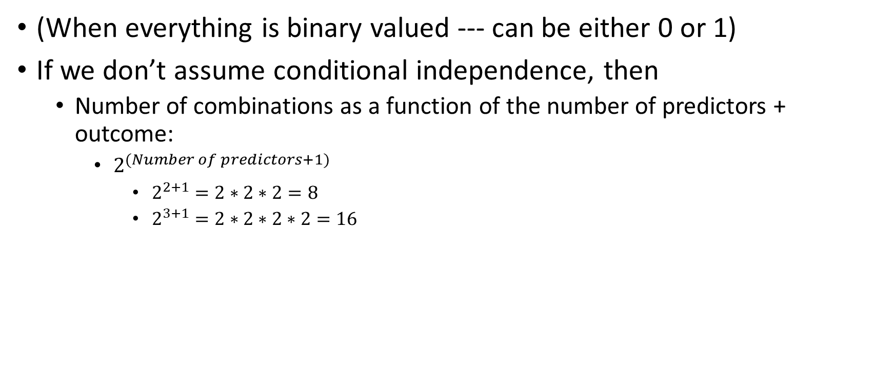
Formula For This
(When everything is binary valued --- can be either 0 or 1)
If we don’t assume conditional independence, then
Number of combinations as a function of the number of predictors + outcome:
$2^{(Number of predictors+1)}$
$2^{2+1}=2∗2∗2=8$
$2^{3+1}=2∗2∗2∗2=16$

Slide 49
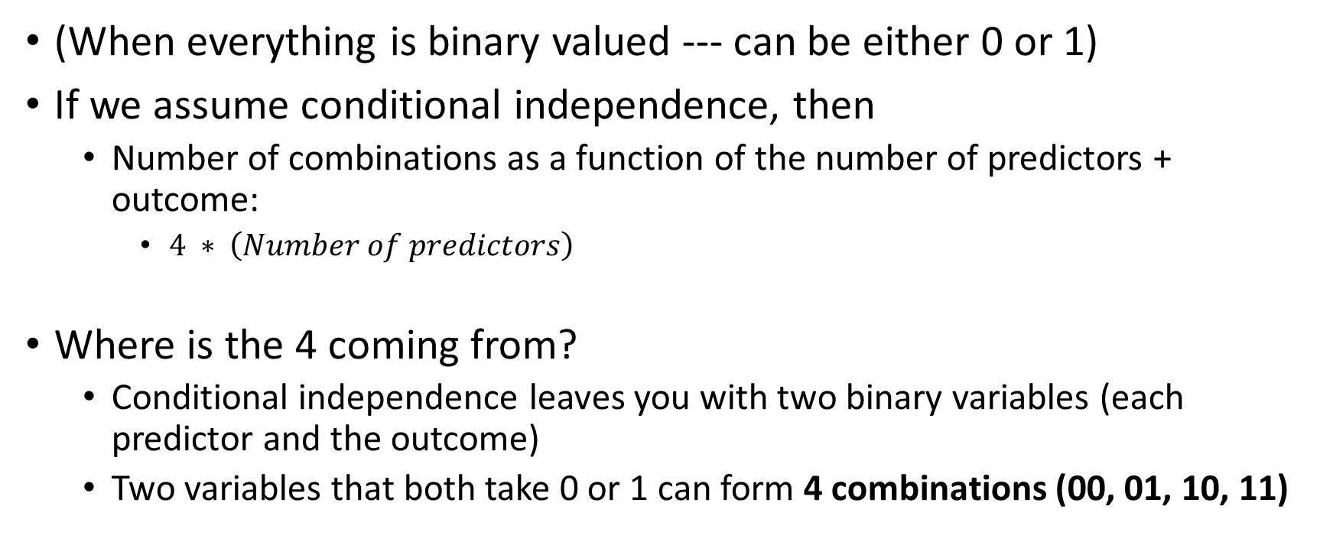
Formula For This
(When everything is binary valued --- can be either 0 or 1)
If we assume conditional independence, then
Number of combinations as a function of the number of predictors + outcome:
$4 ∗ \left(Number of predictors\right)$
Where is the 4 coming from?
Conditional independence leaves you with two binary variables (each predictor and the outcome)
Two variables that both take 0 or 1 can form 4 combinations (00, 01, 10, 11)

Slide 50

Formula For This
(When everything is binary valued --- can be either 0 or 1)
If we assume conditional independence, then
Number of combinations as a function of the number of predictors + outcome:
$4 ∗ \left(Number of predictors\right)$

Slide 51
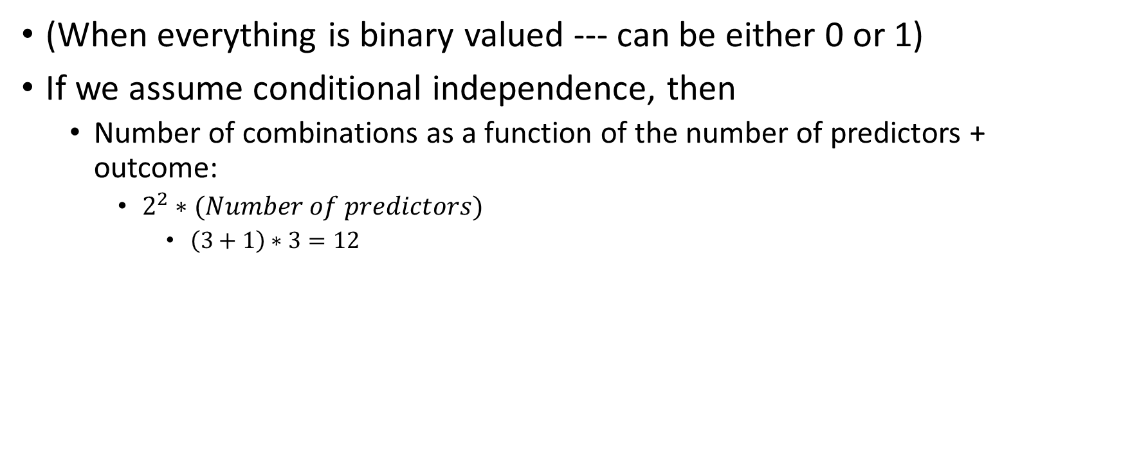
Formula For This
(When everything is binary valued --- can be either 0 or 1)
If we assume conditional independence, then
Number of combinations as a function of the number of predictors + outcome:
$2^{2}∗(Number of predictors)$
$\left(3+1\right)∗3=12$

Slide 52

N Binary Predictors, Binary Outcome
Let N be the number of binary (0/1) predictors.
Without the conditional independence assumption:
Number of combinations: $2^{N}$
With conditional independence assumption:
Number of combinations: $4 ⋅N$

Slide 53

N Binary Predictors, Binary Outcome
Without the conditional independence assumption (CIA):
Number of combinations: $2^{N}$
With conditional independence assumption:
Number of combinations: $4 ⋅N$
If $N=100$
W/O CIA: 10 Quintillion: $10,000,000,000,000,000,000,000,000,000,000$
W/ CIA: $400$

