Slide 1
INST 414: Data Science Techniques Random Forest

Slide 2
Overfitting + Decision Trees

Slide 3
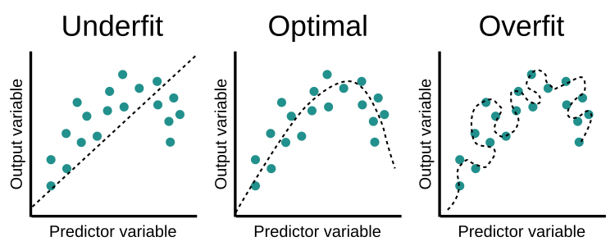
Overfitting/Underfitting

Slide 4
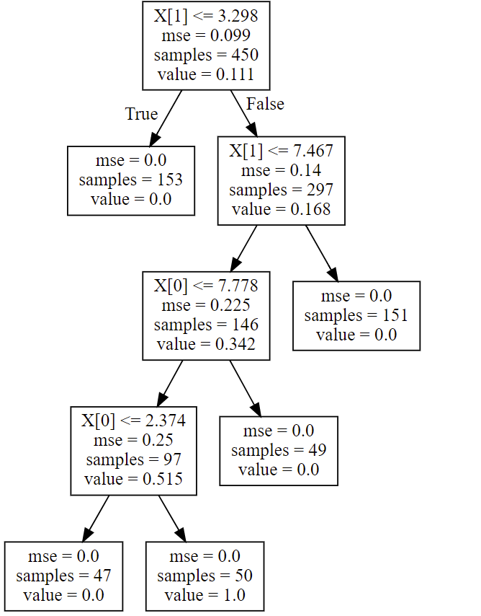
Pros + Cons of Trees
Advantages:
Automatically detect interactions
Easy to explain
Handle both categorical and numeric features
No need to rescale
Disadvantages:
Tend to be outperformed by other methods
Brittle
Can’t extrapolate

Slide 5
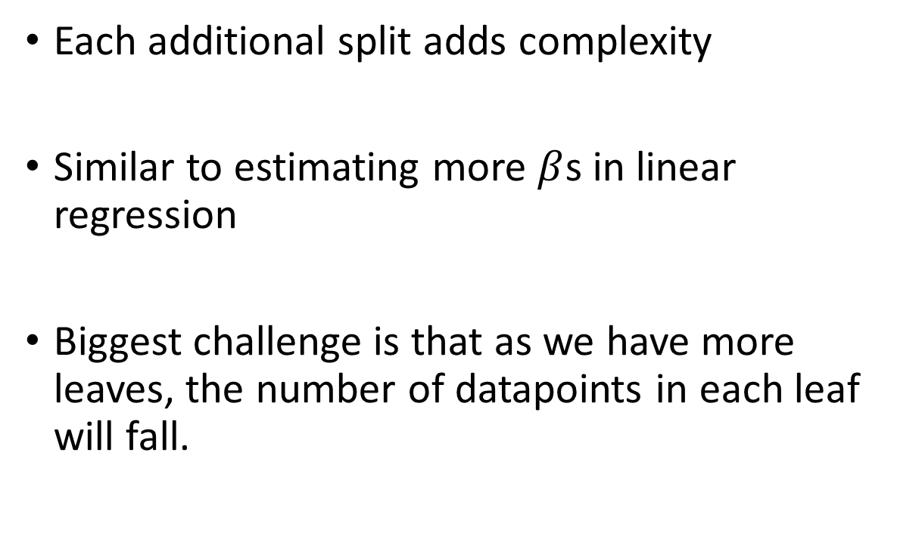
Why Do Decision Trees Tend to Overfit?
Each additional split adds complexity
Similar to estimating more $β$s in linear regression
Biggest challenge is that as we have more leaves, the number of datapoints in each leaf will fall.

Slide 6
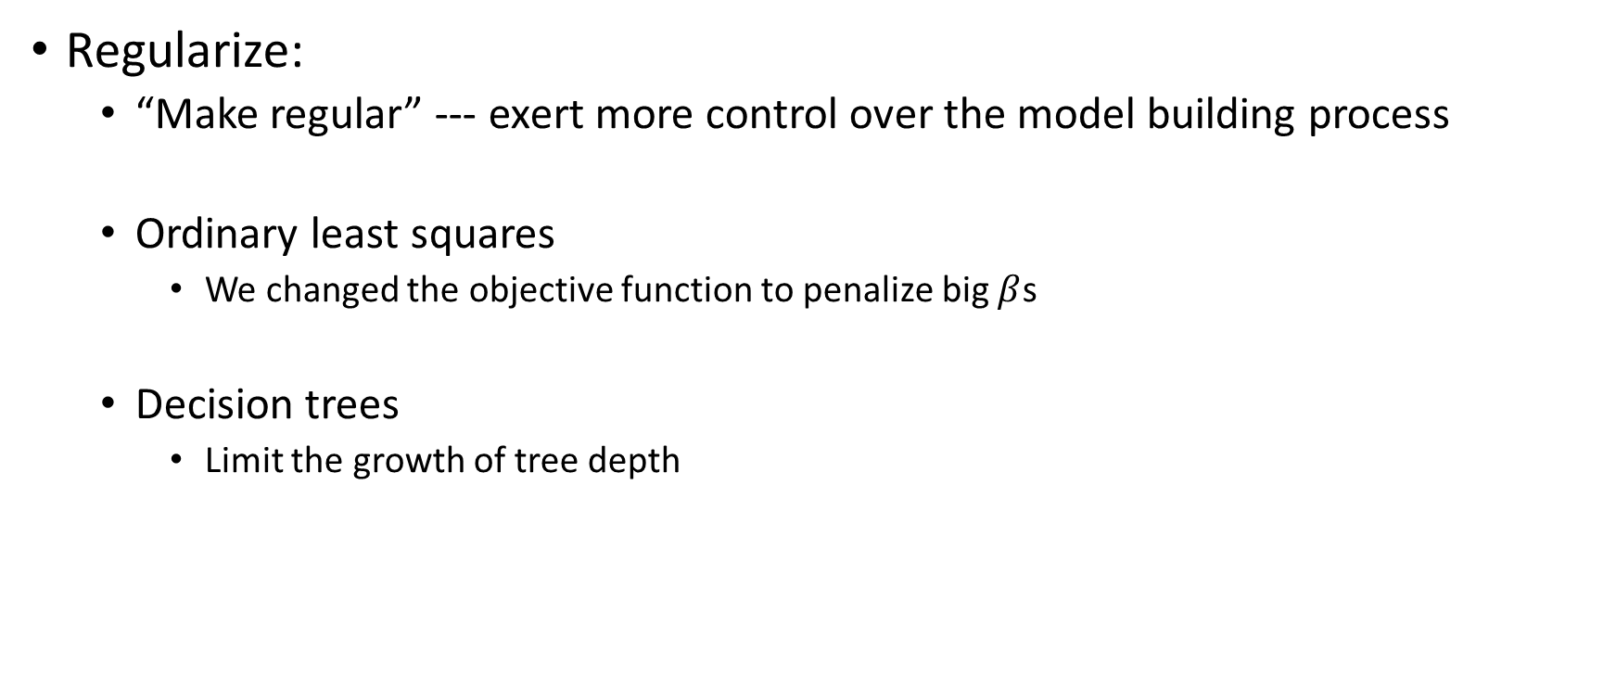
How Do We Reduce/Prevent Over-fitting?
Regularize:
“Make regular” --- exert more control over the model building process
Ordinary least squares
We changed the objective function to penalize big $β$s
Decision trees
Limit the growth of tree depth

Slide 7
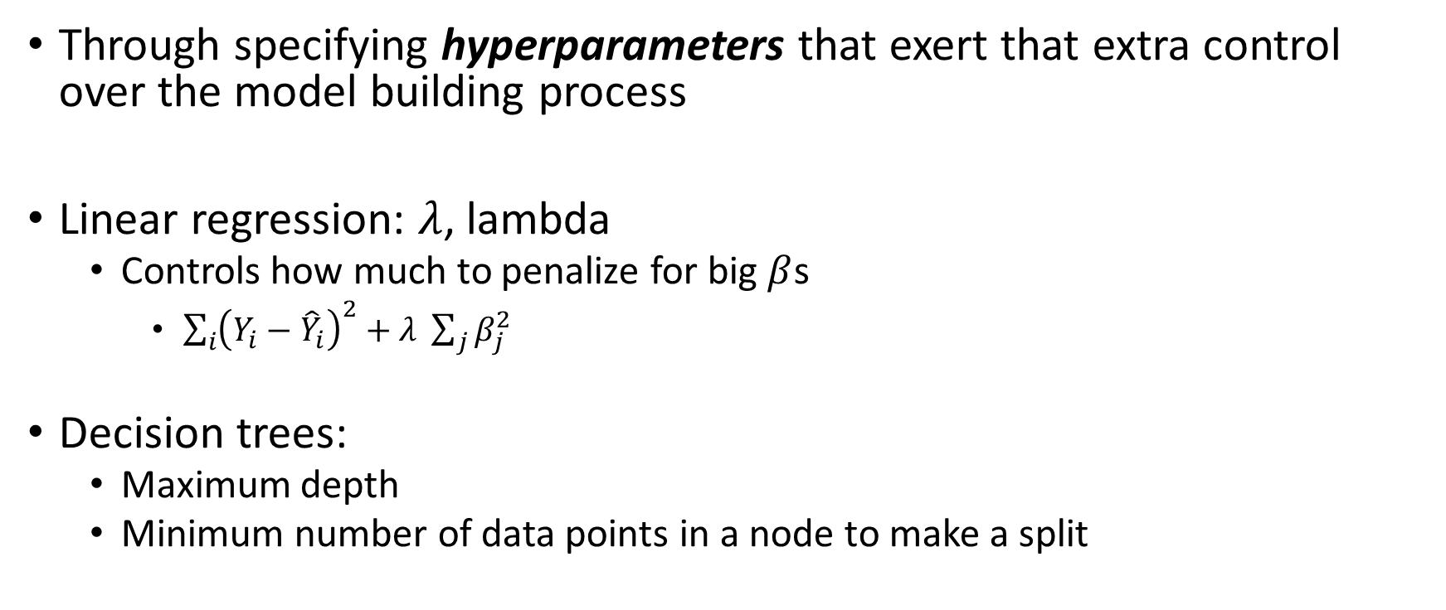
How Do We Regularize
Through specifying hyperparameters that exert that extra control over the model building process
Linear regression: $λ$, lambda
Controls how much to penalize for big $β$s
$\sum_{i}{{\left(Y_{i}−{\hat{Y}}_{i}\right)}^{2}}+λ \sum_{j}{β_{j}^{2}}$
Decision trees:
Maximum depth
Minimum number of data points in a node to make a split

Slide 8
Bias-Variance Tradeoff for Decision Trees
Setup: Run many models with different samples. Look at the predictions across models.
High bias: On average, the predictions are systematically different from the true values
High variance: On average, get very different predictions for the same data point

Slide 9
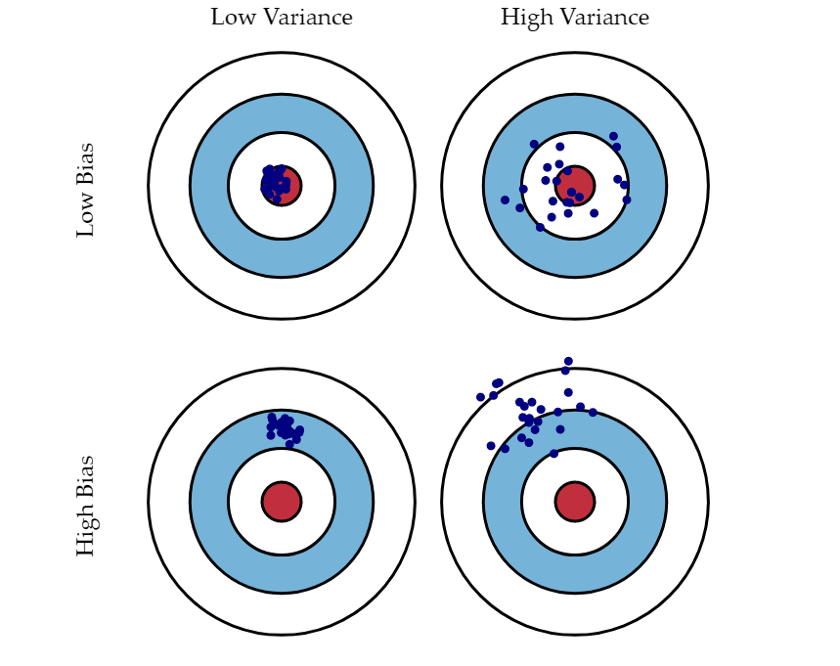
Bias-Variance Tradeoff
Source

Slide 10
Random Forest

Slide 11
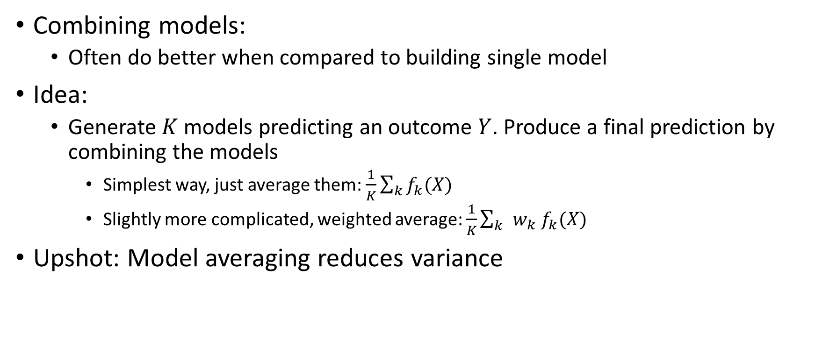
Reducing Variance via Ensemble Learning
Combining models:
Often do better when compared to building single model
Idea:
Generate $K$ models predicting an outcome $Y$. Produce a final prediction by combining the models
Simplest way, just average them: $\frac{1}{K}\sum_{k}{f_{k}(X)}$
Slightly more complicated, weighted average: $\frac{1}{K}\sum_{k }{w_{k} f_{k}(X)}$
Upshot: Model averaging reduces variance

Slide 12
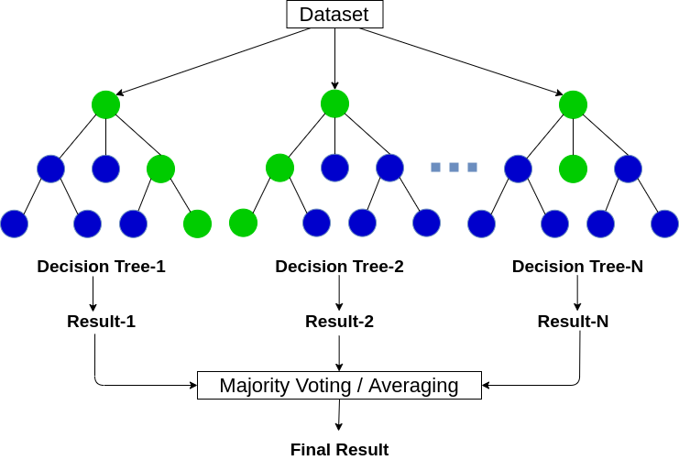
Applying This Idea to Decision Trees
Build many trees and average their predictions
BUT, we only have one dataset, so how do we prevent each tree from being identical?
Introduce some randomness

Slide 13
Bagging
Randomness 1
When building each tree take a bootstrap sample of all datapoints
A bootstrap sample will be the same size as the original sample, but we are sampling with replacement.
Example:
[1, 4, 5, 7]
Bootstrap Sample 1: [1, 1, 5, 7]
Bootstrap Sample 2: [1, 4, 5, 7]
Bootstrap Sample 3: [1, 1, 1, 1]

Slide 14
Bootstrap
Same data points will show up more than once
On average, a data point will be in 2/3rd of trees
Notice that there are datapoints that are not in a particular tree
These are called Out of Bag (OOB)
You can use OOB data points to obtain out of sample performance estimates
Alternative to Cross-Validation

Slide 15
Randomness 2
At each node sample some proportion of the features.
A commonly used proportion is the square root of the number of features, but you can treat this value as a hyperparameter
Upshot: You are not considering EACH FEATURE at EACH SPLIT

Slide 16
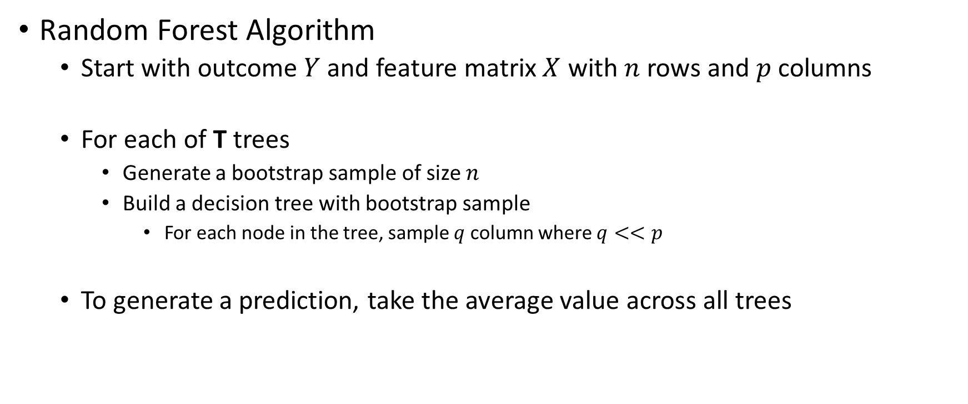
Putting It All Together
Random Forest Algorithm
Start with outcome $Y$ and feature matrix $X$ with $n$ rows and $p$ columns
For each of T trees
Generate a bootstrap sample of size $n$
Build a decision tree with bootstrap sample
For each node in the tree, sample $q$ column where $q<<p$
To generate a prediction, take the average value across all trees

Slide 17
Hyperparameters in Random Forest
Specific to Random Forest
Number of trees
Percentage of columns to sample for each node
Common with Decision Tree
Max depth for each tree
Minimum samples for splitting
Minimum samples in leaf
There are hyperparameters but these are the most commonly tuned

Slide 18
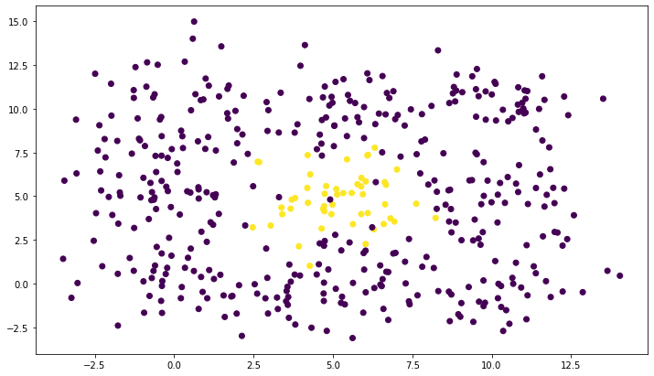



Compare Decision Tree to Random Forest
N = 450
Y = 1, 50
Base Rate = $\frac{50}{450}=\frac{1}{9}$
$$X_{2}$$
$$X_{1}$$

Slide 19
Stumps
Stumps are trees that only split once
Can’t model interactions
Compare a decision stump
With a forest of stumps

Slide 20
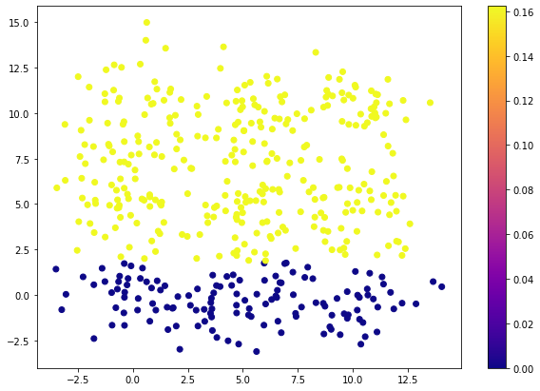


Under-fitting with a Decision Stump
$$X_{2}$$
$$X_{1}$$

Slide 21
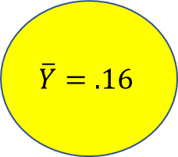
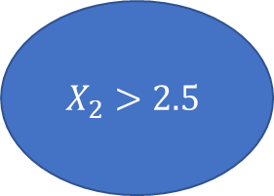
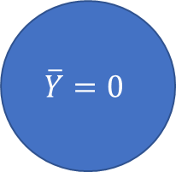
Decision Stump Model
$$X_{2}>2.5$$
True
False
$$\overline{Y}=.16$$
$$\overline{Y}=0$$

Slide 22
Average Underfit Stumps w/ Random Forest

Slide 23
7.5
2.5
2.5
7.5

Slide 24
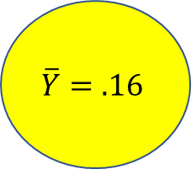
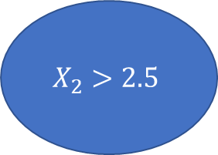
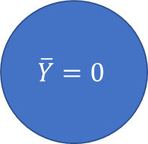
$$X_{2}>2.5$$
7.5
True
False
2.5
$$\overline{Y}=.16$$
$$\overline{Y}=0$$
2.5
7.5

Slide 25

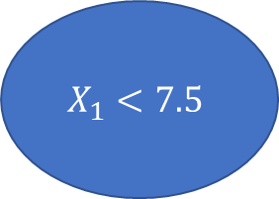

$$X_{1}<7.5$$
7.5
True
False
2.5
$$\overline{Y}=.16$$
$$\overline{Y}=0$$
2.5
7.5

Slide 26

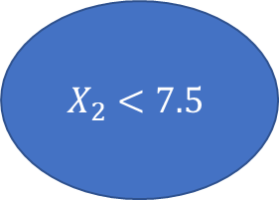

$$X_{2}<7.5$$
7.5
True
False
$$\overline{Y}=.16$$
$$\overline{Y}=0$$
2.5
2.5
7.5

Slide 27
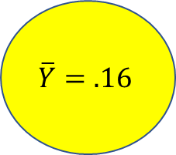
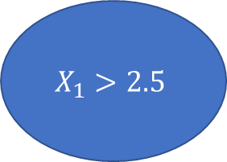
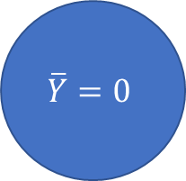
$$X_{1}>2.5$$
7.5
True
False
$$\overline{Y}=.16$$
$$\overline{Y}=0$$
2.5
2.5
7.5

Slide 28
7.5
7.5
2.5
2.5
2.5
7.5
2.5
7.5
7.5
7.5
2.5
2.5
2.5
7.5
2.5
7.5

Slide 29
2
3
2
How often does a region fall in True branch of a split?
7.5
3
4
3
2.5
2
3
2
2.5
7.5

Slide 30
50%
75%
50%
How often does a region fall in True branch of a split?
7.5
75%
100%
75%
2.5
50%
75%
50%
2.5
7.5

Slide 31
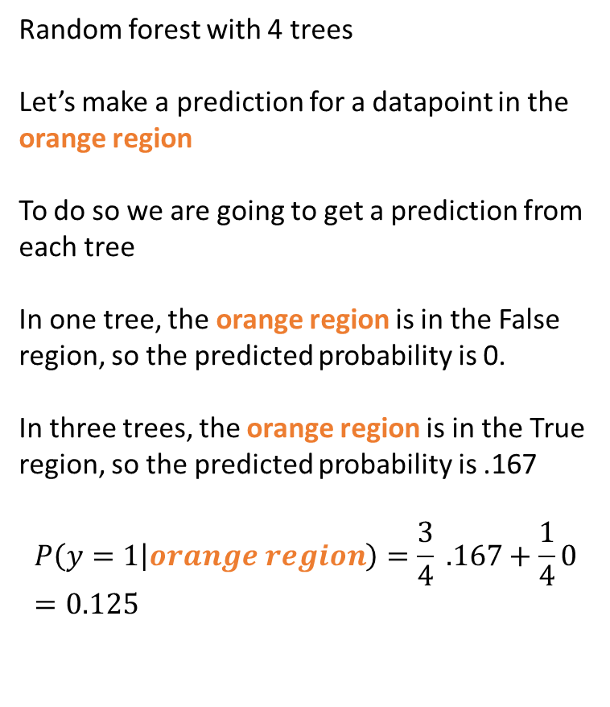
50%
75%
50%
Random forest with 4 trees
Let’s make a prediction for a datapoint in the orange region
To do so we are going to get a prediction from each tree
In one tree, the orange region is in the False region, so the predicted probability is 0.
In three trees, the orange region is in the True region, so the predicted probability is .167
$$P\left(y=1 | orange region\right)=\frac{3}{4} .167+\frac{1}{4}0=0.125$$
7.5
75%
100%
75%
2.5
50%
75%
50%
2.5
7.5

Slide 32
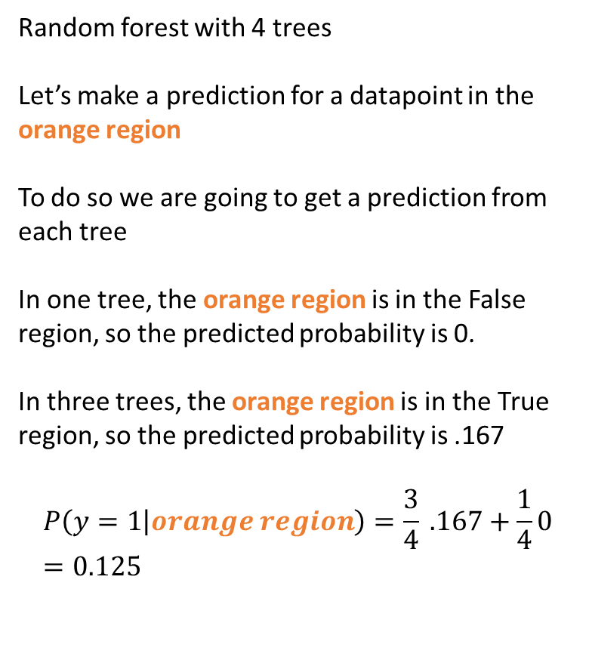
Random forest with 4 trees
Let’s make a prediction for a datapoint in the orange region
To do so we are going to get a prediction from each tree
In one tree, the orange region is in the False region, so the predicted probability is 0.
In three trees, the orange region is in the True region, so the predicted probability is .167
$$P\left(y=1 | orange region\right)=\frac{3}{4} .167+\frac{1}{4}0=0.125$$

Slide 33
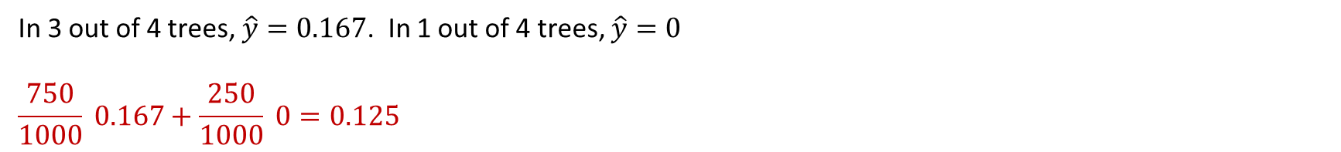
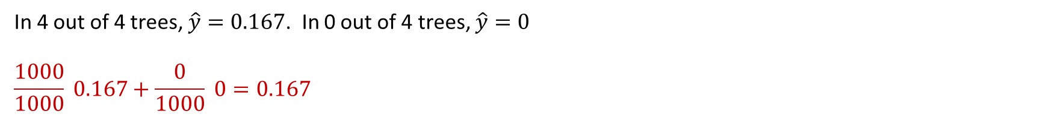
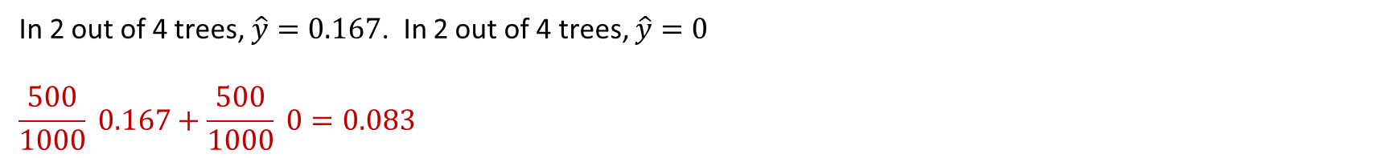
Predictions in Each Region After 1,000 Trees
100%
In 4 out of 4 trees, $\hat{y}=0.167$. In 0 out of 4 trees, $\hat{y}=0$
$$\frac{1000}{1000} 0.167+\frac{0}{1000} 0=0.167$$
75%
In 3 out of 4 trees, $\hat{y}=0.167$. In 1 out of 4 trees, $\hat{y}=0$
$$\frac{750}{1000} 0.167+\frac{250}{1000} 0=0.125$$
50%
In 2 out of 4 trees, $\hat{y}=0.167$. In 2 out of 4 trees, $\hat{y}=0$
$$\frac{500}{1000} 0.167+\frac{500}{1000} 0=0.083$$

Slide 34
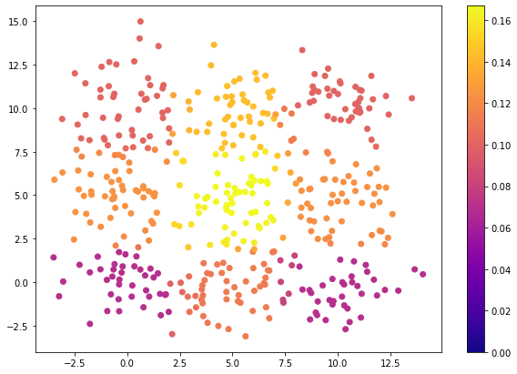
Predicting With a Forest of Stumps
Notice 2 things:
The model is not calibrated
Data points that are y=1 have a predicted probability of being y=1 of 0.167
The model does a great job ranking Y=1 versus Y=0
We will come back to this when we talk about the Area Under the Curve metric

