Slide 1
INST 414: Data Science Techniques Area Under the Curve

Slide 2
Area Under the Curve

Slide 3
Evaluating Binary Prediction Problems
Scenario:
Our outcome variable is a (0,1)
Our prediction model output a score or a probability
Ways we can evaluate the predictive accuracy:
Calibration
Confusion Matrix
Accuracy
Precision
True Positive Rate
Etc.
$$y=0$$
$$y=1$$
True Negative (TN)
False Negative (FN)
$$\hat{y}=0$$
False Positive (FP)
True Positive (TP)
$$\hat{y}=1$$

Slide 4
Evaluating Binary Prediction Problems
$$y=0$$
$$y=1$$
True Negative (TN)
False Negative (FN)
Confusion Matrix
Accuracy
Precision
True Positive Rate
Etc.
Drawback: Confusion matrix approaches require us to choose a threshold (often not obvious what the right threshold is)
$$\hat{y}=0$$
False Positive (FP)
True Positive (TP)
$$\hat{y}=1$$
1
1
1
1
0
1
0
0
0
0.5
0

Slide 5
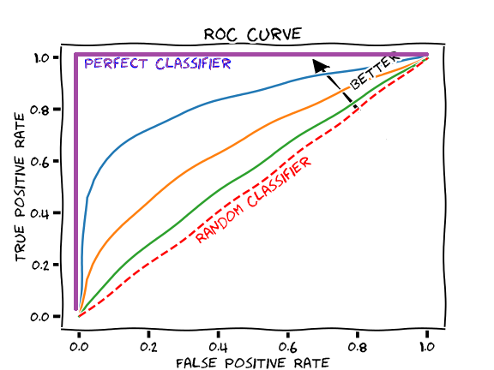
Area Under the Curve (AUC)
Full name:
Area under the receiver operating characteristic curve (AUC-ROC)
A metric that captures how well a model ranks Y=1s versus Y=0s
Importantly: Doesn’t rely on a single threshold.

Slide 6
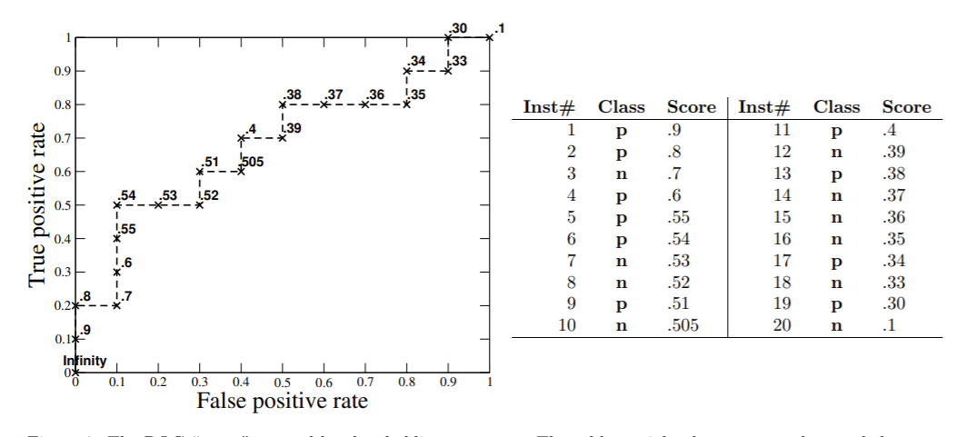
Why Not Use All the Thresholds?

Slide 7
Why Not Use All the Thresholds?
$TPR=\frac{TP}{TP+FN}=\frac{1}{1+9}=.1$ $FPR=\frac{FP}{FP+TN}=\frac{0}{0+10}=0$

Slide 8
Why Not Use All the Thresholds?
$TPR=\frac{TP}{TP+FN}=\frac{2}{2+8}=.2$ $FPR=\frac{FP}{FP+TN}=\frac{0}{0+10}=0$

Slide 9
Why Not Use All the Thresholds?
$TPR=\frac{TP}{TP+FN}=\frac{2}{2+8}=.2$ $FPR=\frac{FP}{FP+TN}=\frac{1}{1+9}=.1$

Slide 10
Why Not Use All the Thresholds?
$TPR=\frac{TP}{TP+FN}=\frac{5}{5+5}=.5$ $FPR=\frac{FP}{FP+TN}=\frac{1}{1+9}=.1$

Slide 11
Why Not Use All the Thresholds?
$TPR=\frac{TP}{TP+FN}=\frac{10}{10+0}=1$ $FPR=\frac{FP}{FP+TN}=\frac{9}{9+1}=.9$

Slide 12
Why Not Use All the Thresholds?
$TPR=\frac{TP}{TP+FN}=\frac{10}{10+0}=1$ $FPR=\frac{FP}{FP+TN}=\frac{10}{10+0}=1$

Slide 13
So What?
The area under this line is called the Area Under the Receiver Operating Characteristic Curve. (AUC)
Has a very nice probabilistic interpretation:
AUC is the probability that a randomly chosen member of Y=1 class is ranked higher than a randomly chosen member of Y=0
AUC = 1 is perfect classifier
AUC = 0.5 is a random classifier
AUC < 0.5 you did something wrong

