Slide 1
INST 414: Data Science Techniques Sources of Bias I

Slide 2
Bias in Predictions and the Importance of Base Rates

Slide 3
What Do We Mean by Bias?
Define a “fairness criterion”
For example, that False Positive Rates should be balanced between groups (race, gender, age, etc)
Could be more than one
If the criteria are not balanced, we’ll call this biased or unfair for today’s discussion.
There are infinite definitions of bias, so no claim that this is the only way to measure it

Slide 4
Our Data
Will be coming from police arrests
So we will either want to predict arrest in the future (next year)
Or use arrest data to predict another outcome (likelihood of dropping out of high school)
Or you could use arrest data as a predictor (X) or outcome to predict (Y)

Slide 5
Where Does Bias Come From?
Arrested
$$P\left(Arrest=1 | Crime=1, Report=1\right)$$
Crime Reported
$$P\left(Report=1 | Crime=1 \right)$$
Not Arrested
$$P\left(Arrest=0 | Crime=1, Report=1\right)$$
Crime Committed
Arrested
$$P\left(Arrest=1 | Crime=1, Report=0\right)$$
$$P\left(Report=0 | Crime=1 \right)$$
Crime Not Reported
Not Arrested
$$P\left(Arrest=0 | Crime=1, Report=0\right)$$

Slide 6
Where Does Bias Come From?
$$P\left(Arrest=1 | Crime=1, Race=A\right)$$
Arrested
Crime
Not Arrested
$$P\left(Arrest=0 | Crime=1, Race=A\right)$$
$$P\left(Arrest=1 | Crime=1, Race=B\right)$$
Arrested
Crime
Not Arrested
$$P\left(Arrest=0 | Crime=1, Race=B\right)$$

Slide 7
Where Does Bias Come From? Scenario 1
Arrested
$P\left(Arrest=1 | Crime=1, Race=A\right)=50\%$
Crime
Not Arrested
$$P\left(Arrest=0 | Crime=1, Race=A\right)=50\%$$
Arrested
$$P\left(Arrest=1 | Crime=1, Race=B\right)=100\%$$
Crime
Not Arrested
$$P\left(Arrest=0 | Crime=1, Race=B\right)=0\%$$

Slide 8
Where Does Bias Come From? Scenario 1
Arrested
$P\left(Arrest=1 | Crime=1, Race=A\right)=50\%$
Crime
Not Arrested
$$P\left(Arrest=0 | Crime=1, Race=A\right)=50\%$$
In this scenario, one group is more likely to be re-arrested given that they committed a crime
Arrested
$$P\left(Arrest=1 | Crime=1, Race=B\right)=100\%$$
Crime
Not Arrested
$$P\left(Arrest=0 | Crime=1, Race=B\right)=0\%$$

Slide 9
Where Does Bias Come From? Scenario 2
Arrested
$P\left(Arrest=1 | Crime=1, Race=A\right)=100\%$
Crime
Not Arrested
$$P\left(Arrest=0 | Crime=1, Race=A\right)=0\%$$
Arrested
$$P\left(Arrest=1 | Crime=1, Race=B\right)=100\%$$
Crime
Not Arrested
$$P\left(Arrest=0 | Crime=1, Race=B\right)=0\%$$

Slide 10
No Differences in Measurement
Arrested
$P\left(Arrest=1 | Crime=1, Race=A\right)=100\%$
Crime
Not Arrested
$$P\left(Arrest=0 | Crime=1, Race=A\right)=0\%$$
In this scenario, both groups are always arrested if they have committed a crime.
Arrested
$$P\left(Arrest=1 | Crime=1, Race=B\right)=100\%$$
Crime
Not Arrested
$$P\left(Arrest=0 | Crime=1, Race=B\right)=0\%$$

Slide 11
What Leads to Bias
We are going to imagine a world where everything is measured perfectly
We are going to compare two subgroups: race=0 and race=1
One subgroup will have a higher arrest rate than the other one
Why is there a difference in re-arrest rate?
Important for real-world discussions
Today we primarily care about the math

Slide 12
Example
Predicting arrest in 2021 ($Arrest_{2021})$
Models:
1) No predictors
2) + Arrest in 2020 $(Arrest_{2020})$
3) + Defendant’s race ($race)$
4) + Interaction ($Arrest_{2020} ∗race)$
Ordinary Least Squares

Slide 13
Example
Models:
1) No predictors
$P\left(Arrest_{2021}|preds\right)=β_{0}$
2) + Arrest in 2020 $\left(Arrest_{2020}\right)$
$P\left(Arrest_{2021}|preds\right)=β_{0}+β_{1} Arrest_{2020}$
3) + Defendant’s race ($race)$
$P\left(Arrest_{2021}|preds\right)=β_{0}+β_{1}⋅ Arrest_{2020}+β_{2}⋅ race$
4) + Interaction ($Arrest_{2020} ∗race)$
$P\left(Arrest_{2021}|preds\right)=β_{0}+β_{1}⋅ Arrest_{2020}+β_{2}⋅ race+β_{3}⋅{Arrest}_{2020}⋅race$
Note “|preds” is just a shorthand for saying that these are conditional probabilities that depend on the predictors

Slide 14
$$P(Arrest_{2021})$$
Simplest Predictor
$Arrest_{2021}=β_{0}+error_{i}$
$$race$$ | $$arrest_{2020}$$ | $$race :arrest_{2020}$$ | $$arrest_{2021}$$
0 | 1 | 0 | 1
0 | 1 | 0 | 0
0 | 0 | 0 | 1
0 | 0 | 0 | 0
0 | 0 | 0 | 0
0 | 0 | 0 | 0
1 | 1 | 1 | 1
1 | 1 | 1 | 1
1 | 1 | 1 | 0
1 | 0 | 0 | 0
1 | 0 | 0 | 1
1 | 0 | 0 | 0

Slide 15
$$P(Arrest_{2021})$$
Simplest Predictor
$Arrest_{2021}=β_{0}+error_{i}$
What is $β_{0}$?
Average value of $Arrest_{2021}$
$$arrest_{2021}$$
1
0
1
0
0
0
1
1
0
0
1
0

Slide 16
$$P(Arrest_{2021})$$
Simplest Predictor
$Arrest_{2021}=β_{0}+error_{i}$
What is $β_{0}$?
Average value of $Arrest_{2021}$
$Arrest_{2021}=\frac{5}{12}$
$$arrest_{2021}$$
1
0
1
0
0
0
1
1
0
0
1
0

Slide 17
$$P(Arrest_{2021})$$
Simplest Predictor
$Arrest_{2021}=β_{0}+error_{i}$
What is $β_{0}$?
Average value of $Arrest_{2021}$
$Arrest_{2021}=\frac{5}{12}$
Everyone gets the same prediction:
$P\left(Arrest_{2021}\right)=\frac{5}{12}=.42$
$$arrest_{2021}$$ | $${\hat{arrest}}_{2021}$$
1 | .42
0 | .42
1 | .42
0 | .42
0 | .42
0 | .42
1 | .42
1 | .42
0 | .42
0 | .42
1 | .42
0 | .42

Slide 18
Compute Fairness Metrics
 | Calibration
 | $$\hat{P}\left(arrest_{2021}\right)$$ | $$P\left(arrest_{2021}\right)$$
$$race=0$$ | $$42\%$$ | $$33\%$$
$$race=1$$ | $$42\%$$ | $$50\%$$
 | Balance for 0s | Balance for 1s
 | Average $$\hat{P}(arrest_{2021}|arrest_{2021}=0)$$ | Average $$\hat{P}(arrest_{2021}|arrest_{2021}=1)$$
$$race=0$$ | 42% | 42%
$$race=1$$ | 42% | 42%

Slide 19
$$P(Arrest_{2021}|Arrest_{2020})$$
Adding in a Predictor
$Arrest_{2021}=β_{0}+β_{1} Arrest_{2020}+error_{i}$
$$race$$ | $$arrest_{2020}$$ | $$race :arrest_{2020}$$ | $$arrest_{2021}$$
0 | 1 | 0 | 1
0 | 1 | 0 | 0
0 | 0 | 0 | 1
0 | 0 | 0 | 0
0 | 0 | 0 | 0
0 | 0 | 0 | 0
1 | 1 | 1 | 1
1 | 1 | 1 | 1
1 | 1 | 1 | 0
1 | 0 | 0 | 0
1 | 0 | 0 | 1
1 | 0 | 0 | 0

Slide 20
$$P(Arrest_{2021}|Arrest_{2020})$$
Adding in a Predictor
$Arrest_{2021}=β_{0}+β_{1} Arrest_{2020}+error_{i}$
$\hat{Arrest_{2021}}=0.29+0.31 Arrest_{2020}$
$\hat{P}\left(Arrest_{2021} | Arrest_{2020}=0\right)=\frac{2}{7}=.29$
$\hat{P}\left(Arrest_{2021} | Arrest_{2020}=1\right)=\frac{3}{5}=.6$
$$arrest_{2020}$$ | $$arrest_{2021}$$
1 | 1
1 | 0
0 | 1
0 | 0
0 | 0
0 | 0
1 | 1
1 | 1
1 | 0
0 | 0
0 | 1
0 | 0

Slide 21
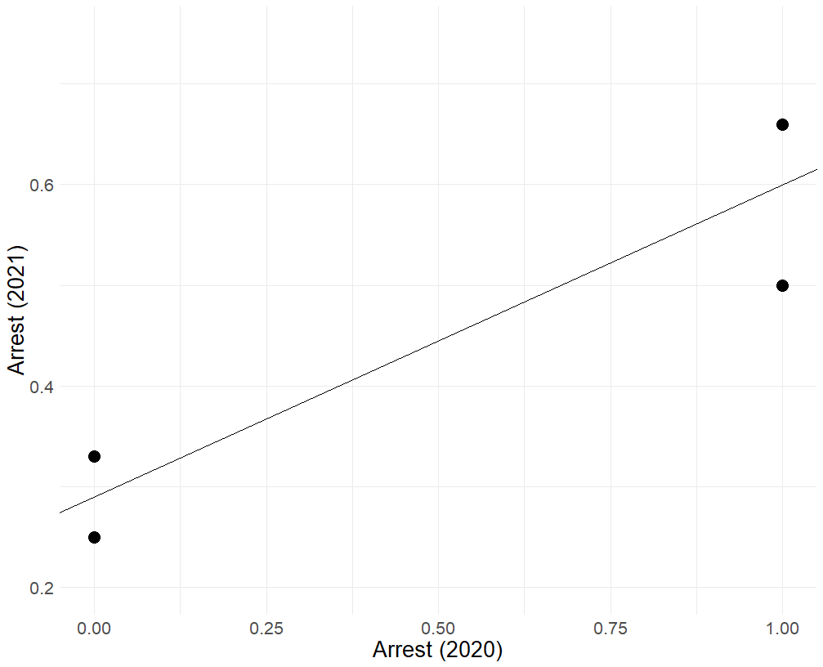
Visualizing the model
Base rate for Race = 1 and $Arrest_{2020}=1$
The line represents the prediction model for everyone:
$$\hat{Arrest_{2021}}=0.29+0.31 Arrest_{2020}$$
The points represent the true outcome rates for our two groups and whether they had an arrest in 2020 or not
Base rate for Race = 1 and $Arrest_{2020}=0$
Base rate for Race = 0 and $Arrest_{2020}=1$
Base rate for Race = 0 and $Arrest_{2020}=0$

Slide 22
Compute Fairness Metrics
 | Calibration
 | $$\hat{P}\left(arrest_{2021}\right)$$ | $$P\left(arrest_{2021}\right)$$
$$race=0, arrest=0$$ | $$29\%$$ | $$25\%$$
$$race=1, arrest=0$$ | $$29\%$$ | $$33\%$$
$$race=0, arrest=1$$ | $$60\%$$ | $$50\%$$
$$race=1, arrest=1$$ | $$60\%$$ | $$67\%$$
 | Balance for 0s | Balance for 1s
 | Average $$\hat{P}(arrest_{2021}|arrest_{2021}=0)$$ | Average $$\hat{P}(arrest_{2021}|arrest_{2021}=1)$$
$$race=0$$ | 36% | 44%
$$race=1$$ | 39% | 50%

Slide 23
$$P(Arrest_{2021}|Arrest_{2020}, Race)$$
Adding in a Predictor
$Arrest_{2021}=β_{0}+β_{1} Arrest_{2020}+β_{2} race+error_{i}$
$$race$$ | $$arrest_{2020}$$ | $$race :arrest_{2020}$$ | $$arrest_{2021}$$
0 | 1 | 0 | 1
0 | 1 | 0 | 0
0 | 0 | 0 | 1
0 | 0 | 0 | 0
0 | 0 | 0 | 0
0 | 0 | 0 | 0
1 | 1 | 1 | 1
1 | 1 | 1 | 1
1 | 1 | 1 | 0
1 | 0 | 0 | 0
1 | 0 | 0 | 1
1 | 0 | 0 | 0

Slide 24
$$P(Arrest_{2021}|Arrest_{2020}, Race)$$
Adding in a Predictor
$\hat{Arrest_{2021}}=.24+ .29 Arrest_{2020}+ . 12 race$
$\hat{P}\left(Arrest_{2021}=1 | Arrest_{2020}=0, race=0\right)=0.24$
$\hat{P}\left(Arrest_{2021}=1 | Arrest_{2020}=0, race=1\right)=0.35$
$\hat{P}\left(Arrest_{2021}=1 | Arrest_{2020}=1, race=0\right)=0.53$
$\hat{P}\left(Arrest_{2021}=1 | Arrest_{2020}=1, race=1\right)=0.65$
$$race$$ | $$arrest_{2020}$$ | $$arrest_{2021}$$ | $${\hat{arrest}}_{2021}$$
0 | 1 | 1 | .53
0 | 1 | 0 | .53
0 | 0 | 1 | .24
0 | 0 | 0 | .24
0 | 0 | 0 | .24
0 | 0 | 0 | .24
1 | 1 | 1 | .65
1 | 1 | 1 | .65
1 | 1 | 0 | .65
1 | 0 | 0 | .35
1 | 0 | 1 | .35
1 | 0 | 0 | .35

Slide 25
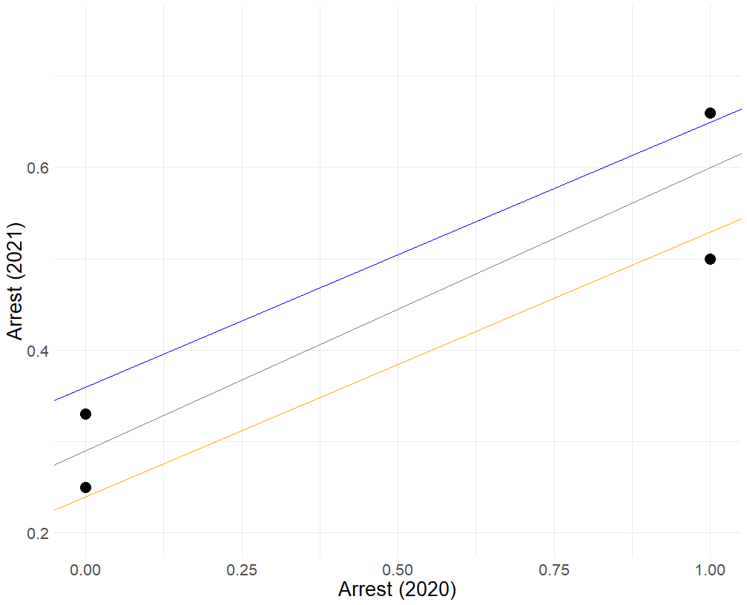
Visualizing the model
Base rate for Race = 1 and $Arrest_{2020}=1$
The orange and blue lines represent the prediction model for race = 0 and race = 1, respectively:
$$\hat{Arrest_{2021}}=.24+ .29 Arrest_{2020}+ . 12 race$$
When race = 0
$$\hat{Arrest_{2021}}=.24+ .29 Arrest_{2020}$$
When race = 1
$$\hat{Arrest_{2021}}=.36+ .29 Arrest_{2020}$$
Base rate for Race = 1 and $Arrest_{2020}=0$
Base rate for Race = 0 and $Arrest_{2020}=1$
Base rate for Race = 0 and $Arrest_{2020}=0$

Slide 26
Compute Fairness Metrics
 | Calibration
 | $$\hat{P}\left(arrest_{2021}\right)$$ | $$P\left(arrest_{2021}\right)$$
$$race=0, arrest=0$$ | $$24\%$$ | $$25\%$$
$$race=1, arrest=0$$ | $$35\%$$ | $$33\%$$
$$race=0, arrest=1$$ | $$53\%$$ | $$50\%$$
$$race=1, arrest=1$$ | $$65\%$$ | $$67\%$$
 | Balance for 0s | Balance for 1s
 | Average $$\hat{P}(arrest_{2021}|arrest_{2021}=0)$$ | Average $$\hat{P}(arrest_{2021}|arrest_{2021}=1)$$
$$race=0$$ | 31% | 38%
$$race=1$$ | 45% | 55%

Slide 27
Add interaction
Adding in a Predictor
$Arrest_{2021}=β_{0}+β_{1} Arrest_{2020}+β_{2} race+β_{3}Arrest_{2020}⋅race+error_{i}$
$$race$$ | $$arrest_{2020}$$ | $$race :arrest_{2020}$$ | $$arrest_{2021}$$
0 | 1 | 0 | 1
0 | 1 | 0 | 0
0 | 0 | 0 | 1
0 | 0 | 0 | 0
0 | 0 | 0 | 0
0 | 0 | 0 | 0
1 | 1 | 1 | 1
1 | 1 | 1 | 1
1 | 1 | 1 | 0
1 | 0 | 0 | 0
1 | 0 | 0 | 1
1 | 0 | 0 | 0

Slide 28
$$P(Arrest_{2021}|Arrest_{2020})$$
Adding in a Predictor
$\hat{Arrest_{2021}}=.25+.25 Arrest_{2020}+.08 race+ .08 Arrest_{2020}:race$
$\hat{P}\left(Arrest_{2021}=1 | Arrest_{2020}=0, race=0\right)=0.25$
$\hat{P}\left(Arrest_{2021}=1 | Arrest_{2020}=0, race=1\right)=0.33$
$\hat{P}\left(Arrest_{2021}=1 | Arrest_{2020}=1, race=0\right)=0.5$
$\hat{P}\left(Arrest_{2021}=1 | Arrest_{2020}=1, race=1\right)=0.67$
$$race$$ | $$arrest_{2020}$$ | $$race :arrest_{2020}$$ | $$arrest_{2021}$$ | $${\hat{arrest}}_{2021}$$
0 | 1 | 0 | 1 | .5
0 | 1 | 0 | 0 | .5
0 | 0 | 0 | 1 | .25
0 | 0 | 0 | 0 | .25
0 | 0 | 0 | 0 | .25
0 | 0 | 0 | 0 | .25
1 | 1 | 1 | 1 | .67
1 | 1 | 1 | 1 | .67
1 | 1 | 1 | 0 | .67
1 | 0 | 0 | 0 | .33
1 | 0 | 0 | 1 | .33
1 | 0 | 0 | 0 | .33

Slide 29
Visualizing the model
Base rate for Race = 1 and $Arrest_{2020}=1$
The line represents the prediction model for everyone:
$$\hat{Arrest_{2021}}=0.29+0.31 Arrest_{2020}$$
The points represent the true outcome rates for our two groups and whether they had an arrest in 2020 or not
Base rate for Race = 1 and $Arrest_{2020}=0$
Base rate for Race = 0 and $Arrest_{2020}=1$
Base rate for Race = 0 and $Arrest_{2020}=0$

Slide 30
Visualizing the model
Base rate for Race = 1 and $Arrest_{2020}=1$
The orange and blue lines represent the prediction model for race = 0 and race = 1, respectively:
$$\hat{Arrest_{2021}}=.24+ .29 Arrest_{2020}+ . 12 race$$
When race = 0
$$\hat{Arrest_{2021}}=.24+ .29 Arrest_{2020}$$
When race = 1
$$\hat{Arrest_{2021}}=.36+ .29 Arrest_{2020}$$
Base rate for Race = 1 and $Arrest_{2020}=0$
Base rate for Race = 0 and $Arrest_{2020}=1$
Base rate for Race = 0 and $Arrest_{2020}=0$

Slide 31
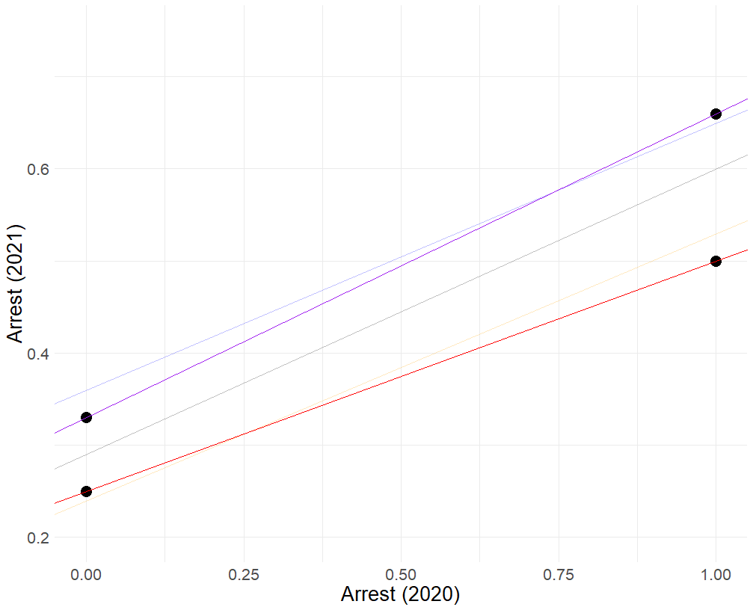
Visualizing the model
Base rate for Race = 1 and $Arrest_{2020}=1$
The red and purple lines represent the prediction model for race = 0 and race = 1, respectively:
$$\hat{Arrest_{2021}}=.25+.25 Arrest_{2020}+.08 race+ .08 Arrest_{2020}:race$$
When race = 0
$$\hat{Arrest_{2021}}=0.25+0.25 Arrest_{2020}$$
When race = 1
$$\hat{Arrest_{2021}}=0.33+0.33 Arrest_{2020}$$
Base rate for Race = 1 and $Arrest_{2020}=0$
Base rate for Race = 0 and $Arrest_{2020}=1$
Base rate for Race = 0 and $Arrest_{2020}=0$

Slide 32
Compute Fairness Metrics
 | Calibration
 | $$\hat{P}\left(arrest_{2021}\right)$$ | $$P\left(arrest_{2021}\right)$$
$$race=0, arrest=0$$ | $$25\%$$ | $$25\%$$
$$race=1, arrest=0$$ | $$33\%$$ | $$33\%$$
$$race=0, arrest=1$$ | $$50\%$$ | $$50\%$$
$$race=1, arrest=1$$ | $$67\%$$ | $$67\%$$
 | Balance for 0s | Balance for 1s
 | Average $$\hat{P}(arrest_{2021}|arrest_{2021}=0)$$ | Average $$\hat{P}(arrest_{2021}|arrest_{2021}=1)$$
$$race=0$$ | 31% | 38%
$$race=1$$ | 44% | 56%

Slide 33
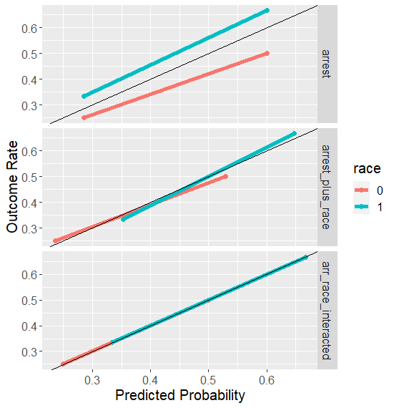
Calibration/PPV Balance
Improves with more features.

Slide 34
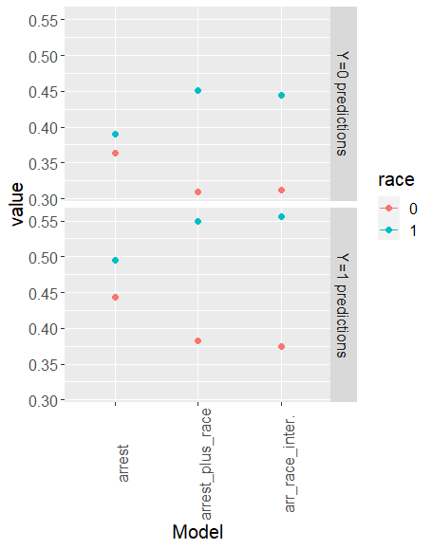
Error Rates
Degrade with more features

Slide 35
What Explains This Pattern?
PPV = $P(y=1|\hat{y}=1)$
$\hat{y}$ is a function of our predictors, so we could say
PPV = $P(y=1|X)$
This should look familiar
The entire training procedure is about finding this quantity

Slide 36
What Explains This Pattern?
But not the case for balance for positive and negative classes (FPR or FNR):
FNR: $P\left(\hat{y}=0 | y=1\right)$
How can we get our algorithms to optimize for this?

Slide 37
Constraints
Recall the objective function for ridge
$$\sum{{\left(y_{i}−{\hat{y}}_{i}\right)}^{2}+λ\sum_{j}{β_{j}^{2}}}$$

Slide 38
Constraints
Recall the objective function for ridge
$$\sum{{\left(y_{i}−{\hat{y}}_{i}\right)}^{2}+λ\sum_{j}{β_{j}^{2}}}$$
Penalty term: $\sum_{j}{β_{j}^{2}}$

Slide 39
Constraints
Other ways you could constrain
$$\sum{{\left(y_{i}−{\hat{y}}_{i}\right)}^{2}+λ Φ(y_{i}, {\hat{y}}_{i})}$$
$Φ\left(y_{i}, {\hat{y}}_{i}\right):$ a constraint to take into account FPR and/or FNR

Slide 40
What Would a “Constraint” Look Like
Differences in False Positive Rates should be zero, or close to zero
$P\left(\hat{y}=1 | y=0,race=0\right)=P\left(\hat{y}=1 | y=0,race=1\right)$
$\frac{1}{N_{0}}\sum_{i=1}^{N_{0}}{{\hat{y}}_{i}\left(1−y_{i}\right)}−\frac{1}{N_{1}}\sum_{j=1}^{N_{1}}{{\hat{y}}_{j}\left(1−y_{j}\right)}$

Slide 41
What Would a “Constraint” Look Like
Differences in False Positive Rates should be zero, or close to zero
$P\left(\hat{y}=1 | y=0,race=0\right)=P\left(\hat{y}=1 | y=0,race=1\right)$
$\frac{1}{N_{0}}\sum_{i=1}^{N_{0}}{{\hat{y}}_{i}\left(1−y_{i}\right)}−\frac{1}{N_{1}}\sum_{j=1}^{N_{1}}{{\hat{y}}_{j}\left(1−y_{j}\right)}$
New objective:
$$\sum_{i=1}^{N}{{\left(y_{i}−{\hat{y}}_{i}\right)}^{2}+λ\sum_{j=1}{β_{j}^{2}+γ\left[\frac{1}{N_{0}}\sum_{k=1}^{N_{0}}{{\hat{y}}_{k}\left(1−y_{k}\right)}−\frac{1}{N_{1}}\sum_{k=1}^{N_{1}}{{\hat{y}}_{j}\left(1−y_{j}\right) }\right|}}$$

Slide 42
What Would a “Constraint” Look Like
Differences in False Positive Rates should be zero, or close to zero
$P\left(\hat{y}=1 | y=0,race=0\right)=P\left(\hat{y}=1 | y=0,race=1\right)$
$\frac{1}{N_{0}}\sum_{i=1}^{N_{0}}{{\hat{y}}_{i}\left(1−y_{i}\right)}−\frac{1}{N_{1}}\sum_{j=1}^{N_{1}}{{\hat{y}}_{j}\left(1−y_{j}\right)}$
New objective:
$$\sum_{i=1}^{N}{{\left(y_{i}−{\hat{y}}_{i}\right)}^{2}+λ\sum_{j=1}{β_{j}^{2}+γ\left[\frac{1}{N_{0}}\sum_{k=1}^{N_{0}}{{\hat{y}}_{k}\left(1−y_{k}\right)}−\frac{1}{N_{1}}\sum_{k=1}^{N_{1}}{{\hat{y}}_{j}\left(1−y_{j}\right) }\right|}}$$

Slide 43
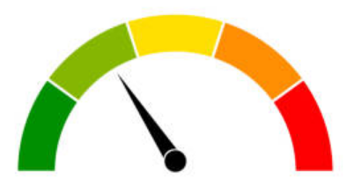
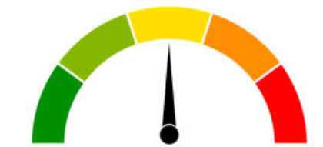
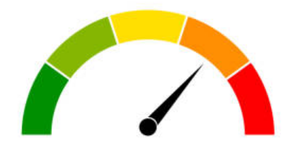
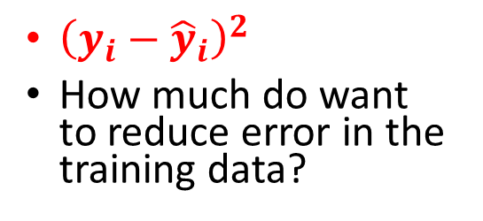
“Control Dials” for Algorithms
$$\sum_{i=1}^{N}{{\left(y_{i}−{\hat{y}}_{i}\right)}^{2}+λ\sum_{j=1}{β_{j}^{2}+γ\left[\frac{1}{N_{0}}\sum_{k=1}^{N_{0}}{{\hat{y}}_{k}\left(1−y_{k}\right)}−\frac{1}{N_{1}}\sum_{k=1}^{N_{1}}{{\hat{y}}_{j}\left(1−y_{j}\right) }\right|}}$$
${\left(y_{i}−{\hat{y}}_{i}\right)}^{2}$
How much do want to reduce error in the training data?
$λ\sum_{j=1}{β_{j}^{2}}$
How much do we want to prevent overfitting?
$γ\left[\frac{1}{N_{0}}\sum_{k=1}^{N_{0}}{{\hat{y}}_{k}\left(1−y_{k}\right)}−\frac{1}{N_{1}}\sum_{k=1}^{N_{1}}{{\hat{y}}_{j}\left(1−y_{j}\right) }\right|$
How much do we want to reduce disparities in False Positive Rates?

Slide 44
The Importance of Base Rates

Slide 45
$$P(Arrest_{2021}=1|Arrest_{2020}, Race)$$
$Arrest_{2021}=.25+.25 Arrest_{2020}+.08 race+.08 Arrest_{2020}⋅race$
$P\left(Arrest_{2021} | Arrest_{2020}=0,Race=0\right)$
$.25+.25 \left(0\right)+.08 \left(0\right)+.08 \left(0⋅0\right)=.25$
$P\left(Arrest_{2021} | Arrest_{2020}=0,Race=1\right)$
$.25+.25 \left(0\right)+.08 \left(1\right)+.08 \left(0⋅1\right)=.33$
$P\left(Arrest_{2021} | Arrest_{2020}=1,Race=0\right)$
$.25+.25 \left(1\right)+.08 \left(0\right)+.08 \left(1⋅0\right)=.5$
$P\left(Arrest_{2021} | Arrest_{2020}=1,Race=1\right)$
$.25+.25 \left(1\right)+.08 \left(1\right)+.08 \left(1⋅1\right)=.66$
$$race$$ | $$arrest_{2020}$$ | $$race :arrest_{2020}$$ | $$arrest_{2021}$$ | $${\hat{arrest}}_{2021}$$
0 | 1 | 0 | 1 | .5
0 | 1 | 0 | 0 | .5
0 | 0 | 0 | 1 | .25
0 | 0 | 0 | 0 | .25
0 | 0 | 0 | 0 | .25
0 | 0 | 0 | 0 | .25
1 | 1 | 1 | 1 | .66
1 | 1 | 1 | 1 | .66
1 | 1 | 1 | 0 | .66
1 | 0 | 0 | 0 | .33
1 | 0 | 0 | 1 | .33
1 | 0 | 0 | 0 | .33

Slide 46
Why Is Race Predictive of the outcome?
Race is a stand-in for missing predictors
Differences in police behavior
Differences in treatment of different subgroups historically
Differences in environment, broadly speaking

Slide 47
How Would We Equalize P-Hats?
$Arrest_{2021}=.25+.25 Arrest_{2020}+.08 race+.08 Arrest_{2020}⋅race$
Adding in predictors that are differentially predictive across groups
$Arrest_{2021}=.25+.25 Arrest_{2020}+.04 race+.08 Arrest_{2020}⋅race+.08 policing⋅race$

Slide 48
We See This Already
Interactions can account for differences in risk across groups.
${Arrest}_{2021}=.24+ .29 Arrest_{2020}+ . 12 race$
$Arrest_{2021}=.25+.25 Arrest_{2020}+.08 race+.08 Arrest_{2020}⋅race$
.12 vs .08
Pure group differences matter less

