Slide 1
INST 414: Data Science Techniques Decision Trees

Slide 2
Decision Trees

Slide 3
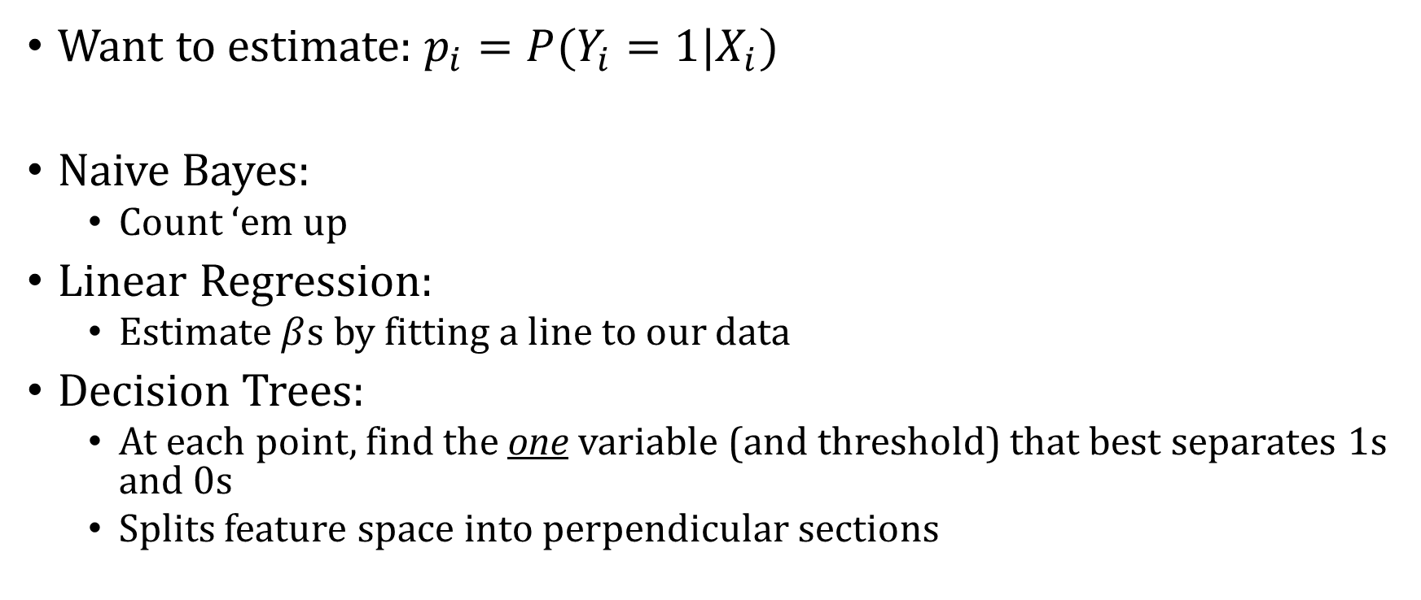
Basics
Want to estimate: $p_{i}=P(Y_{i}=1|X_{i})$
Naive Bayes:
Count ‘em up
Linear Regression:
Estimate $β$s by fitting a line to our data
Decision Trees:
At each point, find the one variable (and threshold) that best separates 1s and 0s
Splits feature space into perpendicular sections

Slide 4
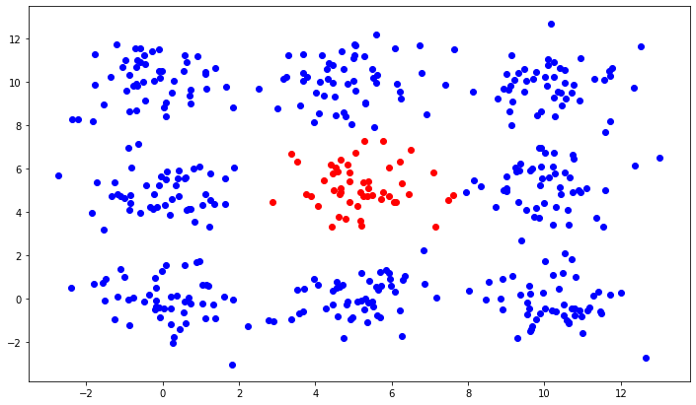
Prediction Problem
Red is Y=1, Blue is Y=0
Two predictors, $X_{1}, X_{2}$

Slide 5
Let’s Use a Linear Model
$y=β_{0}+β_{1}X_{1}+β_{2} X_{2}$
We get
$y=.10+.0009X_{1}+.0009X_{2}$

Slide 6
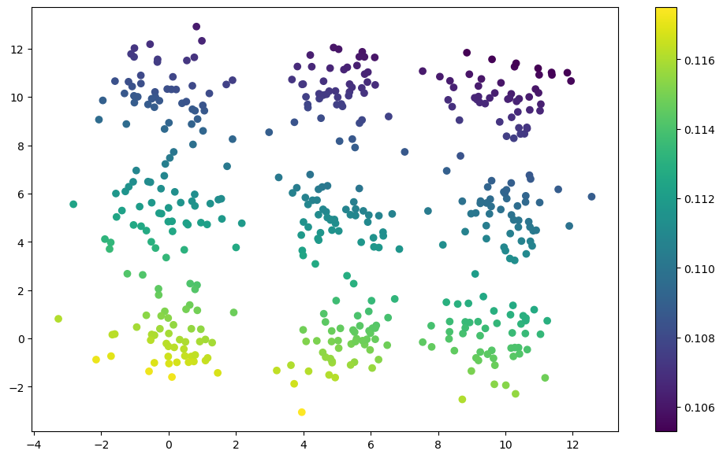
Predictions
Dots are colored by predicted probability. The range is narrow, from .105 to .117

Slide 7
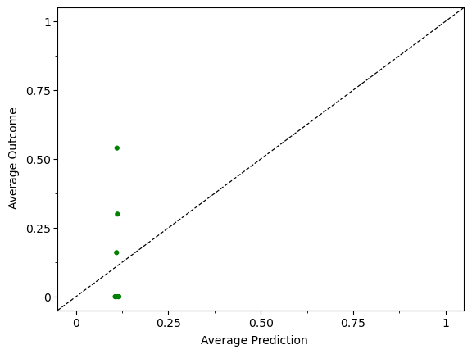
Calibration
Break predictions into 10 equally sized bins (45 data points in each)
Compute the average value of the outcome and average value of the prediction for each bin.
Each point in the plot is (average prediction, average outcome) for each bin
If model was calibrated, points would fall on 45-degree line

Slide 8
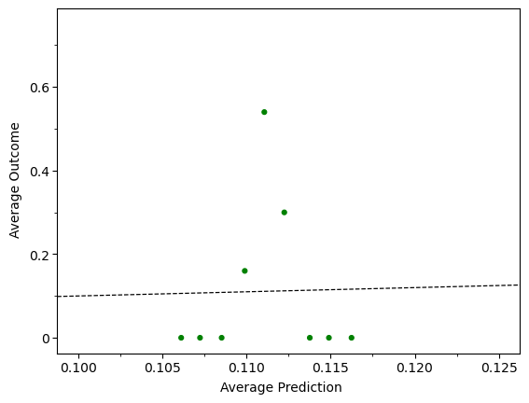
Calibration – Zooming In
Break predictions into 10 equally sized bins (45 data points in each)
Compute the average value of the outcome and average value of the prediction for each bin.
Each point in the plot is (average prediction, average outcome) for each bin
If model was calibrated, points would fall on 45-degree line

Slide 9
Let’s Introduce Interactions
$y=β_{0}+β_{1}X_{1}+β_{2} X_{2}+β_{3}X_{1}^{2}+β_{4}X_{2}^{2}+β_{5}X_{1}X_{2}$
We get
$y=−.04+.09 X_{1}+.09 X_{2}−.01X_{1}^{2}−.01 X_{2}^{2}−.001β_{5}X_{1}X_{2}$

Slide 10
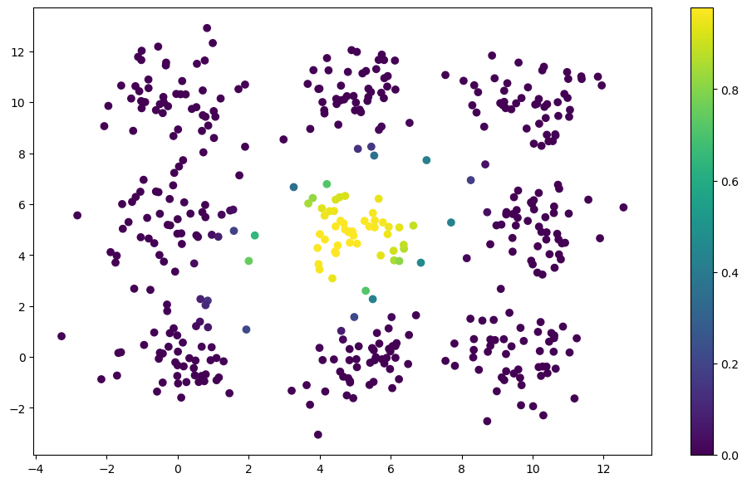
Predictions
Dots are colored by predicted probability.

Slide 11
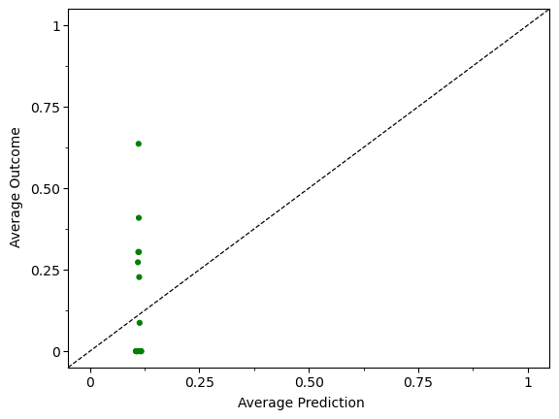
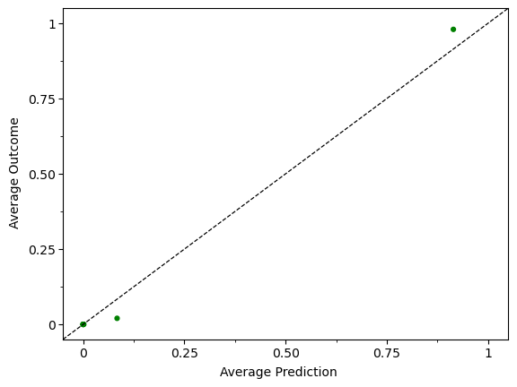
Calibration
Break predictions into 10 equally sized bins (45 data points in each)
Compute the average value of the outcome and average value of the prediction for each bin.
Each point in the plot is (average prediction, average outcome) for each bin
If model was calibrated, points would fall on 45-degree line

Slide 12
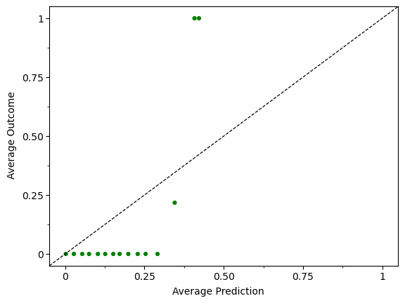
Calibration
Break predictions into 10 equally sized bins (45 data points in each)
Compute the average value of the outcome and average value of the prediction for each bin.
Each point in the plot is (average prediction, average outcome) for each bin
If model was calibrated, points would fall on 45-degree line

Slide 13

Now Let’s Use a Decision Tree
We’re going to feed in $X_{1},$ $X_{2},$ and $y$

Slide 14
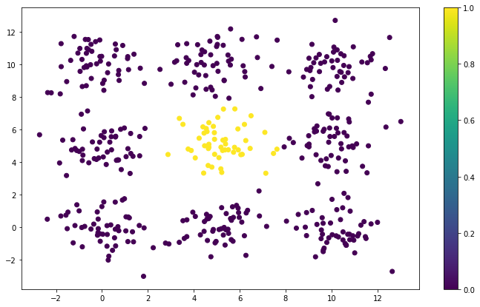
Predictions
Dots are colored by predicted probability. Decision tree gets close to perfect prediction

Slide 15
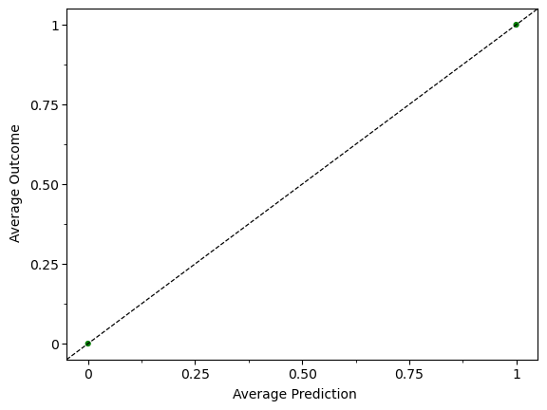
Calibration
Break predictions into 10 equally sized bins (45 data points in each)
Compute the average value of the outcome and average value of the prediction for each bin.
Each point in the plot is (average prediction, average outcome) for each bin
If model was calibrated, points would fall on 45-degree line

Slide 16
What Just Happened?
A decision tree is a method for “cutting up” the input space in a linear fashion.
Identifies regions of the input space where regions are places where the data points are more similar to each other

Slide 17

Decision Tree Terminology
Parent
(or Root) Node
Child Nodes

Slide 18
Decision Tree Terminology
Internal Node
Leaves

Slide 19
Decision Trees Algorithm
At each node:
Cycle through each variable
Cycle through each value the variable can take
Compute a splitting criteria statistic
Basic idea is to find the variable and threshold that:
Classification: best separates the classes
Regression: minimizes the variance
Go until you hit your stopping criteria (will get to this)

Slide 20
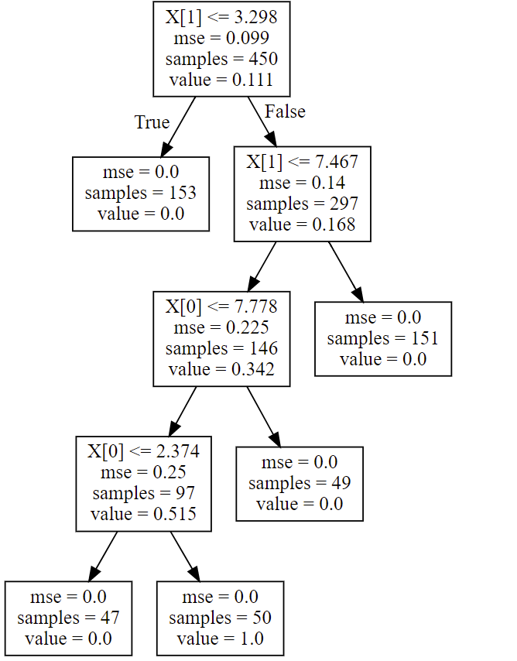

Slide 22
Dividing Up the Feature Space

Slide 23
Dividing Up the Feature Space

Slide 24
Dividing Up the Feature Space
Dividing Up the Feature Space

Slide 26
Dividing Up the Feature Space

