Slide 1
INST 414: Data Science Techniques Decision Trees Splitting Criteria

Slide 2
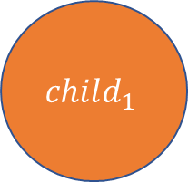

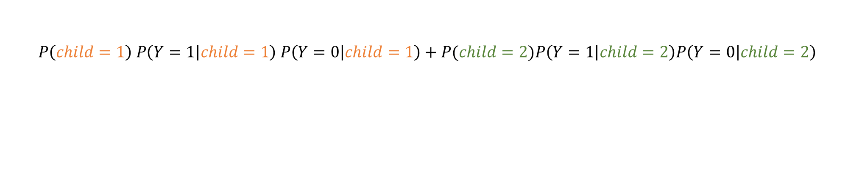
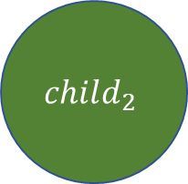
Splitting Criteria for Classification
$$parent$$
Gini Impurity
Measures how well a potential split (variable and threshold) separate the 0s from the 1s. Smaller values mean it does better job separating.
Equation we’ll use for this class:
$$child_{1}$$
$$child_{2}$$
$$P\left(child=1\right) P\left(Y=1 | child=1\right) P\left(Y=0 | child=1\right)+P(child=2)P\left(Y=1 | child=2\right)P\left(Y=0 | child=2\right)$$

Slide 3
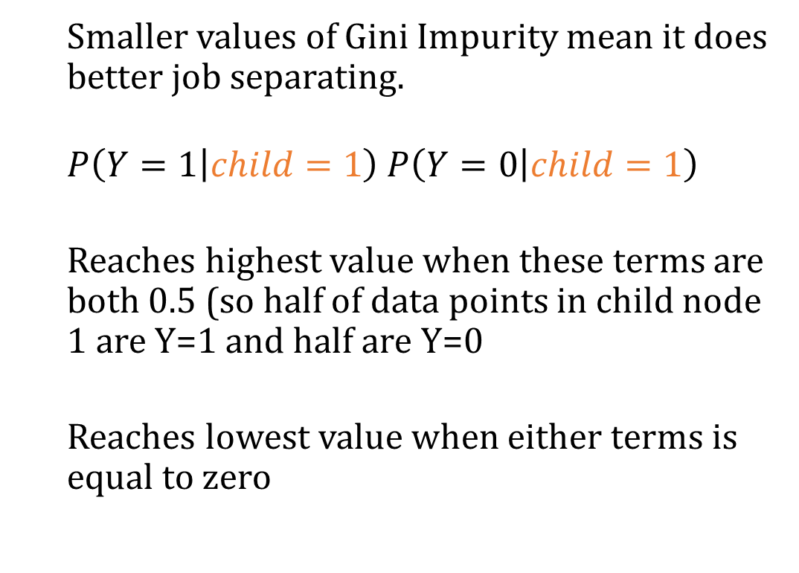
Splitting Criteria for Classification
$$parent$$
Smaller values of Gini Impurity mean it does better job separating.
$$P\left(Y=1 | child=1\right) P\left(Y=0 | child=1\right)$$
Reaches highest value when these terms are both 0.5 (so half of data points in child node 1 are Y=1 and half are Y=0
Reaches lowest value when either terms is equal to zero
$$child_{1}$$
$$child_{2}$$

Slide 4

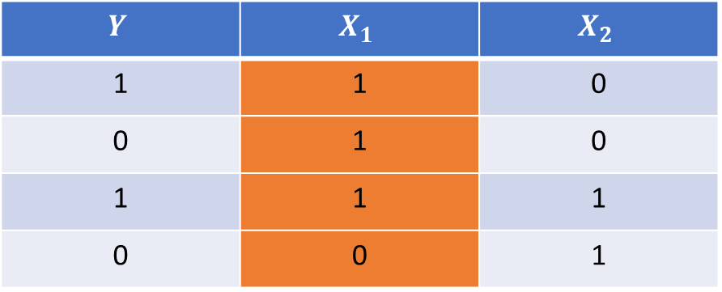
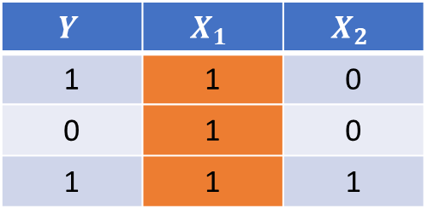
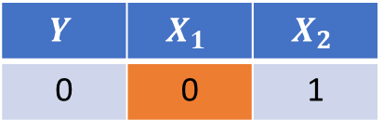
Example #1
$$Y$$ | $$X_{1}$$ | $$X_{2}$$
1 | 1 | 0
0 | 1 | 0
1 | 1 | 1
0 | 0 | 1
$$X_{1}≥1$$
False
True
$$Y$$ | $$X_{1}$$ | $$X_{2}$$
1 | 1 | 0
0 | 1 | 0
1 | 1 | 1
$$Y$$ | $$X_{1}$$ | $$X_{2}$$
0 | 0 | 1

Slide 5

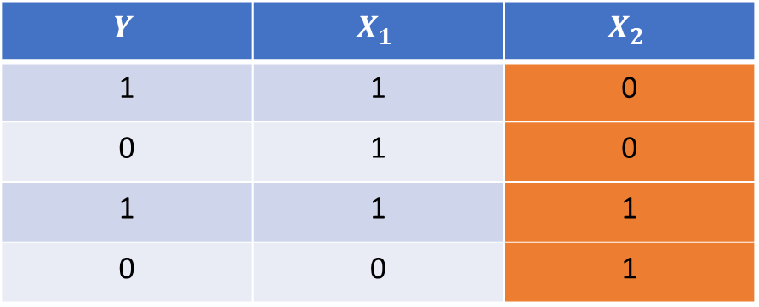
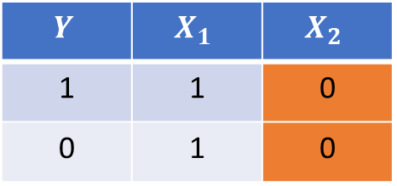
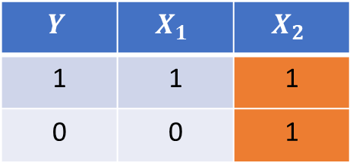
Example #1
$$Y$$ | $$X_{1}$$ | $$X_{2}$$
1 | 1 | 0
0 | 1 | 0
1 | 1 | 1
0 | 0 | 1
$$X_{2}≥1$$
False
True
$$Y$$ | $$X_{1}$$ | $$X_{2}$$
1 | 1 | 0
0 | 1 | 0
$$Y$$ | $$X_{1}$$ | $$X_{2}$$
1 | 1 | 1
0 | 0 | 1

Slide 6
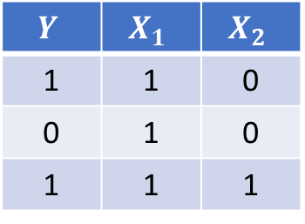
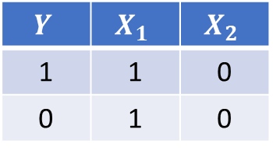
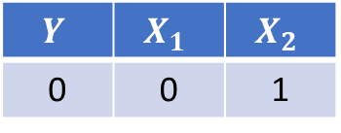
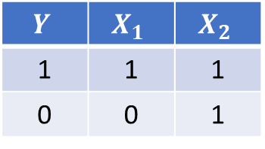
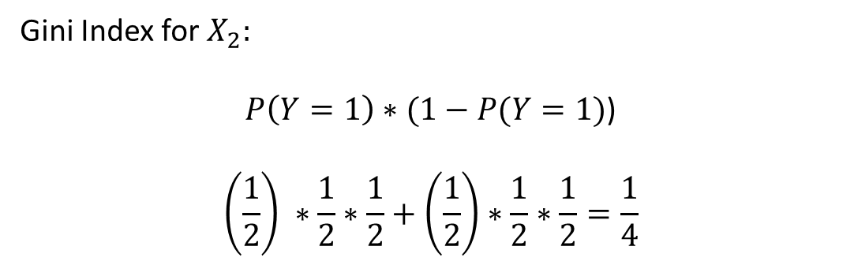
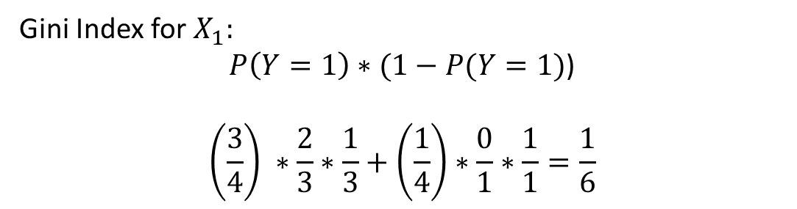
Example #2
$$Y$$ | $$X_{1}$$ | $$X_{2}$$
1 | 1 | 0
0 | 1 | 0
1 | 1 | 1
Gini Index for$X_{1}:$
$P\left(Y=1\right)∗(1−P(Y=1)$)
$$\left(\frac{3}{4}\right) ∗\frac{2}{3}∗\frac{1}{3}+\left(\frac{1}{4}\right)∗\frac{0}{1}∗\frac{1}{1}=\frac{1}{6}$$
$$Y$$ | $$X_{1}$$ | $$X_{2}$$
0 | 0 | 1
$$Y$$ | $$X_{1}$$ | $$X_{2}$$
1 | 1 | 0
0 | 1 | 0
Gini Index for$X_{2}:$
$P\left(Y=1\right)∗(1−P(Y=1)$)
$$\left(\frac{1}{2}\right) ∗\frac{1}{2}∗\frac{1}{2}+\left(\frac{1}{2}\right)∗\frac{1}{2}∗\frac{1}{2}=\frac{1}{4}$$
$$Y$$ | $$X_{1}$$ | $$X_{2}$$
1 | 1 | 1
0 | 0 | 1

Slide 7
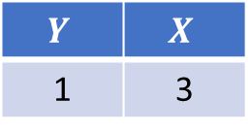

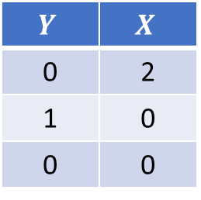
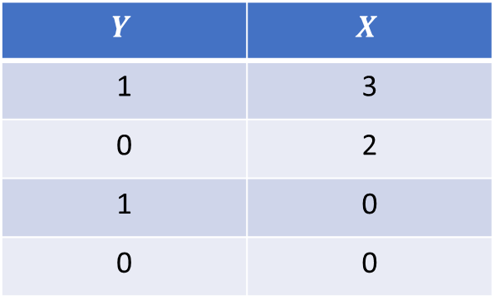

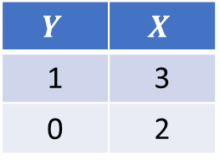
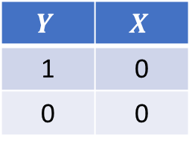
Example #2
$$Y$$ | $$X$$
1 | 3
0 | 2
1 | 0
0 | 0
Run through possible thresholds
One split: [0], [2, 3]
Second split: [0, 2], [3]
$$X≥1$$
$$X≥3$$
False
True
False
True
$$Y$$ | $$X$$
0 | 2
1 | 0
0 | 0
$$Y$$ | $$X$$
1 | 0
0 | 0
$$Y$$ | $$X$$
1 | 3
0 | 2
$$Y$$ | $$X$$
1 | 3

Slide 8
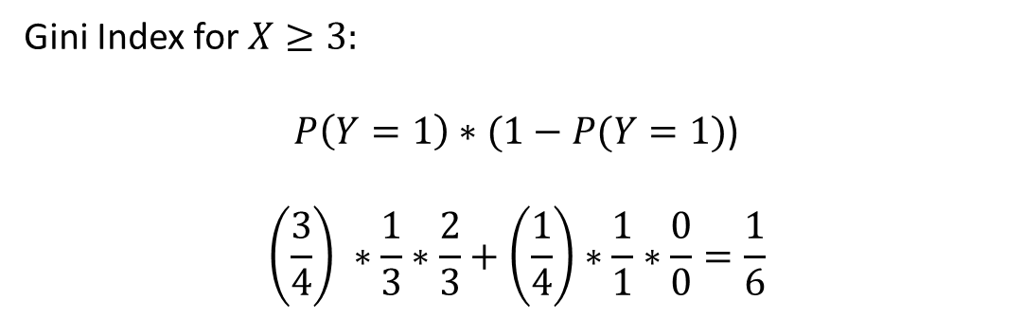
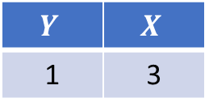
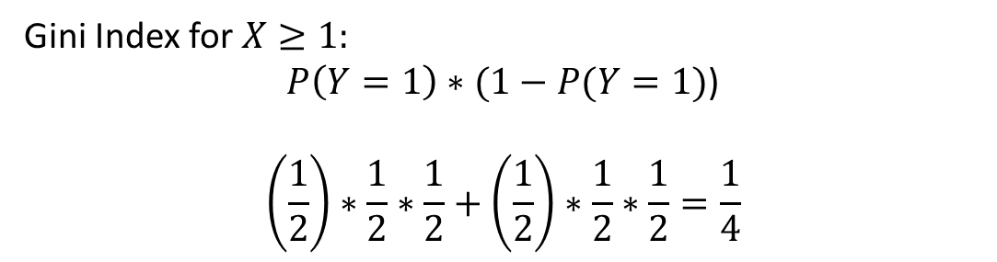
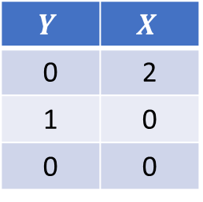
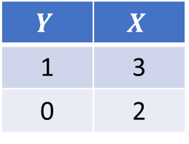
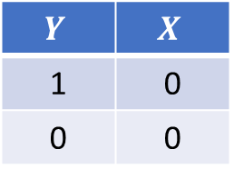
Example #2
Gini Index for$X≥1:$
$P\left(Y=1\right)∗(1−P(Y=1)$)
$$\left(\frac{1}{2}\right)∗\frac{1}{2}∗\frac{1}{2}+\left(\frac{1}{2}\right)∗\frac{1}{2}∗\frac{1}{2}=\frac{1}{4}$$
$$Y$$ | $$X$$
1 | 0
0 | 0
$$Y$$ | $$X$$
1 | 3
0 | 2
Gini Index for$X≥3:$
$P\left(Y=1\right)∗(1−P(Y=1)$)
$$\left(\frac{3}{4}\right) ∗\frac{1}{3}∗\frac{2}{3}+\left(\frac{1}{4}\right)∗\frac{1}{1}∗\frac{0}{0}=\frac{1}{6}$$
$$Y$$ | $$X$$
0 | 2
1 | 0
0 | 0
$$Y$$ | $$X$$
1 | 3

Slide 9
So what is the objective function here?
There is no explicit global objective being optimized
Unlike linear or logistic regression
Greedy and local optimization
No guarantee that reducing variance locally leads to lowest variance solution globally
But it works well
Actually finding global solution is impractical

