Slide 1
CCJS418E: Coding for Criminology
Introduction to
Jupyter and
Python
1

Slide 2
Objectives
By the end of this lab, you will be able to:
Understand what Jupyter is and why we use it
Navigate Jupyter Lab basics
Write and run simple Python code
Grasp fundamental Python concepts
2

Slide 3

What is Jupyter?
Interactive computing environment
Combines code, text, and visualizations
We use Jupyter Hub - a multi-user version
Benefits for beginners:
Write and run code in small chunks
Add explanations alongside code
Easy to experiment and learn
Two popular versions:
Jupyter Lab (What we’ll use)
Jupyter Notebook (The original)
3

Slide 4
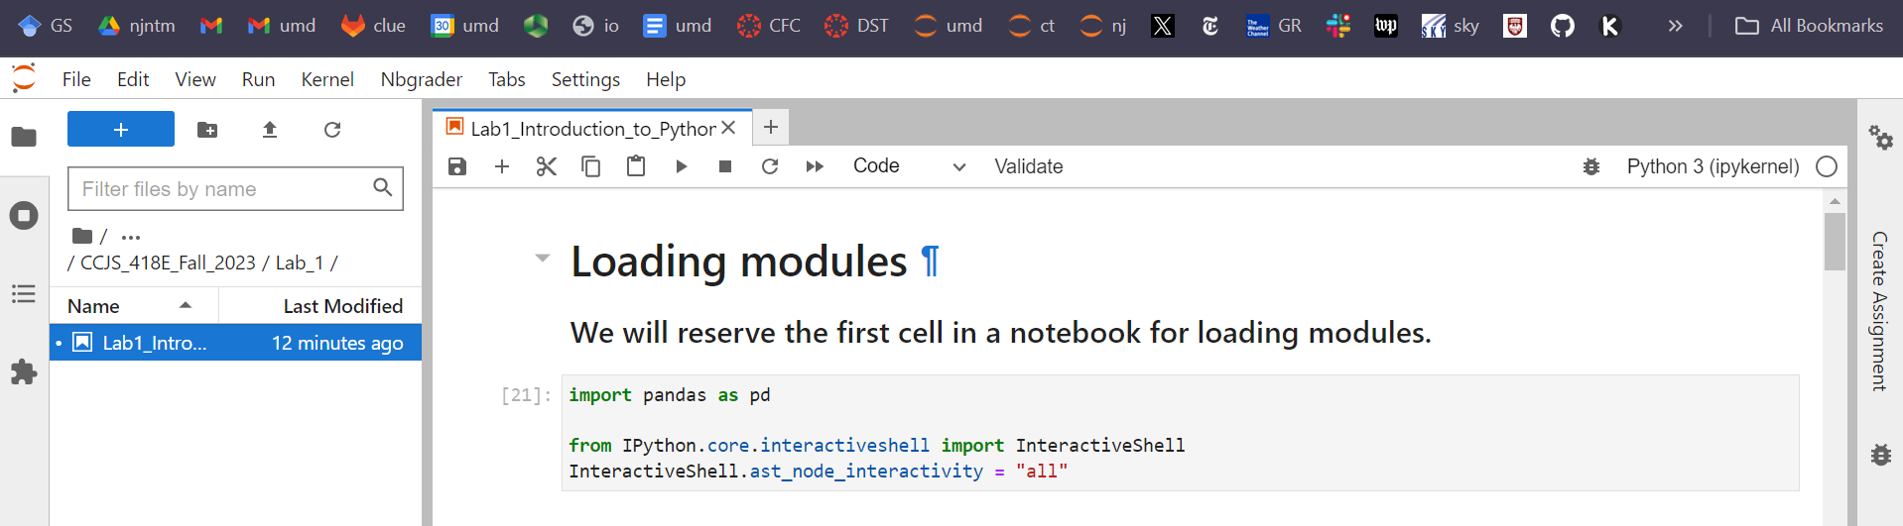
Navigating Jupyter Lab
Main components:
File browser: Manage your files
Notebook: Where you write code and text
Console: For quick code testing
Key actions:
Create a new notebook
Write in code or text (Markdown) cells
Run cells with Shift+Enter
4

Slide 5
What is Jupyter Hub?
Multi-user version of Jupyter Notebook
Key features:
Accessibility: Cloud-based, access from any computer
Consistency: Same environment for all students
Resource Management: More computational power
Collaboration: Easy sharing and teamwork
Real-world Relevance: Used in many organizations
19

Slide 6
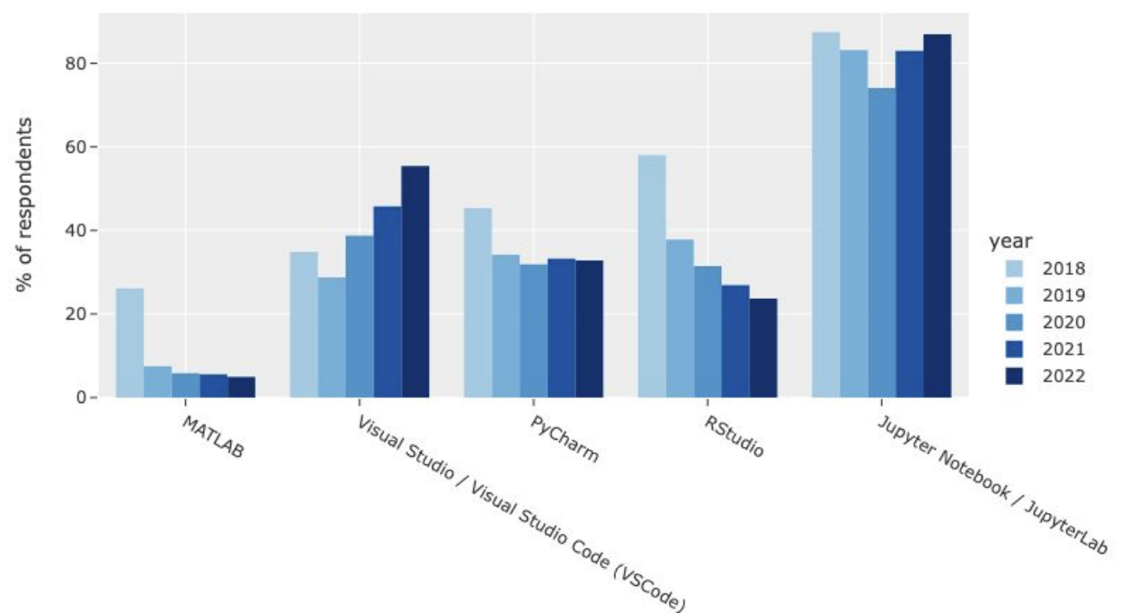
Why Jupyter?
Source: Kaggle 2022 State of Machine Learning and Data Science Report

Slide 7
Navigating Jupyter Lab
Interface components:
File browser
Notebook editor
Console
Terminal
Creating a new notebook
Renaming and organizing notebooks
21

Slide 8
Jupyter Notebook Basics
Understanding cells:
Code cells
Markdown cells
Executing code cells
Adding and deleting cells
Saving and checkpointing
22

Slide 9
What is Markdown?
Lightweight markup language for creating formatted text
Designed for simplicity and readability
Key features:
Easy-to-write using a plain text editor
Easy-to-read in its raw form
Easily converted to HTML and other formats
Common uses:
Documentation (README files, wikis)
Forum & blog posts
Static site generators
Note-taking applications
Benefits:
Platform independent
Future-proof (readable even if renderer fails)
Focuses on content over formatting
24

Slide 10
Markdown in Jupyter Notebooks
Jupyter supports Markdown for rich text formatting
Use Markdown cells for:
Explanations and instructions
Mathematical equations (LaTeX)
Creating headers and subheaders
Embedding images and links
23

Slide 11
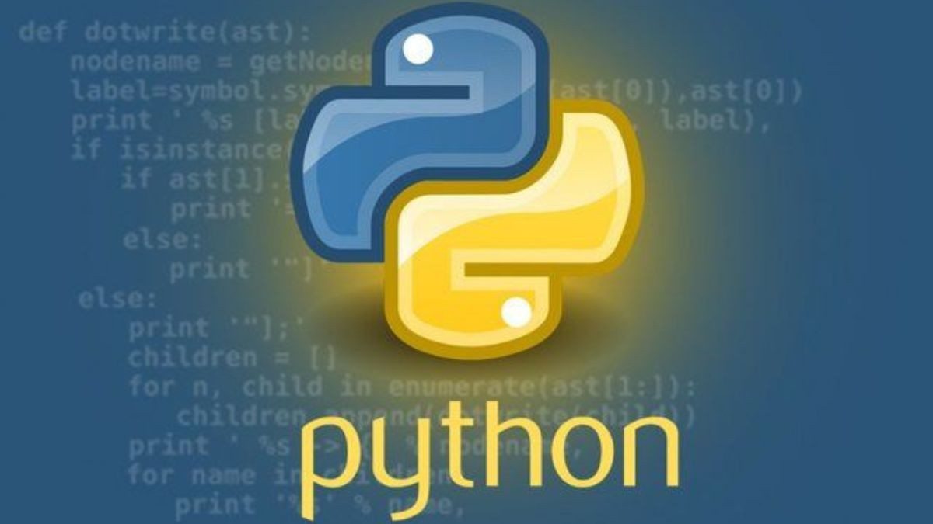

Slide 12
Python Basics: Your New Language
Python is like a very precise language
It has its own grammar and vocabulary
We'll start with the simplest "words" and "sentences"
5

Slide 13
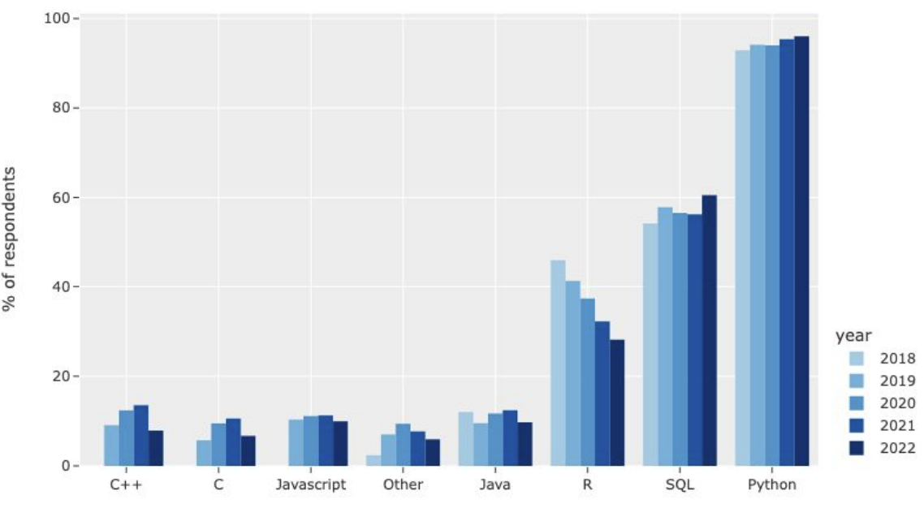
Why Python?
Source: Kaggle 2022 State of Machine Learning and Data Science Report

Slide 14
Python as a Calculator
Basic operations:
Addition: +
Subtraction: -
Multiplication: *
Division: /
Example:
2 + 3 * 4 equals 14
Python follows order of operations!
6

Slide 15
Variables: Storing Information
Variables are like labeled boxes
You can put a value in a variable:
x = 5 (x now holds the value 5)
You can use variables in calculations:
y = x + 3 (if x is 5, y will be 8)
7

Slide 16
Data Types: Different Kinds of Information
Python handles different types of data:
Numbers (integers and decimals)
Text (called "strings")
True/False values (called "booleans")
Examples:
age = 25 (integer)
name = "Alice" (string)
is_student = True (boolean)
8

Slide 17
What Is a Data Type?
A classification that specifies which type of value a variable can hold
Common data types in Python:
Integers (int): Whole numbers
Floating-point (float): Decimal numbers
Strings (str): Text
Booleans (bool): True/False values
Lists: Ordered collections of items
Dictionaries: Key-value pairs
25

Slide 18
What Is a Data Type?
Why does Python (or any language) have types?
Memory allocation: Efficient use of computer resources Operation compatibility: Prevent errors (e.g., adding string to integer) Data integrity: Ensure data is stored and processed correctly Code readability: Makes intentions clear to other programmers Performance optimization: Allows for faster processing of data
In Python:
Dynamic typing: Type is inferred, can change Type checking: Use `type()` function to check data type
25

Slide 19
Working with Text (Strings)
Strings are text enclosed in quotes
You can combine strings:
"Hello" + " " + "World" makes "Hello World"
You can get parts of strings:
If name = "Python", then name0] is "P"
9

Slide 20
Lists: Storing Multiple Items
Lists are collections of items
Created using square brackets:
my_list = [1, 2, 3, 4]
Access items using their position (index):
my_list[0] is 1 (positions start at 0!)
10

Slide 21
Zero-Indexing: A Key Concept
In Python, we start counting from 0, not 1
For a list [10, 20, 30, 40]:
[0] is the first item (10)
[3] is the fourth item (40)
This applies to strings too!
11

Slide 22
Input and Output: Talking to Python
Get information from the user:
name = input("What's your name? ")
Show information to the user:
print("Hello, " + name)
12

Slide 23
Conclusion
Today:
Basics of Jupyter
Simple Python concepts
Next time:
More complex Python structures
How to make decisions in code
15

