Slide 1
INST 414: Data Science Techniques Assessing Real-World Impact

Slide 2
Assessing Algorithms vs. Assessing Impact
In the clean setting, we evaluate predictions against observed outcomes.
We compute AUC, precision, calibration, and fairness metrics.
But real-world systems raise a second question:
What happens when the algorithm is used to make a decision?

Slide 3
Two Real-World Evaluation Problems
Problem 1: Selective labels.
We want to assess the algorithm, but the outcome data are biased or incomplete.
Problem 2: Real-world impact.
We want to assess what changes when the algorithm targets an intervention.

Slide 4
Problem 1: Selective Labels
The algorithm predicts an outcome.
But the outcome is observed only for some people.
Example: if judges detain high-risk defendants, we do not observe whether they would have failed to appear if released.
The question is whether our estimate of model performance is trustworthy.

Slide 5
Problem 2: Real-World Impact
The algorithm ranks people by risk.
The agency uses that ranking to decide who receives an intervention.
The intervention may reduce the outcome.
The question is whether using the model improves outcomes enough to justify the costs.

Slide 6
The Policy Chain
Build a prediction model.
Rank people by predicted risk.
Target an intervention to the highest-risk group.
Estimate how much the intervention changes outcomes.
Compare prevented outcomes to program costs.

Slide 7
Where Cost-Benefit Analysis Enters
Prediction tells us who is high risk.
The treatment effect tells us how much risk falls after intervention.
Cost-benefit analysis combines risk, treatment effects, outcome values, and program costs.
For this lecture and the final project, we will treat the treatment effect as an assumption.

Slide 8
Problem 1: Selective Labels

Slide 9
Selective Labels Problem
Jail
Arraignment
FTA
Released
No FTA

Slide 10
The Issue
Judges detain people based on risk
Released
Jailed

Slide 11
Selective Labels Problem
Jail
Arraignment
FTA
Released
No FTA

Slide 12
The Issue
Judges detain people based on risk
Data available to the algorithm to build prediction model
Released
Jailed
Available data

Slide 13
The Research Question
Can a risk predictor help judges make better decisions?
More aligned with risk of committing a crime
What are we going to compare to make this assessment?
Are the individuals identified by the algorithm higher risk than the individuals identified and detained by the judges

Slide 14


Rankings of Judge and Algorithm
They don’t rank defendants in the same order
A
B
C
D
E
F
G
H
I
J
K
L
M
N
O
P
B
A
C
G
H
I
J
E
F
K
L
D
M
N
O
P

Slide 15
Rankings of Judge and Algorithm
They don’t rank defendants in the same order
Algorithm and judge detain the same number of people
A
B
C
D
E
F
G
H
I
J
K
L
M
N
O
P
B
A
C
G
H
I
J
E
F
K
L
D
M
N
O
P

Slide 16
Rankings of Judge and Algorithm
They don’t rank defendants in the same order
Algorithm and judge detain the same number of people
A
B
C
D
E
F
G
H
I
J
K
L
M
N
O
P
B
A
C
G
H
I
J
E
F
K
L
D
M
N
O
P

Slide 17
Rankings of Judge and Algorithm
They don’t rank defendants in the same order
Algorithm and judge detain the same number of people
Assess risk level of these two groups
A
B
C
D
E
F
G
H
I
J
K
L
M
N
O
P
B
A
C
G
H
I
J
E
F
K
L
D
M
N
O
P

Slide 18
Rankings of Judge and Algorithm
They don’t rank defendants in the same order
Algorithm and judge detain the same number of people
Assess risk level of these two groups
We don’t see outcomes for everybody
A
B
C
D
E
F
G
H
I
J
K
L
M
N
O
P
Jailed
Jailed
B
A
C
G
H
I
J
E
F
K
L
D
M
N
O
P

Slide 19
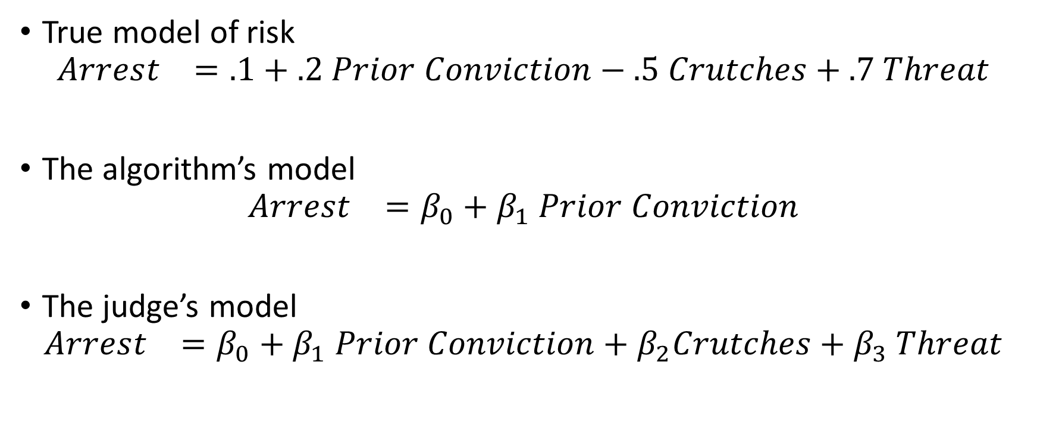
The Issue
True model of risk
$$Arrest_{}=.1+.2 Prior Conviction−.5 Crutches+.7 Threat$$
The algorithm’s model
$$Arrest_{}=β_{0}+β_{1} Prior Conviction$$
The judge’s model
$$Arrest_{}=β_{0}+β_{1} Prior Conviction+β_{2}Crutches+β_{3} Threat$$

Slide 20
The Issue
Judges detain people based on risk
Data available to the algorithm to build prediction model
Algorithm can predict for both jailed and not jailed
Released
Jailed
Available data
Observed Outcome
Imputed Outcome

Slide 21
The Issue
If the judge’s model of risk is accurate, it could be more accurate than the algorithm, but we won’t be able to tell.
If the unobserved information is important, then algorithm’s model imputations of risk for detained will be biased
If you’re interested in the solution to this problem, see:
Human Decisions and Machine Predictions

Slide 22
Recap: The Selective Labels Problem
Want to compare an algorithm to decisions made by a judge
The outcomes are not available for people selected by the judge
The judge has access to information not available to the algorithm
This information is predictive of risk
The judge is using the information accurately

Slide 23
Lessons and Limits of Predicting Shooting Victimization

Slide 24
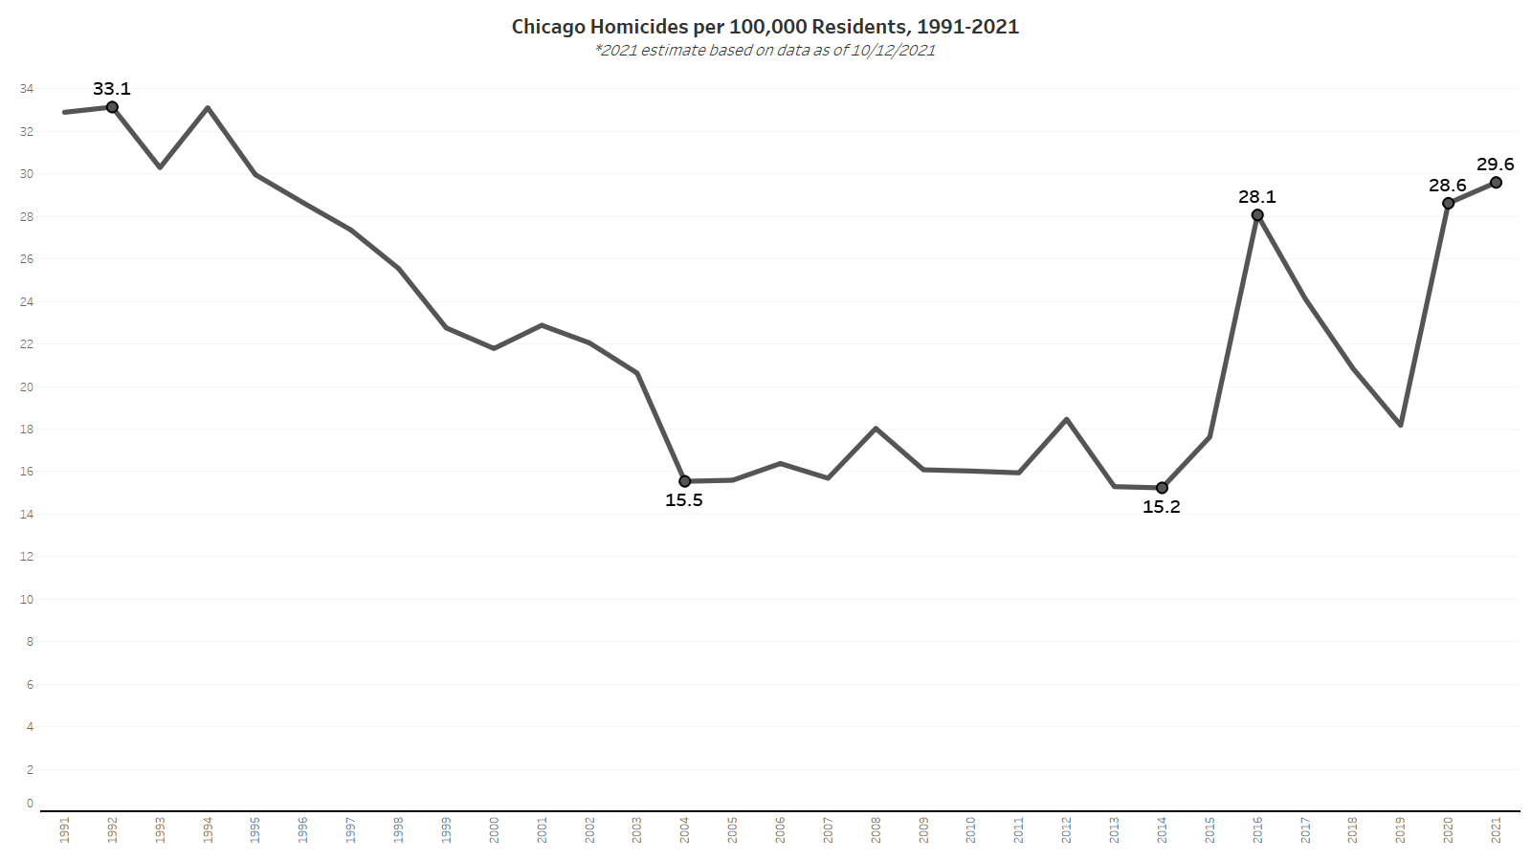
Notes:
15% lower than the peak in the 90s

Slide 25
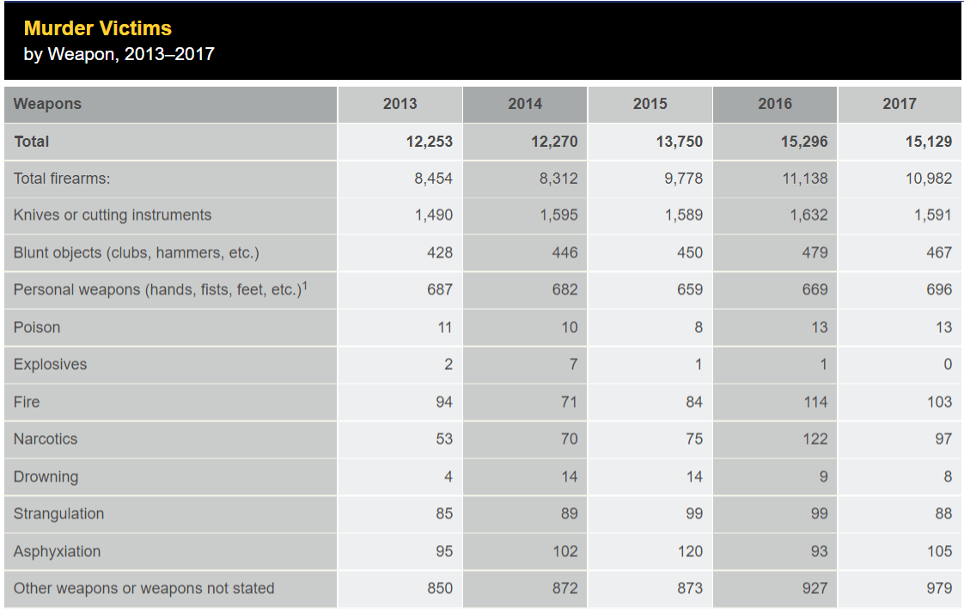
Causes of Homicide
In 2016, firearms accounted for 10,982 out of 15,129 homicides, 72.5%
Source: FBI UCR

Slide 26
Gun Violence Is Highly Concentrated
Geographically, within disadvantaged neighborhoods (Cook & Ludwig 2000; Sampson, Raudenbush & Earls 1997; Sampson 2012; Sharkey 2013)
Demographically, with young black men dying from gun homicide at 20 times rate of white counterparts (CDC 2019)
Socially, among young men with criminal justice contact, within networks (Braga 2003; Green et al. 2017; Papachristos et al. 2015)

Slide 27
Gives Hope
Promising interventions have been shown to be effective in reducing arrests (CBT + Summer Jobs)
People at high risk of being a shooting victim receive no programming
Shootings are very costly (to the victim and the community)
Most investments would pay for themselves if they are effective

Slide 28
Which Shooting Type to Predict?
Most proximate cause of shootings are shooting OFFENDERS
In order to measure offending, we have to use arrests
The share of shootings that lead to an arrest is very small < 20%

Slide 29
Is the outcome measured cleanly?
I.e. w/ little error?
Some shooting offenders are “selectively labeled” when they are arrested
Some have no opportunity of being arrested (police never get any leads)
Upshot: Shooting offending will have measurement error
All arrest outcomes will suffer from this

Slide 30
What about shooting victimization?
If gun shot results in hospitalization, must be reported to police
Severe shootings are well-measured
What’s missed?
“Grazings” that can be treated outside of hospital
Intention to shoot a person, but miss
Predict shooting victimization instead of shooting offending

Slide 31
Why Chicago?
- Higher violence rate than NYC, LA; less than Baltimore, St. Louis, Detroit; similar to Philly
Size + violence rate = sufficient data to train, test model
Training data likely to reflect disparities given history of problematic policing practices

Slide 32
Agenda
Data
Features
Prediction Model
Results overall
Results by subgroup
Potential Impact

Slide 33
Data
12 million records between 1999 to 2019
Arrest Records + Victimization Records
Define 1,400+ features
Demographics
Arrests and Victimizations
Networks

Slide 34
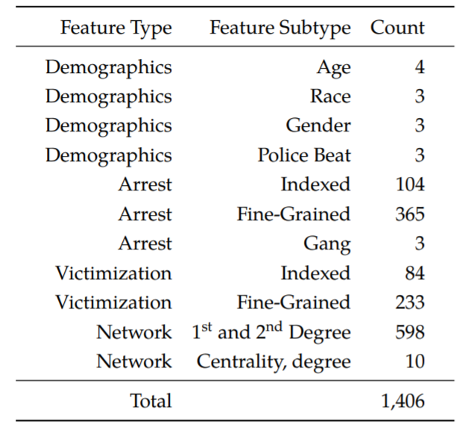
Feature Types
Demographic
Age, race, gender, geography
Arrests
Number of prior arrests in the last year, two years
Number of prior arrests of type X in the last year, two years, etc
Victimizations
Similar but on victimization side

Slide 35
Network Features
Person A and Person B get arrested together
Person A is young and has no arrest history
Person B is older and has many previous arrests was previously arrested with Person C
Person B was also previously arrested with Person C, who was previously a shooting victim
C
Arrest Event
A
B

Slide 36
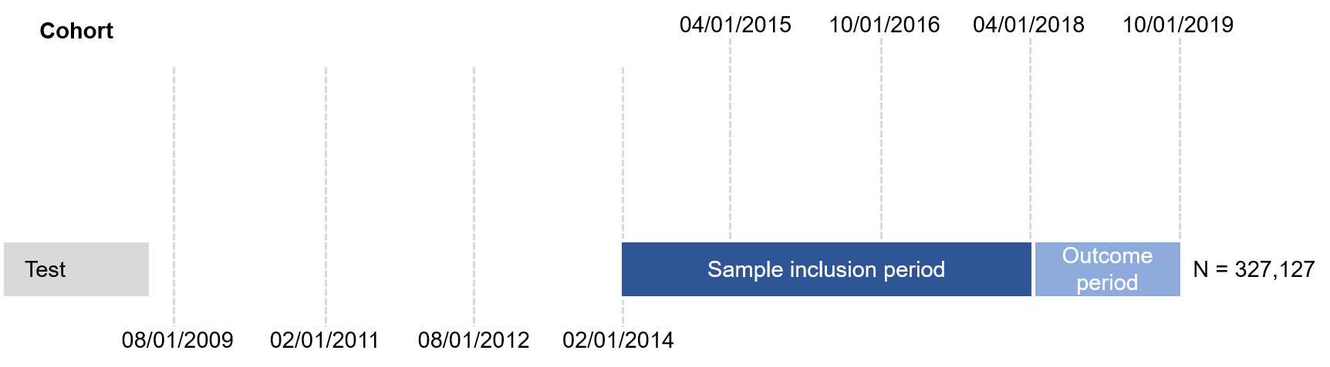
Prediction Setup

Slide 37
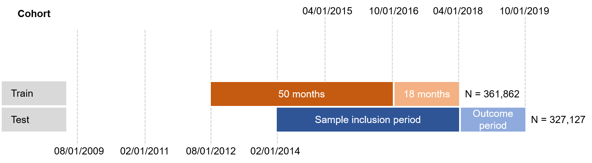
Prediction Setup

Slide 38
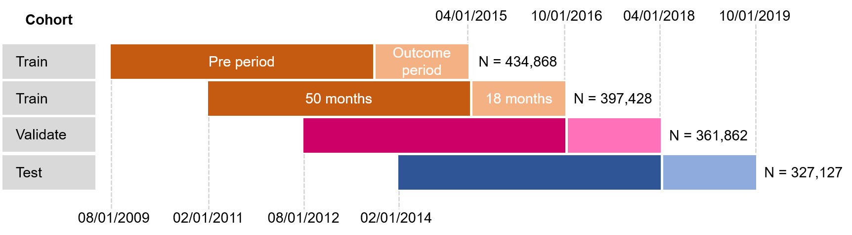
Prediction Setup

Slide 39
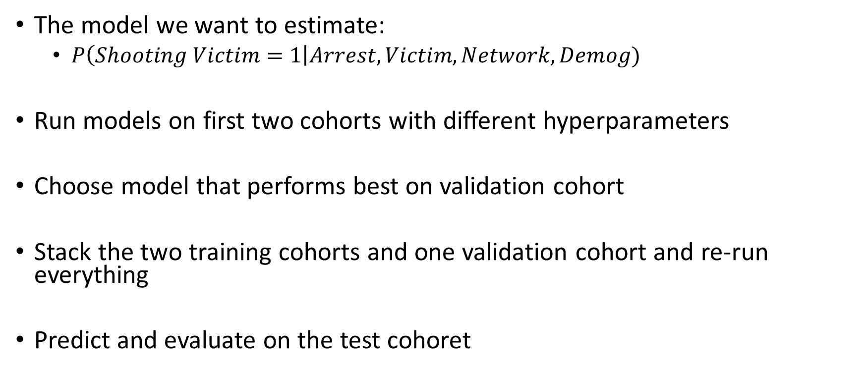
Prediction Setup: Recap
The model we want to estimate:
$P\left(Shooting Victim=1\right|Arrest,Victim,Network, Demog)$
Run models on first two cohorts with different hyperparameters
Choose model that performs best on validation cohort
Stack the two training cohorts and one validation cohort and re-run everything
Predict and evaluate on the test cohoret

Slide 40
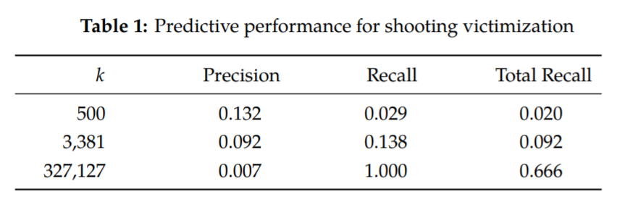
Results

Slide 41
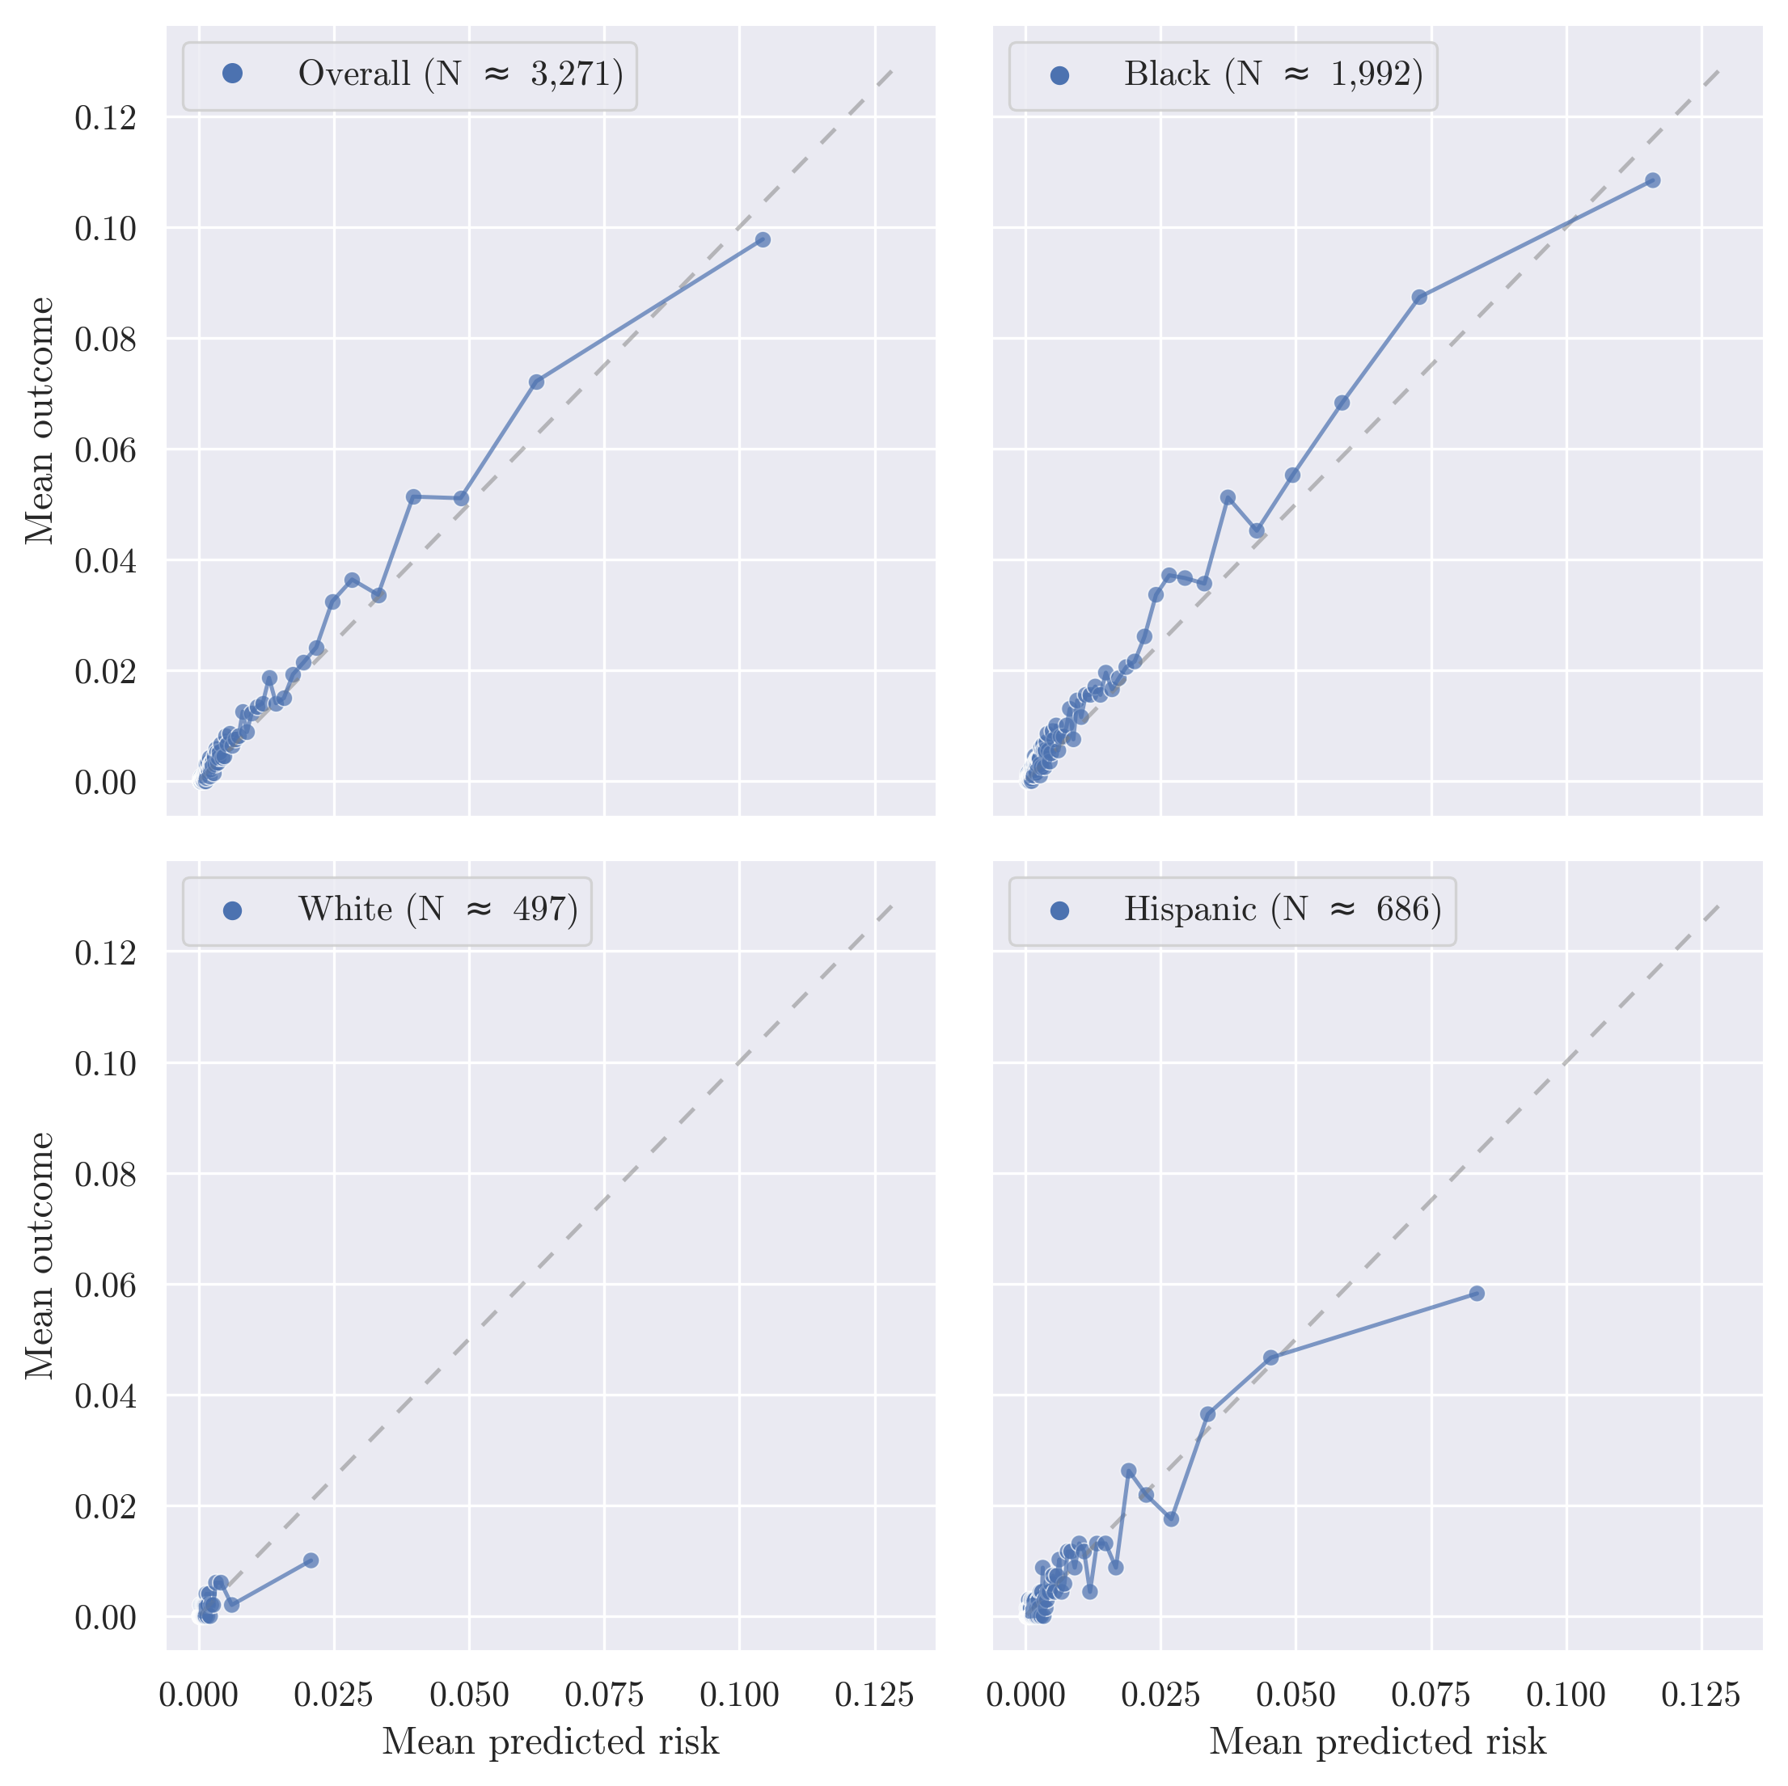
Calibration
Each dot is 1 percent of the prediction sample
Over 90% of the sample gets a predicted probability less that 5%
We appear to be calibrated overall (top left chart)
Some over-prediction for Hispanic and White subgroups relative to Black

Slide 42
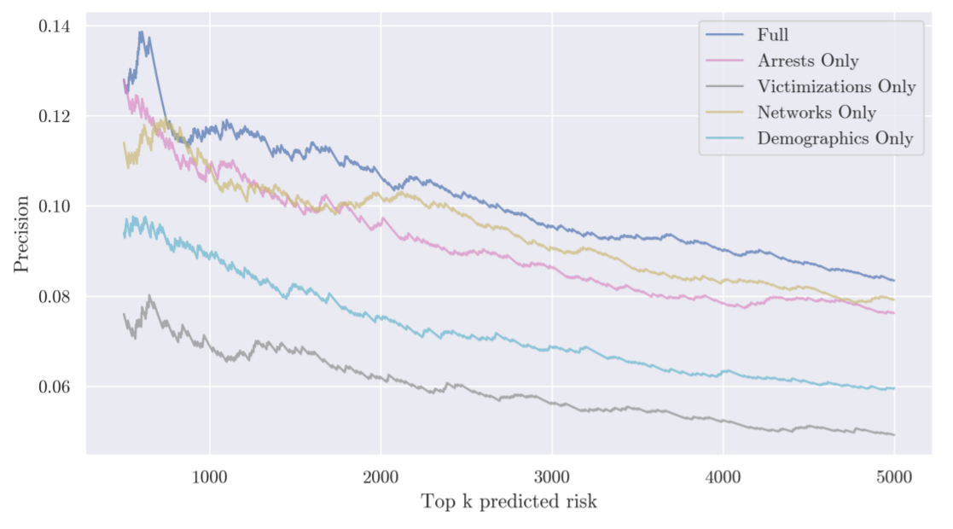
What Features Drive Performance?

Slide 43
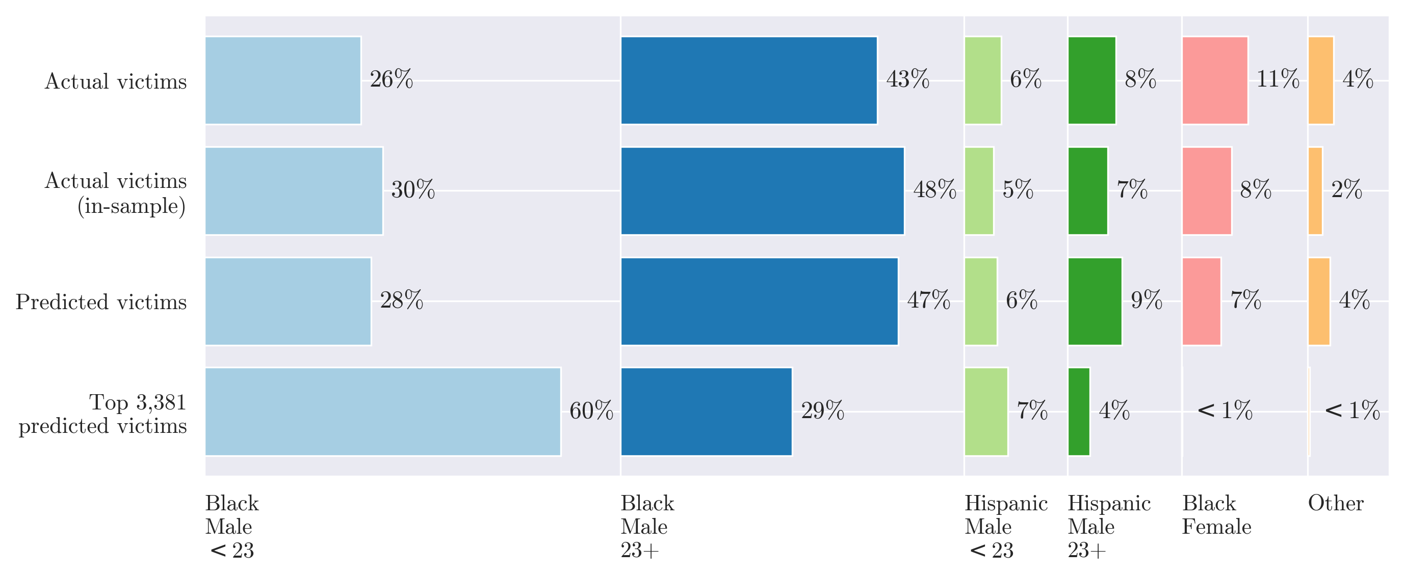
Who Gets Identified

Slide 44
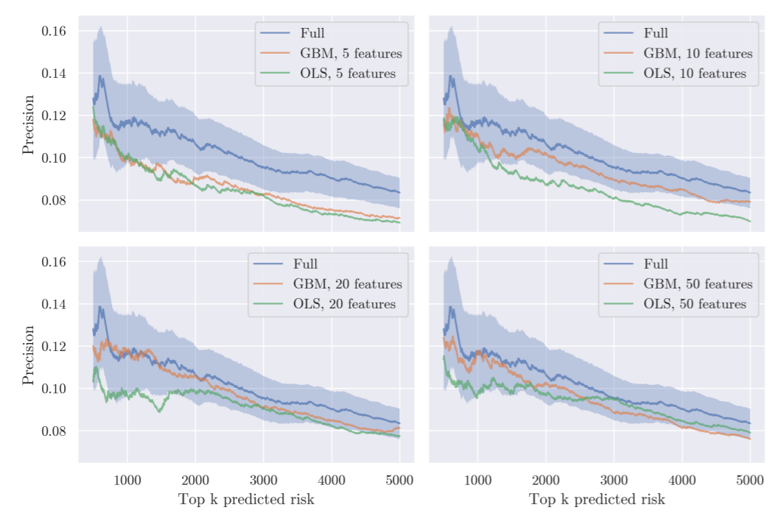
Machine Learning vs Data
Compare Full model
GBM
1,400+ features
GBM + OLS models with many fewer features

Slide 45
Potential Impact
Top 500 people account for 65 shooting victims (13%)
Treat all w/ CBT + Jobs. Cost $20k per person = $10 million
If CBT + Jobs reduced this risk by 50%: 65 victims to 33 victims
Very Crude: Value of a Quality-Adjusted Life Year (QALY). $50K to $150K. Choose $100K
33 * $100k * 1 year = 3.3 million
33 * $100k * 3 year = 9.0 million

Slide 46
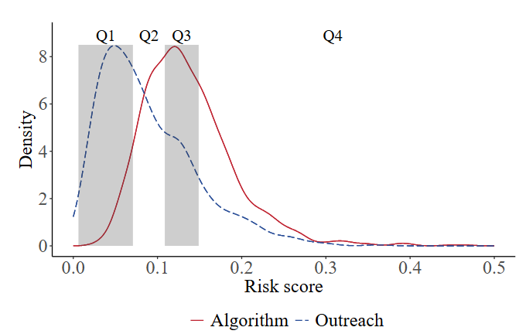
Outreach vs Algorithm
Distribution of risk scores by pathway

Slide 47
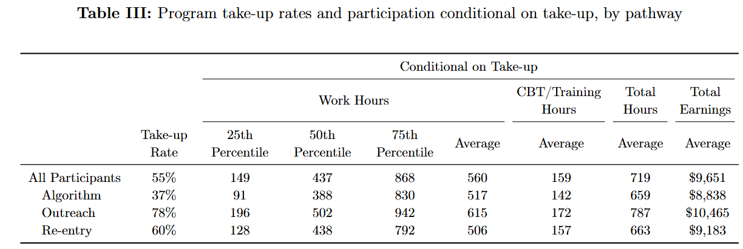
Outreach vs Algorithm
Distribution of risk scores by pathway

Slide 48
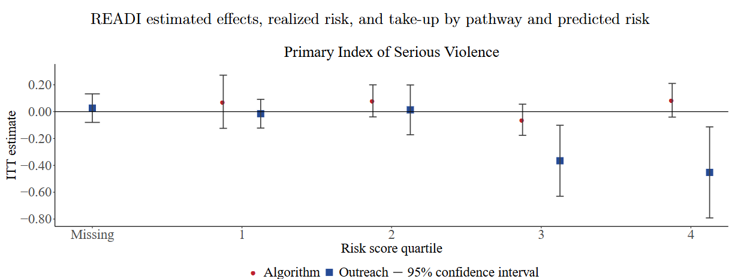
Outreach vs Algorithm

Slide 49
Cost-Benefit Step 1: Start With the Flagged Group
The model ranks people by predicted risk.
Suppose the intervention has K = 500 available slots.
The agency assigns the intervention to the 500 highest-risk people.
Among those 500 people, 65 become shooting victims without the intervention.
That number, 65, is the risk we are trying to reduce.

Slide 50
Cost-Benefit Step 2: Estimate Prevented Harm
Assume the intervention reduces shooting victimization by 50%.
Expected prevented victimizations = 65 × 0.50.
65 × 0.50 = 32.5.
Round to about 33 prevented victimizations.
This is the expected benefit before converting to dollars.

Slide 51
Cost-Benefit Step 3: Convert Benefits to Dollars
Assume each prevented victimization-year is worth $100,000.
One-year benefit = 33 × $100,000 = $3.3 million.
Three-year benefit = 33 × $100,000 × 3 = $9.9 million.
The longer the benefit lasts, the larger the estimated social benefit.

Slide 52
Cost-Benefit Step 4: Compare Benefits to Costs
Assume the program costs $20,000 per person.
Program cost = 500 × $20,000 = $10 million.
Net benefit, 1 year = $3.3 million − $10 million = −$6.7 million.
Net benefit, 3 years = $9.9 million − $10 million = −$0.1 million.
The recommendation depends on the assumptions about effectiveness, cost, and duration.

Slide 53
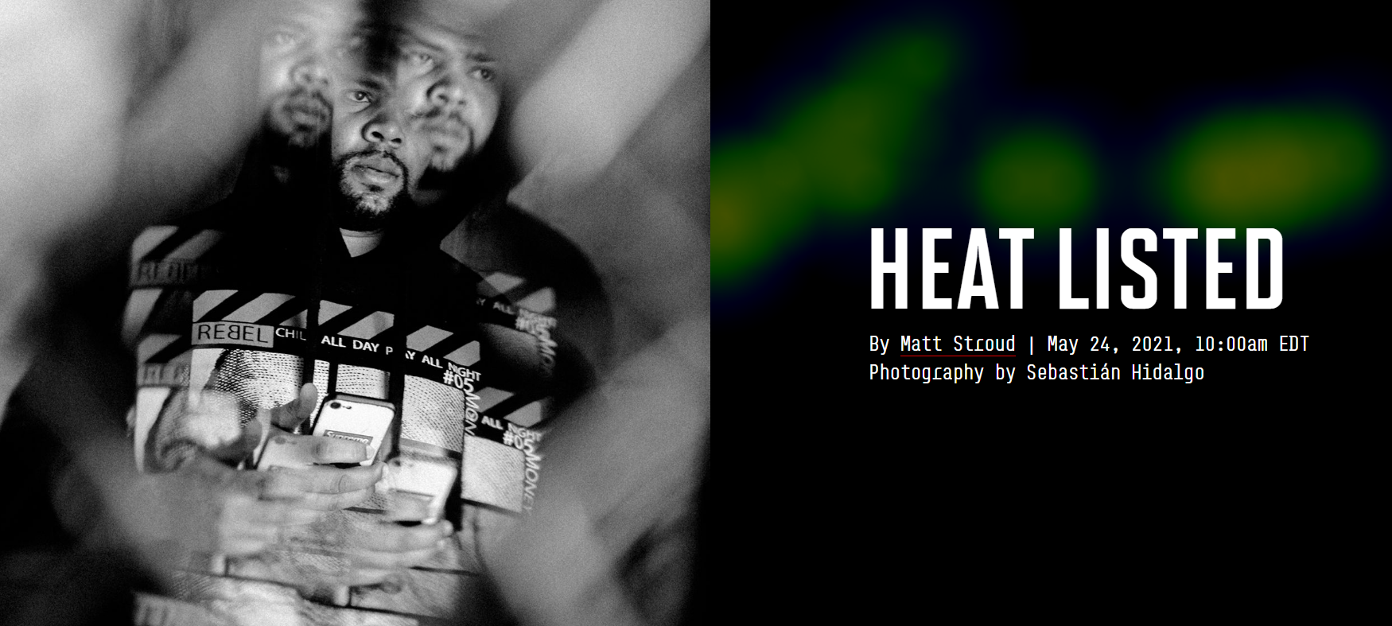
Strategic Subject List

