Slide 1
INST 414: Data Science Techniques
The Impact of
Algorithms and
Fairness

Slide 2
Assessing Algorithms

Slide 3
For the Final
You have been tasked with reducing crime in your state. To do so, you will target an intervention to those who are arrested each year (about 20,000 people)

Slide 4
Final
Build two algorithms
  Create two features (I have provided others)
  Build two algorithms:
    Predict violent rearrest
    Predict any rearrest
  Compute performance and fairness metrics
  Compare social benefit of the two interventions and choose which one to implement.

Slide 5
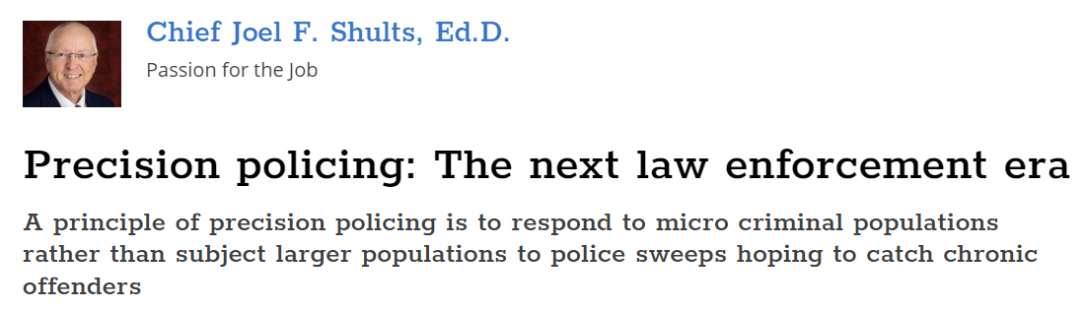
Precision Enforcement
Everyone who is predicted to be high risk of a violent crime will be detained. The cost of detention is relatively high.
Target a small number of people with a high-intensity intervention.

Slide 6
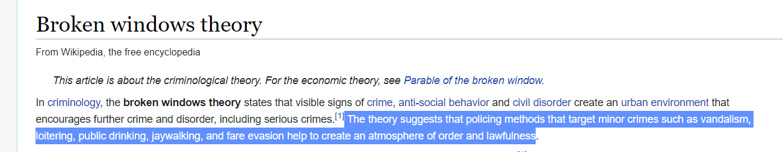
Broken Windows + Online Therapy
Everyone who is predicted to be high risk of any crime will be offered a low cost online behavioral health counseling
Target a large number of people with lower cost intervention

Slide 7
Our Example
Policy Option #1
  Algorithm: Violent Re-arrest
  Intervention: Detention
    Slots: 250
    Treatment Effect: 70% reduction (on all types of rearrests)
Policy Option #2
  Algorithm: Any Re-arrest
  Intervention: Online Therapy
    Slots: 1,000
    Treatment Effect: 20% reduction (on all types of rearrests)

Slide 8
Other Facts
We want to incorporate the fact that different crimes and different interventions have different values.
Social cost of a non-violent crime: $2,000
Social cost of a violent crime: $50,000
Social cost of detention: $6,000

Slide 9
Benefit of Online Therapy
Number of arrests by type among High Risk without Online Therapy
  Nonviolent: 558
  Violent: 96
Treatment effect is 20%. Meaning after intervention, number of arrests is 20% lower.
New-Old = Old * Treatment Effect
Change in number of arrests by type among High Risk with Online Therapy
  Nonviolent: 558 * -.2 = -112 (fewer nonviolent arrests)
  Violent: 96 * -.2 = -19

Slide 10
Benefit of Detention
Number of arrests by type among High Risk without Detention
  Nonviolent: 43
  Violent: 64
Treatment effect is 70%. Meaning after intervention, number of arrests is 70% lower.
New-Old = Old * Treatment Effect
Change in number of arrests by type among High Risk with Detention
  Nonviolent: 43 * (-.7) = -30 (fewer nonviolent arrests)
  Violent: 64 * (-.7) = -45

Slide 11
Converting Benefit to Dollar Values
Benefit of Intervention = Reduction in Violent Crime * Cost of Violent Crime + Reduction in NonViolent Crime * Cost of NonViolent Crime
Benefit of Online Therapy = (-19) * 50000 + (-112) * 2000 = -$1.18 mil
Benefit of Detention= (-45) * 50000 + (-30) * 2000 = -$2.3 mil

Slide 12
Cost of Detention
Cost of Detention = Number of False Positives * Social Cost of Detention
Number of False Positives = Number of People Detained - Number Rearrested for Violent Charge
Number of False Positive = 250 - 64 = 186
Cost of Detention = 186 * 6000 = $1.1 million

Slide 13
Compare Interventions
 | Online Therapy | Detention
Slots | 1,000 | 250
Treatment Effect | -.2 | -.7
Social Benefit | $1.18 million | $2.3 million
Social Cost | $0 | $1.1 million
Total Benefit | $1.18 million | $1.2 million

Slide 14
Fairness
Online Therapy
Measure | Race = 0 | Race = 1
PPV Balance | 85% | 39%
FPR Balance | 9% | 18%
FNR Balance | 51% | 73%
Detention
Measure | Race = 0 | Race = 1
PPV Balance | 36% | 21%
FPR Balance | 87% | 82%
FNR Balance | 3% | 8%

Slide 15
Who Gets the Benefit/Who Suffers the Cost?
Questions to ask yourself
  For online therapy, since it’s a benefit, is the benefit equally distributed between Race = 0 and Race = 1?
    Share in population is 50/50, but share among those predicted high risk is 60/40. So benefit goes more to Race = 0.
  For detention, since it takes away freedoms, we can look at who is more likely to get detained
    Share in population is 50/50, but share among those predicted high risk is 67/33. So Race=0 more likely to bear cost. (Similar Story with FP rate)

Slide 16
Upshot
If you use the dollar-conversion method, the two interventions have similar benefits.
Where they differ is which subgroup gets the costs and benefits.
For the final, you will consider the tradeoffs between social value of the interventions along with how the benefit is distributed among groups in order to decide which one to implement.

Slide 17
Bias in Predictions and the Importance of Base Rates

Slide 18
What Do We Mean by Bias?
Define a “fairness criterion”
  For example, that False Positive Rates should be balanced between groups (race, gender, age, etc)
  Could be more than one
If the criteria are not balanced, we’ll call this biased or unfair for today’s discussion.
There are infinite definitions of bias, so no claim that this is the only way to measure it

Slide 19
Our Data
Will be coming from police arrests
So we will either want to predict arrest in the future (next year)
Or use arrest data to predict another outcome (likelihood of dropping out of high school)
Or you could use arrest data as a predictor (X) or outcome to predict (Y)

Slide 20
Where Does Bias Come From?
Arrested
$$P\left(Arrest=1 | Crime=1, Report=1\right)$$
Crime Reported
$$P\left(Report=1 | Crime=1 \right)$$
Not Arrested
$$P\left(Arrest=0 | Crime=1, Report=1\right)$$
Crime Committed
Arrested
$$P\left(Arrest=1 | Crime=1, Report=0\right)$$
$$P\left(Report=0 | Crime=1 \right)$$
Crime Not Reported
Not Arrested
$$P\left(Arrest=0 | Crime=1, Report=0\right)$$

Slide 21
Where Does Bias Come From?
$$P\left(Arrest=1 | Crime=1, Race=A\right)$$
Arrested
Crime
Not Arrested
$$P\left(Arrest=0 | Crime=1, Race=A\right)$$
$$P\left(Arrest=1 | Crime=1, Race=B\right)$$
Arrested
Crime
Not Arrested
$$P\left(Arrest=0 | Crime=1, Race=B\right)$$

Slide 22
Where Does Bias Come From? Scenario 1
Arrested
$P\left(Arrest=1 | Crime=1, Race=A\right)=50\%$
Crime
Not Arrested
$$P\left(Arrest=0 | Crime=1, Race=A\right)=50\%$$
Arrested
$$P\left(Arrest=1 | Crime=1, Race=B\right)=100\%$$
Crime
Not Arrested
$$P\left(Arrest=0 | Crime=1, Race=B\right)=0\%$$

Slide 23
Where Does Bias Come From? Scenario 1
Arrested
$P\left(Arrest=1 | Crime=1, Race=A\right)=50\%$
Crime
Not Arrested
$$P\left(Arrest=0 | Crime=1, Race=A\right)=50\%$$
In this scenario, one group is more likely to be re-arrested given that they committed a crime
Arrested
$$P\left(Arrest=1 | Crime=1, Race=B\right)=100\%$$
Crime
Not Arrested
$$P\left(Arrest=0 | Crime=1, Race=B\right)=0\%$$

Slide 24
Where Does Bias Come From? Scenario 2
Arrested
$P\left(Arrest=1 | Crime=1, Race=A\right)=100\%$
Crime
Not Arrested
$$P\left(Arrest=0 | Crime=1, Race=A\right)=0\%$$
Arrested
$$P\left(Arrest=1 | Crime=1, Race=B\right)=100\%$$
Crime
Not Arrested
$$P\left(Arrest=0 | Crime=1, Race=B\right)=0\%$$

Slide 25
No Differences in Measurement
Arrested
$P\left(Arrest=1 | Crime=1, Race=A\right)=100\%$
Crime
Not Arrested
$$P\left(Arrest=0 | Crime=1, Race=A\right)=0\%$$
In this scenario, both groups are always arrested if they have committed a crime.
Arrested
$$P\left(Arrest=1 | Crime=1, Race=B\right)=100\%$$
Crime
Not Arrested
$$P\left(Arrest=0 | Crime=1, Race=B\right)=0\%$$

Slide 26
What Leads to Bias
We are going to imagine a world where everything is measured perfectly
We are going to compare two subgroups: race=0 and race=1
One subgroup will have a higher arrest rate than the other one
  Why is there a difference in re-arrest rate?
    Important for real-world discussions
    Today we primarily care about the math

Slide 27
Example
Predicting arrest in 2021 ($Arrest_{2021})$
Models:
  1) No predictors
  2) + Arrest in 2020 $(Arrest_{2020})$
  3) + Defendant’s race ($race)$
  4) + Interaction ($Arrest_{2020} ∗race)$
Ordinary Least Squares

Slide 28
Example
Models:
  1) No predictors
    $P\left(Arrest_{2021}|preds\right)=β_{0}$
  2) + Arrest in 2020 $\left(Arrest_{2020}\right)$
    $P\left(Arrest_{2021}|preds\right)=β_{0}+β_{1} Arrest_{2020}$
  3) + Defendant’s race ($race)$
    $P\left(Arrest_{2021}|preds\right)=β_{0}+β_{1}⋅ Arrest_{2020}+β_{2}⋅ race$
  4) + Interaction ($Arrest_{2020} ∗race)$
    $P\left(Arrest_{2021}|preds\right)=β_{0}+β_{1}⋅ Arrest_{2020}+β_{2}⋅ race+β_{3}⋅{Arrest}_{2020}⋅race$
Note “|preds” is just a shorthand for saying that these are conditional probabilities that depend on the predictors

Slide 29
$$P(Arrest_{2021})$$
Simplest Predictor
  $Arrest_{2021}=β_{0}+error_{i}$
$$race$$ | $$arrest_{2020}$$ | $$race :arrest_{2020}$$ | $$arrest_{2021}$$
0 | 1 | 0 | 1
0 | 1 | 0 | 0
0 | 0 | 0 | 1
0 | 0 | 0 | 0
0 | 0 | 0 | 0
0 | 0 | 0 | 0
1 | 1 | 1 | 1
1 | 1 | 1 | 1
1 | 1 | 1 | 0
1 | 0 | 0 | 0
1 | 0 | 0 | 1
1 | 0 | 0 | 0

Slide 30
$$P(Arrest_{2021})$$
Simplest Predictor
  $Arrest_{2021}=β_{0}+error_{i}$
What is $β_{0}$?
  Average value of $Arrest_{2021}$
$$arrest_{2021}$$
1
0
1
0
0
0
1
1
0
0
1
0

Slide 31
$$P(Arrest_{2021})$$
Simplest Predictor
  $Arrest_{2021}=β_{0}+error_{i}$
What is $β_{0}$?
  Average value of $Arrest_{2021}$
  $Arrest_{2021}=\frac{5}{12}$
$$arrest_{2021}$$
1
0
1
0
0
0
1
1
0
0
1
0

Slide 32
$$P(Arrest_{2021})$$
Simplest Predictor
  $Arrest_{2021}=β_{0}+error_{i}$
What is $β_{0}$?
  Average value of $Arrest_{2021}$
  $Arrest_{2021}=\frac{5}{12}$
Everyone gets the same prediction:
  $P\left(Arrest_{2021}\right)=\frac{5}{12}=.42$
$$arrest_{2021}$$ | $${\hat{arrest}}_{2021}$$
1 | .42
0 | .42
1 | .42
0 | .42
0 | .42
0 | .42
1 | .42
1 | .42
0 | .42
0 | .42
1 | .42
0 | .42

Slide 33
Compute Fairness Metrics
 | Calibration
 | $$\hat{P}\left(arrest_{2021}\right)$$ | $$P\left(arrest_{2021}\right)$$
$$race=0$$ | $$42\%$$ | $$33\%$$
$$race=1$$ | $$42\%$$ | $$50\%$$
 | Balance for 0s | Balance for 1s
 | Average $$\hat{P}(arrest_{2021}|arrest_{2021}=0)$$ | Average $$\hat{P}(arrest_{2021}|arrest_{2021}=1)$$
$$race=0$$ | 42% | 42%
$$race=1$$ | 42% | 42%

Slide 34
$$P(Arrest_{2021}|Arrest_{2020})$$
Adding in a Predictor
  $Arrest_{2021}=β_{0}+β_{1} Arrest_{2020}+error_{i}$
$$race$$ | $$arrest_{2020}$$ | $$race :arrest_{2020}$$ | $$arrest_{2021}$$
0 | 1 | 0 | 1
0 | 1 | 0 | 0
0 | 0 | 0 | 1
0 | 0 | 0 | 0
0 | 0 | 0 | 0
0 | 0 | 0 | 0
1 | 1 | 1 | 1
1 | 1 | 1 | 1
1 | 1 | 1 | 0
1 | 0 | 0 | 0
1 | 0 | 0 | 1
1 | 0 | 0 | 0

Slide 35
$$P(Arrest_{2021}|Arrest_{2020})$$
Adding in a Predictor
  $Arrest_{2021}=β_{0}+β_{1} Arrest_{2020}+error_{i}$
  $\hat{Arrest_{2021}}=0.29+0.31 Arrest_{2020}$
  $\hat{P}\left(Arrest_{2021} | Arrest_{2020}=0\right)=\frac{2}{7}=.29$
  $\hat{P}\left(Arrest_{2021} | Arrest_{2020}=1\right)=\frac{3}{5}=.6$
$$arrest_{2020}$$ | $$arrest_{2021}$$
1 | 1
1 | 0
0 | 1
0 | 0
0 | 0
0 | 0
1 | 1
1 | 1
1 | 0
0 | 0
0 | 1
0 | 0

Slide 36
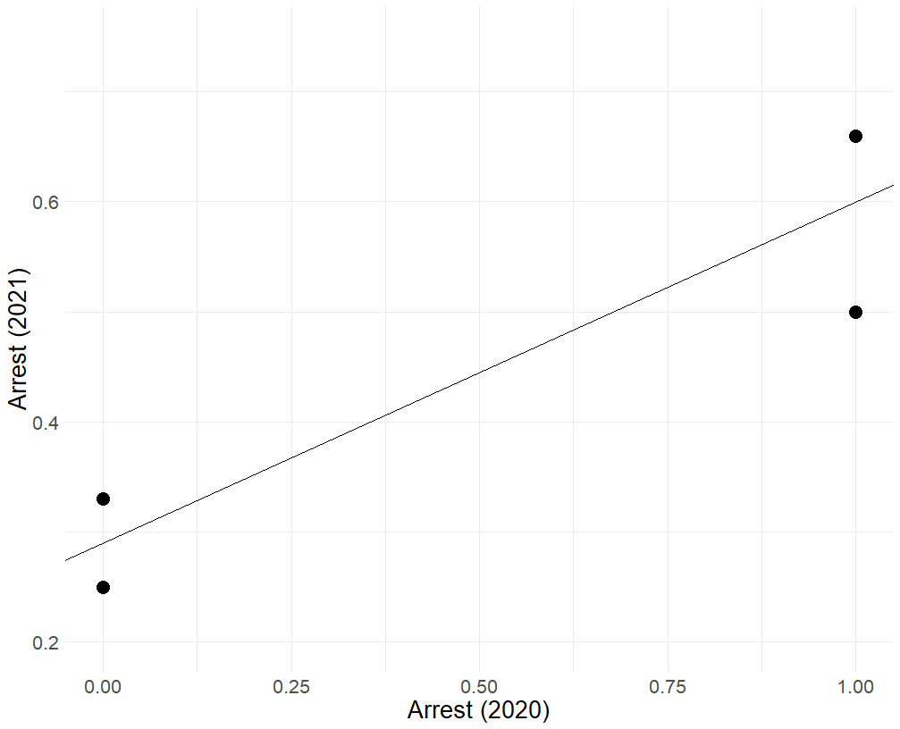
Visualizing the model
Base rate for Race = 1 and $Arrest_{2020}=1$
The line represents the prediction model for everyone:
$$\hat{Arrest_{2021}}=0.29+0.31 Arrest_{2020}$$
The points represent the true outcome rates for our two groups and whether they had an arrest in 2020 or not
Base rate for Race = 1 and $Arrest_{2020}=0$
Base rate for Race = 0 and $Arrest_{2020}=1$
Base rate for Race = 0 and $Arrest_{2020}=0$

Slide 37
Compute Fairness Metrics
 | Calibration
 | $$\hat{P}\left(arrest_{2021}\right)$$ | $$P\left(arrest_{2021}\right)$$
$$race=0, arrest=0$$ | $$29\%$$ | $$25\%$$
$$race=1, arrest=0$$ | $$29\%$$ | $$33\%$$
$$race=0, arrest=1$$ | $$60\%$$ | $$50\%$$
$$race=1, arrest=1$$ | $$60\%$$ | $$67\%$$
 | Balance for 0s | Balance for 1s
 | Average $$\hat{P}(arrest_{2021}|arrest_{2021}=0)$$ | Average $$\hat{P}(arrest_{2021}|arrest_{2021}=1)$$
$$race=0$$ | 36% | 44%
$$race=1$$ | 39% | 50%

Slide 38
$$P(Arrest_{2021}|Arrest_{2020}, Race)$$
Adding in a Predictor
  $Arrest_{2021}=β_{0}+β_{1} Arrest_{2020}+β_{2} race+error_{i}$
$$race$$ | $$arrest_{2020}$$ | $$race :arrest_{2020}$$ | $$arrest_{2021}$$
0 | 1 | 0 | 1
0 | 1 | 0 | 0
0 | 0 | 0 | 1
0 | 0 | 0 | 0
0 | 0 | 0 | 0
0 | 0 | 0 | 0
1 | 1 | 1 | 1
1 | 1 | 1 | 1
1 | 1 | 1 | 0
1 | 0 | 0 | 0
1 | 0 | 0 | 1
1 | 0 | 0 | 0

Slide 39
$$P(Arrest_{2021}|Arrest_{2020}, Race)$$
Adding in a Predictor
  $\hat{Arrest_{2021}}=.24+ .29 Arrest_{2020}+ . 12 race$
$\hat{P}\left(Arrest_{2021}=1 | Arrest_{2020}=0, race=0\right)=0.24$
$\hat{P}\left(Arrest_{2021}=1 | Arrest_{2020}=0, race=1\right)=0.35$
$\hat{P}\left(Arrest_{2021}=1 | Arrest_{2020}=1, race=0\right)=0.53$
$\hat{P}\left(Arrest_{2021}=1 | Arrest_{2020}=1, race=1\right)=0.65$
$$race$$ | $$arrest_{2020}$$ | $$arrest_{2021}$$ | $${\hat{arrest}}_{2021}$$
0 | 1 | 1 | .53
0 | 1 | 0 | .53
0 | 0 | 1 | .24
0 | 0 | 0 | .24
0 | 0 | 0 | .24
0 | 0 | 0 | .24
1 | 1 | 1 | .65
1 | 1 | 1 | .65
1 | 1 | 0 | .65
1 | 0 | 0 | .35
1 | 0 | 1 | .35
1 | 0 | 0 | .35

Slide 40
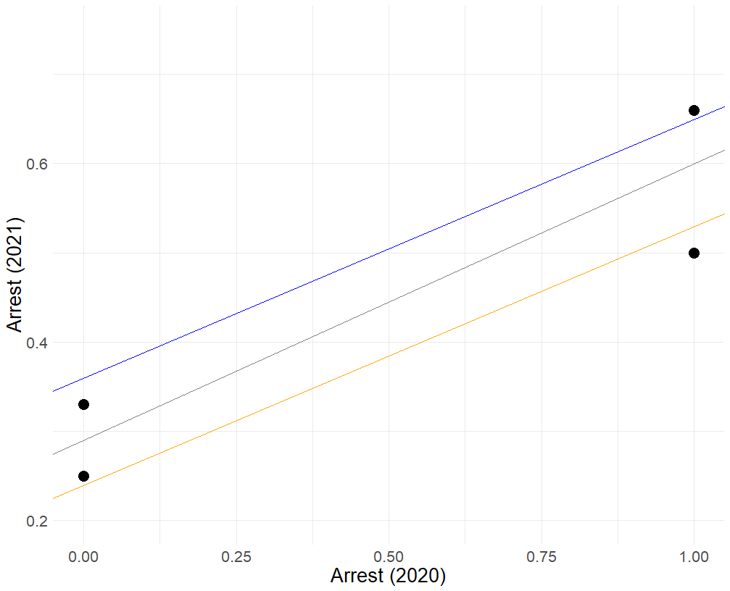
Visualizing the model
Base rate for Race = 1 and $Arrest_{2020}=1$
The orange and blue lines represent the prediction model for race = 0 and race = 1, respectively:
$$\hat{Arrest_{2021}}=.24+ .29 Arrest_{2020}+ . 12 race$$
When race = 0
$$\hat{Arrest_{2021}}=.24+ .29 Arrest_{2020}$$
When race = 1
$$\hat{Arrest_{2021}}=.36+ .29 Arrest_{2020}$$
Base rate for Race = 1 and $Arrest_{2020}=0$
Base rate for Race = 0 and $Arrest_{2020}=1$
Base rate for Race = 0 and $Arrest_{2020}=0$

Slide 41
Compute Fairness Metrics
 | Calibration
 | $$\hat{P}\left(arrest_{2021}\right)$$ | $$P\left(arrest_{2021}\right)$$
$$race=0, arrest=0$$ | $$24\%$$ | $$25\%$$
$$race=1, arrest=0$$ | $$35\%$$ | $$33\%$$
$$race=0, arrest=1$$ | $$53\%$$ | $$50\%$$
$$race=1, arrest=1$$ | $$65\%$$ | $$67\%$$
 | Balance for 0s | Balance for 1s
 | Average $$\hat{P}(arrest_{2021}|arrest_{2021}=0)$$ | Average $$\hat{P}(arrest_{2021}|arrest_{2021}=1)$$
$$race=0$$ | 31% | 38%
$$race=1$$ | 45% | 55%

Slide 42
Add interaction
Adding in a Predictor
  $Arrest_{2021}=β_{0}+β_{1} Arrest_{2020}+β_{2} race+β_{3}Arrest_{2020}⋅race+error_{i}$
$$race$$ | $$arrest_{2020}$$ | $$race :arrest_{2020}$$ | $$arrest_{2021}$$
0 | 1 | 0 | 1
0 | 1 | 0 | 0
0 | 0 | 0 | 1
0 | 0 | 0 | 0
0 | 0 | 0 | 0
0 | 0 | 0 | 0
1 | 1 | 1 | 1
1 | 1 | 1 | 1
1 | 1 | 1 | 0
1 | 0 | 0 | 0
1 | 0 | 0 | 1
1 | 0 | 0 | 0

Slide 43
$$P(Arrest_{2021}|Arrest_{2020})$$
Adding in a Predictor
  $\hat{Arrest_{2021}}=.25+.25 Arrest_{2020}+.08 race+ .08 Arrest_{2020}:race$
$\hat{P}\left(Arrest_{2021}=1 | Arrest_{2020}=0, race=0\right)=0.25$
$\hat{P}\left(Arrest_{2021}=1 | Arrest_{2020}=0, race=1\right)=0.33$
$\hat{P}\left(Arrest_{2021}=1 | Arrest_{2020}=1, race=0\right)=0.5$
$\hat{P}\left(Arrest_{2021}=1 | Arrest_{2020}=1, race=1\right)=0.67$
$$race$$ | $$arrest_{2020}$$ | $$race :arrest_{2020}$$ | $$arrest_{2021}$$ | $${\hat{arrest}}_{2021}$$
0 | 1 | 0 | 1 | .5
0 | 1 | 0 | 0 | .5
0 | 0 | 0 | 1 | .25
0 | 0 | 0 | 0 | .25
0 | 0 | 0 | 0 | .25
0 | 0 | 0 | 0 | .25
1 | 1 | 1 | 1 | .67
1 | 1 | 1 | 1 | .67
1 | 1 | 1 | 0 | .67
1 | 0 | 0 | 0 | .33
1 | 0 | 0 | 1 | .33
1 | 0 | 0 | 0 | .33

Slide 44
Visualizing the model
Base rate for Race = 1 and $Arrest_{2020}=1$
The line represents the prediction model for everyone:
$$\hat{Arrest_{2021}}=0.29+0.31 Arrest_{2020}$$
The points represent the true outcome rates for our two groups and whether they had an arrest in 2020 or not
Base rate for Race = 1 and $Arrest_{2020}=0$
Base rate for Race = 0 and $Arrest_{2020}=1$
Base rate for Race = 0 and $Arrest_{2020}=0$

Slide 45
Visualizing the model
Base rate for Race = 1 and $Arrest_{2020}=1$
The orange and blue lines represent the prediction model for race = 0 and race = 1, respectively:
$$\hat{Arrest_{2021}}=.24+ .29 Arrest_{2020}+ . 12 race$$
When race = 0
$$\hat{Arrest_{2021}}=.24+ .29 Arrest_{2020}$$
When race = 1
$$\hat{Arrest_{2021}}=.36+ .29 Arrest_{2020}$$
Base rate for Race = 1 and $Arrest_{2020}=0$
Base rate for Race = 0 and $Arrest_{2020}=1$
Base rate for Race = 0 and $Arrest_{2020}=0$

Slide 46
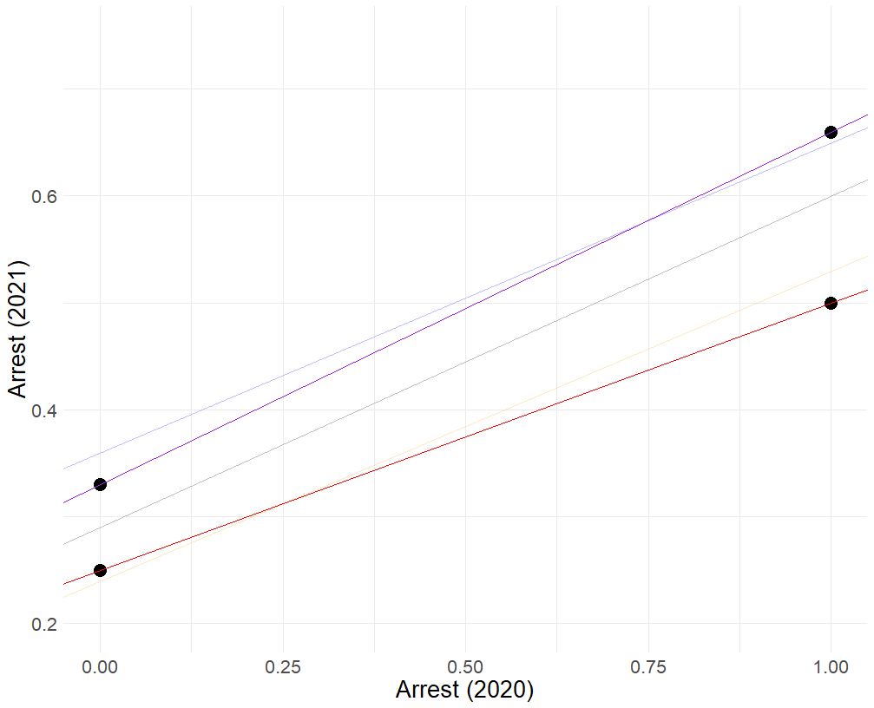
Visualizing the model
Base rate for Race = 1 and $Arrest_{2020}=1$
The red and purple lines represent the prediction model for race = 0 and race = 1, respectively:
  $$\hat{Arrest_{2021}}=.25+.25 Arrest_{2020}+.08 race+ .08 Arrest_{2020}:race$$
When race = 0
$$\hat{Arrest_{2021}}=0.25+0.25 Arrest_{2020}$$
When race = 1
$$\hat{Arrest_{2021}}=0.33+0.33 Arrest_{2020}$$
Base rate for Race = 1 and $Arrest_{2020}=0$
Base rate for Race = 0 and $Arrest_{2020}=1$
Base rate for Race = 0 and $Arrest_{2020}=0$

Slide 47
Compute Fairness Metrics
 | Calibration
 | $$\hat{P}\left(arrest_{2021}\right)$$ | $$P\left(arrest_{2021}\right)$$
$$race=0, arrest=0$$ | $$25\%$$ | $$25\%$$
$$race=1, arrest=0$$ | $$33\%$$ | $$33\%$$
$$race=0, arrest=1$$ | $$50\%$$ | $$50\%$$
$$race=1, arrest=1$$ | $$67\%$$ | $$67\%$$
 | Balance for 0s | Balance for 1s
 | Average $$\hat{P}(arrest_{2021}|arrest_{2021}=0)$$ | Average $$\hat{P}(arrest_{2021}|arrest_{2021}=1)$$
$$race=0$$ | 31% | 38%
$$race=1$$ | 44% | 56%

Slide 48
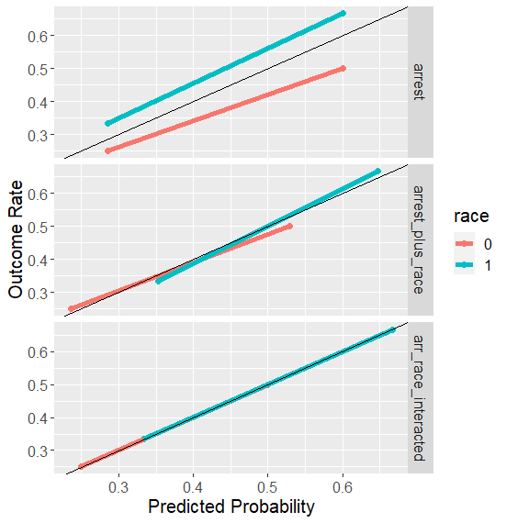
Calibration/PPV Balance
Improves with more features.

Slide 49
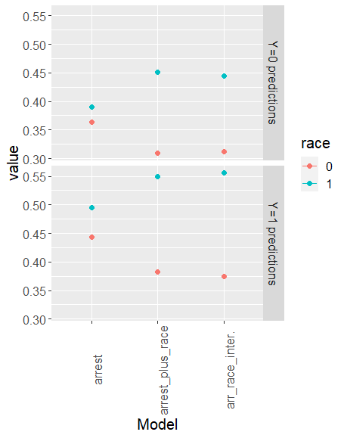
Error Rates
Degrade with more features

Slide 50
What Explains This Pattern?
PPV = $P(y=1|\hat{y}=1)$
$\hat{y}$ is a function of our predictors, so we could say
PPV = $P(y=1|X)$
This should look familiar
The entire training procedure is about finding this quantity

Slide 51
What Explains This Pattern?
But not the case for balance for positive and negative classes (FPR or FNR):
  FNR: $P\left(\hat{y}=0 | y=1\right)$
How can we get our algorithms to optimize for this?

Slide 52
Constraints
Recall the objective function for ridge
$$\sum{{\left(y_{i}−{\hat{y}}_{i}\right)}^{2}+λ\sum_{j}{β_{j}^{2}}}$$

Slide 53
Constraints
Recall the objective function for ridge
$$\sum{{\left(y_{i}−{\hat{y}}_{i}\right)}^{2}+λ\sum_{j}{β_{j}^{2}}}$$
Penalty term: $\sum_{j}{β_{j}^{2}}$

Slide 54
Constraints
Other ways you could constrain
$$\sum{{\left(y_{i}−{\hat{y}}_{i}\right)}^{2}+λ Φ(y_{i}, {\hat{y}}_{i})}$$
$Φ\left(y_{i}, {\hat{y}}_{i}\right):$ a constraint to take into account FPR and/or FNR

Slide 55
What Would a “Constraint” Look Like
Differences in False Positive Rates should be zero, or close to zero
  $P\left(\hat{y}=1 | y=0,race=0\right)=P\left(\hat{y}=1 | y=0,race=1\right)$
  $\frac{1}{N_{0}}\sum_{i=1}^{N_{0}}{{\hat{y}}_{i}\left(1−y_{i}\right)}−\frac{1}{N_{1}}\sum_{j=1}^{N_{1}}{{\hat{y}}_{j}\left(1−y_{j}\right)}$

Slide 56
What Would a “Constraint” Look Like
Differences in False Positive Rates should be zero, or close to zero
  $P\left(\hat{y}=1 | y=0,race=0\right)=P\left(\hat{y}=1 | y=0,race=1\right)$
  $\frac{1}{N_{0}}\sum_{i=1}^{N_{0}}{{\hat{y}}_{i}\left(1−y_{i}\right)}−\frac{1}{N_{1}}\sum_{j=1}^{N_{1}}{{\hat{y}}_{j}\left(1−y_{j}\right)}$
New objective:
$$\sum_{i=1}^{N}{{\left(y_{i}−{\hat{y}}_{i}\right)}^{2}+λ\sum_{j=1}{β_{j}^{2}+γ\left[\frac{1}{N_{0}}\sum_{k=1}^{N_{0}}{{\hat{y}}_{k}\left(1−y_{k}\right)}−\frac{1}{N_{1}}\sum_{k=1}^{N_{1}}{{\hat{y}}_{j}\left(1−y_{j}\right) }\right|}}$$

Slide 57
What Would a “Constraint” Look Like
Differences in False Positive Rates should be zero, or close to zero
  $P\left(\hat{y}=1 | y=0,race=0\right)=P\left(\hat{y}=1 | y=0,race=1\right)$
  $\frac{1}{N_{0}}\sum_{i=1}^{N_{0}}{{\hat{y}}_{i}\left(1−y_{i}\right)}−\frac{1}{N_{1}}\sum_{j=1}^{N_{1}}{{\hat{y}}_{j}\left(1−y_{j}\right)}$
New objective:
$$\sum_{i=1}^{N}{{\left(y_{i}−{\hat{y}}_{i}\right)}^{2}+λ\sum_{j=1}{β_{j}^{2}+γ\left[\frac{1}{N_{0}}\sum_{k=1}^{N_{0}}{{\hat{y}}_{k}\left(1−y_{k}\right)}−\frac{1}{N_{1}}\sum_{k=1}^{N_{1}}{{\hat{y}}_{j}\left(1−y_{j}\right) }\right|}}$$

Slide 58
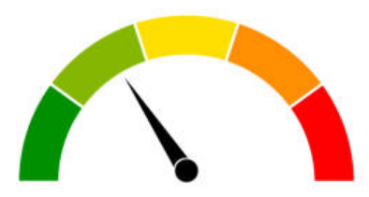
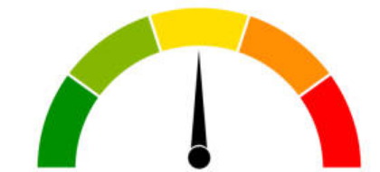
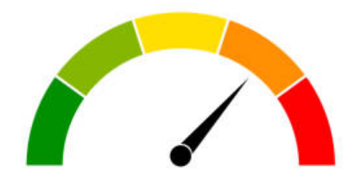
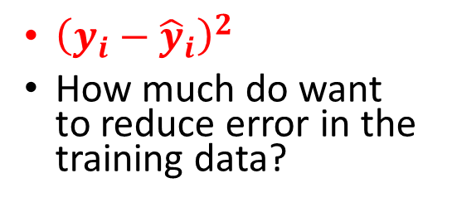
“Control Dials” for Algorithms
$$\sum_{i=1}^{N}{{\left(y_{i}−{\hat{y}}_{i}\right)}^{2}+λ\sum_{j=1}{β_{j}^{2}+γ\left[\frac{1}{N_{0}}\sum_{k=1}^{N_{0}}{{\hat{y}}_{k}\left(1−y_{k}\right)}−\frac{1}{N_{1}}\sum_{k=1}^{N_{1}}{{\hat{y}}_{j}\left(1−y_{j}\right) }\right|}}$$
${\left(y_{i}−{\hat{y}}_{i}\right)}^{2}$
How much do want to reduce error in the training data?
$λ\sum_{j=1}{β_{j}^{2}}$
How much do we want to prevent overfitting?
$γ\left[\frac{1}{N_{0}}\sum_{k=1}^{N_{0}}{{\hat{y}}_{k}\left(1−y_{k}\right)}−\frac{1}{N_{1}}\sum_{k=1}^{N_{1}}{{\hat{y}}_{j}\left(1−y_{j}\right) }\right|$
How much do we want to reduce disparities in False Positive Rates?

Slide 59
The Importance of Base Rates

Slide 60
$$P(Arrest_{2021}=1|Arrest_{2020}, Race)$$
$Arrest_{2021}=.25+.25 Arrest_{2020}+.08 race+.08 Arrest_{2020}⋅race$
$P\left(Arrest_{2021} | Arrest_{2020}=0,Race=0\right)$
  $.25+.25 \left(0\right)+.08 \left(0\right)+.08 \left(0⋅0\right)=.25$
$P\left(Arrest_{2021} | Arrest_{2020}=0,Race=1\right)$
  $.25+.25 \left(0\right)+.08 \left(1\right)+.08 \left(0⋅1\right)=.33$
$P\left(Arrest_{2021} | Arrest_{2020}=1,Race=0\right)$
  $.25+.25 \left(1\right)+.08 \left(0\right)+.08 \left(1⋅0\right)=.5$
$P\left(Arrest_{2021} | Arrest_{2020}=1,Race=1\right)$
  $.25+.25 \left(1\right)+.08 \left(1\right)+.08 \left(1⋅1\right)=.66$
$$race$$ | $$arrest_{2020}$$ | $$race :arrest_{2020}$$ | $$arrest_{2021}$$ | $${\hat{arrest}}_{2021}$$
0 | 1 | 0 | 1 | .5
0 | 1 | 0 | 0 | .5
0 | 0 | 0 | 1 | .25
0 | 0 | 0 | 0 | .25
0 | 0 | 0 | 0 | .25
0 | 0 | 0 | 0 | .25
1 | 1 | 1 | 1 | .66
1 | 1 | 1 | 1 | .66
1 | 1 | 1 | 0 | .66
1 | 0 | 0 | 0 | .33
1 | 0 | 0 | 1 | .33
1 | 0 | 0 | 0 | .33

Slide 61
Why Is Race Predictive of the outcome?
Race is a stand-in for missing predictors
  Differences in police behavior
  Differences in treatment of different subgroups historically
  Differences in environment, broadly speaking

Slide 62
How Would We Equalize P-Hats?
$Arrest_{2021}=.25+.25 Arrest_{2020}+.08 race+.08 Arrest_{2020}⋅race$
Adding in predictors that are differentially predictive across groups
$Arrest_{2021}=.25+.25 Arrest_{2020}+.04 race+.08 Arrest_{2020}⋅race+.08 policing⋅race$

Slide 63
We See This Already
Interactions can account for differences in risk across groups.
${Arrest}_{2021}=.24+ .29 Arrest_{2020}+ . 12 race$
$Arrest_{2021}=.25+.25 Arrest_{2020}+.08 race+.08 Arrest_{2020}⋅race$
.12 vs .08
Pure group differences matter less

