Slide 1
INST 414: Data Science Techniques Sources of Bias (Part II)

Slide 2
Where We Are
Last time: fairness metrics can conflict even with perfectly measured outcomes.
Today: what changes when variables are measured imperfectly?
Main question: calibrated to what?

Slide 3
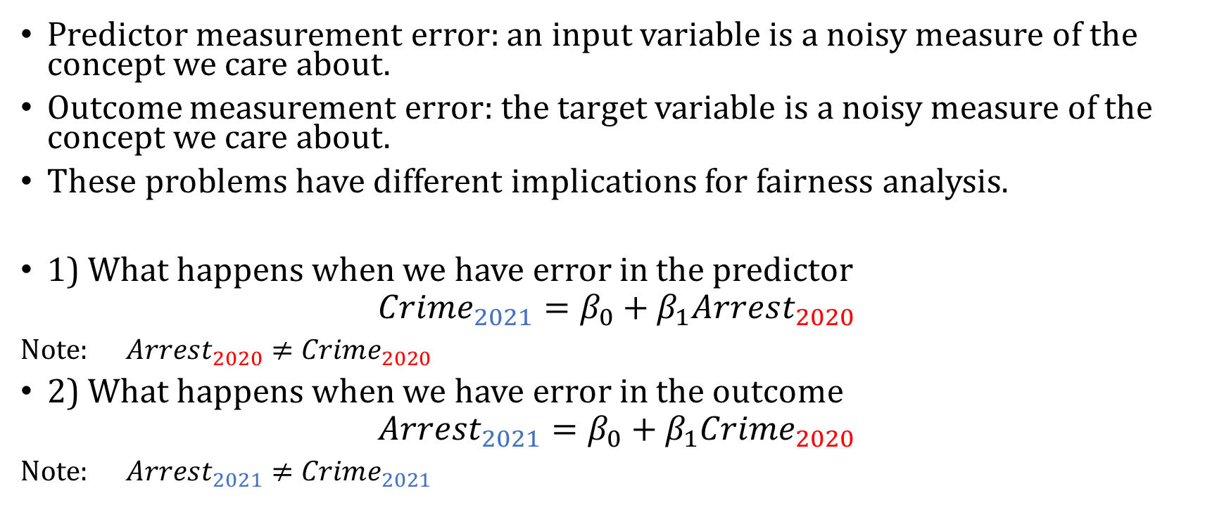
Two Different Problems
Predictor measurement error: an input variable is a noisy measure of the concept we care about.
Outcome measurement error: the target variable is a noisy measure of the concept we care about.
These problems have different implications for fairness analysis.
1) What happens when we have error in the predictor
$$Crime_{2021}=β_{0}+β_{1}Arrest_{2020}$$
Note: $Arrest_{2020}≠Crime_{2020}$
2) What happens when we have error in the outcome
$$Arrest_{2021}=β_{0}+β_{1}Crime_{2020}$$
Note: $Arrest_{2021}≠Crime_{2021}$

Slide 4
Running Example
Concept we care about: crime.
Observed variable in the data: arrest.
Arrests are not the same thing as crimes.
A risk assessment trained on arrests is learning patterns in arrests.

Slide 5
Causes of Bias in Predictions (Part II)

Slide 6
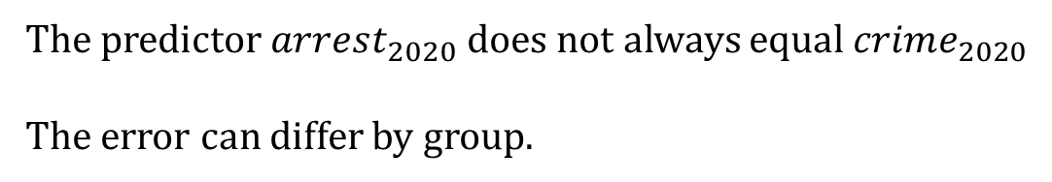
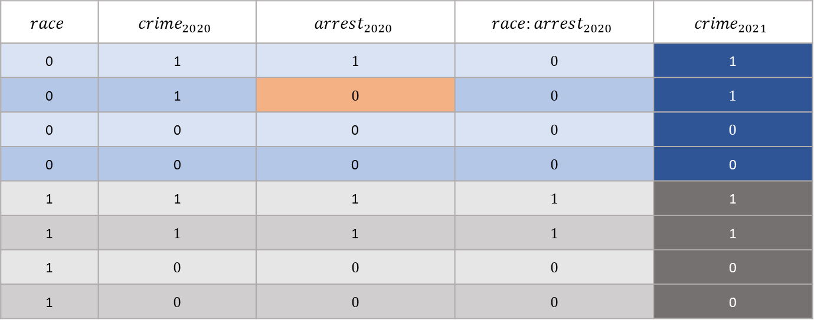
Toy Data: Predictor Measured With Bias
$$race$$ | $$crime_{2020}$$ | $$arrest_{2020}$$ | $$race:arrest_{2020}$$ | $${crime}_{2021}$$
0 | 1 | 1 | 0 | 1
0 | 1 | 0 | 0 | 1
0 | 0 | 0 | 0 | 0
0 | 0 | 0 | 0 | 0
1 | 1 | 1 | 1 | 1
1 | 1 | 1 | 1 | 1
1 | 0 | 0 | 0 | 0
1 | 0 | 0 | 0 | 0
The predictor $arrest_{2020}$ does not always equal $crime_{2020}$
The error can differ by group.

Slide 7
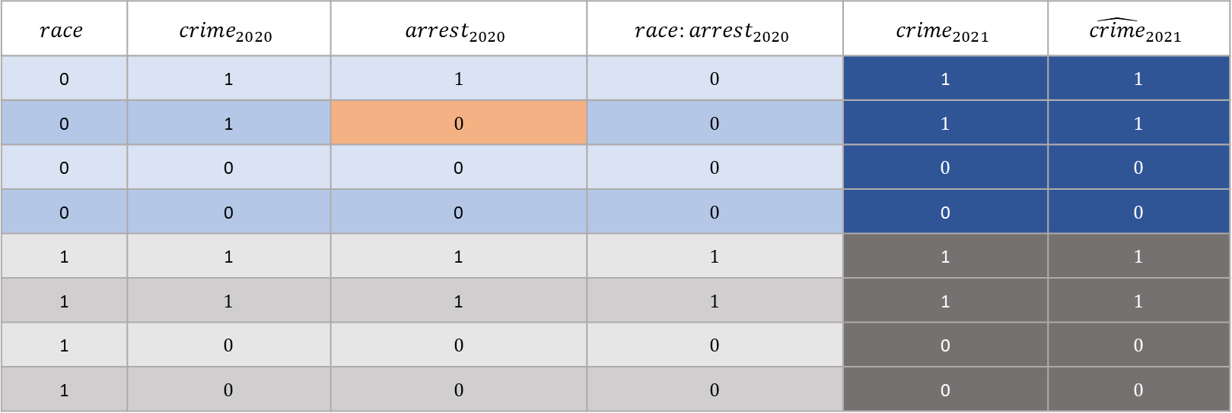
Perfectly Measured World
$$race$$ | $$crime_{2020}$$ | $$arrest_{2020}$$ | $$race:arrest_{2020}$$ | $${crime}_{2021}$$ | $${\hat{crime}}_{2021}$$
0 | 1 | 1 | 0 | 1 | 1
0 | 1 | 0 | 0 | 1 | 1
0 | 0 | 0 | 0 | 0 | 0
0 | 0 | 0 | 0 | 0 | 0
1 | 1 | 1 | 1 | 1 | 1
1 | 1 | 1 | 1 | 1 | 1
1 | 0 | 0 | 0 | 0 | 0
1 | 0 | 0 | 0 | 0 | 0
$$crime_{2021}=0+1⋅crime_{2020}$$

Slide 8

Model 1: Use Arrests Instead of Crimes
$$race$$ | $$crime_{2020}$$ | $$arrest_{2020}$$ | $$race:arrest_{2020}$$ | $${crime}_{2021}$$ | $${\hat{crime}}_{2021}$$
0 | 1 | 1 | 0 | 1 | 1
0 | 1 | 0 | 0 | 1 | .2
0 | 0 | 0 | 0 | 0 | .2
0 | 0 | 0 | 0 | 0 | .2
1 | 1 | 1 | 1 | 1 | 1
1 | 1 | 1 | 1 | 1 | 1
1 | 0 | 0 | 0 | 0 | .2
1 | 0 | 0 | 0 | 0 | .2
$${crime}_{2021}=0.2+0.8⋅arrest_{2020}$$
The model sees arrest_2020, not crime_2020.
If arrest_2020 is biased, the same observed value may mean different true risk across groups.
A color-blind model can be calibrated to the wrong information.

Slide 9
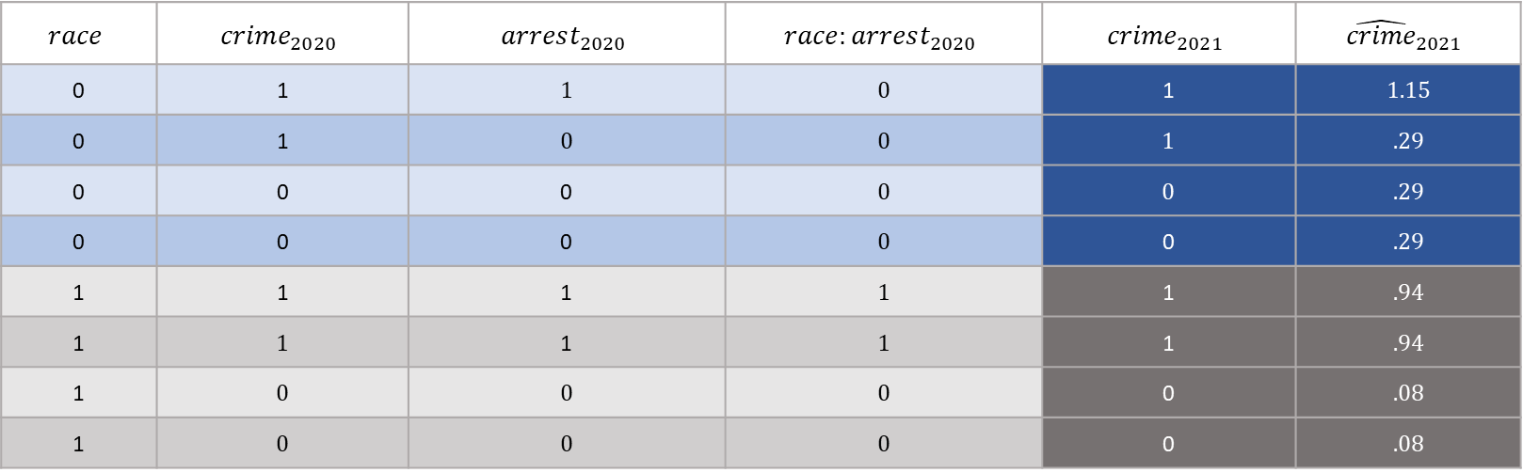
Model 2: Add Group Information
$$race$$ | $$crime_{2020}$$ | $$arrest_{2020}$$ | $$race:arrest_{2020}$$ | $${crime}_{2021}$$ | $${\hat{crime}}_{2021}$$
0 | 1 | 1 | 0 | 1 | 1.15
0 | 1 | 0 | 0 | 1 | .29
0 | 0 | 0 | 0 | 0 | .29
0 | 0 | 0 | 0 | 0 | .29
1 | 1 | 1 | 1 | 1 | .94
1 | 1 | 1 | 1 | 1 | .94
1 | 0 | 0 | 0 | 0 | .08
1 | 0 | 0 | 0 | 0 | .08
$${crime}_{2021}=0.29+0.86⋅arrest_{2020}−.21 race$$
Group membership can partly stand in for missing or biased information.
This can move predicted probabilities closer to the true outcome rate within groups.
This is not because group membership causes the outcome; it is correlated with what the data failed to measure.

Slide 10

Model 3: Add Interactions
$$race$$ | $$crime_{2020}$$ | $$arrest_{2020}$$ | $$race:arrest_{2020}$$ | $${crime}_{2021}$$ | $${\hat{crime}}_{2021}$$
0 | 1 | 1 | 0 | 1 | 1
0 | 1 | 0 | 0 | 1 | .33
0 | 0 | 0 | 0 | 0 | .33
0 | 0 | 0 | 0 | 0 | .33
1 | 1 | 1 | 1 | 1 | 1
1 | 0 | 1 | 1 | 1 | 1
1 | 0 | 0 | 1 | 0 | .0
1 | 0 | 0 | 0 | 0 | .0
$${crime}_{2021}=0.33+0.667⋅arrest_{2020}−.33 race+.33arrest_{2020}:race$$
Interactions allow predictors to mean different things for different groups.
Example: arrest_2020 may be a stronger proxy for crime_2020 in one group than another.
This is why interactions can matter for calibration.

Slide 11
What Did We Learn?
When the predictors are measured with bias, it’s still possible to have a calibrated model by taking race into account
It’s possible to use sensitive information such as someone’s race to generate a different prediction for them and make the algorithm fairer (affirmative action)
As opposed to a color-blind policy

Slide 12
Outcome Measurement Error
Now suppose the predictor is not the main problem.
The problem is the target variable itself.
Example: arrest_2021 is used as the outcome, but what we really care about is crime_2021.
If arrest_2021 misses crimes differently across groups, the outcome is biased.

Slide 13
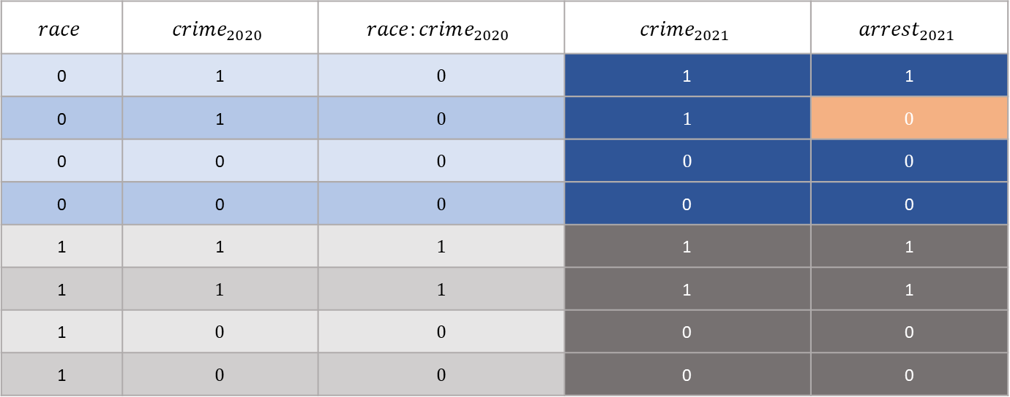
Data With Measurement Error
$$race$$ | $$crime_{2020}$$ | $$race:crime_{2020}$$ | $$crime_{2021}$$ | $$arrest_{2021}$$
0 | 1 | 0 | 1 | 1
0 | 1 | 0 | 1 | 0
0 | 0 | 0 | 0 | 0
0 | 0 | 0 | 0 | 0
1 | 1 | 1 | 1 | 1
1 | 1 | 1 | 1 | 1
1 | 0 | 0 | 0 | 0
1 | 0 | 0 | 0 | 0
The model is trained to predict arrest_2021.
If arrest_2021 is biased, the target itself is distorted.

Slide 14
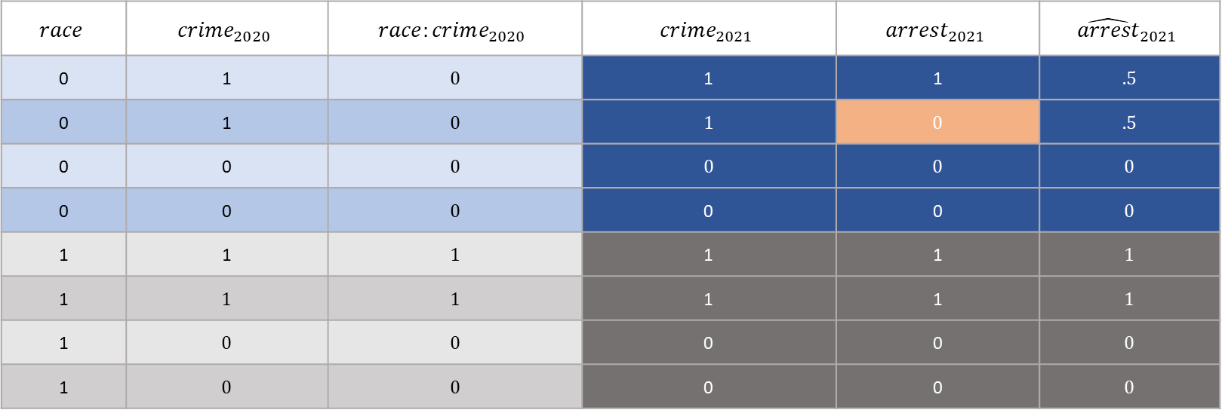
Accounting for Interaction
$$race$$ | $$crime_{2020}$$ | $$race:crime_{2020}$$ | $$crime_{2021}$$ | $$arrest_{2021}$$ | $${\hat{arrest}}_{2021}$$
0 | 1 | 0 | 1 | 1 | .5
0 | 1 | 0 | 1 | 0 | .5
0 | 0 | 0 | 0 | 0 | 0
0 | 0 | 0 | 0 | 0 | 0
1 | 1 | 1 | 1 | 1 | 1
1 | 1 | 1 | 1 | 1 | 1
1 | 0 | 0 | 0 | 0 | 0
1 | 0 | 0 | 0 | 0 | 0
$$arrest_{2021}=0.0+0.5⋅crime_{2020}+0.0 race+.5 crime_2020:race$$

Slide 15
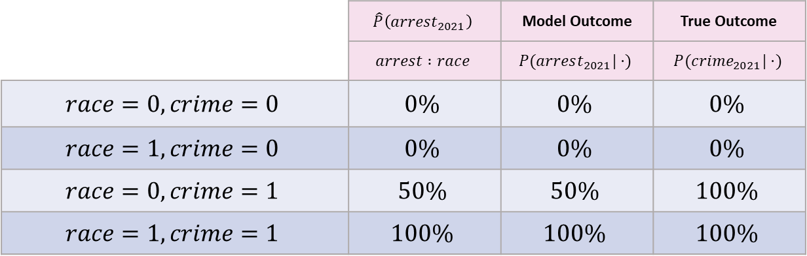
Calibration to the Observed Outcome
 | $$\hat{P}\left(arrest_{2021}\right)$$ | Model Outcome | True Outcome
 | $$arrest :race$$ | $$P(arrest_{2021}|⋅)$$ | $$P(crime_{2021}|⋅)$$
$$race=0, crime=0$$ | $$0\%$$ | $$0\%$$ | $$0\%$$
$$race=1, crime=0$$ | $$0\%$$ | $$0\%$$ | $$0\%$$
$$race=0, crime=1$$ | $$50\%$$ | $$50\%$$ | $$100\%$$
$$race=1, crime=1$$ | $$100\%$$ | $$100\%$$ | $$100\%$$
A model can be calibrated to arrest_2021.
That means predicted probabilities match observed arrest rates.
But observed arrest rates may not match true crime rates.

Slide 16
Why Adding Group Information Cannot Fully Fix This
Group information can help predict the biased observed outcome.
But the model still does not observe the true outcome.
If the target is arrest, the model learns arrest patterns, not crime patterns.

Slide 17
Criminal Justice Risk Assessments
Many risk assessments predict future arrest or rearrest.
Arrest is an administrative event, not the same as offending.
Calibration to rearrest can look statistically correct while still reflecting unequal enforcement.

Slide 18
Main Takeaway
Calibration is always calibration to a particular outcome variable.
If the outcome variable is biased, calibration can hide the problem rather than solve it.
Before asking whether a model is calibrated, ask: what is the outcome actually measuring?

