Slide 1
Optimization and Maintenance of NASA GEOS Software
Zain Jerath
Mentors: Matthew Thompson, Hamid Oloso

Slide 2
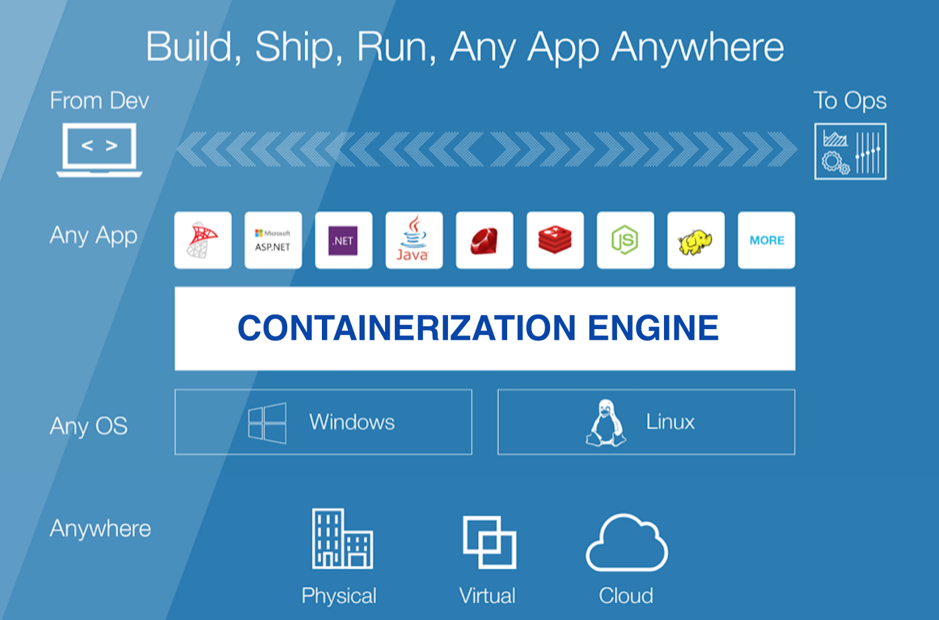
Containerization
Goal: Isolate build and run of GEOS in user spaces (https://gmao.gsfc.nasa.gov/GEOS_systems/)
Containerization: Bundles dependencies, data, and scripts with given application
Portability: Containerization allows run on any system with same architecture and binary file format

Slide 3

Docker
Containerization using Docker allows for build and run of GEOS designated for M1 chip users
Images built using ubuntu OS, gcc compiler, and openmpi on M1 Mac
Build and run use cases employed on personal networks and devices

Slide 4

Singularity
GEOS later containerized using Singularity to ensure compatibility with NCCS Discover HPC cluster
Images built using ubuntu OS and intel compiler on Windows laptop
Build and run use cases employed on NASA network at GSFC

Slide 5
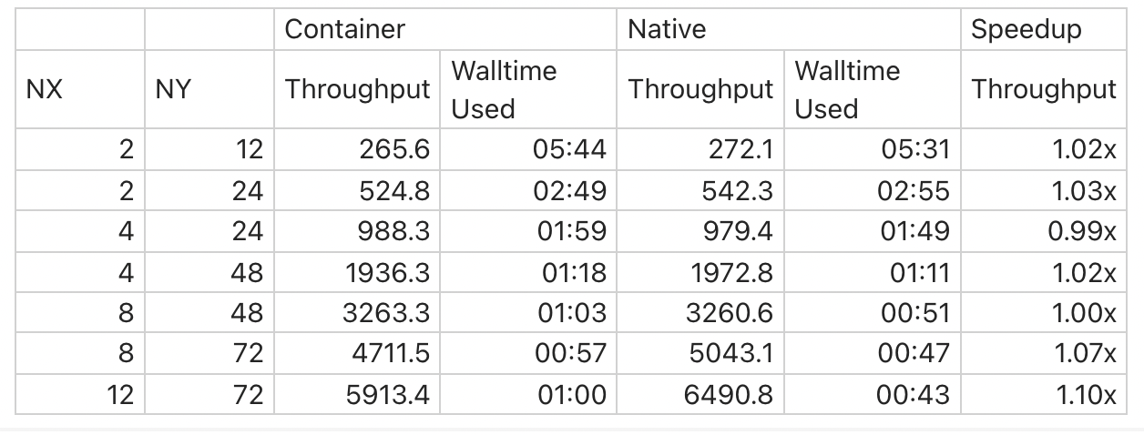
Results

