Slide 1
Introduction to KMeans

Slide 2
Unsupervised Learning
Supervised learning used labeled data pairs (x, y) to learn a function f : X→Y.
But, what if we don’t have labels?
No labels = unsupervised learning
Only some points are labeled = semi-supervised learning
  Labels may be expensive to obtain, so we only get a few.
Clustering is the unsupervised grouping of data points. It can be used for knowledge discovery.

Slide 3
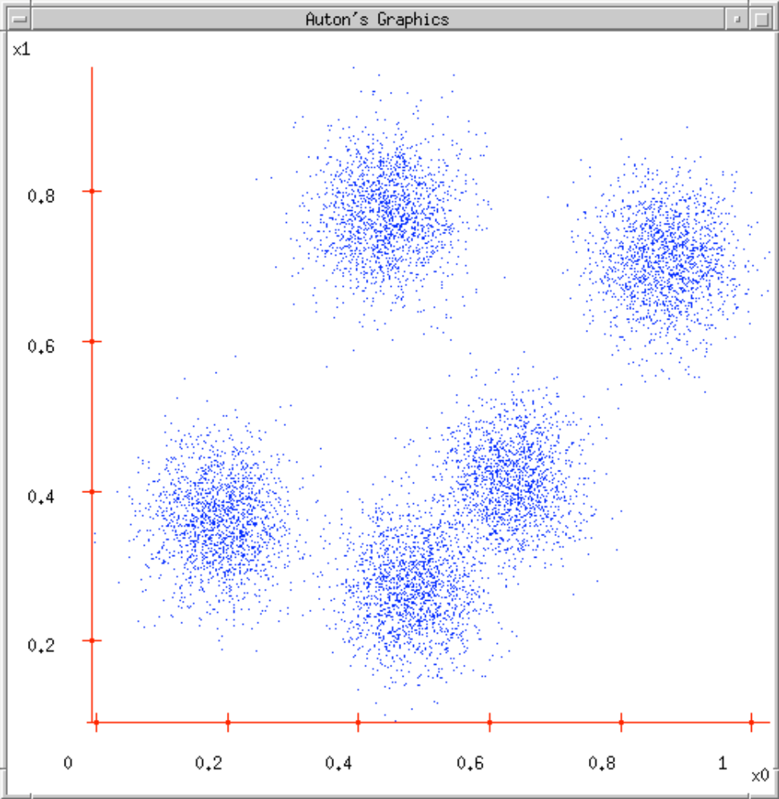
Clustering Data

Slide 4
K-Means Clustering
K-Means ( k , data )
Randomly choose k cluster center locations (centroids).
Loop until convergence
  Assign each point to the cluster of the closest centroid.
  Reestimate the cluster centroids based on the data assigned to each.

Slide 5
K-Means Clustering
K-Means ( k , data )
Randomly choose k cluster center locations (centroids).
Loop until convergence
  Assign each point to the cluster of the closest centroid.
  Reestimate the cluster centroids based on the data assigned to each.

Slide 6
K-Means Clustering
K-Means ( k , data )
Randomly choose k cluster center locations (centroids).
Loop until convergence
  Assign each point to the cluster of the closest centroid.
  Reestimate the cluster centroids based on the data assigned to each.

Slide 7
Problems with K-Means
Very sensitive to the initial points.
  Do many runs of k-Means, each with different initial centroids.
  Seed the centroids using a better method than random. (e.g. Farthest-first sampling)
Must manually choose k.
  Learn the optimal k for the clustering. (Note that this requires a performance measure.)

