Slide 1
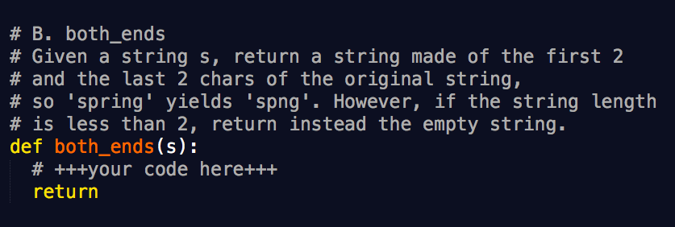
Exercise

Slide 2
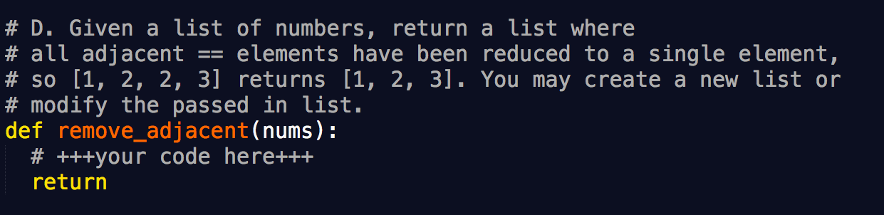
Exercise

Slide 3
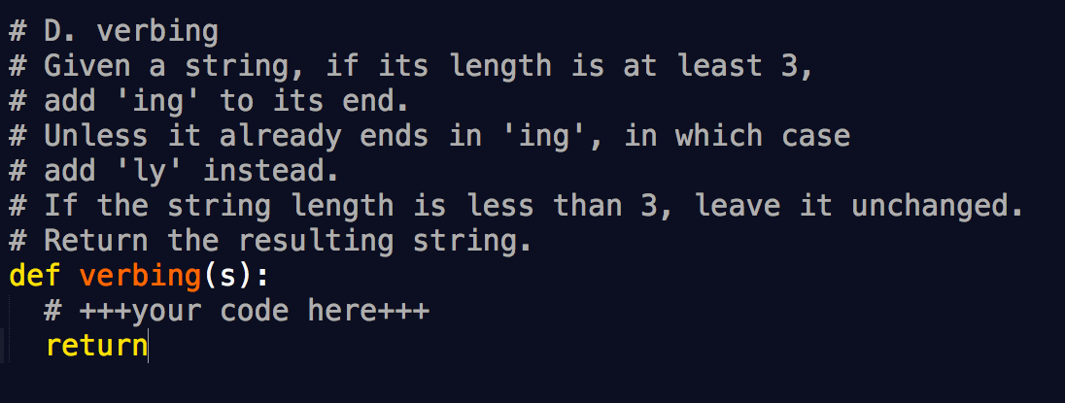
Exercise

Slide 4
NumPy
Create a vector of size 10 with all the elements are 0 but the fifth value which is 1
Create a 3x3 matrix with values ranging from 0 to 8

Slide 5
Exercise (RDD)
Build a RDD with contents from 1 to 10, and then calculate the mean
rdd = sc.parallelize([(‘a’,1), (‘b’, 2), (‘a’, 3)])
Transform the key to uppercase and then calculate the sum of the group by key
[(‘A’, 4), (‘B’, 2)]

Slide 6
Exercise (Spark SQL)
df = sqlContext.createDataFrame([('a', 1), ('b', 2), ('a', 3)], ["key", "value"])
- Transform the key to uppercase and then calculate the sum of the group by key
[(‘A’, 4), (‘B’, 2)]

Slide 7
Run the ML examples
KMeans

