Slide 1

横向扩展区块链
Main Chain Validators
Main Chain
Candidate Nodes
Voting
Block Header Record
Chain 1
…..
Mapping Child
Chain with VRF
Child Chain1
Timer
Mapping
Chain 2
Child Chain2
Pay Cost
…
….
….
Submit block header
Create Chain
Collector
CMC
Chain N
Create block with BFT
Child ChainN
Sync block header
Observer
Challenge
Sync block header
Notes:
挂载的平行链所有交易继在保证区块链安全性的情况下，横向扩展区块链。
续沿用本链的共识和数据区块，保证链的安全性。平行链的算力并没有分离出去，对交易的处理能力没有受到影响，随着更多的子链加入，整个链的TPS呈线性增长的趋势。
BUMO的子链挂载条数在3000这个极值范围,TPS呈线性增长突破900万,超过3000条子链由于整个网络限制，TPS保持相对稳定状态
1、验证节点成为子链验证节点属于主链，质押申请成为子链验证节点。
2、主链管理子链验证节点，VRF验证
3、激励方式：主链激励BU，子链自已的原生Token，收集者质押金BU
4、角色：主链验证节点，子链验证节点，收集者，观察者，普通节点
5、子链提交区块头到主链
6、挑战者机制

Slide 2
多链框架
Candidate Nodes
Main Chain
Voting
Main Chain
…..
Block Header Record
Mapping with VRF
Chain 1
Child Chain1
Submit block header
Challenge
….
….
Nodes
Collector
Pledge
Sync block header
Chain N
Child ChainN
Observer
Sync block header
Notes:
双层多态的主子链体系
多链账本
安全的 Firework 共识
挑战者机制
激励机制

Slide 3
多链框架
Validators Manager
BU Nodes
BU Chains
Pledge
Vote
Main Chain
Main Chain Validators
1
2
3
4
5
6
7
8
Withdraw
Abolish
Block Header Record
Child Vaildators
Child Chain Manager
1
2
3
4
Child Chain 1
Create
Bidding
Child Vaildators
Withdraw
Abolish
Child Chain 2
Cost
Pledge
1
2
3
4
5
Child Vaildators
Record
Reword
Child Chain 3
Manage
Lock BU
Child Vaildators
1
2
3
4
5
6
Child Chain Asset
Child Native Token
Child Chain 4
Other Vaildators
1
2
3
4
5
6
7
BU Asset
Child Other Token
Child Reserve Validators
BU Transfer Receipt
Consensus
Collector Nodes
Reword
Observer Nodes
Main Chain: DPOS +BFT
Child Chain: DPOS + BFT
BU
Child Native Token
Normal Nodes

Slide 4
多链框架
Consensus
BU Nodes
BU Chains
Main Chain
Main Chain Validators
Main Chain
DPOS +BFT
1
2
3
4
5
6
7
8
Child Chain
Child Vaildators
Block Header Record
POS + VRF + BFT
1
2
3
4
Child Chain 1
Child Vaildators
Scalable Ledger
Child Chain 2
Child Vaildators
1
2
3
4
5
Independence
Child Chain 3
Prevent Replay Attacks
Child Vaildators
1
2
3
4
5
6
Auditability
Other Vaildators
Child Chain N
1
2
3
4
5
6
7
Reword
Proposer Nodes
….
Consensus
Challenger Nodes
….
Archive Nodes
Proposal
Normal Nodes

Slide 5
VRF
Sign
SK
Entropy
Proof
Hash
Key pair
Random
PK
Verify

Slide 6
双层多态主子链
挑战者机制
1
2
3
4
5
6
7
8
1
2
3
4
1
2
3
4
5
1
2
3
4
5
6
高扩展的多链账本体系
激励
安全的 Firework 共识

Slide 7
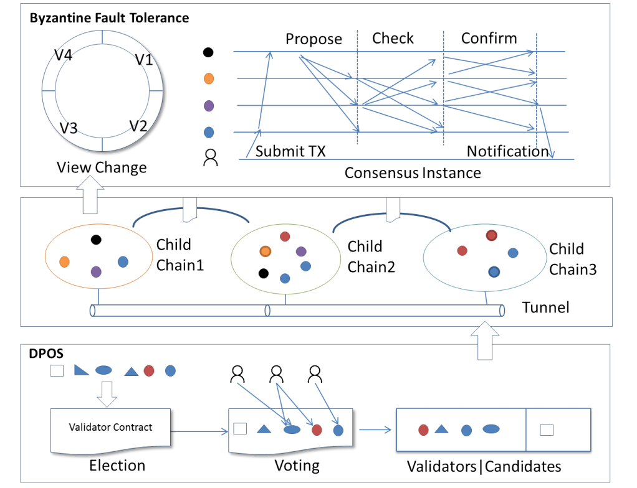
Firework
VRF

Slide 8
轻默克尔树
State Merkle Tree Sn
State Merkle Tree Sn+1
R
0x1001
R’
0x2001
Consensus Cn(C,D)
0...15
0...15
A
0x1002
B
0x1003
A’
0x2002
B
0x1003
0...15
0...15
0...15
0...15
C
0x1004
D
0x1005
E
0x1006
F
0x1007
C’
0x2004
D’
0x2005
E
0x1006
F
0x1007
State Merkle Tree S’n
State Merkle Tree S’n+1
R
0x1001
R’
0x2001
Consensus Cn(C,D)
0...15
0...15
A
0x1002
B
0x1003
A’
0x2002
B
0x1003
0...15
0...15
0...15
C
0x1004
D
0x1005
E
0x1006
F
0x1007
C’
0x2004
D’
0x2005

Slide 9
轻节点演算
Light Client
Only store state root hash.
Obsever
Provided light merkel tree.
Store full state
State Merkle Tree Sn
R
0x1001
0...15
A
0x1002
B
0x1003
0...15
0...15
C
0x1004
D
0x1005
E
0x1006
F
0x1007
Process tx
1
1
Process tx
2
Get data for {C,D}
3
Pre-execution tx
4
Reply light merkel tree: {R, A, C, D, B}）
Verify {R, A, C, D, B}
5
Same Result
Excecute tx
R’
0x2001
Excecute tx
6
6
0...15
A’
0x2002
B
0x1003
0...15
0...15
C’
0x2004
D’
0x2005
E
0x1006
F
0x1007
Notes:
无状态客户端只存储状态的root信息，观察客户端存储链的全状态信息。无状态客户端想执行交易tx，在链上对应的状态为D，无状态客户端并不知道D的状态，所以它会向观察者客户端请求D的状态以及会影响D变化的Merkel分支Witness: {R, A, C, D, B},无状态客户端执行完毕后会把所影响的C’状态，以及被影响的Merkel分支广播给全网节点。

Slide 10
扩容方案
BDN 分发
Layer0
组播锁定组
QUIC UDP协议
DAG
扩容方案
Layer1
隔离见证
分片
侧链
Layer2
子链
状态通道

Slide 11
Initialized
Running
Pending

Slide 12
Internal Channel
Bu Chain
1
2
3
4
5
6
7
8
BU Chain
Commit Channel 2 Tx
Commit Channel 1 Tx
Message Queue
Message Queue
Channel N
Channel 1
Message Queue
Message Queue
Bob
Alice
Message Queue
Message Queue
Audit
Audit
Validator
Register
Channel Manager 1
…
Channel Manager N
Auditor
Commit Tx,Receipt, State
Commit Tx,Receipt, State
Channel Party
Notes:
1、一条链
2、多个内置通道
3、链的数据所有人共享
4、通道的人只有部分人共享
5、通道需要在链上注册
6、通道内的交易内部共识后，并把交易、收据、用户状态写入链上合约
7、通道内需要引入监管机制
8、用户发交易只依赖于BU Chain，不会感知到通道的存在

Slide 13
Multi Channel
Channel 1
BU Chain
Channel N
Message Queue
Message Queue
Message Queue
Message Queue
Message Queue
Message Queue
AMC
Register
Channel Manager 1
…
Channel Manager N
Validator
Commit Block Header,SPV
Commit Block Header,SPV
Bu Chain
Auditor
1
2
3
4
5
6
7
8
Channel Party
Notes:
1、一条链
2、多个内置通道(子链)
3、链的数据所有人共享
4、通道的人只有部分人共享
5、通道（子链）需要在链上注册
6、通道（子链）内的交易内部共识后，并把区块头写入链上的合约
7、通道内需要引入监管机制
8、跨链使用审计者（公证人）交易

Slide 14
Relay Chain
AMC
Parallel Chain N
Relay Chain
Register Chain
RMC
AMC
Other Chain
CMC
AMC
Cross ZKA Queue
Commit Block Header
Parallel Chain 2
ICP
Validator for Relay Chain
Report
Cross ZKA Transfer
Validator for Parallel Chain
Data Privacy
Audit Data
Collector
AMC
Adapter
Parallel Chain 1
Auditor
Notes:
跨链的目的：
通过跨链协议实现资产的跨链转移。平行链的任意资产可以转移到中继链或者任意其他平行链。中继链的资产也可以转移到其他任意的平行链。
跨链架构的基础：
通过中继链保证链之间的安全与信任问题。
怎样实现的呢？
1、平行链注册。
2、平行链提交区块和SPV证明到中继链
3、跨链资产转移
4、审计区块和交易
ICP: InterChain Communication Protocol
CMC:Chain Manager Contract
AMC:Asset Mangager Contract
ZKA：Zero-knowledge Asset

Slide 15
Relay Chain
AMC
Parallel Chain N
Relay Chain
Register Chain
RMC
Privacy Asset Contract
AMC
PMC
Physical isolation
Other Chain
CMC
AMC
Cross ZKA Queue
Commit Block Header
Parallel Chain 2
ICP
Validator for Relay Chain
Report
Cross ZKA Transfer
Validator for Parallel Chain
Data Privacy
Audit Data
Collector
AMC
Adapter
Parallel Chain 1
Auditor
Notes:
跨链的目的：
通过跨链协议实现资产的跨链转移。平行链的任意资产可以转移到中继链或者任意其他平行链。中继链的资产也可以转移到其他任意的平行链。
跨链架构的基础：
通过中继链保证链之间的安全与信任问题。
怎样实现的呢？
1、平行链注册。
2、平行链提交区块和SPV证明到中继链
3、跨链资产转移
4、审计区块和交易
ICP: InterChain Communication Protocol
CMC:Chain Manager Contract
AMC:Asset Mangager Contract
ZKA：Zero-knowledge Asset

Slide 16
Auditor
RelayChain RMC
Committee Members
1
Register proposal
2
Stored record
3
Voting proposal
4
Audit proposal
5
Notice the result

Slide 17
Parallel Chain
Collector
Relay Chain CMC
1
Pack ZKAP,
or pack block
2
Notify to collector
3
Commit proposal for ZKAP or block header
4
Processing proposal
5
Notice the result
6
Prepare for next operation

Slide 18
Parallel Chain
Auditor
Relay Chain CMC
Committee Members
Other Chain
Appear major fault,
And has been submitted
to relay chain.
1
2
Synchronize block
Synchronous contract data
3
4
Check for consistency
5
Commit proposal with spv
7
Suspend processing with
fault chain’s asset
6
Validators calculation
and affirm.
8
Committee arbitration

