Slide 1
MOMCOZY · CREATOR CONTENT BRIEF
Momcozy Wellness 1
Industry First* Warm-Massage Breast Pump
FOR WORKING MOMS
Elevated Comfort. High Performance, Naturally
Confidential — all information here is under embargo. Do not share externally.
*Based on available market data as of November 2025.

Slide 2
OUTLINE
What’s in this brief
Three parts. Part 2 is written for you specifically; Parts 1 and 3 are the same for every creator on this campaign.
01
Product Information
What it is · Selling points by priority · Specs
02
Content Brief
Your audience · Video topics · Key messages
03
Guidelines & Delivery
Usage · Compliance · Timeline · Rights
2

Slide 3
01
Product Information
What it is, what it does, and what you can say about it

Slide 4
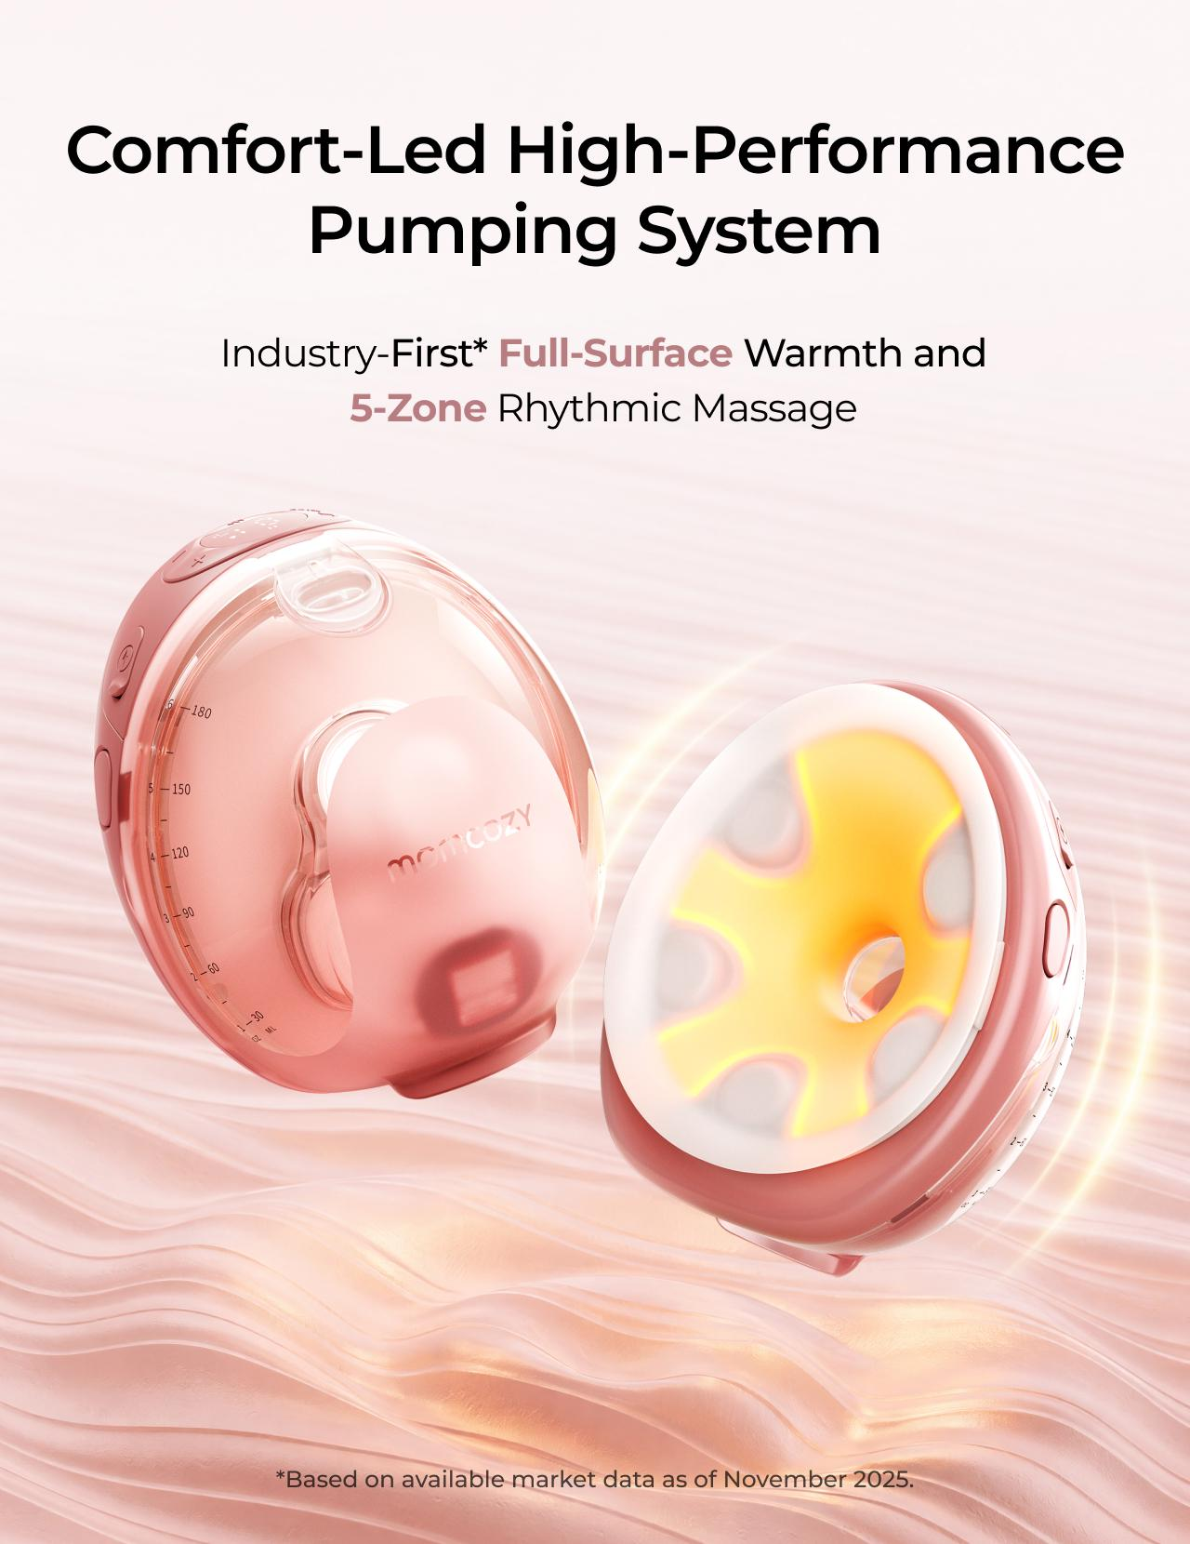
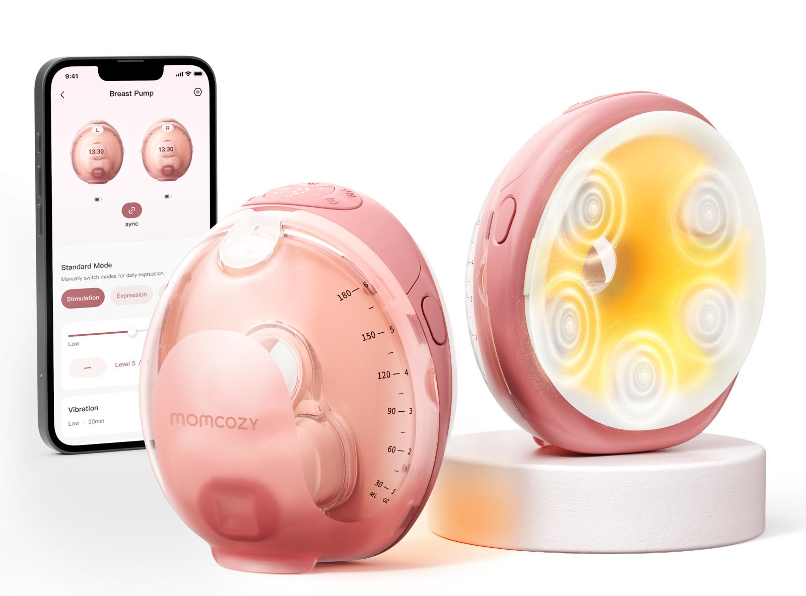
PRODUCT OVERVIEW
Momcozy Wellness 1
Industry First* Warm-Massage Breast Pump
Momcozy Wellness 1 is a wearable breast pump built to make pumping feel warmer, gentler, and just easier to fit into real life.
Slogan
Elevated Comfort. High Performance, Naturally
MSRP
$329.99 USD
Official link
https://momcozy.com/products/momcozy-wellness-1-warm-massage-wearable-breast-pump-w1?
Launch / region
US
SUGGESTED USE SCENARIOS
At-Home
Workday
On the Go
Nighttime
Pump while caring for baby and managing everyday life.
Pump discreetly and effectively throughout the workday.
Pump while commuting, shopping, or running errands.
Pump comfortably with minimal disruption.
*Based on available market data as of November 2025.
4

Slide 5
KEY SELLING POINTS
Selling points, by priority
P0 messages must appear. P1 and P2 are selectable — choose one of each. P3 is optional.
Tier | Key message | What this means for moms
P0 | Full-Surface Warmth | Three adjustable warmth levels cover the full flange-to-breast contact area, helping you feel more relaxed before pumping starts.
P0 | 5-Zone Suction-Synced Massage | Five massage zones pulse when the pump pulls and pause when it releases, instead of buzzing continuously throughout the session..
P1 | DoubleFit™ Soft Dual-Layer Flange | The soft inner layer sits gently against your skin, while the supportive outer layer helps keep a steady seal as you move.
P1 | Smart App Control | Start, pause, adjust suction levels, and log your milk output—all from your phone.
P1 | Easy to Use | One-press release makes removal easier, and only five washable parts after use.
P2 | Transparent Top & 6 oz Collector | The transparent top lets you check nipple alignment and milk flow without removing the pump, while the 6 oz collector supports longer sessions.
P2 | Expert-Tuned Programs & Personalized Rhythm | Start with an expert-tuned program, then adjust warmth, massage, suction, and modes in the App and save your preferred rhythm.
P2 | SoftPulse Baby-Like Suction | Small, steady micro pulses feel more like a baby’s natural suck—gentler on the breast, with up to 295 mmHg strength available when needed.
P3 | Auto Shutoff | Massage stops automatically after 5 minutes and warmth after 15 minutes by default, so you do not need to keep checking the clock.
P3 | Long Battery Use | Get up to 10 pumping-only sessions on one charge, or up to 6 with warmth and massage on, with massage noise below 50 dB.
5
Notes:
不用动

Slide 6
SPECIFICATIONS
Specs you may be asked about
Facts only. None of these numbers may be turned into a performance or health claim.
Item | Spec | Item | Spec
Warmth levels | 99°F / 102°F / 106°F (3 levels) | Massage | Surround massage, 3 levels, synced to suction
Max suction | Up to 295 mmHg | Collector capacity | 6 oz
Parts to wash | 5 milk-contact parts | Battery | Up to 10 sessions (pump only) / up to 6 (warmth + massage on)
Noise | Below 50 dB with massage on | Auto shutoff | Massage 5 min / warmth 15 min (default)
App | Momcozy App — warmth, massage, suction, modes, manual output log | Flange | DoubleFit™ soft dual-layer
Never phrase a spec as an outcome. “Three warmth levels” is a fact. “Warms you up so you pump more” is a claim — see the red lines in Part 3.
6

Slide 7
02
Content Brief
For Working Moms

Slide 8
YOUR AUDIENCE & CONTEXT
Who you’re speaking to
Everything in Part 2 assumes this context. If it does not match your channel, please let us know before you film.
THE CREATOR
WHAT TO SHOW
Moms who have returned to work and pump during the workday — at a desk, in a lactation room, or between meetings.
1
Product positioning for this creator type: the Warm-Massage Wearable Breast Pump designed to help working moms shift from workplace tension into a calmer, more manageable pumping routine — without putting the whole day on pause.
2
Show pumping inside a real workday, not a staged one. The interesting part is the transition — closing a laptop, finding twenty minutes, and coming back.
3
Keep it experience-led. Do not frame warmth or massage as stress relief, therapy, or a treatment for anything.
8

Slide 9
VIDEO TOPICS
Content Directions for Reference
★
Pick the one topic that fits your channel best. You know your audience better than we do — choose the angle you can genuinely pull off in your own life, and use authetic and organic tone to deliver the content
Pumping Between Two Meetings
01
I Had 20 Minutes Between Meetings — Here’s My Pumping Reset
A Real Pumping Routine at the Office or Lactation Room
02
What Pumping at Work Actually Looks Like
Afternoon Fatigue and the Mental Load of Pumping
03
When Pumping Feels Like One More Task on My Calendar
Returning-to-Work Experience and Advice
04
3 Things I Wish I Knew Before Pumping at Work
Work Pumping Bag or Desk-Drawer Essentials
05
What’s in My Work Pumping Bag
9

Slide 10
VIDEO TOPICS — DETAIL
Topic Explained in details
Scenario on the left, the key related supporting points to carry on the right.
01
Pumping Between Two Meetings
KEY MESSAGES
“I Had 20 Minutes Between Meetings — Here’s My Pumping Reset”
P0
Full-Surface Warmth
A short window between two calls: how you set up, pump, and get back to the desk.
P0
5-Zone Suction-Synced Massage
Format: POV workday vlog with voice-over
P2
Expert-Tuned Programs & Personalized Rhythm: Preset programs to keeps sessions consistent at work.
P1
Smart App Control: Control everything from
your phone.
02
A Real Pumping Routine at the Office or Lactation Room
KEY MESSAGES
“What Pumping at Work Actually Looks Like”
P0
Full-Surface Warmth
A full-day walk-through: morning prep, the designated pump break, and what happens with the milk afterwards. Unglamorous is fine — realistic is the point.
P0
5-Zone Suction-Synced Massage
Format: Documentary-style “Day in My Life” vlog
P1
Smart App Control: Control everything from your phone.
P2
Easy to Use: One-press release, and only 5 milk-contact parts to wash.
10
Notes:
making pumping easier

Slide 11
VIDEO TOPICS — DETAIL
Topic Explained in details
Scenario on the left, the key related supporting points to carry on the right.
03
Afternoon Fatigue and the Mental Load of Pumping
KEY MESSAGES
“When Pumping Feels Like One More Task on My Calendar”
P0
Full-Surface Warmth
The end-of-day version of the routine, and how the session itself feels different from the way it used to.
P0
5-Zone Suction-Synced Massage
P2
SoftPulse Baby-Like Suction: Creates a gentler-feeling rhythm.
Talk about how the session feels. Do not frame it as relieving stress, anxiety or fatigue.
Expert-Tuned Programs & Personalized Rhythm: Preset programs to Get You Pumping Faster.
P2
Format: Emotional storytelling, before-and-after mood comparison
P2
04
Returning-to-Work Experience and Advice
KEY MESSAGES
“3 Things I Wish I Knew Before Pumping at Work”
P0
Full-Surface Warmth
Practical advice for moms about to go back. Frame it as what you learned the hard way, not as a product list inttroduction
P0
5-Zone Suction-Synced Massage
P2
Easy to Use: Saves time between sessions.
Format: Talking with B-roll and practical tips
P2
Expert-Tuned Programs & Personalized Rhythm: Builds a consistent work routine.
11

Slide 12
VIDEO TOPICS — DETAIL
Topic Explained in details
Scenario on the left, the key related supporting points to carry on the right.
05
Work Pumping Bag or Desk-Drawer Essentials
KEY MESSAGES
“What’s in My Work Pumping Bag”
P0
Full-Surface Warmth
What you actually carry, and why each thing is important
P0
5-Zone Suction-Synced Massage
Format: Fast-paced checklist-style video
P3
Long Battery Use: Reduces on-the-go charging.
P1
Smart App Control: Enables phone-based adjustments.
12

Slide 13
REASONS TO BELIEVE
Why each message is true
You do not need to recite these on camera. You do need to understand them, so your own words stay accurate.
Core message | Reason to believe
Transition more smoothly from work mode into pumping mode. | Warmth covers the full flange-to-breast contact area — not only a few isolated points — with 99°F, 102°F and 106°F settings for fast, even warming.
Warmth and surround rhythmic massage work together throughout the pumping session. | 5-Zone Suction-Synced Massage uses gentle rhythmic vibration that activates during each pull and pauses on release, with 3 levels — not kneading or rolling motions. The massage follows the same rhythm as suction instead of vibrating continuously or randomly.
Feel more in control throughout the workday. | Adjust warmth, massage, suction and modes from the phone; choose an expert-tuned program or save a routine that works for you. You can also log milk output manually and review changes over time in the app.
Fit pumping more easily into a real workday. | One-press release, and only 5 milk-contact parts to wash. Up to 10 pumping-only sessions per charge, or up to 6 with warmth and massage active, with noise below 50 dB.
Spend less time readjusting before each session. | A transparent top helps you check nipple alignment and milk flow. The DoubleFit™ dual-layer flange combines soft, skin-friendly silicone contact with a more supportive, stable seal.
13

Slide 14
03
Guidelines & Delivery
Usage · Compliance · Timeline · Rights

Slide 15
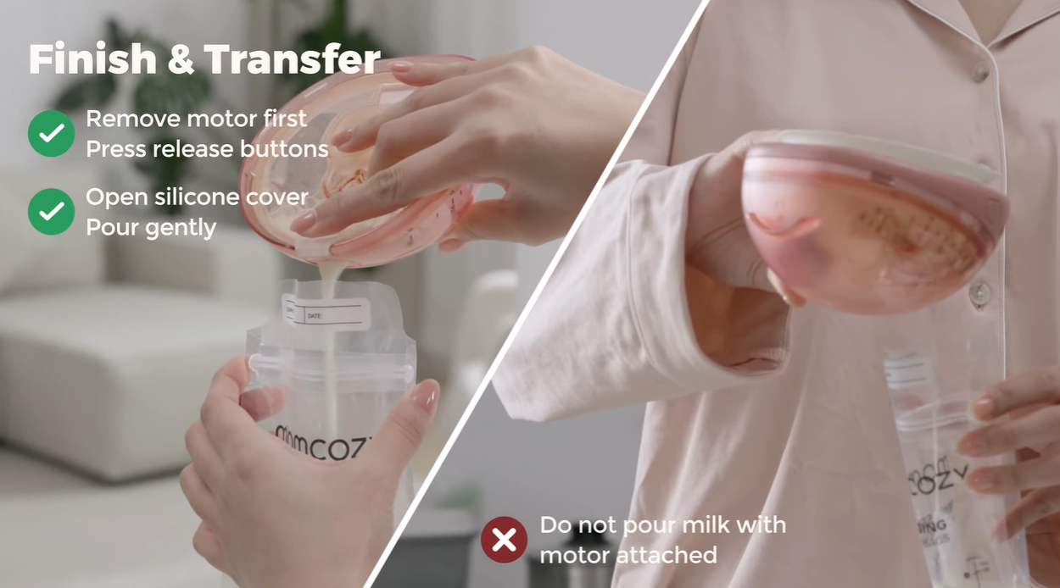
PRODUCT USAGE & DO’S
How to use it on camera
Getting these wrong is the most common reason a video has to be reshot.
Product usage — safety
✓ Do’s
Use the full product name "Momcozy Wellness 1" each time you mention it.
Hold the product on camera so viewers can see what you are describing.
Rewrite the suggested lines in your own voice — accuracy matters, wording does not.
FTC Disclosure: clearly disclose sponsored content using #ad or Paid Partnership in a visible position within the content.
Remove the motor before pouring milk.
Flange accessories are not microwave-safe. Do not sterilize them in a microwave.
Please use the product as demonstrated in the instruction video (link :https://www.youtube.com/watch?v=YLZGj2YY2e4.)
For your safety, do not use the breast pump while driving.
Must do in every post
Tag @momcozy_breastfeeding @momcozyofficial
Use hashtags: #wearablepumps #momcozybreastpump #pumpingmom #pumpingtips #ad / paid partnership
Please include a natural, non-salesy CTA at the end of the video, such as “Feel free to leave any questions in the comments” or “If you’re interested, check out the link in my bio to learn more.” Please also add the product link below to your bio for tracking purposes: [达人推广自行替换]
15

Slide 16
COMPLIANCE
Red lines — not negotiable
A video that crosses any of these cannot be published, and will have to be reshot.
✕
Do not claim or imply that Momcozy Wellness 1 can unclog, clear, or break up clogged milk ducts, relieve breast engorgement, treat, relieve, or prevent mastitis, increase milk supply, provide more complete emptying, guarantee faster let-down, or provide deep massage.
✕
Do not provide personalized medical advice. For persistent pain or discomfort, encourage viewers to consult a healthcare professional.
✕
Do not mention or compare competitor brands or products. You may only refer to “my old pump” or "pump I used before".
✕
Do not include alcohol, guns, violence, blood, or drugs.
✕
Do not show you are driving while pumping in front of camera
16

Slide 17
TIMELINE & RIGHTS
Delivery, timing and usage rights
Tell us early if anything is going to slip.
Stage | Deliverable | Due | Owner
Product received | Shipment confirmation | — | Momcozy
Draft submission | First cut of the video | Within 14 days of receiving the product | Creator
Feedback | Revision notes | ［ ］ | Momcozy
Final delivery | Final edit + raw footage (no subtitles / end cards) | ［ ］ | Creator
Publish | Live post | As agreed via email | Creator
Reporting | Backend screenshots / performance data | ［ ］ | Creator
Usage rights & confidentiality
· Momcozy retains full usage and secondary editing rights for 3 months across owned and paid channels, including TikTok Spark Ads, Instagram Ads, website, social media, paid advertising, and email marketing.
· Please provide the final edited video, raw footage (without subtitles or end cards), and allow Momcozy to use your photo and bio when reposting the content.
· All information shared by Momcozy is confidential and may not be disclosed to any third party without prior written consent from Momcozy.
17

Slide 18
Thank you
We’re glad you’re part of this campaign.

