Slide 1
MOMCOZY · CREATOR CONTENT BRIEF
Momcozy Wellness 1
Industry First* Warm-Massage Breast Pump
FOR HEALTHCARE-WORKER MOMS
Elevated Comfort. High Performance, Naturally
Confidential — all information here is under embargo. Do not share externally.
*Based on available market data as of November 2025.

Slide 2
OUTLINE
What’s in this brief
Three parts. Part 2 is written for you specifically; Parts 1 and 3 are the same for every creator on this campaign.
01
Product Information
What it is · Selling points by priority · Specs
02
Content Brief
Your audience · Video topics · Key messages
03
Guidelines & Delivery
Usage · Compliance · Timeline · Rights
2

Slide 3
01
Product Information
What it is, what it does, and what you can say about it

Slide 4
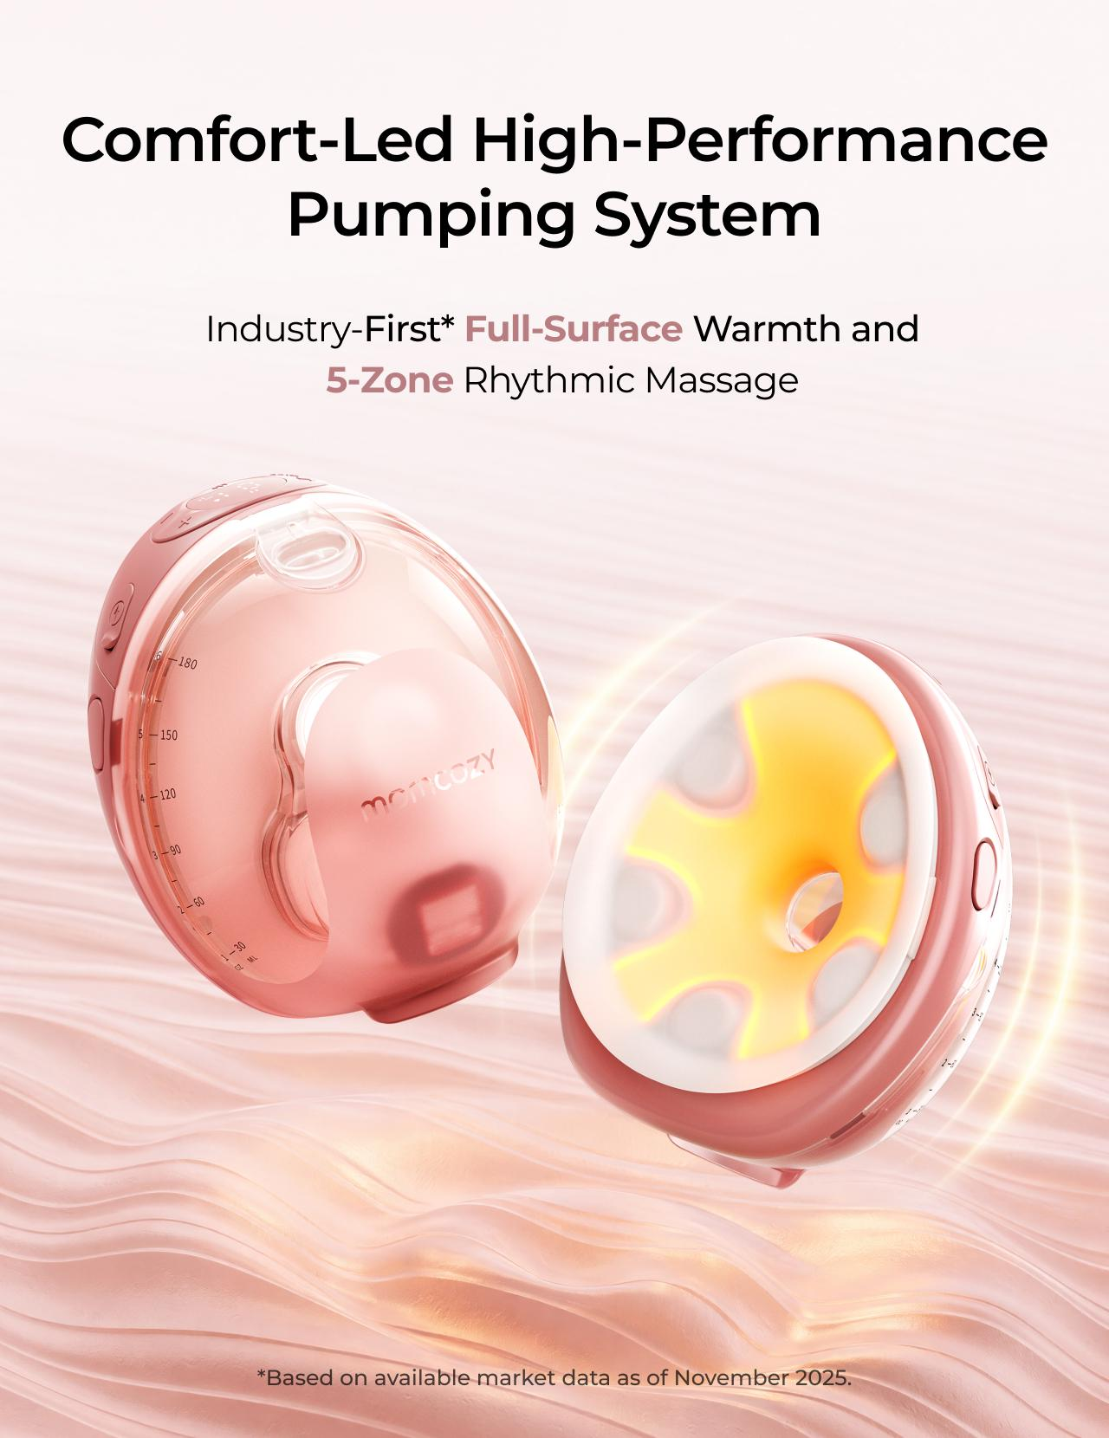
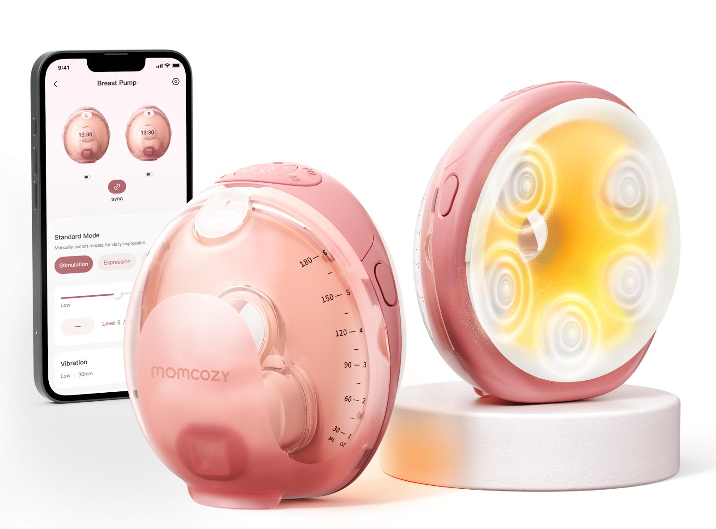
PRODUCT OVERVIEW
Momcozy Wellness 1
Industry First* Warm-Massage Breast Pump
Momcozy Wellness 1 is a wearable breast pump built to make pumping feel warmer, gentler, and just easier to fit into real life.
Slogan
Elevated Comfort. High Performance, Naturally
MSRP
$329.99 USD
Official link
https://momcozy.com/products/momcozy-wellness-1-warm-massage-wearable-breast-pump-w1?
Launch / region
US
SUGGESTED USE SCENARIOS
At-Home
Workday
On the Go
Nighttime
Pump while caring for baby and managing everyday life.
Pump discreetly and effectively throughout the workday.
Pump while commuting, shopping, or running errands.
Pump comfortably with minimal disruption.
*Based on available market data as of November 2025.
4

Slide 5
KEY SELLING POINTS
Selling points, by priority
P0 messages must appear. P1 and P2 are selectable — choose one of each. P3 is optional.
Tier | Key message | What this means for moms
P0 | Full-Surface Warmth | Three adjustable warmth levels cover the full flange-to-breast contact area, helping you feel more relaxed before pumping starts.
P0 | 5-Zone Suction-Synced Massage | Five massage zones pulse when the pump pulls and pause when it releases, instead of buzzing continuously throughout the session..
P1 | DoubleFit™ Soft Dual-Layer Flange | The soft inner layer sits gently against your skin, while the supportive outer layer helps keep a steady seal as you move.
P1 | Smart App Control | Start, pause, adjust suction levels, and log your milk output—all from your phone.
P1 | Easy to Use | One-press release makes removal easier, and only five washable parts after use.
P2 | Transparent Top & 6 oz Collector | The transparent top lets you check nipple alignment and milk flow without removing the pump, while the 6 oz collector supports longer sessions.
P2 | Expert-Tuned Programs & Personalized Rhythm | Start with an expert-tuned program, then adjust warmth, massage, suction, and modes in the App and save your preferred rhythm.
P2 | SoftPulse Baby-Like Suction | Small, steady micro pulses feel more like a baby’s natural suck—gentler on the breast, with up to 295 mmHg strength available when needed.
P3 | Auto Shutoff | Massage stops automatically after 5 minutes and warmth after 15 minutes by default, so you do not need to keep checking the clock.
P3 | Long Battery Use | Get up to 10 pumping-only sessions on one charge, or up to 6 with warmth and massage on, with massage noise below 50 dB.
5
Notes:
不用动

Slide 6
SPECIFICATIONS
Specs you may be asked about
Facts only. None of these numbers may be turned into a performance or health claim.
Item | Spec | Item | Spec
Warmth levels | 99°F / 102°F / 106°F (3 levels) | Massage | Surround massage, 3 levels, synced to suction
Max suction | Up to 295 mmHg | Collector capacity | 6 oz
Parts to wash | 5 milk-contact parts | Battery | Up to 10 sessions (pump only) / up to 6 (warmth + massage on)
Noise | Below 50 dB with massage on | Auto shutoff | Massage 5 min / warmth 15 min (default)
App | Momcozy App — warmth, massage, suction, modes, manual output log | Flange | DoubleFit™ soft dual-layer
Never phrase a spec as an outcome. “Three warmth levels” is a fact. “Warms you up so you pump more” is a claim — see the red lines in Part 3.
6

Slide 7
02
Content Brief
For Healthcare-Worker Moms

Slide 8
YOUR AUDIENCE & CONTEXT
Who you’re speaking to
Everything in Part 2 assumes this context. If it does not match your channel, tell us before you film.
THE CREATOR
WHAT TO SHOW
Healthcare-worker moms who are currently pumping. Their audience trusts them because they speak from both clinical exposure and lived experience.
1
All creators are suggested to wear nurse uniforms or healthcare workwear in the video, to establish an authentic healthcare-work context. Please do not expose any information of the hospital or clinc in front of camera.
Show how wearable pumping fits naturally into a high-demanding work routine — supporting comfort, secure fit, and easier pumping during designated private moments, without interrupting work or care responsibilities.
2
3
Prioritize authentic, experience-led content over clinical demonstrations. Show how the pump supports a comfortable, hands-free routine through long workdays, private breaks, and overnight pumping — without making medical, milk-supply, or treatment claims.
8

Slide 9
VIDEO TOPICS
Content Directions for Reference
★
Pick the one topic that fits your channel best. You know your audience better than we do — choose the angle you can genuinely pull off in your own life, and use authetic and organic tone to deliver the content
Workday Pumping
01
Spend a day with me as a healthcare provider who is currently breastfeeding
Personal Wearable Pump Review
02
Share my honest experience using a wearable pump and how it fits into my breastfeeding journey.
Practical Pumping Education
03
Share my personal pumping experience, including routines, challenges, and tips that helped me along the way.
9

Slide 10
VIDEO TOPICS — DETAIL
Topic Explained in details
Scenario on the left, the key messages to carry on the right.
01
Workday Pumping
KEY MESSAGES
P0
Full-Surface Warmth
Documentary-style, ranging from a single pumping moment to a full-day routine.
Pick the angle that matches your own shift:
· Moment-focused — one session up close: product details, comfort, how it feels.
· Full-day flow — getting ready for work, a designated pump break, then come home, pouring milk and cleaning up.
· Overnight / late shift — a calm, low-disruption routine during an overnight break or after a late shift.
P0
5-Zone Suction-Synced Massage
P1
DoubleFit™ Soft Dual-Layer Flange：helps provide a soft, steady fit as you move through your day.
P1
P1
Smart App Control— makes it easy to log and review your pumping output over time.
Format: vlog
02
Personal Wearable Pump Review
KEY MESSAGES
A healthcare-worker mom shares her personal experience and her reasons for recommending the product — framed as a product review, in an authentic first-person perspective.
P0
Full-Surface Warmth
P0
5-Zone Suction-Synced Massage
P1
DoubleFit™ Soft Dual-Layer Flange:helps provide a soft, steady fit as you move through your day.
Speak from your own experience only. Do not frame your recommendation as professional or medical advice.
P1
P1
Smart App Control— makes it easy to log and review your pumping output over time.
Format: First-person review
10

Slide 11
VIDEO TOPICS — DETAIL
Topic Explained in details
Scenario on the left, the key messages to carry on the right.
03
Practical Pumping Education
KEY MESSAGES
A healthcare professional or experienced pumping mom leads a practical Q&A covering comfort, fit, finding a personal rhythm, and making pumping feel easier during a busy workday.
P0
Full-Surface Warmth
P0
5-Zone Suction-Synced Massage
Keep every answer on comfort and routine. Redirect any medical question to “please consult your own provider.”
P1
DoubleFit™ Soft Dual-Layer Flange：helps provide a soft, steady fit as you move through your day.
P2
Expert-Tuned Programs & Personalized Rhythm — lets you adjust and save a pumping rhythm that feels right for your routine.
Format: Q&A / talking-head with product B-roll
11

Slide 12
REASONS TO BELIEVE
Why each message is true
You do not need to recite these on camera. You do need to understand them, so your own words stay accurate.
Core message | Reason to believe
Pumping can fit into a demanding shift without taking over the day. | Fully hands-free wearable design; one-press release and only 5 washable parts after use.
Warmth helps the body ease into pumping. | Three warmth levels (99°F / 102°F / 106°F) cover the full flange-to-breast contact area — not only a few isolated points.
The massage follows the pump, instead of buzzing through the whole session. | Surround massage activates on each pull and pauses on release, with 3 levels — not kneading or rolling motions.
A secure fit means less readjusting mid-shift. | The DoubleFit™ dual-layer flange combines soft, skin-friendly silicone contact with a more supportive, stable seal.
13

Slide 13
03
Guidelines & Delivery
Usage · Compliance · Timeline · Rights

Slide 14
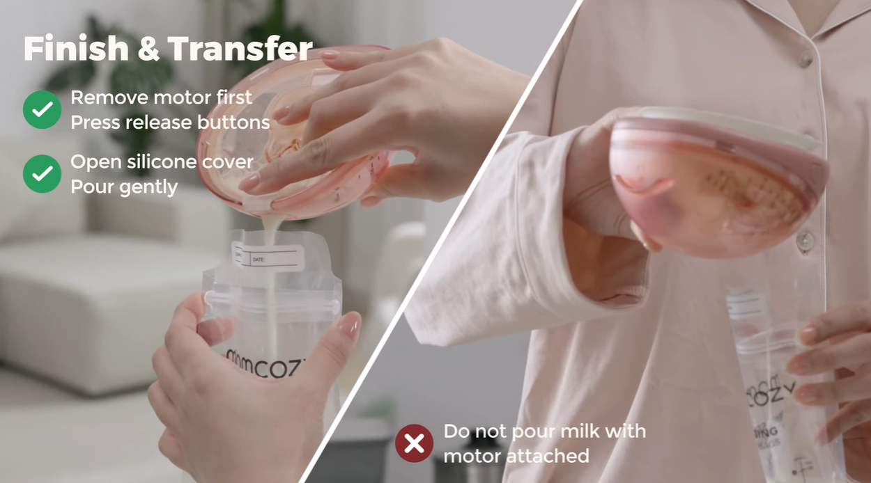
PRODUCT USAGE & DO’S
How to use it on camera
Getting these wrong is the most common reason a video has to be reshot.
Product usage — safety
✓ Do’s
Use the full product name "Momcozy Wellness 1" each time you mention it.
Hold the product on camera so viewers can see what you are describing.
Rewrite the suggested lines in your own voice — accuracy matters, wording does not.
FTC Disclosure: clearly disclose sponsored content using #ad or Paid Partnership in a visible position within the content.
Remove the motor before pouring milk.
Flange accessories are not microwave-safe. Do not sterilize them in a microwave.
Please use the product as demonstrated in the instruction video (link :https://www.youtube.com/watch?v=YLZGj2YY2e4.)
For your safety, do not use the breast pump while driving.
Must do in every post
Tag @momcozy_breastfeeding @momcozyofficial
Use hashtags: #wearablepumps #momcozybreastpump #pumpingmom #pumpingtips #ad / paid partnership
Please include a natural, non-salesy CTA at the end of the video, such as “Feel free to leave any questions in the comments” or “If you’re interested, check out the link in my bio to learn more.” Please also add the product link below to your bio for tracking purposes: [达人推广自行替换]
15

Slide 15
COMPLIANCE
Red lines — not negotiable
A video that crosses any of these cannot be published, and will have to be reshot.
✕
Do not claim or imply that Momcozy Wellness 1 can unclog, clear, or break up clogged milk ducts, relieve breast engorgement, treat, relieve, or prevent mastitis, increase milk supply, provide more complete emptying, guarantee faster let-down, or provide deep massage.
✕
Do not provide personalized medical advice. For persistent pain or discomfort, encourage viewers to consult a healthcare professional.
✕
Do not mention or compare competitor brands or products. You may only refer to “my old pump.”
✕
Do not include alcohol, guns, violence, blood, or drugs.
✕
Do not show you are driving while pumping in front of camera
16

Slide 16
TIMELINE & RIGHTS
Delivery, timing and usage rights
Tell us early if anything is going to slip.
Stage | Deliverable | Due | Owner
Product received | Shipment confirmation | — | Momcozy
Draft submission | First cut of the video | Within 14 days of receiving the product | Creator
Feedback | Revision notes | ［ ］ | Momcozy
Final delivery | Final edit + raw footage (no subtitles / end cards) | ［ ］ | Creator
Publish | Live post | As agreed via email | Creator
Reporting | Backend screenshots / performance data | ［ ］ | Creator
Usage rights & confidentiality
· Momcozy retains full usage and secondary editing rights for 3 months across owned and paid channels, including TikTok Spark Ads, Instagram Ads, website, social media, paid advertising, and email marketing.
· Please provide the final edited video, raw footage (without subtitles or end cards), and allow Momcozy to use your photo and bio when reposting the content.
· All information shared by Momcozy is confidential and may not be disclosed to any third party without prior written consent from Momcozy.
17

Slide 17
Thank you
We’re glad you’re part of this campaign.

