Slide 1
MOMCOZY · CREATOR CONTENT BRIEF
Momcozy Wellness 1
Industry First* Warm-Massage Breast Pump
FOR MOMS OF MULTIPLE KIDS
Elevated Comfort. High Performance, Naturally
Updated Aug, 2026
Confidential — all information here is under embargo until launch. Do not share externally.
*Based on available market data as of November 2025.

Slide 2
OUTLINE
What’s in this brief
Three parts. Part 2 is written for you specifically; Parts 1 and 3 are the same for every creator on this campaign.
01
Product Information
What it is · Selling points by priority · Specs
02
Content Brief
Your audience · Video topics · Key messages
03
Guidelines & Delivery
Usage · Compliance · Timeline · Rights
2

Slide 3
01
Product Information
What it is, what it does, and what you can say about it

Slide 4
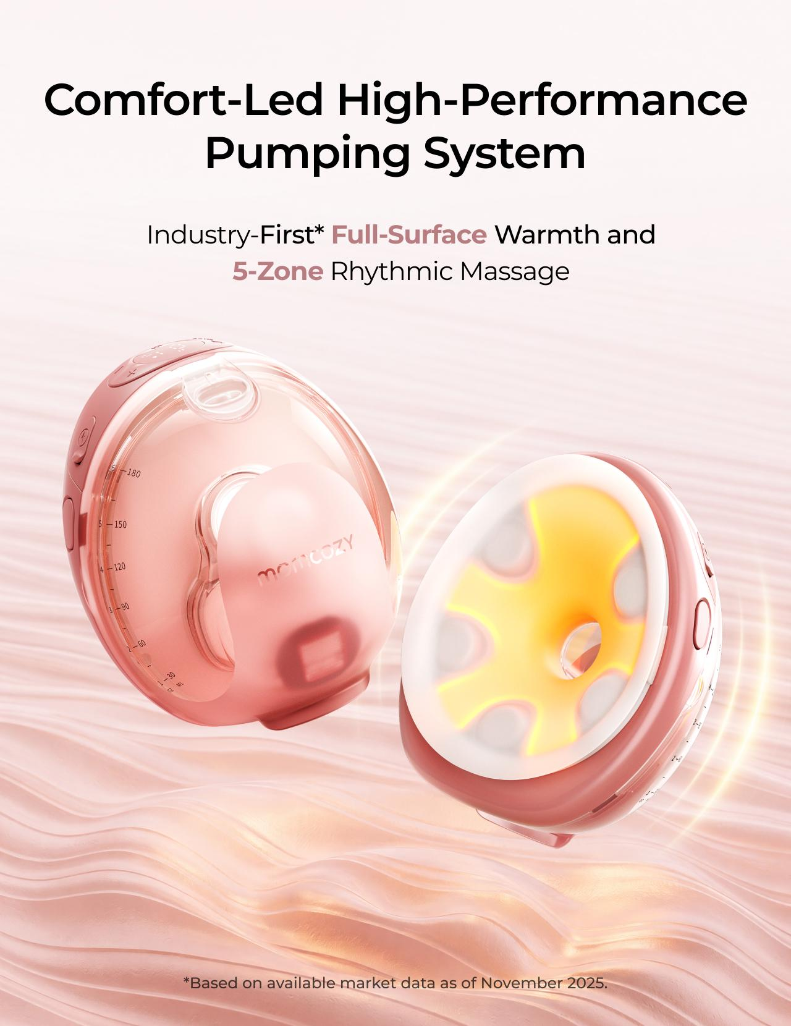
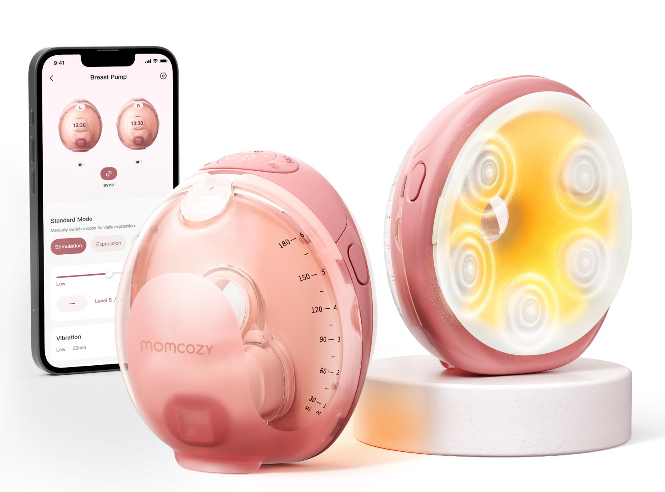
PRODUCT OVERVIEW
Momcozy Wellness 1
Industry First* Warm-Massage Breast Pump
Momcozy Wellness 1 is a wearable breast pump built to make pumping feel warmer, gentler, and just easier to fit into real life.
Slogan
Elevated Comfort. High Performance, Naturally
MSRP
$329.99 USD
Official link
https://momcozy.com/products/momcozy-wellness-1-warm-massage-wearable-breast-pump-w1?
Launch / region
US
SUGGESTED USE SCENARIOS
At-Home
Workday
On the Go
Nighttime
Pump while caring for baby and managing everyday life.
Pump discreetly and effectively throughout the workday.
Pump while commuting, shopping, or running errands.
Pump comfortably with minimal disruption.
*Based on available market data as of November 2025.
4

Slide 5
KEY SELLING POINTS
Selling points, by priority
P0 messages must appear. P1 and P2 are selectable — choose one of each. P3 is optional.
Tier | Key message | What this means for moms
P0 | Full-Surface Warmth | Three adjustable warmth levels cover the full flange-to-breast contact area, helping you feel more relaxed before pumping starts.
P0 | 5-Zone Suction-Synced Massage | Five massage zones pulse when the pump pulls and pause when it releases, instead of buzzing continuously throughout the session..
P1 | DoubleFit™ Soft Dual-Layer Flange | The soft inner layer sits gently against your skin, while the supportive outer layer helps keep a steady seal as you move.
P1 | Smart App Control | Start, pause, adjust suction levels, and log your milk output—all from your phone.
P1 | Easy to Use | One-press release makes removal easier, and only five washable parts after use.
P2 | Transparent Top & 6 oz Collector | The transparent top lets you check nipple alignment and milk flow without removing the pump, while the 6 oz collector supports longer sessions.
P2 | Expert-Tuned Programs & Personalized Rhythm | Start with an expert-tuned program, then adjust warmth, massage, suction, and modes in the App and save your preferred rhythm.
P2 | SoftPulse Baby-Like Suction | Small, steady micro pulses feel more like a baby’s natural suck—gentler on the breast, with up to 295 mmHg strength available when needed.
P3 | Auto Shutoff | Massage stops automatically after 5 minutes and warmth after 15 minutes by default, so you do not need to keep checking the clock.
P3 | Long Battery Use | Get up to 10 pumping-only sessions on one charge, or up to 6 with warmth and massage on, with massage noise below 50 dB.
5

Slide 6
SPECIFICATIONS
Specs you may be asked about
Facts only. None of these numbers may be turned into a performance or health claim.
Item | Spec | Item | Spec
Warmth levels | 99°F / 102°F / 106°F (3 levels) | Massage | Surround massage, 3 levels, synced to suction
Max suction | Up to 295 mmHg | Collector capacity | 6 oz
Parts to wash | 5 milk-contact parts | Battery | Up to 10 sessions (pump only) / up to 6 (warmth + massage on)
Noise | Below 50 dB with massage on | Auto shutoff | Massage 5 min / warmth 15 min (default)
App | Momcozy App — warmth, massage, suction, modes, manual output log | Flange | DoubleFit™ soft dual-layer
Never phrase a spec as an outcome. “Three warmth levels” is a fact. “Warms you up so you pump more” is a claim — see the red lines in Part 3.
6

Slide 7
02
Content Brief
For Moms of Multiple Kids

Slide 8
VIDEO TOPICS
8 topics to choose from
★
Pick the one topic that fits your channel best. You know your audience better than we do — choose the angle you can genuinely pull off in your own life, and film that one.
01
How priorities changed between babies
After Pumping for ［X］ Babies, Here’s What I Actually Look for in a Pump
02
Comparing Welless 1 with pumps she has used before
I’ve Tried Different Breast Pumps — Here’s What Feels Different About Wellness 1
03
Why she would choose Wellness 1
3 Reasons I’d Choose the Wellness 1 at This Stage of Motherhood
04
Testing Wellness 1 during a real multi-child routine
Can This Pump Actually Fit Into a Multi-Kid Routine?
05
First-time mom versus experienced mom
The Pump I Needed With My First Baby vs. What I Need Now
06
An in-depth review beyond suction strength
Why I Don’t Choose a Breast Pump Based on Suction Alone Anymore
07
Pumping when several family needs overlap
What I Use When Both Kids Need Me and I Still Have to Pump
08
Reviewing the complete routine
Wear, Pump, Pour and Clean: My Honest Wellness 1 Review
9

Slide 9
VIDEO TOPICS — DETAIL
Topics 01–02
Scenario on the left, the related massages to carry on the right.
01
How priorities changed between babies
KEY MESSAGES
“After Pumping for ［X］ Babies, Here’s What I Actually Look for in a Pump”
Full-Surface Warmth.
P0
Establish credibility through experience and show how her priorities have evolved from suction alone to warmth, massage, visible alignment, app control and the complete routine.
P0
5-Zone Suction-Synced Massage.
P2
Expert-Tuned Programs & Personalized Rhythm.
Format: Experience-led video with real-life footage
02
Comparing Wellness 1 with pumps you has used before
KEY MESSAGES
P0
Full-Surface Warmth.
“I’ve Tried Different Breast Pumps — Here’s What Feels Different About W1”
The goal is not to prove that Wellness 1 “beats” another pump. It is to explain why Wellness 1 better matches what she needs at this stage of motherhood.
P0
5-Zone Suction-Synced Massage.
P1
DoubleFit™ Soft Dual-Layer Flange.
Comparison-shaped topic. You may only refer to “my old pump.” Do not name, show or hint at another brand — including packaging, logos and distinctive shapes in frame.
Format: In-depth review with on-screen comparisons
10

Slide 10
VIDEO TOPICS — DETAIL
Topics 03–04
Scenario on the left, the key messages to carry on the right.
03
Why she would choose Wellness 1
KEY MESSAGES
“3 Reasons I’d Choose the Wellness 1 at This Stage of Motherhood”
P0
Full-Surface Warmth.
Provide clear and easy-to-understand reasons for choosing Wellness 1, while highlighting its differentiated combination of features.
P0
5-Zone Suction-Synced Massage.
P2
SoftPulse Baby-Like Suction for a smoother pumping experience.
Format: “Three reasons” list-style video
04
Testing Wellness 1 during a real multi-child routine
KEY MESSAGES
“Can This Pump Actually Fit Into a Multi-Kid Routine?”
P0
Full-Surface Warmth.
Demonstrate through real life — not just verbal claims — how the pump can fit into a busy family routine.
P0
5-Zone Suction-Synced Massage.
P2
Easy to Use with One-Press Assembly and Only 5 Parts to Clean.
Format: Day-in-the-life video with a real product test
P1
Smart App Control: manage every session from your phone.
11

Slide 11
VIDEO TOPICS — DETAIL
Topics 05–06
Scenario on the left, the key messages to carry on the right.
05
First-time mom versus experienced mom
KEY MESSAGES
“The Pump I Needed With My First Baby vs. What I Need Now”
P0
Full-Surface Warmth
Use the evolution of her motherhood experience to explain why her product choice has changed.
P0
5-Zone Suction-Synced Massage.
P2
Transparent Top & 6 oz Collector
The comparison is between two versions of you — not between two brands. “My old pump” only.
P2
Easy to Use with One-Press Assembly and Only 5 Parts to Clean.
P2
Format: Emotional storytelling, “Then vs. Now” comparison
06
An in-depth review beyond suction strength
KEY MESSAGES
“Why I Don’t Choose a Breast Pump Based on Suction Alone Anymore”
P0
Full-Surface Warmth.
Move beyond a specification-based comparison and demonstrate an experienced evaluation of the complete pumping routine.
P0
5-Zone Suction-Synced Massage.
P1
DoubleFit™ Soft Dual-Layer Flange.
Format: Educational in-depth review
12

Slide 12
VIDEO TOPICS — DETAIL
Topics 07–08
Scenario on the left, the key messages to carry on the right.
07
Pumping when several family needs overlap
KEY MESSAGES
“What I Use When Both Kids Need Me and I Still Have to Pump”
P0
Full-Surface Warmth.
Show the reality of pumping as a mom of multiple children, while highlighting wearability, app control and easier routine management.
P0
5-Zone Suction-Synced Massage.
P2
Easy to Use with One-Press Assembly and Only 5 Parts to Clean.
P1
Smart App Control: manage every session from your phone.
Format: Real-situation short video with voice-over
08
Reviewing the complete routine
KEY MESSAGES
“Wear, Pump, Pour and Clean: My Honest Wellness 1 Review”
P0
Full-Surface Warmth.
Help viewers understand the complete experience rather than focusing on a single product feature.
P0
5-Zone Suction-Synced Massage.
P2
Easy to Use with One-Press Assembly and Only 5 Parts to Clean.
Format: Step-by-step review
P2
Transparent Top & 6 oz Collector.
P1
Smart App Control: manage every session from your phone.
13

Slide 13
REASONS TO BELIEVE
Why each message is true
You do not need to recite these on camera. You do need to understand them, so your own words stay accurate.
Core message | Reason to believe
My reason for choosing Wellness 1 comes from the complete combination of features — not one individual specification. | W1 combines full-surface warmth, surround suction-synced massage, SoftPulse gentle pulses and the DoubleFit™ dual-layer flange — delivering more even warmth, a gentler feel and smoother emptying, without sacrificing strong suction or a secure seal.
Warmth and massage are the key experiences that set Wellness 1 apart from a basic breast pump. | Warmth covers the full flange-to-breast contact area — not only a few isolated points — with 99°F, 102°F and 106°F settings for fast, even warming. Surround massage uses gentle rhythmic vibration that activates during each pull and pauses on release, with 3 levels.
After using different breast pumps, I now care more about the complete experience. | Full-surface warmth, surround rhythmic massage, SoftPulse micro pulses and the DoubleFit™ dual-layer flange work together. Wellness 1 also lets you adjust warmth, massage, suction and modes from the phone.
App control better fits the real-life needs of a mom with multiple children. | Adjust warmth, massage, suction and modes from the phone; choose an expert-tuned program or save a routine that works for you.
The transparent top means I don’t have to rely on feel alone to check my positioning. | A transparent top helps you check nipple alignment and milk flow, while the clear collector holds 6 oz.
How well a pump fits into my current life matters more than specifications alone. | One-press release, and only 5 milk-contact parts to wash. The transparent top also lets you check placement and milk flow without repeatedly removing the pump.
14

Slide 14
03
Guidelines & Delivery
Usage · Compliance · Timeline · Rights

Slide 15
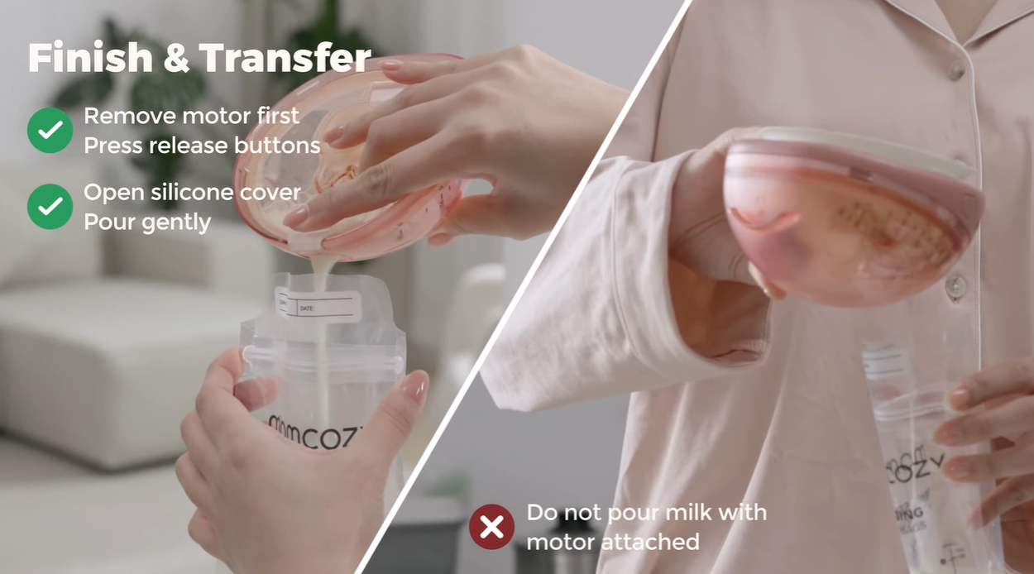
PRODUCT USAGE & DO’S
How to use it on camera
Getting these wrong is the most common reason a video has to be reshot.
Product usage — safety
✓ Do’s
Use the full product name "Momcozy Wellness 1" each time you mention it.
Hold the product on camera so viewers can see what you are describing.
Rewrite the suggested lines in your own voice — accuracy matters, wording does not.
FTC Disclosure: clearly disclose sponsored content using #ad or Paid Partnership in a visible position within the content.
Remove the motor before pouring milk.
Flange accessories are not microwave-safe. Do not sterilize them in a microwave.
Please use the product as demonstrated in the instruction video (link :https://www.youtube.com/watch?v=YLZGj2YY2e4.)
For your safety, do not use the breast pump while driving.
Must do in every post
Tag @momcozy_breastfeeding @momcozyofficial
Use hashtags: #wearablepumps #momcozybreastpump #pumpingmom #pumpingtips #ad / paid partnership
Please include a natural, non-salesy CTA at the end of the video, such as “Feel free to leave any questions in the comments” or “If you’re interested, check out the link in my bio to learn more.” Please also add the product link below to your bio for tracking purposes: https://www.amazon.com/dp/B0G6417BM1?maas=maas_adg_565A2414873D2F93B2A2CD8C4C0FCC05_afap_abs&ref_=aa_maas&tag=maas
15

Slide 16
COMPLIANCE
Red lines — not negotiable
A video that crosses any of these cannot be published, and will have to be reshot.
✕
Do not claim or imply that Momcozy Wellness 1 can unclog, clear, or break up clogged milk ducts, relieve breast engorgement, treat, relieve, or prevent mastitis, increase milk supply, provide more complete emptying, guarantee faster let-down, or provide deep massage.
✕
Do not provide personalized medical advice. For persistent pain or discomfort, encourage viewers to consult a healthcare professional.
✕
Do not mention or compare competitor brands or products. You may only refer to “my old pump.”
✕
Do not include alcohol, guns, violence, blood, or drugs.
17

Slide 17
TIMELINE & RIGHTS
Delivery, timing and usage rights
Tell us early if anything is going to slip.
Stage | Deliverable | Due | Owner
Product received | Shipment confirmation | — | Momcozy
Draft submission | First cut of the video | Within 14 days of receiving the product | Creator
Feedback | Revision notes | ［ ］ | Momcozy
Final delivery | Final edit + raw footage (no subtitles / end cards) | ［ ］ | Creator
Publish | Live post | As agreed via email | Creator
Reporting | Backend screenshots / performance data | ［ ］ | Creator
Usage rights & confidentiality
· Momcozy retains full usage and secondary editing rights for 3 months across owned and paid channels, including TikTok Spark Ads, Instagram Ads, website, social media, paid advertising, and email marketing.
· Please provide the final edited video, raw footage (without subtitles or end cards), and allow Momcozy to use your photo and bio when reposting the content.
· All information shared by Momcozy is confidential and may not be disclosed to any third party without prior written consent from Momcozy.
18

Slide 18
Thank you
We’re glad you’re part of this launch.
Your contact: ［ name / email ］
Asset download:
［ link ］
Compliance questions:
［ name / email ］

