Slide 1
McKinsey Global Survey respondents are much more likely to predict a near-term recession than they were last quarter.
Share of respondents ranking each global scenario as the most likely to occur in 2024-25，%
Recession driven by too-high interest rates for too long
Recession
38
Rising uncertainty causes consumer sentiment to drop； economy enters a recession
Recession
53
Inflation remains high due to strong demand; interest rates are high; growth rates slows slightly
Soft landing
63
Soft landing
47
Growth accelerates
Mar 2024
June 2024
Note: Figures may not sum to 100%， because of rounding.
Source: McKinsey Global Surveys on economic conditions, 2024; McKinsey's Global Economics Intelligence analysis

Slide 2
In multiple regions, growing shares of respondents believe the unemployment rates in their countries will increase.
Share of respondents expecting their countries’ unemployment rate to increase, next 6 months，¹ ％ by office location
Greater
China²
Asia-
Pacific
Developing
markets³
Europe
North
America
India
¹Respondents who answered “stay the same，" "decrease，" or "don't know" are not shown. Mar 4-8, 2024, n = 957; June 3-7, 2024, n= 927.
²Includes Hong Kong and Taiwan.
³Includes Central and South America, Middle East, North Africa, South Asia, and sub-Saharan Africa.
Source: McKinsey Global Surveys on economic conditions, Mar 4-8, 2024, and June 3-7,2024

Slide 3
Closing the employment gap facing ethnocultural minorities would be a triple win.
Job vacancy rates are rising across Europe
Ethnocultural minorities are a meaningful share of the population
Vacancy rate development in EU-27 countries， %
Size and population share in 11 EU countries
2,9%
44 million
Total ethnocultural
minorities
10%
Share of total
population
2,2%
2,3%
1,7%
33%
from Asia
27%
from MENA¹
16%
from Latin
America
24%
Other²
2.9%
average job vacancy rate for EU-27 in 2022 （equivalent to~6 million）
Note: EME = ethnocultural minority employee.
¹The Middle East and North Africa.
²includes 14% from sub-Saharan Africa and 10% from Turkiye.

Slide 4
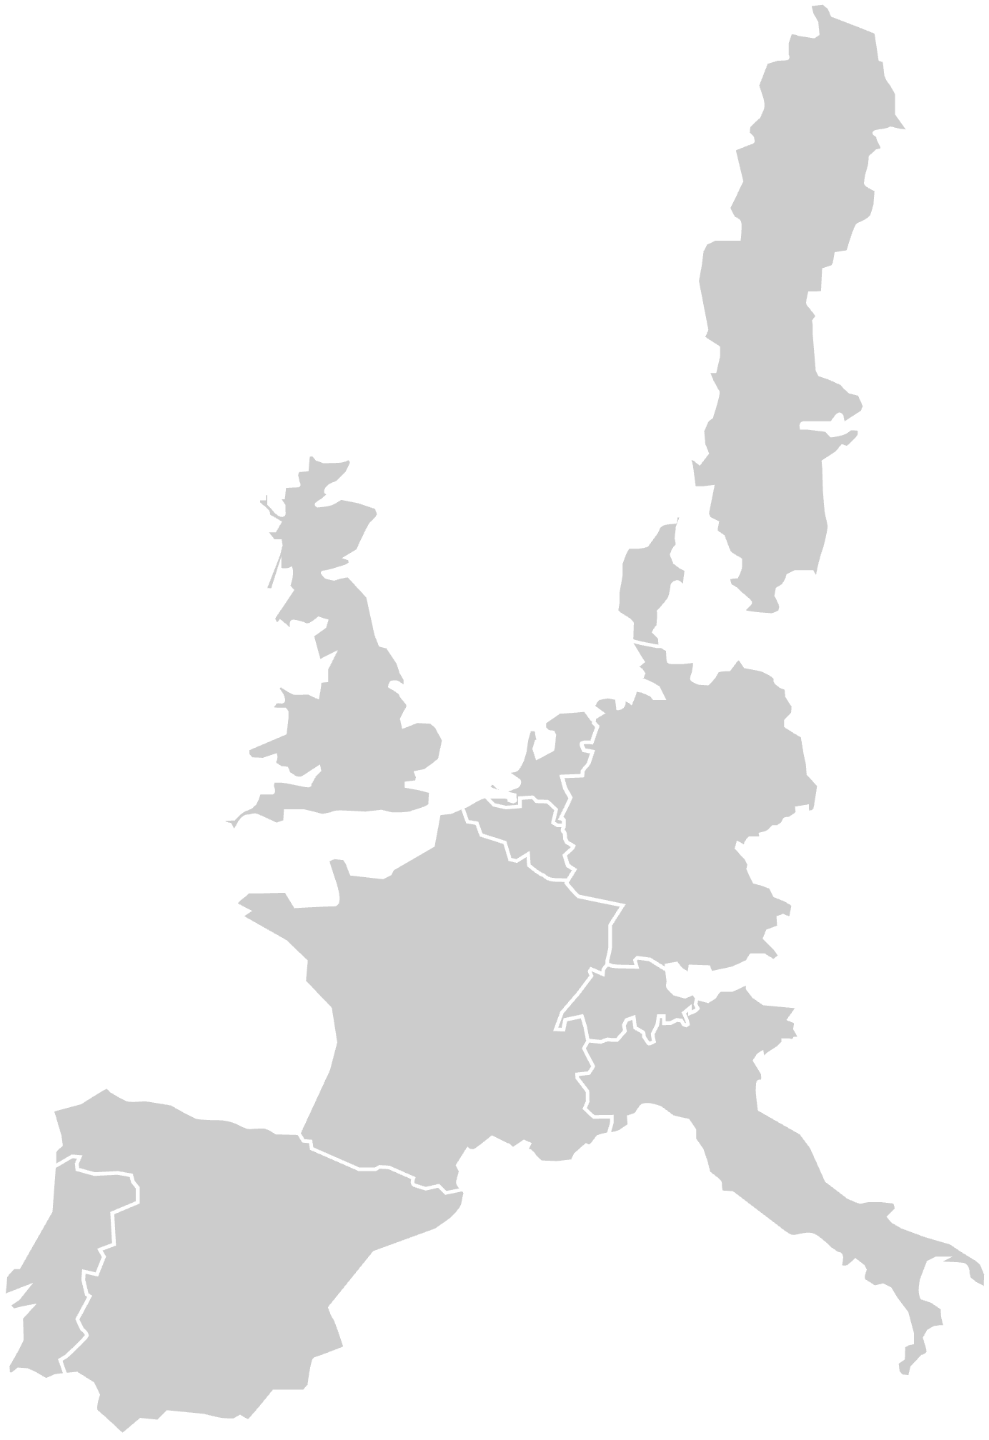
Closing the employment gap facing ethnocultural minorities would be a triple win.
Ethnocultural minority representation
across 11 countries
Breakdown by country of ethnocultural
minority populations，¹%
Size of ethnocultural minority
population within country, million
（total = 44 million）
Asia
²
SuD-Saharan Atrica
Middle East and North Africa
Turkiye
100%
（xx%） Share of national population
（average share = 10%）
Latin America and Caribbean
1.2
England and Wales
Sweden
（11%）
58
5
23
14
1
Netherlands
（17%）
Germany
38
25
4
6
26
Belgium
（15%）
0.5
Denmark
（5%）
France
11
51
8
23
6
England and
Wales （rest
of UK not
included）
（18%）
10.9
Italy
42
27
13
17
1
3.0
Spain
14
30
47
8
1.7
9.3
Germany
（11%）
Netherlands
25
27
24
9
15
France
（13%）
9.0
Belgium
14
41
11
21
13
Sweden
23
46
9
17
5
Spain
（7%）
3.9
Italy
（7%）
Denmark
35
34
6
12
14
0.5
3.3
Switzerland
（5%）
Switzerland
32
17
15
21
16
Portugal
（8%）
Total
33
27
16
14
10
Note: Figures may not sum to 100%， because of rounding. Most of these figures are underestimates because they include only people with a recent migration background （1st and 2nd generation）.
¹Breakdown of region of origin excludes a） Portugal as breakdown by country of origin is not possible. and b）Italians who have naturalized （approximately 1.2 million）.
²Excludes Russia.
Source: Analysis is based on national census data and other citizenship- and naturalization-related data; for details, see Exhibit Alin the appendix

Slide 5
Ethnocultural minority employees report a range of obstacles to finding a job, advancing in their careers, and feeling included in the workplace.
Nonminority and ethnocultural minority employee （EME） survey responses， % of respondents
Nonminority
EME
EMEs are more likely to
report experiencing at least
1 barrier to employment¹
EMEs are more likely to
report missing out on career
advancement opportunities²
EMEs are more likely to
report experiencing at
least 1 biased behavior³
EMEs are more likely to
report an intention to resign
from their current position
within the year⁴
~2.0x
~2.0x
~2.5x
~2.0x
¹Question： "Have you faced any of the following challenges during your latest job search？” Possible answers: language barriers; lack of recognition of international qualifications; limited access to job opportunities; discrimination based on cultural background; other: please specify; none of the above; and prefer not to say.
²Question： "In the last year, have you missed out on a raise, promotion, or chance to get ahead？" Possible answers: yes, I missed out on a raise; yes, I missed out on a promotion; yes, I missed out on a chance to get ahead; no, I did not miss out on any of these opportunities; and prefer not to say.
³Question： "In the last year, over the normal course of business, have you experienced any of the following？" Possible answers: hearing or overhearing negative comments about your ethnic background; being confused with someone else of the same ethnicity; having others take or get credit for your ideas; being interrupted or spoken over more than others; being told you need to be "nicer" or less aggressive or angry; hearing others express surprise at your language skills, competence or other technical abilities; having others comment on your appearance in a way that made you feel uncomfortable; having others comment on your family or home life （eg, clothing choice, decor, food choices） in a way that made you feel uncomfortable; none of the above; or prefer not to say.
⁴Question：“How likely is it that you will leave your company in the next year？" Possible answers: very likely, likely, neither likely nor unlikely, unlikely, and very unlikely. The answers considered for the chart are very likely or likely.
Source: McKinsey 2023 employee experience survey of 3,963 respondents in Denmark, France, Germany, Italy, and the Netherlands

Slide 6
European employers are incorporating ethnocultural minority employee inclusion in their diversity strategies and executive teams.
Analysis of 150 of the largest companies by market
cap across five countries in Europe¹
Gap to parity based on ethnocultural
minority share of population，%
Mean share of executives from
diverse regions of origin,² %
Share of companies stating that they
incorporate ethnocultural minority inclusion
into global diversity strategies，³ %
Share of ethno-
cultural minorities
in population,⁴ %
Overall
11
Netherlands
17
France
13
Germany
11
Denmark
8
Italy
7
¹Analysis based on data from 30 of the largest companies by market cap in each country. Companies are allocated to countries based on the location of their headquarters.
²Based on public information on region of origin, such as nationality, nationality of parents, or both. Where this information was not available, no region of origin has been inferred.
³Ethnocultural minority inclusion is counted as part of a diversity, equity, and inclusion （DEI） strategy if the company has a section dedicated to cultural and ethnical diversity on its DEl landing page or in its sustainability, annual, or diversity report.
⁴Population analysis using proxy for ethnocultural minority, based on available data from national censuses.

Slide 7
Organizations are preparing for the next wave of SG&A cost management.
But confidence in meeting targets is low
Timeline to launch SG&A improvement program, December 2020
Respondents， ％
Q3
Q4
However...
70%
feel "somewhat unprepared"
or worse when asked about
confidence in meeting
spend-reduction targets
Completed or ongoing
Within the next 6 months
7-12 months
Not planned
Source: McKinsey Corporate Business Functions Practice

Slide 8

Regardless of goal, automation efforts were more likely to succeed when linked to strategic priorities, not short-term returns.
Primary reason for increased automation investments in the last 12 months
Respondents，％
x
% of respondents who say their
automation efforts have been successful
67%
of organizations
increased
investment in
automation
early in the
pandemic, and
expected to
continue to do so
Automation is a strategic priority
Manage costs in the long term （next 2-3 years）
Keep pace with competitors
Concerns on business- process effectiveness
Automation is a priority for one of our leaders
Increase remote work
Reduce costs in the next 12 months
94
81
76
68
63
59
43

Slide 9
Cost management, growth, and digital capabilities are top priorities in both corporate centers and business units.
Top 3 priorities to tackle economic uncertainty
Frequency of appearing in respondents' top 3 priorities， %
Corporate centers
Business units
Cost management
Growth
Digital capabilities
Performance management
Reskilling
Pricing
Risk management
Reorga- nization
M&A

Slide 10
Reviewing all sales, general, and administrative investments helps leaders make conscious, strategic choices.
Sales, general, and administrative investments, illustrative, indexed to 100
Resolve
Some spending will
naturally contract
due to changes
in customer and
employee activity
Resilience
Other spend categories will
require choices to manage
spend thoughtfully and to
reallocate as the Crisis
continues to untold
Return
Recovery will
present opportunities to reactivate operations, invest，and reallocate
resources
Reimagine
and reform
Lessons learned
and new
capabilities
can enable a
healthier future
cost base
85
65
Precrisis
Downturn
During crisis
Recovery
Postcrisis

Slide 11
Procurement and IT show the most maturity among corporate functions in deploying advanced analytics.
Level of sophistication of advanced analytics currently being deployed within corporate functions，¹
% of respondents （n = 302）
Legal
Marketing
HR
Finance
Real estate
IT
Procurement
Less sophisticated forms of analytics
Predictive analytics
Prescriptive analytics
3
Sophistication
LESS
MORE
¹Question: Respondents were asked to rate the sophistication of analytics they were able to deploy in their function on a scale of 1 （least mature） to 5（most mature）， where level 1= basic reporting of data only; 2 = reporting with the ability to drill down into data; 3 = trend analytics; 4 = predictive analytics to inform decision making; and 5 = more advanced prescriptive analytics
²Including basic reporting, reporting with drill-down capability,trend analyses,etc.
Source: Mckinsey Corporate & Business Functions Survey of 302 s6nar ' executives globally across industries, May 2022

