Slide 1
Density-Based Clustering

Slide 2
Density-Based Clustering
Goal: cluster together points that are densely packed together.
How should we define density?
Given a fixed radius 𝝴 around a point, if there are at least min_pts number of points in that area, then this section is dense.

Slide 3
Example
Min_pts = 3

Slide 4
Example
𝝴-neighborhood of this point
Min_pts = 3
𝝴
dense ✔

Slide 5
Example
Min_pts = 3

Slide 6
Example
Min_pts = 3
𝝴
Not dense 𐄂

Slide 7
Example
Min_pts = 3

Slide 8
Example
Min_pts = 3
𝝴
Not dense 𐄂
But… That point was part of a dense section earlier…

Slide 9
Density-Based Clustering
We need to distinguish between points at the core of a dense region and points at the border of a dense region.
Let’s define:
Core point: if its 𝝴-neighborhood contains at least min_pts
Border point: if it is in the 𝝴-neighborhood of a core point
Noise point: if it is neither a core nor border point

Slide 10
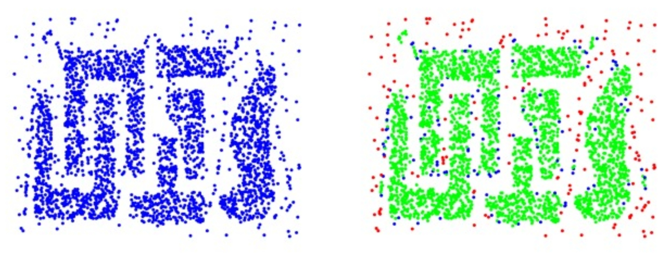
Density-Based Clustering
Core | Border | Noise

Slide 11
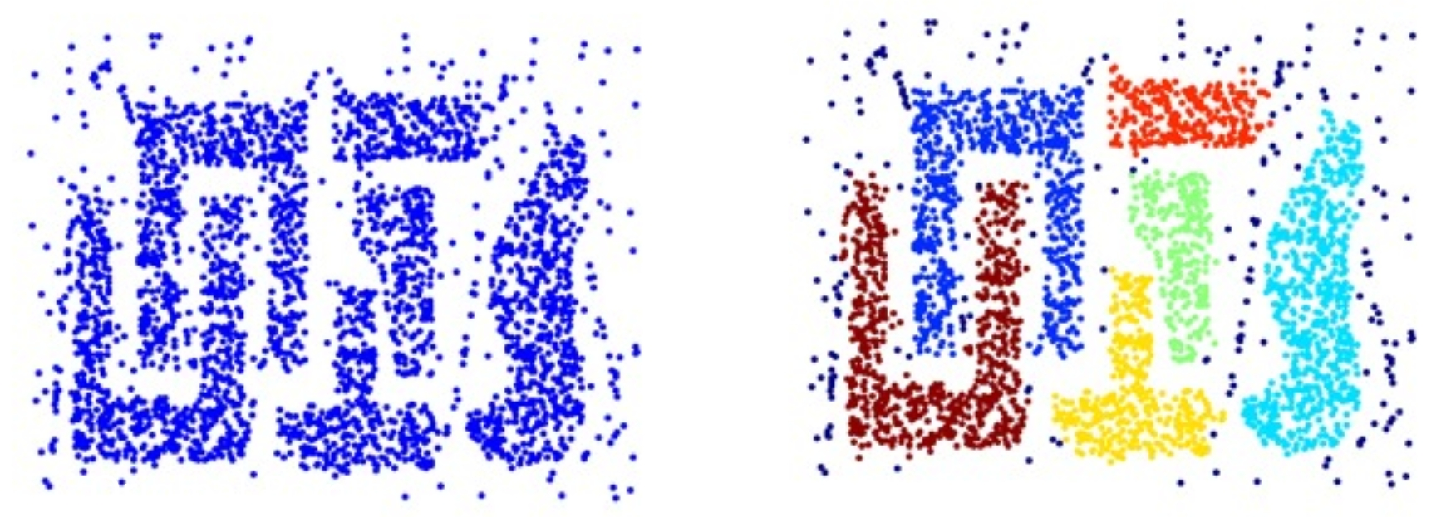
Density-Based Clustering
Create clusters by connecting core points

Slide 12
DBScan Algorithm
𝝴 and min_pts given:
Find the 𝝴-neighborhood of each point
Label the point as core if it contains at least min_pts
Label points in its neighborhood that are not core as border
Label points as noise if they are neither core nor border
For each core point, assign to the same cluster all core points in its neighborhood
Assign border points to nearby clusters

Slide 13
DBScan - Benefits
Can identify clusters of different shapes and sizes
Resistant to noise

Slide 14
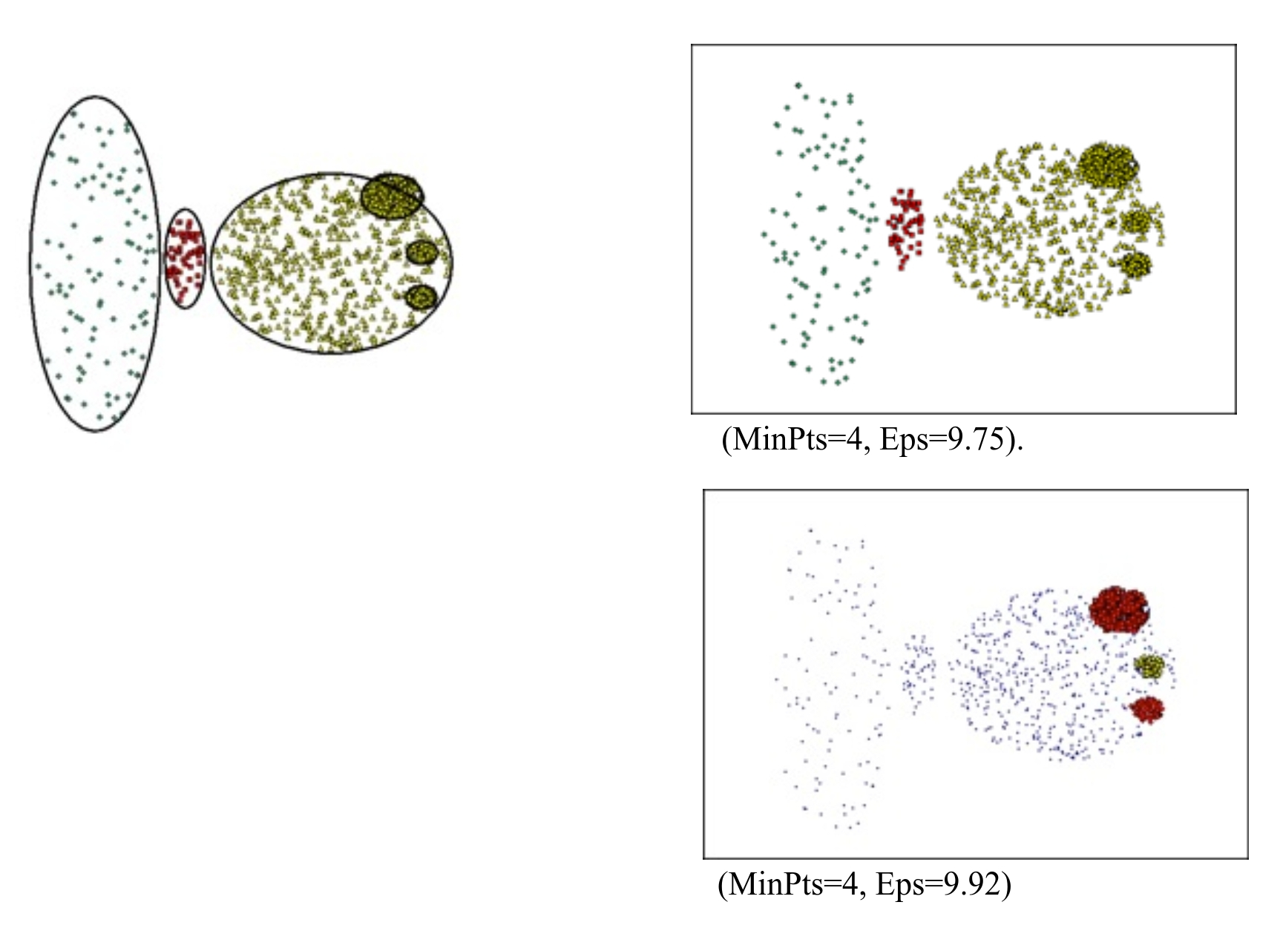
DBScan - Limitations
Can fail to identify clusters of varying densities.
Tends to create clusters of the same density.
Notion of density is problematic in high-dimensional spaces

Slide 15
Demo

