Slide 1
GF(2^{m})域上脉动结构乘法器
姓知道名：张秉异 叶汉辰 顾晨昊

Slide 2
Outline
Obejctive
Algorithm
RTL Design
Simulation
SoC Design
DC Synthesis
Notes:
这是本次汇报的基本框架。

Slide 3
Outline
Obejctive
Algorithm
RTL Design
Simulation
SoC Design
DC Synthesis

Slide 4
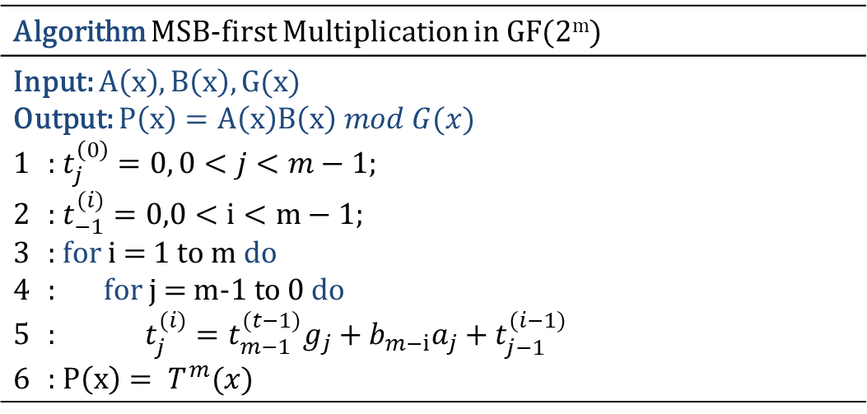
Obejctive
Algorithm MSB-first Multiplication in GF(2^{m})
Input: $A\left(x\right),B\left(x\right),G(x)$ Output: $P\left(x\right)=A\left(x\right)B\left(x\right) mod G(x)$ 10: $t_{j}^{\left(0\right)}=0, 0<j<m−1$; 20: $t_{−1}^{(i)}=0,0<i<m−1;$ 30: $\text{f}\text{or} \text{i}\text{ = 1 }\text{to} \text{m} \text{do}$ 40: $\text{f}\text{or} \text{j}\text{ = }\text{m}\text{−1} \text{to} \text{0} \text{do}$ 50:$t_{j}^{(i)}=t_{m−1}^{(t−1)}g_{j}+b_{m−i}a_{j}+t_{j−1}^{(i−1)}$ 60:$P\left(x\right)= T^{m}(x)$

Slide 5
Outline
Obejctive
Algorithm
RTL Design
Simulation
SoC Design
DC Synthesis

Slide 6

Algorithm
Basic Unit
$$t_{j}^{\left(i\right)}=t_{m−1}^{\left(t−1\right)}g_{j}+b_{m−i}a_{j}+t_{j−1}^{\left(i−1\right)}$$

Slide 7
Algorithm
8×8 Systolic Array

Slide 8
Algorithm
8×8 Systolic Array

Slide 9
Outline
Obejctive
Algorithm
RTL Design
Simulation
SoC Design
DC Synthesis

Slide 10
RTL Design
basic_element.v

Slide 11
RTL Design
one_bit.v

Slide 12
RTL Design
digital_serial.v

Slide 13
RTL Design
8socWrapper.v
Notes:
在我们的设计中，digital_serial模块的a和g是固定的163bit输入。
设立一个计数器，自0计数到$\left\lceil 163/8\right\rceil −1$，代表本设计需要$\left\lceil 163/8\right\rceil$个时钟周期完成，在第$\left\lceil 163/8\right\rceil +1$个时钟周期输出结果。每个时钟周期，将b的高8位取出，并将其左移8位，把取出的高8位送入digital_serial模块。
在计数的第1个时钟周期，t_{in,n}为0，其他时钟周期t_{in,n}取的是上一个时钟周期的输出t_{out,n-1}。

Slide 14
Outline
Obejctive
Algorithm
RTL Design
Simulation
SoC Design
DC Synthesis

Slide 15
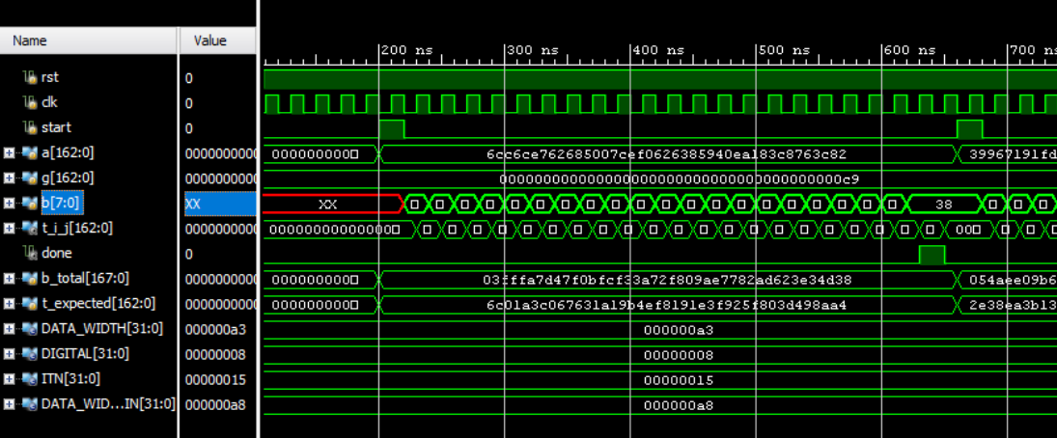
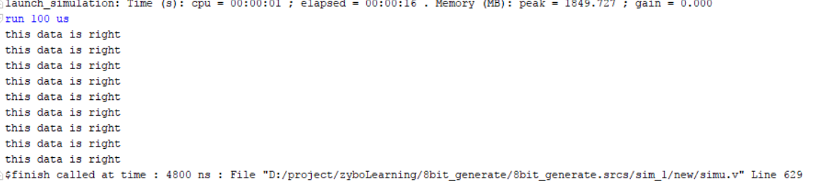
Simulation
Software | Vivado Simulation
Language | Verilog
8bit

Slide 16
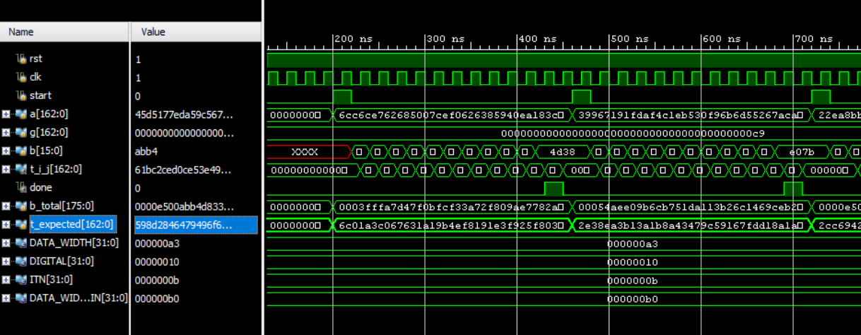
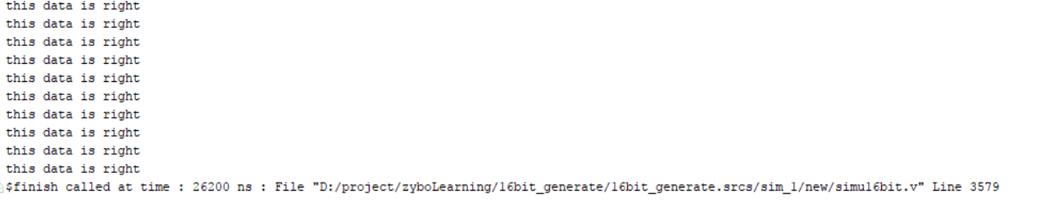
Simulation
Software | Vivado Simulation
Language | Verilog
16bit

Slide 17
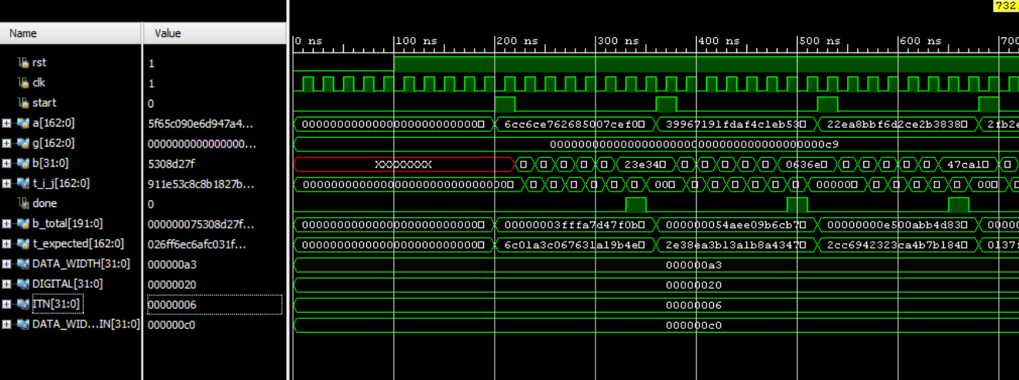
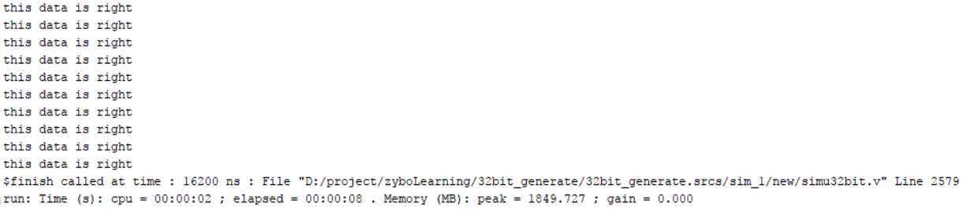
Simulation
Software | Vivado Simulation
Language | Verilog
32bit

Slide 18
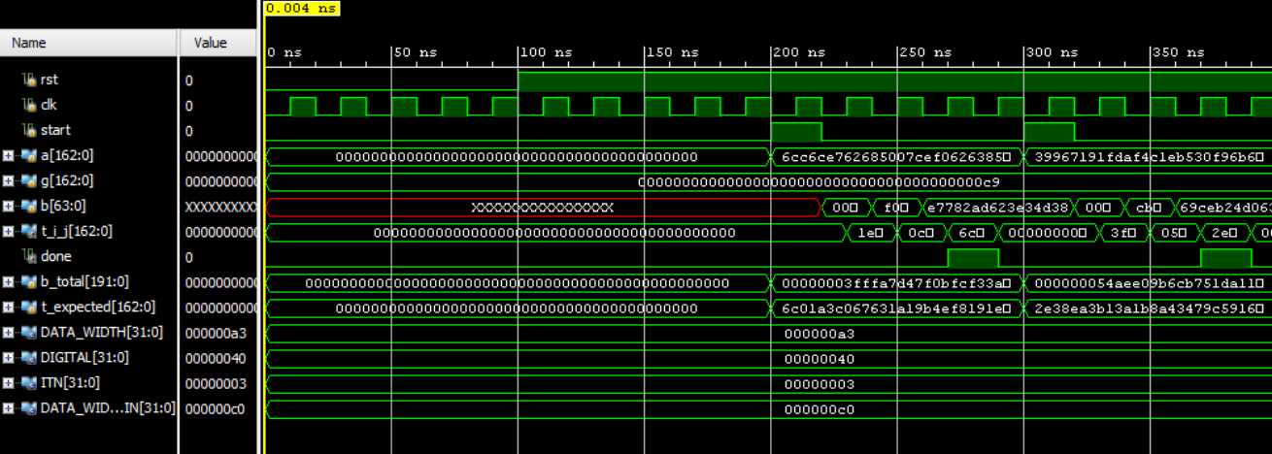
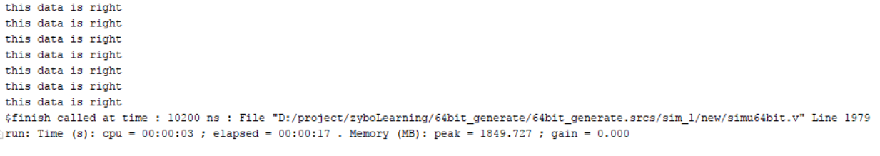
Simulation
Software | Vivado Simulation
Language | Verilog
64bit

Slide 19
Outline
Obejctive
Algorithm
RTL Design
Simulation
SoC Design
DC Synthesis

Slide 20
SoC Design
Vivado Synthesis
 | LUTs | Registers | Power (W) | Freq (MHz)
8 bit | 1331 | 178 | 0.376 | 260
16 bit | 2631 | 178 | 0.389 | 142
32 bit | 5240 | 178 | 0.458 | 75

Slide 21
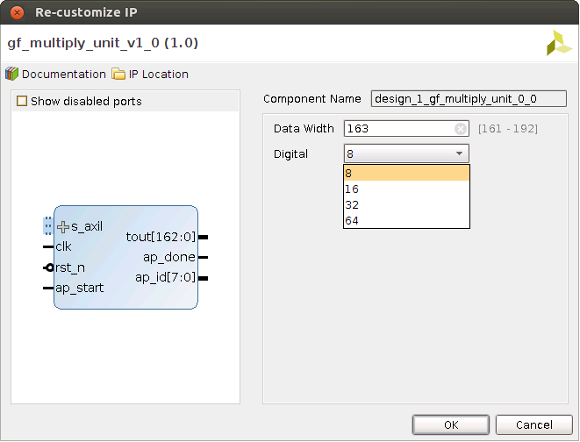
SoC Design
IP Package

Slide 22
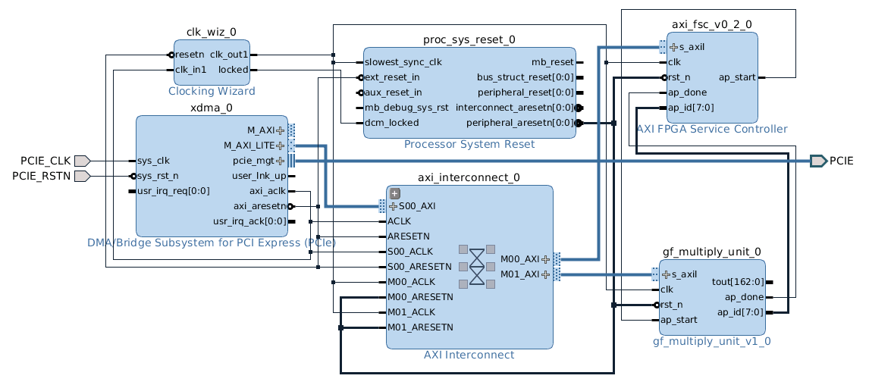
SoC Design
Architecture

Slide 23
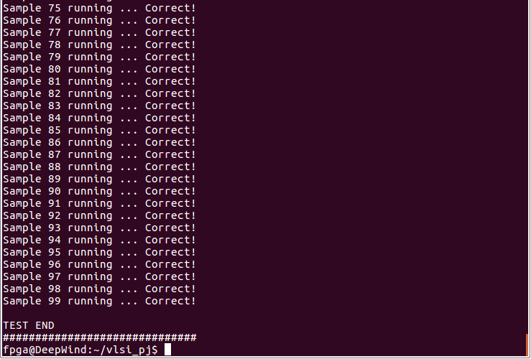
SoC Design
Verification

Slide 24
Outline
Obejctive
Algorithm
RTL Design
Simulation
SoC Design
DC Synthesis

Slide 25
DC Synthesis
Area Power F_{MAX}

Slide 26
DC Synthesis
Throughput Rate

Slide 27
One more thing
Perl → RTL

Slide 28
THANK YOU
Notes:
如上。

