Slide 1
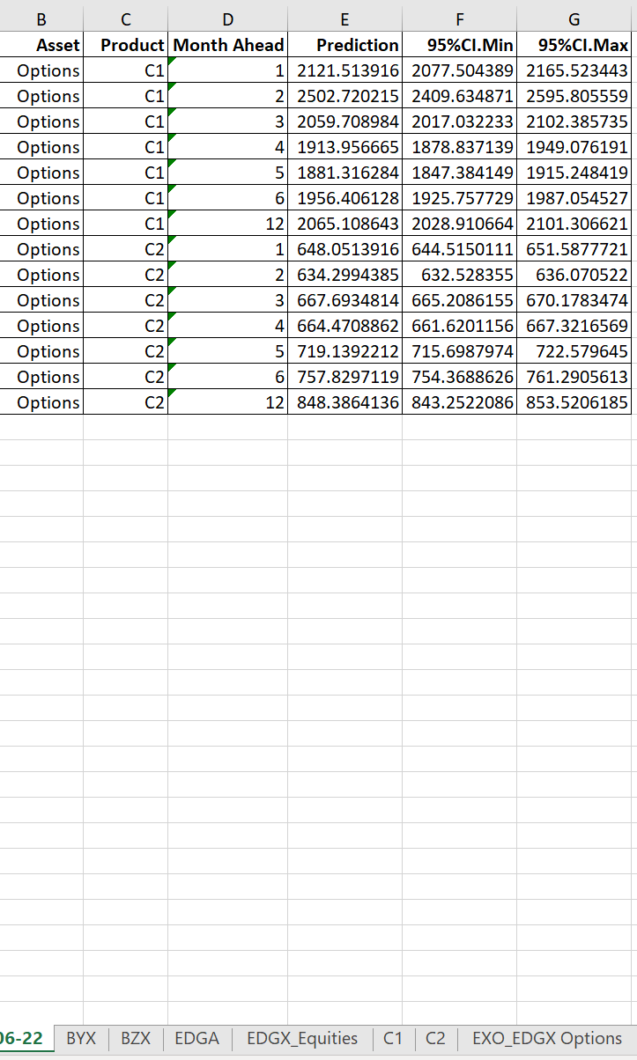
To run the script:
Open folder “ModelPrediction”, follow the instruction in PredictAll Tool Manual.txt
To get predictions:
Open "Logical Ports Prediction.xlsx", you’ll see the predictions from 6/2022 in a new tab named "06-22",
If the last month of Port Quantities is 7/2022, the tab would be "07-22"

Slide 2
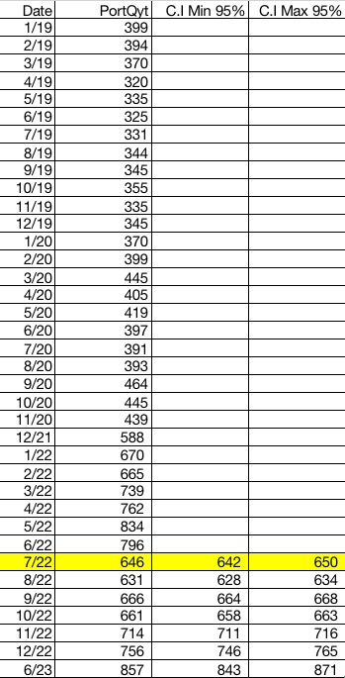
Model Accuracy
Accuracy would improve if using daily port quantities to increase the sample size.

Slide 3
Data Update Each Month:
Logical Ports Prediction.xlsx
Daily market (Need Process): Dow Jones/SPX (Open folder Daily_Monthly, follow the instruction in “DailytoMonthly Manual.txt”)
1.1 Dow Jones_Monthly
1.2 S&P 500_SPX
Monthly Data:
2.1 Equities Mkt Share&Volume
2.2 Options Mkt Share&Volume
2.3 Futures Mkt Volume
2.4 U.S. Inflation
2.5 FED
2.6 U.S. GDP (1) (2)
2.7 Unemployment Rate
Target Variables
1.0 Order Entry Port Quantities

Slide 4
User Tips:
Move the folder ModelPrediction outside of OneDrive to use the tool. The tool cannot access the “Logical Port Prediction.xlsx” since OneDrive would block the access.
Don’t change the column name, variables or sheet name before using the model. You need to change the script and Excel file in the meanwhile.
Retrain the model for every 4-6 months to catch up the recent changes.

Slide 5
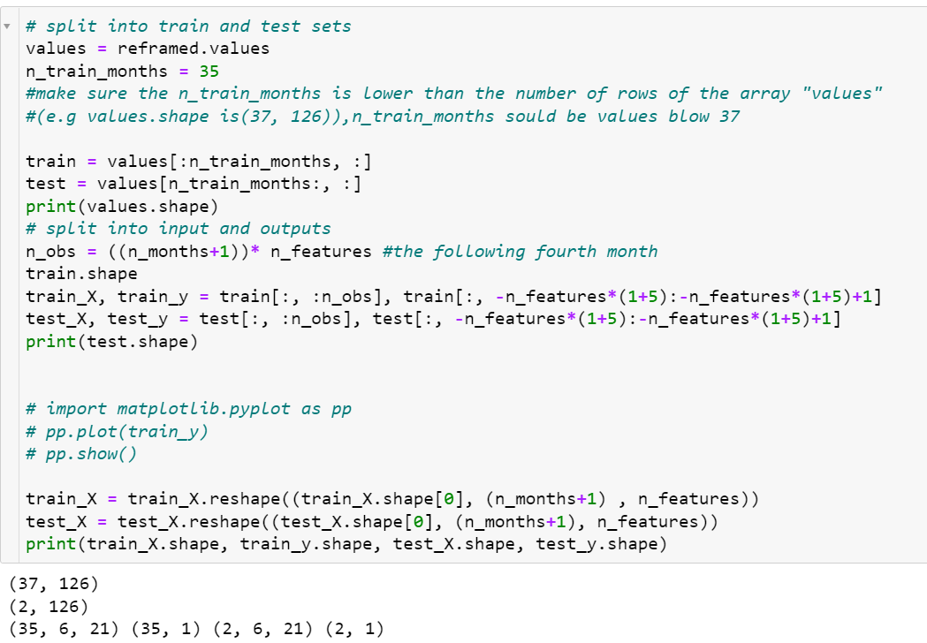
For future interns to train the model:
Step 1: In the folder Train & Prediction, open training file for each product.
(e.g. BZX_1m_Train.ipynb means the 1-month training model for BZX)
Make sure the n_train_months is below the number of rows the array “values” (e.g. as is shown in the image)
Step 2: To Change the range of CI. 95% and improve model accuracy in the prediction outcome, you could tune the following parameters:
n_train_months (training sample size)
n_months (the number of lag hours)
epochs
ensemble

