Slide 1
Towards a Game-Theoretic Framework for Information Retrieval
ChengXiang (“Cheng”) Zhai
Department of Computer Science
University of Illinois at Urbana-Champaign
http://www.cs.uiuc.edu/homes/czhai
Email: czhai@illinois.edu
Keynote at SIGIR 2015, Aug. 12, 2015, Santiago, Chile

Slide 2






Search is everywhere, and part of everyone’s life
Web Search
Desk Search
Enterprise Search
Social Media Search
Site Search
X Search
X=“mobile”, “medical”, “product”, …
… …

Slide 3


Search & Big (Text) Data: make big data much smaller, but more useful & support knowledge provenance
Information Retrieval
Analysis
Decision Support
Big
Text Data
Small
Relevant Data

Slide 4




Search accuracy matters!
# Queries /Day
X 1 sec
X 10 sec
4,700,000,000
(2013)
~13,000,000 hrs
~1,300,000 hrs
1,600,000,000
(2013)
~440,000 hrs
~4,400,000 hrs
… …
2,000,000
(2013)
~550 hrs
~5,500 hrs
How can we optimize all search engines in a general way?
Sources:
Google, Twitter: http://www.statisticbrain.com/
PubMed: http://www.ncbi.nlm.nih.gov/About/tools/restable_stat_pubmed.html

Slide 5
However, this is an ill-defined question!
How can we optimize all search engines in a general way?
What is a search engine?
What is an optimal search engine?
What should be the objective function to optimize?

Slide 6


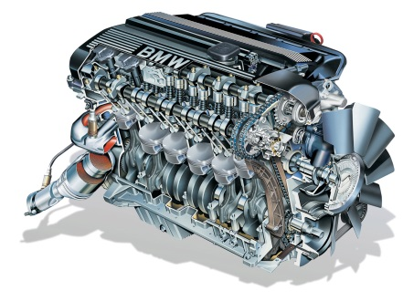
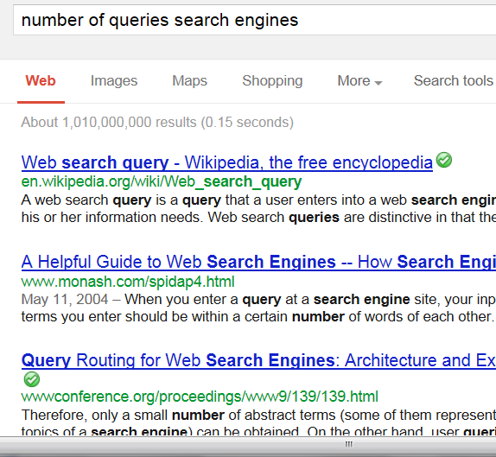



Current-generation search engines
Document collection
k
number of queries search engines
Query Q
Retrieval task = rank documents for a query
D
Interface = ranked list
( “10 blue links”)
Ranked
list
π
Machine Learning
Score(Q,D)
Retrieval
Model
Optimal Search Engine=optimal score(q,d)
Objective = ranking accuracy on training data
User
Model
Minimum NLP

Slide 7
Current search engines are well justified
Probability ranking principle [Robertson 77]:returning a ranked list of documents in descending order of probability that a document is relevant to the query is the optimal strategy under two assumptions:
The utility of a document (to a user) is independent of the utility of any other document
A user would browse the results sequentially
Intuition: if a user sequentially examines one doc at each time, we’d like the user to see the very best ones first

Slide 8
Success of Probability Ranking Principle
Vector Space Models: [Salton et al. 75], [Singhal et al. 96], …
Classic Probabilistic Models: [Maron & Kuhn 60], [Harter 75], [Robertson & Sparck Jones 76], [van Rijsbergen 77], [Robertson 77], [Robertson et al. 81], [Robertson & Walker 94], …
Language Models: [Ponte & Croft 98], [Hiemstra & Kraaij 98], [Zhai & Lafferty 01], [Lavrenko & Croft 01], [Kurland & Lee 04], …
Non-Classic Logic Models: [van Rijsbergen 86], [Wong & Yao 95], …
Inference Network: [Turtle & Croft 90]
Divergence from Randomness: [Amati & van Rijsbergen 02], [He & Ounis 05], …
Learning to Rank: [Fuhr 89], [Gey 94], ...
Axiomatic retrieval framework [Fang et al. 04], [Clinchant & Gaussier 10], [Fang et al. 11], …
Many others
Most information retrieval models are to optimize score(Q,D)

Slide 9
Limitations of optimizing Score(Q,D)
Assumptions made by PRP don’t hold in practice
Utility of a document depends on others
Users don’t strictly follow sequential browsing
As a result
Redundancy can’t be handled (duplicated docs have the same score!)
Collective relevance can’t be modeled
Heuristic post-processing of search results is inevitable

Slide 10
Improvement: Score a whole ranked list!
Instead of scoring an individual document, score an entire candidate ranked list of documents [Zhai 02; Zhai & Lafferty 06]
A list with redundant documents on the top can be penalized
Collective relevance can be captured also
Powerful machine learning techniques can be used [Cao et al. 07]
PRP extended to address interaction of users [Fuhr 08]
However, scoring is still for just one query: score(Q, π)
Optimal SE = optimal score(Q, π)
Objective = Ranking accuracy on training data

Slide 11
Limitations of single query scoring
No consideration of past queries and history
Can’t optimize the utility over an entire session
No modeling of a user’s task
…

Slide 12
Beyond single query: some recent topics
No consideration of past queries and history
➔ Implicit feedback (e.g, [Shen et al. 05] ), personalized search
(see, e.g., [Teevan et al. 10])
No modeling of a user’s task
➔ intent modeling (see, e.g. , [Shen et al. 06]), task inference
(see, e.g., [Wang et al. 13])
Can’t optimize the utility over an entire session
➔ Active feedback (e.g., [Shen & Zhai 05]), exploration-exploitation
tradeoff (e.g., [Agarwal et al. 09], [Karimzadehgan & Zhai 13])
➔ POMDP for session search (e.g., [Luo et al. 14])
How can we address all these problems in a
unified formal framework

Slide 13
Proposal: A Game-Theoretic Framework for IR
Retrieval process = cooperative game-playing
Players: Player 1= search engine; Player 2= user
Rules of game:
Player take turns to make “moves”
First move = “user entering the query” (in search) or “system recommending information” (in recommendation)
User makes the last move (usually)
For each move of the user, the system makes a response move (shows an interaction interface), and vice versa
Objective: help the user complete the (information seeking) task with minimum effort & minimum operating cost for search engine

Slide 14
Search = a game played by user and search engine
(Find useful information
with minimum effort)
(Help user find useful information
with minimum effort, minimum system cost)
User
System
A₁ : Enter a query
Which information items to present?
How to present them?
Which items
to view?
R₁: results (i=1, 2, 3, …)
Which aspects/parts of the item
to show? How?
A₂ : View item
No
View more?
R₂: Item summary/preview
A₃ : Scroll down or click on
“Back”/”Next” button

Slide 15
Major benefits of IR as game playing
General
A formal framework to integrate research in user studies, evaluation, retrieval models, and efficient implementation of IR systems
A unified roadmap for identifying unexplored important IR research topics
Specific
Naturally optimize performance on an entire session instead of that on a single query (optimizing the chance of winning the entire game)
Optimize the collaboration of machines and users (maximizing collective intelligence) [Belkin 96]
Naturally crowdsource relevance judgments from users (active feedback)
…

Slide 16
New General Research Questions
How should we design an IR game?
How to design “moves” for the user and the system?
How to design the objective of the game?
How to go beyond search to support access and task completion?
How to formally define the optimization problem and compute the optimal strategy for the IR system?
How do we characterize an IR game?
Which category of games does IR game fit? (Not stochastic collaborative game!)
To what extent can we directly apply existing game theory?
What new challenges must be solved?
How to evaluate such a system?
Simulation? MOOCs?

Slide 17
Formalization of the IR Game
Given S, U, C, A_{t} , and H, choose
the best R_{t} from all possible
responses to A_{t}
Situation S
History H={(A_{i},R_{i})}
i=1, …, t-1
Query=“light laptop”
User U: A₁ A₂ … … A_{t-1} A_{t}
System: R₁ R₂ … … R_{t-1}
Click on “Next” button
R_{t} =?
The best ranking for the query
The best ranking of unseen items
C
R_{t} ∈ r(A_{t})
Best interface!
All possible rankings of items in C
Info Item
Collection
All possible rankings of unseen items
All possible interfaces

Slide 18
Apply Bayesian Decision Theory
Observed
User Model
Knowledge State
(seen items,
readability level, …)
Situation: S
User: U
Interaction history: H
Current user action: A_{t}
Document collection: C
M=(K, θ_{U},B, T,… )
Task
Information
need
Browsing behavior
All possible responses:
r(A_{t})={r₁, …, r_{n}}
L(r_{i},M,S)
Loss Function
Optimal response: r* (minimum loss)
Bayes risk
Inferred
Observed
An extension of risk minimization [Zhai & Lafferty 06, Shen et al. 05]

Slide 19
Simplification of Computation
Approximate the Bayes risk (posterior mode)
Two-step procedure
Step 1: Compute an updated user model M* based on the currently available information
Step 2: Given M*, choose an optimal response to minimize the loss function

Slide 20
Optimal Interactive Retrieval
User U
IR system
A₁
M*₁
P(M₁|U,H,A₁,C,S)
L(r,M*₁,S)
R₁
A₂
State = M
M*₂
P(M₂|U,H,A₂,C,S)
L(r,M*₂,S)
A₃
R₂
…
Can be modeled by a Partially Observable Markov Decision Process:
POMDP, Multi-armed Bandit, Belief POMDP, …
Optimal Policy Computation: Reinforcement Learning

Slide 21
1. MDP/POMDP has been explored recently for IR… (e.g., [Guan et al. 13], [Jin et al. 13], [Luo et al. 14])
Existing work is already moving in this direction
See the ACM SIGIR 2014 Tutorial on Dynamic Information Retrieval Modeling: http://www.slideshare.net/marcCsloan/dynamic-information-retrieval-tutorial
2. Economics in interactive IR (e.g., [Azzopardi 11, Azzopardi 14])
3. Multi-armed Bandit has been explored for optimizing
online learning to rank (e.g., [Hofmann et al. 11]) and content
display and aggregation (e.g., [Pandey et al. 07], [Diaz 09])
4. Search engine as learning agent (e.g., [Hofmann 13])
5. Reinforcement learning has also been used in multiple
related problems (e.g., dialogue systems [Singh et al. 02, Li et
al. 09], filtering & recommendation [Seo & Zhang 00, Theocharous
et al. 15])
… …

Slide 22
Instantiation of IR Game: Moves
User moves: Interactions can be modeled at different levels
Low level: keyboard input, mouse clicking & movement, eye-tracking
Medium level: query input, result examination, next page button
High level: each query session as one “move” of a user
System moves: can be enriched via sophisticated interfaces, e.g.,
User action = “input one character” in the query: System response = query completion
User action = “scrolling down”: System response = adaptive summary
User action = “entering a query”: System response = recommending related queries
User action = “entering a query”: System response = ask a clarification question

Slide 23
Example of new moves (new interface): Explanatory Feedback
Optimize combined intelligence ➔
Leverage human intelligence to help search engines
Add new “moves” to allow a user to help a search engine with minimum effort
Explanatory feedback
I want documents similar to this one except for not matching “X” (user typing in “X”)
I want documents similar to this one, but also further matching “Y” (user typing in “Y”)
…

Slide 24
Instantiation of IR Game: User Model M
M = formal user model capturing essential knowledge about a user’s status for optimizing system moves
Essential component: θ_{U} = user’s current information need
K = knowledge status (seen items)
Readability level
T= task
Patience-level
B= User behavior
Potentially include all findings from user studies!
An attempt to formalize existing models such as
Anomalous State of Knowledge (ASK) [Belkin 80, Belkin et al. 82]
Cognitive IR Theory [Ingwersen 96]

Slide 25
Instantiation of IR Game: Inference of User Model
P(M|U, H, A_{t}, C,S) = system’s current belief about user model M
Enables inference of the formal user model M based on everything the system has available so far about the user and his/her interactions
Instantiation can be based on
Findings from user studies, and
Machine learning using user interaction log data for training
Current search engines mostly focused on estimating/updating the information need θ_{U}
Future search engines must also infer/update many other variables about the user (e.g., task, exploratory vs. fixed item search, reading level, browsing behavior)
Existing work has already provided techniques for doing these (e.g., reading level [Collins-Thompson et al. 11], modeling decision point [Thomas et al. 14])

Slide 26
Instantiation of IR Game: Loss Function
L(R_{t} ,M,S): loss function combines measures of
Utility of R_{t} for a user modeled as M to finish the task in situation S
Effort of a user modeled as M in situation S
Cost of system performing R_{t}
Tradeoff varies across users and situations
Utility of R_{t} is a sum of
ImmediateUtility(R_{t} ) and
FutureUtilityFromInteraction(R_{t} ), which depends on user’s interaction behavior

Slide 27
Instantiation of IR Game: Loss Function (cont.)
Formalization of utility depends on research on evaluation, task modeling, and user behavior modeling
Traditional evaluation measures tend to use
Very simple user behavior model (sequential browsing)
Straightforward combination of effort and utility
They need to be extended to incorporate more sophisticated user behavior models (e.g., [de Vries et al. 04] , [Smucker & Clarke 12], [Baskaya et al. 13])

Slide 28

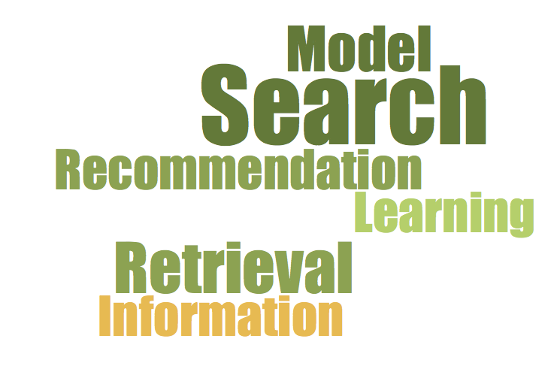


Example of Instantiation: Information Card Model [Zhang & Zhai 15]
How to optimize the interface design?
… or a combination of some of these?
How to allocate screen space among different blocks?

Slide 29
IR Game = “Card Playing”
In each interaction lap
… facing an (evolving) retrieval context
… the retrieval system tries to play a card
… that optimizes the user’s expected surplus
… based on the user’s action model and reward / cost estimates
… given all the constraints on card

Slide 30
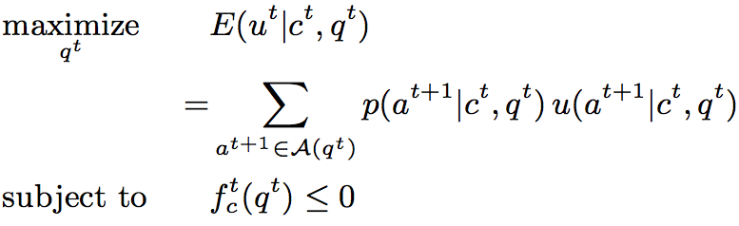

Slide 31
Interface card

Slide 32
Context

Slide 33
Action set

Slide 34
Action model

Slide 35

Reward Cost
Action surplus

Slide 36
Expected surplus

Slide 37
Constraint(s)

Slide 38
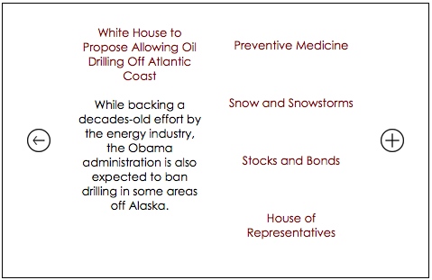
Sample Interface: Medium sized screen

Slide 39
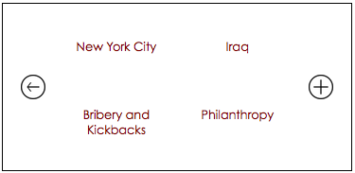

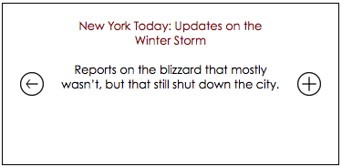
Sample Interface: Smaller screen

Slide 40
IR Game & Diversification: Different Reasons for Diversification
Redundancy reduction ➔ reduce user effort
Diverse information needs (e.g., overview, subtopic retrieval) ➔ increase the immediate utility
Active relevance feedback ➔ increase future utility

Slide 41
Capturing diversification with different loss functions
Redundancy reduction: Loss function includes a redundancy measure
Special case: list presentation + MMR [Zhai et al. 03]
Diverse information needs: loss function defined on latent topics
Special case: PLSA/LDA + topic retrieval [Zhai 02]
Active relevance feedback: loss function considers both relevance and benefit for feedback
Special case: hard queries + feedback only [Shen & Zhai 05]

Slide 42
An interesting new problem: Crowdsourcing judgments from users
Assumption: Approximate relevance judgments with clickthroughs
Question: how to optimize the exploration-exploitation tradeoff when leveraging users to collect clicks on lowly-ranked (“tail”) documents?
Where to insert a candidate ?
Which user should get this “assignment” and when?
Potential solution must include a model for a user’s behavior

Slide 43
Summary: Answers to Basic Questions
What is a search engine?
What is an optimal search engine?
What should be the objective function to optimize?
How can we solve such an optimization problem?
A system that plays the “retrieval game” with one or more users
A system that plays the “retrieval game” optimally
Complete user task + minimize user effort + minimize system cost
Decision/Game-Theoretic Framework
+ Formal Models of Tasks & Users
+ Modeling and Measuring System Cost
+ Machine Learning
+ Efficient Algorithms

Slide 44
Major benefits of IR as game playing
General
A formal framework to integrate research in user studies, evaluation, retrieval models, and efficient implementation of IR systems
A unified roadmap for identifying unexplored important IR research topics
Specific
Naturally optimize performance on an entire session instead of that on a single query (optimizing the chance of winning the entire game)
Optimize the collaboration of machines and users (maximizing collective intelligence)
Naturally crowdsource relevance judgments from users (active feedback)
…

Slide 45
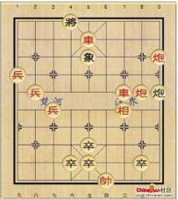
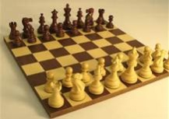
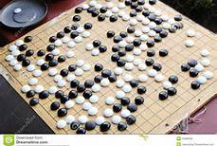
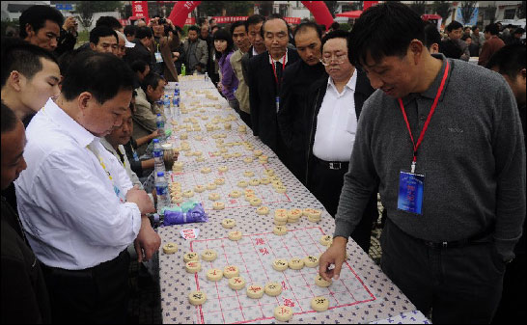
Intelligent IR System in the Future: Optimizing multiple games simultaneously
Game 2
Game k
Game 1
Mobile service
search
Medical advisor
Learning engine
(MOOC)
Intelligent
IR System
Log
Support whole workflow of a user’s task (multimodel info access, info analysis, decision support, task support)
Minimize user effort (natural dialogue; help user choose a good move)
Minimize system operation cost (resource overhead)
Learn to adapt & improve over time from all users/data
Documents

Slide 46
Action Item: future research requires integration of multiple fields/topics
Psychology
User action
Interactive Service
(Search, Browsing, Recommend…)
Human-Computer
Interaction
Document
Collection
Game Theory (Economics)
System response
Information Retrieval
(Evaluation, Models, Efficient Algorithms, … )
User
Understanding
User
Model
Document
Representation
Document
Understanding
User Studies
Natural Language Processing
Machine Learning
(particularly reinforcement learning)
External User
Info (social network)
User interaction Log
External Doc
Info (structures)

Slide 47
Thank You!
Questions/Comments?

Slide 48
References
Note: the references are inevitably incomplete due to the breadth of the topic;
if you know of any important missing references, please email me at czhai@illinois.edu.
[Agarwal et al. 09] Deepak Agarwal, Bee-Chung Chen, and Pradheep Elango. 2009. Explore/Exploit Schemes for Web Content Optimization. In Proceedings of the 2009 Ninth IEEE International Conference on Data Mining (ICDM '09), 2009.
[Amati&van Rijsbergen 2002] G. Amati and C. J. van Rijsbergen. Probabilistic models of information retrieval based on measuring the divergence from randomness. ACM Transactions on Information Retrieval. 2002.
[Azzopardi 11] Leif Azzopardi. 2011. The economics in interactive information retrieval. In Proceedings of ACM SIGIR 2011, pp. 15-24.
[Azzopardi 14] Leif Azzopardi, Modelling interaction with economic models of search, Proceedings of ACM SIGIR 2014.
[Baskaya et al. 13] Feza Baskaya, Heikki Keskustalo, and Kalervo Järvelin. 2013. Modeling behavioral factors ininteractive information retrieval. In Proceedings of ACM CIKM 2013, 2297-2302.
[Belkin 80] Belkin, N.J. "Anomalous states of knowledge as a basis for information retrieval". The Canadian Journal of Information Science, 5, 1980, pages 133-143.

Slide 49
References (cont.)
[Belkin et al. 82] Belkin, N.J., Oddy, R.N., Brooks, H.M. "ASK for information retrieval: Part I. Background and theory". The Journal of Documentation, 38(2), 1982, pages 61-71.
[Belkin 96] Belkin, N. J. (1996). Intelligent information retrieval: Whose intelligence? Proceedings of the Fifth International Symposium for Information Science, Konstanz: Universitätsverlag Konstanz, 25-31.
[Cao et al. 07] Zhe Cao, Tao Qin, Tie-Yan Liu, Ming-Feng Tsai, and Hang Li. 2007. Learning to rank: from pairwise approach to listwise approach. In Proceedings of the 24th international conference on Machine learning (ICML '07), pp.129-136, 2007
[Clinchant & Gaussier 10] Stéphane Clinchant, Éric Gaussier: Information-based models for ad hoc IR. SIGIR 2010: 234-241
[Collins-Thompson et al. 11] Kevyn Collins-Thompson, Paul N. Bennett, Ryen W. White, Sebastian de la Chica, and David Sontag. 2011. Personalizing web search results by reading level. In Proceedings of ACM CIKM 2011, 403-412.
[de Vries et al. 04] A. P. de Vries, G. Kazai, and M. Lalmas. Tolerance to irrelevance: A user-effort oriented evaluation of retrieval systems without predefined retrieval unit. In Proc. RIAO, pages 463–473, 2004.
[Diaz 09] Fernando Diaz. 2009. Integration of news content into web results. In Proceedings of WSDM 2009, pp. 182-191.

Slide 50
References (cont.)
[Fang et al. 04] H. Fang, T. Tao, C. Zhai, A formal study of information retrieval heuristics. SIGIR 2004.
[Fang et al. 11] H. Fang, T. Tao, C. Zhai, Diagnostic evaluation of information retrieval models, ACM Transactions on Information Systems, 29(2), 2011
[Fuhr 89] Norbert Fuhr: Optimal Polynomial Retrieval Functions Based on the Probability Ranking Principle. ACM Trans. Inf. Syst. 7(3): 183-204 (1989)
[Fuhr 08] Norbert Fuhr. 2008. A probability ranking principle for interactive information retrieval. Inf. Retr. 11, 3 (June 2008), 251-265.
[Gey 94] F. Gey. Inferring probability of relevance using the method of logistic regression. SIGIR 1994.
[Guan et al. 13] Dongyi Guan, Sicong Zhang, Hui Yang: Utilizing query change for session search. ACM SIGIR 2013: 453-462
[Harter 75] S. P. Harter. A probabilistic approach to automatic keyword indexing. Journal of the American Society for Information Science, 1975.
[He&Ounis 05] B. He and I. Ounis. A study of the dirichlet priors for term frequency normalization. SIGIR 2005.
[Hiemstra&Kraaij 98] D. Hiemstra and W. Kraaij. Twenty-one at TREC-7: ad-hoc and cross-language track. TREC-7. 1998.

Slide 51
References (cont.)
[Hofmann et al. 11] Katja Hofmann, Shimon Whiteson, Maarten de Rijke: Balancing Exploration and Exploitation in Learning to Rank Online. ECIR 2011: 251-263
[Hofmann 13] Katja Hofmann, Fast and Reliable Online Learning to Rank for Information Retrieval, Doctoral Dissertation, 2013.
[Ingwersen 96] Peter Ingwersen, Cognitive Perspectives of Information Retrieval Interaction: Elements of a Cognitive IR Theory. Journal of Documentation, v52 n1 p3-50 Mar 1996
[Jin et al. 13] Xiaoran Jin, Marc Sloan, and Jun Wang. 2013. Interactive exploratory search for multi page search results. In Proceedings of WWW 2013, pp. 655-666.
[Karimzadehgan & Zhai 13] Maryam Karimzadehgan, ChengXiang Zhai. A Learning Approach to Optimizing Exploration-Exploitation Tradeoff in Relevance Feedback, Information Retrieval , 16(3), 307-330, 2013.
[Kurland&Lee 2004] O. Kurland and L. Lee. Corpus structure, language models, and ad hoc information retrieval. SIGIR 2004.
[Lavrenko&Croft 2001] V. Lavrenko and B. Croft. Relevance-based language models. SIGIR 2001.
[Li et al. 09] Lihong Li, Jason D. Williams, and Suhrid Balakrishnan, Reinforcement Learning for Spoken Dialog Management using Least-Squares Policy Iteration and Fast Feature Selection, in Proceedings of the Tenth Annual Conference of the International Speech Communication Association (INTERSPEECH-09), 2009.

Slide 52
References (cont.)
[Luo et al. 14] J. Luo, S. Zhang, G. H. Yang, Win-Win Search: Dual-Agent Stochastic Game in Session Search. ACM SIGIR 2014.
[Maron&Kuhn 60] M. E. Maron and J. L. Kuhns. On relevance, probabilistic indexing and information retrieval. Journal o f the ACM, 1960.
[Pandey et al 07] S. Pandey, D. Chakrabarti, and D. Agarwal. 2007. Multi-armed bandit problems with dependent arms. In Proceedings of ICML 2007.
[Ponte&Croft 1998] J. Ponte and W. B. Croft. A language modeling approach to information retrieval. SIGIR 1998.
[Robertson&Sparck Jones 76] S. Robertson and K. Sparck Jones. Relevance weighting of search terms. Journal of the American Society for Information Science, 1976.
[Robertson 77] S. E. Robertson. The probability ranking principle in IR. S. E. Robertson. Journal of Documentation, 1977.
[Robertson 81] S. E. Robertson, C. J. van Rijsbergen and M. F. Porter. Probabilistic models of indexing and searching. Information Retrieval Search, 1981.
[Robertson&Walker 1994] S. E. Robertson and S. Walker. Some simple effective approximations to the 2-Poisson model for probabilistic weighted retrieval. SIGIR 1994.
[Salton et al. 75] G. Salton, C.S. Yang and C. T. Yu. A theory of term importance in automatic text analysis. Journal of the American Society for Information Science, 1975.

Slide 53
References (cont.)
[Seo & Zhang 00] Young-Woo Seo and Byoung-Tak Zhang. 2000. A reinforcement learning agent for personalized information filtering. In Proceedings of the 5th international conference on Intelligent user interfaces (IUI '00). 248-251.
[Shen et al. 05] Xuehua Shen, Bin Tan, and ChengXiang Zhai, Implicit User Modeling for Personalized Search , In Proceedings of the 14th ACM International Conference on Information and Knowledge Management ( CIKM'05), pages 824-831.
[Shen & Zhai 05] Xuehua Shen, ChengXiang Zhai, Active Feedback in Ad Hoc Information Retrieval, Proceedings of the 28th Annual International ACM SIGIR Conference on Research and Development in Information Retrieval ( SIGIR'05), 59-66, 2005.
[Shen et al. 06] Dou Shen, Jian-Tao Sun, Qiang Yang, and Zheng Chen. 2006. Building bridges for web query classification. In Proceedings of the 29th annual international ACM SIGIR 2006, pp. 131-138.
[Singh et al. 02] Satinder Singh, Diane Litman, Michael Kearns, and Marilyn Walker. Optimizing dialogue management with reinforcement learning: experiments with the NJFun system. Journal of Artificial Intelligence Research, 16:105-133, 2002.
[Singhal et al. 96] A. Singhal, C. Buckley and M. Mitra. Pivoted document length normalization. SIGIR 1996.
[Smucker & Clarke 12] Mark D. Smucker and Charles L.A. Clarke. 2012. Time-based calibration of effectiveness measures. In Proceedings of ACM SIGIR 2012; 95-104.

Slide 54
References (cont.)
[Teevan et al. 10] Jaime Teevan, Susan T. Dumais, Eric Horvitz: Potential for personalization. ACM Trans. Comput.-Hum. Interact. 17(1) (2010)
[Theocharous et al. 15] G. Theocharous, P. Thomas, & M. Ghavamzadeh. “Ad Recommendation Systems for Life-Time Value Optimization”. WWW 2015 Workshop on Ad Targeting at Scale.
[Thomas et al. 14] Paul Thomas, Alistair Moffat, Peter Bailey, and Falk Scholer. 2014. Modeling decision points in user search behavior. In Proceedings of the 5th Information Interaction in Context Symposium (IIiX '14). 239-242.
[Turtle & Croft 90] H. Turtle and W. B. Croft. 1989. Inference networks for document retrieval. In Proceedings of ACM SIGIR 1990, 1990. pp. 1-24.
[van Rijsbergen 86] C. J. van Rijsbergen. A non-classical logic for information retrieval. C. J. van Rijsbergen. The Computer Journal, 1986.
[van Rijsbergen 77] C. J. van Rijbergen. A theoretical basis for the use of co-occurrence data in information retrieval. C. J. van Rijbergen. Journal of Documentation, 1977.
[Wang et al. 13] Hongning Wang, Yang Song, Ming-Wei Chang, Xiaodong He, Ryen W. White, and Wei Chu. 2013. Learning to extract cross-session search tasks, WWW’ 2013. 1353-1364.

Slide 55
References (cont.)
[Wong&Yao 95] S. K. M. Wong and Y. Y. Yao. On modeling information retrieval with probabilistic inference. ACM Transactions on Information Systems. 1995.
[Zhai&Lafferty 01] C. Zhai and J. Lafferty. A study of smoothing methods for language models applied to ad hoc information retrieval. SIGIR 2001.
[Zhai 02] ChengXiang Zhai, Risk Minimization and Language Modeling in Information Retrieval, Ph.D. thesis, Carnegie Mellon University, 2002.
[Zhai et al. 03] ChengXiang Zhai, William W. Cohen, and John Lafferty, Beyond Independent Relevance: Methods and Evaluation Metrics for Subtopic Retrieval , Proceedings of the 26th Annual International ACM SIGIR Conference on Research and Development in Information Retrieval ( SIGIR'03 ), pages 10-17, 2003.
[Zhai & Lafferty 06] ChengXiang Zhai, John D. Lafferty: A risk minimization framework for information retrieval. Inf. Process. Manage. 42(1): 31-55 (2006)
[Zhang & Zhai 15] Yinan Zhang, ChengXiang Zhai, Information Retrieval as Card Playing: A Formal Model for Optimizing Interactive Retrieval Interface. In Proceedings of ACM SIGIR 2015, pp. 685-694.

