Slide 1
Module Detection & Evaluation

Slide 2
Components of evaluating a method
Dataset (precise2k)
Post-processing:
Transformations
Filtering (ex.
Known regulatory interactions (regulondb)
Module definitions
Minimal co-regulation
Strict co-regulation
Interconnected subgraphs
Prediction model (ex. Genie3 is a direct network inference method)
Each prediction model has its own
Model parameters (ex. RF/Many-tree, Ntrees, threshold)
Evaluation metrics

Slide 3
Defining a baseline = reference regulatory network permutated baseline = shuffled training data set
Extract regulators gene targets as modules which are consequently used as a baseline reference
(filters modules greater than 5 genes)
Alternative definitions of what a module is:
Minimal coregulation
Strict coregulation
Graph clustering methods with varied cutoffs
MCL interconnected subgraphs
Affinity propagation interconnected subgraphs
Transitivity clustering interconnected subgraphs

Slide 4
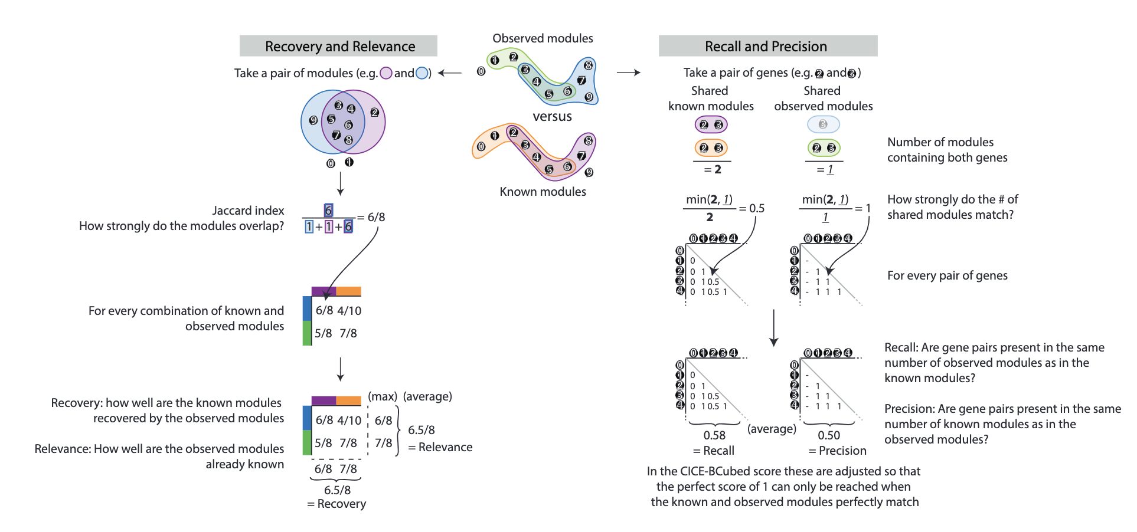
Evaluation metrics
Each score assesses the similarity between a set of known modules and a set of observed modules. The recovery and
relevance will try to match individual modules between the two sets using the Jaccard index, a measure of overlap
between two mathematical sets. The recovery tries to match known modules with observed modules, while the
relevance tries to match observed modules with known modules. The recall and precision scores will compare the
number of times a pair of genes is together present in observed modules versus those in known modules. The recall
determines whether a pair of genes is present in at least the same number of modules in the known modules as in
the observed modules, and vice-versa for the precision.

Slide 5
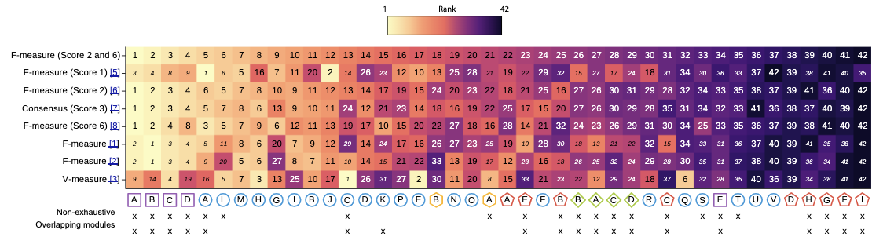
Additional scoring metric definitions
Each score (y-axis) assesses the correspondence between a set of observed and known modules. Some scores have some
difficulties with handling overlapping and/or non-exhaustive module assignment (Supplementary Note 1). Ranks
which are potentially unreliable, if also the method detects non-exhaustive and/or overlapping modules (bottom),
are therefore shown in a smaller font. Despite this, we found that the overall ranking of most methods was similar
between most scores.

Slide 6
Characterization of the code base
conf – contains configuration files for large runs
lib – codebase for computing module metrics
Notebooks – description for how they set up the pipeline, executes code through the config files and scripts
scripts – calls functions from lib to execute code

Slide 7
Scripts
moduledetection.py
1. loads expression data set
2. executes a module detection method (genie3, ica etc) returns modules. module detection methods are loaded from method[‘params’][‘method’]. This is itself a function that takes the arguments of the gene expression datast (E) and method["params"] keywords
3. These values are written to output_folder = sys.argv[3] under /modules.json where sys.argv[3]
moduledetection_baseline.py
1. loads expression data set
2. executes the baseline method and returns modules. module detection methods are loaded from method[‘params’][‘method’]. This is itself a function that takes the arguments of the gene expression datast (E) and method["params"] keywords
3. These values are written to output_folder = sys.argv[5] under /modules.json where sys.argv[5]

Slide 8
Lib
Modulescomparison.py
ModulesComparison
__init__ Takes in 3 arguments: two different module sets to be compared, and the set of all genes in the dataset, G. Calculates the membership matricies for both modules and then calcvulates the jaccard similarity matrix between the two membership matricies. Score: takes in the baseline and scores to be computed and outputs the scores for each scoring method. Then compares the scores to the baseline scores, and Computes additional scores such as fmeasure_wiwie, fmeasure_flowcap, and vmeasure_wiwie if specified in scorenames.
Scoring Methods:
Recovery and relevance (rr) - Calculates the maximum Jaccard similarity for each module in modulesA (recovery) and modulesB (relevance). Averages the scores to get overall recovery and relevance. Computes the harmonic mean of recovery and relevance (F1rr).
Recall and precision (rp) - Uses ebcubed.cal_ebcubed to calculate recall and precision based on the Jaccard similarity matrix. Averages the recall and precision scores. Computes the harmonic mean of recall and precision (F1rp).
Consensus - Uses the Munkres algorithm to find the best matching between modules of modulesA and modulesB based on the Jaccard similarity matrix. Calculates a consensus score based on the matching.
Combined F1 score - If both "rr" and "rp" are in scorenames, calculates the harmonic mean of recovery, relevance, recall, and precision (F1rprr).

Slide 9
Lib (Part 2)
ModevalKnownmodules
__init__ initializes the object with a baseline flag and a list of configurations called 'settings' that is provided when the class is called.
run Executes the evaluation using the provided multiprocessing pool (something defined that tells the computer how much processing power to use for this task). It does this by preparing a list to hold jobs, creating a multiprocessing manager, initializing a dictionary for stored scores, preparing a list of parameters for each setting, using 'starmap' to apply 'modeval worker' (see more on this later) to each set of parameters in parallel, and finally, collecting all of the scores to a single list and then converting that list into a data frame.
save saves the evaluation scores to files. load loads the evaluation scores from the files
modevalworker Evaluates a set of modules against known modules for a given setting. Loads modules, run info, and dataset from specified locations. If baseline is True, loads baseline scores. Iterates through known modules in the dataset, computes scores using modevalscorer, and appends results to settingscores. Stores results in the shared scores dictionary.
modevalscorer Scores the modules against known modules. Extracts all genes from known modules. Filters the input modules to retain only genes present in allgenes and removes small modules. Creates a ModulesComparison object and computes scores using the provided baselines (if any).

Slide 10
Lib (Part 3)
Modevalcoverage
__init__ initializes the object with a baseline flag and a list of configurations called 'settings' that is provided when the class is called. Initializes attributes self.settings and self.baseline
Run Executes evaluations using multiprocessing (mp.Pool) on a list of settings (self.settings). Uses a shared dictionary (scores) managed by mp.Manager() to store evaluation results. Calls modeval_coverage_worker function for each setting in self.settings using pool.starmap(). After processing, aggregates results into a Pandas DataFrame (self.scores). Shuts down the multiprocessing manager (manager.shutdown()).
save saves the evaluation scores to files. load loads the evaluation scores from the files
modevalcoverageworker Loads dataset and baseline if specified. Computes evaluation scores using modbindevalscorer function. Stores evaluation results in the shared dictionary scores.
modbindevalscorer Performs evaluation on modules (modules) and binding data (binding). Calculates various metrics such as true positives, false positives, odds ratios, p-values, q-values, and AUC (Area Under the Curve) for odds ratios (aucodds). Returns a dictionary scores containing the computed metrics.
Modeval
__init__ accepts settings and initializes self.settings. save saves the self.scores to a json. load loads scores from another file
Not sure what purpose this serves

Slide 11
Lib (Part 4)
ModevalFunctional
__init__ Initializes with settings, which are configurations for evaluation.
run Executes evaluations using multiprocessing (mp.Pool) on a list of settings (self.settings). Uses a shared dictionary (scores) managed by mp.Manager() to store evaluation results. Calls modenrichevalworker function for each setting in self.settings using pool.starmap(). After processing, aggregates results into a Pandas DataFrame (self.scores). Shuts down the multiprocessing manager (manager.shutdown()).
save saves the evaluation scores to files. load loads the evaluation scores from the files
modenrichevalworker Loads dataset and modules configuration. Iterates over gene sets (gsets) defined in the dataset. For each gene set, loads membership and connectivity data. Calls modenrichevalscorer function to compute evaluation scores (settingscores) for each gene set. Stores the scores in the shared dictionary scores under the setting ID.
modenrichevalscorer Filters modules based on a size criterion (filter_size(5)). Calls test_enrichment function to compute p-values, q-values, and odds ratios (odds) related to enrichment of modules. Filters odds ratios (filteredodds) based on q-values (qvals).Computes several evaluation metrics: bhi: Bi-Hub Index calculated based on module connectivity. faucodds: Folded AUC for odds ratios, considering both direct and reverse enrichments. Returns a dictionary scores containing these computed metrics.
Misc
Test_enrichment - Calculates statistical tests (Fisher's exact test) on module enrichment.
Cal_bhi - Calculates the Bi-Hub Index based on module connectivity
Cal_aucodds and Cal_faucodds - Calculate the Area Under the Curve (AUC) for odds ratios, with cal_faucodds providing a folded version.
Filterfisher - Applies Fisher's exact test to filter enrichments based on statistical significance.

Slide 12
Lib (Part 5)
Modulecontainers
Modules class
Method: cal_membership: gets the set of all genes in in modules if G = None, iterates over modules and appends to membership if the gene in the module is also in the reference of all genes returns a pandas dataframe where the columns are the gene names and the indices are name ”M {module number}" shuffle: Shuffles the modules while keeping the internal structure (size, number and overlap) the same. Infers the entire set of genes from what modules are given if the entire set is not given. cal_connectivity: creates a data frame of each gene in G as the rows and columns, effectively displaying the connectivity of each gene with each other gene, and sets the connectivity of each gene with itself (the diagonal of this data frame) to TRUE, setting up the data frame.

Slide 13
Configuration files
Setting
For each method, there is a .json file containing the name and location (of the files) of the dataset, the file location of the method, the name of the regulatory network and known modules, output folder, and setting id (a number used to categorize these settings) for each known module of each regulatory network in the dataset.
Datasets
Includes information about each dataset, including where in the files they are located and their knownmodules, regulatory networks, and parameters (where the dataset came from and what organism it is from)
Paramexplo
Subsample

Slide 14
Notebook 0: Generating Baseline
Running a method on different parameter settings and datasets
Sets the dataset names equal to the names of the different datasets used for the data
Loads a .py file of blueprints of the various methods, including static and dynamic parameters for methods where it is necessary.
Sets the blueprints for the baseline_permuted method as methodblueprint.
Makes a folder for the parameters, and then iterates over all possible combinations of dynamic parameters (if the method has them), for each combination creates a method configuration dictionary for both static and dynamic paramters, and then saves this output to a json file, and updates lists with the method and the location of its configuration file.
Creates a settings folder and output folder for each known module within each dataset, and saves information about each to be used later. Loads those settings and puts them into a pandas dataframe for easy manipulation.
Creates a file of commands to be run in parallel, running the moduledetection_baseline.py script under several different parameters in parallel to set up the various files within the output folders and write information needed to set up the baseline to them.

Slide 15
Notebook 0: Generating Baseline
Evaluating the method
By comparing with known modules
Creates a pool of processors to run the coming functions with
Filters the human datasets out of the settings and runs ModevalKnownmodules with the filtered settings
Gets the scores generated by ModevalKnownmodules and concatenates them into a single data frame. Then groups the scores by known module name, regulatory network name, and baseline name, takes the mean of the scores, and sets the baseline equal to this modified dataframe and saves it.
Using the coverage of regulators
The same as the previous section, but evaluates only the human datasets and uses ModevalCoverage. ModevalCoverage uses a different scoring system than ModevalKnownmodules and outputs one values that seems to be a harmonic mean of all the other scores

Slide 16
Notebook 0: Generating Baseline
Comparing with Other Methods
Defines a new function: score_method, which initializes methodscores and iterates over all possible pairs of grouped dataframes by datasetname and goldstandard, filtering out groups where one dataset is synthetic and one is not, and filtering out groups where goldstandards are not comparable. Identifies the optimal parameters in the reference dataset by finding the parameters corresponding to the highest score. Tries to find rows in the dataset of interest (scoresoi) that match the optimal parameters from the reference dataset (bestparams). Prints a message if no matching parameters are found or if multiple rows match. Appends a dictionary to methodscores containing names of the dataset of interest and dataset of reference, the maximum score of the datatset of interest, the method name, gold standard names of the datasets, and other relevant details like runtime, the module definition, and the organism involved. Then it returns this data frame.

Slide 17
Notebook 0: Generating Baseline
Comparing with other methods
Initializes a finalscores list, and for each method name, iterates, loading a json file for the setting name, creating two pandas dataframes, Creates two DataFrames, settings_dataset and settings_method, by extracting parameters from the dataset and method JSON files and including a settingid for each setting, prints the current method name, and retrieves the parameters of interest of the method name. Creates a scores dataframe, and runs ModevalKnownmodules with settings_name. Sets the scores column to the F1rprr_permuted scores, Modifies the moduledef column to categorize known modules. Merges modeval.scores with settings_dataset and settings_method on settingid. Appends the merged scores to the scores DataFrame. Then does the same with ModevalCoverage, using aucodds_permuted instead of the F1rprr_permuted scores. Calls the score_method function with the combined scores DataFrame. Adds organismnetoi and organismnetor columns to methodscores, extracting the organism name from goldstandardoi and goldstandardor. The appends methodscores to the final scores list. FInally, outside of the iteration concatenates the finalscores dataframe.

Slide 18
Notebook 0: Generating Baseline
Comparing with other methods
The function add_weights calculates and assigns weights to scores based on the distribution of moduledef within each organismoi group. These weights are intended to balance the influence of different moduledef categories.
Filters scores for training data by selecting rows where the dataset and gold standard match between the test and reference datasets. Applies the add_weights function to the filtered scores. Data frame is grouped by method, and for each group (x), np.average() is applied to calculate the weighted average of score using weight as weights, which computes the weighted average score for each method based on the training data.
A similar process is applied for test scores, but the filtering selects rows where the data set a goldstandard do not match.
Writes these scores to csv files.
Generates a horizontal bar plot to visualize the training and test scores for each method.

