Slide 1
Summary
Prior knowledge: opening weekend take has a lot prediction power of total gross revenue
Goal: predict domestic gross before first weekend
Feature extraction:
Dummy variables: Director, Studio, Genre, Month (seasonality)
Derived variables:
Average gross and counts over the history of Directors, Studios
Temporal information from last year of Directors, Studios
Title length: word count
Model fit:
Linear: 0.42 (R^2)
Gradient Boosting Regressor: 0.45 (test R^2)
Optimization:
Hyper-parameter tuning: number of trees, minimum sample per leaf, tree depth
Variable selection: variable importance based on Tree model
Other models:
Predict opening weekend take: ~ 0.5 (R^2)
Predict metascore: ~ 0.3 (R^2)

Slide 2
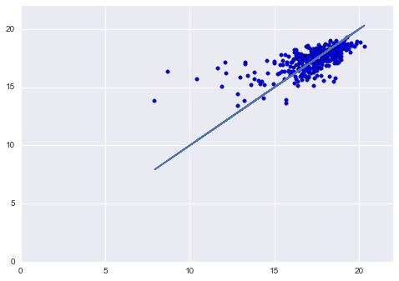
Prediction over real word
log(domestic gross)
Predict
Real

Slide 3
Feature selection
R^2
# Features
number of trees: 100, minimum sample per leaf: 20, tree depth: 3

Slide 4
Interesting variables
With only Dummy
Added History summary
variable | normalized
Log_production_budget | 1
runtime_minutes | 0.95870145
year | 0.457412936
title_word_count | 0.18063809
studio_Warner Bros. Pictures | 0.140676817
month_05 | 0.114997073
studio_IFC Films | 0.101228497
genre_comedy | 0.098678064
genre_adventure | 0.098419953
rating_R | 0.095699929
rating_G | 0.085713165
genre_fantasy | 0.074321642
rating_PG_13 | 0.073013874
genre_fi | 0.068837931
genre_drama | 0.065750808
genre_sci | 0.062180888
genre_romance | 0.060118957
month_10 | 0.058904913
month_07 | 0.058576516
month_06 | 0.052350893
variable | normalized
studio_log_avg_gross | 1
log_production_budget | 0.942349226
studio_pre_log_avg_gross | 0.687840488
year | 0.520604729
runtime_minutes | 0.505703839
studio_log_count | 0.466238104
director_log_avg_gross | 0.44912377
year_pre_log_avg_count | 0.342928485
year_pre_log_avg_gross | 0.198214785
genre_war | 0.155577961
rating_R | 0.145696974
genre_drama | 0.142771471
director_log_avg_count | 0.139663738
month_09 | 0.13428457
genre_thriller | 0.118213317
genre_fantasy | 0.109242407
title_word_count | 0.105380001
month_10 | 0.101541466
month_05 | 0.092705088
genre_crime | 0.086788823

