Slide 1
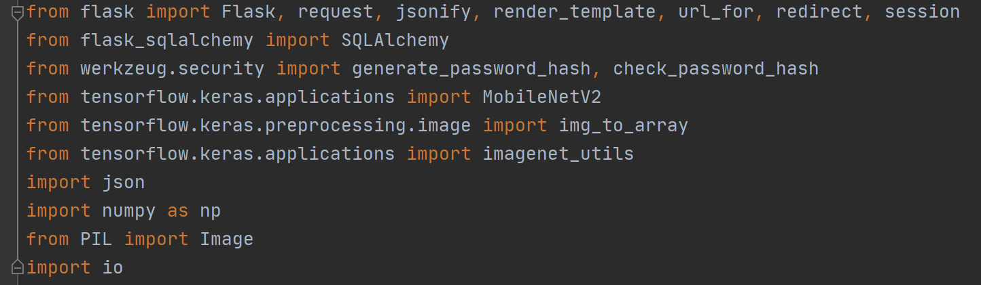
App - Overview
Task Goals:
There are 2 major functions on this app server are required:
Provide image prediction service.
Provide historical prediction record database check service, which includes a UI interface and requires user registration and login to access.
Design concept:
The idea is to use Python to build app backend, and HTML to build app UI frontend. To achieve this, several packages are required, which includes:
Flask: The web framework written in Python, used to create server, routes and communicate with HTML frontend
Flask-SQLAlchemy: An extension for Flask, used to create local database for data storage
Werkzeug: A WSGI web application library. werkzeug.security contains functions that can generate and check hash passwords, which will be used for user registration and login function development.
Tensorflow: The deep learning framework, used to load deep learning models for image prediction and do image pre-processing.
Json: Used to load local json files.
Numpy: Used to manipulate numpy-array like images
PIL (Pillow): Used to do image pre-processing such as mode conversion and resizing.
Io: Used to load files in various format.
The Python import code

Slide 2
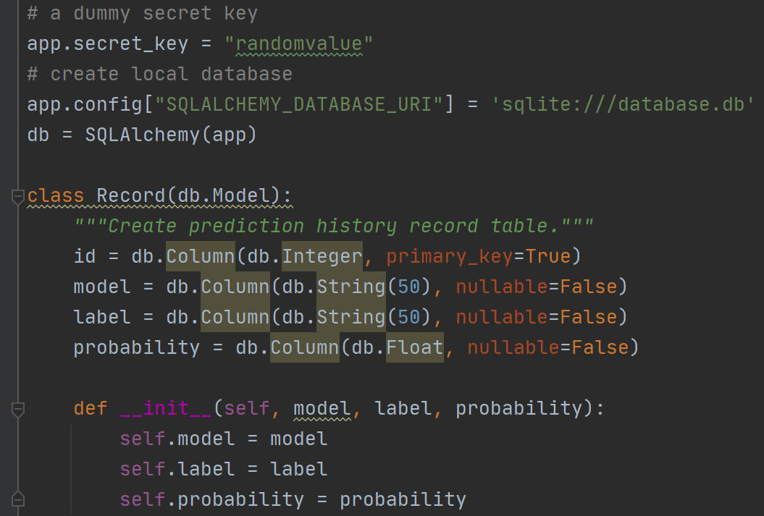
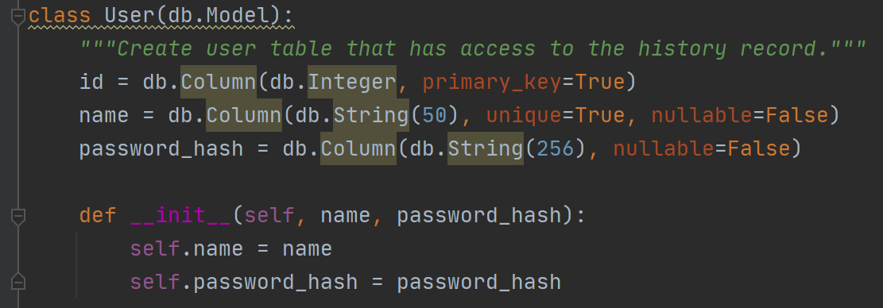
App – Database creation
This section will show the code for database creation. The database contains 2 tables, which are:
Record: used to store model prediction results, which includes 3 columns (apart from id):
model: string with max. length of 50, indicates which model is used for prediction.
label: string with max. length of 50, indicates the prediction result.
probability: float, indicates the top prediction probability.
User: used to store user registration information, which includes 2 columns (apart from id):
name: string with max. length of 50, indicates the registered username.
password_hash: string with max. length of 256, indicates the registered password which has been converted to a hash value.
The User table
The database creation and Record table, secret_key is for flask session which will be used later

Slide 3
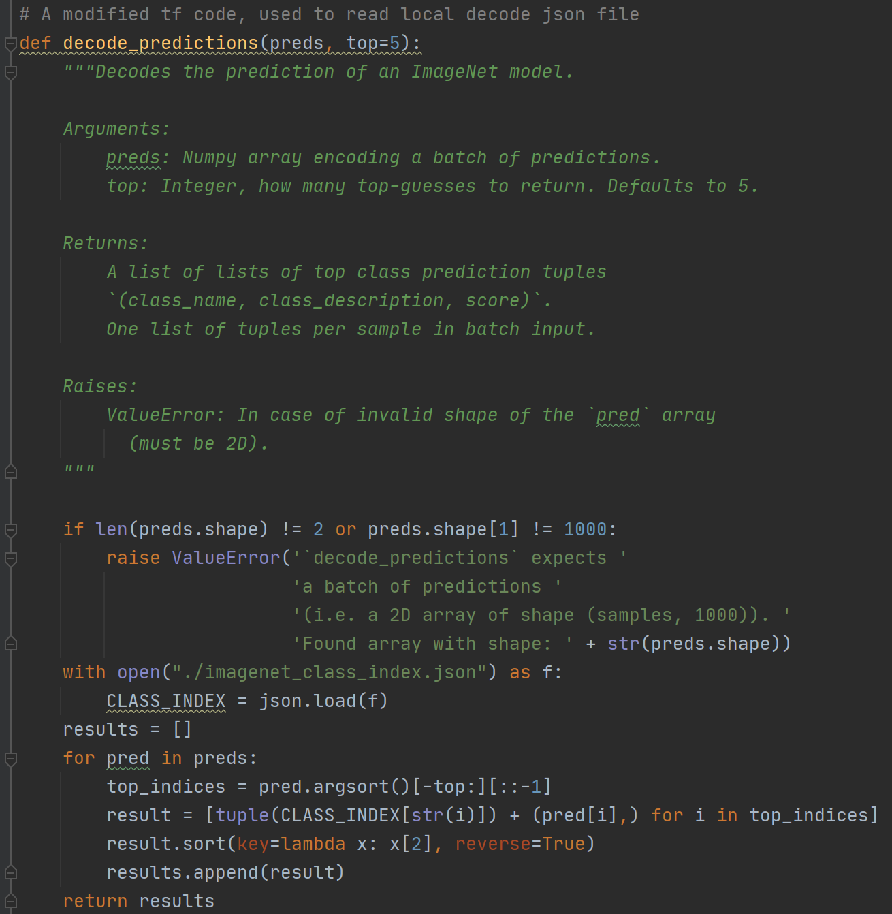
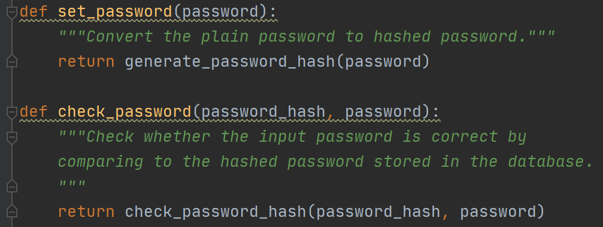
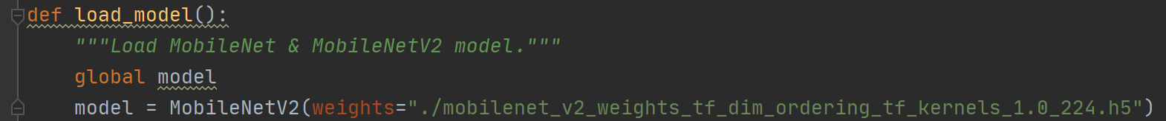
App – Utility Functions
This section will show the code for various utility functions that will be used to achieve password hash encoding, image-pre-processing, image prediction etc.
Set_password and check_password function
Set model to be global variable for ease of use
load_model function to load load MobileNetV2 model locally
MobileNetV2 was selected as it is small while gives acceptable detection accuracy.
The modified area
decode_prediction function converts the raw prediction matrix output to a list which contains imagenet id, label and prediction probability.
This is a modified TF source code which can load decode json locally instead of from internet.

Slide 4
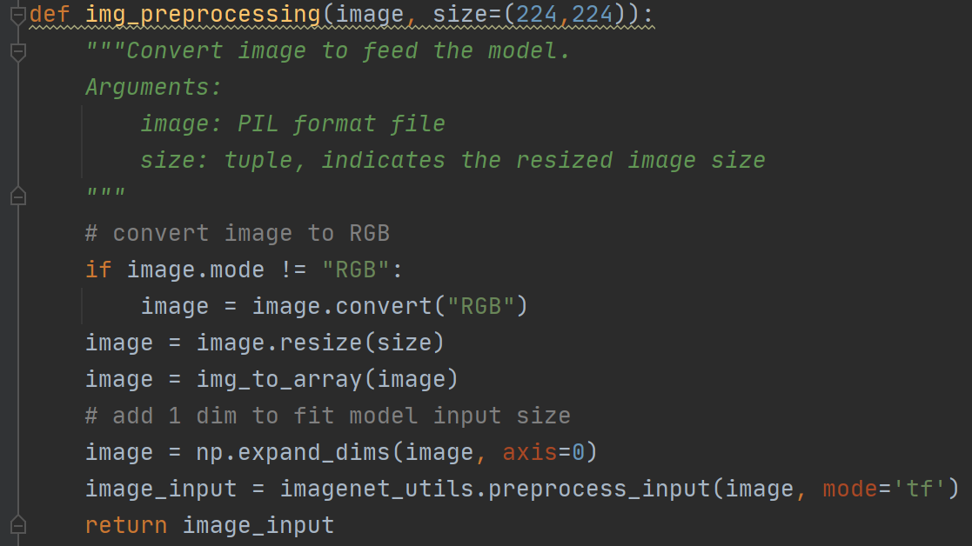
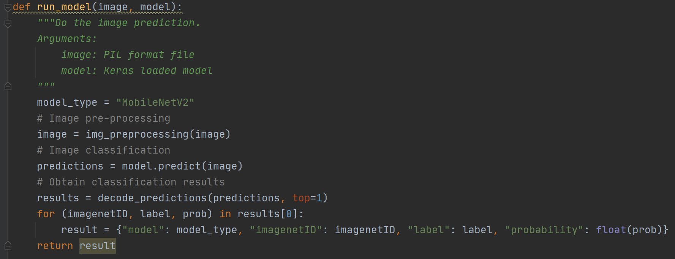
App – Utility Functions (continued)
img_preprocessing function will convert the input image file to the deep learning model input format.
run_model function takes the input image to do image pre-processing first (via img_preprocessing function);
Then the formatted image will be feeded to the deep learning model to do the prediction.
Finally the raw prediction result will be decoded (via decode_prediction function shown in previous page) to generate a readable list which contains all the information needed.

Slide 5
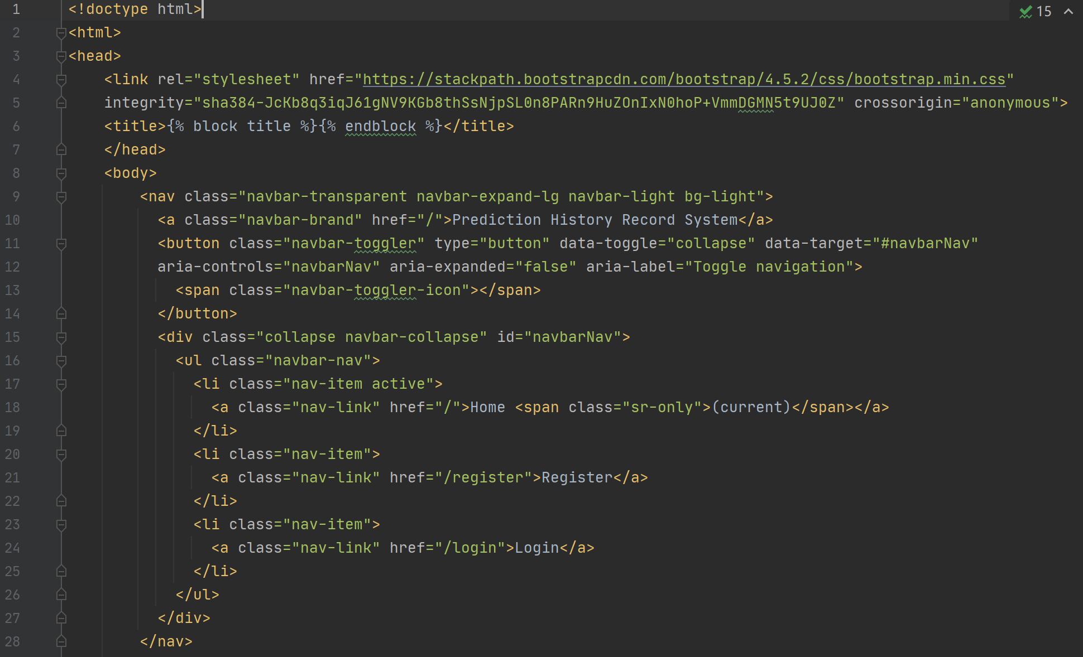
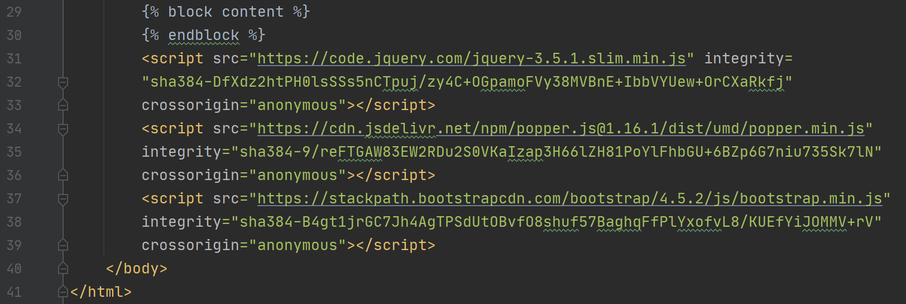
App – Routes Overview
This section will show the code for each route. There are 5 different routes, which are:
@app.route("/"): Home page
@app.route("/register", methods=["POST", "GET"]): Registration page
@app.route("/login", methods=["POST", "GET"]): Login page
@app.route("/predict", methods=["POST"]): Predict request
@app.route("/history", methods=["GET"]): Historic prediction record page
For home, registration, login and historic prediction record page, a HTML file was written respectively to generate UI interface. Besides there is a base.html file which provide the common framework among all web pages. Below is the code for base.html:
Load bootstrap JS
Load bootstrap CCS
2 orange blocks indicates the area that allows the children html to modify
Load bootstrap navbar

Slide 6
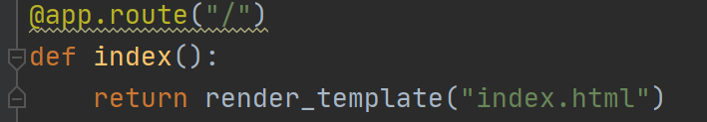
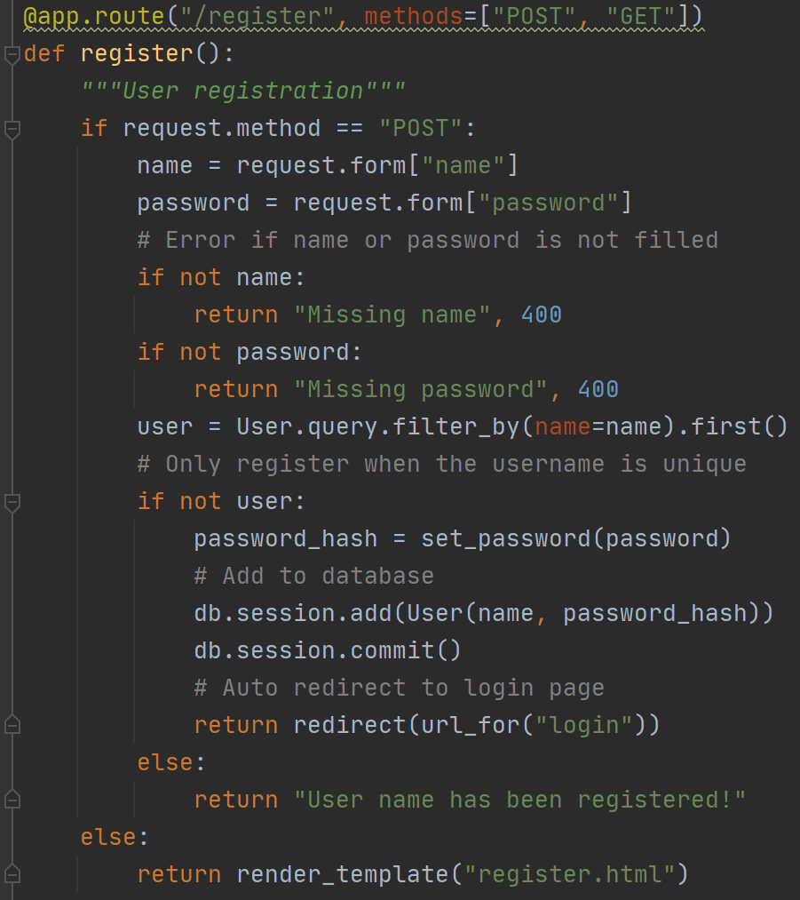
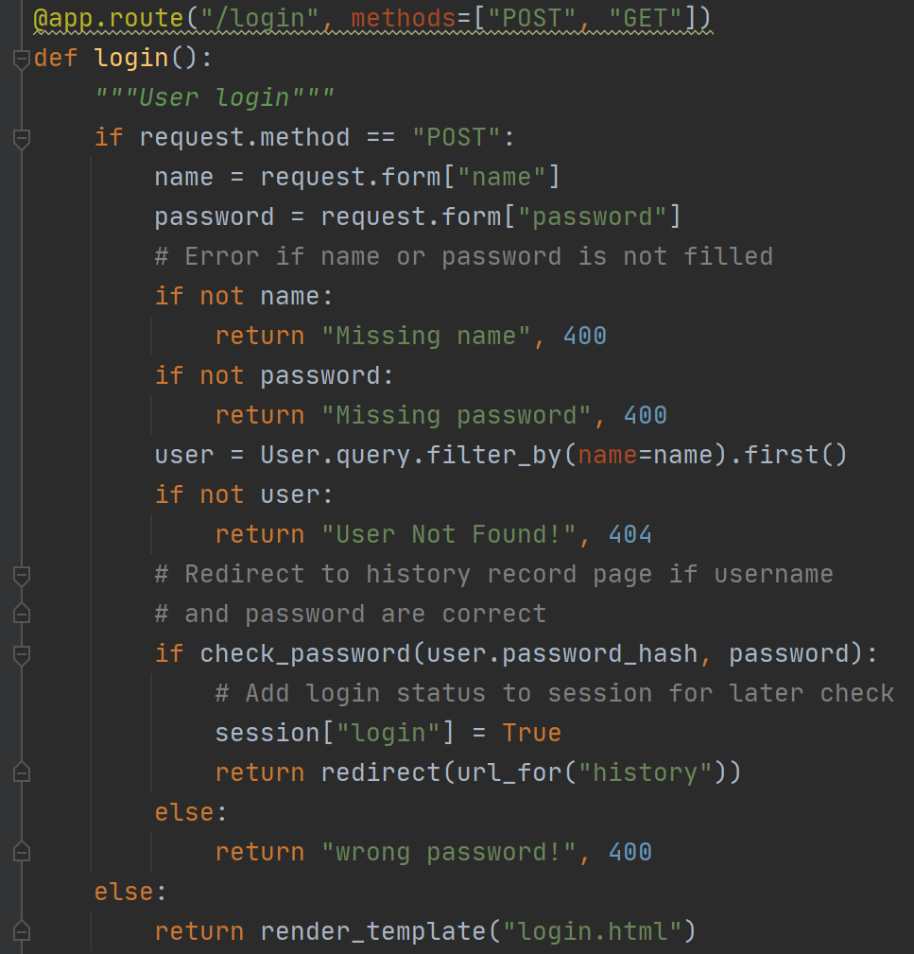
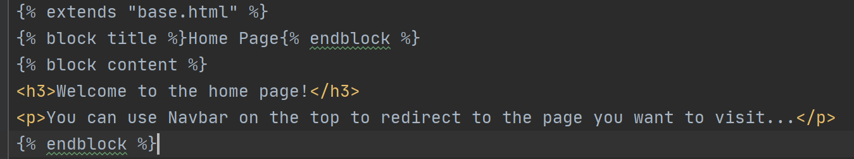
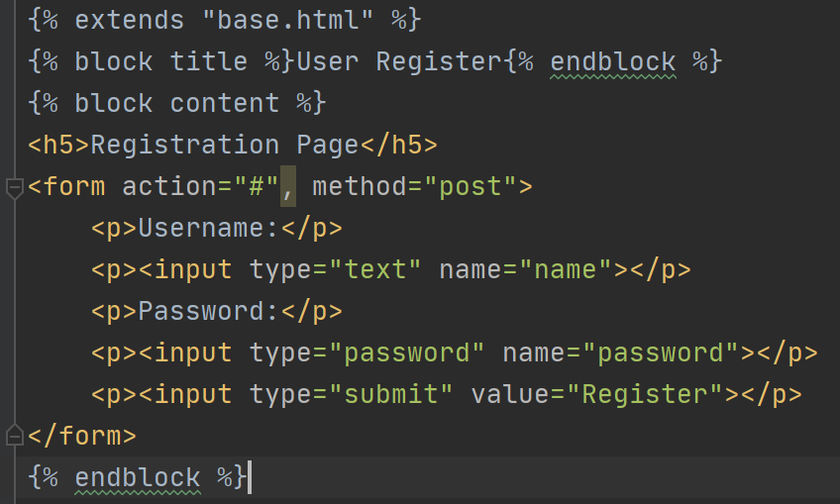
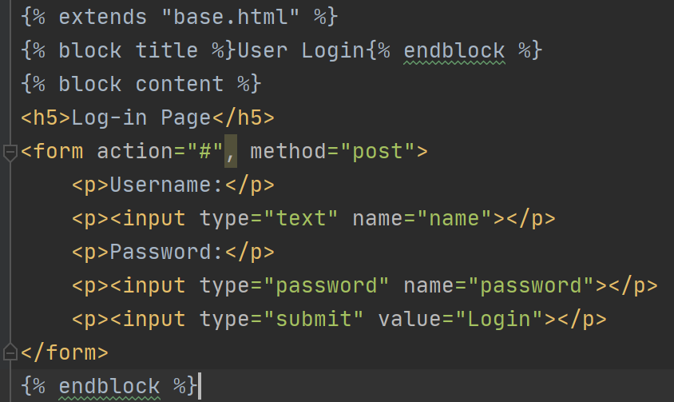
App – Home, Registration & Login
This section will show the code for @app.route("/"), @app.route("/register", methods=["POST", "GET"]) & @app.route("/login", methods=["POST", "GET"])
Obtain username & plain password if POST
Return error msg if input missing
The Python & HTML code for the home page
Return error msg if the input username was missing in db
Convert password to hash value and store username & hashed password to db if input username is not in db
Automatically redirect to historic record page if password is correct; Use session to record login status
Automatically redirect to login page after registration
Return error msg if the input username was found in db
Inherit properties from parent base.html
Build username, password input block and submission block
The Python & HTML code for the registration page
The Python & HTML code for the login page

Slide 7
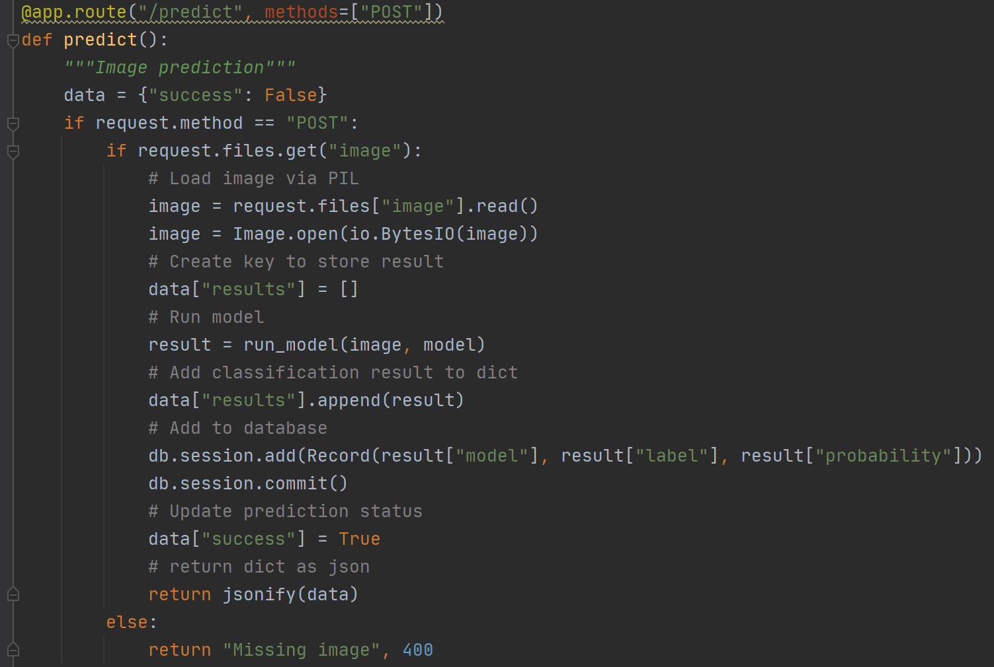
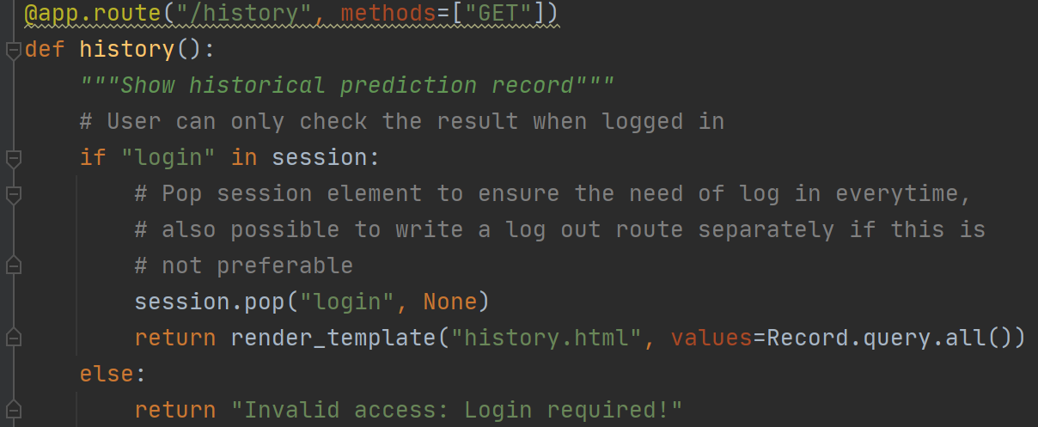
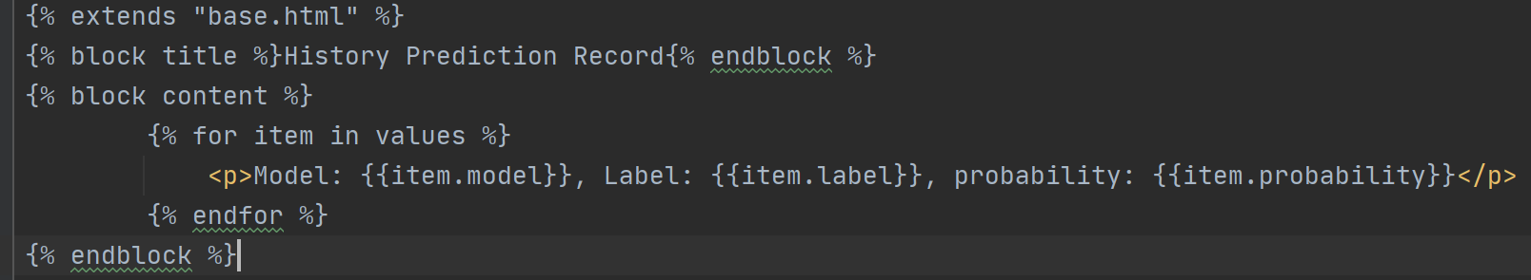
App – Predict & History
This section will show the code for @app.route("/predict", methods=["POST”]) & @app.route("/history", methods=["GET"])
Can only access historic record page if login succeeds
Read uploaded image in bytes
Open uploaded image via PIL
Load run_model function for prediction
Return all the db value to the web UI
Print out db values in line
Add desired info into db, imagenet id is not needed
The Python code for the predict request
The Python & HTML code for the historic record page

Slide 8
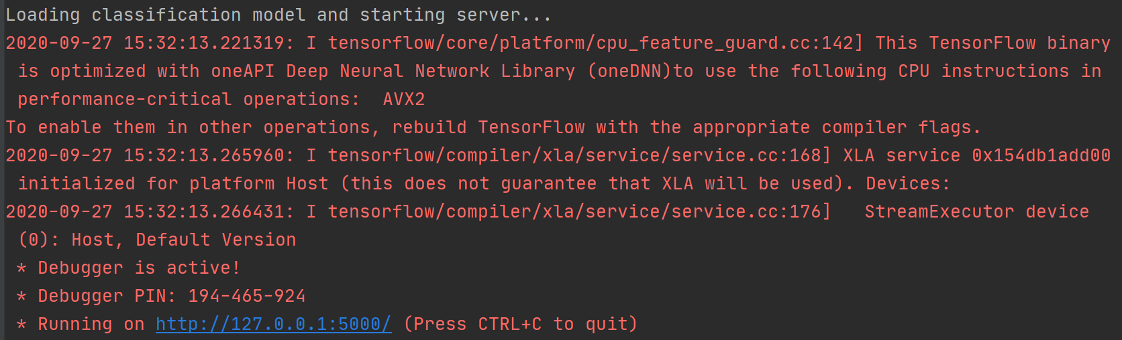
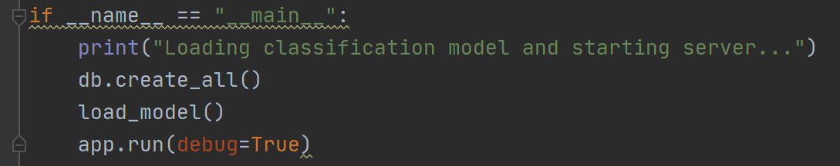
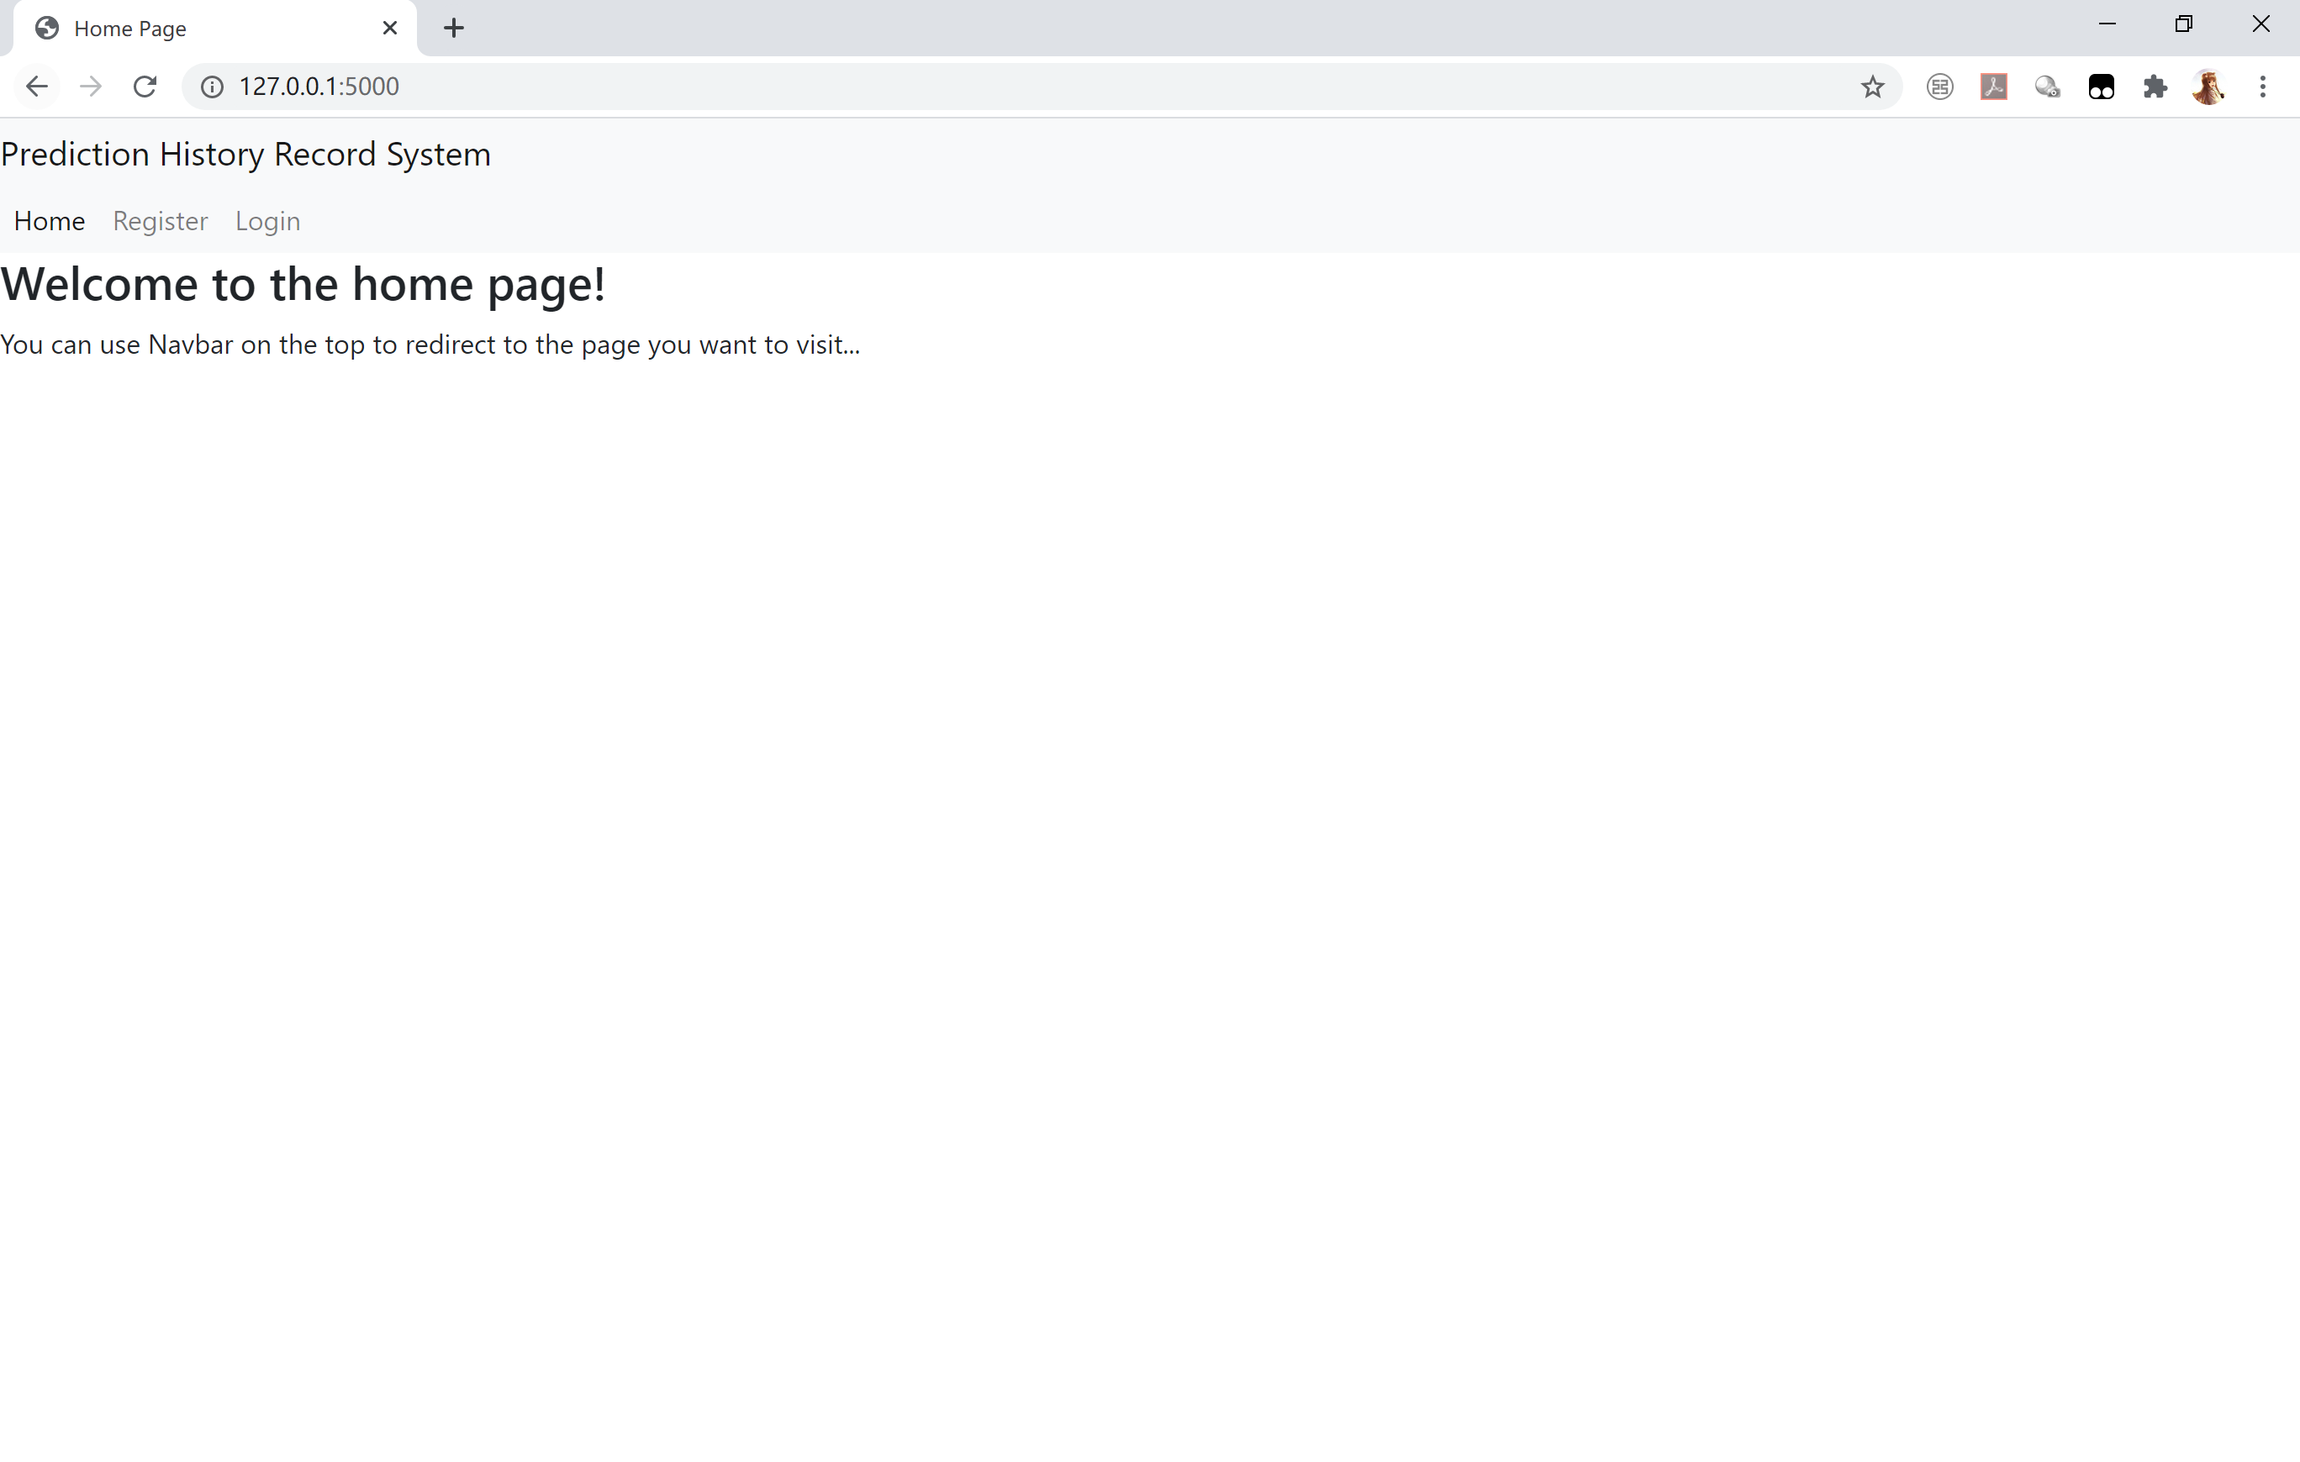
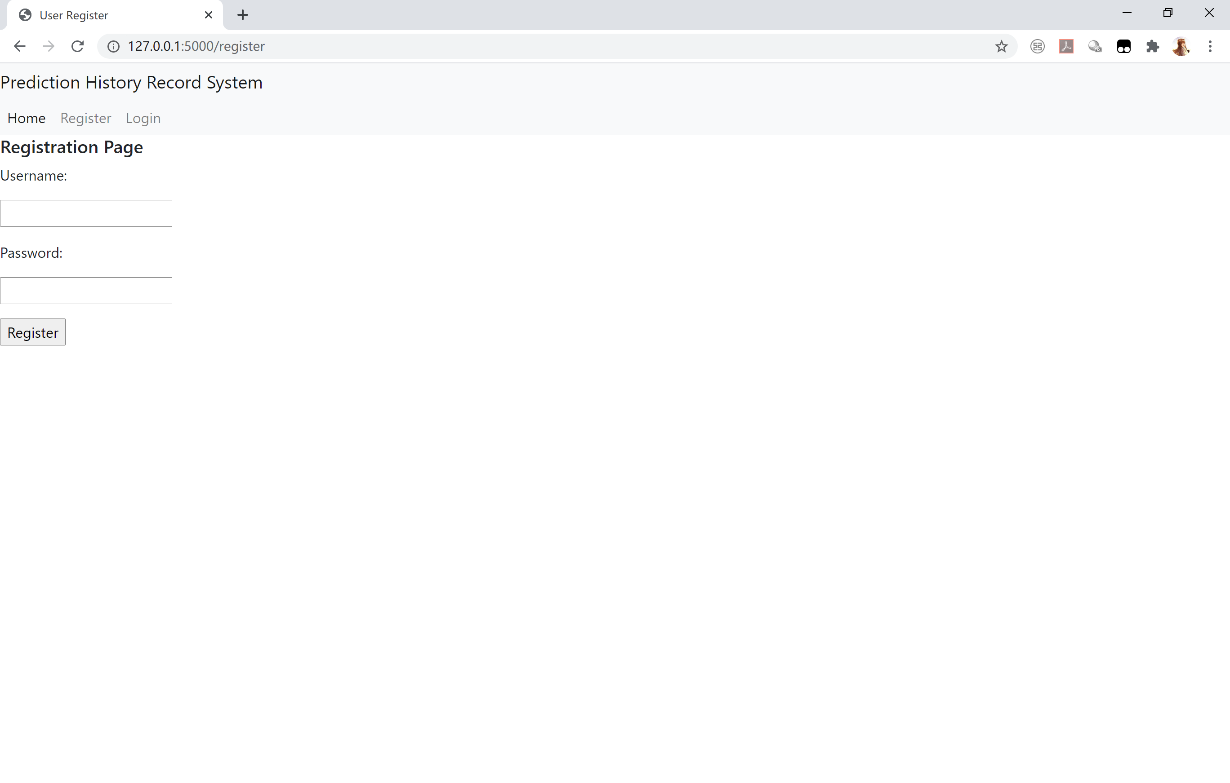

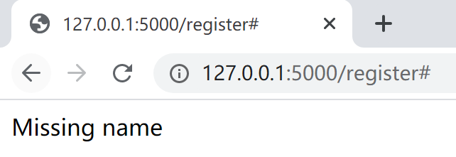
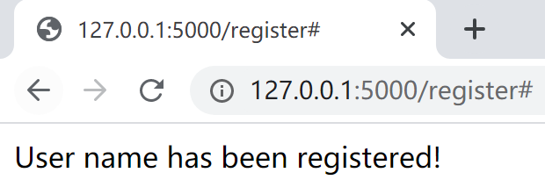
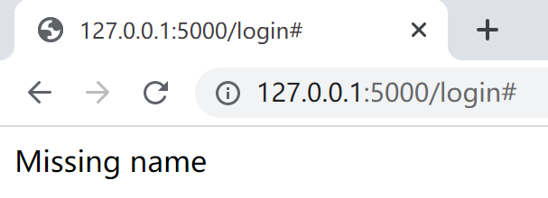
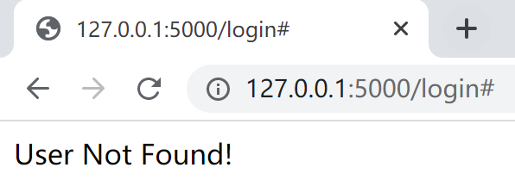
App – Run Demo & UI Interface
This section will run the app and show the UI interface.
Create table & database before app runs
Load deep learning model before app runs to avoid reloading for each prediction
The Python code to run the app
App running: access UI interface via http://127.0.0.1:5000/
Below is the web UI interface preview. The web UI is used to access historical prediction record table for authenticated user only.
3 buttons allows to switch between home, registration and login page
Username & password input on registration page
Username & password input on login page
Home Page
Registration Page
Log-in Page
Error case in registration page:
Error case in login page:
Empty username or password
Duplicated username
Empty username or password
User not registered

Slide 9
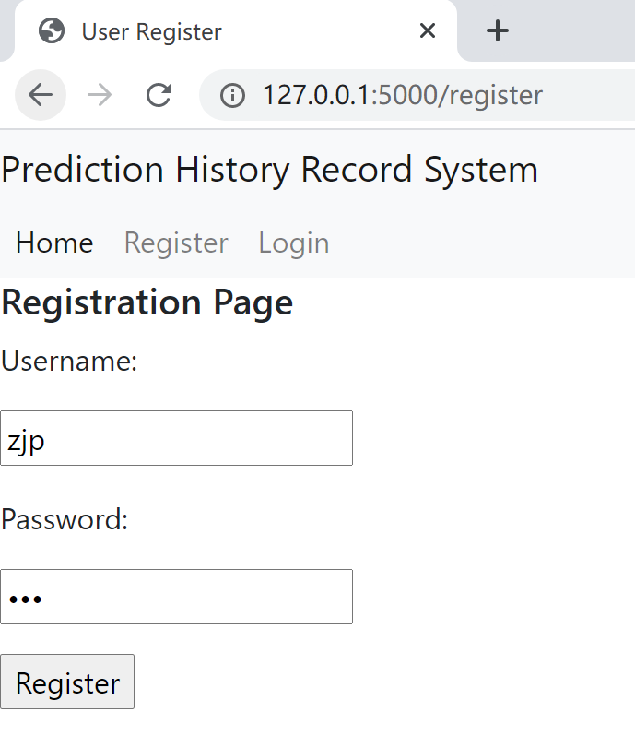
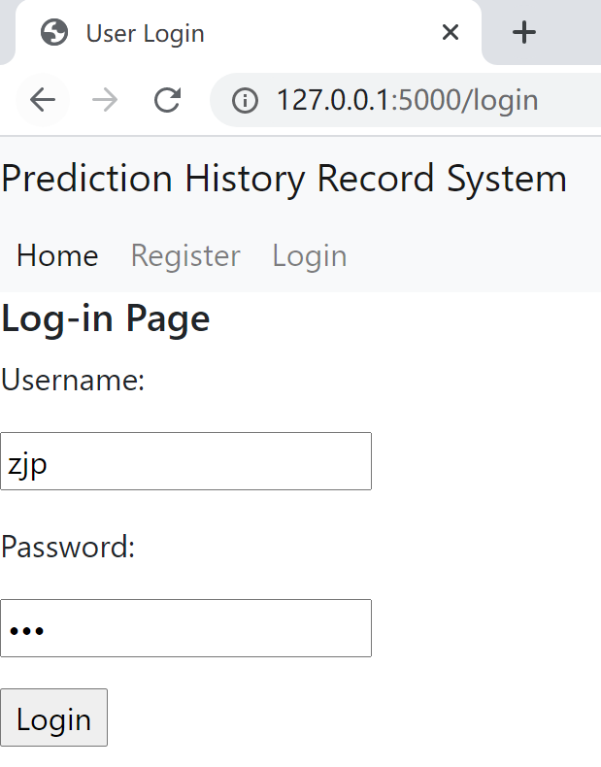
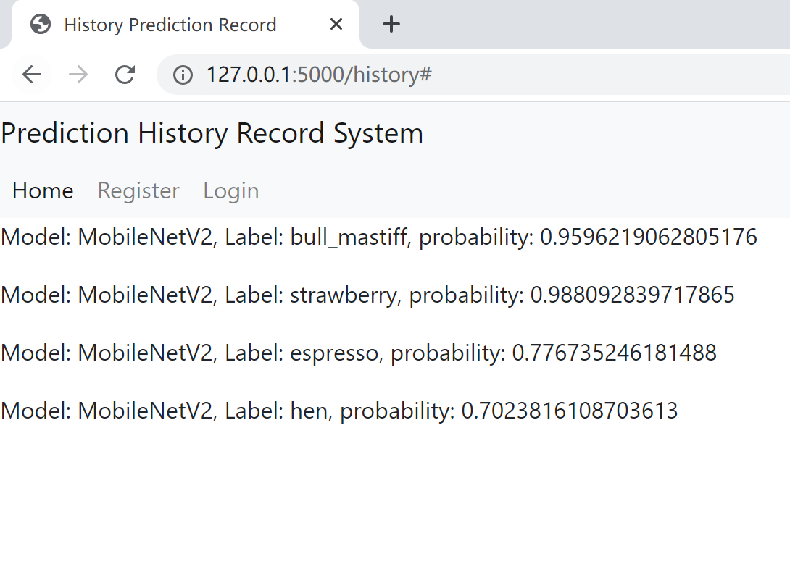
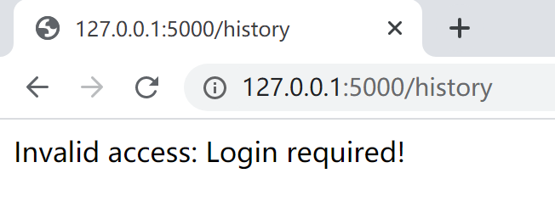
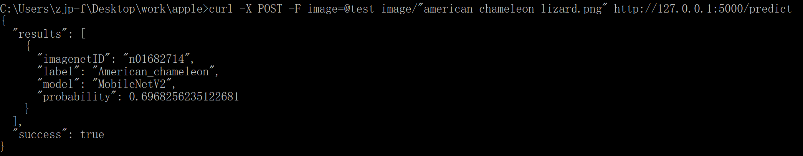
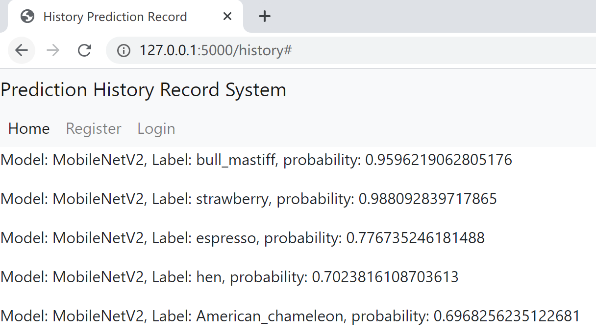
App – Run Demo & UI Interface (continued)
Demo to access the historical prediction record table:
Note if directly type in historical prediction record table access will be denied
1. Register the user
2. Log in with registered info
3. Access the historical prediction record table
Demo for image prediction:
Result returned directly on cmd
The general format to do the prediction in windows cmd via cURL is:
curl -X POST -F image=@your_image_location.png http://127.0.0.1:5000/predict
If check the historical prediction record table the new result has been stored

Slide 10
App – Future Development
Currently the app can only predict 1 image with 1 model, and the image prediction process can only be done in cmd instead of UI interface, which causes some inconvenience. Below are some ideas to process multiple images with multiple model selection choice on the UI interface:
Create a predict.html as a child of base.html
Add file upload block and set to support multiple file upload
Add model selection radio button for multiple model choice
In app.py modify the load_model function to load all the models
In app.py modify the model argument in the run_model function to allow run model conditionally based on radio button selection in predict.html
In app.py modify the predict function to get a list of uploaded images from upload block in predict.html and process the run_model function for each image
Note with this new process it should be able to predict multiple images with 1 certain model at 1 time. If multiple images need to be predicted with multiple models at 1 time then multiple upload blocks are needed, ad for each block a drag-down list block for the model selection is needed.
Potentially the run_model process within predict function can be improved to run parallel.

