Slide 1
Copernicus, Galileo, and the Scientific Method
Zachary Rohrbach, Avon High School
AAPT-IN, March 8, 2025

Slide 2
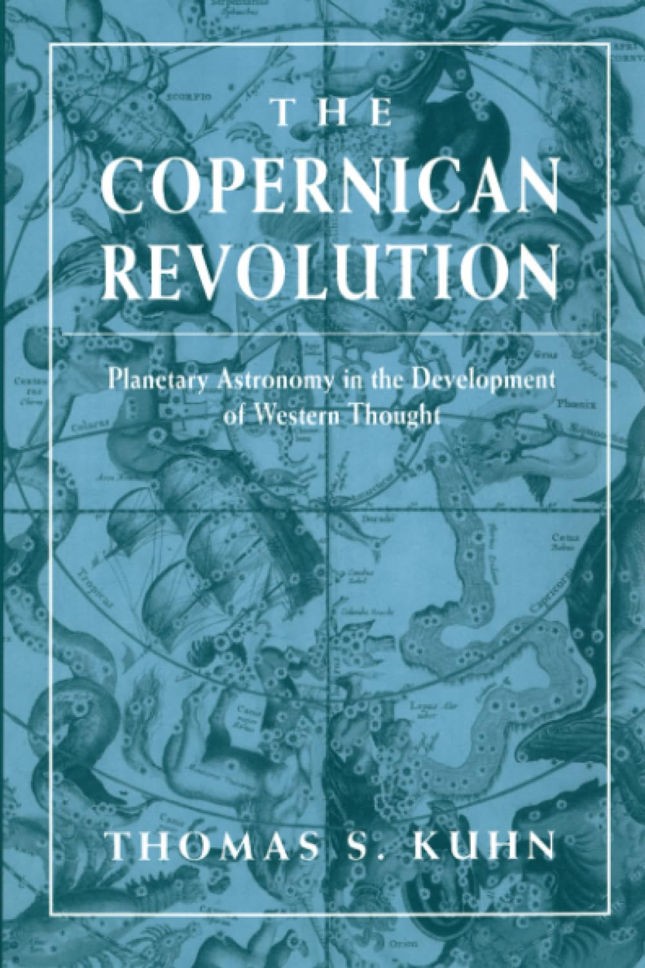
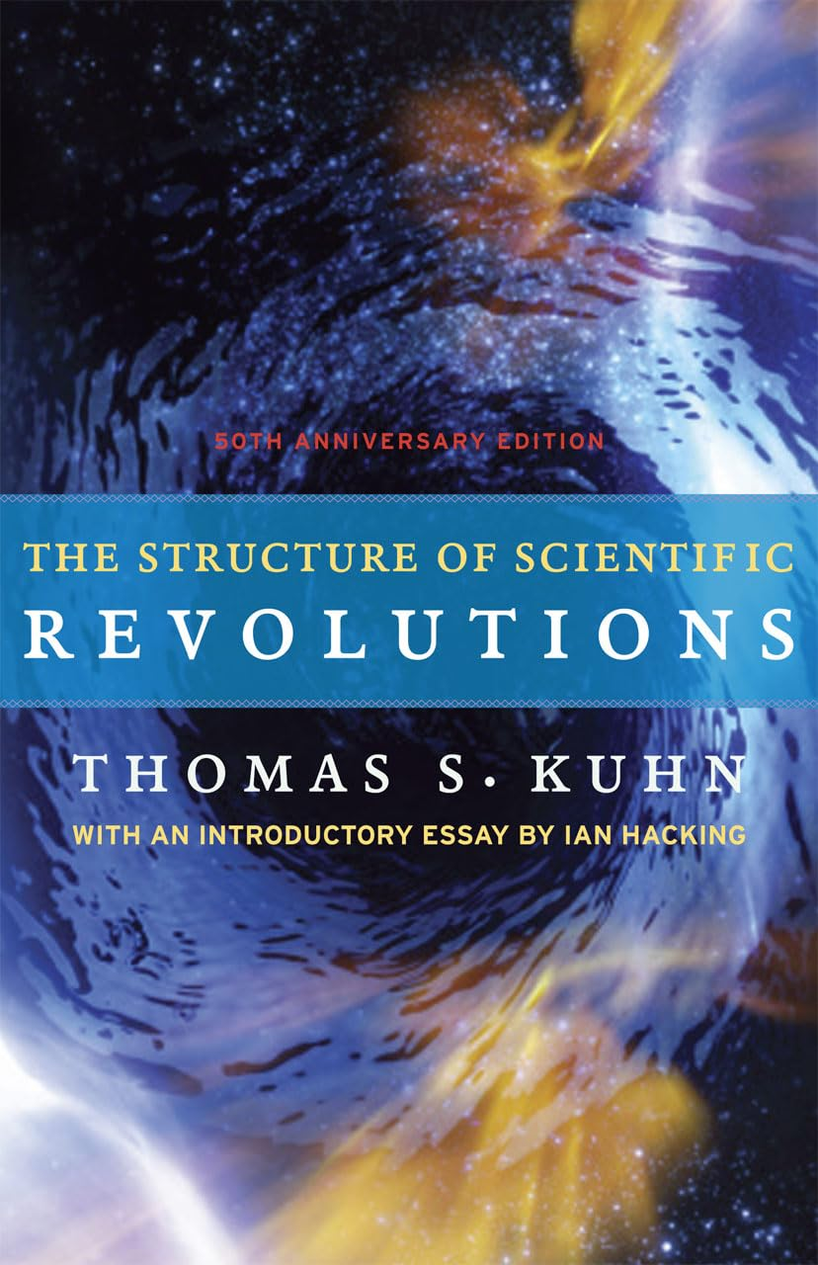
Book Recommendations

Slide 3
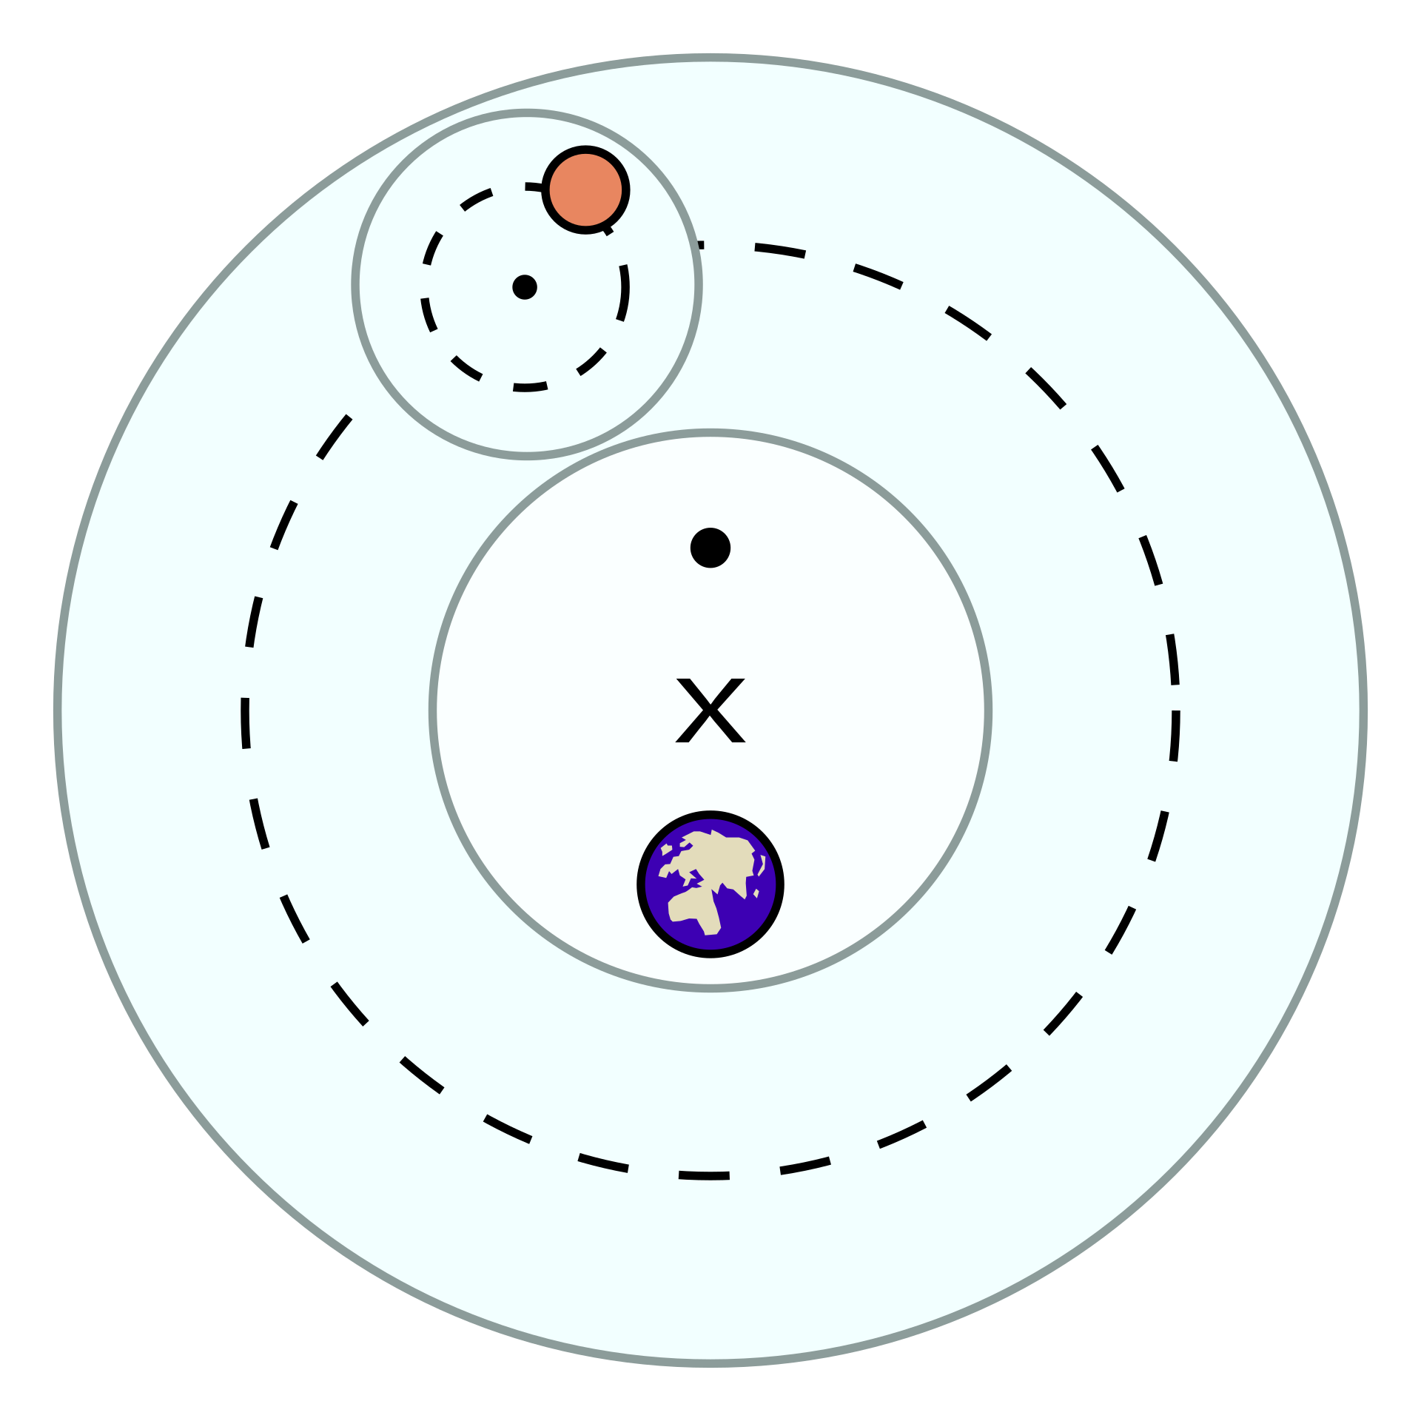
Ptolemaic Astronomy
equant
epicycle
eccentric
deferent
Image Credit: Public Domain, https://commons.wikimedia.org/w/index.php?curid=486480

Slide 4
The story of the scientific method
New theories must explain all the old data
New theories must explain new data that old theories can’t explain
New theories must make new predictions

Slide 5
An “ideal case” of Scientific Progress
Theory Relativity

Slide 6



New theories must explain all the old data
Lorentz Transformations
In the limit $v≪c$
$γ={\left(1−\frac{v^{2}}{c^{2}}\right)}^{−1/2}$
$t^{′}=γ\left(t−\frac{vx}{c^{2}}\right)$
$x^{′}=γ(x−vt)$
$KE=\left(γ−1\right)mc^{2}$
$γ≈{\left(1+\frac{1}{2}\frac{v^{2}}{c^{2}}\right)}^{ }$
$t^{′}≈t$
$x^{′}≈x$
$KE≈\left(\frac{1}{2}\frac{v^{2}}{c^{2}}\right)mc^{2}=\frac{1}{2}mv^{2}$

Slide 7
New theories must explain new data that old theories can’t explain
Michelson-Morely Experiment
Hafele–Keating Experiment (clocks in the airplanes)

Slide 8
New theories must make new predictions
Gravitational Lensing
Bending of light during solar eclipses

Slide 9
The protypical scientific Breakthrough?
The Copernican Revolution

Slide 10
New theories must explain all the old data
Motion of Planets
Ethics
Theology
Motion
Meteorology
Psychology
Cosmology
Metaphysics
Causes
Motion of Planets

Slide 11
New theories must explain new data that old theories can’t explain
The predictions at first were not “better”
How could they be? Ptolomy was 1500 years* “ahead”
The theory at first was not that much simpler (169-170)
The Copernican system still had epicycles and eccentrics (although he excised equants).
Both Copernican and Ptolemaic models had >30 circles
Copernicus’ system wasn’t even heliocentric!

Slide 12


Not heliocentric??

Slide 13
New theories must make new predictions
There’s a win here
Copernicus gave an order to the planets
Inferior planets had to be closer than the Earth
Planets with longer years must be farther away
Copernicus did predict the phases of Venus

Slide 14
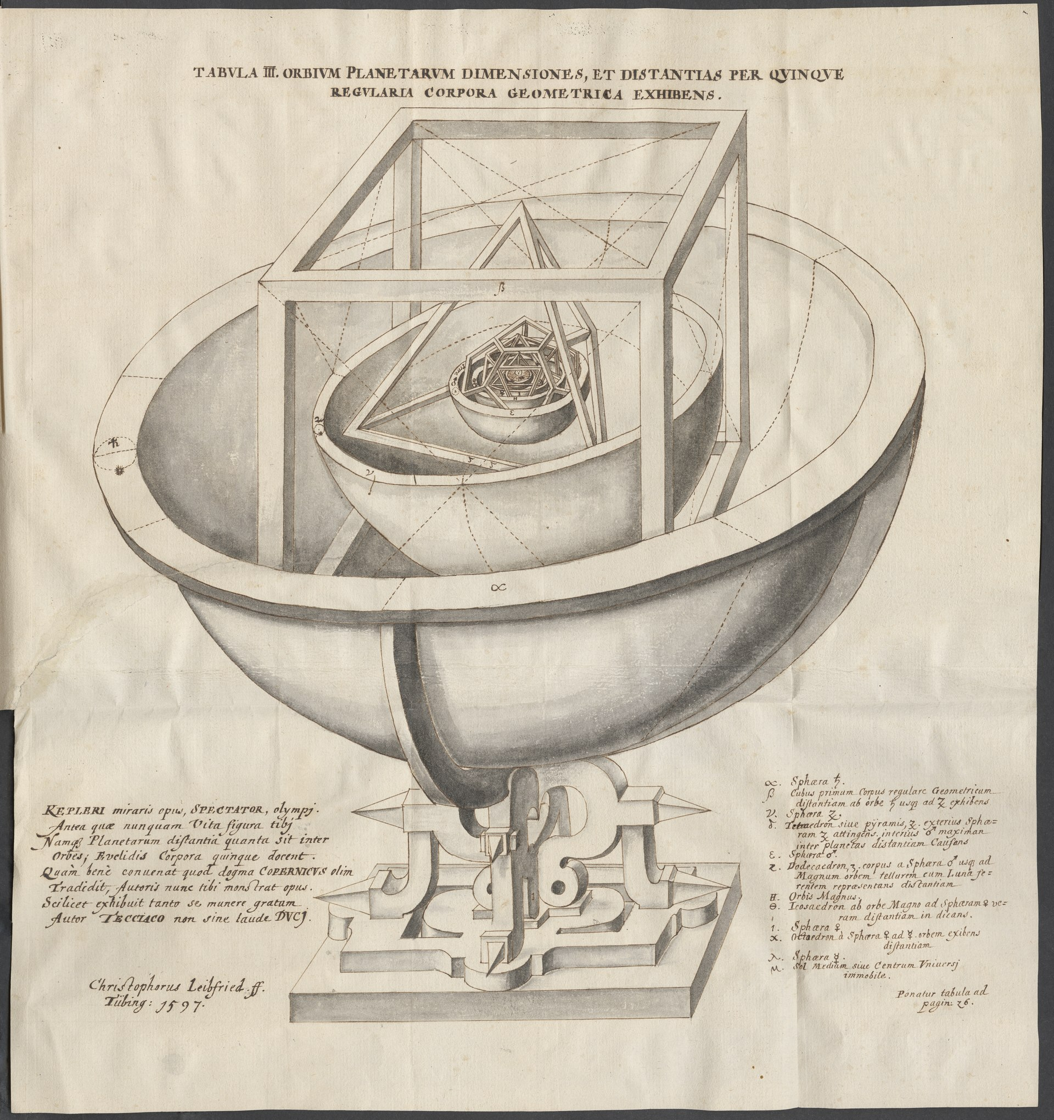
Kepler
Image Credit:
By Johannes Kepler – Prodromus dissertationvm cosmographicarvm, continens mysterivm cosmographicvm de admirabili proportione orbium coelestium
courtesy of the L. Tom Perry Special Collections, Harold B. Lee Library, Brigham Young University, Public Domain, https://commons.wikimedia.org/w/index.php?curid=109834352

Slide 15
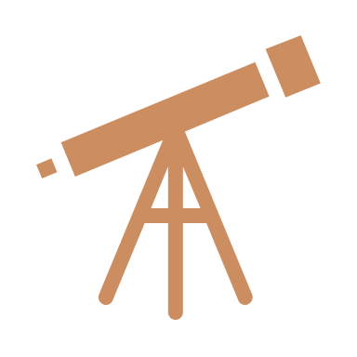
Galileo
Kepler had already solved the math
Kuhn calls Galileo’s telescope the “mopping up operation” (220)
New stars, galaxies
Phases of Venus
Jupiter’s moons
Galileo’s evidence is “strange.” “None… [except phases of Venus] provide direct evidence of the main tenants of Copernicus’ theory” (224)

Slide 16
Conclusions
The Galileo story is more complicated than we learn in school
Science is fascinating and its development is not linear
The Scientific Method (insofar as there is one) does not have a stranglehold on growth and development of knowledge (and it can’t succeed alone)
The Ptolemaic system was truly ingenious, even if it is obsolete

