Slide 1
Energy is made up
Interesting Conceptual Discussions around Energy and its Definition
Zachary J. Rohrbach
Avon High School
September 2020, IN-AAPT Fall Meeting
zjrohrbach@avon-schools.org
www.rohrbachscience.com

Slide 2







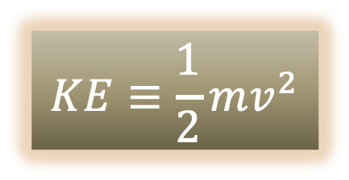
What is kinetic energy?
$$v^{2}=v_{0}^{2}+2ad$$
$$W≡Fd$$
$$a=\frac{v^{2}−v_{0}^{2}}{2d}$$
$$W=mad$$
$$W=m\left(\frac{v^{2}−v_{0}^{2}}{2d}\right)d$$
$$W=\frac{1}{2}mv^{2}−\frac{1}{2}mv_{0}^{2}$$
$$KE≡\frac{1}{2}mv^{2}$$
$$W=ΔKE$$
Giancolli. Physics: Principles with Applications, 7th ed. p.143

Slide 3


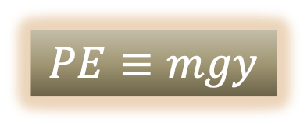







What is potential energy?
$$W=ΔKE$$
$$W_{NC}+W_{C}=ΔKE$$
$$W_{NC}−ΔPE=ΔKE$$
$$W_{C}=Fd$$
$$0−ΔPE=ΔKE$$
$$W_{C}=−mg(y−y_{0})$$
$$−\left(PE−PE_{0}\right)=KE−KE_{0}$$
$$W_{C}=−ΔPE$$
$$KE_{0}+PE_{0}=KE+PE$$
$$PE≡mgy$$
Giancolli. Physics: Principles with Applications, 7th ed. pp.146-150

Slide 4
So, in summary…
Work is made up
If we define it, we can also make up KE
If we additionally make up the idea of ‘conservative’ and ‘non-conservative’ work, we can use made-up KE and made-up W to make up PE
But all of these made up things do something interesting! They automatically conserve themselves!
Energy is a handy ‘bookkeeping method’!

Slide 5
Interesting discussion points
A 'microcosm’ of science
illustrates the boundary between nature and man's abstraction of nature
science as 'what works' as opposed to 'what is'
Applications to chemistry
what is chemistry without energy?
but at its core, chemistry is about atoms colliding and applying forces across distances
For second-year students
definition discussion
energy is defined as ‘the ability to do work’
in practice, we often consider work as the transfer of energy
The power of the square
Émilie du Châtelet (highly recommend NOVA’s Einstein’s Big Idea)
the Pythagorean theorem is even hidden in the definition of energy

Slide 6





Hidden Pythagorean theorem
What minimum speed must a high jumper leave the ground in order to lift his com 2.1 meters and cross the bar with a speed of 0.50 m/s?
$$\vec{v}′$$
$$\vec{v}$$
$$KE_{x}+KE_{y}=PE_{x}^{′}+PE_{y}^{′}+KE_{x}^{′}+KE_{y}^{′}$$
$$\frac{1}{2}m(v_{x}^{2}+v_{y}^{2})=mgy′+\frac{1}{2}mv_{x}^{′2}$$
Problem credit: Giancolli. Physics: Principles with Applications, 7th ed. Problem #34, p. 165
Image credits: High Jump silhouette & Female Runner silhouette by Natasha Sinegina on Creazilla / CC BY 4.0

