Slide 1
Fostering Literacy in the Physics Classroom
Zachary J. Rohrbach
Avon High School

Slide 2
Audience
Honors Physics I
Physics I
Integrated Chem/Phys

Slide 3
A Disclaimer…
This is great for the conceptual stuff; you can’t use it for learning quantitative methods…

Slide 4
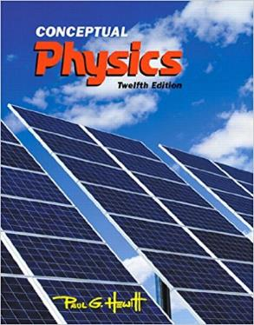

Textbooks

Slide 5
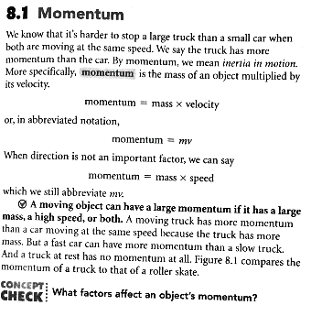
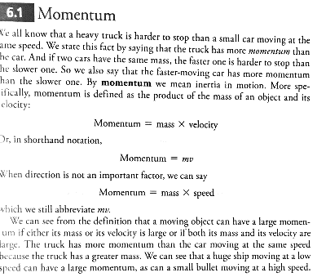
Overly Scaffolded Texts
Hewitt 8th Edition
Hewitt 12th edition

Slide 6
Mindset Shift
“Read Chapter 24 over the weekend and then I will present the entire chapter to you over again next week”
There has to be an expectation that reading is the way you get the information.
The kids need to know that if they don’t read, you won’t be bailing them out

Slide 7
Mindset Shift
“Read this and answer these questions”
Something needs to get away from the “hunt and peck” that the kids have learned to do so well
Ideally, students will generate their own questions

Slide 8
Mindset Shift
“Read this and take notes”
We can’t assume they know how to take notes or read for meaning.
Often they have been trained that reading is about “getting done”

Slide 9
Strategies I always use
Reading usually happens in class; not at home
Read first; then do the assignment
Give students more time than it is comfortable to give.
“If you’re finished, find one more thing”

Slide 10
Specific Activity: Four Q/A’s
Come up with 4 quiz essay questions from the reading and answer them
Sometimes everyone does the same reading
Sometimes I break up reading and then go around to groups
Class follow-up
Sometimes I randomly call on students to share Q/A’s
Sometimes Q/A’s are jumping off point for my lecture

Slide 11
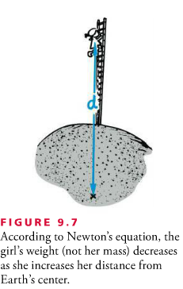
Specific Activity: Figures & Captions
Pick a figure out of the book. Relate it to the reading

Slide 12
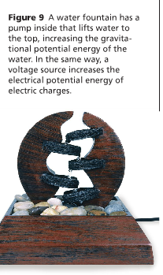
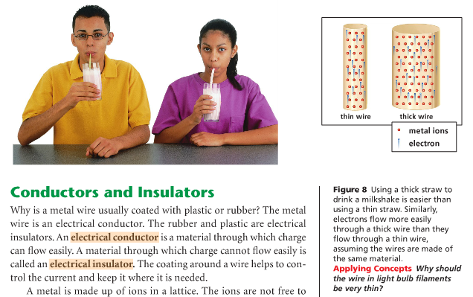
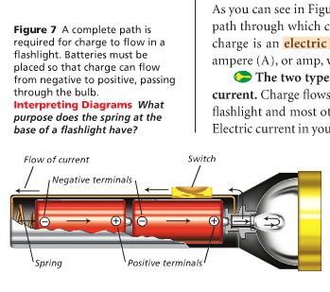
Specific Activity: Figures & Captions
Pick a figure out of the book. Relate it to the reading
ICP Example:

Slide 13
Specific Activity: Draw your Own Figure

