Slide 1
Teaching ICP to Multilingual Learners
Zachary J. Rohrbach
Avon High School
IN-AAPT Spring Meeting
April 13, 2024

Slide 2
Terms
ESL – English as a Second Language (c. 2000s)
ENL – English as a New Language (c. 2010s)
ELL – English Language Learners (c. 2015)
ML – Multilingual Learner (c. 2023)

Slide 3
My Situation at Avon High School
I teach two sections of ML Inclusion Integrated Chem/Phys
I also teach one section of General Ed Integrated Chem/Phys
My class has an instructional aid
I have no specific ML training. (This presentation is about my experiences and nothing more!)

Slide 4
Misconceptions
“You teach physics. You must teach all the smart kids.”
Physics is for everyone.
Richard Feynman in QED: The only difference between what I’m telling you and what a PhD student does is the math.

Slide 5
Misconceptions
“Why do you teach language learners? You don’t speak Spanish.”
ML Instruction is about supports for learning English. Not about translations.
In Avon, a plurality of ML students speak Spanish, but not a majority.

Slide 6
“Why do you teach language learners? You don’t speak Spanish.”
ML Instruction is about supports for learning in English. Not about translations.
In Avon, a plurality of ML students speak Spanish, but not a majority.

Slide 7
Misconceptions
“Doesn’t teaching an ML Inclusion class put native English speakers at a disadvantage?”
ML Teaching Strategies are supports that are helpful for ALL students.
Focus should be on content and vocabulary, not the other peripherals

Slide 8
My Two Big ML Support Strategies
Class Notebook
Vocabulary

Slide 9
Class Notebook
I provide the notebook
Thanks Indiana State Legislature!!!
25¢ ea. at Back-to-School Sales
Notebook stays in the classroom
Table of Contents
“Make your notebook look like mine”
All Quizzes and Tests are Open-Note
This is the key to making them care about their notebook
In my experience, it does NOT become a crutch when they take ownership in it

Slide 10
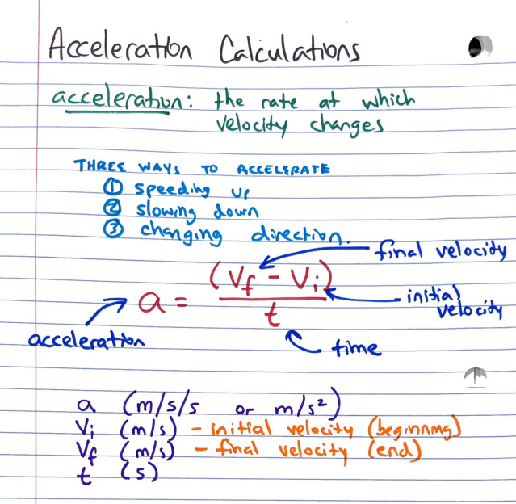
Notebook Samples

Slide 11
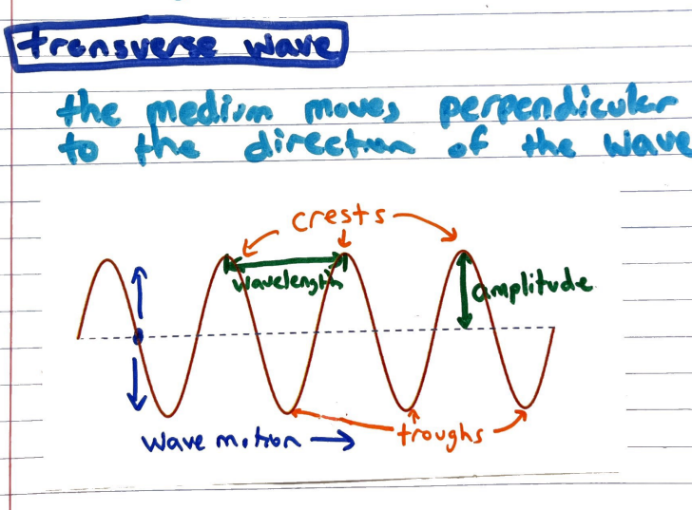
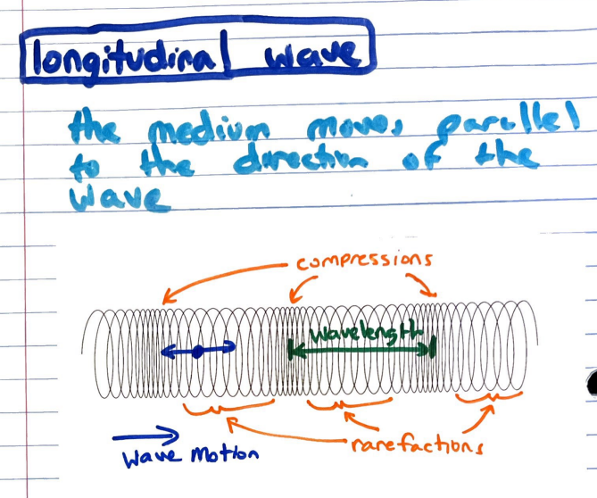
Notebook Samples

Slide 12
Notebook Success Stories
During the final exam, students knowing their notebook well enough that they can use it as a helpful resource
Students asking to keep their notebook at the end of the year
Having something to point to during class when a student is stuck

Slide 13
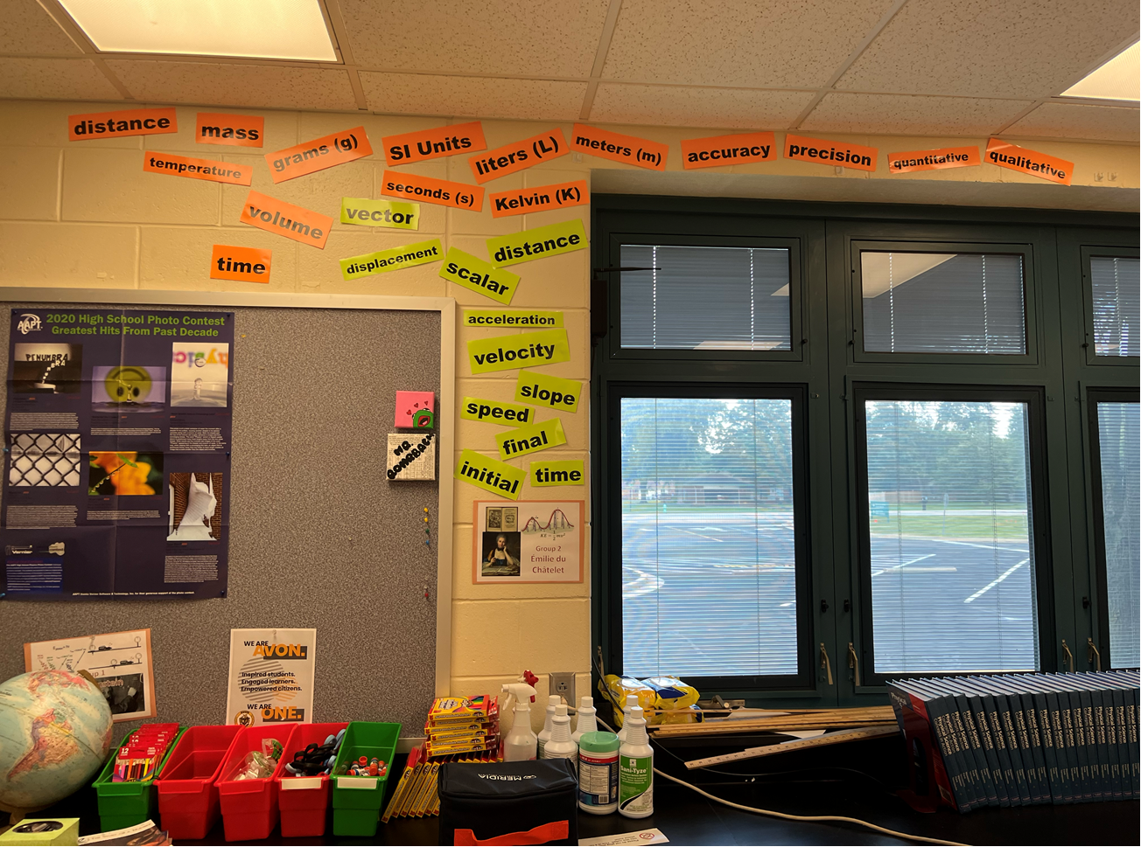
Focus on Vocabulary

Slide 14
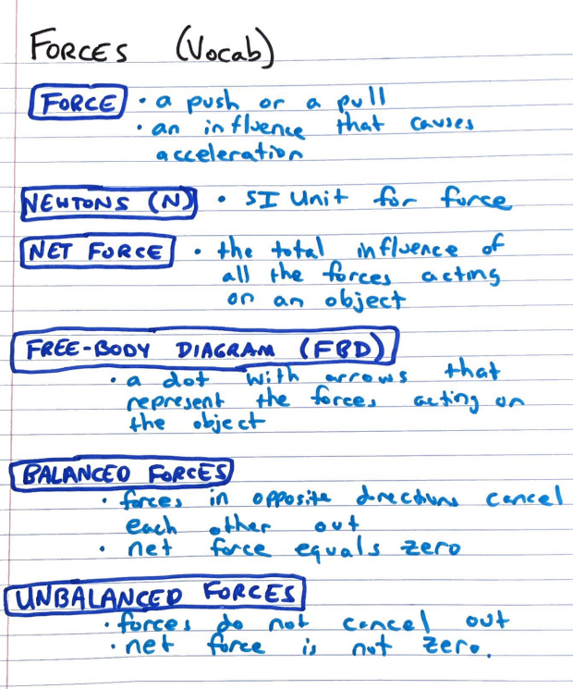
Focus on Vocabulary

Slide 15
Unexpected Vocabulary Challenges
Confusion and unfamiliarity with the difference between “increases” and “decreases”
Need to be explicit about units:
m vs mi
in, yd, ft
Cannot rely on familiarity with things like “Italian dressing” (when talking about heterogeneous mixtures)

