Slide 1

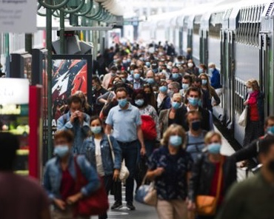
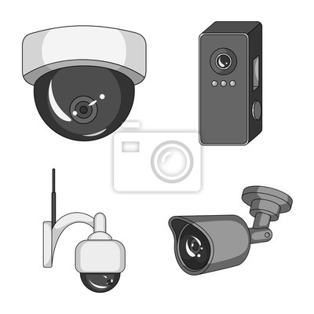
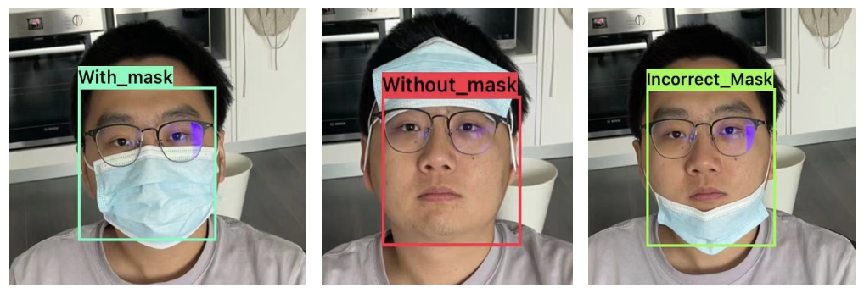


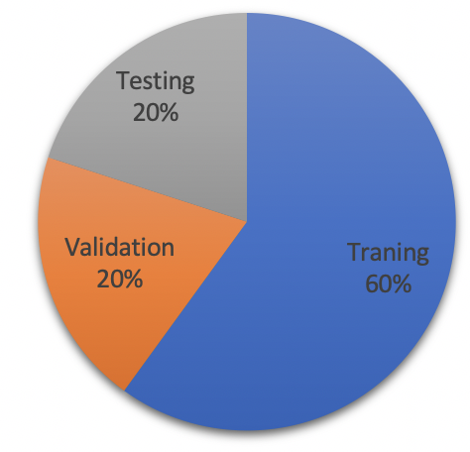
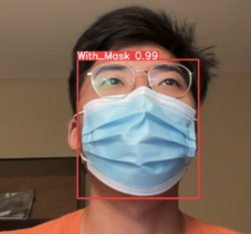

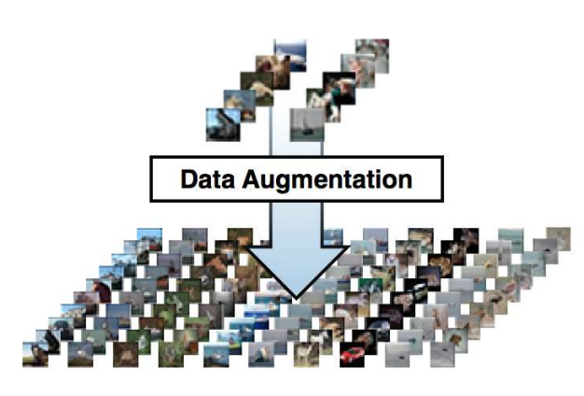

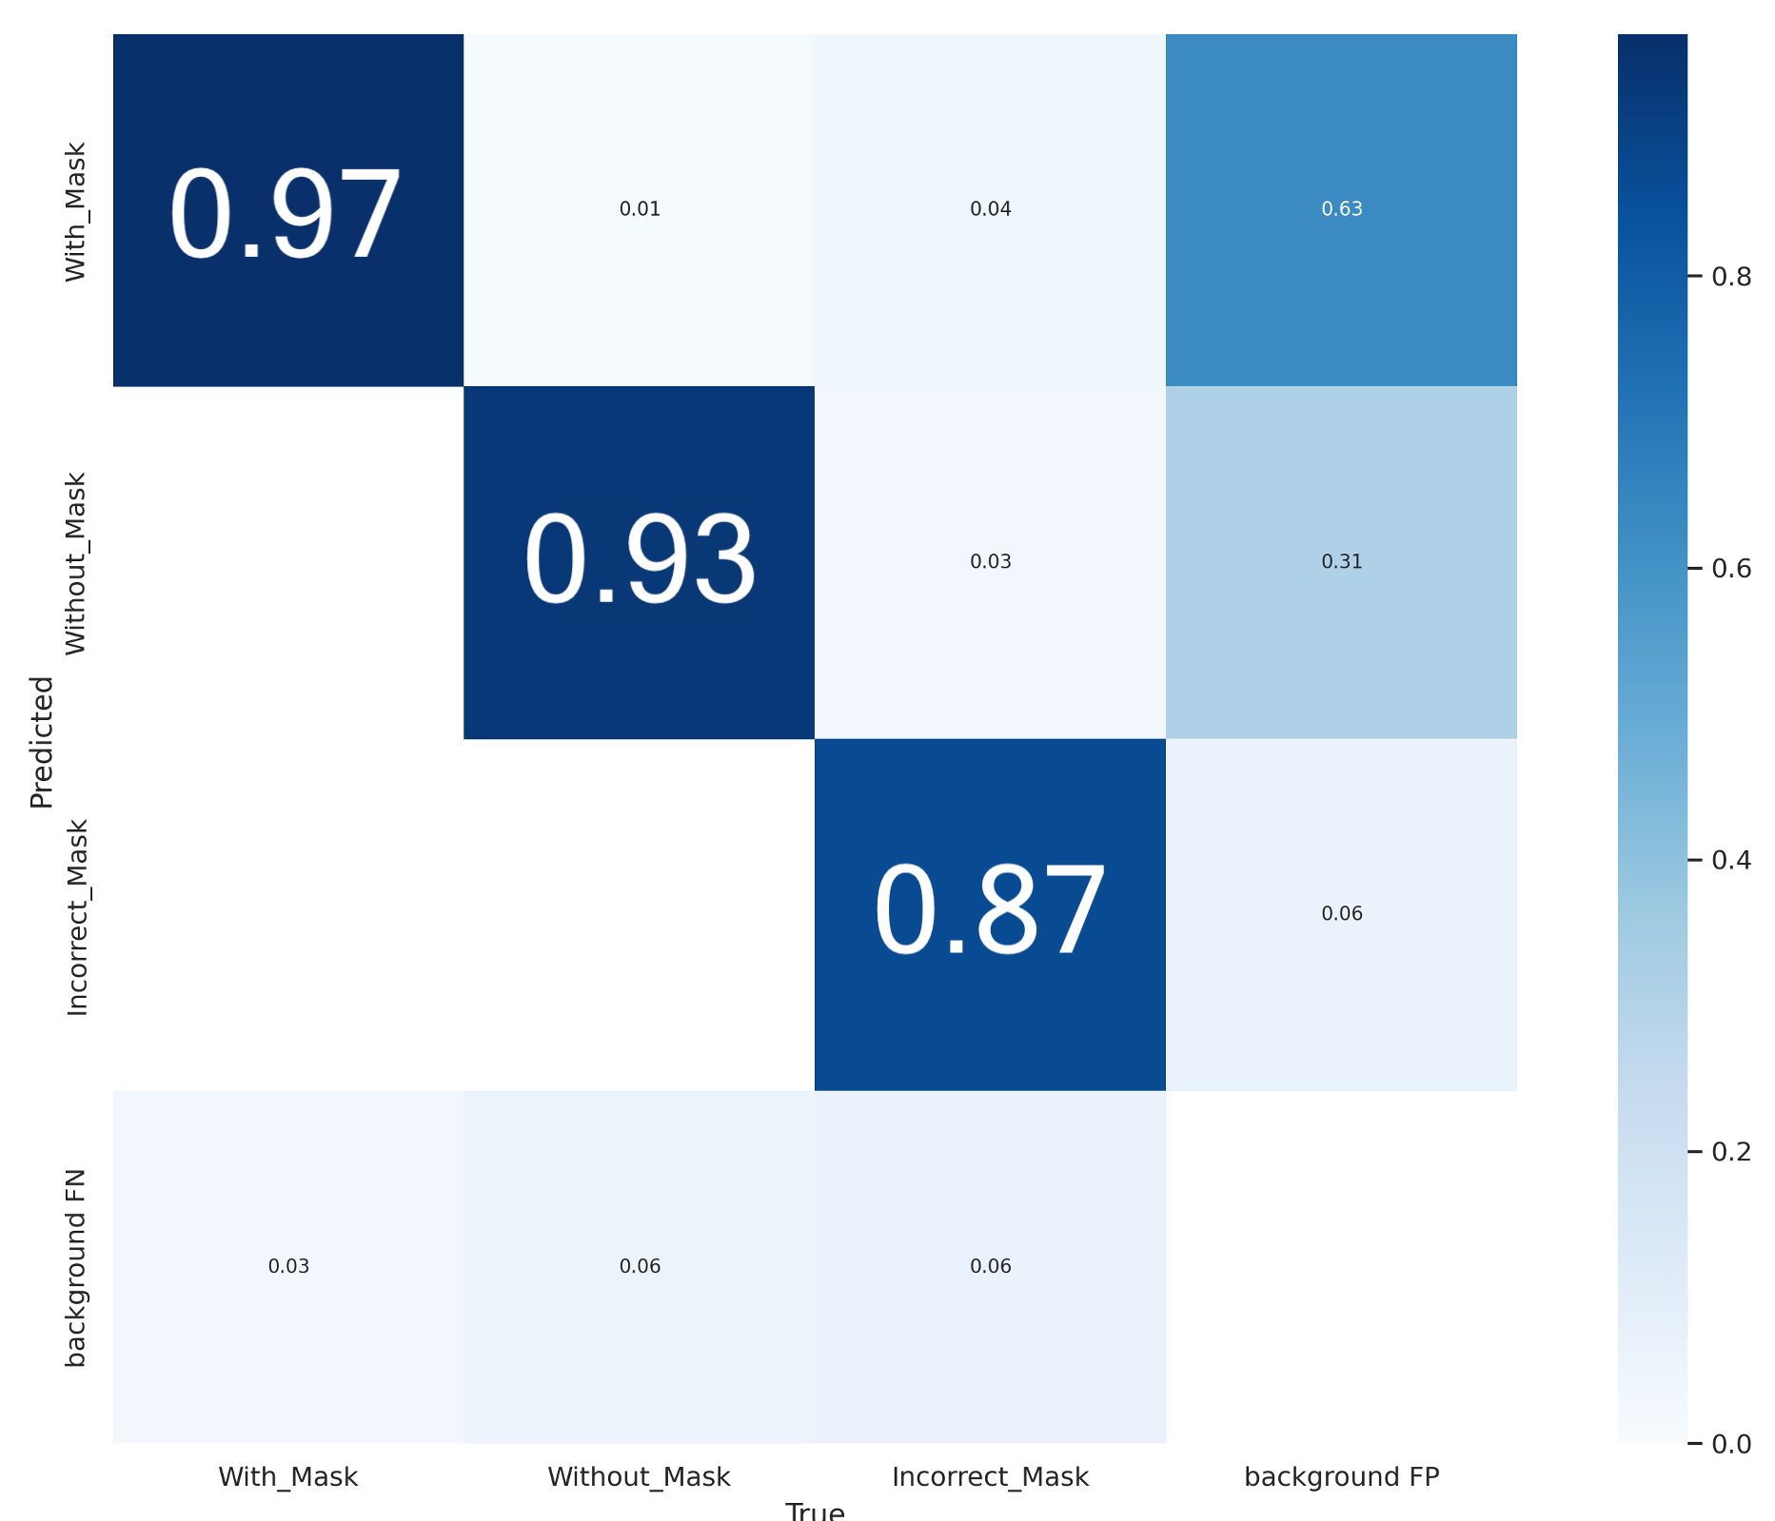



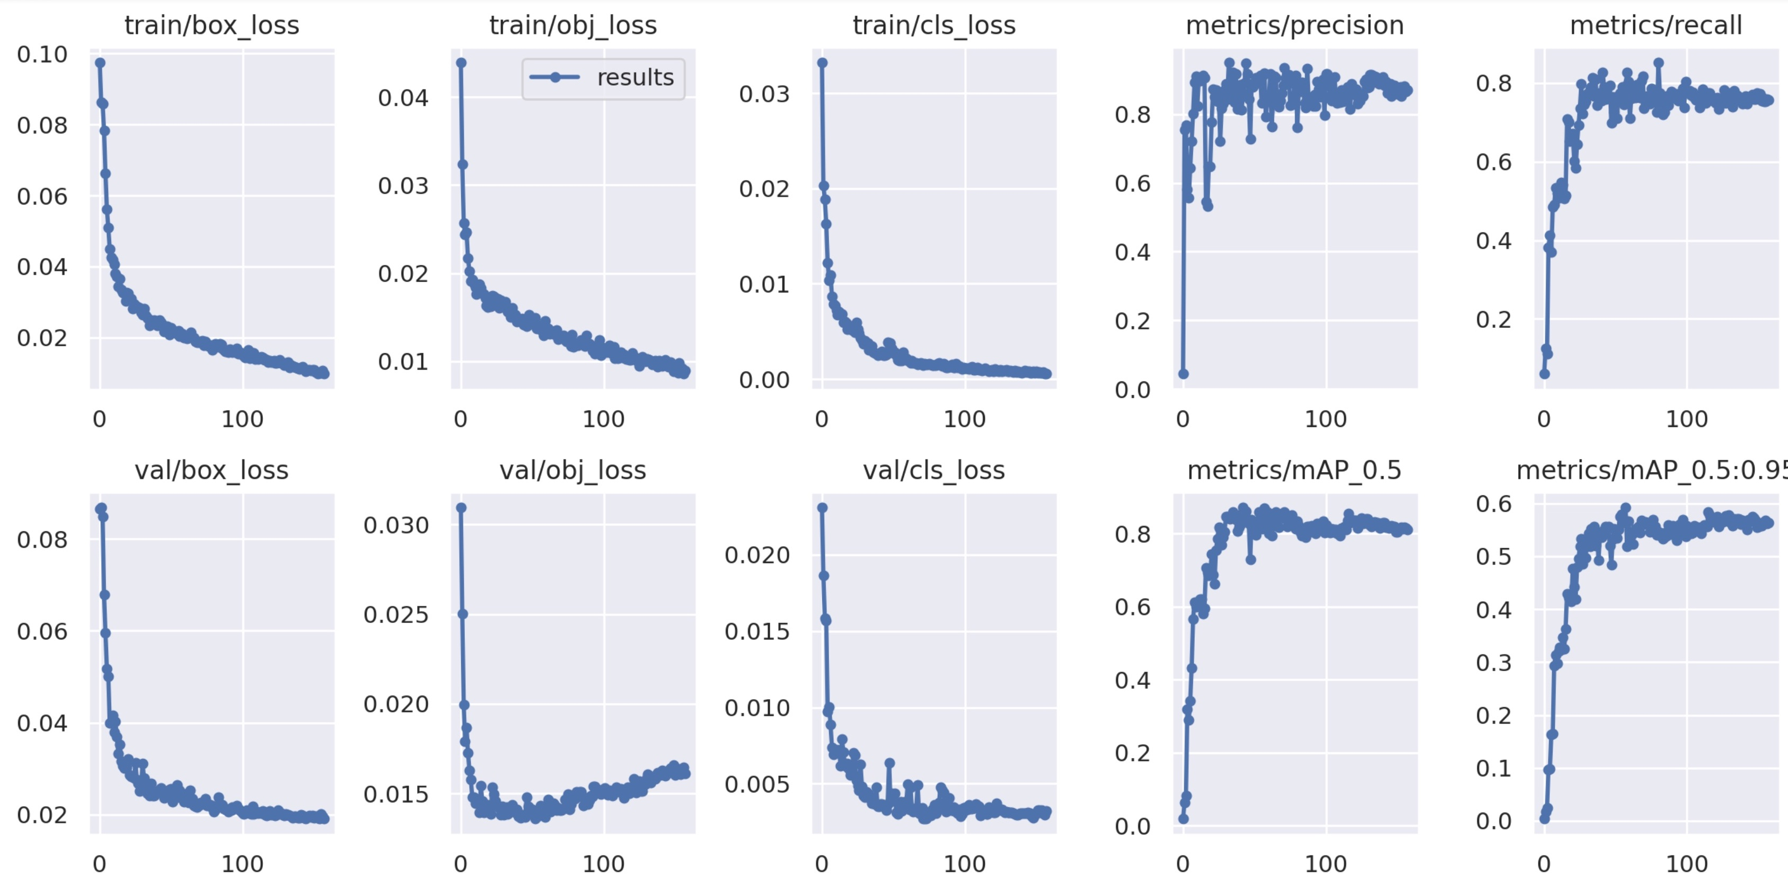
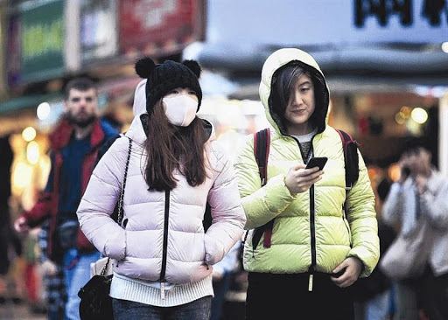
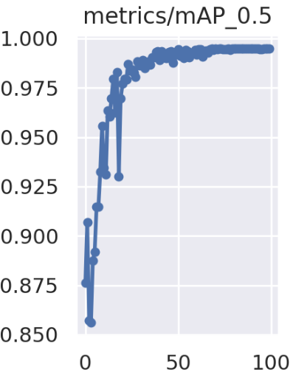
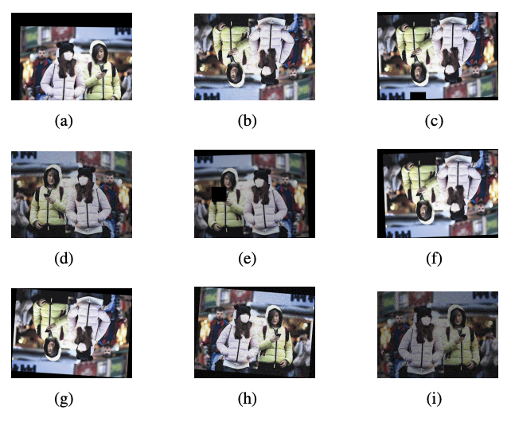
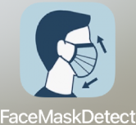
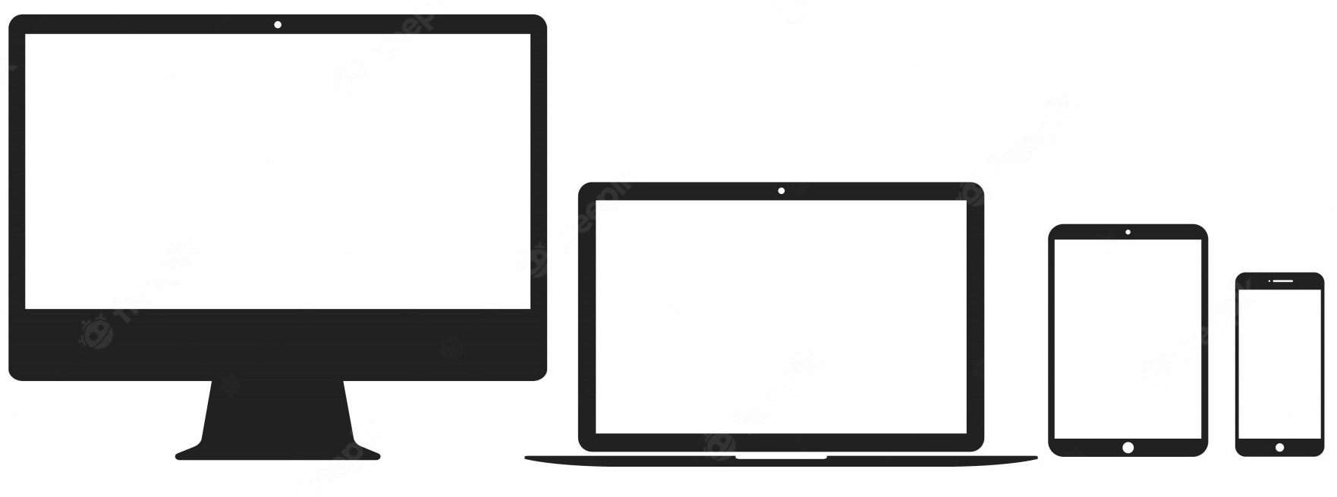

Real-time Facemask Wearing Detection
Problem Introduction:
Methodology
Result Comparison
Promote proper face mask wearing at the early stage of a respiratory infectious diseases, which could prevent or slow down the outbreak of next global pandemic.
Use Computer Vision method to help health workers easily identify mask wearing status in the crowd.
Goal & Objectives
1. Capture real-time video
2. Raw data input & preprocess
Figure 2.1 Mask wearing 3 classification results
Train different C.V. algorithms and make comparisons.
Optimize the model for Multi-classification usage.
Develop and integrate the C.V. model into a Real-time video camera application. (e.g. iOS , Desktop App.)
Model | Overall Accuracy | Speed | FLOPS | Accuracy for Each Class
 |  |  |  | With mask | Without mask | Incorrect mask
MobileNet | 90.9% | 35.3ms | 0.20 G | 83% | 92% | 55%
YOLOv5s | 95.6% | 14.5ms | 16.5 G | 97% | 93% | 87%
SSD | 93.8% | 26.5ms | 2.75 G | 97% | 95% | 35%
Dataset & C.V. Algorithms
4. Convert model
3. Train and Optimize the model
Table 2.2 Performance Comparison Table
Data Training-Validation-Testing ratio:
Conclusion & Application
YOLOv5: Best performance
A. 831
Raw data
B. 9141 images
C. Divide the dataset
5. Develop iOS App
6. Real-time result rendering
Used for public area mask wearing monitoring
Computer Vision Algorithms:
Data Augmentation
SSD
(* Single-Shot-Detector)
Develop & integrates into an iOS App and Desktop App.
1. Add Noise
2. Brightness
3. Cut out
4. Rotate
5. Translation
6. Shift
7. Flip
$$C_{7}^{2}$$
Re-train
Figure 1.1 Illustration of training progress with YOLOv5

