Slide 1
Intro to OpenStack Trove & Database as a Service (DBaaS)
OpenStack Seattle Meetup
Ken Rugg, CEO Tesora
March 15, 2016

Slide 2
Transformation of Cloud Data Management
Traditional IT
Provisioning by admins
Database management by specialists
Waterfall development
Few large machines / bare metal
Oracle Enterprise licenses
Captive audience
Cloud
Self Service Provisioning
Developers manage their own databases
Agile development
Many small machines / virtualization
Many data management technologies
Competition with AWS

Slide 3
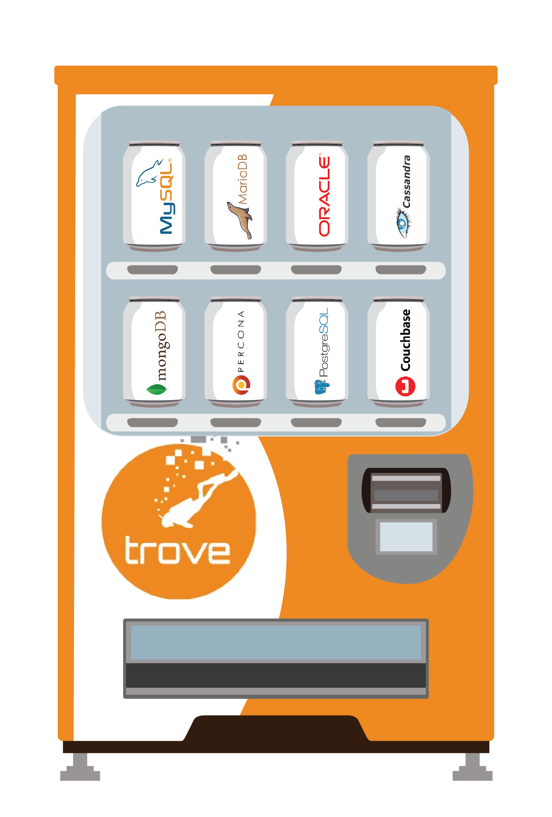
The Solution: Database as a Service
The delivery of database software & related storage “as-a-service”
Available on-demand, without any hardware or software installation or configuration
A fully managed service maintained & administered by the service provider

Slide 4
Amazon is demonstrating the importance of DBaaS
DynamoDB was the fastest growing service in AWS history in 2012
Werner Vogels, Amazon CTO, AWS Blog June 2012
Redshift is now the fastest growing AWS service ever
Werner Vogels, Amazon CTO, The Register, April 2015
45% of Amazon customers have implemented and are expanding use of RDS
Jeffrey Hammond, Forrester Blog, September 2013
AWS database business currently on a $1 billion revenue run rate
Andy Jassy, the SVP of AWS - TechCrunch, October 2015
Amazon’s #1 hiring focus – 84 open positions in DBaaS in November 2015
Deutsche Bank Markets Research - NetworkWorld, November 2015

Slide 5
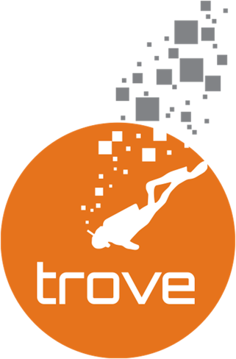
Trove in a Nutshell
Database as a Service for OpenStack
API’s for both development and operations
Self service database provisioning
Full database lifecycle management
Multi-database support
Both Relational and NoSQL

Slide 6
What is Trove? RDS for OpenStack …and DynamoDB …and RedShift
…and API’s for DevOPs
Amazon AWS
OpenStack
Developer API
Developer API
Trove
DynamoDB
RedShift
NoSQL
DW
RDS
RDBMS
Amazon Internal API
Operations API
EC2
S3
Swift
Nova
…
EBS
…
Cinder

Slide 7
Complete Database Lifecycle Management
Provision
On demand
Wide DB selection
Clusters & single instances
Secure
Automated patch management
Users/permissions
Restricted root access
Manage
Manage schemas
Create replicas for scale & availability
Backup/restore
Tune
Manage log files
API’s to tune fleets of servers, not just single instances
Sane defaults

Slide 8







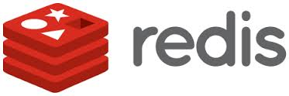
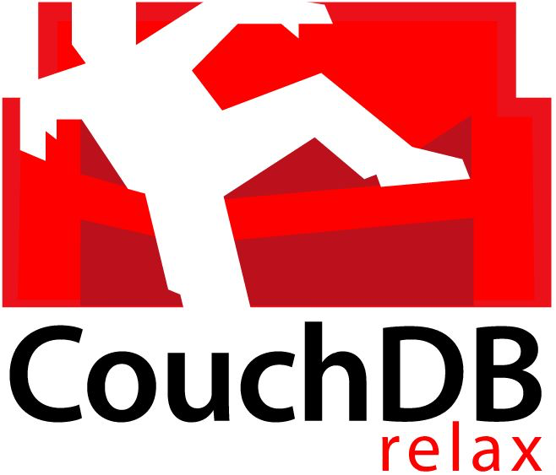



Multi-database – support for 13 different databases
SQL
NoSQL

Slide 9


Different Use Cases Require Different Databases
Not all users or applications are the same…
Different needs for
Stability & Scalability
Development vs. QA vs. Production
SQL vs. NoSQL vs. Data Warehouse vs. Big Data
Oracle for
ERP
MongoDB for eCommerce Website
Oracle
HR Intranet
Stability
Exadata
Data warehouse
Cassandra for
IoT
Redis Cluster Testing
PostgreSQL for
New App Dev
MySQL for
a Test App
Scalability/Variability
Notes:
Replace pictures with use case/value
Left models = community models
Right are unique to us

Slide 10
Different Use Cases Require Different Databases
Not all users or applications are the same…
Different needs for
Stability & Scalability
Development vs. QA vs. Production
SQL vs. NoSQL vs. Data Warehouse vs. Big Data
OLTP
Oracle for
ERP
Webscale Apps
MongoDB for eCommerce Website
Analytics
Oracle
HR Intranet
Stability
Exadata
Data warehouse
Cassandra for
IoT
Development
Testing at Scale
Redis Cluster Testing
PostgreSQL for
New App Dev
MySQL for
a Test App
Scalability/Variability
Notes:
Replace pictures with use case/value
Left models = community models
Right are unique to us

Slide 11
Deployment options to support varied use cases
Bare Metal
Tesora DBaaS:
Lets users choose the right provisioning option for each use case
Bare metal for high end transactional throughput
Massively scalable clusters for web applications or high volume testing
Simple VM provisioning for development
Multi-tenant for resource optimization & efficient management
Cluster
OLTP
Oracle for
ERP
Webscale Apps
Multi-tenant
MongoDB for eCommerce website
Analytics
Oracle
HR Intranet
Stability
Exadata
Data warehouse
Cassandra for
IoT
Development
Testing at Scale
Single/VM
Redis Cluster Testing
PostgreSQL for
New App Dev
MySQL for
a Test App
Scalability/Variability
Notes:
Replace pictures with use case/value
Left models = community models
Right are unique to us

Slide 12
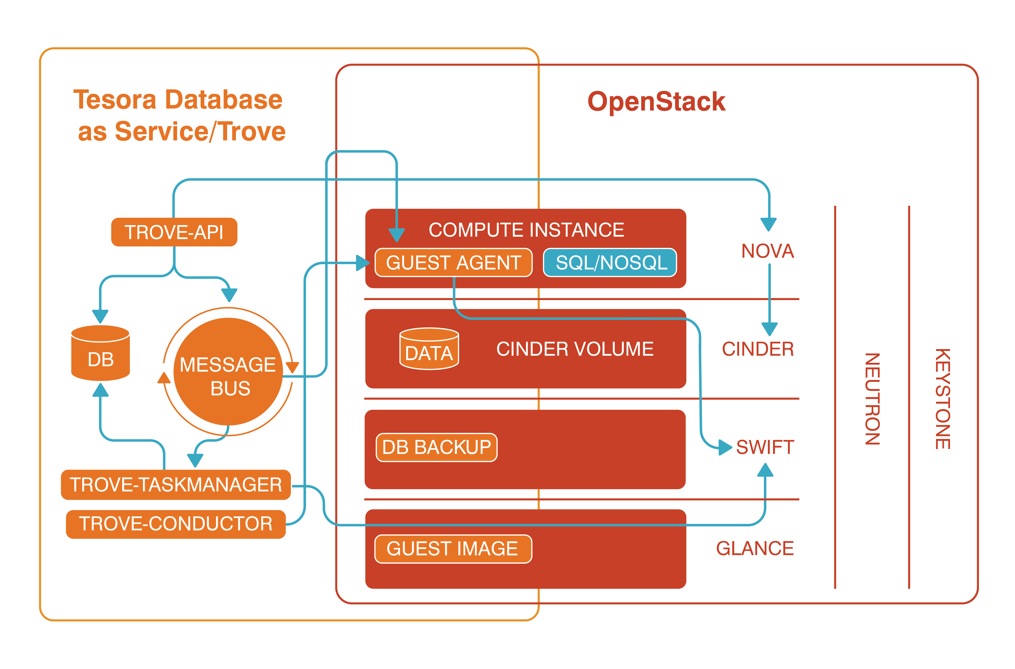
OpenStack Trove Architecture

Slide 13
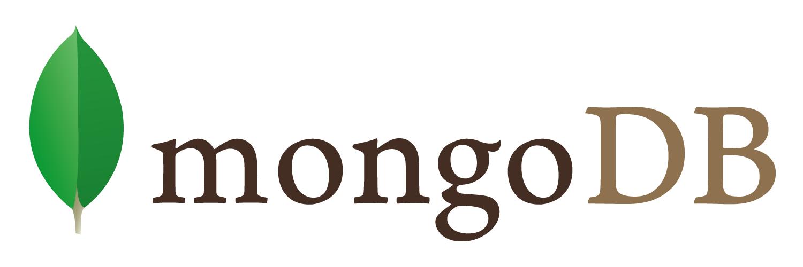
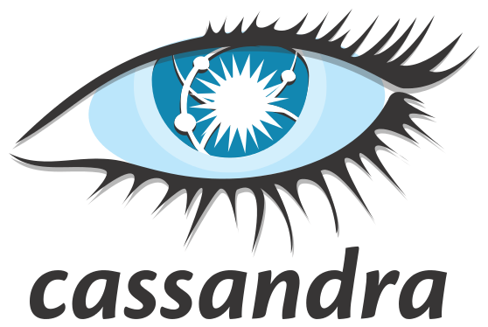

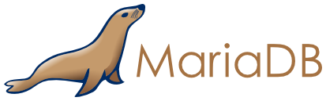
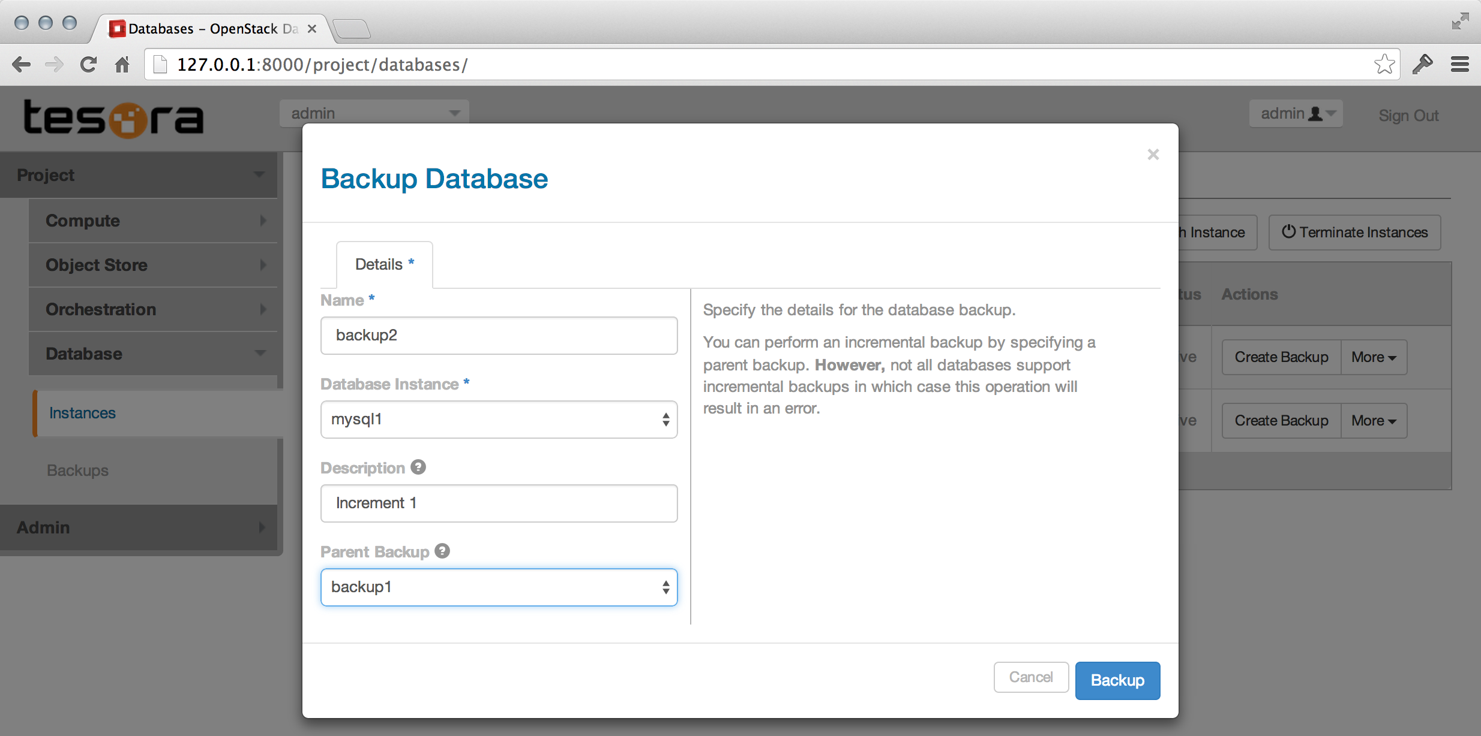

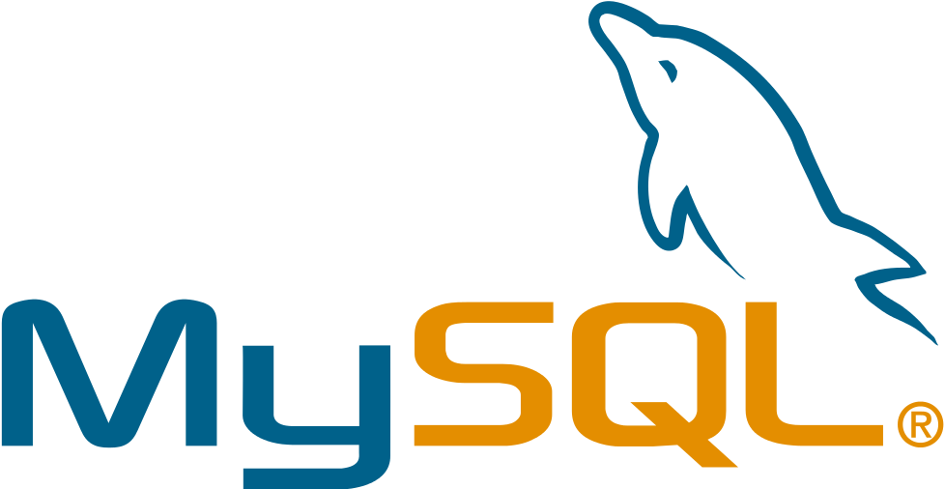


Trove Multi-Datastore Architecture
Datastore-agnostic code in Trove Controller and Dashboard
Datastore specific code isolated to guest agents
Guest Agent
Guest Agent
Trove Dashboard (Horizon)
Guest Agent
Trove Controller
Guest Agent
Guest Agent
Guest Agent
Guest Agent
Guest Agent
Guest Agent
Notes:
Should come directly after the main architecture slide

Slide 14
Using OpenStack Trove

Slide 15
Getting started with OpenStack Trove
As a Trove user
Tesora DBaaS platform, a Trove packaging tailored for the enterprise
http://tesora.com/download-tesora-dbaas-platform-community-edition
As a Trove developer
$ git clone http://github.com/openstack/trove-integration
$ cd trove-integration/scripts
$ ./redstack install
$ ./redstack kick-start mysql
On top of DevStack
Add to localrc:
ENABLED_SERVICES+=,trove,tr-api,tr-tmgr,tr-cond
Swift should also be enabled for Backup and Restore.
ENABLED_SERVICES+=,s-proxy,s-object,s-container,s-account
SWIFT_HASH=<swift-hash-here>

Slide 16
Provisioning a database instance with Trove
$ trove create <instance-name> <flavor-id>
--size <volume-size>
Support for flavors
Support for volumes using Cinder
Optional parameters to create
Image per ‘datastore type’ and ‘version’
Support AZs using --availability_zone
Support for Neutron using --nic
Notes:
{
"instance": {
"status": "BUILD",
"updated": "2014-06-05T19:33:46",
"name": "test",
"links": [
{
"href": "https://region-a.geo-1.database.hpcloudsvc.com/v1.0/39745227274204/instances/ce629494-a64d-41ed-b73c-04cb28bb33bb",
"rel": "self"
},
{
"href": "https://region-a.geo-1.database.hpcloudsvc.com/instances/ce629494-a64d-41ed-b73c-04cb28bb33bb",
"rel": "bookmark"
}
],
"created": "2014-06-05T19:33:46",
"id": "ce629494-a64d-41ed-b73c-04cb28bb33bb",
"flavor": {
"id": "1002",
"links": [
{
"href": "https://region-a.geo-1.database.hpcloudsvc.com/v1.0/39745227274204/flavors/1002",
"rel": "self"
},
{
"href": "https://region-a.geo-1.database.hpcloudsvc.com/flavors/1002",
"rel": "bookmark"
}
]
},
"datastore": {
"version": "5.5",
"type": "mysql"
}
}
}

Slide 17
Managing a database with Trove
Resize flavor
Resize volume
Datastore specific extensions:
Create Database / Schema
Create Users
Grant Users Permissions on Databases
Enable a Root User

Slide 18
Backup and Restore
$ trove backup-create
<backup-name> <instance-id>
Optional params:
Description through --description
Incremental backups using –parent
To Restore backup use create:
$ trove create
<instance-name> <flavor-id>
--size <volume-size>
--backup <backup-id>
Fully managed
Triggered and tracked via API
Streamed to Swift (OpenStack Object Storage)
Incremental & full backups
Multiple formats per datastore supported via strategies:
XtraBackup (Percona)
mysqldump

Slide 19
Backup Strategies
trove/guestagent/
[…]
backup/
common/
datastore/
[…]
strategies/
[…]
trove/guestagent/strategies/backup
base.py
base.pyc
couchbase_impl.py
couchbase_impl.pyc
__init__.py
__init__.pyc
mysql_impl.py
mysql_impl.pyc
postgresql_impl.py
trove/guestagent/strategies
backup/
[…]
replication/
restore/
storage/
grep class guestagent/strategies/backup/mysql_impl.py
class MySQLDump(base.BackupRunner):
class InnoBackupEx(base.BackupRunner):
class InnoBackupExIncremental(InnoBackupEx):
Notes:
Let’s shift gears for a couple of minutes and talk briefly about the architecture from a different perspective.
Trove must be able to address many different kinds of datastores. Some are NoSQL, some are SQL (and I’m playing with a graph database
as well). Each of these implements a certain capability in a different way. Let’s talk about backup and restore as an example.
Once you get the software, in the trove/guestagent directory, you’ll find a directory called strategies. And under strategies, one called backup,
and under backup you’ll see the actual implementation for the specific datastore. Now looking at the MySQL implementation, you’ll see that
there are two backup capabilities (full backup) and one incremental backup method.
At configuration you can specify which implementation you would like to use. And you could implement a new strategy for your datastore
thereby making Trove extensible and modular.

Slide 20
Replication
$ trove create <instance-name> <flavor-id>
--size <volume-size>
--replica_of <instance-id>
Support for async or GTID based semi-sync replication for MySQL
Manual detach using
$ trove update <instance-id> --detach-replica-source

Slide 21
Clusters
$ trove cluster-create <datastore> <ds-version>
Optional parameters to cluster-create
--instance <flavor_id=flavor_id,volume=volume>
Specify multiple times to create multiple instances for your cluster
Common interface for multiple clustering models
Cassandra, Redis, Couchbase – Add and remove nodes (all peers)
MongoDB – sets up config servers, query nodes and shards/replicas
MySQL – uses Percona XtrDB Cluster (Galera) for synchronous master-master replication

Slide 22
Learn More about Trove
Trove Wiki – https://wiki.openstack.org/wiki/Trove
Trove Source – https://git.openstack.org/cgit/openstack/trove
On IRC - #openstack-trove
Getting Started Videos – http://Tesora.com/videos/
Download Tesora Platform - http://Tesora.com/downloads
Trove Day
Tesora.com/troveday
Slideshare.net/Tesoracorp
LinkedIn - OpenStack Trove Group
Contact information
Contact Tesora info@tesora.com www.tesora.com @tesoracorp | Contact Ken krugg@tesora.com www.tesora.com @kenrugg

Slide 23
Thank You!

