Slide 1
Trove + Kubernetes + OVN to build DBaaS Cloud
By Zeng Jian @JD

Slide 2
Agenda
. Trove architecture
. Kubernetes architecture
Computer
Storage
Network
Flat Network
OVN
. Challenge
. Plan & Progress

Slide 3
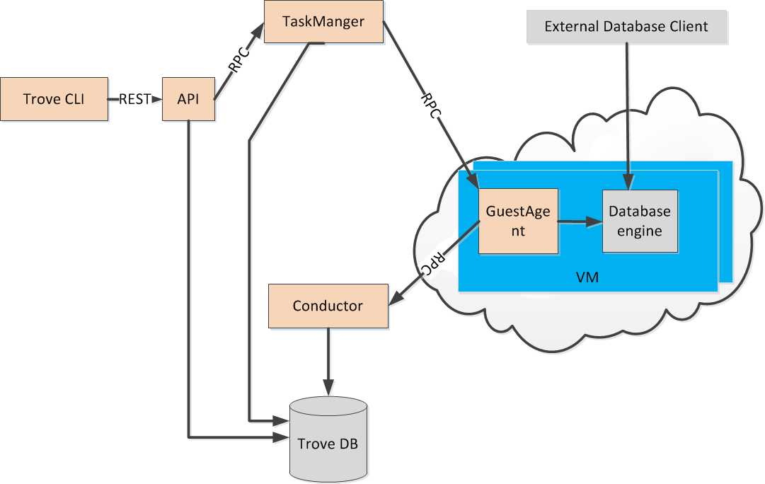
Trove Architecture

Slide 4
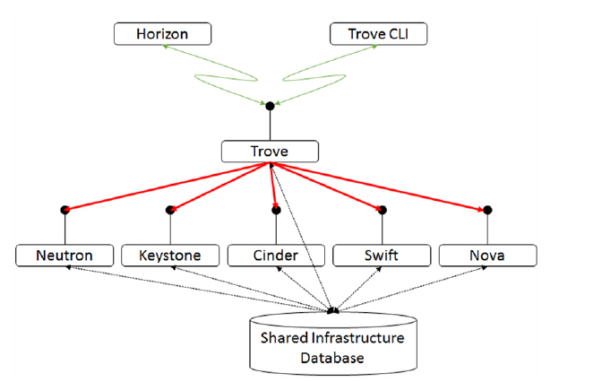
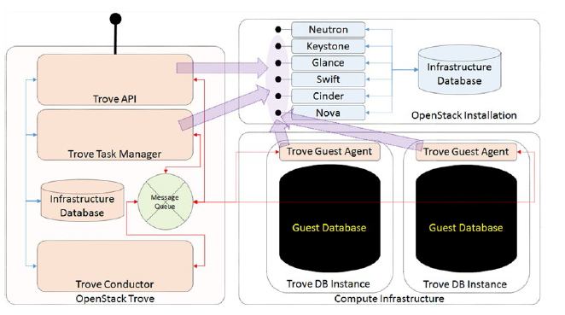
Trove with OpenStack

Slide 5
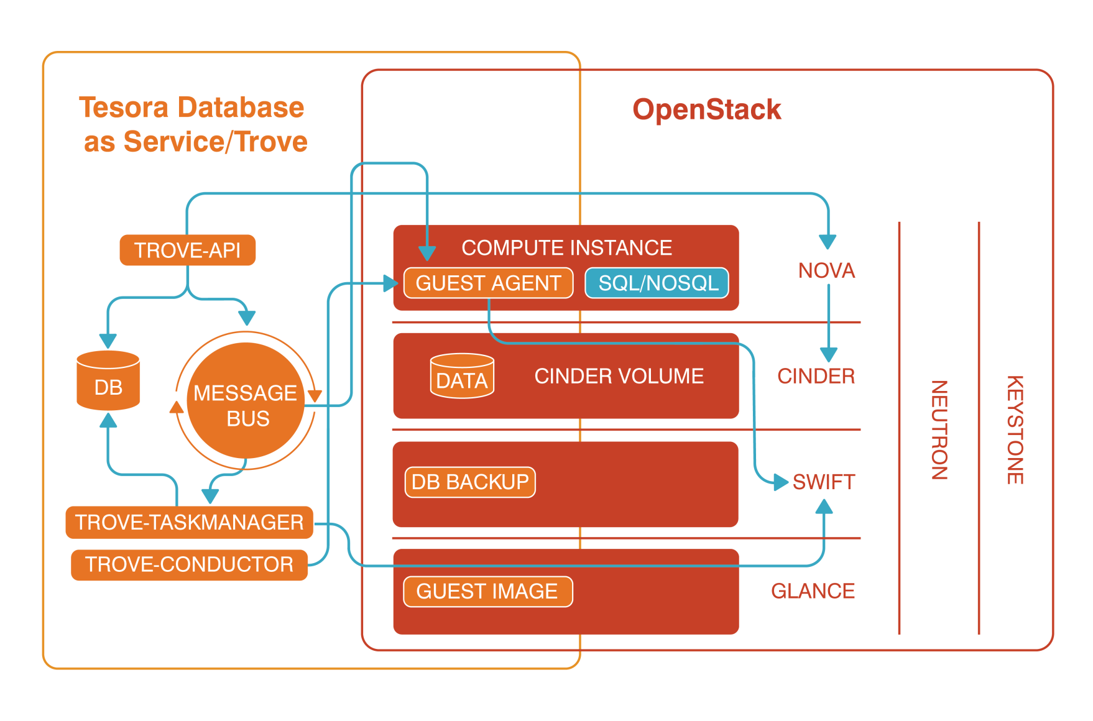
Trove with OpenStack

Slide 6
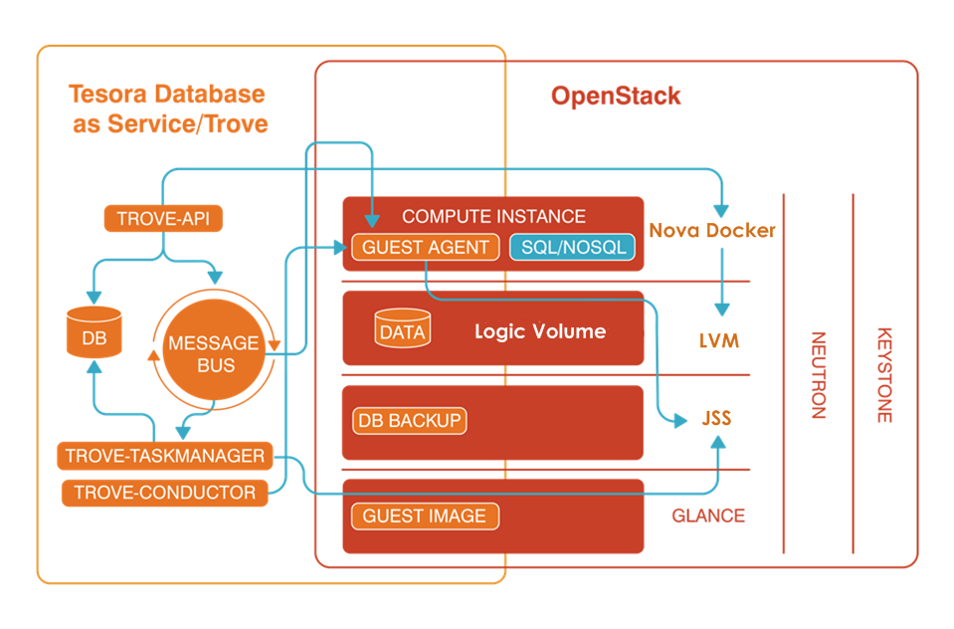
Trove with JDOS

Slide 7
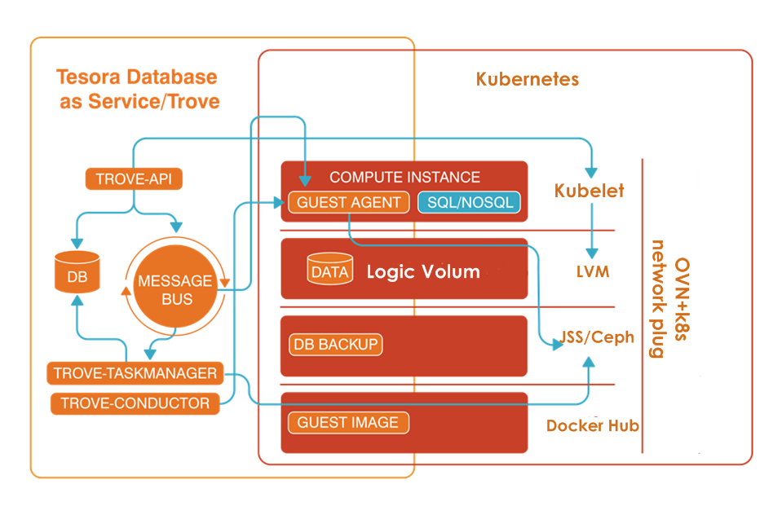
Trove with Kuberneters

Slide 8
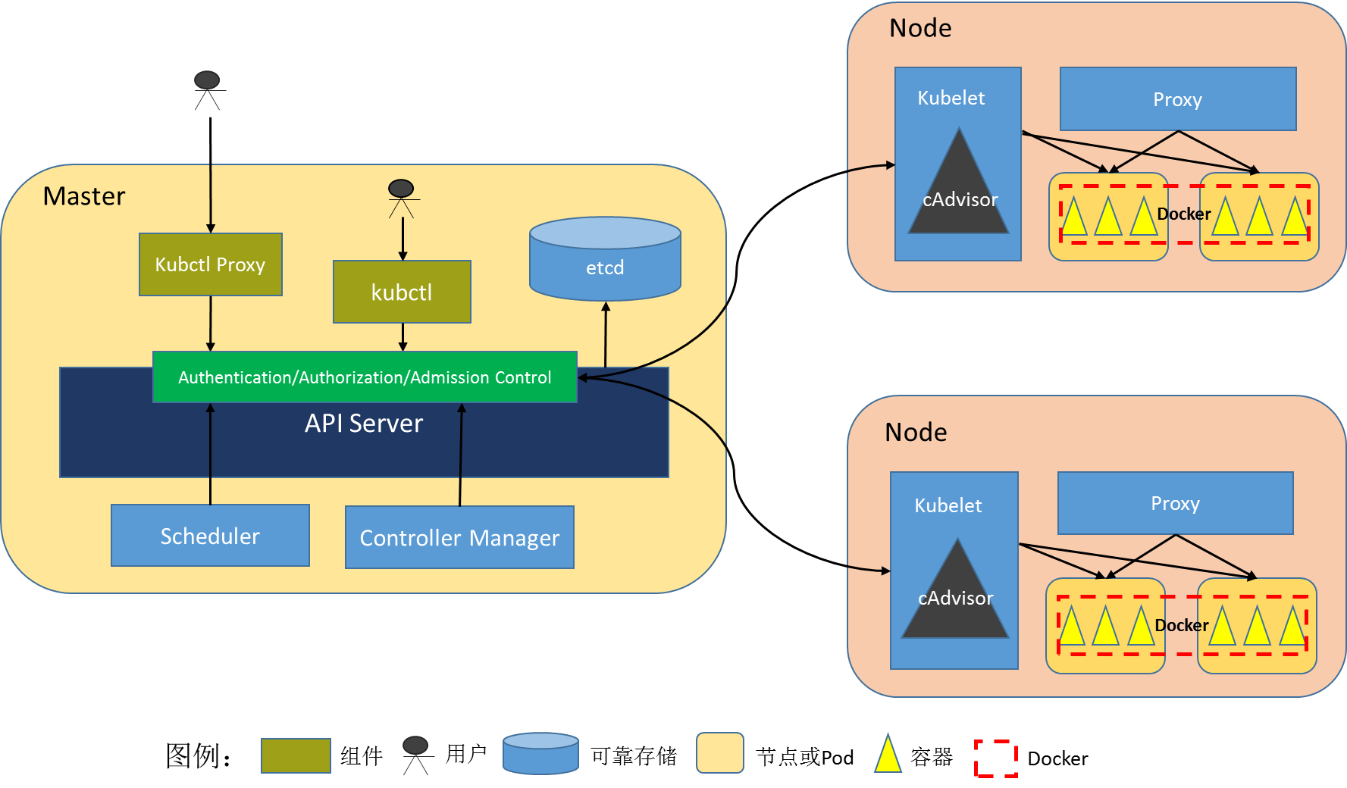
Kubernetes Architectures

Slide 9
Computer
. Kuber-Scheduler:
dispatch instance to different Node with many factor,
cpu, memory resource limit;
. Kubelet:
manage Docker lifecycle: create, delete, restart,
Use cAdvisor to monitor resource, docker, node status;
. Controller manager:
HA - replicator controller
. API server:
RESTfull API server,
Authentication Authorization and Admission Control
called by other components

Slide 10
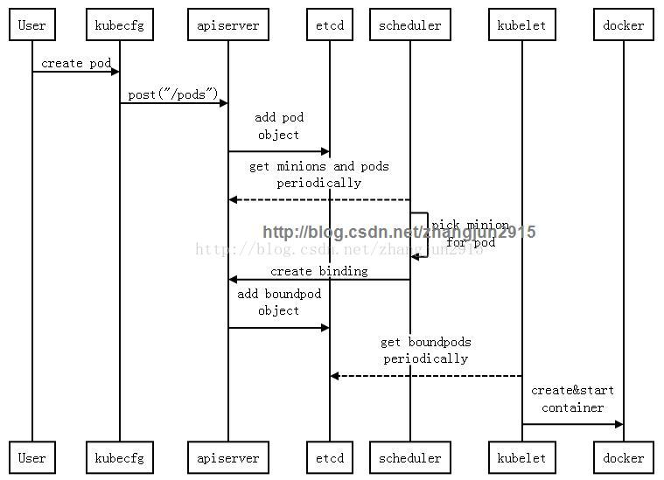
Computer

Slide 11
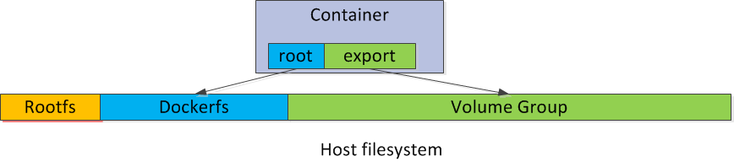
Storage
. The same as Trove with JDOS, using LVM
Quota, volume-mount
Resize online, xfs
Use device-mapper as Docker fs
Advance feature:
snapshot with lvm, filesystem level, not app
level, fast

Slide 12
Network
. To keep network topology the same as Trove with
JDOS (coexist, communicate)
Flat network topology, not overlay
Using OVS, with Vlan
Using OVN to manage the network topology
Using kubelet network plugin to attach container
into the network

Slide 13
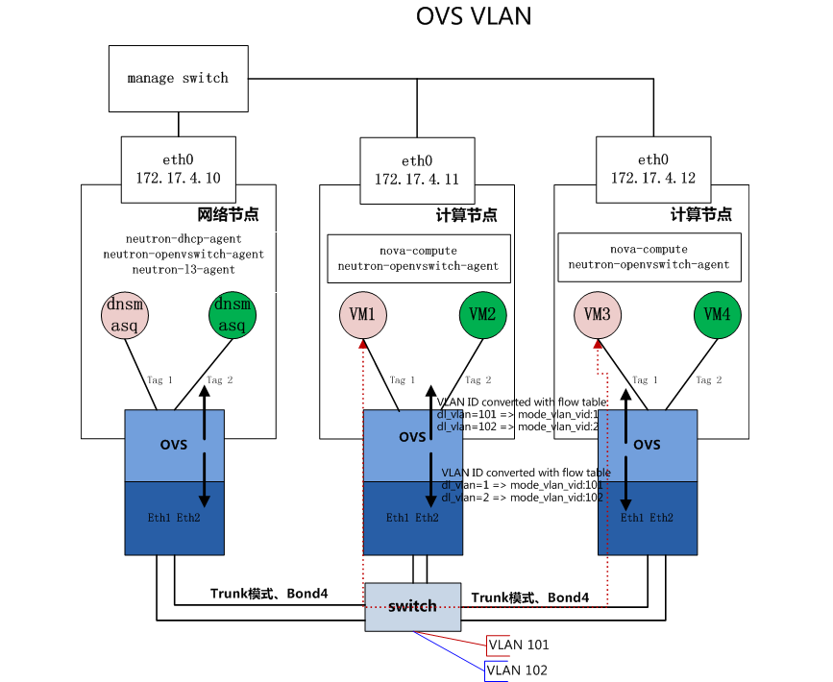
Network-JDoS-Flat

Slide 14
Network-JDoS-Flat-ComputerNode
[root@A01-R06-I178-127 ~]# ovs-vsctl show
2705c9c3-861c-4f51-b649-9813950d181b
Bridge br-int
fail_mode: secure
Port "tapf3054bef-62"
tag: 8
Interface "tapf3054bef-62"
Port "int-br-eth1"
Interface "int-br-eth1"
type: patch
options: {peer="phy-br-eth1"}
Port br-int
Interface br-int
type: internal
Port "tap3877c90a-d5"
tag: 14
Interface "tap3877c90a-d5"
Bridge "br-eth1"
Port "br-eth1"
Interface "br-eth1"
type: internal
Port "phy-br-eth1"
Interface "phy-br-eth1"
type: patch
options: {peer="int-br-eth1"}
Port "eth1"
Interface "eth1"
ovs_version: "2.1.3"
[root@A01-R06-I178-127 ~]# ovs-vsctl -V
ovs-vsctl (Open vSwitch) 2.1.3
Compiled Oct 10 2014 14:20:08

Slide 15
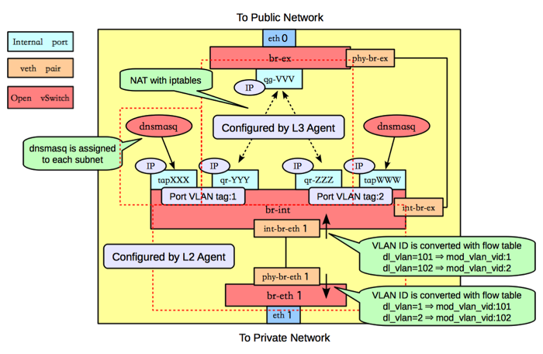
Network-JDoS-Flat-NetworkNode

Slide 16
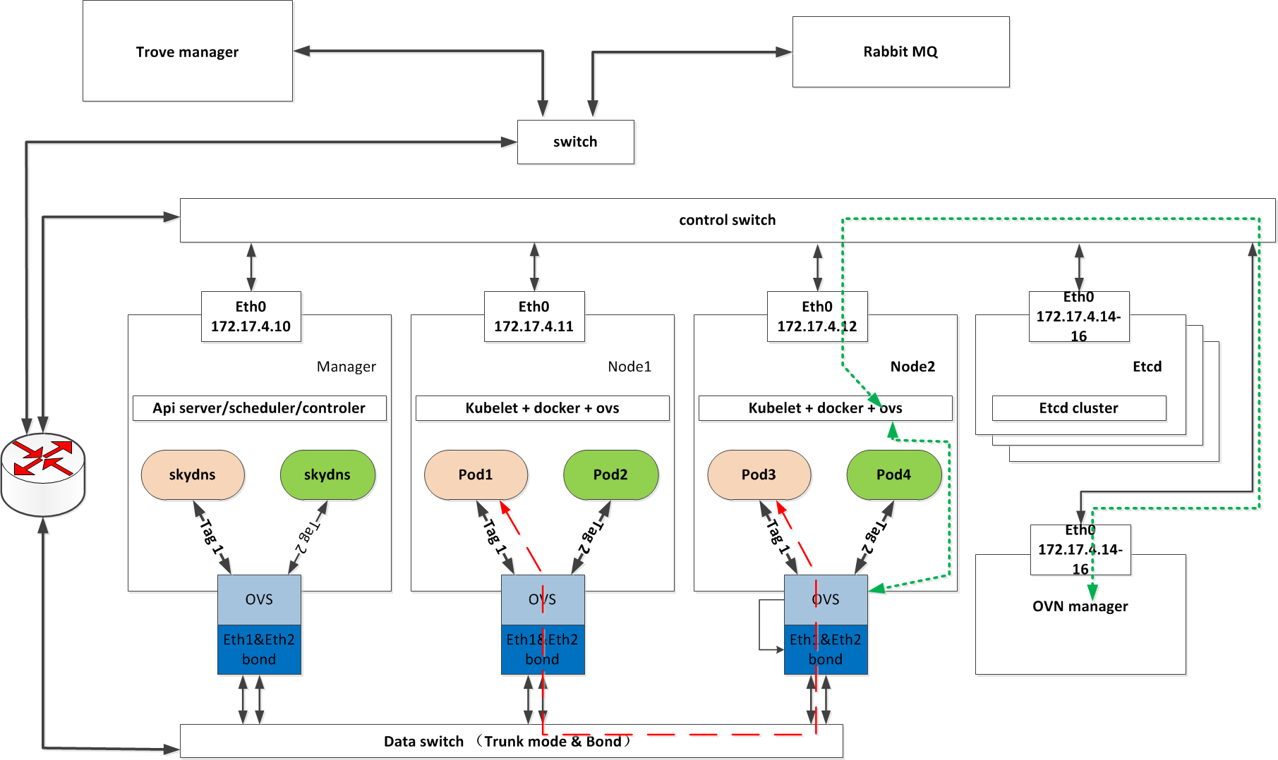
Network-K8s-Flat

Slide 17
Network-OVN
What is OVN?
• Open source virtual networking for Open vSwitch (OVS)
• Provides L2/L3 virtual networking
– Logical switches and routers
– Security groups
– L2/L3/L4 ACLs
– Multiple tunnel overlays (Geneve, STT, and VXLAN)
– TOR-based and software-based logical-physical gateways
• Work on same platforms as OVS
– Linux (KVM and Xen)
– Containers
– DPDK
– Hyper-V
• Integration with OpenStack and other CMSs

Slide 18
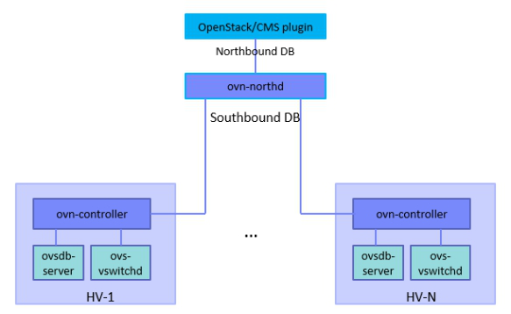
Network-OVN
The OVN Databases
• ovn-northbound
– OpenStack/CMS integration point
– High-level, desired state
• Logical ports -> logical switches -> logical routers
• ovn-southbound
– Run-time state
• Location of logical ports
• Location of physical endpoints
• Logical pipeline generated based on configured and run-time state

Slide 19
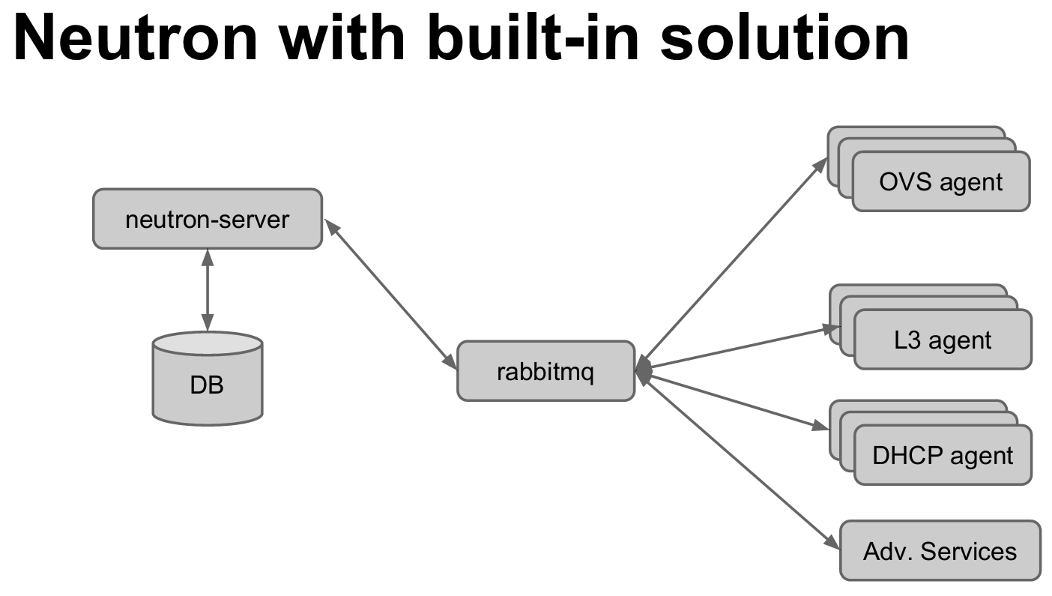

Slide 20
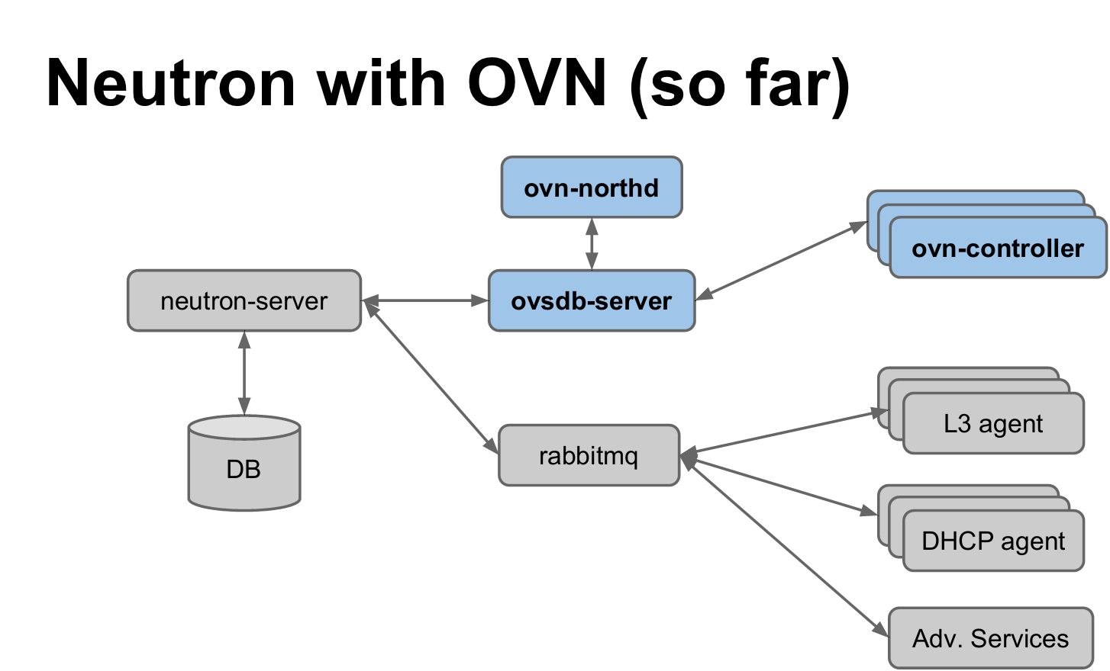
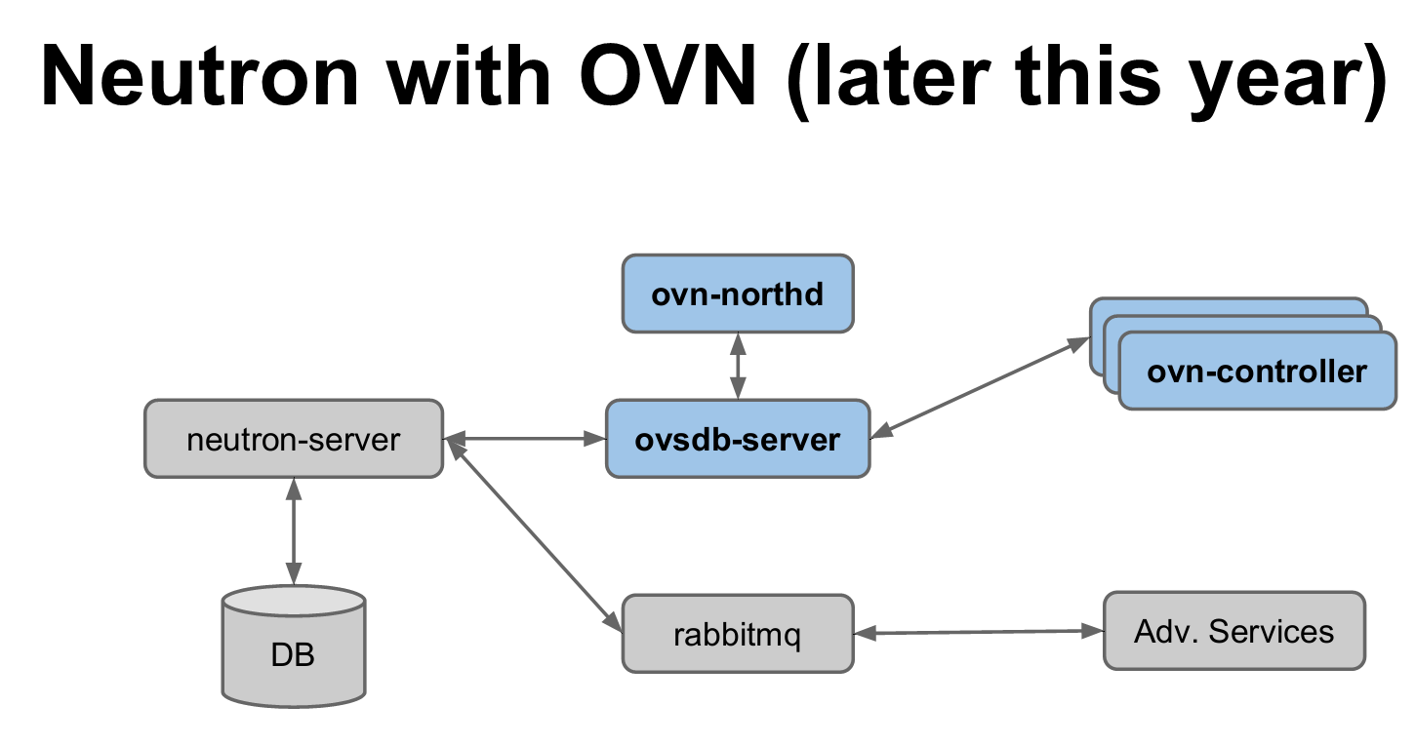

Slide 21
Challenge
. K8s not support disk quota
. K8s not support scatter instances to different
nodes
. K8s not support update cpu/mem/disk quota
online
. Need to change the scheduler to conside disk resource.
. K8s not contain network manager, need add
IPAM and network manager ourself(OVN plugin)
. Need add Disk r/w rate limit in k8s
. Need add Network send/receive rate limit in k8s
. K8s is new with some bug/flaw unknown …

Slide 22
Plan & Progress
Items | Periods | Status
Disk quota | 2w | Done
Disk scheduler | 1w | Done
scatter instances (pods) | 1w | Done
Upgrade online | 2w | On progress
Network manager | 4w | On progress
HA | 2w | …
… | … | …

Slide 23
Q&A

Slide 24
