Slide 1

Data-Driven Drafting
Predicting NBA career success from college statistics
Zion Tippetts
STAT 486

Slide 2
Research Question
Can college statistics predict long-run NBA career success?
Which pre-draft indicators matter most?
PTS | ORB | DRB | TRB | AST | STL | BLK | TOV | FG% | FT% | 3P%
2

Slide 3
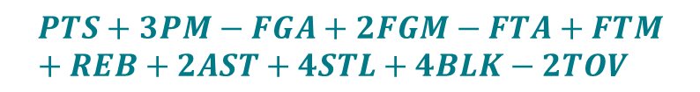

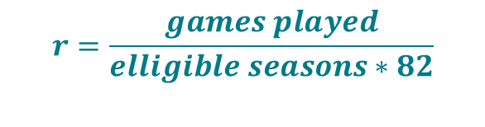
Outcome: Success Composite
Target: Composite Success Metric
Formula
$$Success=0.7∗z\left(Fantasy PPG\right)+0.3∗z(log(1+r)$$
$$Fantasy=$$
$$PTS+3PM−FGA+2FGM−FTA+FTM+REB+2AST+4STL+4BLK−2TOV$$
$$r=\frac{games played}{elligible seasons∗82}$$
3

Slide 4

Data & Cohort
Source: Basketball Reference
Data
College (totals, per 100, advanced) & NBA (totals) player data
Cohort
Player entered the NBA between 2011-2022 (12-year window)
Player attended college (excludes international prospects)
Minimum of 2 NBA seasons with GP ≥ 10 and MP ≥ 100
4

Slide 5

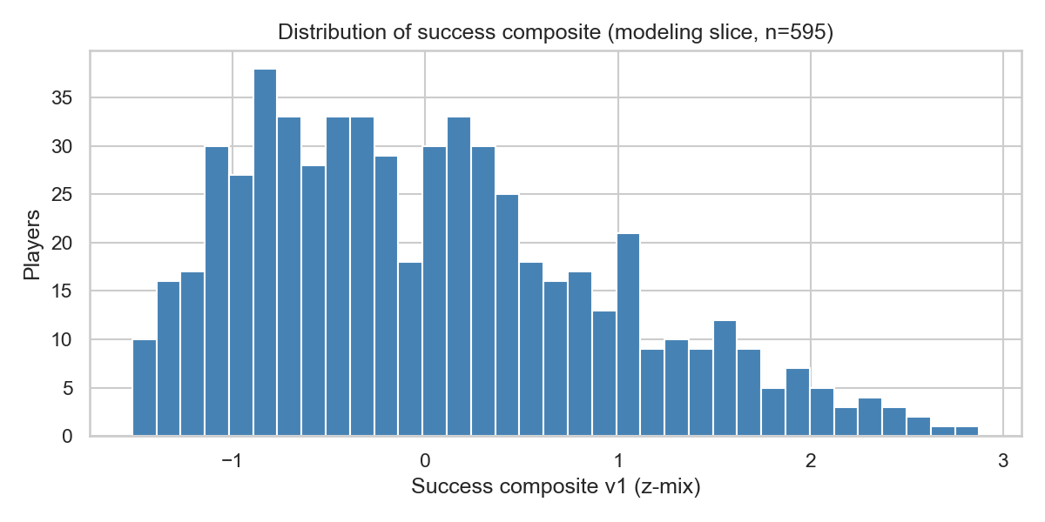



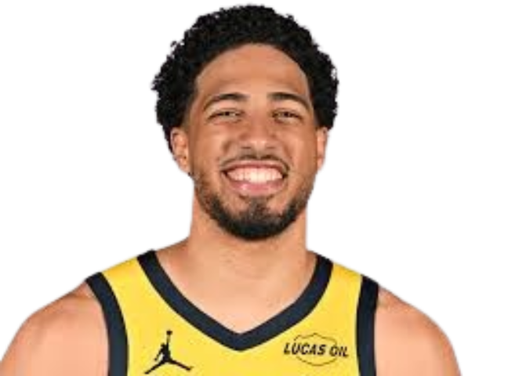
EDA Highlights
Success composite is centered near 0, right-skewed
5

Slide 6
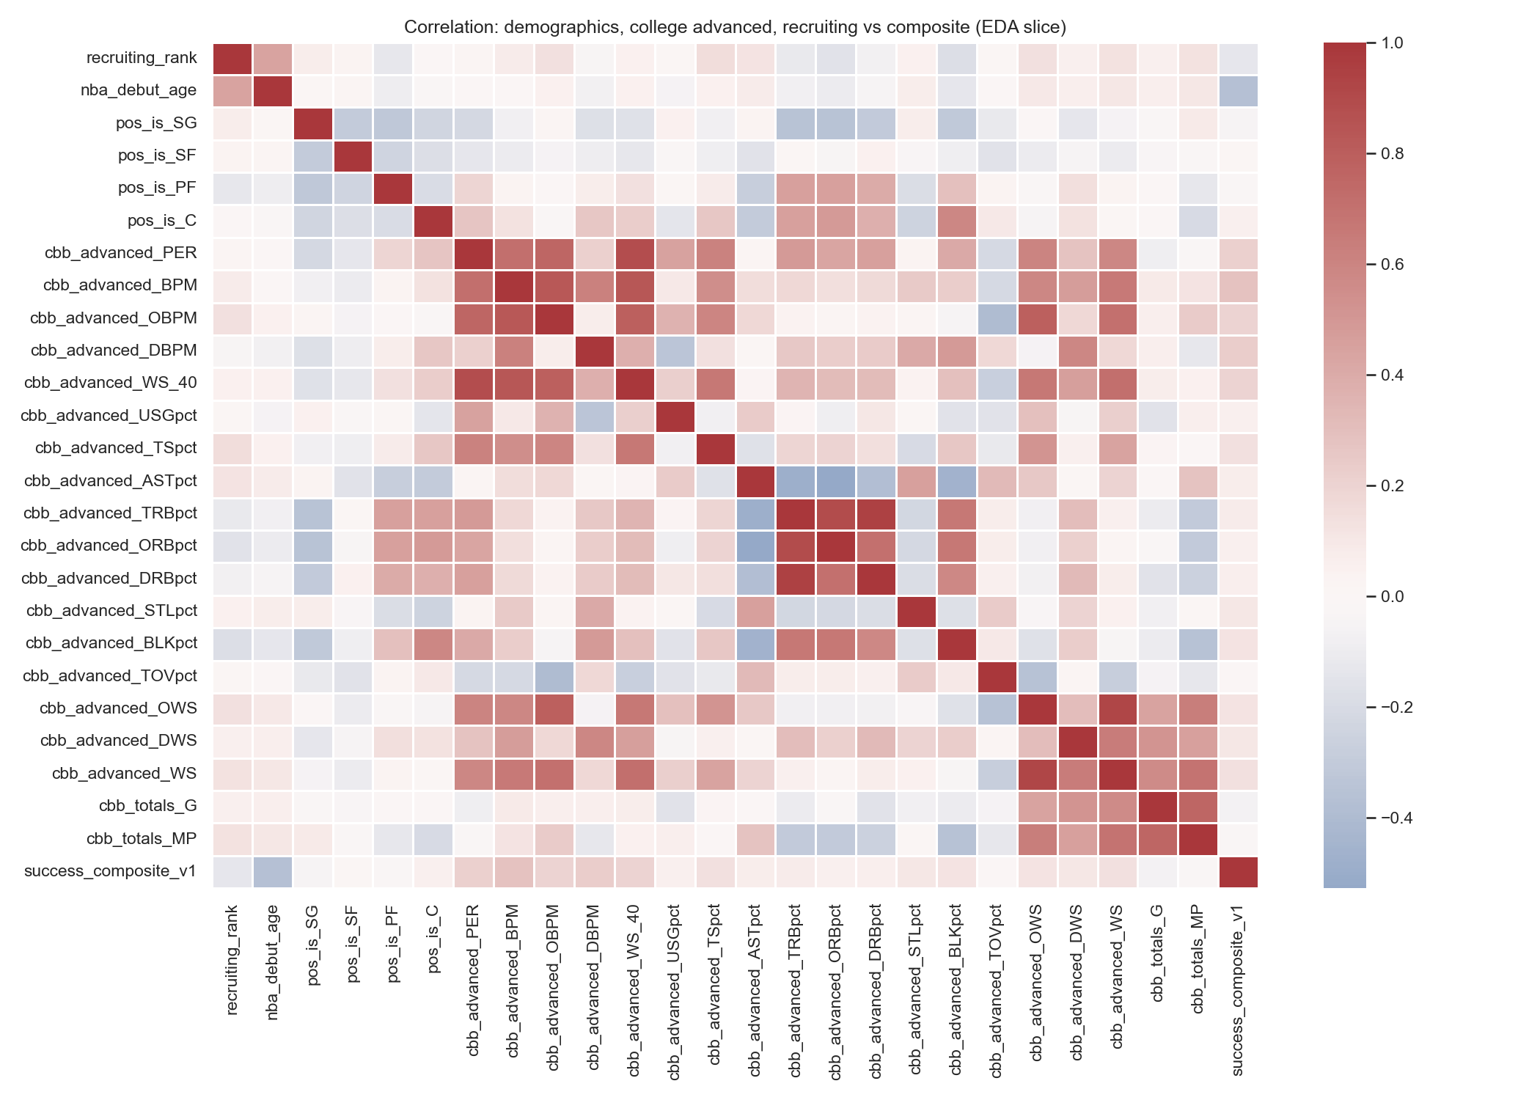
EDA Highlights
College BPM & PER have highest correlation with success composite
Strong collinearity across some of the advanced college statistics
6

Slide 7
Supervised Modeling
Target & Models
Predict success composite using:
Ridge, Lasso, RF, HGB on 595 players meeting criteria
Features
22 inputs: debut age, four rookie position dummies (PG ref), 17 college advanced stats
Preprocessing & Split
Median imputation everywhere; scale Ridge/Lasso; 80/20 split, fixed seed, CV only on train
Tuning
5-fold CV on train ( RMSE ) · Ridge: α grid · Lasso: LassoCV · RF / HGB: randomized search (24 & 30 draws)
Evaluation
RMSE, MAE, R² on the held-out 20%
7

Slide 8
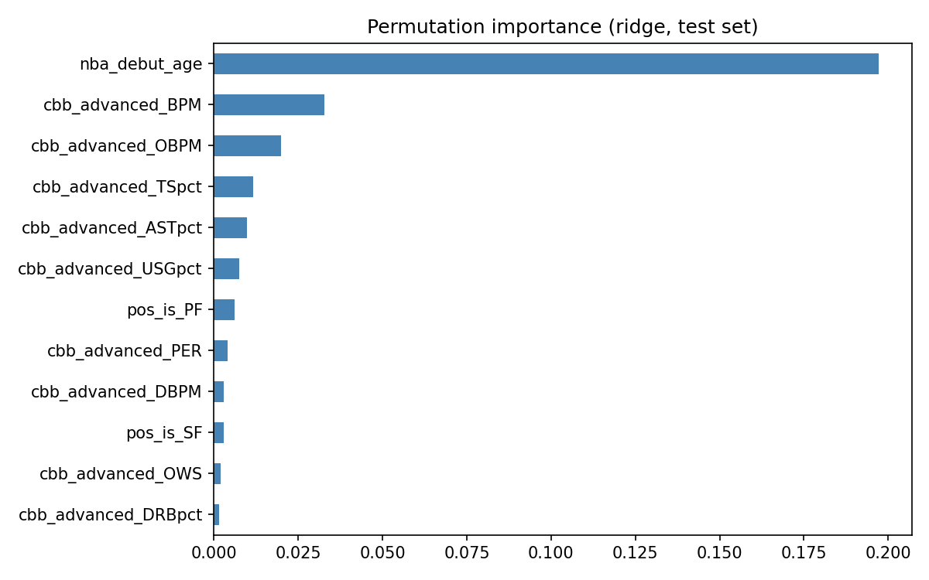
Supervised Modeling
Ridge Permutation Importance
Lasso keeps 5 nonzero terms:
Age, BPM, DBPM, STL%, TOV%
Model | Test R²
Ridge | 0.139
LassoCV | 0.152
Random Forest | 0.138
Gradient Boosting | 0.124
*Test set, 25 reps
8

Slide 9
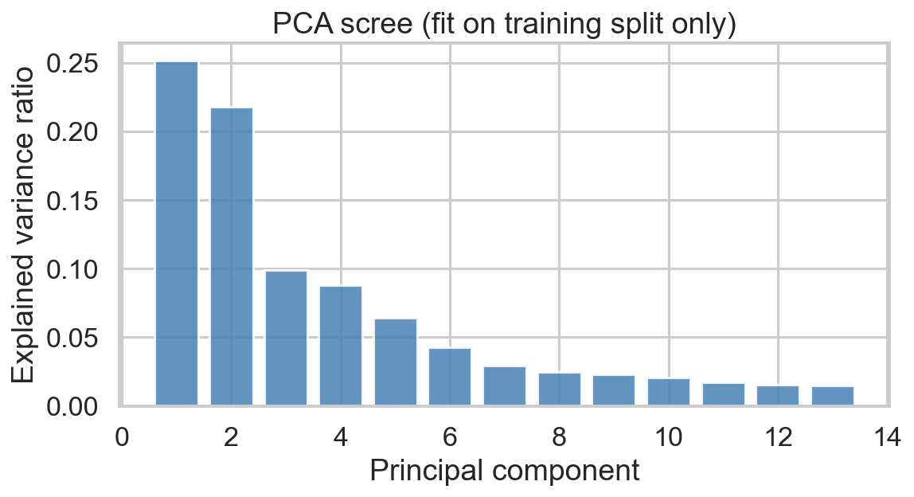
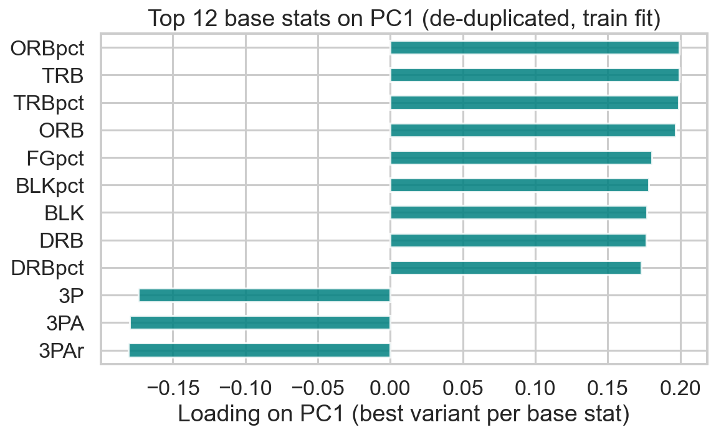
PCA — Dimensionality Reduction
80 overlapping college features
median impute + scale on train only
keep 13 PCs for 90% train variance
Setup
PC1
contrasts interior vs perimeter playstyles
Success
Corr(PC1, success) ≈ 0.14 on train
9

Slide 10
Limitations and Next Steps
Active players may have less “prime” years accounted for
No era adjustment: NBA scoring environment changes over time
College box scores alone are inherently limited
Next steps:
• Regress on PC scores instead of raw features (use 13 PCs as model inputs).
• Cluster PC scores to discover player archetypes.
• Richer data (combine measurements, scouting reports) could improve signal.
10

Slide 11
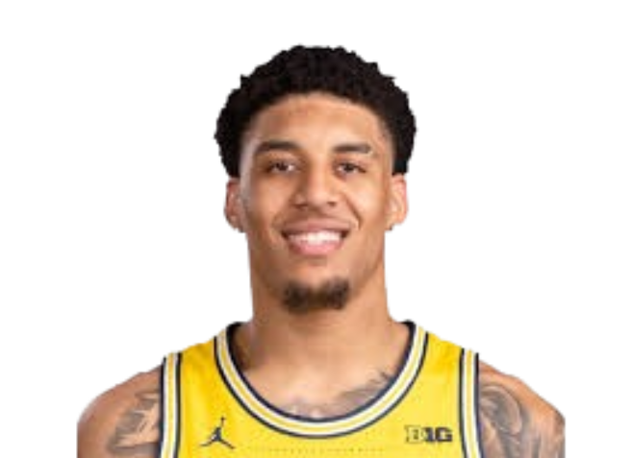
Key Takeaways
College stats weakly predict NBA success (R² ≈ 0.15)
Debut age and BPM are the top drivers.
PCA reveals the main axis of variation is role
Both methods agree: pre-draft box scores provide modest signal at best
11

