Slide 1
Chapter 2: Intro to Relational Model

Slide 2
Answer the following question
In the context of this book, which one of the following is a relation (multiple selection):
1) Your pet dog and you
2) Your bank account and you
3) All the members in a football team
4) All the students currently attending this class

Slide 3
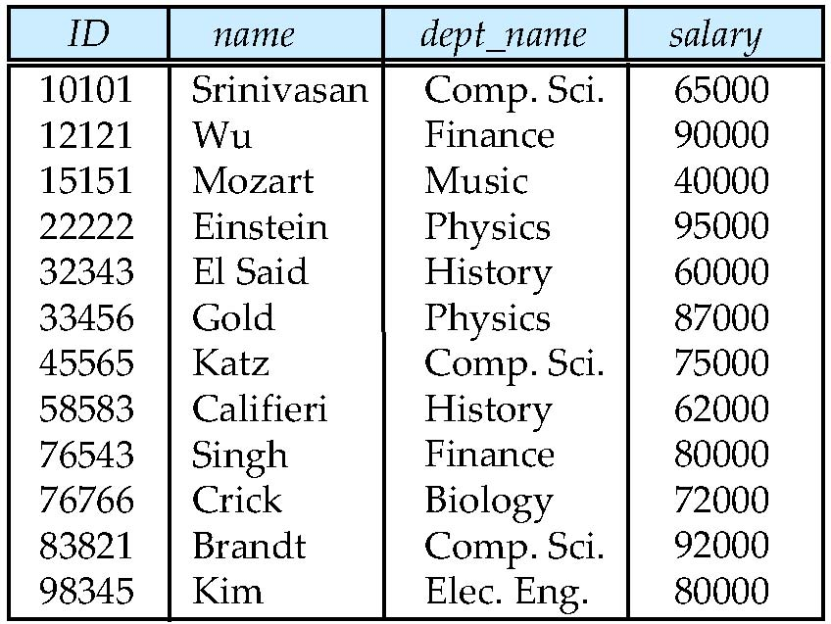
Example of a Relation
attributes
(or column names)
tuples
(or rows)
Order of tuples is irrelevant (tuples may be stored in an arbitrary order)

Slide 4
Relation Schema and Instance
A₁, A₂, …, A_{n} are attributes
R = (A₁, A₂, …, A_{n} ) is a relation schema
Example:
instructor = (ID, name, dept_name, salary)
Formally, given sets D₁, D₂, …. D_{n} a relation r is a subset of D₁ x D₂ x … x D_{n} Thus, a relation is a set of n-tuples (a₁, a₂, …, a_{n}) where each a_{i} ∈ D_{i}
The subset is not always rational, especial temporary relation
Naming rule: Upper case “R” is a schema, lower case “r” is an instance. r(R) refers to relation instance “r” based on the schema “R”
both R and r are sets
R is a set of attributes
r is a set of tuples
Table is the an alternative concept to relation instance

Slide 5
Domain of Attribute
The set of allowed values for each attribute is called the domain of the attribute
Attribute values are (normally) required to be atomic; that is, indivisible.
Strictly indivisible example: store first name and last name separately, first name: “三”，last name：“张”
If do not query by last name or first name frequently, can store the full name in one attribute, name: “张三”
Non atomic examples: two telephone numbers stored in one attribute; all the information of a book stored in one attribute, including information of author, title, publisher, etc.
The special value null is a member of every domain. Null means the values is unknows or does not exist. Example: domain of Semester: Spring, Summer, Autumn, Winter, null; domain of Grade: integer 0 to 100, and null
The null value causes complications in the definition of many operations

Slide 6
Database
A database consists of multiple relations
Information about an enterprise is broken up into parts
instructor student advisor
Bad design: univ (instructor -ID, name, dept_name, salary, student_Id, ..) results in
repetition of information (e.g., two students have the same instructor)
the need for null values (e.g., represent an student with no advisor)
Normalization theory deals with how to design “good” relational schemas
Database schema -- is the logical structure of the database.
Database instance -- is a snapshot of the data in the database at a given instant in time.

Slide 7
Keys
Let K ⊆ R
K is a superkey of R if values for K are sufficient to identify a unique tuple of each possible relation r
Example: {ID} and {ID,name} are both superkeys of instructor.
Superkey K is a candidate key if K is minimal (If we remove one more attribute in K, K will not be a superkey)
Example: {ID} is a candidate key for Instructor
Candidate key can have more than one attribute
Example: grade(student_id, course_id, grade)
One of the candidate keys is selected to be the primary key.
Exampe: student(student_id, name, mobile_phone, email), how many candidate keys, which one will be the primary key
Foreign key constraint: Value in one relation must appear in another
Referencing relation ；Referenced relation
Example: dept_name in instructor is a foreign key from instructor referencing department

Slide 8
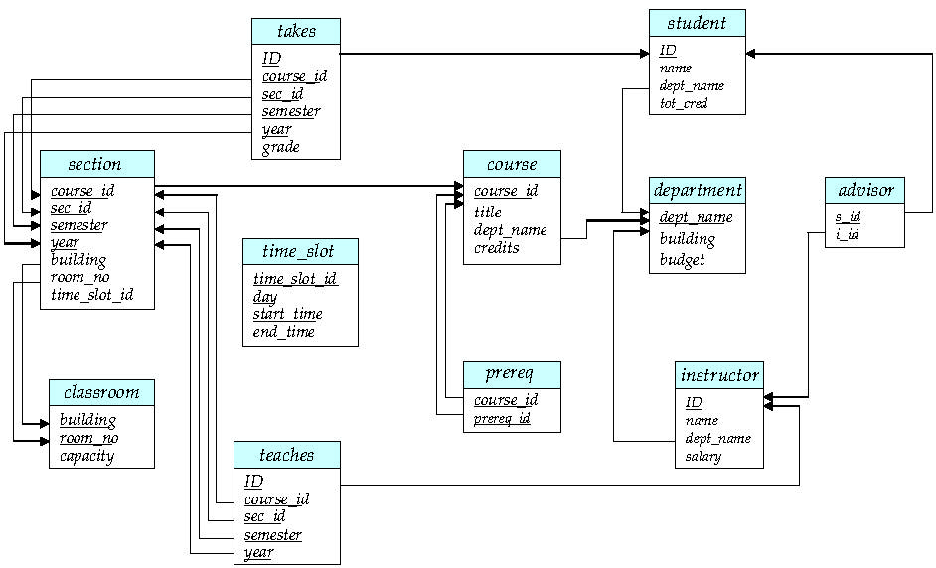
Schema Diagram for University Database

Slide 9
Relational Query Languages
Procedural vs.non-procedural, or declarative
“Pure” languages:
Relational algebra
Tuple relational calculus
Domain relational calculus
The above 3 pure languages are equivalent in computing power
We will concentrate in this chapter on relational algebra
Not Turing-machine equivalent

Slide 10
Relational Algebra
Procedural language, but not a traditional programming language
Input and output are all relations
Part One: Relational Algebra – Basic Operators, mainly:
For one relation:
select: σ
project: ∏
rename: ρ
For two relations:
union: ∪
set difference: –
Cartesian product: x
Part two: Relational Algebra - Additional Operations
Operations that can be expressed with basic operations, for example: intersection can be expressed with union and set difference
Part three: Relational Algebra - Extended Operations
Operations that can not be expressed with basic operations. Mainly aggregation functions

Slide 11
Relational Algebra – Basic Operators
Six basic operators
select: σ
project: ∏
union: ∪
set difference: –
Cartesian product: x
rename: ρ

Slide 12
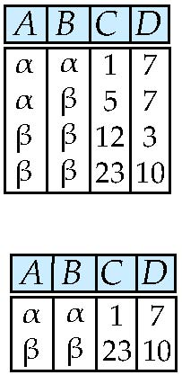
Select Operation – Example
Relation r
σ_{A=B ^ D > 5} (r)

Slide 13
Select Operation
The select operation selects tuples that satisfy a given predicate.
Notation: σ _{p}(r)
p is called the selection predicate
Defined as: σ_{p}(r) = {t | t ∈ r and p(t)}
Where p is a formula in propositional calculus consisting of terms connected by : ∧ (and), ∨ (or), ¬ (not) Each term is one of:
<attribute> op <attribute> or <constant>
where op is one of: =, ≠, >, ≥. <. ≤
Example of selection: σ _{dept_name=“Physics”}(instructor)
σ _{dept_name=“Physics”} ∧ _{salary >50000} (instructor)

Slide 14
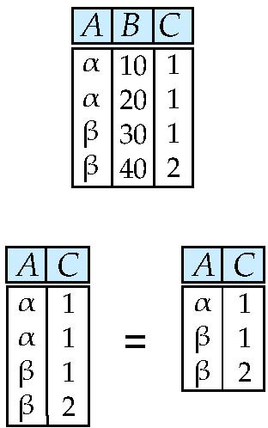
Project Operation – Example
Relation r:
∏_{A,C} (r)

Slide 15
Project Operation
A unary operation that returns its argument relation, with certain attributes left out.
Notation:
where A₁, A₂ are attribute names and r is a relation name.
The result is defined as the relation of k columns obtained by erasing the columns that are not listed
Duplicate rows removed from result, since relations are sets
Example: To eliminate the dept_name attribute of instructor ∏_{ID, name, salary} (instructor)
∏_{course_id} (σ _{semester=“Fall” Λ year=2009} (section))

Slide 16
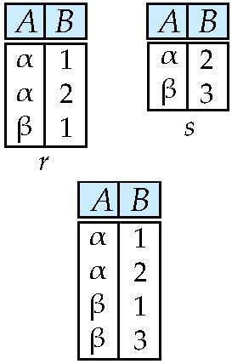
Union Operation – Example
Relations r, s:
r ∪ s:

Slide 17
Union Operation
The union operation allows us to combine two relations
Notation: r ∪ s
Defined as:
r ∪ s = {t | t ∈ r or t ∈ s}
For r ∪ s to be valid.
1. r, s must have the same arity (same number of attributes)
2. The attribute domains must be compatible (example: 2nd column of r deals with the same type of values as does the 2nd column of s)
Duplicate rows removed from result
Example: to find all courses taught in the Fall 2009 semester, or in the Spring 2010 semester, or in both ∏_{course_id} (σ _{semester=“Fall” Λ year=2009} (section)) ∪ ∏_{course_id} (σ _{semester=“Spring” Λ year=2010} (section))

Slide 18
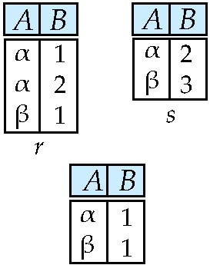
Set Difference – Example
Relations r, s:
r – s:

Slide 19
Set Difference Operation
The set-difference operation allows us to find tuples that are in one relation but are not in another.
Notation r – s
Defined as:
r – s = {t | t ∈ r and t ∉ s}
Set differences must be taken between compatible relations.
r and s must have the same arity
attribute domains of r and s must be compatible
Example: to find all courses taught in the Fall 2009 semester, but not in the Spring 2010 semester ∏_{course_id} (σ _{semester=“Fall” Λ year=2009} (section)) − ∏_{course_id} (σ _{semester=“Spring” Λ year=2010} (section))

Slide 20
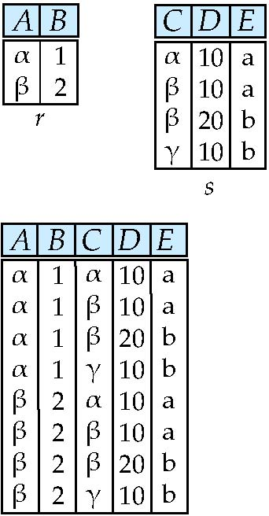
Cartesian-Product Operation – Example
Relations r, s:
r x s:

Slide 21
Cartesian-Product Operation
The Cartesian-product operation (denoted by X) allows us to combine information from any two relations.
Notation r x s
Defined as:
r x s = {t q | t ∈ r and q ∈ s}
Assume that attributes of r(R) and s(S) are disjoint. (That is, R ∩ S = ∅, or, no attributes with the same name).
If attributes of r(R) and s(S) are not disjoint, then renaming must be used, e.g, instructor.ID, teaches.ID.
The resulting relation may be huge
In real application, most of the tuples in the resulting relation may be useless. Followed by “σ”, “x” may be the most frequently used operation in database applications, as database consists of many interrelated relations.

Slide 22
Join Operation
The Cartesian-Product
instructor X teaches
associates every tuple of instructor with every tuple of teaches.
Most of the resulting rows have information about instructors who did NOT teach a particular course.
To get only those tuples of “instructor X teaches “ that pertain to instructors and the courses that they taught, we write:
σ _{instructor.id = teaches.id} (instructor x teaches ))
We get only those tuples of “instructor X teaches” that pertain to instructors and the courses that they taught.
The result of this expression, shown in the next slide

Slide 23
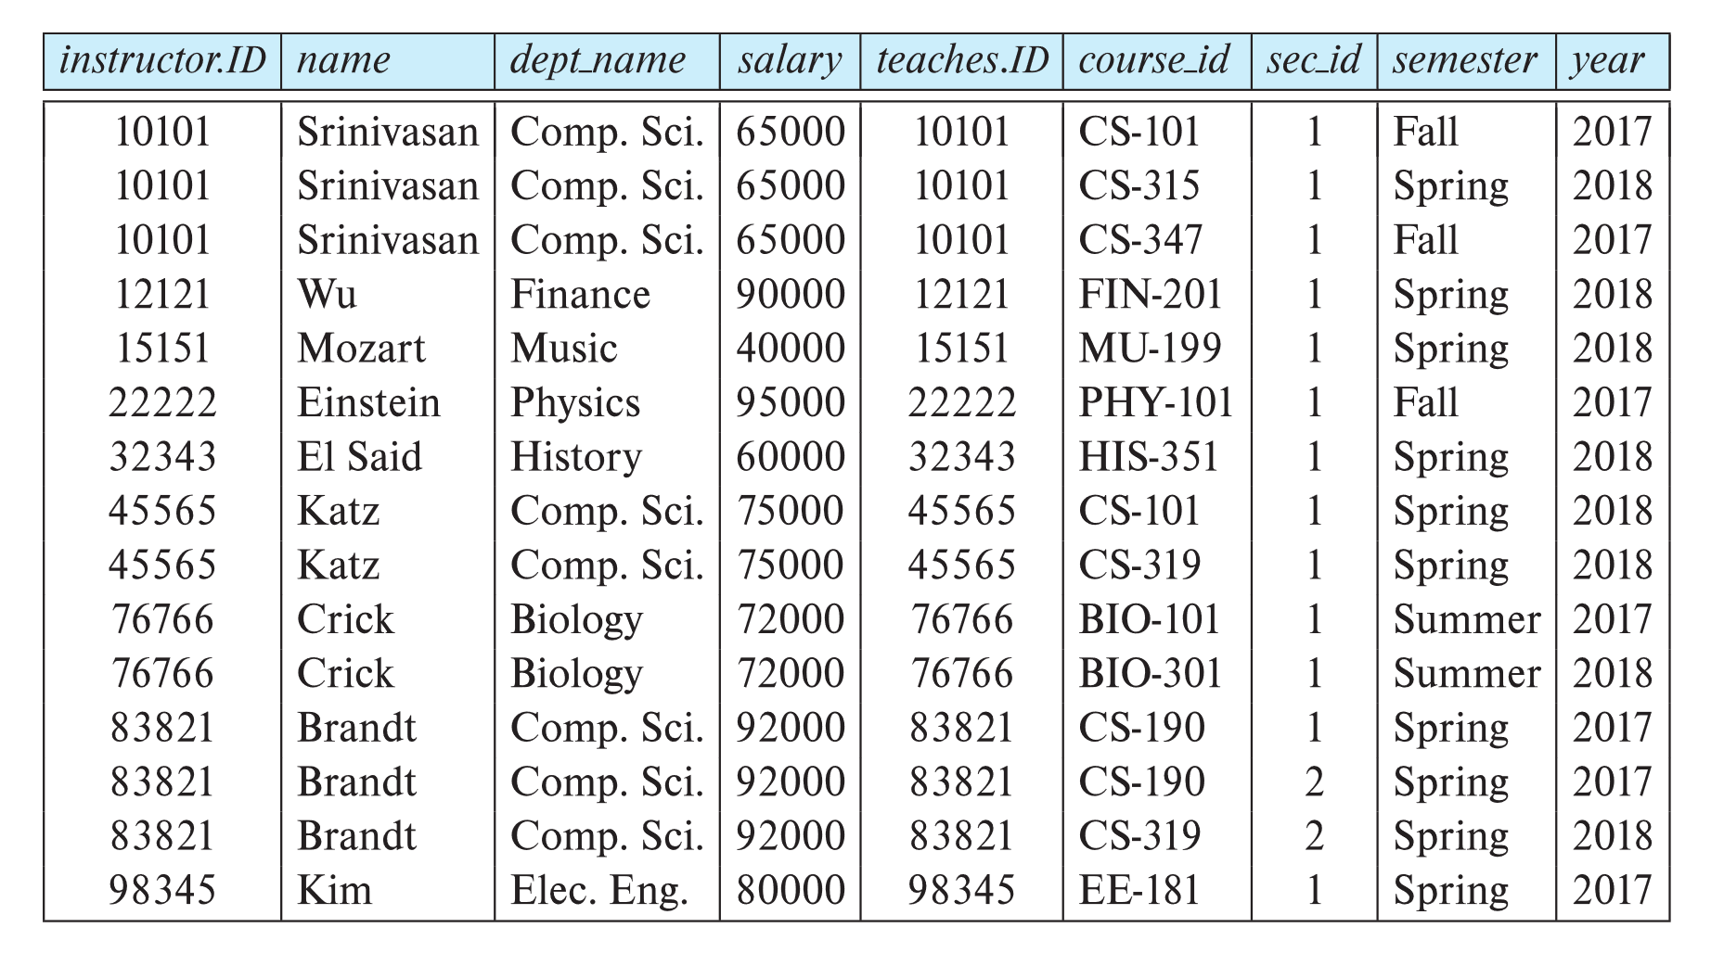
Join Operation (Cont.)
The table corresponding to:
σ _{instructor.id = teaches.id} (instructor x teaches))

Slide 24
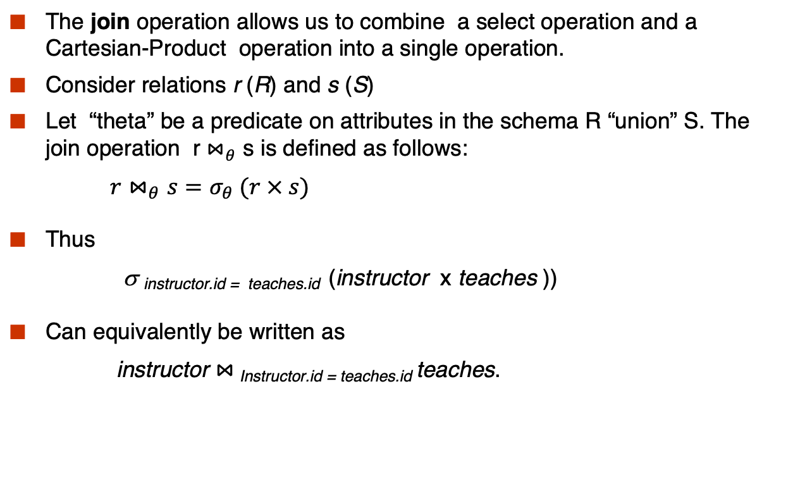
Join Operation (Cont.)
The join operation allows us to combine a select operation and a Cartesian-Product operation into a single operation.
Consider relations r (R) and s (S)
Let “theta” be a predicate on attributes in the schema R “union” S. The join operation r $⋈_{θ}$ s is defined as follows:
$r⋈_{θ}s=σ_{θ} (r × s)$
Thus
σ _{instructor.id = teaches.id} (instructor x teaches ))
Can equivalently be written as
instructor $⋈_{ }$_{Instructor.id = teaches.id} teaches.

Slide 25
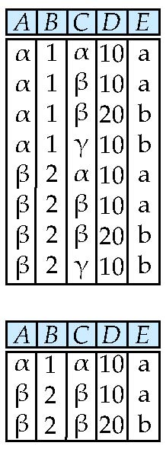
Composition of Operations
Can build expressions using multiple operations
Example: σ_{A=C}(r x s)
r x s
σ_{A=C}(r x s)
∏_{instructor.name,course_id} (σ _{instructor.ID=teaches.ID} (instructor x teaches))

Slide 26
Composition of Operations – Cont.
Find the names of all instructors in the Physics department, along with the course_id of all courses they have taught
Query 1 ∏_{instructor.name,course_id} (σ_{dept_name=“Physics”} ( σ _{instructor.ID=teaches.ID} (instructor x teaches)))
Query 2 ∏_{instructor.name,course_id} (σ_{instructor.ID=teaches.ID} ( σ _{dept_name=“Physics”} (instructor) x teaches))

Slide 27
Rename Operation
Allows us to refer to a relation by more than one name.
Example:
ρ _{x} (E)
returns the expression E under the name X
If a relational-algebra expression E has arity n, then
returns the result of expression E under the name X, and with the
attributes renamed to A₁ , A₂ , …., A_{n} .

Slide 28
Rename Operation-Example
Find instructors whose salary is greater than some instructors (at least one instructor) in physics department
∏_{Instructor.ID}(σ _{instructor.salary >d.salary} (instructor x ρ_{d} (σ _{department = “physics”}( instructor))))

Slide 29
Formal Definition
A basic expression in the relational algebra consists of either one of the following:
A relation in the database
A constant relation
Let E₁ and E₂ be relational-algebra expressions; the following are all relational-algebra expressions:
E₁ ∪ E₂
E₁ – E₂
E₁ x E₂
σ_{p} (E₁), P is a predicate on attributes in E₁
∏_{s}(E₁), S is a list consisting of some of the attributes in E₁
ρ _{x} (E₁), x is the new name for the result of E₁

Slide 30
Relational Algebra - Additional Operations
We define additional operations that do not add any power to the
relational algebra, but that simplify common queries.
Set intersection
Natural join
Assignment
Outer join
Division

Slide 31
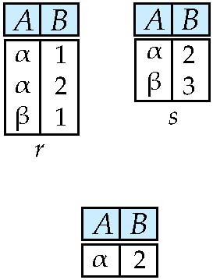
Set-Intersection Operation – Example
Relation r, s:
r ∩ s

Slide 32
Set-Intersection Operation
The set-intersection operation allows us to find tuples that are in both the input relations.
Notation: r ∩ s
Defined as:
r ∩ s = { t | t ∈ r and t ∈ s }
Assume:
r, s have the same arity
attributes of r and s are compatible
Note: r ∩ s = r – (r – s)
r
s

Slide 33
Natural-Join Operation
Notation: r s
Let r and s be relations on schemas R and S respectively. Then, r s is a relation on schema R ∪ S obtained as follows:
Consider each pair of tuples t_{r} from r and t_{s} from s.
If t_{r} and t_{s} have the same value on each of the attributes in R ∩ S, add a tuple t to the result, where
t has the same value as t_{r} on r
t has the same value as t_{s} on s
Example:
R = (A, B, C, D)
S = (E, B, D)
Result schema = (A, B, C, D, E)
r s is defined as: ∏_{r.A, r.B, r.C, r.D, s.E} (σ_{r.B = s.B ∧ r.D = s.D} (r x s))

Slide 34
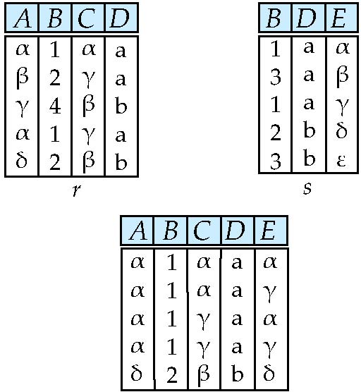
Natural Join Example
Relations r, s:
r s
∏_{instructor.name,course_id} ( instructor teaches)

Slide 35
Natural Join Properties
Find the names of all instructors in the Comp. Sci. department together with the course titles of all the courses that the instructors teach
∏ _{name, title} (σ _{dept_name=“Comp. Sci.”} (instructor teaches course))
Natural join is associative
(instructor teaches) course is equivalent to instructor (teaches course)
Natural join is commutative
instruct teaches is equivalent to teaches instructor

Slide 36
Assignment Operation
The assignment operation (←) provides a convenient way to express complex queries.
Can assign temporary result to a temporary relation variable
A complex query consists of a series of assignments followed by an expression whose value is displayed as a result of the query.
Example:
d ← σ _{department = “physics”}( instructor)
result = ∏_{instructor.ID}(σ _{instructor.salary >d.salary}(instructor x d))

Slide 37
Outer Join
An extension of the join operation that avoids loss of information.
Computes the join and then adds tuples form one relation that does not match tuples in the other relation to the result of the join.
Uses null values:
null signifies that the value is unknown or does not exist

Slide 38
Outer Join – Example
Relation instructor1
ID
name
dept_name
10101
12121
15151
Srinivasan
Wu
Mozart
Comp. Sci.
Finance
Music
Relation teaches1
ID
course_id
10101
12121
76766
CS-101
FIN-201
BIO-101

Slide 39
Outer Join – Example
Natural Join instructor teaches
ID
name
dept_name
course_id
10101
12121
Srinivasan
Wu
Comp. Sci.
Finance
CS-101
FIN-201
Left Outer Join
instructor teaches
ID
name
dept_name
course_id
10101
12121
15151
Srinivasan
Wu
Mozart
Comp. Sci.
Finance
Music
CS-101
FIN-201
null

Slide 40
Outer Join – Example
Right Outer Join
instructor teaches
ID
name
dept_name
course_id
10101
12121
76766
Srinivasan
Wu
null
Comp. Sci.
Finance
null
CS-101
FIN-201
BIO-101
Full Outer Join
instructor teaches
ID
name
dept_name
course_id
10101
12121
15151
76766
Srinivasan
Wu
Mozart
null
Comp. Sci.
Finance
Music
null
CS-101
FIN-201
null
BIO-101

Slide 41
Outer Join using Joins
Outer join can be expressed using basic operations
e.g. r s can be written as
(r s) U (r – ∏_{R}(r s) x {(null, …, null)}

Slide 42
Division Operator
Given relations r(R) and s(S), such that S ⊂ R, r ÷ s is the largest relation t(R-S) such that t x s ⊆ r
E.g. let r(ID, course_id) = ∏_{ID, course_id} (takes ) and s(course_id) = ∏_{course_id} (σ_{dept_name=“Biology”}(course ) ) then r ÷ s gives us students who have taken all courses in the Biology department

Slide 43
Division Using Basic Operations
Can write r ÷ s as
temp1 ← ∏_{R-S} (r ) temp2 ← ∏_{R-S} ((temp1 x s ) – ∏_{R-S,S} (r )) result = temp1 – temp2
The result to the right of the ← is assigned to the relation variable on the left of the ←.

Slide 44
Relational Algebra - Extended Operations
Generalized Projection
Aggregate Functions

Slide 45
Generalized Projection
Extends the projection operation by allowing arithmetic functions to be used in the projection list.
E is any relational-algebra expression
Each of F₁, F₂, …, F_{n} are arithmetic expressions involving constants and attributes in the schema of E.
Given relation instructor(ID, name, dept_name, salary) where salary is annual salary, get the same information but with monthly salary
∏_{ID, name, dept_name, salary/12} (instructor)

Slide 46

Aggregate Functions and Operations
Aggregation function takes a collection of values and returns a single value as a result.
avg: average value min: minimum value max: maximum value sum: sum of values count: number of values
Aggregate operation in relational algebra
E is any relational-algebra expression
G₁, G₂ …, G_{n} is a list of attributes on which to group (can be empty)
On which to group: to do the aggregation based on a subset of E. For any two tuples t1 and t2 in the subset, t1.G1 = t2.G1, t1.G2 = t2.G2, ..., t1.Gn=t2.Gn
Each F_{i} is an aggregate function
Each A_{i} is an attribute name
Notes:
On which to group: to do the aggregation based on a subset of E. For any two tuples t1 and t2 in the subset, t1.G1 = t2.G1, t1.G2 = t2.G2, ..., t1.Gn=t2.Gn

Slide 47
Aggregate Operation – Example
Relation r:
A
B
C
α
α
β
β
α
β
β
β
7
7
3
10
_{sum(c)} (r)
sum(c )
A
sum(c)
A
B
sum(c)
27
α
β
14
13
α
α
β
α
β
β
7
7
13
_{A} _{sum(c)} (r) ; _{A,B} _{sum(c)}(r)

Slide 48
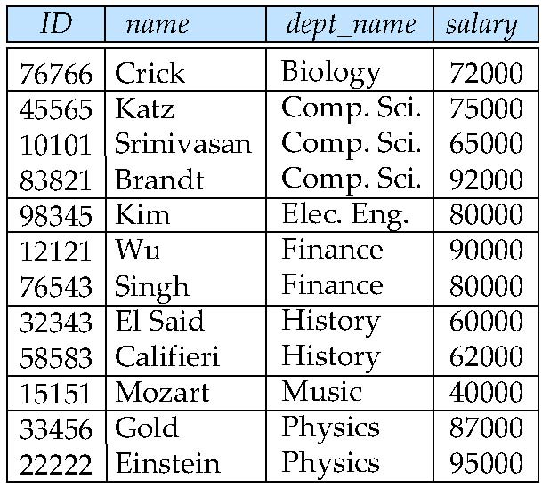
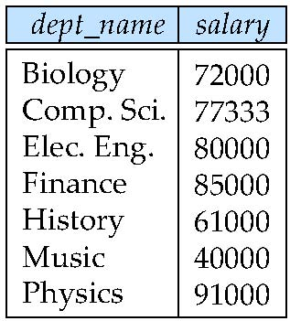
Aggregate Operation – Example
Find the average salary in each department
_{dept_name} _{avg(salary)} (instructor)
avg_salary

Slide 49
Aggregate Functions (Cont.)
Result of aggregation does not have a name
Can use rename operation to give it a name
For convenience, we permit renaming as part of aggregate operation
_{dept_name} _{avg(salary) as avg_sal} (instructor)

Slide 50
Modification of the Database
The content of the database may be modified using the following operations:
Deletion
Insertion
Updating
All these operations can be expressed using the assignment operator

Slide 51
Null Values
It is possible for tuples to have a null value, denoted by null, for some of their attributes
null signifies an unknown value or that a value does not exist.
The result of any arithmetic expression involving null is null.
5 + null = null
Aggregate functions simply ignore null values (as in SQL)
avg, min, max, sum, count(c): ignore null
count(*): count the number of records, if there are null values in some records, they will still be counted
For duplicate elimination and grouping, null is treated like any other value, and two nulls are assumed to be the same (as in SQL)

Slide 52
Null Values
Comparisons with null values return the special truth value: unknown
Three-valued logic using the truth value unknown:
OR: (unknown or true) = true, (unknown or false) = unknown (unknown or unknown) = unknown
AND: (true and unknown) = unknown, (false and unknown) = false, (unknown and unknown) = unknown
NOT: (not unknown) = unknown
In SQL “P is unknown” evaluates to true if predicate P evaluates to unknown
Result of select predicate is treated as false if it evaluates to unknown

Slide 53
Selection of tuples
Relation r
Select tuples with A=B and D > 5
σ _{A=B and D > 5} (r)

Slide 54
Selection of Columns (Attributes)
Relation r:
Select A and C
Projection
Π _{A, C} (r)

Slide 55
Joining two relations – Cartesian Product
Relations r, s:
r x s:

Slide 56
Union of two relations
Relations r, s:
r ∪ s:

Slide 57
Set difference of two relations
Relations r, s:
r – s:

Slide 58
Set Intersection of two relations
Relation r, s:
r ∩ s

Slide 59
Joining two relations – Natural Join
Let r and s be relations on schemas R and S respectively. Then, the “natural join” of relations R and S is a relation on schema R ∪ S obtained as follows:
Consider each pair of tuples t_{r} from r and t_{s} from s.
If t_{r} and t_{s} have the same value on each of the attributes in R ∩ S, add a tuple t to the result, where
t has the same value as t_{r} on r
t has the same value as t_{s} on s

Slide 60
Natural Join Example
Relations r, s:
Natural Join
r s

Slide 61
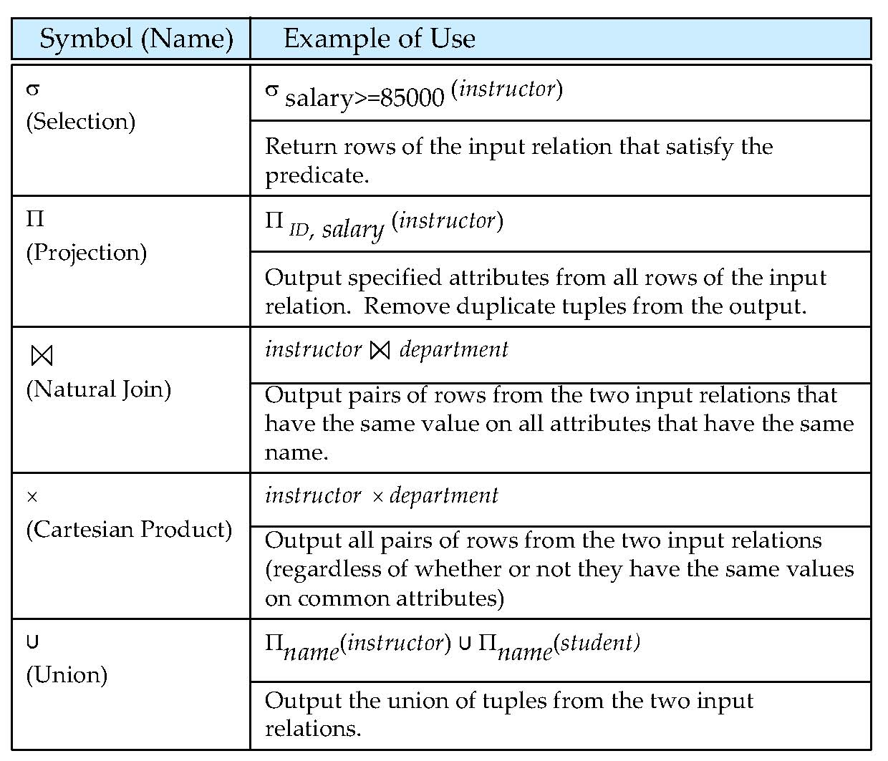
Figure in-2.1

Slide 62
End of Chapter 2 Exercise 7,12,13,15

Slide 63
Figure 2.01

Slide 64
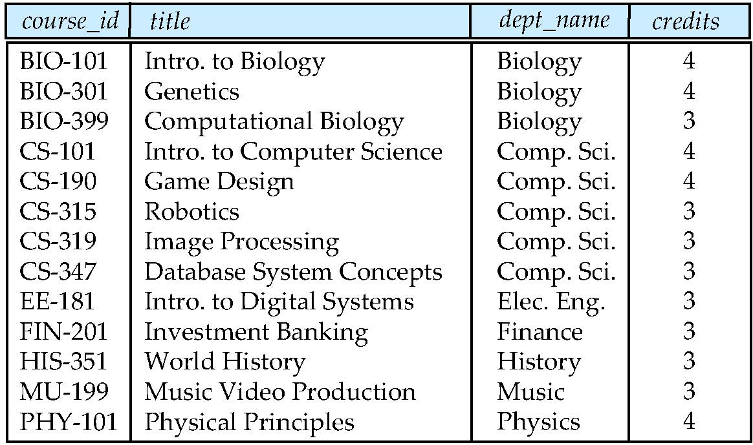
Figure 2.02

Slide 65
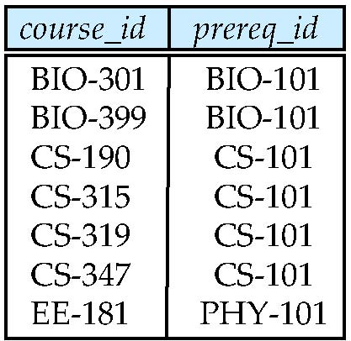
Figure 2.03

Slide 66
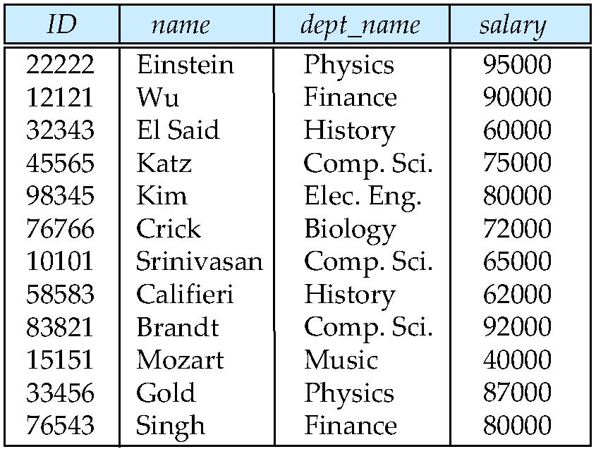
Figure 2.04

Slide 67
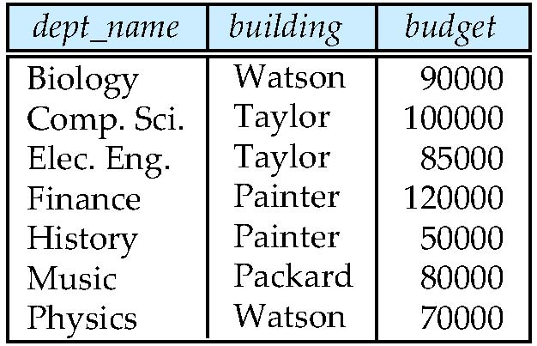
Figure 2.05

Slide 68
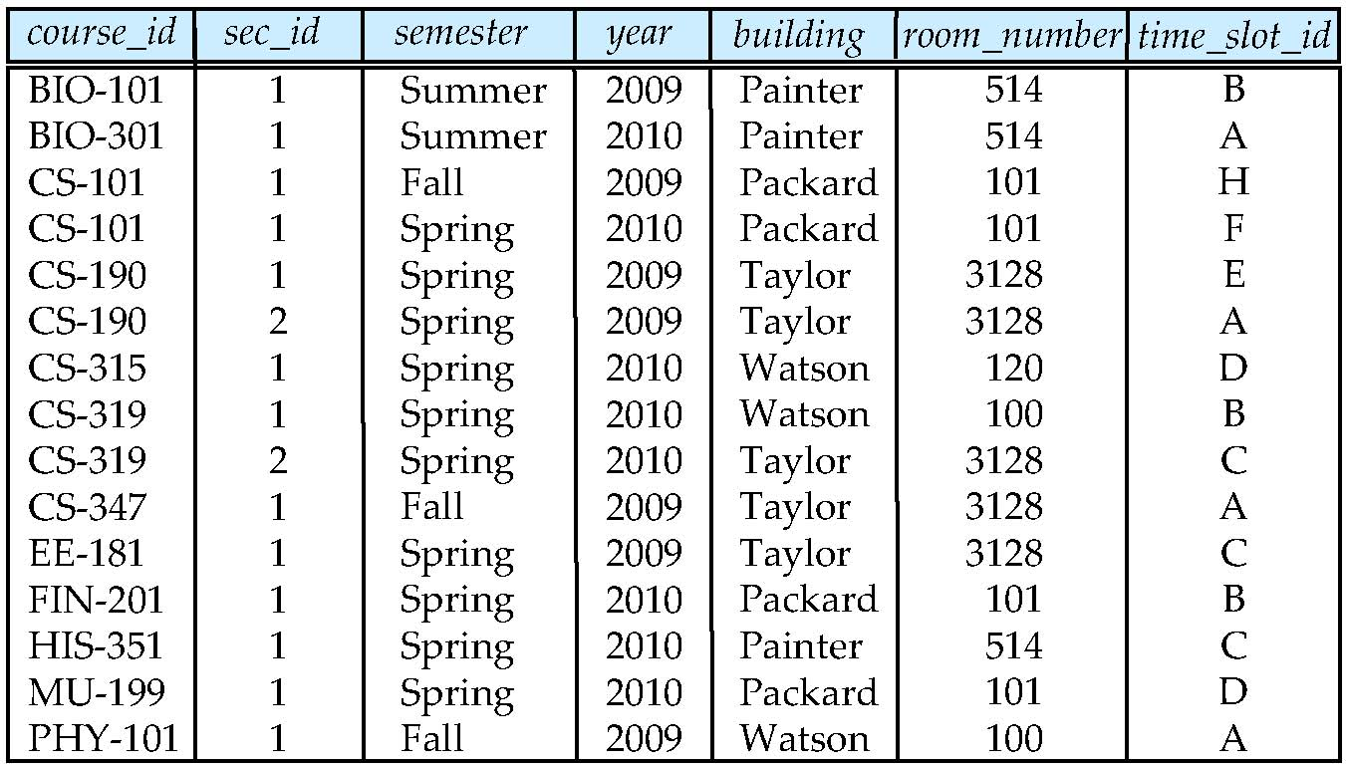
Figure 2.06

Slide 69
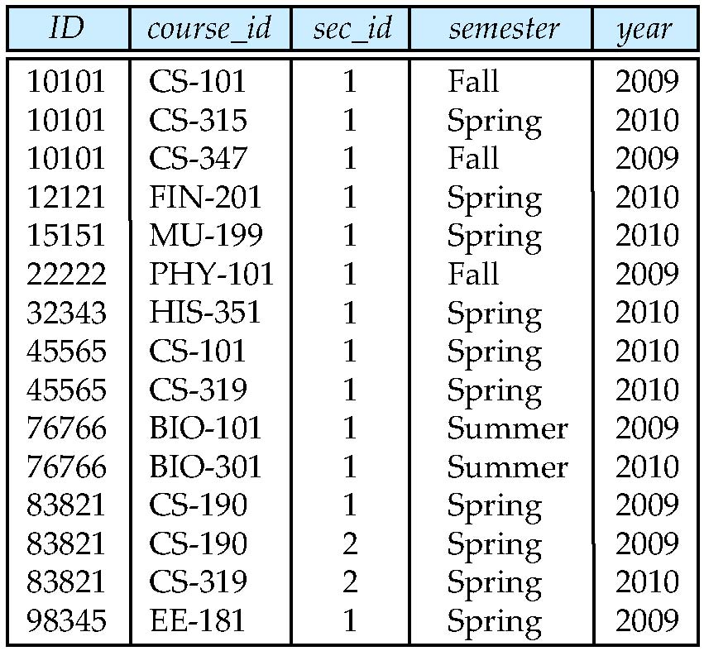
Figure 2.07

Slide 70
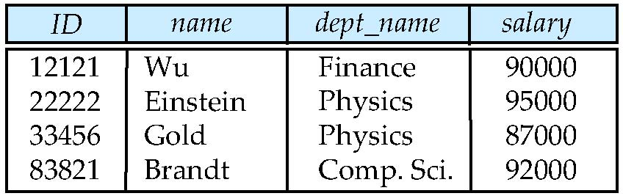
Figure 2.10

Slide 71
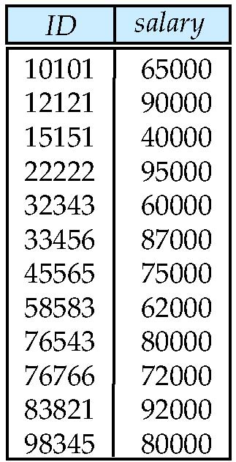
Figure 2.11

Slide 72
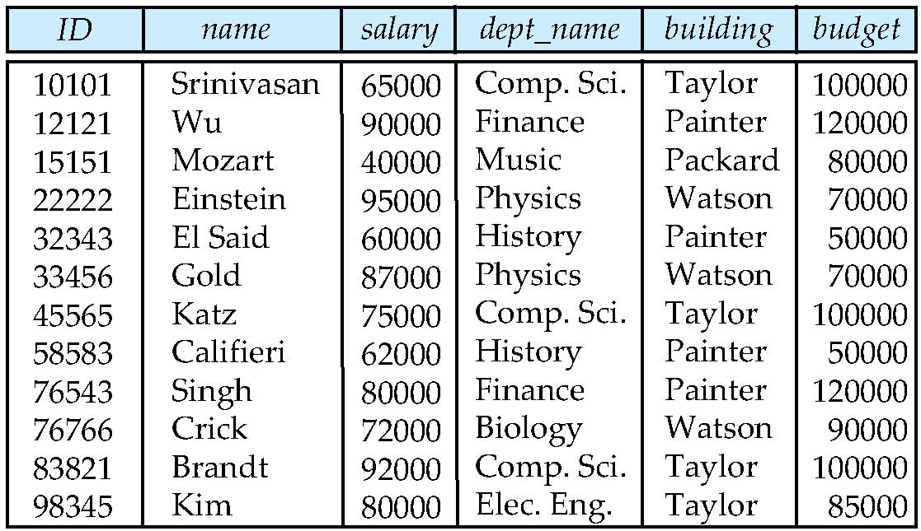
Figure 2.12

Slide 73
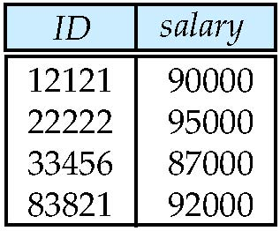
Figure 2.13

