Slide 1
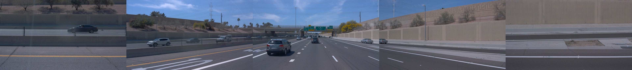


A Photorealistic Closed-Loop Simulator
for Benchmarking Autonomous Driving
Notes:
Original vector SVG logo fades in automatically for 1.5 s. The slide advances automatically after 2.2 s.

Slide 2
Notes:
Black chapter slide. 2000+ GS assets from nuScenes, Waymo, NuRec. Original logo vectors and timing are preserved.

Slide 3
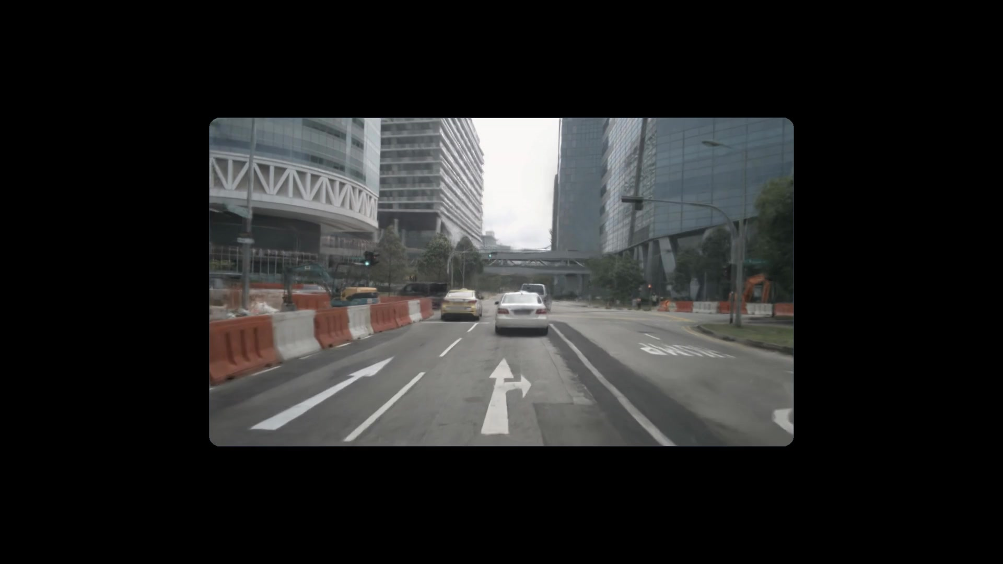
Notes:
nuScenes, Waymo, NuRec in that order. Each dataset plays one scene for 2 seconds, moves it to the upper left in 0.8 seconds, unfolds an 8 by 8 grid in 0.9 seconds, then plays the full grid for 6 seconds and fades out in 0.267 seconds. A 0.133 second gap separates the datasets. Black margins and rounded corners. Sources start at 1 second. Waymo uses the supplied single-scene asset and 63 randomly selected scenes cropped to the middle forward camera only. The short supplied asset loops at its end. Embedded film plays automatically.

Slide 4
Policy Evaluation
Notes:
Policy Evaluation chapter. Black background. Advances automatically after 3 seconds.

Slide 5
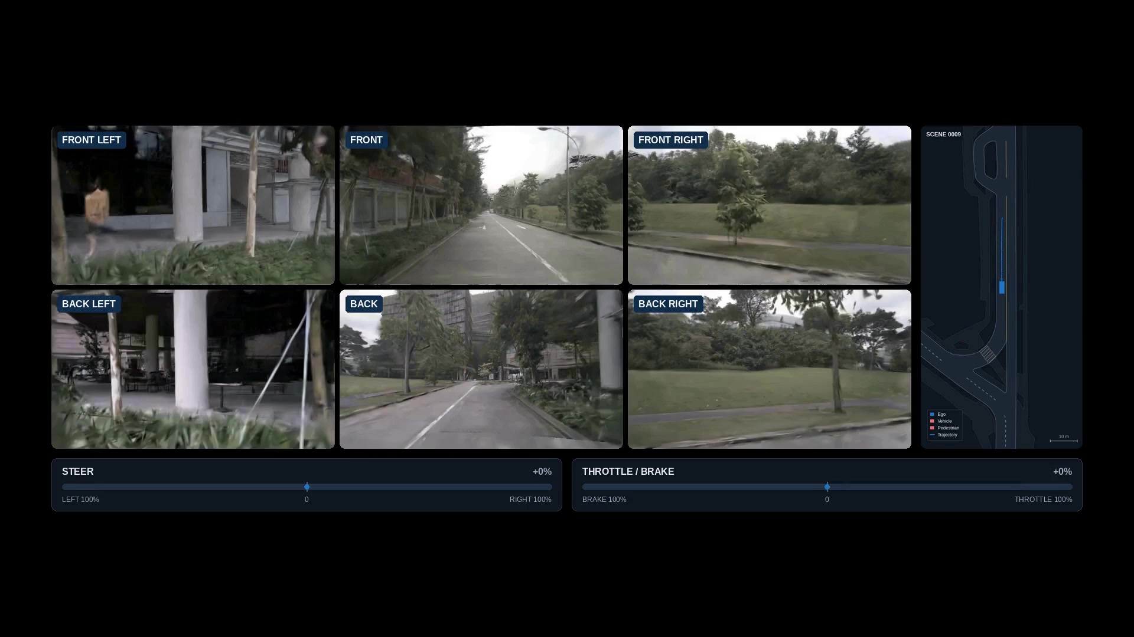
Notes:
UniAD scene 0009 eval plays for 4 seconds. FRONT continues playing while moving to the upper left for 0.7 seconds, with its camera label removed. All 12 policies then start together from source zero and play 7 seconds, including the 0.8 second unfold. Recordings loop at their own end. Native 0.1 second simulation footage and source recordings remain preserved. Black margins, rounded corners and policy captions. Embedded film plays automatically.

Slide 6
Play with Web Controller
Notes:
Play with Web Controller chapter. Black background. Advances automatically after 3 seconds.

Slide 7
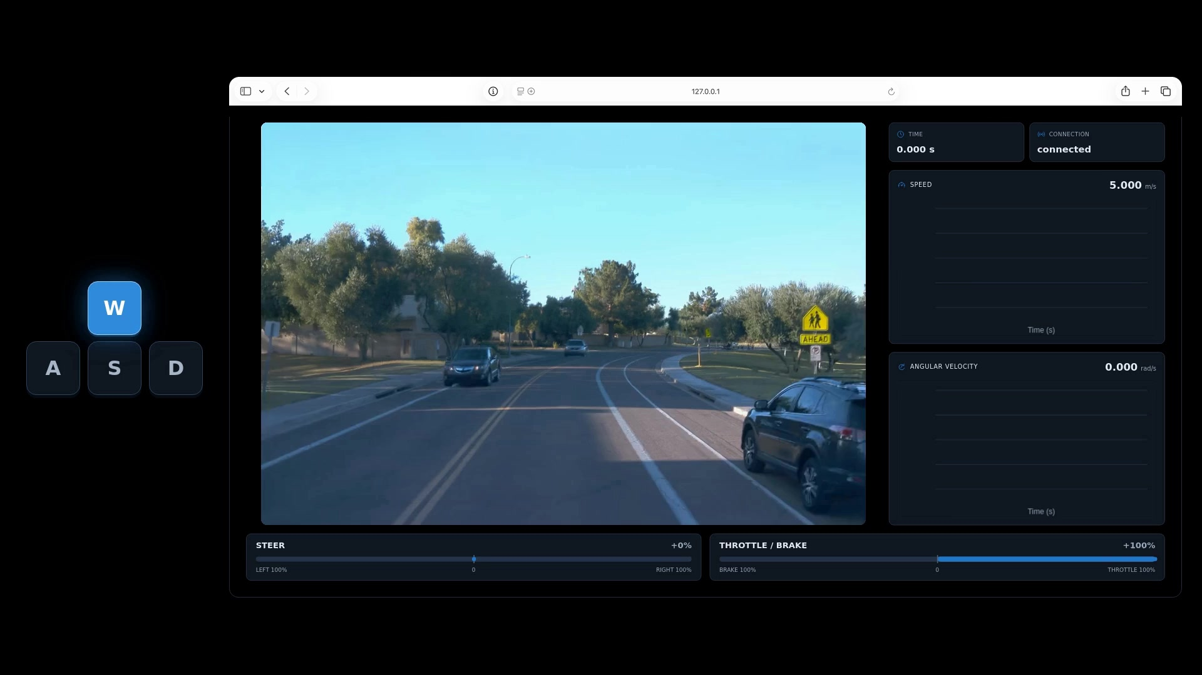
Notes:
Web Controller demonstration from the supplied controller.mp4. The Safari browser frame, WASD key sequence, blue control bars and charts are preserved. Speed and yaw rate are illustrative bicycle-model calculations from the keyboard sequence, not measured footage telemetry. Source footage and edit parameters are preserved in assets/promo/sources/web-controller/. Embedded film plays automatically, muted. The last frame remains visible at the end.

Slide 8
Reactive Traffic

Slide 9
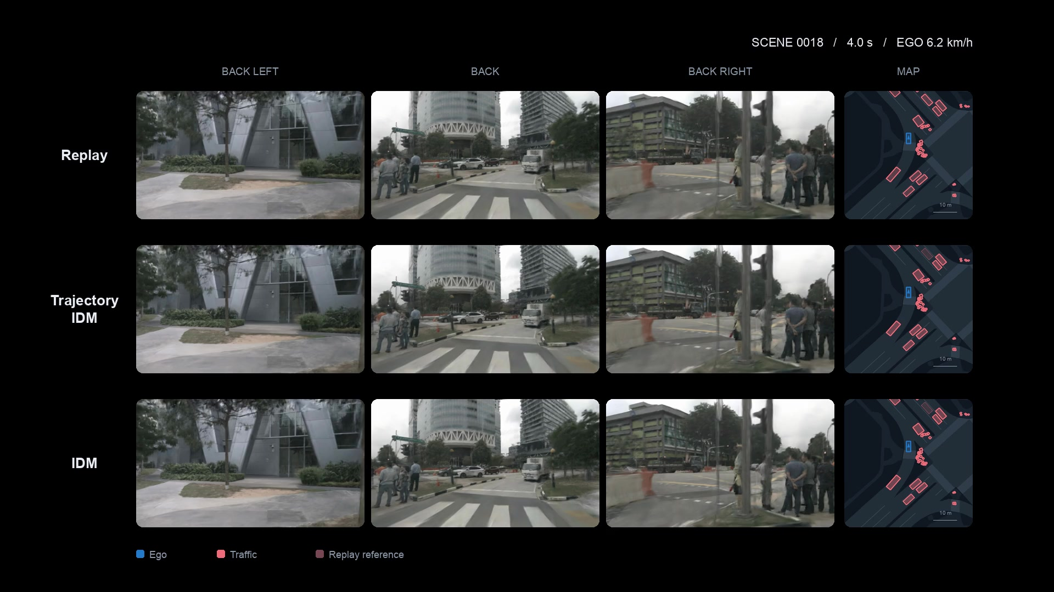

Slide 10
Extensible Renderer Interface

Slide 11
Multi Modal Rendering

Slide 12
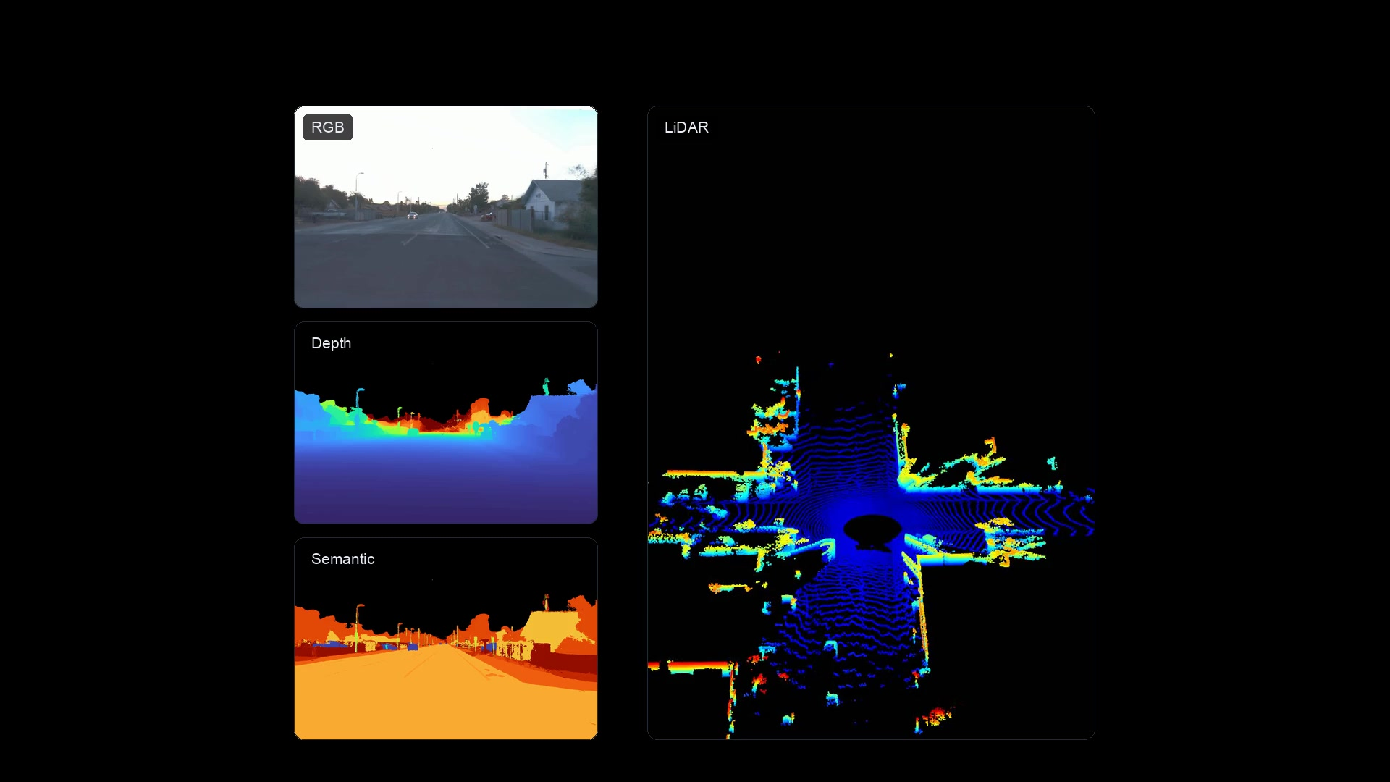
Multi Modal Rendering

Slide 13
Object Editing

Slide 14
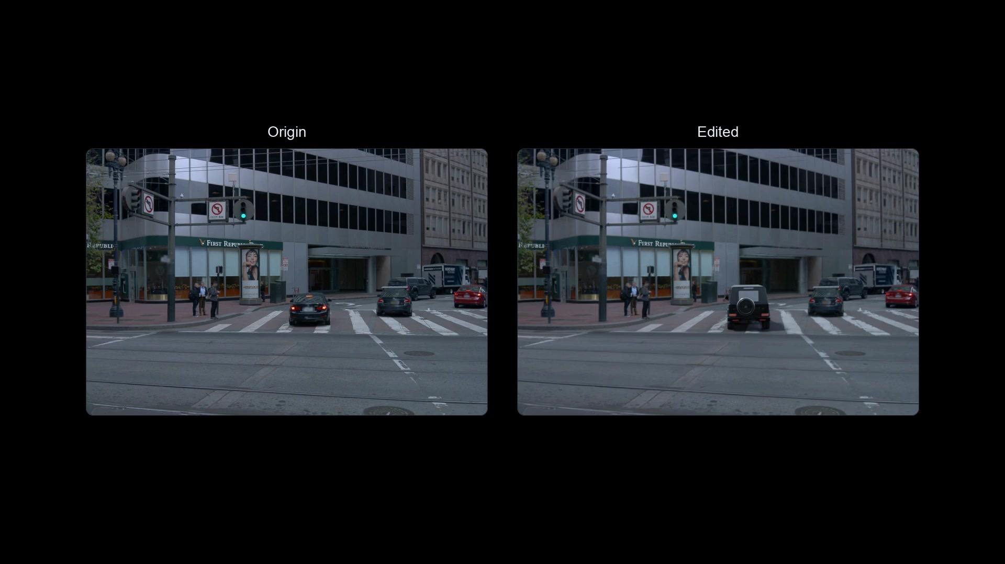
Object Editing

Slide 15
Renderer Variants

Slide 16
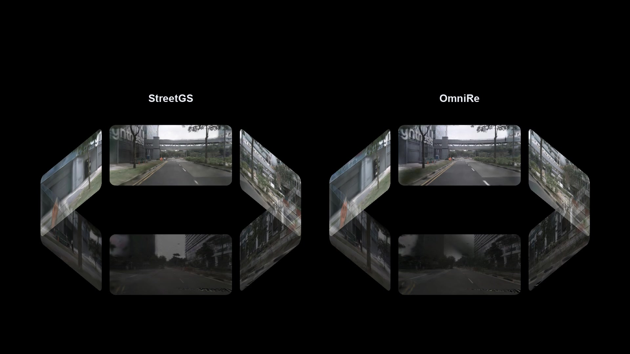
Renderer Variants

Slide 17
Thank You

