Slide 1
课程学习

Slide 2
课程说明
课程
课程共有5门课：数据结构、计算机系统（ICS）、计算机体系结构、操作系统、编译原理。
学习资料
每门课程包含课程主页、网课视频、Lab、参考书籍。参考书籍以英文书刊为主。
可根据自身实际情况灵活学习。

Slide 3
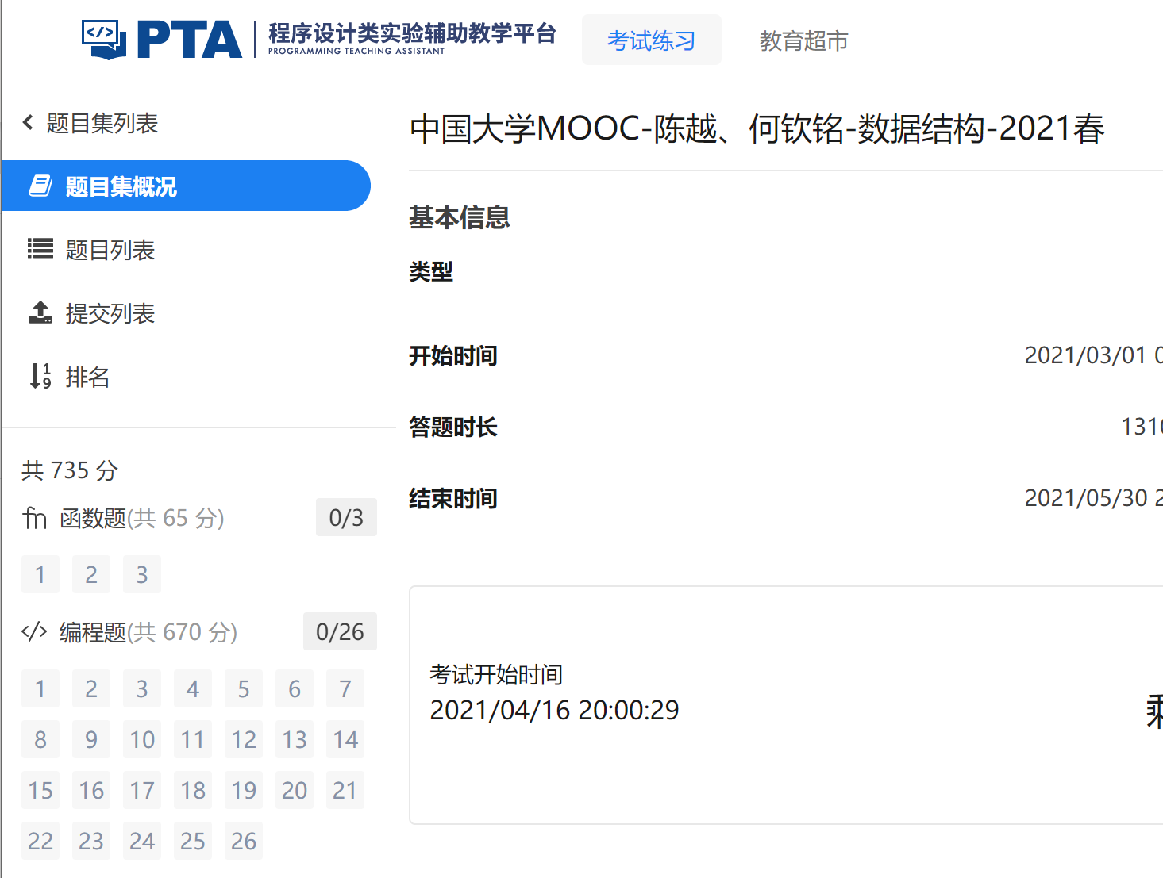
数据结构
课程 | 1）MOOC浙江大学《数据结构》课程 https://www.icourse163.org/course/ZJU-93001?from=searchPage | 偏重数据结构理论基础，同时注重使用C语言实现。目前更新至第九讲： 第一讲 基本概念 第二讲 线性结构 第三讲 树（上） 第四讲 树（中） 第五讲 树（下） 第六讲 图（上） 第七讲 图（中） 第八讲 图（下） 第九讲 排序（上）
LAB | 2）PTA平台Lab习题：《中国大学MOOC-陈越、何钦铭-数据结构-2021春》 | 与MOOC网课内容同步，目前已更新29个Lab练习，标题如下： 复杂度1 最大子列和问题 复杂度2 Maximum Subsequence Sum 线性结构1 两个有序链表序列的合并 线性结构2 一元多项式的乘法与加法运算 线性结构3 Reversing Linked List 线性结构4 Pop Sequence 树1 树的同构 树2 List Leaves 树3 Tree Traversals Again 树4 是否同一棵二叉搜索树 树5 Root of AVL Tree 树6 Complete Binary Search Tree 树7 堆中的路径 树8 File Transfer 树9 Huffman Codes 复杂度3 二分查找 二叉搜索树的操作集 图1 列出连通集 图2 Saving James Bond - Easy Version 图3 六度空间 图4 哈利·波特的考试 图5 Saving James Bond - Hard Version 图6 旅游规划 图7 公路村村通 图8 How Long Does It Take 图9 关键活动 排序1 排序 排序2 Insert or Merge 排序3 Insertion or Heap Sort

Slide 4
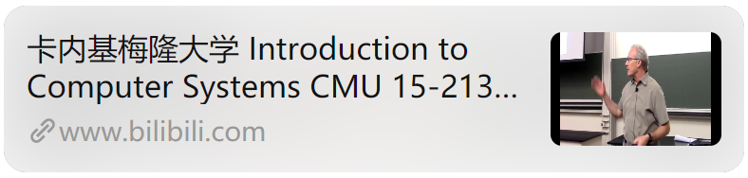
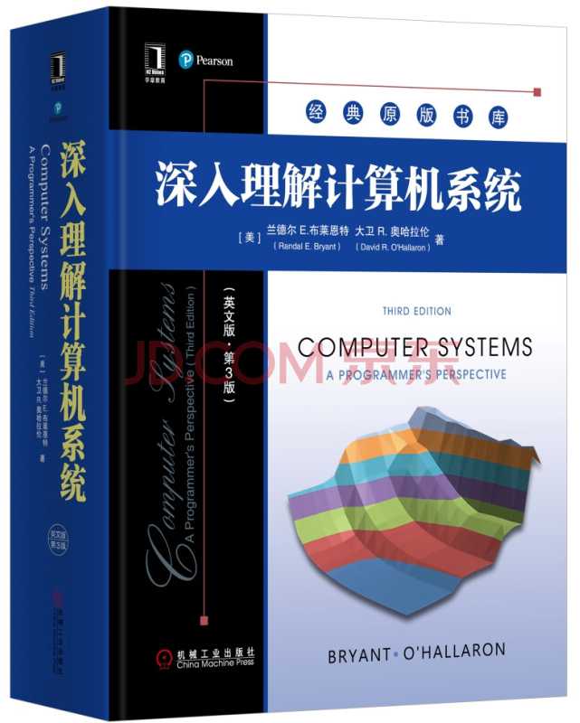
计算机系统
课程 | 1）CMU 15-213: Introduction to Computer Systems | 课程共分为27次课堂视频，每节课约1小时，涵盖下列主题： Course Overview Bits, Bytes, and Integer Bits, Bytes, and Integer (Cont'd) Floating Point Machine Level Program 1 - Basics Machine Level Program 2 - Control Machine Level Program 3 - Procedures Machine Level Program 4 - Data Machine Level Program 5 - Advanced Topics Program Optimization The Memory Hierarchy Cache Memories Linking Exceptional Control Flow: Exceptions and Processes Exceptional Control Flow: Signals and Nonlocal Jumps System Level I/O Virtual Memory Concepts Virtual Memory Systems Dynamic Memory Allocation - Basic Concepts Dynamic Memory Allocation - Advanced Concepts Network Programming - Part 1 Network Programming - Part 2 Concurrent Programming Synchronization - Basics Synchronization - Advanced Thread Level Parallelism Future of Computing
教材 |  | 教材与CMU课堂视频内容相对应，包含章节如下： 信息的表示和处理 程序的机器级表示 处理器体系结构 优化程序性能 存储器层次结构 链接 异常控制流 虚拟内存 系统级I/O 网络编程 并发编程
Notes:
给英文 英文第三版

Slide 5
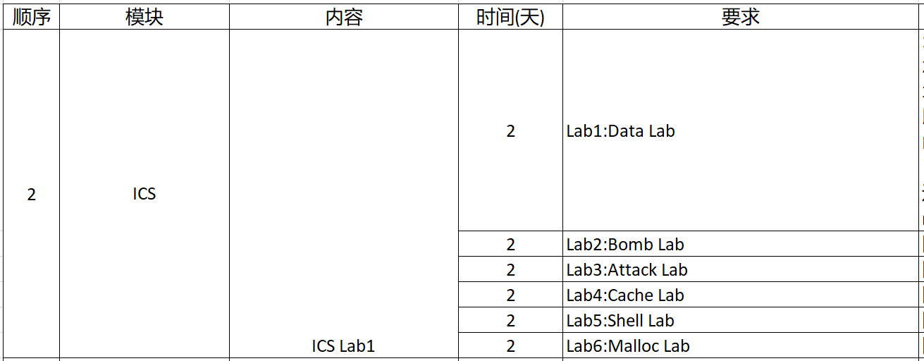
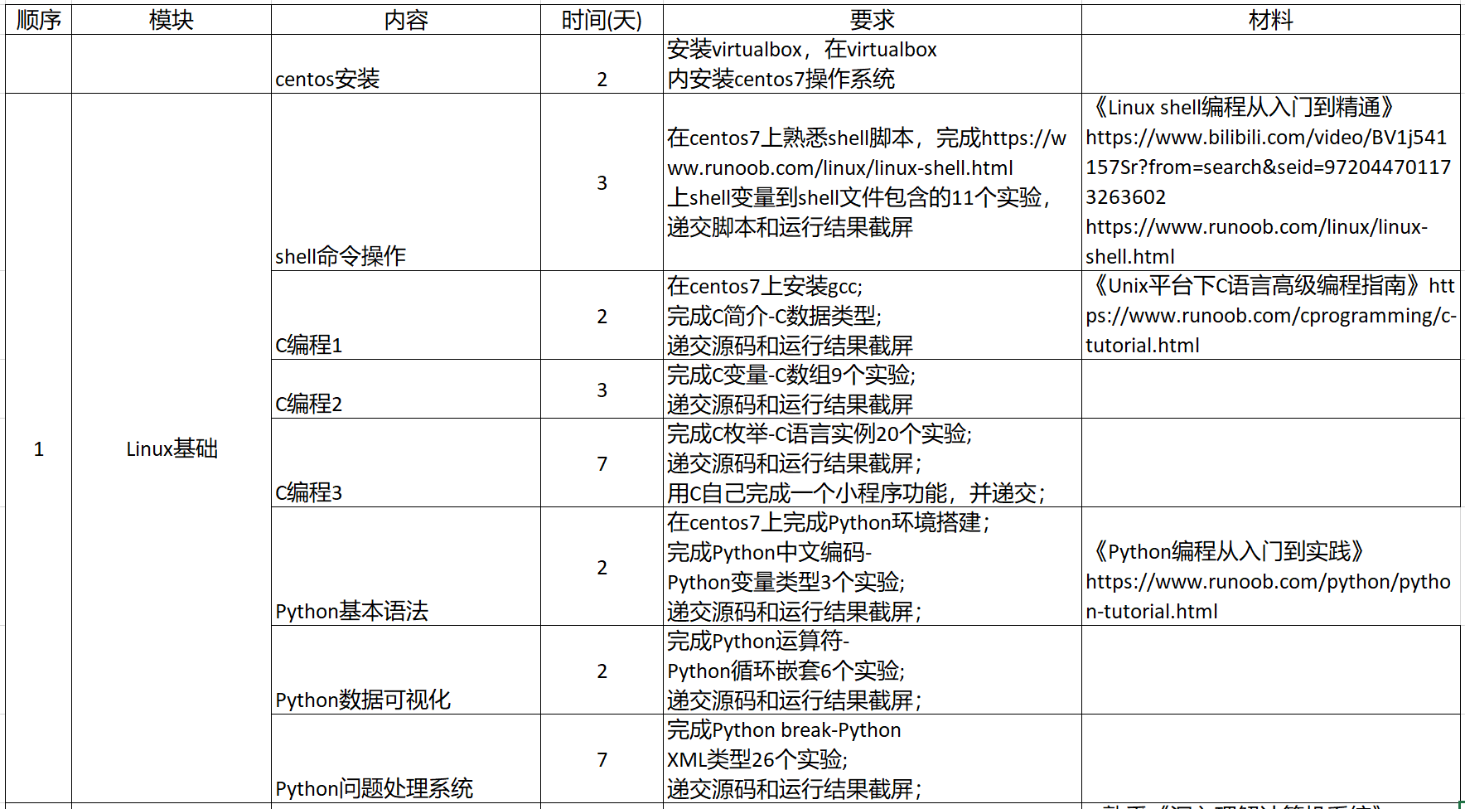
计算机系统
Lab基础训练ICS部分 | http://csapp.cs.cmu.edu/3e/labs.html
Lab基础训练Linux基础

Slide 6
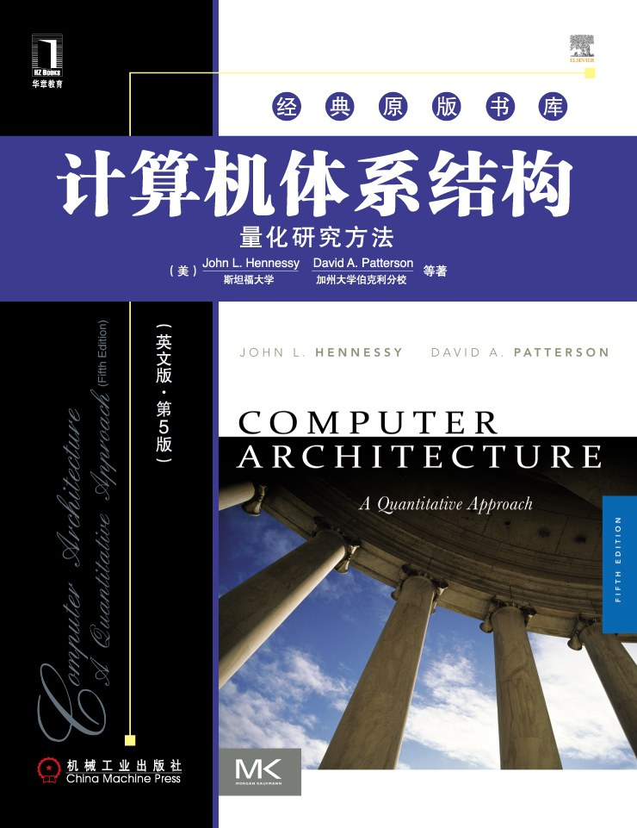

体系结构
课程 | https://course.ece.cmu.edu/~ece447/s15/doku.php https://b23.tv/XzOpFb | L1. Introduction and Basics L2. Fundamental Concepts and ISA L3. ISA Tradeoffs L4. ISA Tradeoffs (cont.) & MIPS ISA L5. Intro to Microarchitecture: Single-Cycle L6. Multi-Cycle and Microprogrammed Microarchitectures L7. Pipelining L8. Pipelining II: Data and Control Dependence Handling L9. Branch Prediction I L10. Branch Handling and Branch Prediction II L11. Precise Exceptions, State Maintenance, State Recovery L12. Out-of-Order Execution L13. Out-of-Order Execution and Data Flow L14. SIMD Processing (Vector and Array Processors L15. GPUs, VLIW, DAE L16. Static Instruction Scheduling L17. Memory Hierarchy and Caches L18. Caches, Caches, Caches L19. High Performance Caches L20. Virtual Memory L21. Main Memory L22. Memory Controller L23. Memory Management L24. Simulation and Memory Latency Tolerance L25. Prefetching L26. More Prefetching and Emerging Memory Technologies L27. Multiprocessors L28. Memory Consistency and Cache Coherence L29. Cache Coherence L30. In-Memory Processing L31. Predictable Performance L32. Heterogeneous Systems L33. Interconnection Networks
LAB | https://course.ece.cmu.edu/~ece447/s15/doku.php?id=labs | Lab 1: Instruction Level MIPS Simulator Lab 1.5: SystemVerilog Warm-Up Lab 2: Single-Cycle MIPS Lab 3: Pipelined MIPS Lab 4: Branch Prediction Lab 5: Data Cache Lab 6: Simulating Caches and Branch Prediction Lab 7: Memory Hierarchy Lab 8: Multicore and Cache Coherence
书籍

Slide 7
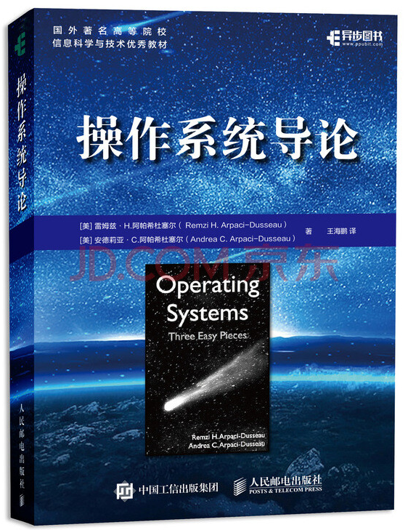
操作系统
课程与视频 | https://pdos.csail.mit.edu/6.828/2018/schedule.html
LAB | 同上 | Lab 1: C, Assembly, Tools, and Bootstrapping Lab 2: Memory management Lab 3: User-Level Environments Lab 4: Preemptive Multitasking Lab 5: File system, spawn, and sh Lab 6: Networking
书籍
Monday | Tuesday | Wednesday | Thursday | Friday
sep 3 | sep 4 Reg Day | sep 5 LEC 1 (fk): Operating systems (handouts: xv6 source, xv6 book) Preparation: Unix intro Assignment: Lab 1: C, Assembly, Tools, and Bootstrapping | sep 6 | sep 7
sep 10 LEC 2 (ab): PC hardware and x86 programming slides, notes Preparation: Read Bootstrap/PC hardware appendices and the related xv6 source files Assignment: HW: Boot xv6 | sep 11 | sep 12 LEC 3 (TAs): C and gdb (pointers example) Homework 1 due: Boot xv6 Preparation: Read 2.9 (Bitwise operators), 5.1 (Pointers and Addresses) through 5.5(Character Pointers and Functions) and 6.4 (pointers to structures) in K&R Assignment: HW: shell Assignment: Lab 2: Memory management | sep 13 DUE: Lab 1 | sep 14
sep 17 LEC 4 (fk): Shell & OS organization Preparation: Read chapter 0 of the xv6 book. Homework 2 due: shell | sep 18 | sep 19 LEC 5 (fk): Isolation mechanisms Preparation: Read "Chapter 1: Operating system organization" and the related xv6 source files Assignment: HW: system calls | sep 20 | sep 21
sep 24 LEC 6 (ab): Virtual memory (1) (handouts: page table translation and registers) (slides) Preparation: Read "Chapter 2: Page Tables" Homework 3 due: system calls Assignment: HW lazy page allocation | sep 25 | sep 26 LEC 7 (ab): Virtual memory (2) (handout: JOS virtual memory layout) (slides) Homework 4 due: HW lazy page allocation Assignment: HW xv6 CPU alarm Assignment: Lab 3: User-Level Environments | sep 27 DUE: Lab 2 | sep 28
oct 1 LEC 8 (fk): System calls, interrupts, exceptions (handouts: IDT) Preparation: Read "Traps, interrupts, and drivers" and the related xv6 source files Homework 5 due: HW xv6 CPU alarm Assignment: HW multithreaded programming | oct 2 | oct 3 LEC 9 (ab): Multiprocessors and locking (slides) Preparation: Read "Locking" with spinlock.c and skim mp.c Homework 6 due: HW multithreaded programming Assignment: HW xv6 locks | oct 4 DUE: Lab 3 (Part A) | oct 5 ADD DATE
oct 8 - oct 9 Columbus Day |  | oct 10 Hacking day Assignment: Lab 4: Preemptive Multitasking | oct 11 DUE: Lab 3 (Part B) | oct 12
oct 15 LEC 10 (ab): Processes and switching Preparation: Read "Scheduling" up to "Sleep and wakeup" and proc.c, swtch.S Homework 7 due: HW xv6 locks Assignment: HW uthreads | oct 16 | oct 17 LEC 11 (fk): sleep&wakeup Preparation: Read remainder of "Scheduling", and corresponding parts of proc.c Homework 8 due: HW uthreads Assignment: HW barrier | oct 18 DUE: Lab 4 (Part A) | oct 19
oct 22 LEC 12 (fk): File systems Preparation: Read bio.c, fs.c, sysfile.c, file.c and "File system" except for the logging sections Homework 9 due: HW barrier Assignment: HW big files | oct 23 | oct 24 LEC 13 (fk): Crash recovery Preparation: Read log.c and the logging sections of "File system" Homework 10 due: HW big files Assignment: HW crash Assignment: Lab 6: Networking Assignment: Lab 7: Final project | oct 25 DUE: Lab 4 (Part B) | oct 26
oct 29 Quiz #1 open book and notes scope: Lectures 1 through 13, HW 1 through 10, labs 1 through 3 practice: previous years' quizzes. | oct 30 | oct 31 Hacking day Assignment: Lab 5: File system, spawn, and sh | nov 1 DUE: Lab 4 (Part C) | nov 2 DUE: Piazza discussion final project
nov 5 LEC 14 (fk): File system performance and fast crash recovery Homework 11 due: HW crash Preparation: Read Journaling the Linux ext2fs Filesystem (1998) Assignment: mmap() | nov 6 | nov 7 LEC 15 (ab): Virtual Memory (3) (slides) Preparation: Read Virtual Memory Primitives for User Programs (1991) Homework 12 due: mmap | nov 8 DUE: Final project proposal (if doing project) | nov 9
nov 12 Veteran's Day | nov 13 | nov 14 LEC 16 (fk): OS Organization Preparation: Read Exokernel (1995) Homework 13 due: HW exokernel question | nov 15 DUE: Lab 5 | nov 16
nov 19 LEC 17 (cc): Kernels and HLL Preparation: Read the Biscuit paper (2018) Homework 14 due: HW Biscuit question | nov 20 | nov 21 DROP DATE LEC 18 (ab): Scalable locks (slides) (code) Preparation: Read Non-scalable locks paper (2012) Homework 15 due: ticket lock question | nov 22 - nov 23 Thanksgiving
nov 26 LEC 19 (ab): Scaling OSes slides Preparation: Read RCU (2013) Homework 16 due: RCU question DUE: Email us a status update on your final project (a paragraph) | nov 27 | nov 28 LEC 20 (ab): Virtual Machines (1) (slides) Preparation: Read Software vs Hardware Virtualization (2006) Homework 17 due: VM question | nov 29 | nov 30
dec 3 LEC 21 (ab): Virtual Machines (2) (slides) Preparation: Read Dune: Safe User-level Access to Privileged CPU Features (2012) Homework 18 due: Dune question | dec 4 | dec 5 Hacking day | dec 6 DUE: Lab 6 (networking) or lab 7 (Final project) | dec 7
dec 10 LEC 22 (fk): High-performance networking Preparation: Read IX: A Protected Dataplane Operating System for High Throughput and Low Latency (2014) Homework 19 due: IX question | dec 11 | dec 12 LAST DAY OF CLASSES LEC 23: demos in class Project sign-offs | dec 13 | dec 14
dec 17 | dec 18 | dec 19 | dec 20 Quiz #2 DUPONT-Gym, 9am-11pm open book, notes, and papers. scope: Lectures 14 through last lecture (dec 12), labs 4 and 5. practice: previous years' quizzes. | dec 21

Slide 8
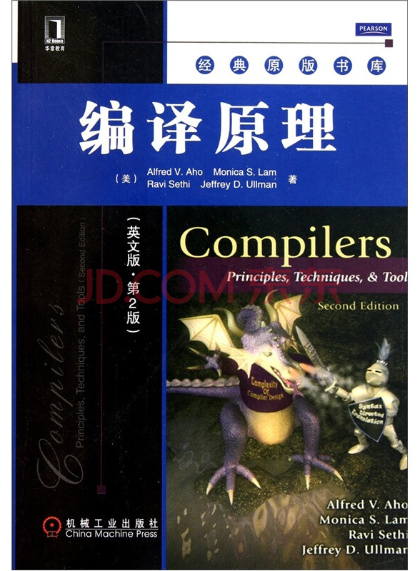
编译原理
课程与视频 | https://web.stanford.edu/class/cs143/ | Course Overview Cool: The Course Project Lexical Analysis Implementation of Lexical Analysis Introduction to Parsing Syntax-Directed Translation Top-Down Parsing & Bottom-Up Parsing I Bottom-Up Parsing II Semantic Analysis & Type Checking I Type Checking II Run-time Environments Code Generation
LAB | https://web.stanford.edu/class/cs143/ | Programming Assignment 1 Programming Assignment 2 Programming Assignment 3
书籍

