Slide 1

CA6000 / SAT STUDY / AI PROGRAMMING / CASE STUDY
Learning to Predict
Boolean Satisfiability
3,000 instances
30 features; exact SAT labels.
A QRefactorBench-Inspired
Neural Network Case Study
A real trained MLP
PyTorch weights and history.
Generate → inspect → clean → train → evaluate
An auditable workflow for CA6000
Reproducible code
Name / Student ID / Partner: complete before submission
No API key or QPU required.
CA6000 | Boolean Satisfiability Prediction | Coursework
01 / 08

Slide 2
CA6000 / SAT STUDY / AI PROGRAMMING / DATA SOURCE
From a research case to a dataset
Existing classical program
Independent input instances
pilot-001: enumerate assignments
and return whether all clauses
can be satisfied.
Labels come from exhaustive
evaluation of the original code.
4–5 variables; 2-CNF, 3-CNF
and mixed formulas.
Random clauses, no planted labels.
3,000 accepted canonical groups;
1,677 UNSAT / 1,323 SAT.
Remove duplicates under literal/clause order and all variable renamings.
Save the generator seed, source hash, formulas and labels.
Coursework data are separate from DRAFT benchmark cases and quantum-suitability labels.
CA6000 | Boolean Satisfiability Prediction | Coursework
02 / 08

Slide 3
CA6000 / SAT STUDY / AI PROGRAMMING / CLEANING
Make data quality visible and reproducible
Issue in training copy
Detected
Pandas repair
Missing feature cells
8
Training-median imputation
Text / infinity / negative counts
3 / 1 / 2
to_numeric + replace + mask
Duplicates / invalid label
4 / 1 rows
drop_duplicates + label filter
Impossible literal total
1: 100,000,000
Domain check → NaN → impute
Errors are intentionally injected only into the training copy.
1,799 clean rows; 15 imputed cells. Raw, validation and test records stay intact.
CA6000 | Boolean Satisfiability Prediction | Coursework
03 / 08

Slide 4
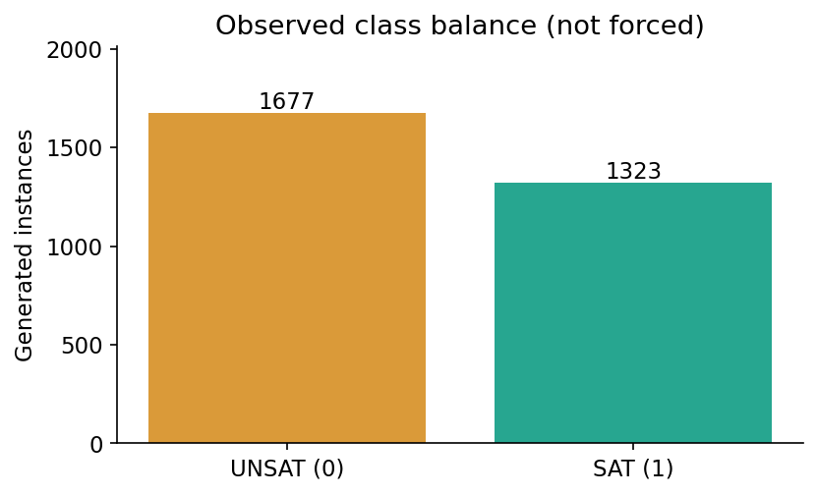
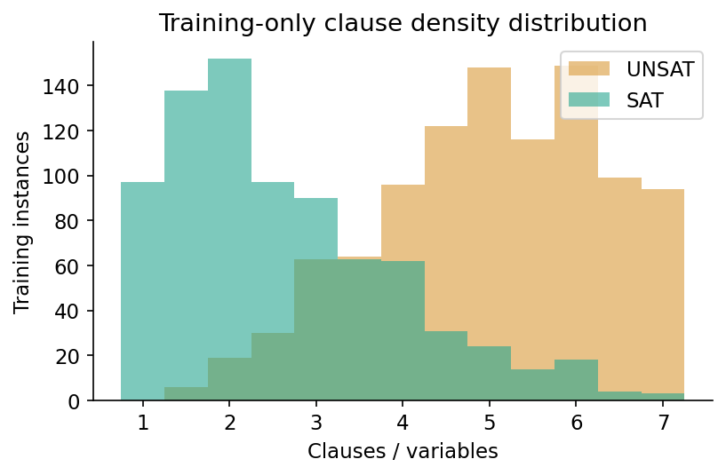
CA6000 / SAT STUDY / AI PROGRAMMING / DATA ANALYSIS
Explore class balance and formula structure
Cleaned training statistics (all 30 features are available in CSV)
n_clauses mean=17.718 median=18.000 variance=70.820
clause_variable_ratio mean=3.902 median=4.000 variance=3.089
total_literals mean=45.540 median=42.000 variance=555.293
CA6000 | Boolean Satisfiability Prediction | Coursework
04 / 08

Slide 5
CA6000 / SAT STUDY / AI PROGRAMMING / MODEL & PROTOCOL
Learn from training data; reserve the test set
Train: 1,799
Validation: 600
Test: 601
Fit medians, means and scales.
Learn network parameters.
Select the checkpoint using
validation BCE loss only.
Evaluate after both models
and threshold are fixed.
MLP: 30 → 64 ReLU → 32 ReLU → 1 logit
4,097 parameters · BCEWithLogitsLoss · Adam · sigmoid threshold = 0.5
Compare with majority class and a separately trained linear classifier.
Features use formula statistics only — no solver output, labels or runtime.
Canonical groups are disjoint; ID and formula hash are never model inputs.
CA6000 | Boolean Satisfiability Prediction | Coursework
05 / 08

Slide 6
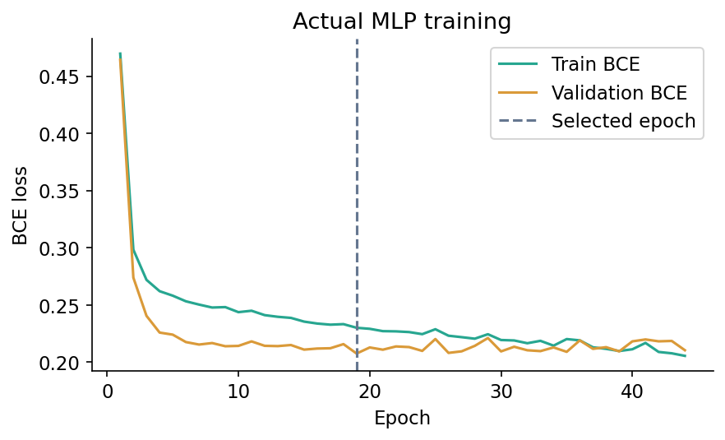
CA6000 / SAT STUDY / AI PROGRAMMING / TRAINING
The network was actually trained locally
Fixed configuration
Adam lr = 0.001
Batch size = 64
Weight decay = 0.0001
Recorded run
Seed = 42; CPU
44 epochs executed
Best checkpoint: epoch 19
Early-stop patience = 25
Save weights, per-epoch losses, preprocessing and split group IDs.
CA6000 | Boolean Satisfiability Prediction | Coursework
06 / 08

Slide 7
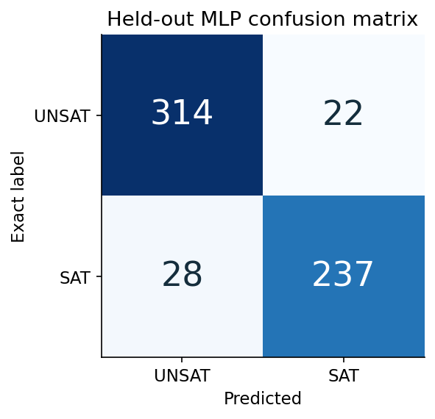
CA6000 / SAT STUDY / AI PROGRAMMING / EVALUATION
Held-out results: useful, but still fallible
91.68%
MLP test accuracy · 551 / 601 correct
Linear baseline 90.85%
Majority baseline 55.91%
SAT precision 91.51%
SAT recall 89.43%
22 false SAT / 28 false UNSAT.
Feature-distinct subset: 91.62% (597).
One split; no significance claim.
Exact solving is still the verifier.
CA6000 | Boolean Satisfiability Prediction | Coursework
07 / 08

Slide 8
CA6000 / SAT STUDY / AI PROGRAMMING / DELIVERY & REFLECTION
What was built, and what was learned
Reproducible deliverables
AI assistance and limits
Generator + immutable dataset
Pandas cleaning + EDA
PyTorch training + saved inference
Interactive prediction / exact check
Report, English slides and tests
Codex helped draft and debug code,
tests, plots and documentation.
Small synthetic distribution; lossy
features; no solver replacement
or quantum-advantage claim.
bash scripts/run_sat_app.sh
Demo: http://127.0.0.1:8766
A trained neural prediction is checked against exact classical behavior.
CA6000 | Boolean Satisfiability Prediction | Coursework
08 / 08

