Slide 1
Latency Performance Evaluation
MACSAD & different P4_16 use cases

Slide 2
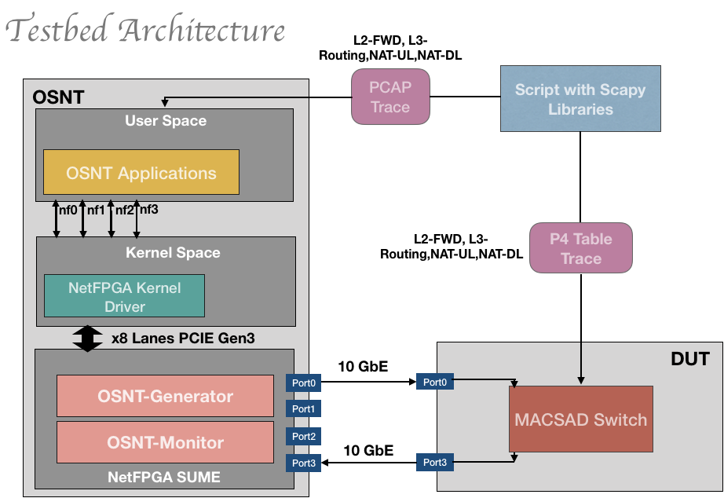
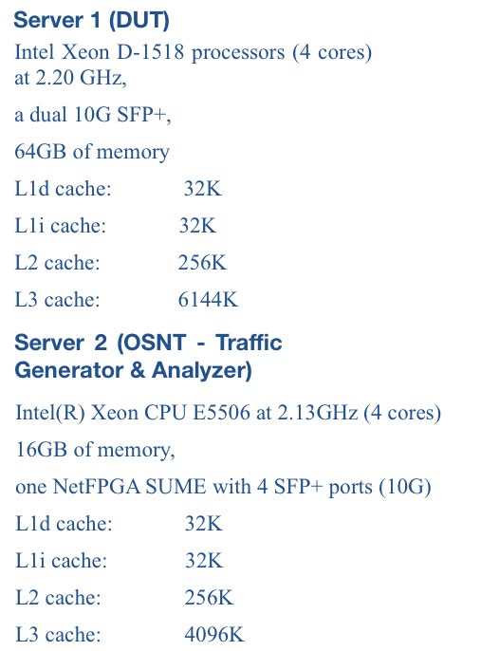
Testbed

Slide 3
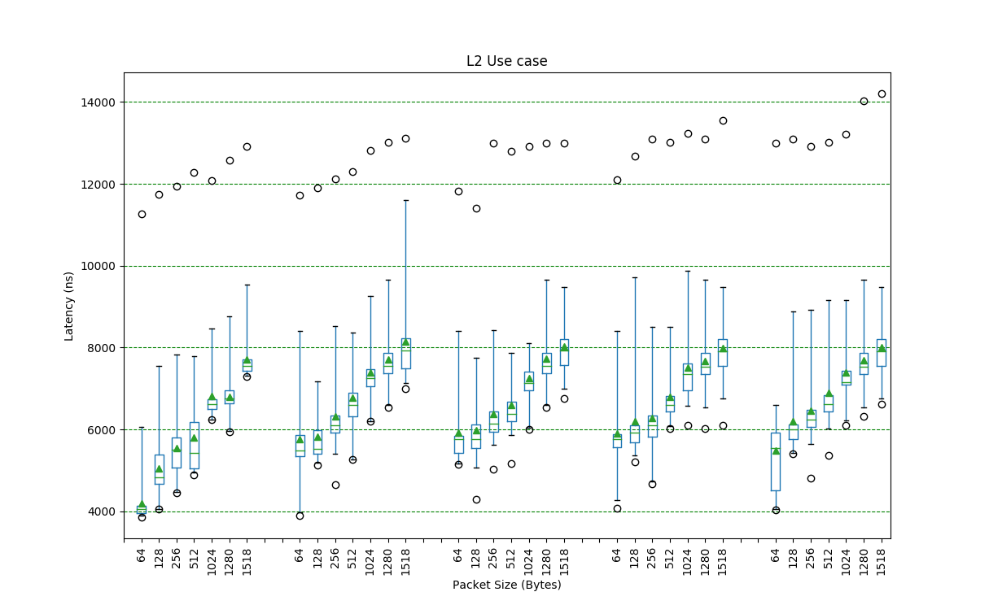
Outlier
99%
[boxplots feat. max/min, 99%-1%, 1st, 3rd Quartile, median and average]
3rd Quartile
Mean
Median
1st Quartile
1%

Slide 4
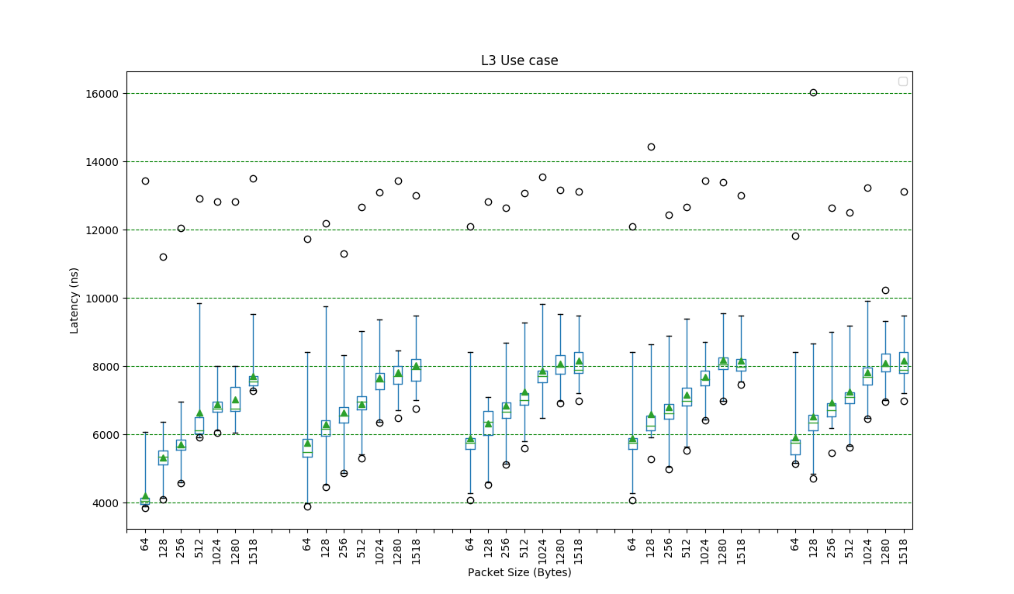

Slide 5
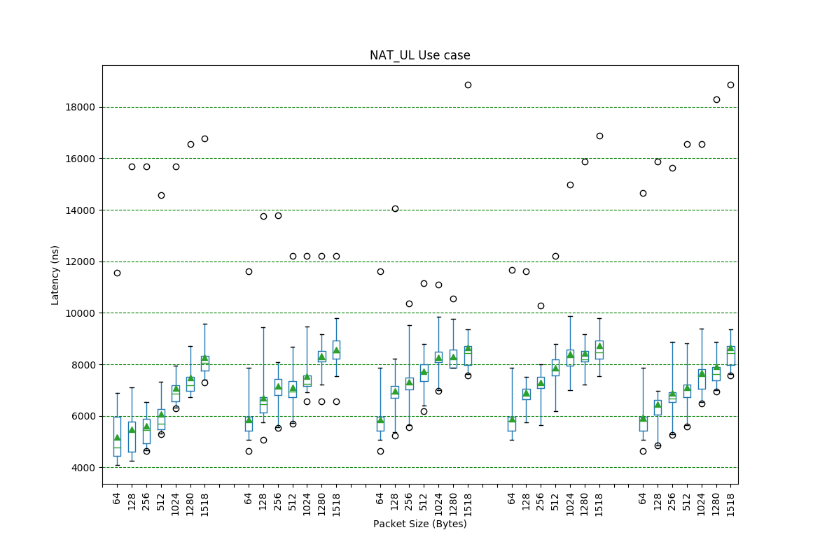

Slide 6
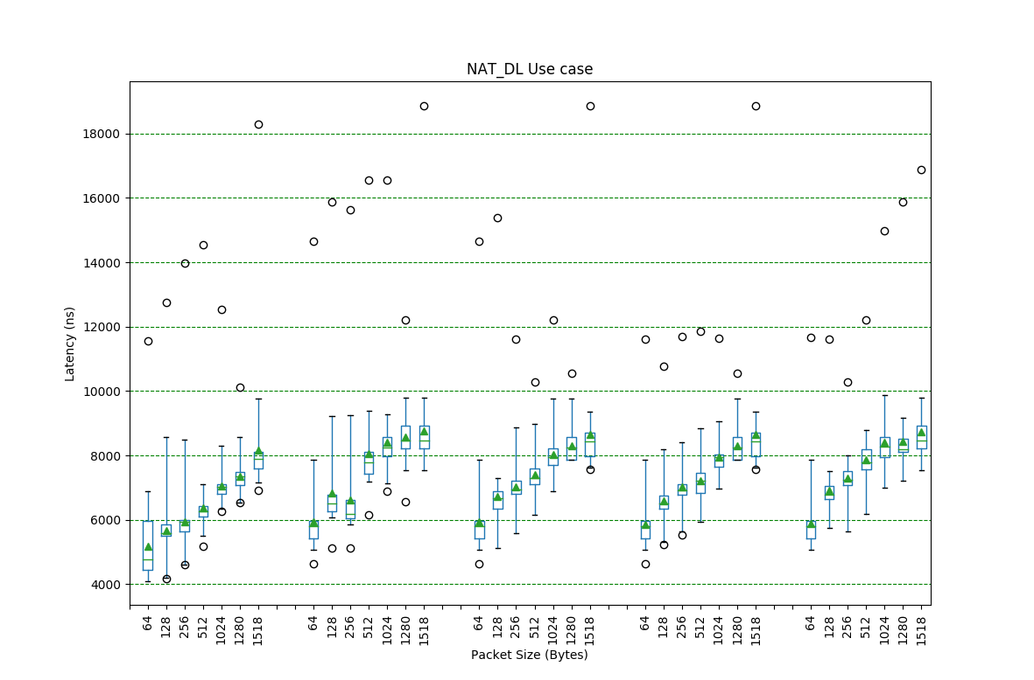

Slide 7
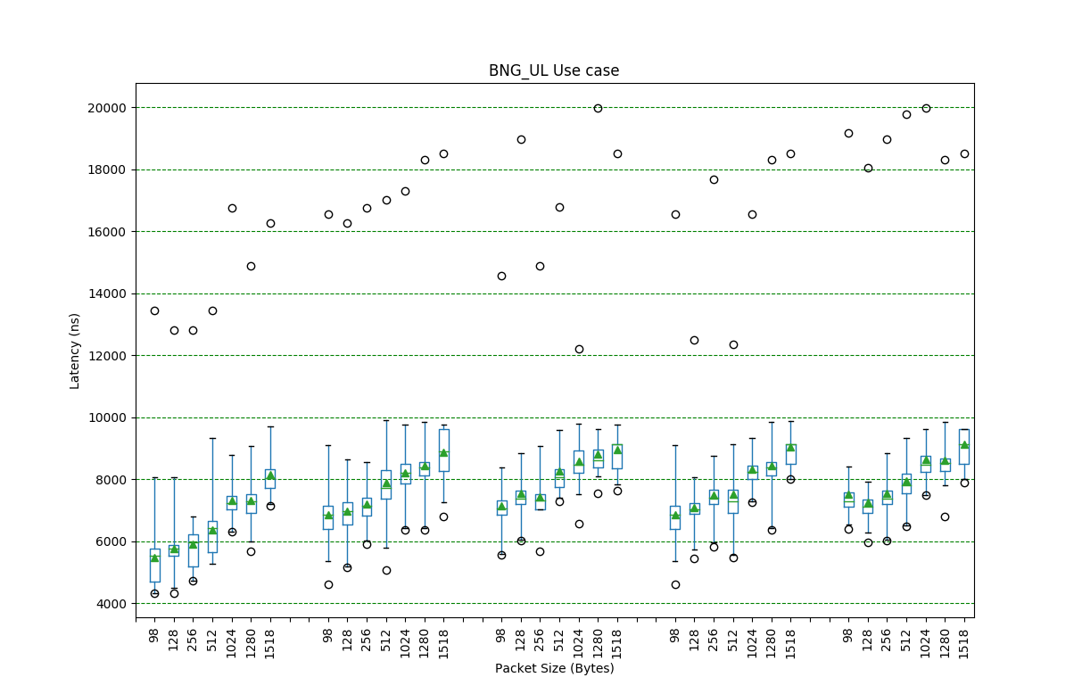

Slide 8
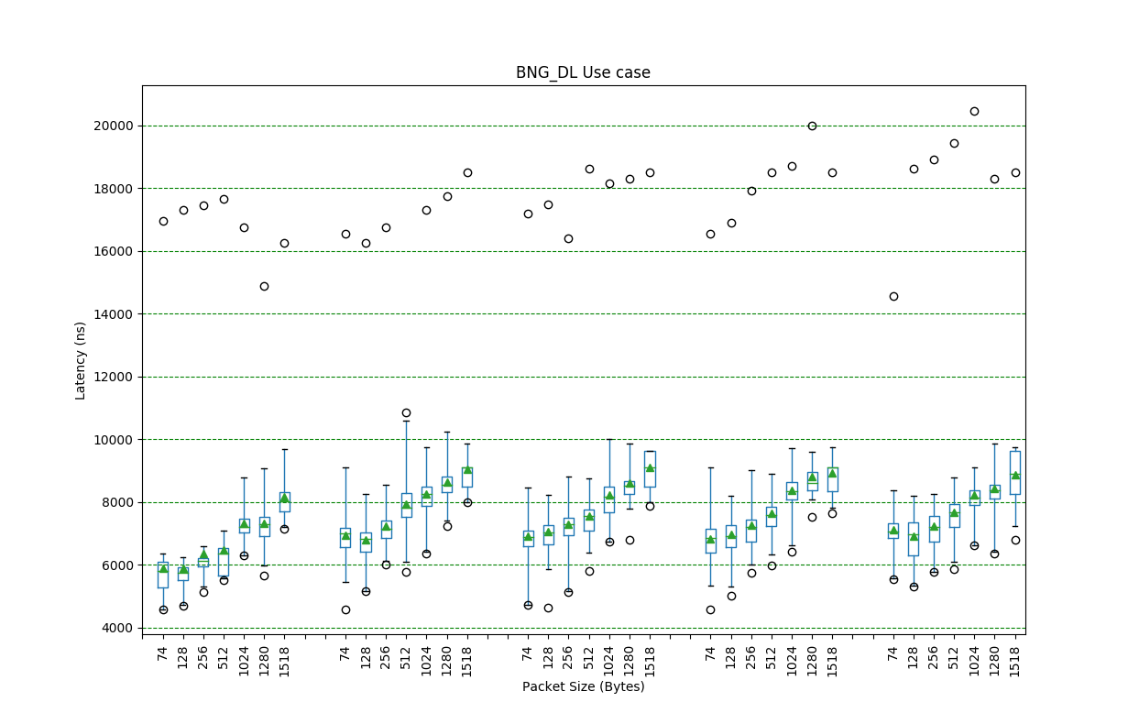

Slide 9
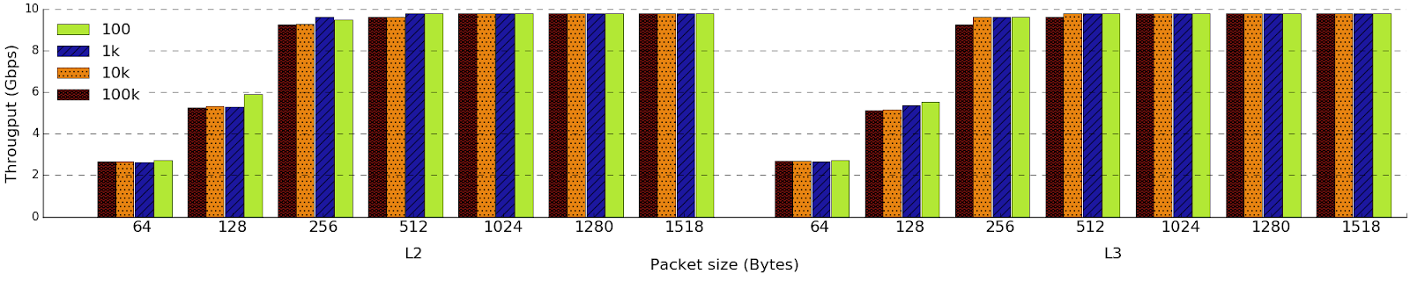
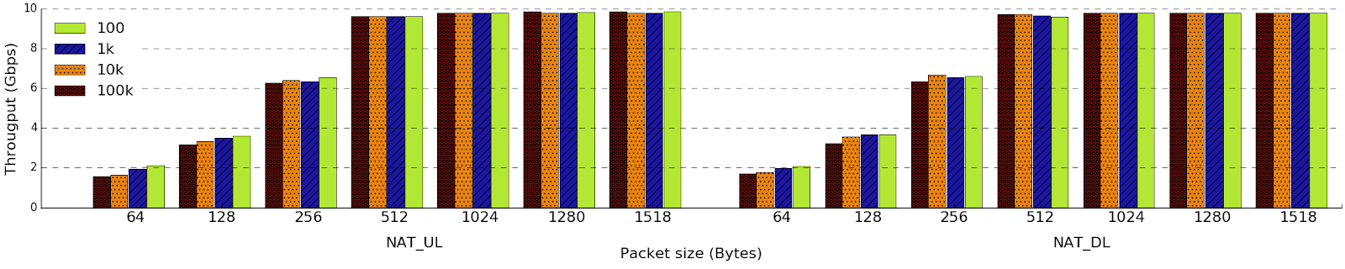
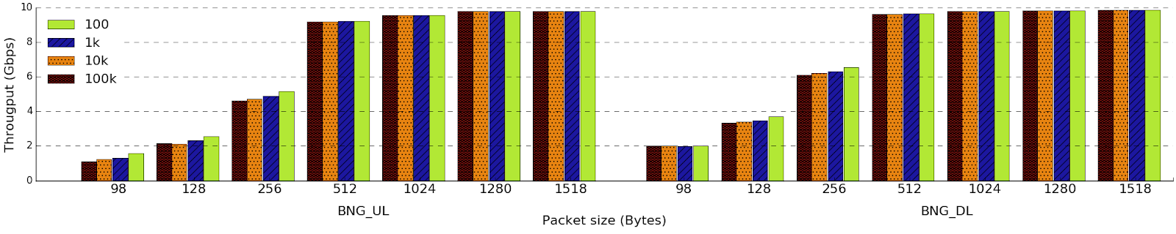
Throughput in L2 & L3
Throughput in NAT
Throughput in BNG

