Slide 1
INF-556 Lab: P4
nov/2017
Hands-on using a pre-configured VM

Slide 2
Agenda
Overview
Environment Setup
P4 Program Execution
P4 Examples
L2 Switch
Simple Router
Simple Router + ACL
P4 Dependency Graph Generator

Slide 3
Overview
This tutorial aims to
show some P4 examples,
present types of software switch (behavioral models),
integration with Mininet
use P4-graphs tool to generate P4 dependency graphs.
We provide a Virtual Machine with all previously installed packages that the software switch needs to run P4 programs.

Slide 4
Why behavioral model V2?
P4 provides two types of behavioral model (BM). BM is a software switch which runs with the P4 defined datapath.
The bmv2 embodies various new features and will be the defacto switch for P4 from now on.
Some interesting features of bmv2 are:
Second version of the P4 switch written in C++.
It is not necessary to auto-generate new code and recompile the switch every time the P4 code is modified (Static).
Debug logging feature is available.
Unit tests possible.

Slide 5
P4 Execution Process

Slide 6
How to execute a P4 program?
How to execute a simple P4 program?
Transform the P4 code into json representation:
p4c-bm2 --json <path to JSON file> <path to P4 file>
Then, execute the simple_switch target using the json file generated above:
sudo ./simple_switch -i 0@<iface0> -i 1@<iface1> <path to JSON file>
<iface0> and <iface1> are the interfaces which are bound to the switch (port0 and port1)
“ simple_switch” target is the model target to be used with every P4 program.

Slide 7
How to use P4 switch CLI ?
Using CLI to populate tables
The runtime_CLI tool connects to the Thrift RPC server through 9090 port. One CLI can only connect to one switch device.
./runtime_CLI.py --json <path to JSON file> --thrift-port 9090
The CLI is realized using the Python’s cmd module and supports auto-completion.
table_set_default <table name> <action name> <action parameters> table_add <table name> <action name> <match fields> => <action parameters> [priority] table_delete <table name> <entry handle>

Slide 8
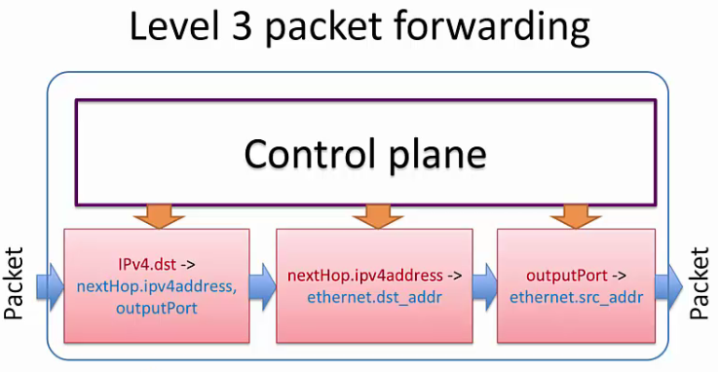
P4 Pipeline Example Overview
Illustrative representation of the “Simple Router” example:

Slide 9
Hands On
Practical Activities

Slide 10
(DONE) P4 Environment Setup
Download the P4 tutorial VM image. OVA Source:
https://intrig.dca.fee.unicamp.br:8840/owncloud/index.php/s/cdv26HcrJTlgJTF
password: p4
Install the hypervisor. (Virtualbox)
Credentials for accessing:
user: ubuntu
password: ubuntu

Slide 11
P4 Environment Setup
The behavioral model v2 code is already downloaded at:
$cd ~/behavioral-model/
Create necessary veth interfaces required by P4 Switch. (Need to execute this script each time the VM starts)
$sudo ./tools/veth_setup.sh
The P4 code base is already downloaded and compiled in the VM. The next slides will explain how to install the “behavioral-model” and “p4c-bm” code for informational purpose. You can directly move to the P4 examples section.

Slide 12
(DONE) P4 Environment Setup
Compile and build bmv2
To build the behavioral-model code:
$ ./autogen.sh
$ ./configure
$ make
$ make install
You can build ‘bmv2’ with different configuration options:
Disable logging macros for higher performance:
./configure --disable-logging-macros
Enable debug mode: ./configure --enable-debugger
In debug, you may disable compiler optimizations and enable symbols in the binary: ./configure 'CXXFLAGS=-O0 -g'

Slide 13
(DONE) P4 Environment Setup
Compile and build p4c-bm
It generates Json configuration file required for the bmv2. Usage of the json file is explained later.
To install p4c-bm on your machine:
$ git clone https://github.com/p4lang/p4c-bm
$ cd p4c-bm
$ sudo pip install -r requirements.txt
$ sudo pip install -r requirements_v1_1.txt (only P4 v1.1 programs)
$ sudo python setup.py install
Try :
$ p4c-bmv2 -h
--json to generate a JSON representation of the P4 program
--pd to generate the PD C++ code
--p4-v1.1 if your input program is a P4 v1.1 program

Slide 14
P4 Example Applications

Slide 15
P4 Examples and Documentation
Find the P4 examples at:
$ ~/behavioral-model/targets
l2_switch
simple_router
simple_router + ACL
P4 documentation:
P4_14 specification: https://p4lang.github.io/p4-spec/
Code repository: https://github.com/p4lang/

Slide 16
L2 Switch

Slide 17
L2 switch
Compiling your first .p4 program
Open a terminal and generate json file for ‘l2_switch’ target as below:
cd ~/behavioral-model/targets/l2_switch
sudo p4c-bmv2 --json l2_switch.json l2_switch.p4
Q1: Open the the code l2_switch.p4 and answer to the following questions: - How many and which packet headers are defined in the p4 program?
- How many tables are defined?
- Which are the contents (packet header fields) used for lookup in each table? (Tip: In addition to inspecting the P4 code, analyze the image outputs of: p4-graphs l2_switch.p4)

Slide 18
L2 switch
Start the P4 data plane
sudo ./l2_switch -i 0@veth1 -i 1@veth3 -i 2@veth5 -i 3@veth7 l2_switch.json
Thrift port was not specified, will use 9090
Adding interface veth1 as port 0
Adding interface veth3 as port 1
Adding interface veth5 as port 2
Adding interface veth7 as port 3
Thrift server was started

Slide 19
Use CLI with L2 switch
In another terminal, we launch the CLI tool to populate the tables using the runtime_CLI script.
cd ~/behavioral-model/targets/l2_switch
./runtime_CLI --json l2_switch.json --thrift-port 9090

Slide 20
Use CLI with L2 switch
CLI examples for runtime manipulation of P4 tables
$: show_tables
dmac [implementation=None, mk=ethernet.dstAddr(exact, 48)] smac [implementation=None, mk=ethernet.srcAddr(exact, 48)]
$: show_ports
port # iface name status extra info
==================================================
0 veth1 UP out_pcap=veth1.pcap; in_pcap=veth1.pcap
1 veth3 UP out_pcap=veth3.pcap; in_pcap=veth3.pcap
2 veth5 UP out_pcap=veth5.pcap; in_pcap=veth5.pcap
3 veth7 UP out_pcap=veth7.pcap; in_pcap=veth7.pcap
$: show_actions
_nop []
broadcast []
forward [port(9)]
mac_learn []

Slide 21
Use CLI with L2 switch
Run the below commands to update the tables:
RuntimeCmd: table_set_default smac mac_learn
Setting default action of smac
action: mac_learn
runtime data:
RuntimeCmd: table_set_default dmac forward 1
Setting default action of dmac
action: forward
runtime data: 00:01
Q2: What do these two commands do?
Notes:
https://github.com/p4lang/p4factory/blob/master/targets/l2_switch/add_demo_entries.bash

Slide 22
1. Test L2 switch
Testing
Once the tables are updated with the default entries, close the CLI and ping any IP address. From another terminal you may capture packets from the interface veth3 of the P4 dataplane.
Terminal #1: ping -I veth1 <any IP address>
From 10.0.2.15 icmp_seq=1 Destination Host Unreachable
From 10.0.2.15 icmp_seq=2 Destination Host Unreachable
Terminal #2: sudo tshark -i veth3
Capturing on 'veth3'
1 0.000000 6a:b6:4c:1a:4a:f4 -> Broadcast ARP 42 Who has <any IP address>? Tell 10.0.2.15

Slide 23
Simple Router

Slide 24
2. simple_router
Be sure to end the process of the l2_switch by running ctrl+c on the terminal it was running it
Generate json file for ‘simple_router’ target as below:
cd ~/behavioral-model/targets/simple_router/
sudo p4c-bmv2 --json simple_router.json simple_router.p4
Run simple_router in Mininet (analogous to the L2 switch example).
cd ~/behavioral-model/mininet/
sudo python 1sw_demo.py --behavioral-exe ../targets/simple_router/simple_router --json ../targets/simple_router/simple_router.json

Slide 25
2. Use CLI with simple_router
In another terminal, we launch the CLI tool to populate the tables using the runtime_CLI script.
cd ~/behavioral-model/targets/simple_router/
./runtime_CLI < commands.txt
The file commands.txt have the following tables entries.
table_set_default send_frame _drop
table_set_default forward _drop
table_set_default ipv4_lpm _drop
table_add send_frame rewrite_mac 1 => 00:aa:bb:00:00:00
table_add send_frame rewrite_mac 2 => 00:aa:bb:00:00:01
table_add forward set_dmac 10.0.0.10 => 00:04:00:00:00:00
table_add forward set_dmac 10.0.1.10 => 00:04:00:00:00:01
table_add ipv4_lpm set_nhop 10.0.0.10/32 => 10.0.0.10 1
table_add ipv4_lpm set_nhop 10.0.1.10/32 => 10.0.1.10 2
Q3: For each table of the datapath pipeline, describe the inserted entries (Key:Match fields + Value:Actions).

Slide 26
2. Test simple_router with mininet
Testing:
Once the tables are updated with necessary entries, ping will be successful in mininet topology.
mininet > h1 ping h2
PING 10.0.1.10 (10.0.1.10) 56(84) bytes of data.
64 bytes from 10.0.1.10: icmp_seq=7 ttl=63 time=4.71 ms
64 bytes from 10.0.1.10: icmp_seq=8 ttl=63 time=4.48 ms
64 bytes from 10.0.1.10: icmp_seq=9 ttl=63 time=0.960 ms
Finally, stop “mininet”:
mininet > exit

Slide 27
Simple Router + ACL

Slide 28
3. simple_router + ACL
Generate json file for ‘simple_router’ target as below:
cd ~/p4lang/bmv2/targets/simple_router_acl
sudo p4c-bmv2 --json simple_router_acl.json simple_router_acl.p4
Run simple_router_acl in Mininet
sudo mn -c
cd ~/p4lang/bmv2/mininet/
sudo python 1sw_demo.py --behavioral-exe ../targets/simple_router/simple_router --json ../targets/simple_router_acl/simple_router_acl.json

Slide 29
3. Use CLI with simple_router + ACL
In another terminal, we launch the CLI tool to populate the tables using the runtime_CLI script.
cd ~/p4lang/bmv2/targets/simple_router_acl
./runtime_CLI < commands.txt
The commands.txt has the following rules:
table_set_default send_frame _drop
table_set_default forward _drop
table_set_default ipv4_lpm _drop
table_add send_frame rewrite_mac 1 => 00:aa:bb:00:00:00
table_add send_frame rewrite_mac 2 => 00:aa:bb:00:00:01
table_add forward set_dmac 10.0.0.10 => 00:04:00:00:00:00
table_add forward set_dmac 10.0.1.10 => 00:04:00:00:00:01
table_add ipv4_lpm set_nhop 10.0.0.10/32 => 10.0.0.10 1
table_add ipv4_lpm set_nhop 10.0.1.10/32 => 10.0.1.10 2
Q4: Compare the P4 code of simple router with simple router + ACL. Explain the main observed differences.

Slide 30
3. Test simple_router with mininet + ACL
Testing:
Once the tables are updated with necessary entries, ping will be successful in mininet topology.
mininet > h1 ping h2
PING 10.0.1.10 (10.0.1.10) 56(84) bytes of data.
64 bytes from 10.0.1.10: icmp_seq=7 ttl=63 time=4.71 ms
64 bytes from 10.0.1.10: icmp_seq=8 ttl=63 time=4.48 ms
64 bytes from 10.0.1.10: icmp_seq=9 ttl=63 time=0.960 ms
Enter hosts “h1” and “h2” with the xterm command:
mininet > xterm h1 h2
Notes:
Q3: Compare the P4 code in simple router and simple router + ACL. Explain the differences between them.

Slide 31
3. Test simple_router with mininet + ACL
By default, h1 and h2 does not have any filter configured in their systems.
Add the following rule to filter the traffic:
cd ~/p4lang/bmv2/targets/simple_router_acl
./runtime_CLI
# Filter all traffic
RuntimeCmd: table_set_default acl _drop
Setting default action of acl
action: _drop
runtime data:

Slide 32
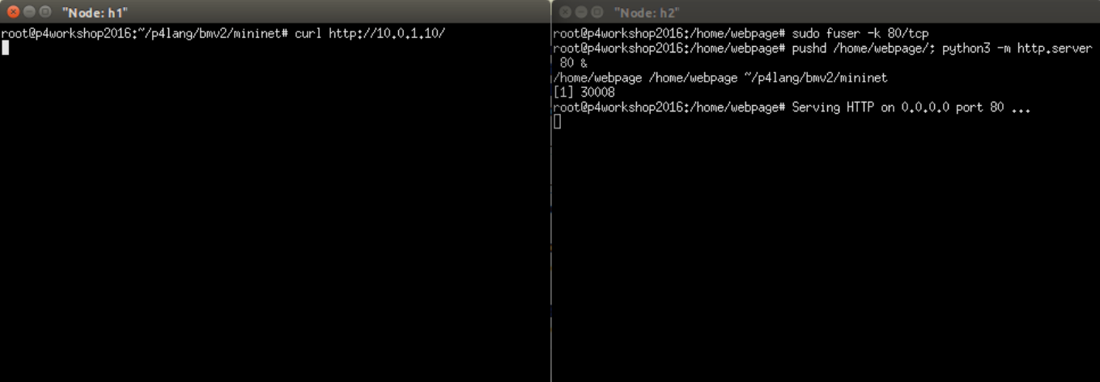
3. Test simple_router with mininet + ACL
Testing all traffic filtered using the curl command:
In h2:
sudo fuser -k 80/tcp
pushd /home/webpage/; python3 -m http.server 80 &
In h1
curl http://10.0.1.10

Slide 33
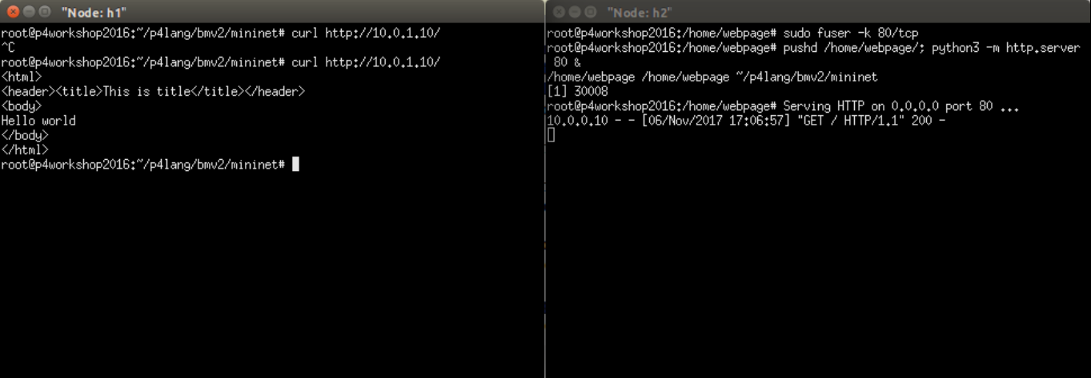
3. Test simple_router with mininet + ACL
Add the following rule to allow the traffic:
# Allow all traffic
RuntimeCmd: table_set_default acl _nop
Setting default action of acl
action: _nop
Testing all traffic allowed using the curl command:
In h2:
sudo fuser -k 80/tcp
pushd /home/webpage/; python3 -m http.server 80 &
In h1
curl http://10.0.1.10

Slide 34
P4 Dependency Graph Generator

Slide 35
P4 Dependency Graph Generator
In complex P4 programs it is difficult to comprehend the table relationships. The p4-graphs utility generates dependency graphs for a P4 program using graphviz.
cd ~/p4lang/bmv2/targets/simple_router/
p4-graphs simple_router.p4
P4-graphs generates different images for different P4 abstractions as mention below:
simple_router.ingress.tables_dep.png
simple_router.tables.png
simple_router.parser.png
simple_router.ingress.tables_dep.dot
simple_router.tables.dot
simple_router.parser.dot

Slide 36
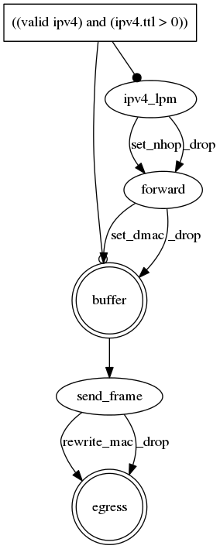
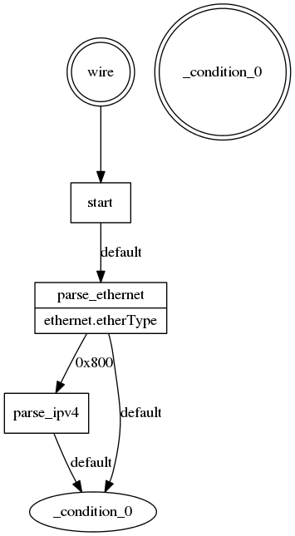
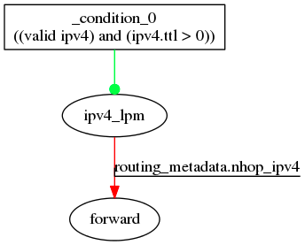
P4 Dependency Graph Generator
Ingress Table
Table
Parser

Slide 37
P4 Dependency Graph Generator
Run the P4 Dependency Graph Generator on the Simple Router
cd ~/p4lang/bmv2/targets/simple_router/
p4-graphs simple_router.p4
Now run the P4 Dependency Graph Generator on Simple Router + ACL cd ~/p4lang/bmv2/targets/simple_router_acl/
p4-graphs simple_router_acl.p4
Q5: Explain the differences between the graphs generated by simple_router.p4 and simple_router_acl.p4:
simple_router.ingress.tables_dep.png <-> simple_router_acl.ingress.tables_dep.png
simple_router.tables.png <-> simple_router_acl.tables.png
simple_router.parser.png <-> simple_router_acl.parser.png

Slide 38
(OPTIONAL) Router with ACL+
Further experimenting with the ACL

Slide 39
simple_router + ACL
Launch the CLI tool to populate the tables using the runtime_CLI script.
cd ~/p4lang/bmv2/targets/simple_router_acl
sudo p4c-bmv2 --json simple_router_acl.json simple_router_acl.p4
sudo ./simple_router -i 1@veth1 -i 2@veth2 simple_router_acl.json
In another terminal, run the below commands to install state into the tables.
cd ~/p4lang/bmv2/targets/simple_router_acl
./runtime_CLI < commands.txt
table_set_default send_frame _drop
table_set_default forward _drop
table_set_default ipv4_lpm _drop
table_add send_frame rewrite_mac 1 => 00:aa:bb:00:00:00
table_add send_frame rewrite_mac 2 => 00:aa:bb:00:00:01
table_add forward set_dmac 10.0.0.10 => 00:04:00:00:00:00
table_add forward set_dmac 10.0.1.10 => 00:04:00:00:00:01
table_add ipv4_lpm set_nhop 10.0.0.10/32 => 10.0.0.10 1
table_add ipv4_lpm set_nhop 10.0.1.10/32 => 10.0.1.10 2

Slide 40
simple_router_acl
Optional Q6: Which command(s) would you need to run to block traffic based on:
(i) a specific TCP destination port? (ii) a specific destination IP subnet? (iii) a specific source MAC address?
Optional Q7: Do you need to modify the P4 program of simple_router_acl?
Tips:
Use nmap to test connectivity to a specific port
nmap --source-port <# port> <target IP> -p <target port>
Use it to add a rule to drop traffic coming from a specific port:
runtime_CLI> table_add acl _drop <# port> <# port> =>
Use nc to open a specific port :
nc -l <# port>
Notes:
Drop all ports TCP: table_set_default acl _drop
Allow all ports TCP: table_set_default acl _nop
Drop specific port: table_add acl _drop 0x80 0x80 =>
Demonstrate with : h2: Up to the port 80 (nc -l 80)
h1: nmap --source-port 80 10.0.1.10 -p 80 (FILTERED!)

Slide 41
References
[1] https://github.com/p4lang/
[2] https://github.com/p4lang/tutorials/
[3] http://p4.org

Slide 42
Credits
P4.org
INTRIG / Prof. Christian Rothenberg
Fabricio Rodriguez
Javier Richard Quinto Ancieta
P Gyanesh Patra
Celso Henrique Cesila
Daniel Feferman

