Slide 1
可编程逻辑阵列
刘鹏
浙江大学信息与电子工程学院
liupeng@zju.edu.cn
Notes:
ROM, SRAM, and PLA

Slide 2
可编程逻辑阵列（Programmable Logic Arrays，PLAs)
Pre-fabricated building block of many AND/OR gates
Actually NOR or NAND
”Personalized" by making or breaking connections among gates
Programmable array block diagram for sum of products form
• • •
inputs
AND array
OR array
product terms
outputs
• • •

Slide 3
使能概念（Enabling Concept）
Shared product terms among outputs
F0 = A + B' C'
F1 = A C' + A B
F2 = B' C' + A B
F3 = B' C + A
example:
input side:
personality matrix
1 = uncomplemented in term
0 = complemented in term
– = does not participate
product inputs outputs
term A B C F0 F1 F2 F3 AB 1 1 – 0 1 1 0 B'C – 0 1 0 0 0 1 AC' 1 – 0 0 1 0 0 B'C' – 0 0 1 0 1 0 A 1 – – 1 0 0 1
output side:
1 = term connected to output
0 = no connection to output
reuse of terms

Slide 4
编程前
All possible connections available before "programming"
In reality, all AND and OR gates are NANDs

Slide 5
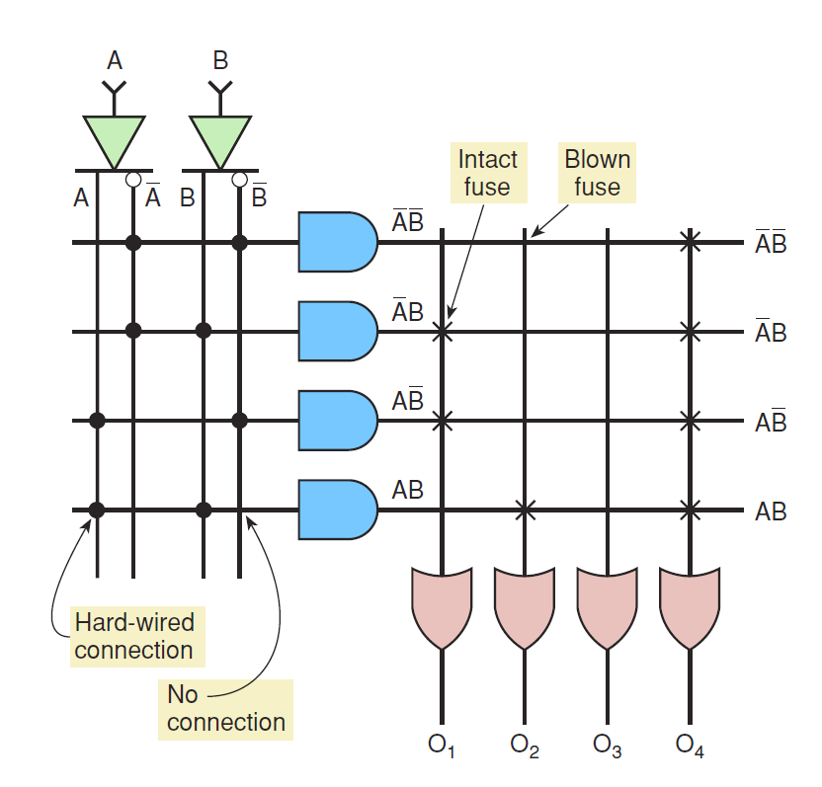
PLD符号

Slide 6
编程后
Unwanted connections are "blown"
Fuse (normally connected, break unwanted ones)
Anti-fuse (normally disconnected, make wanted connections)
A
B
C
AB
B'C
AC'
B'C'
A
F0
F1
F2
F3

Slide 7
高扇入（Fan-in）结构的一种表示
Short-hand notation--don't have to draw all the wires
Signifies a connection is present and perpendicular signal is an input to gate
notation for implementing
F0 = A B + A' B'
F1 = C D' + C' D
A
B
C
D
AB
A'B'
CD'
C'D
AB+A'B'
CD'+C'D

Slide 8
可编程逻辑阵列例子
Multiple functions of A, B, C
F1 = A B C
F2 = A + B + C
F3 = A' B' C'
F4 = A' + B' + C'
F5 = A xor B xor C
F6 = (A xnor B xnor C)’
full decoder as for memory address
bits stored in memory
A
B
C
A'B'C'
A'B'C
A'BC'
A'BC
AB'C'
AB'C
ABC'
ABC
A B C F1 F2 F3 F4 F5 F6
0 0 0 0 0 1 1 0 0
0 0 1 0 1 0 1 1 1
0 1 0 0 1 0 1 1 1
0 1 1 0 1 0 1 0 0
1 0 0 0 1 0 1 1 1
1 0 1 0 1 0 1 0 0
1 1 0 0 1 0 1 0 0
1 1 1 1 1 0 0 1 1
F1
F2
F3
F4
F5
F6

Slide 9
PLA 设计例子
BCD to Gray code converter
A B C D W X Y Z 0 0 0 0 0 0 0 0 0 0 0 1 0 0 0 1 0 0 1 0 0 0 1 1 0 0 1 1 0 0 1 0 0 1 0 0 0 1 1 0 0 1 0 1 1 1 1 0 0 1 1 0 1 0 1 0 0 1 1 1 1 0 1 1 1 0 0 0 1 0 0 1 1 0 0 1 1 0 0 0 1 0 1 – – – – – 1 1 – – – – – –
A
A
0 0 X 1
0 1 X 1 0 1 X X
0 1 X X
0 1 X 0
0 1 X 0 0 0 X X
0 0 X X
D
D
C
C
B
B
K-map for W
K-map for X
A
A
0 1 X 0
0 1 X 0 1 1 X X
1 1 X X
0 0 X 1
1 0 X 0 0 1 X X
1 0 X X
minimized functions:
W = A + B D + B C
X = B C'
Y = B + C
Z = A'B'C'D + B C D + A D' + B' C D'
D
D
C
C
B
B
K-map for Y
K-map for Z

Slide 10
PLA 设计例子
Code converter: programmed PLA
A B C D
minimized functions:
W = A + B D + B C
X = B C'
Y = B + C
Z = A'B'C'D + B C D + A D' + B' C D'
A
BD
BC
BC'
B
C
A'B'C'D
BCD
AD'
BCD'
not a particularly good
candidate for PLA
implementation since no terms are shared among outputs
however, much more compact and regular implementation when compared with discrete AND and OR gates
W X Y Z

Slide 11
PLA设计例子
BCD to Gray code converter
A B C D W X Y Z 0 0 0 0 0 0 0 0 0 0 0 1 0 0 0 1 0 0 1 0 0 0 1 1 0 0 1 1 0 0 1 0 0 1 0 0 0 1 1 0 0 1 0 1 1 1 1 0 0 1 1 0 1 0 1 0 0 1 1 1 1 0 1 1 1 0 0 0 1 0 0 1 1 0 0 1 1 0 0 0 1 0 1 – – – – – 1 1 – – – – – –
A
A
0 0 X 1
0 1 X 1 0 1 X X
0 1 X X
0 1 X 0
0 1 X 0 0 0 X X
0 0 X X
D
D
C
C
B
B
K-map for W
K-map for X
A
A
0 1 X 0
0 1 X 0 1 1 X X
1 1 X X
0 0 X 1
1 0 X 0 0 1 X X
1 0 X X
minimized functions:
W =
X =
Y =
Z =
D
D
C
C
B
B
K-map for Y
K-map for Z

Slide 12
PLA 设计例子#1
BCD to Gray code converter
A B C D W X Y Z 0 0 0 0 0 0 0 0 0 0 0 1 0 0 0 1 0 0 1 0 0 0 1 1 0 0 1 1 0 0 1 0 0 1 0 0 0 1 1 0 0 1 0 1 1 1 1 0 0 1 1 0 1 0 1 0 0 1 1 1 1 0 1 1 1 0 0 0 1 0 0 1 1 0 0 1 1 0 0 0 1 0 1 – – – – – 1 1 – – – – – –
A
A
0 0 X 1
0 1 X 1 0 1 X X
0 1 X X
0 1 X 0
0 1 X 0 0 0 X X
0 0 X X
D
D
C
C
B
B
K-map for W
BC’
K-map for X
A
A
0 1 X 0
0 1 X 0 1 1 X X
1 1 X X
0 0 X 1
1 0 X 0 0 1 X X
1 0 X X
minimized functions:
W =
X =
Y =
Z =
D
D
C
C
B
B
K-map for Y
K-map for Z

Slide 13
PLA 设计例子#2
Magnitude comparator
A B C D
A'B'C'D'
A'BC'D
ABCD
AB'CD'
AC'
A'C
B'D
BD'
A'B'D
B'CD
ABC
BC'D'
A
A
1 0 0 0
0 1 0 0 0 0 1 0
0 0 0 1
0 1 1 1
1 0 1 1 1 1 0 1
1 1 1 0
D
D
C
C
B
B
K-map for EQ
K-map for NE
A
A
0 0 0 0
1 0 0 0 1 1 0 1
1 1 0 0
0 1 1 1
0 0 1 1 0 0 0 0
0 0 1 0
D
D
C
C
B
B
K-map for LT
K-map for GT
EQ NE LT GT

Slide 14
多路选择器/解复器
Direct point-to-point connections between gates
Multiplexer: route one of many inputs to a single output
Demultiplexer: route single input to one of many outputs
control
control
multiplexer
demultiplexer
4x4 switch

Slide 15
多路选择器
Multiplexers/Selectors: general concept
2^{n} data inputs, n control inputs (called "selects"), 1 output
Used to connect 2^{n} points to a single point
Control signal pattern forms binary index of input connected to output
I₁ I₀ A Z 0 0 0 0 0 0 1 0 0 1 0 1 0 1 1 0 1 0 0 0 1 0 1 1 1 1 0 1 1 1 1 1
A Z 0 I₀ 1 I₁
Z = A' I₀ + A I₁
functional form
logical form
two alternative forms
for a 2:1 Mux truth table

Slide 16
多路选择器
2:1 mux: Z = A' I0 + A I1
4:1 mux: Z = A' B' I0 + A' B I1 + A B' I2 + A B I3
8:1 mux: Z = A'B'C'I0 + A'B'CI1 + A'BC'I2 + A'BCI3 + AB'C'I4 + AB'CI5 + ABC'I6 + ABCI7
In general, Z = Σ (m_{k}I_{k})
in minterm shorthand form for a 2^{n}:1 Mux
n
2 -1
k=0
I0 I1 I2 I3 I4 I5 I6 I7
8:1 mux
Z
I0 I1 I2 I3
4:1 mux
Z
I0 I1
2:1 mux
Z
A
A B
A B C

Slide 17
多路选择器级联
Large multiplexers implemented by cascading smaller ones
I0 I1 I2 I3
8:1 mux
4:1 mux
alternative implementation
2:1 mux
Z
I0 I1
2:1 mux
8:1 mux
I4 I5 I6 I7
4:1 mux
I2 I3
2:1 mux
4:1 mux
Z
B C
I4 I5
2:1 mux
A
control signals B and C simultaneously choose one of I0, I1, I2, I3 and one of I4, I5, I6, I7 control signal A chooses which of the upper or lower mux's output to gate to Z
I6 I7
2:1 mux
C
A B

Slide 18
多路选择器作为查找表（Lookup Tables，LUTs）
2^{n}:1 multiplexer implements any function of n variables
With the variables used as control inputs and
Data inputs tied to 0 or 1
In essence, a lookup table
Example:
F(A,B,C) = m0 + m2 + m6 + m7 = A'B'C' + A'BC' + ABC' + ABC = A'B'(C') + A'B(C') + AB'(0) + AB(1)
1 0 1 0 0 0 1 1
0 1 2 3 4 5 6 7
8:1 MUX
F
S2
S1
S0
A
B
C

Slide 19
多路选择器作为查找表（Lookup Tables，LUTs）
2^{n-1}:1 mux can implement any function of n variables
With n-1 variables used as control inputs and
Data inputs tied to the last variable or its complement
Example:
F(A,B,C) = m0 + m2 + m6 + m7 = A'B'C' + A'BC' + ABC' + ABC = A'B'(C') + A'B(C') + AB'(0) + AB(1)
1 0 1 0 0 0 1 1
0 1 2 3 4 5 6 7
A B C F 0 0 0 1 0 0 1 0 0 1 0 1 0 1 1 0 1 0 0 0 1 0 1 0 1 1 0 1 1 1 1 1
C' C' 0 1
C' C' 0 1
0 1 2 3
F
4:1 MUX
F
8:1 MUX
S1
S0
S2
S1
S0
A
B
A
B
C

Slide 20
多路选择器作为查找表（Lookup Tables，LUTs）
Generalization
Example: F(A,B,C,D) implemented by an 8:1 MUX
I₀ I₁ . . . I_{n-1} I_{n} F . . . . 0 0 0 1 1 . . . . 1 0 1 0 1 0 I_{n} I_{n}' 1
four possible
configurations of truth table rows
can be expressed as a function of I_{n}
n-1 mux control variables
single mux data variable
A
1 D 0 1 D’ D D’ D’
0 1 2 3 4 5 6 7
1 0
1 0
1 1
0 0
choose A,B,C as control variables multiplexer implementation
8:1 MUX
D
1 1
0 1
0 1
1 0
C
S2
S1
S0
B
A
B
C

Slide 21
解复器 / 译码器
Decoders / demultiplexers: general concept
Single data input, n control inputs, 2^{n} outputs
Control inputs (called “selects” (S)) represent binary index of output to which the input is connected
Data input usually called “enable” (G)
1:2 Decoder:
O0 = G • S’
O1 = G • S
3:8 Decoder:
O0 = G • S2’ • S1’ • S0’
O1 = G • S2’ • S1’ • S0
O2 = G • S2’ • S1 • S0’
O3 = G • S2’ • S1 • S0
O4 = G • S2 • S1’ • S0’
O5 = G • S2 • S1’ • S0
O6 = G • S2 • S1 • S0’
O7 = G • S2 • S1 • S0
2:4 Decoder:
O0 = G • S1’ • S0’
O1 = G • S1’ • S0
O2 = G • S1 • S0’
O3 = G • S1 • S0

Slide 22
解复器作为通用逻辑
n:2^{n} decoder implements any function of n variables
With the variables used as control inputs
Enable inputs tied to 1 and
Appropriate min-terms summed to form the function
0 1 2 3 4 5 6 7
A'B'C' A'B'C A'BC' A'BC AB'C' AB'C ABC' ABC
demultiplexer generates appropriate
Min-term based on control signals
(it "decodes" control signals)
“1”
3:8 DEC
S2
S1
S0
A
B
C

Slide 23
解复器作为通用逻辑
F1 = A' B C' D + A' B' C D + A B C D
F2 = A B C' D’ + A B C
F3 = (A' + B' + C' + D')
0 A'B'C'D' 1 A'B'C'D 2 A'B'CD' 3 A'B'CD 4 A'BC'D' 5 A'BC'D 6 A'BCD' 7 A'BCD 8 AB'C'D' 9 AB'C'D 10 AB'CD' 11 AB'CD 12 ABC'D' 13 ABC'D 14 ABCD' 15 ABCD
F1
4:16 DEC
Enable
F2
F3
A
B
C
D

Slide 24
译码器级联
5:32 decoder
1x2:4 decoder
4x3:8 decoders
0 A'B'C'D'E' 1 2 3 4 5 6 7
0 1 2 A'BC'DE' 3 4 5 6 7
3:8 DEC
3:8 DEC
S2
S1
S0
S2
S1
S0
0 1 2 3
F
2:4 DEC
S1
S0
0 1 2 3 4 5 6 7 ABCDE
0 AB'C'D'E' 1 2 3 4 5 6 7 AB'CDE
A
B
3:8 DEC
3:8 DEC
S2
S1
S0
S2
S1
S0
C
D
E
C
D
E

Slide 25
只读存储器（ROM）
Two dimensional array of 1s and 0s
Entry (row) is called a "word"
Width of row = word-size
Index is called an "address"
Address is input
Selected word is output
word lines (only one is active – decoder is just right for this)
1
1
1
1
n
2 -1
i
word[i] = 0011 word[j] = 1010
decoder
j
0
internal organization
0 n-1
Address
bit lines (normally pulled to 1 through resistor – selectively connected to 0 by word line controlled switches)

Slide 26
ROM和组合逻辑
Combinational logic implementation (two-level canonical form) using a ROM
F0 = A' B' C + A B' C' + A B' C
F1 = A' B' C + A' B C' + A B C
F2 = A' B' C' + A' B' C + A B' C'
F3 = A' B C + A B' C' + A B C'
A B C F0 F1 F2 F3
0 0 0 0 0 1 0 0 0 1 1 1 1 0 0 1 0 0 1 0 0 0 1 1 0 0 0 1
1 0 0 1 0 1 1
1 0 1 1 0 0 0
1 1 0 0 0 0 1
1 1 1 0 1 0 0
ROM 8 words x 4 bits/word
A B C F0 F1 F2 F3
address
outputs
truth table
block diagram

Slide 27
ROM结构
Similar to a PLA structure but with a fully decoded AND array
Completely flexible OR array (unlike PAL)
n address lines
• • •
inputs
memory array (2^{n} words by m bits)
decoder
2^{n} word lines
outputs
• • •
m data lines

Slide 28
ROM与 PLA对比
ROM
Design time is short (no need to minimize output functions)
Most input combinations are needed (e.g., code converters)
Little sharing of product terms among output functions
Size doubles for each additional input
Can't exploit don't cares
Cheap (high-volume component)
Can implement any function of n inputs
Medium speed
PLA
Design tools are available for multi-output minimization
There are relatively few unique min-term combinations
Many min-terms are shared among the output functions
Most complex in design, need more sophisticated tools
Can implement any function up to a product term limit
Slow (two programmable planes)

Slide 29
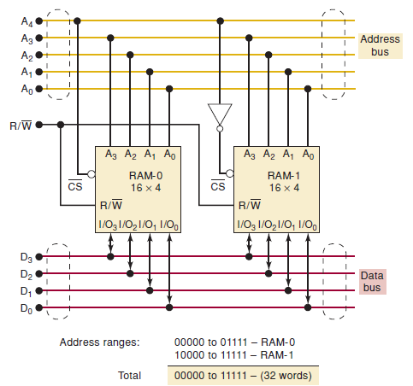
扩展字大小和存储容量

Slide 30
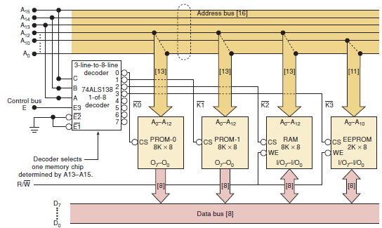

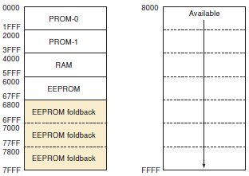
地址译码的系统例子
Notes:
In many instances, it is necessary to use various memory devices in the same memory system.
The ROM portion is made up of two 8K x 8 devices (PROM-0 and PROM-1).
The RAM section requires a single 8K x 8 device.
The EEPROM available is only a 2K x 8 device.
The memory system requires a decoder to select only one device at a time. This decoder divides the entire memory space (assuming 16 address bits) into 8K address blocks.
The upper three address lines control the decoder.
The 13 lower-order address lines are tied directly to the address inputs on the memory chips.
The only exception to this the EEPROM, which has only 11 address lines for its 2-Kbyte capacity.
The same contents of the EEPROM will also appear at the addresses 6800-6FFF, 7000-77FF, and 7800-7FFF.

